Slide 1


Optimizing Brownian heat engine with shortcut strategy
XXVII Sitges Conference on Statistical Mechanics
Jinfu Chen
Peking University
31 May, 2023

Slide 2
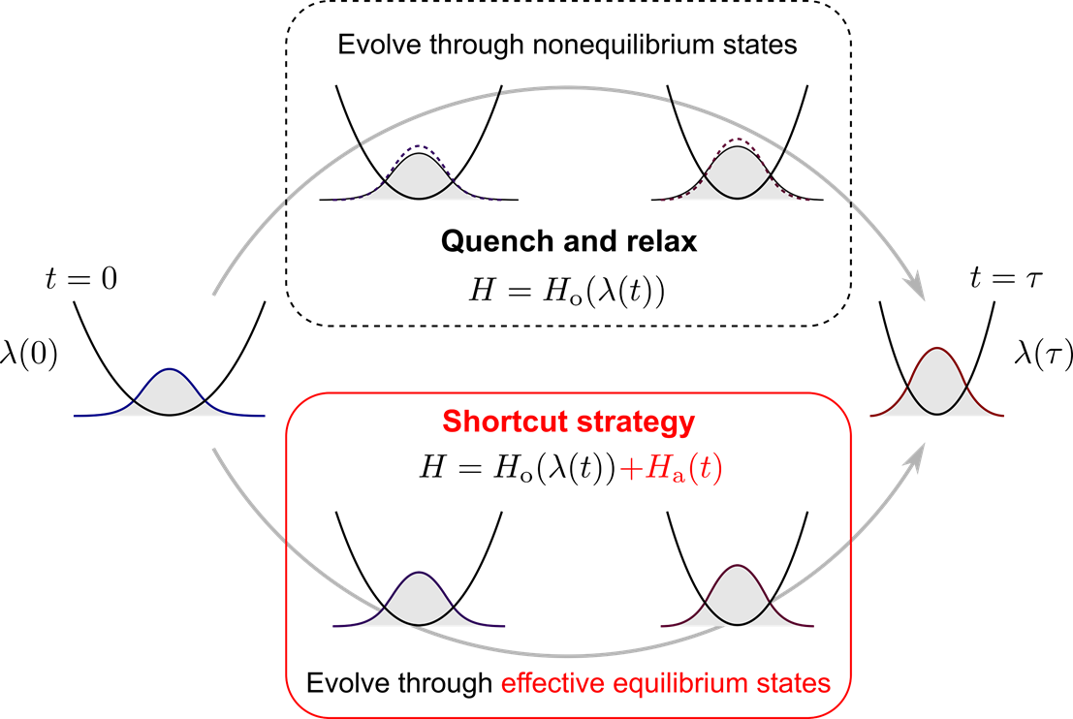
Transformation between two equilibrium states
I. A. Martínez, A. Petrosyan, D. Guéry-Odelin, E. Trizac, and S. Ciliberto, Nat. Phys. 12, 843 (2016).
G. Li, H. T. Quan and Z. C. Tu, Phys. Rev. E 96, 012144 (2017).

Slide 3
Outline
Shortcut strategy for underdamped Brownian motion
Optimizing Brownian heat engine with shortcut strategy
Discussions on underdamped and overdamped limits
Summary and outlook

Slide 4
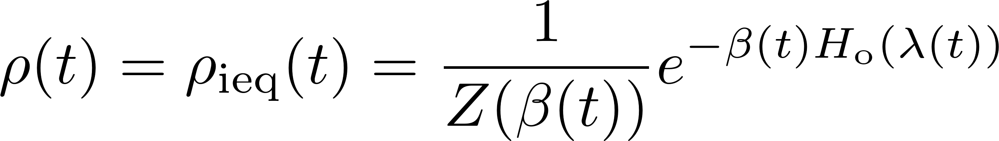
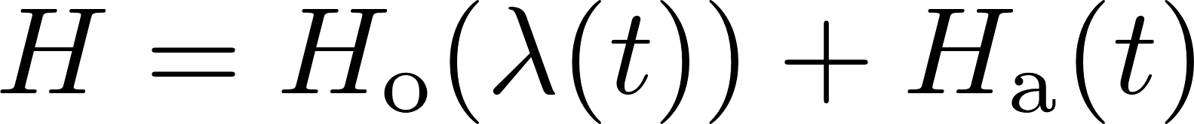
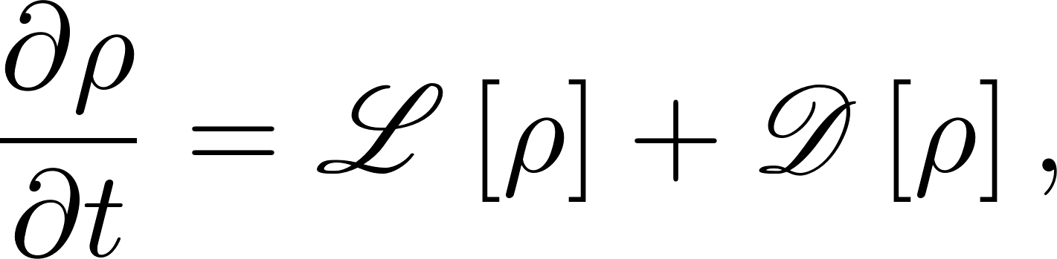
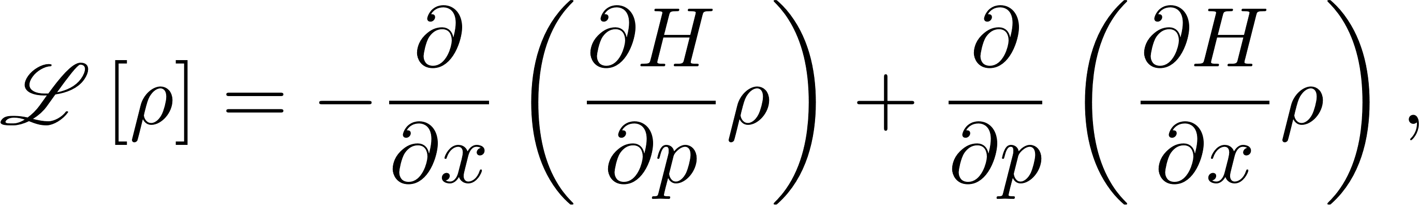
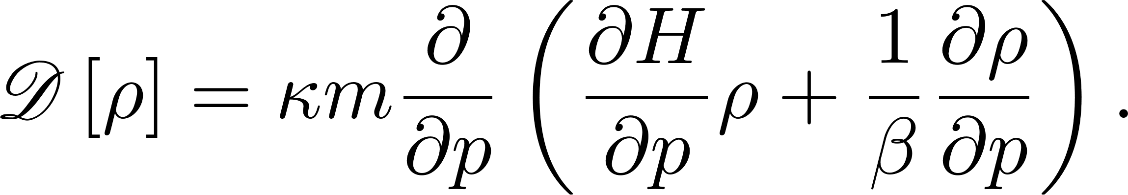
Shortcut strategy of evolution
Consider a Brownian particle trapped in a potential.
Goal: let the system evolve along
Total Hamiltonian:
Dynamics: the Fokker-Planck equation
origin
auxiliary
Deterministic
Dissipative
Shortcuts to isothermality: G. Li, H. T. Quan and Z. C. Tu, Phys. Rev. E 96, 012144 (2017)

Slide 5
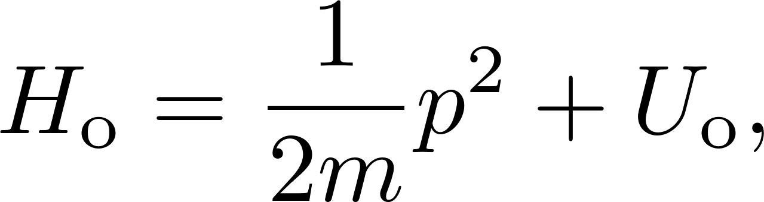
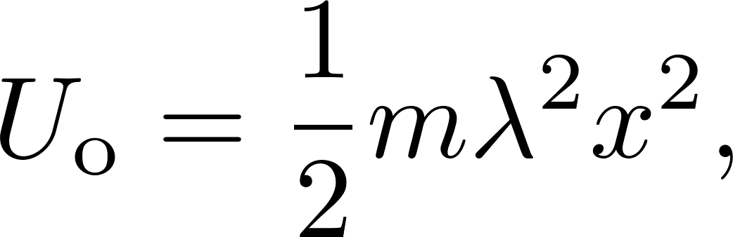
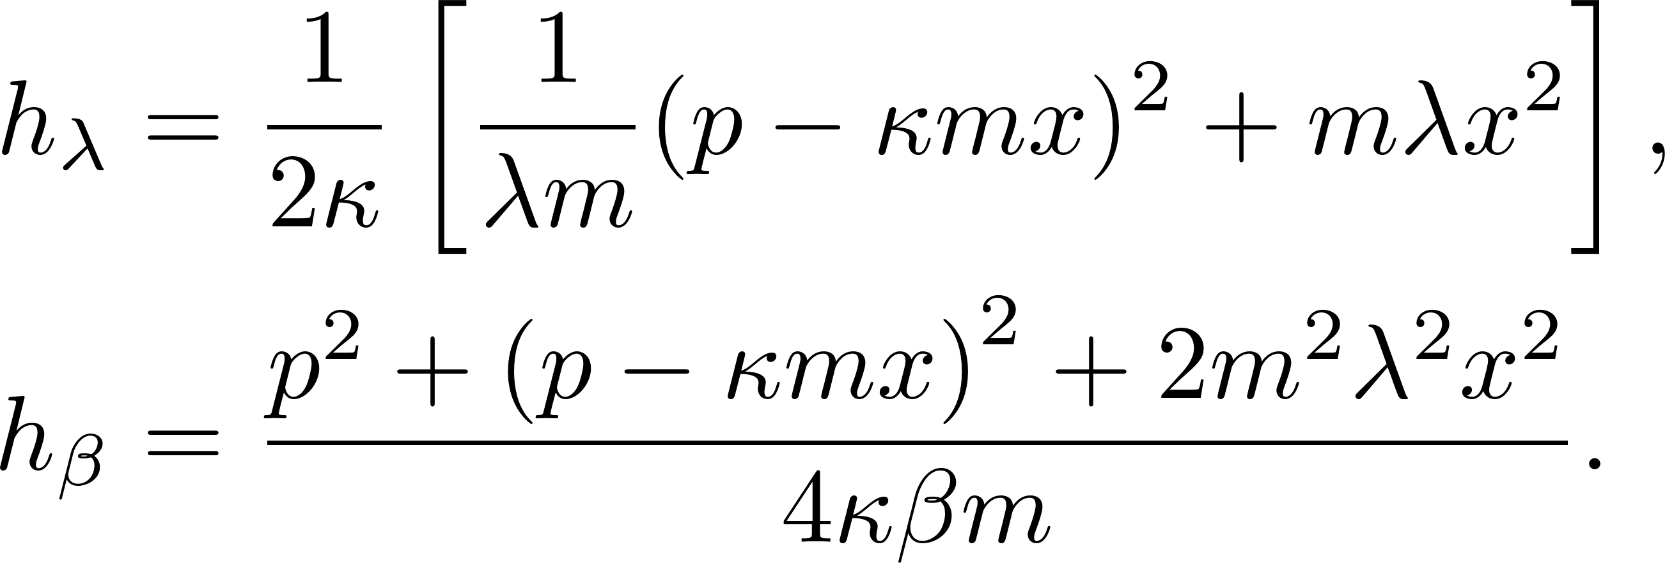
Shortcut strategy of evolution
We consider harmonic potential
The auxiliary Hamiltonian is solved in the form
where
Y. Jun and P. Y. Lai, Phys. Rev. Res. 3, 033130 (2021)

Slide 6
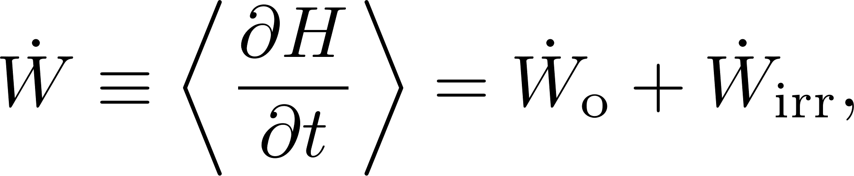
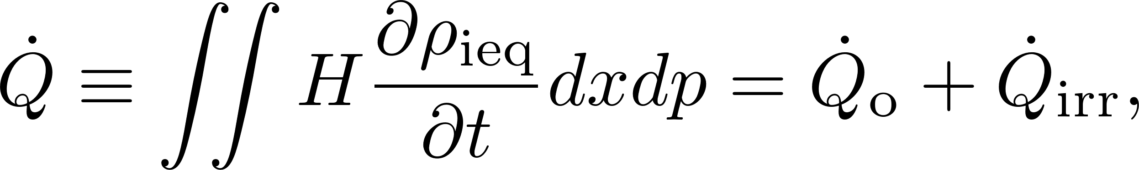
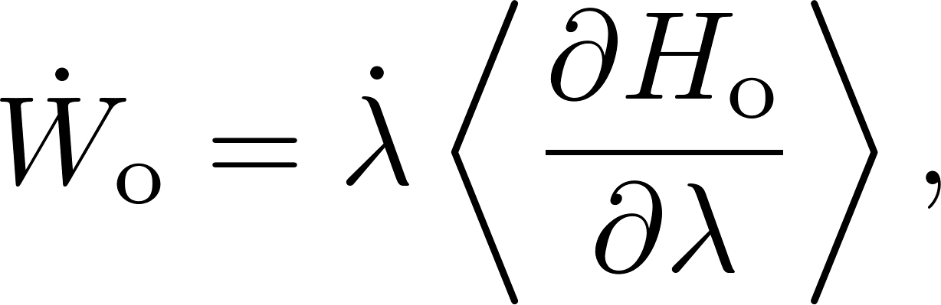
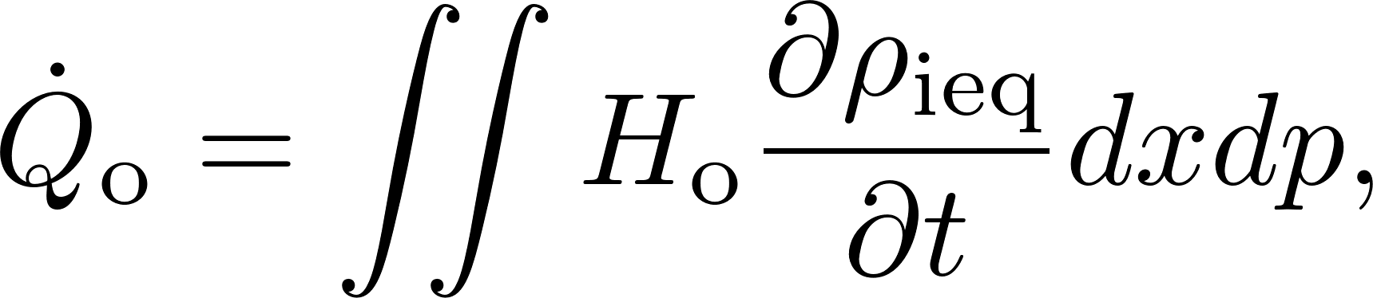
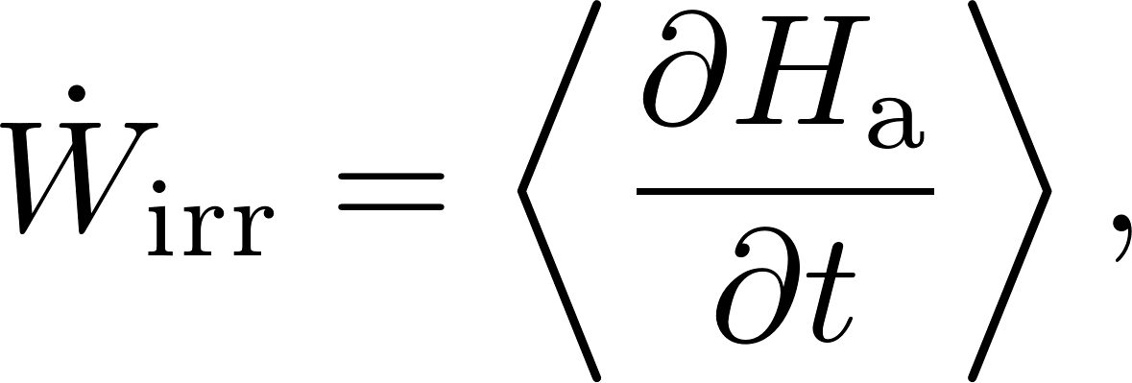
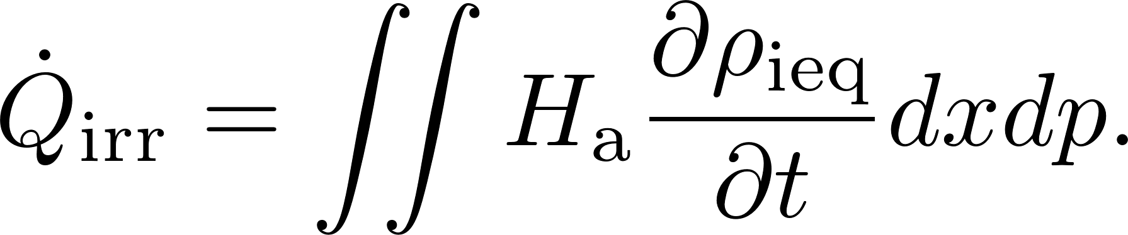
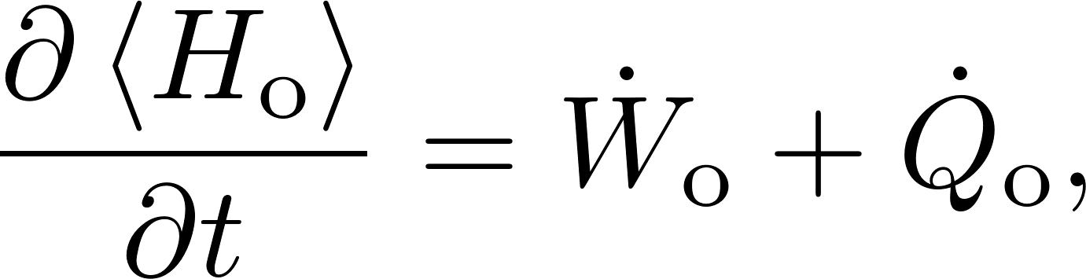
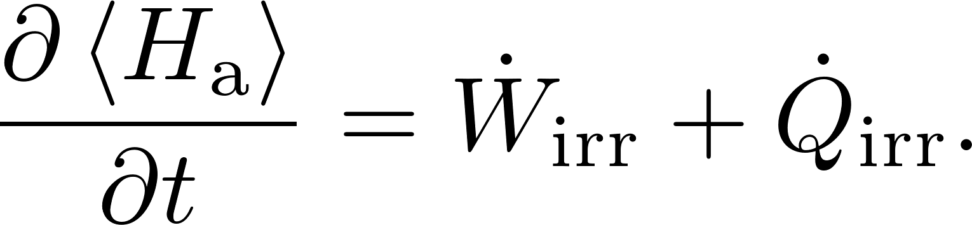

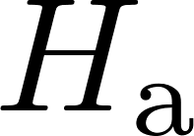

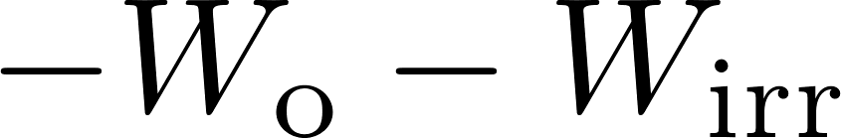

Energetics in shortcut processes
The average input power and the average heat flux are
We divide work and heat into quasistatic and irreversible parts
First law:
Maximizing the output work = maximizing
is switched off initially and finally

Slide 7
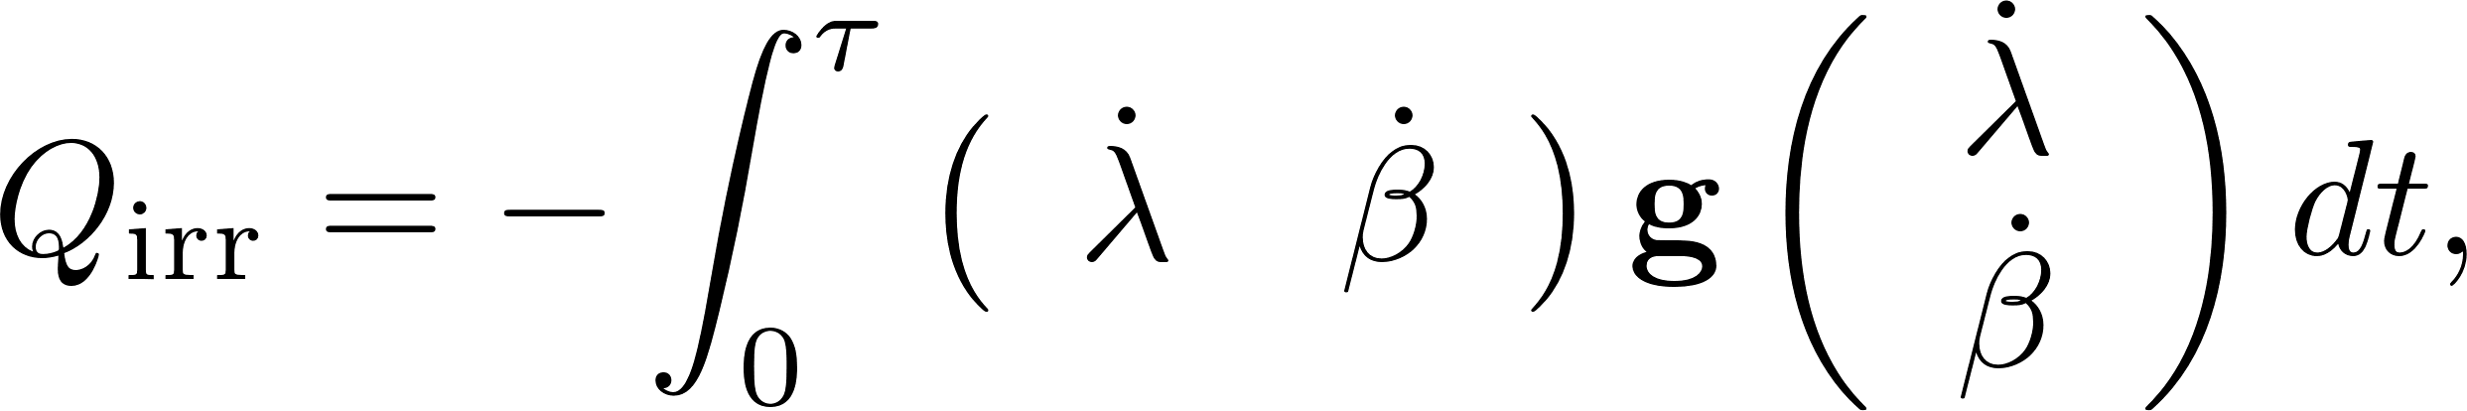
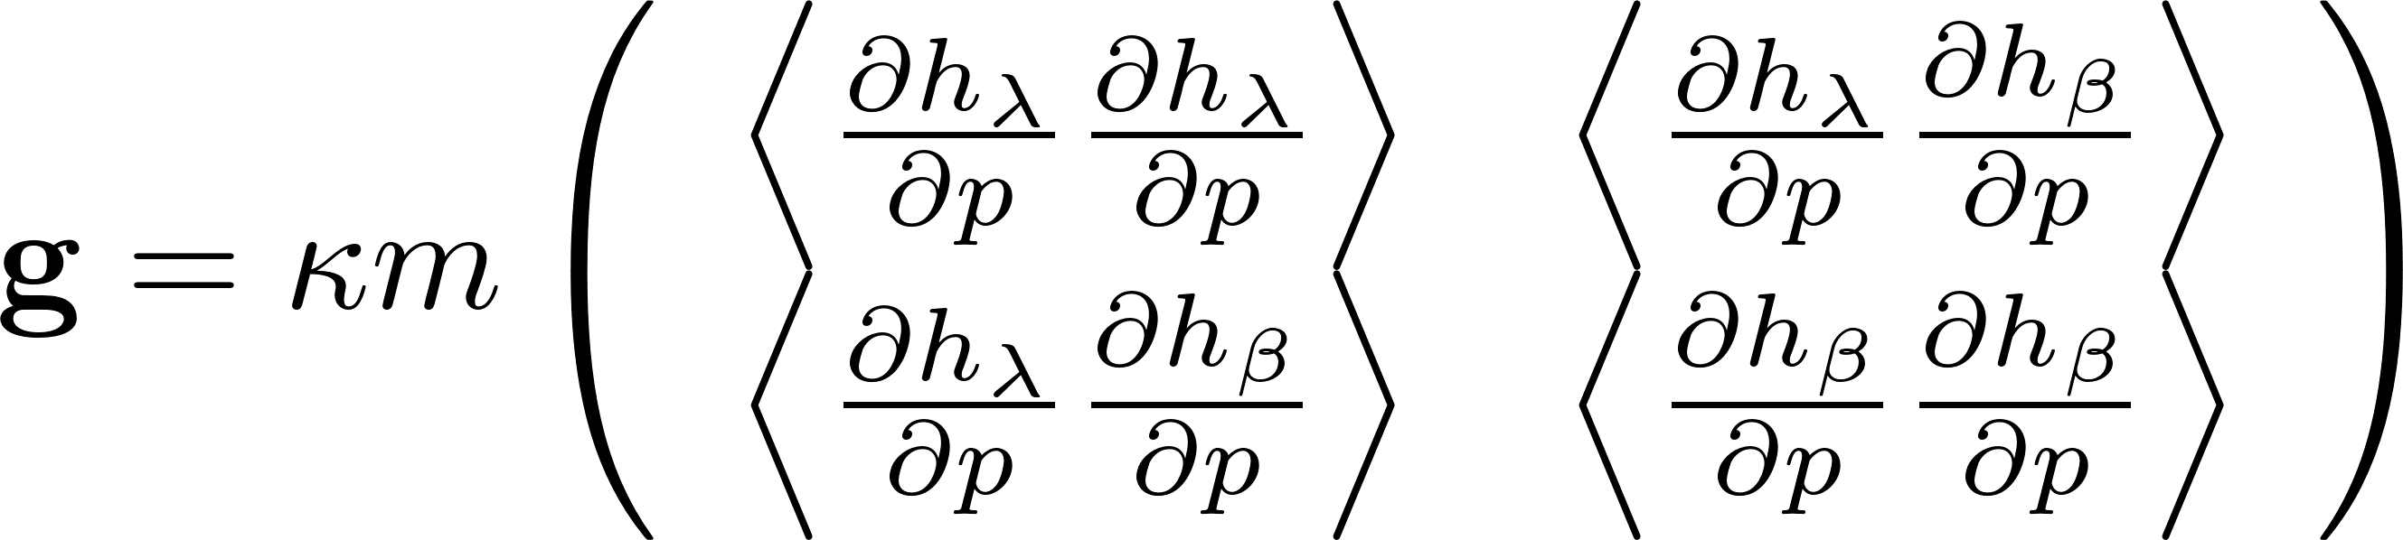
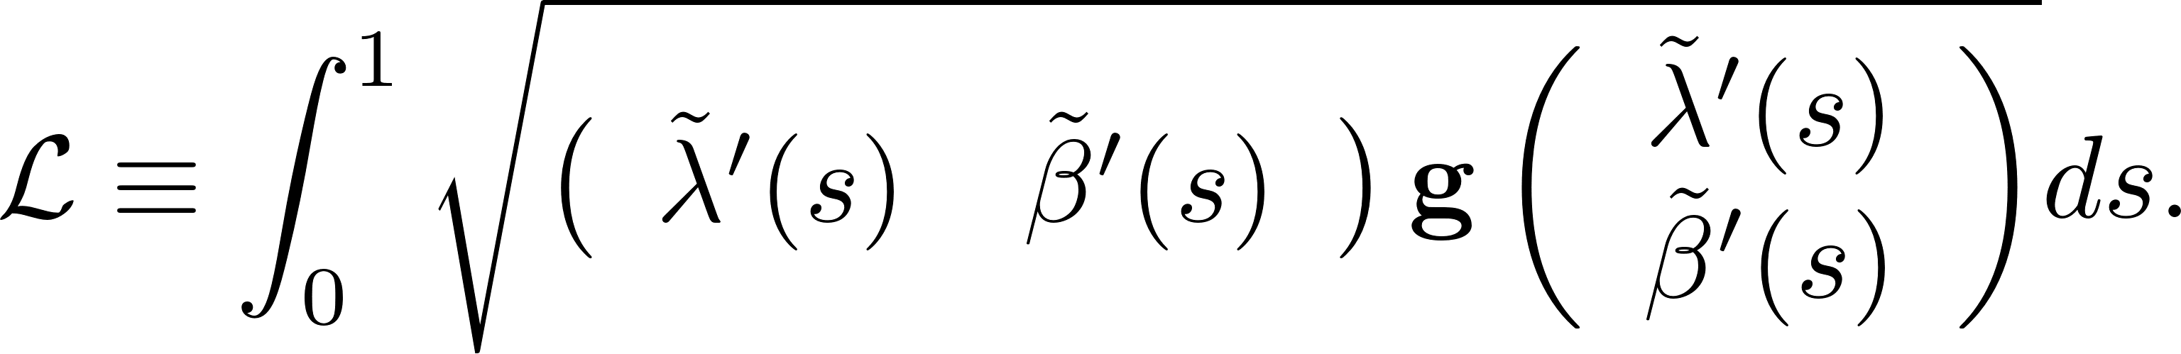
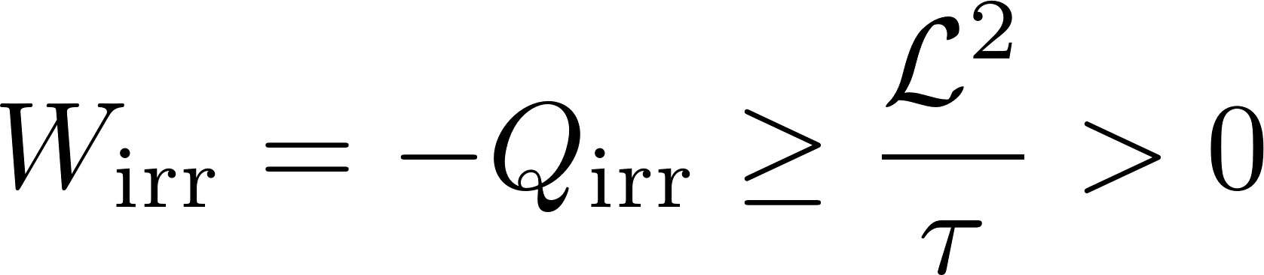
Thermodynamic length of irreversibility
For shortcut processes, the irreversible heat is exactly
The irreversible work (or heat) is bounded by
Equality is reached for the optimal protocol.
We next consider cyclic control of a Brownian heat engine.
metric:
Thermodynamic length:
G. Li, JFC, C. P. Sun, H. Dong, Phys. Rev. Lett. 128, 230603 (2022)
JFC, Phys. Rev. E 106, 054108 (2022)

Slide 8
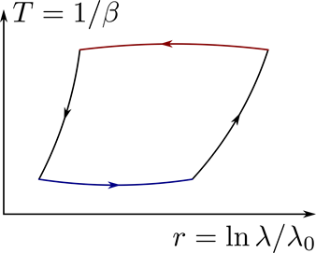

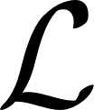
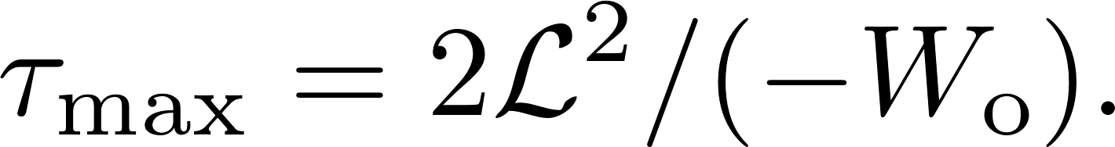
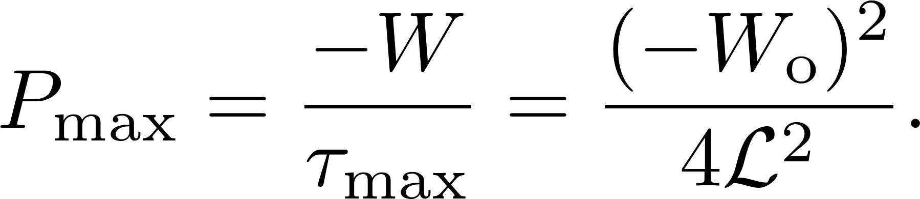
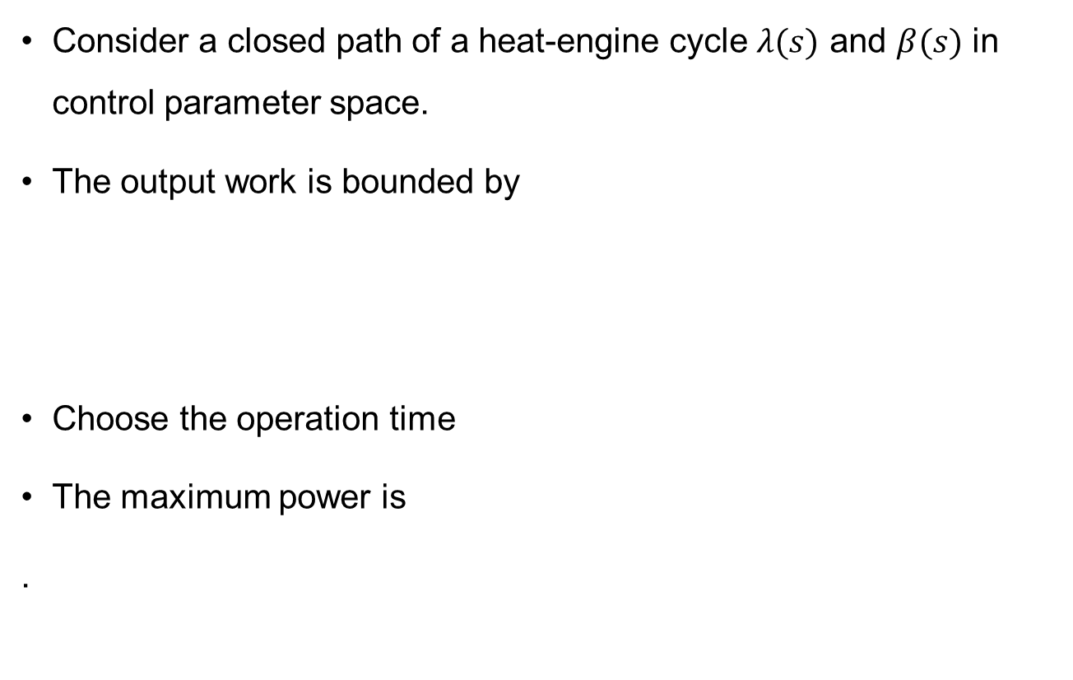
Brownian heat engine: maximum power
Consider a closed path of a heat-engine cycle $λ(s)$ and $β(s)$ in control parameter space.
The output work is bounded by
Choose the operation time
The maximum power is
.
: work of quasistatic cycle
: thermodynamic length of closed path
JFC, Phys. Rev. E 106, 054108 (2022)

Slide 9
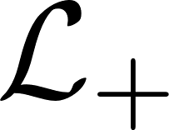

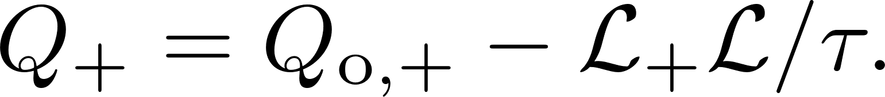
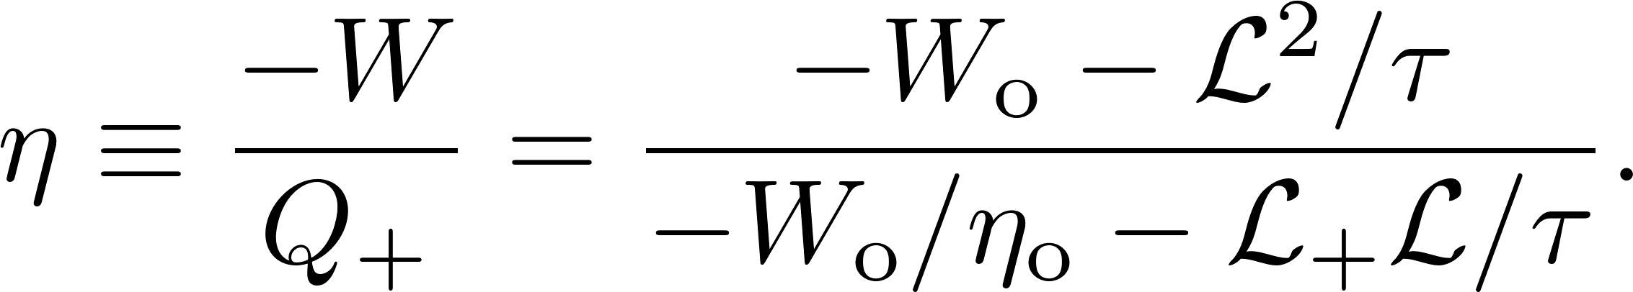
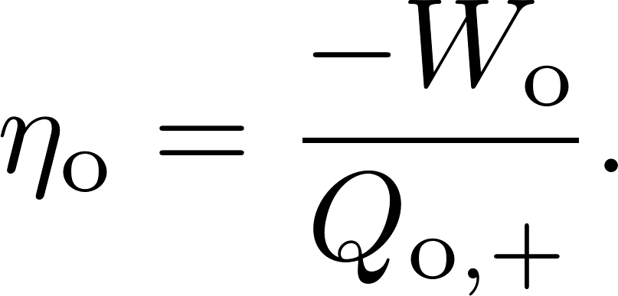
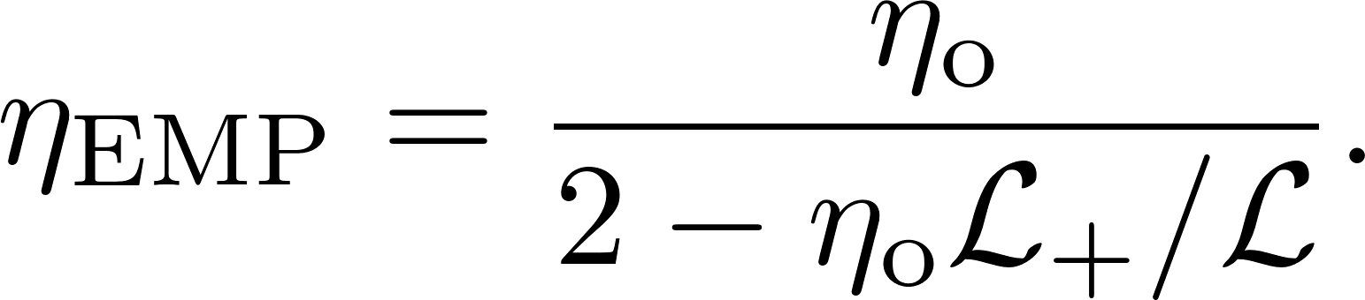
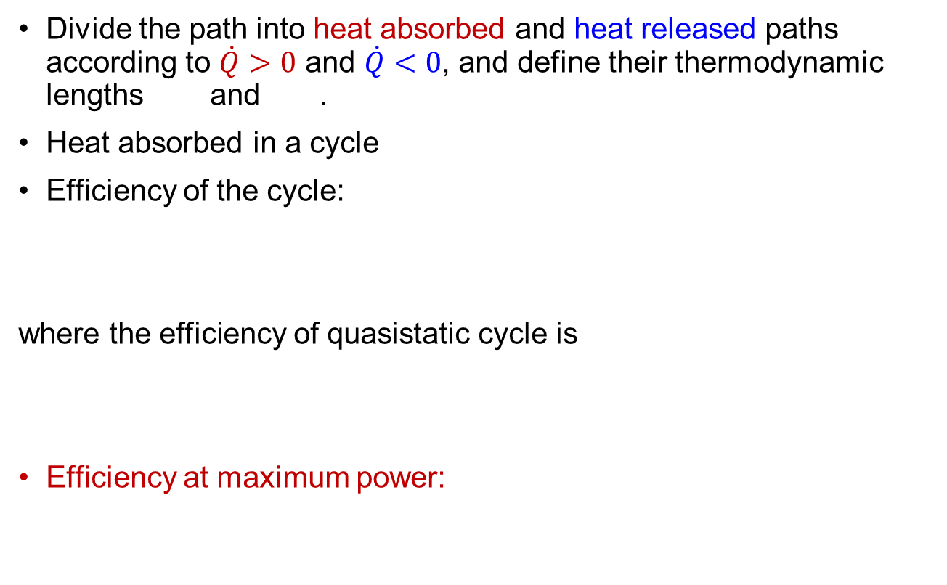
Shortcut Brownian heat engine: EMP
Divide the path into heat absorbed and heat released paths according to $\dot{Q}>0$ and $\dot{Q}<0$, and define their thermodynamic lengths and .
Heat absorbed in a cycle
Efficiency of the cycle:
where the efficiency of quasistatic cycle is
Efficiency at maximum power:

Slide 10
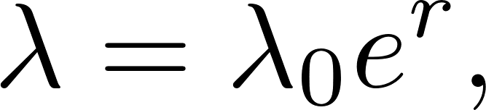
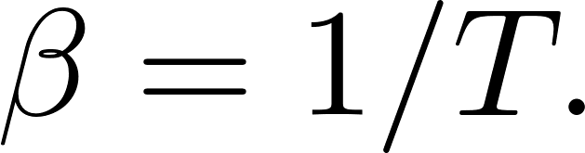
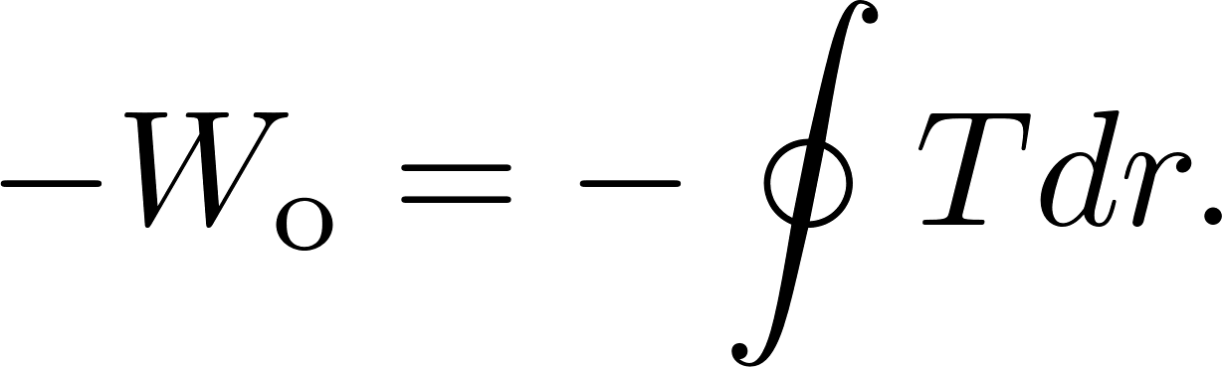
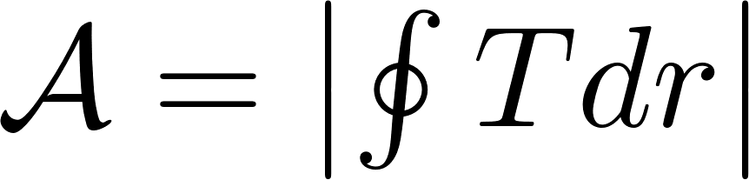
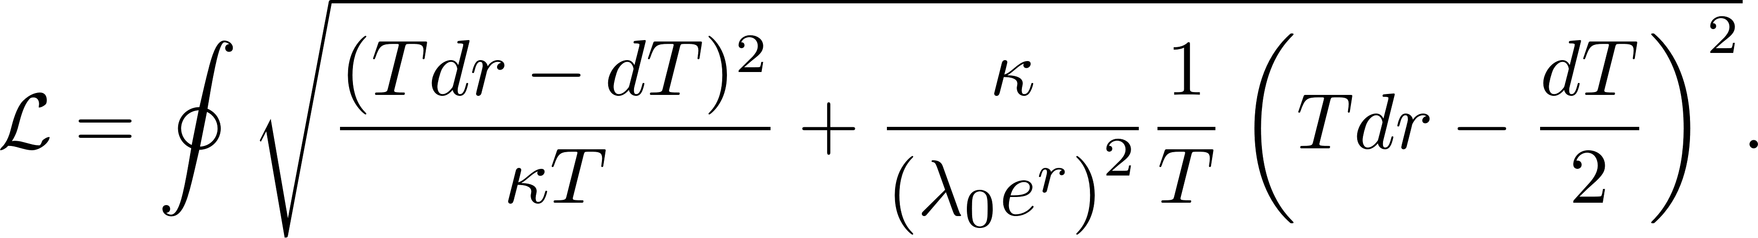
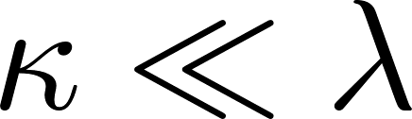
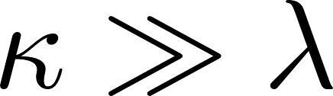
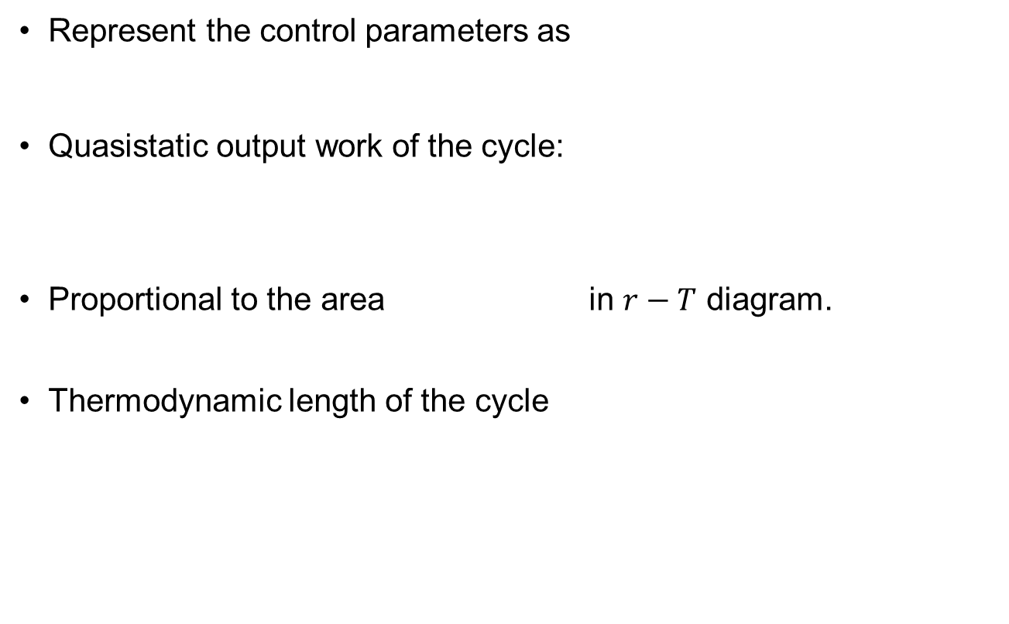
Results for harmonic potential
Represent the control parameters as
Quasistatic output work of the cycle:
Proportional to the area in $r−T$ diagram.
Thermodynamic length of the cycle
Dissipation in underdamped limit
Dissipation in overdamped limit

Slide 11
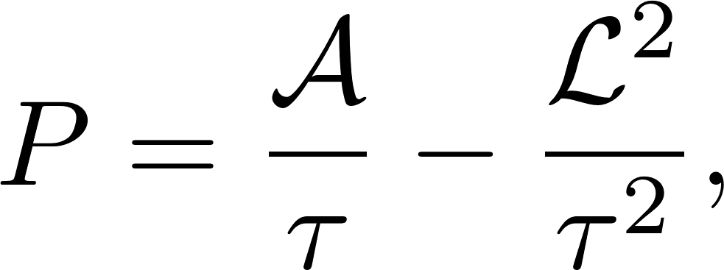

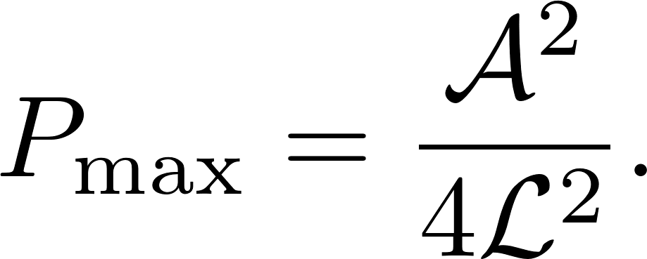
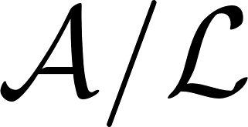
Optimization of heat-engine cycle
For the optimal cycle on a given closed path, the power is
where and are the area and the thermodynamic length of the closed path.
Two aspects for optimizing cycles with shortcut strategy:
    Along a given closed path, manipulate the control parameters with a proper constant velocity to reach the maximum power
    Find out a closed path with large .

Slide 12
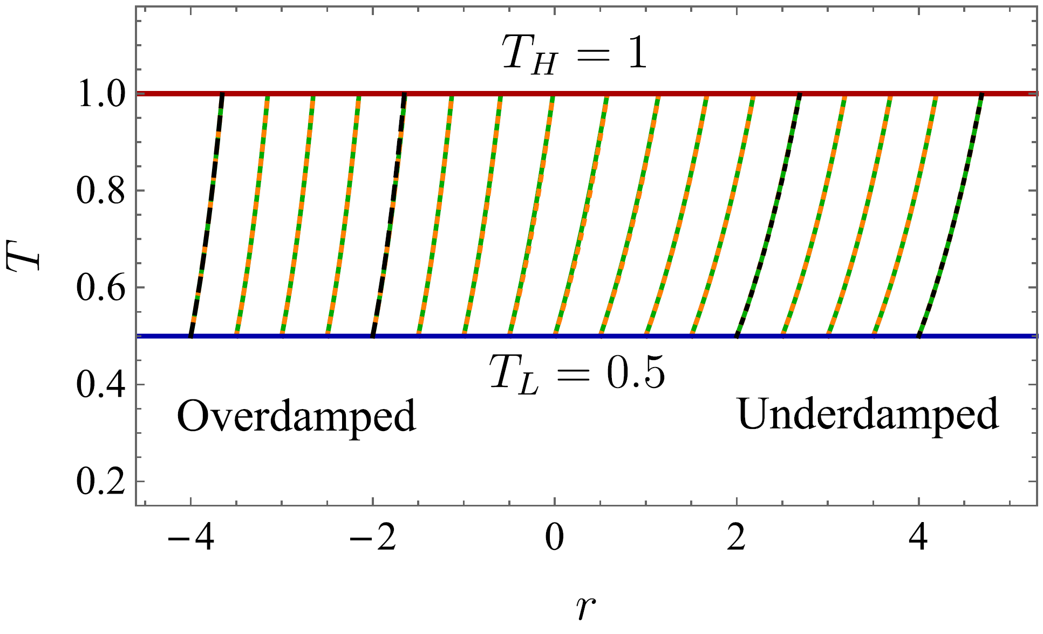
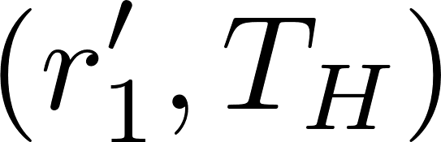
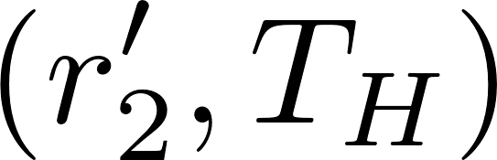
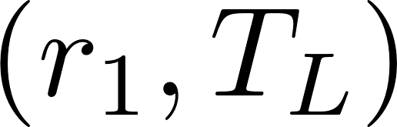
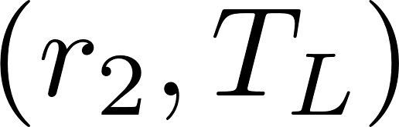







Optimization in general damped situation
Choose two isothermal lines ($T_{L}$ and $T_{H}$) and two connecting paths to form a closed cycle.
Connecting paths are shortest geodesic curves or exponential paths
We choose $α_{1,2}$ to minimize or fixed as

Slide 13




Underdamped limit
In the underdamped limit $κ≪λ$, the thermodynamic length is similified to
Choose the exponential paths with $α=1$ (zero length), and obtain
Agree with Curzon and Ahlborn’s prediction [Am. J. Phys 43, 22 (1975)].

Slide 14





Overdamped limit
In the overdamped limit $κ≫λ$,
Choose the exponential paths with $α=2$ (zero length), and obtain
The quasistatic efficiency is
EMP matches that in [T. Schmiedl and U. Seifert, Europhys. Lett. 81, 20003 (2007)].
Heat leakage from momentum degree of freedom

Slide 15






$P_{max}$ and $η_{EMP}$ in general damped situation
$P_{max}$ is the largest with the shortest exponential paths.
Underdamped regime ($r≫0$): large $P_{max}$, Curzon-Ahlborn’s type.
Overdamped regime ($r≪0$): small $P_{max}$, Schmiedl-Seifert’s type.

Slide 16

Control of the cycle
Connecting processes consume time according to thermodynamic length
The control of a typical cycle
JFC, Phys. Rev. E 106, 054108 (2022)

Slide 17



Traditional optimization vs. Shortcut strategy
Given protocol, solve cycle diagram.
Irreversibility: deviation from quasi-static cycles.
Thermodynamic length valid for slow driving processes.
Optimal cycles are only solved in overdamped limit [T. Schmiedl and U. Seifert, Europhys. Lett. 81, 20003 (2007)]
and underdamped limits [A. Dechant, N. Kiesel, and E. Lutz, Europhys. Lett. 119, 50003 (2017) and Y. H. Chen, JFC, Z. Fei, and H. T. Quan, Phys. Rev. E 106, 024105 (2022)].
Given cycle diagram, solve $H_{a}\left(t\right)$.
Irreversibility: energy cost to implement $H_{a}\left(t\right)$.
Exact thermodynamic length for arbitrary finite-time processes.
Geometric interpretation of the optimization to acquire large output power

Slide 18


Summary and Outlook
Shortcut strategy: a new way to construct and optimize the Brownian heat engines.
Generalization to power-law potentials
Strict $1/τ$ scaling of irreversible heat in shortcut processes.
The performance of the optimal heat-engine cycle with shortcut strategy is characterized by $𝒜$ and $ℒ$.
Better understanding of the optimal cycles in the underdamped and the overdamped limits.
Extension to open quantum systems under external driving and also active systems.
JFC, Phys. Rev. E 106, 054108 (2022)

Slide 19


Slide 20
Approximate shortcuts with momentum-independent auxiliary Hamiltonian see
G. Li, C. P. Sun, H. Dong, Phys. Rev. E, 107, 014103 (2023)

Slide 21

Lindblad master equation

