Slide 1

An introduction to large deviation theory - I
Jinfu Chen, June 19 @Thursday Lecture

Slide 2
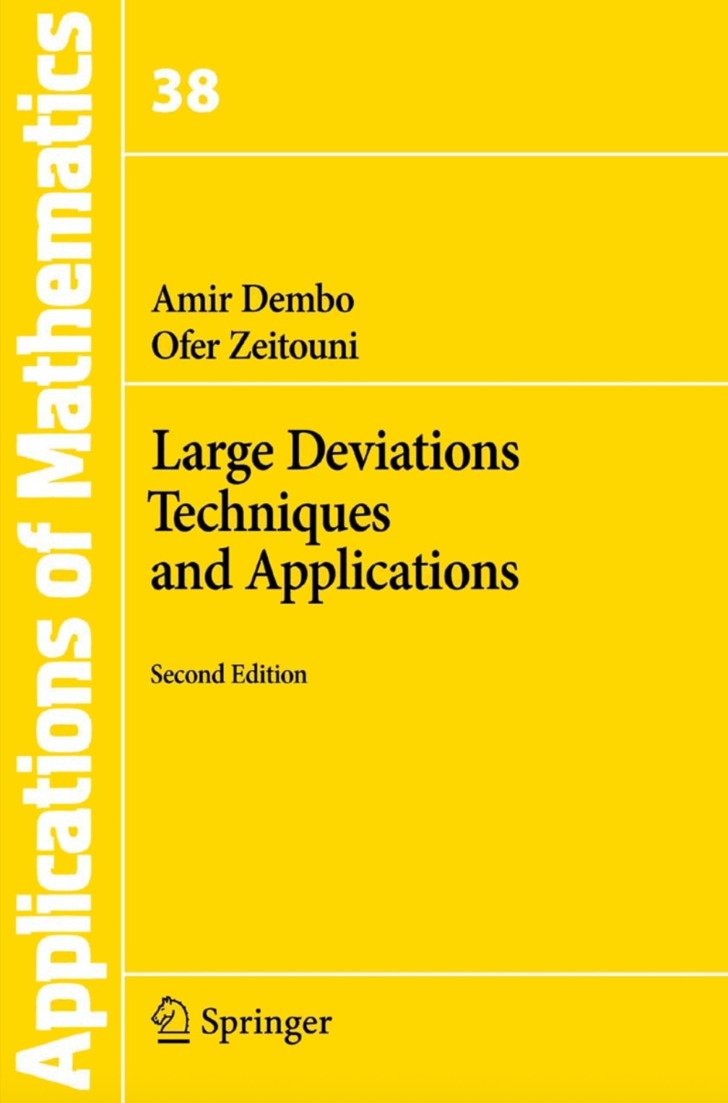
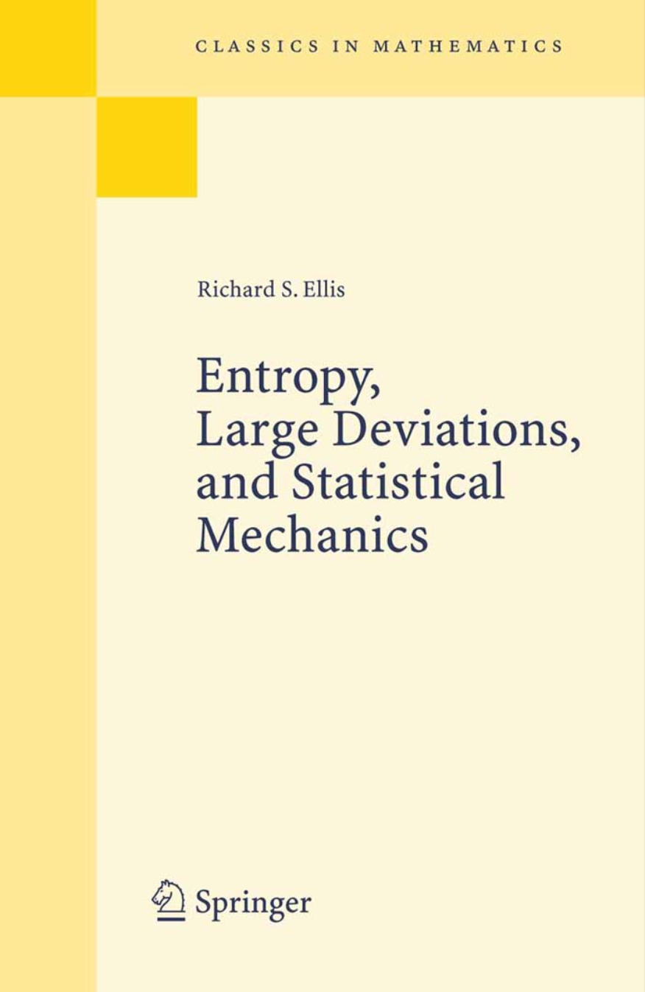
References for Large deviation Theory

Slide 3
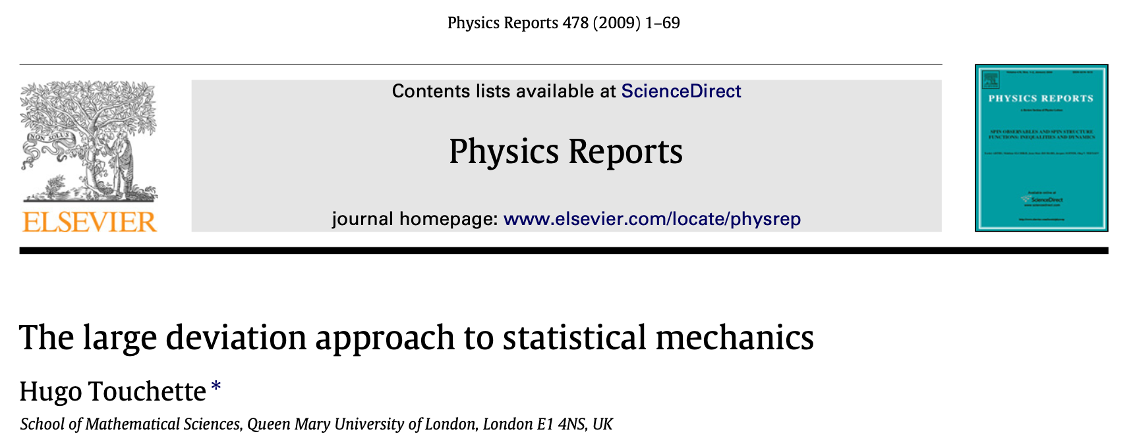
References for Large deviation Theory
H. Touchette, The large deviation approach to statistical mechanics, Phys. Rep. 478, 1 (2009).

Slide 4
Motivation & Overview
Whenever physicists calculate an entropy or free energy function, large deviation theory is at play.
Large deviation theory provides a rigorous mathematical description for statistical physics, for example, to better understand the maximum entropy principle.
Large deviation theory is also involved when studying the properties of many-particle systems, whether in equilibrium or not.

Slide 5
Motivation & Overview
For mathematicians, the large deviation is
  A theory describing the exponential decay of probabilities of rare.
  A calculus of exponential-order probabilities based on saddle-point approximations.
  A generalization of Cramér’s Theorem for sample means of i.i.d. random variables.
  An extension or refinement of the Law of Large Numbers and the Central Limit Theorem.

Slide 6

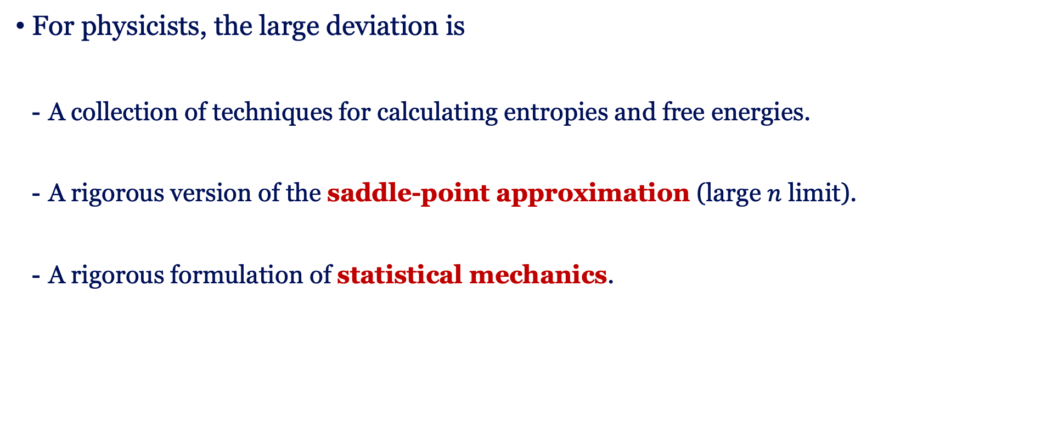
Motivation & Overview
For physicists, the large deviation is
  A collection of techniques for calculating entropies and free energies.
  A rigorous version of the saddle-point approximation (large $n$ limit).
  A rigorous formulation of statistical mechanics.
Thermodynamic limit ($n→∞$)
Microscopic models
Macroscopic properties
Large deviation theory

Slide 7
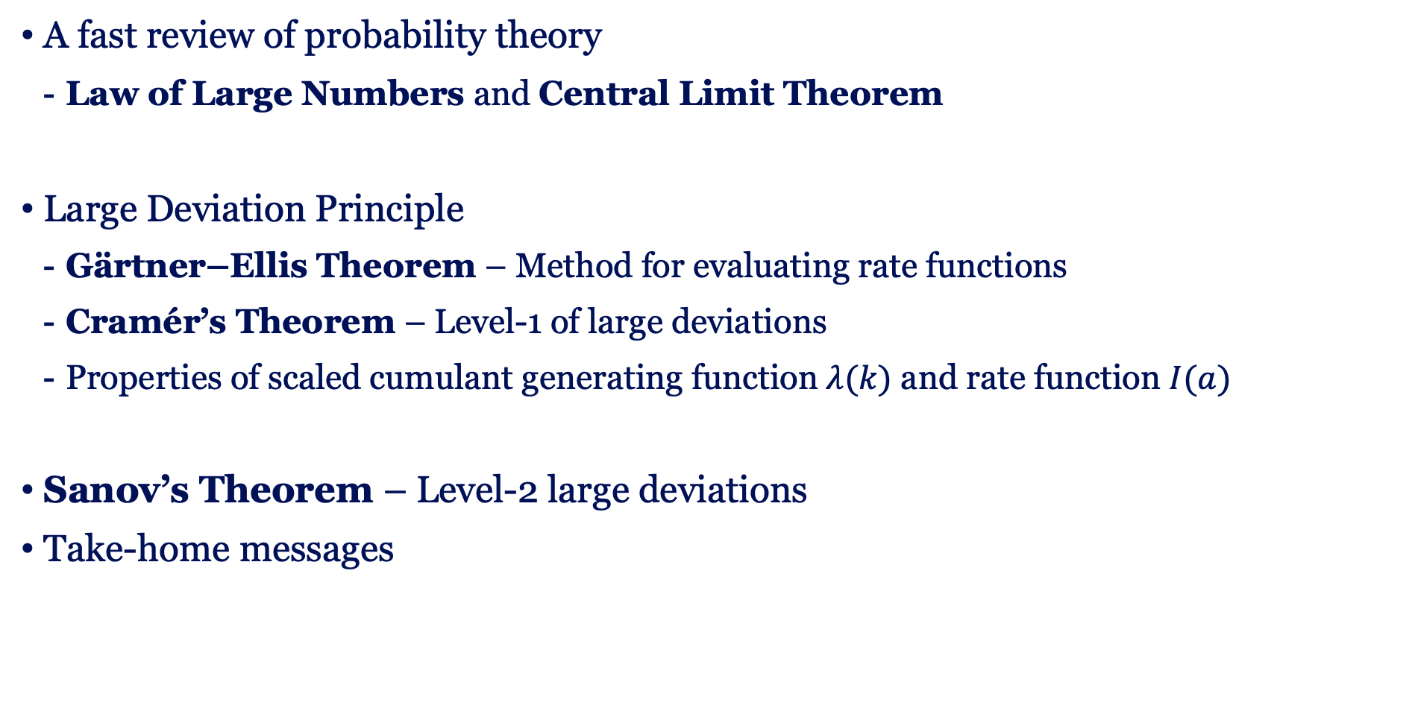
Content
A fast review of probability theory
  Law of Large Numbers and Central Limit Theorem
Large Deviation Principle
  Gärtner–Ellis Theorem – Method for evaluating rate functions
  Cramér’s Theorem – Level-1 of large deviations
  Properties of scaled cumulant generating function$λ(k)$ and rate function $I(a)$
Sanov’s Theorem – Level-2 large deviations
Take-home messages

Slide 8
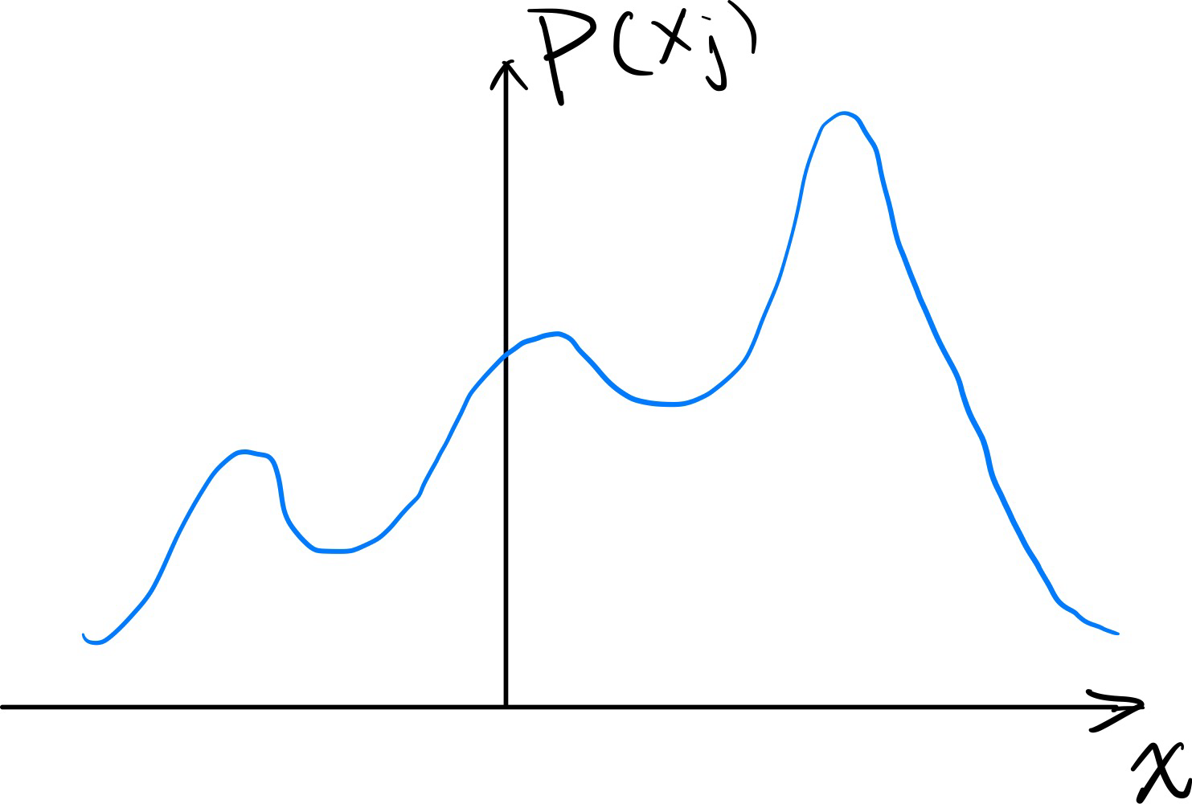
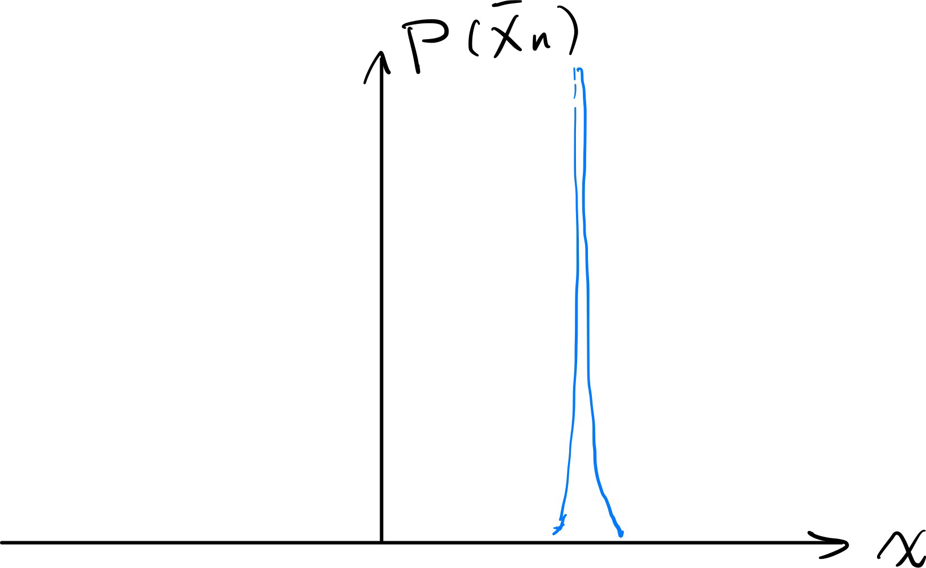
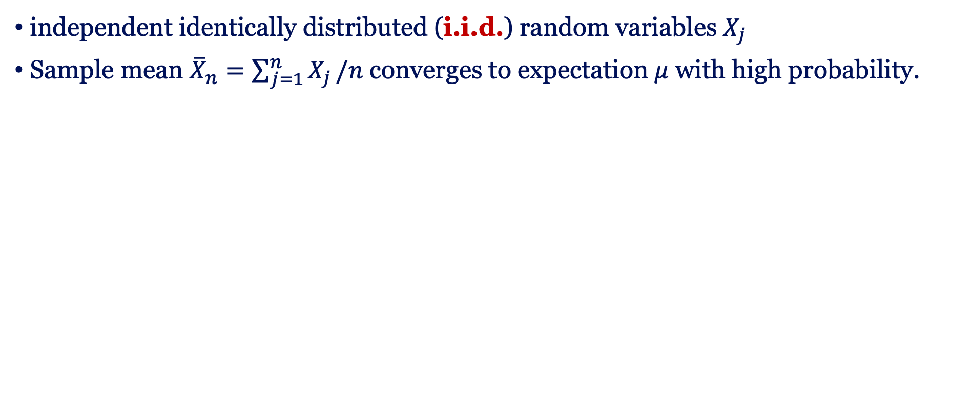
Law of Large Numbers (LLN):
independent identically distributed (i.i.d.) random variables $X_{j}$
Sample mean ${\overline{X}}_{n}=\sum_{j=1}^{n}{X_{j}}/n$ converges to expectation $μ$ with high probability.
Weak LLN | Strong LLN

Slide 9
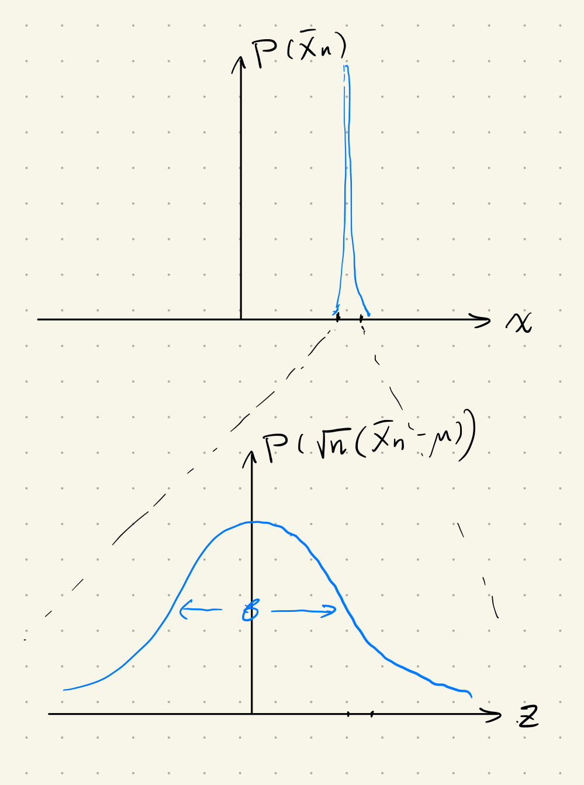

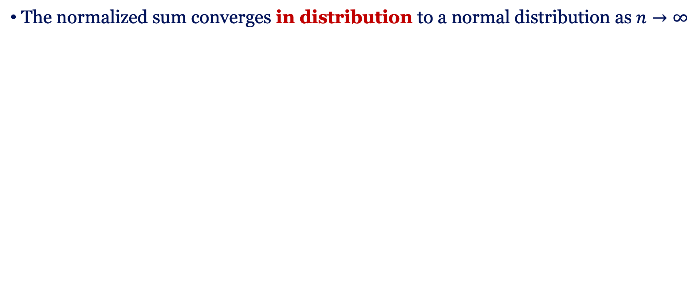
Central Limit Theorem:
The normalized sum converges in distribution to a normal distribution as $n→∞$
Central Limit Theorem

Slide 10
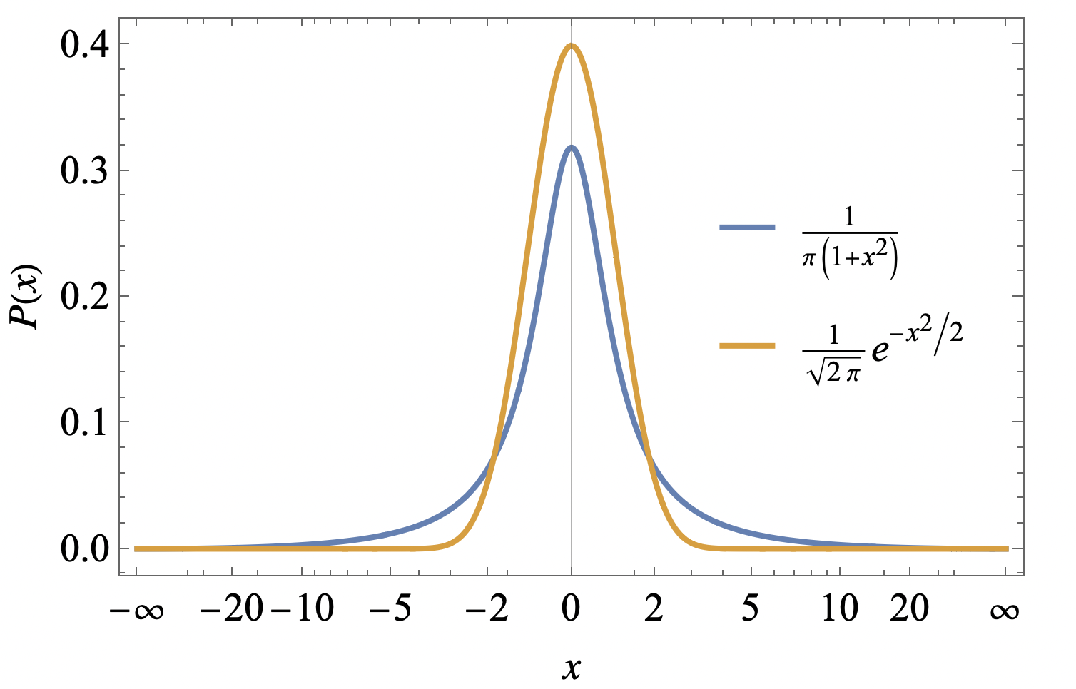
Remark
The validity of the Law of Large Numbers and the Central Limit Theorem requires the existence of some moments of the random variables.
Existence of variance weak LLN and Central Limit Theorem
strong LLN
Counterexample: Cauchy distribution
To make life easier, we focus on light-tailed distributions in the following.
+ i.i.d.

Slide 11
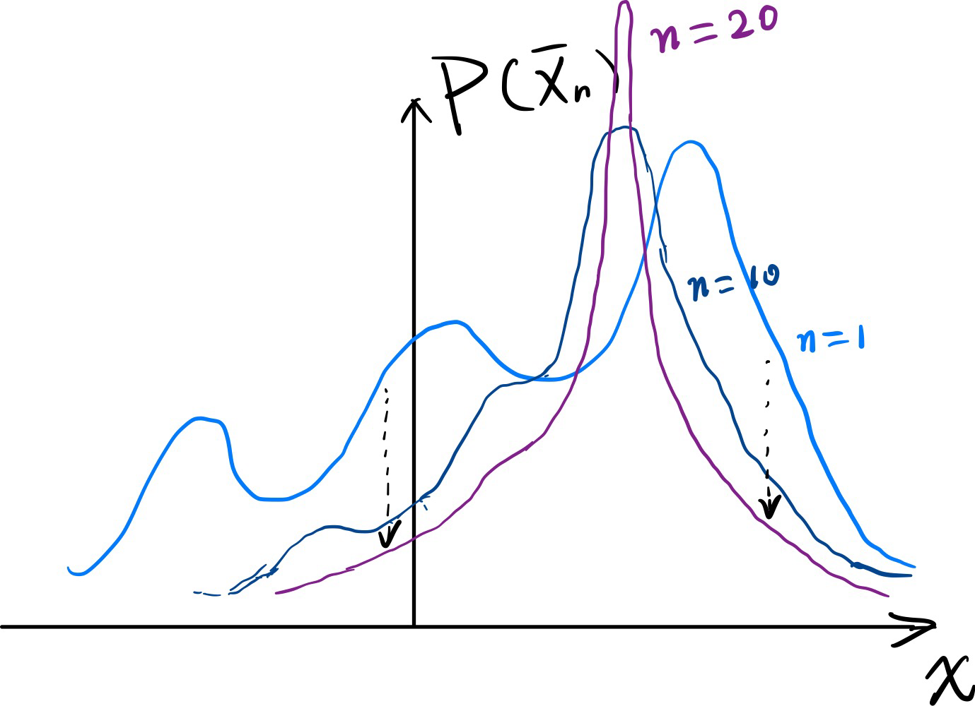
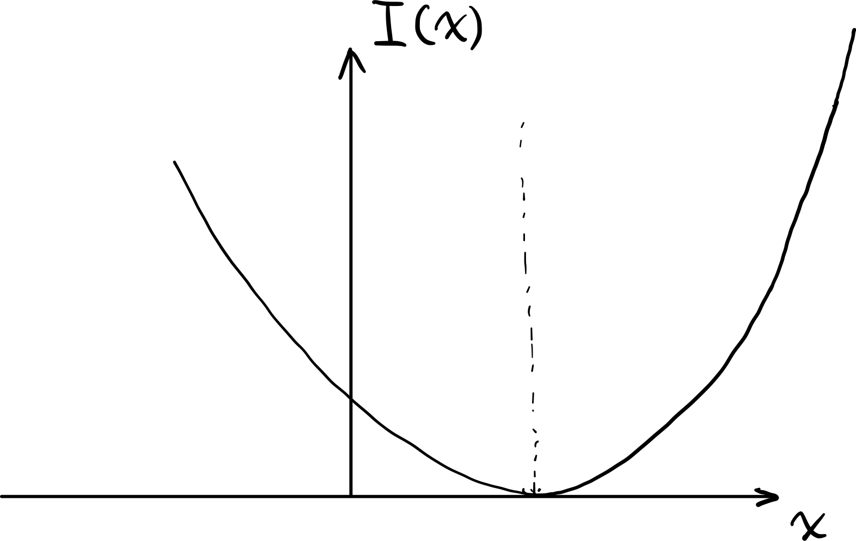
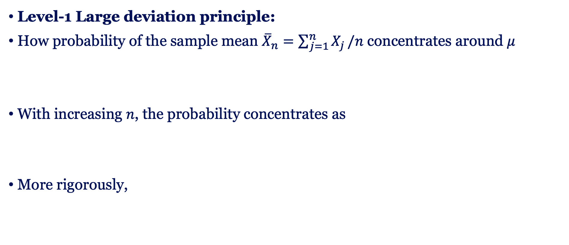
What is Large Deviation Principle?
Level-1 Large deviation principle:
How probability of the sample mean ${\overline{X}}_{n}=\sum_{j=1}^{n}{X_{j}}/n$ concentrates around $μ$
With increasing $n$, the probability concentrates as
More rigorously,

Slide 12
I will introduce level-1 (Cramér’s Theorem) and level-2 (Sanov’s Theorem) large deviation principles, and method (Gärtner–Ellis Theorem) to evaluate the rate functions.
We focus on i.i.d. random variables. The results are also applicable to broader contexts in statistical physics.
We will evaluate with simple examples:
Gaussian sample mean, Random bits, Symbol frequencies, Exponential sample mean.

Slide 13

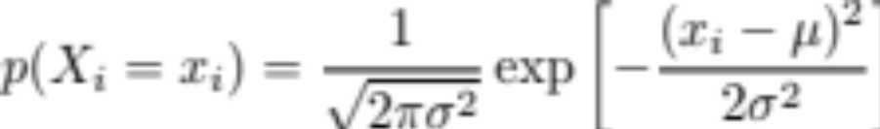
Gaussian Sample Mean
Sequence:
i.i.d. Gaussian random variables
The sample mean is also Gaussian
Its distribution
Rate function:

Slide 14

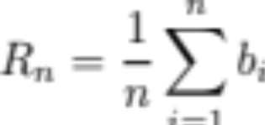
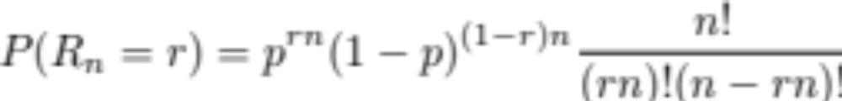


Random bits
Sequence:
i.i.d. random bits
The sample mean
Law of Large Number:
Central Limit Theorem:

Slide 15
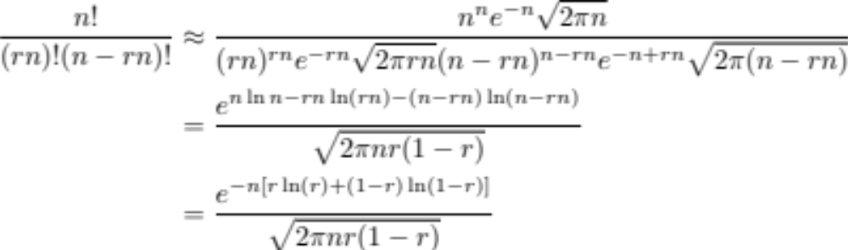
Random bits – Large Deviation
We use the Strling formula

Slide 16
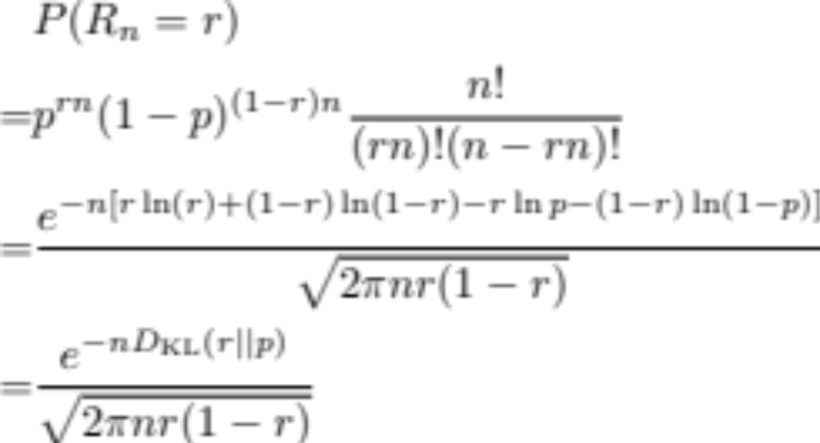
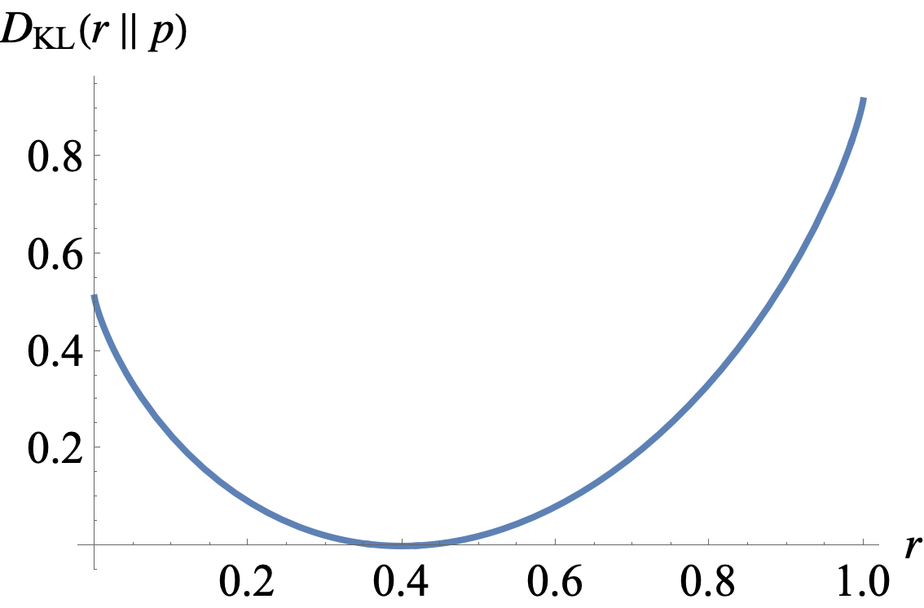


Random bits – Large Deviation
The rate function is

Slide 17

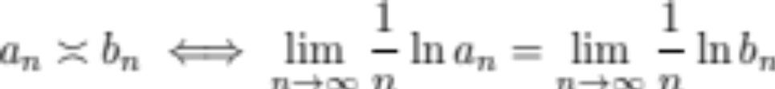
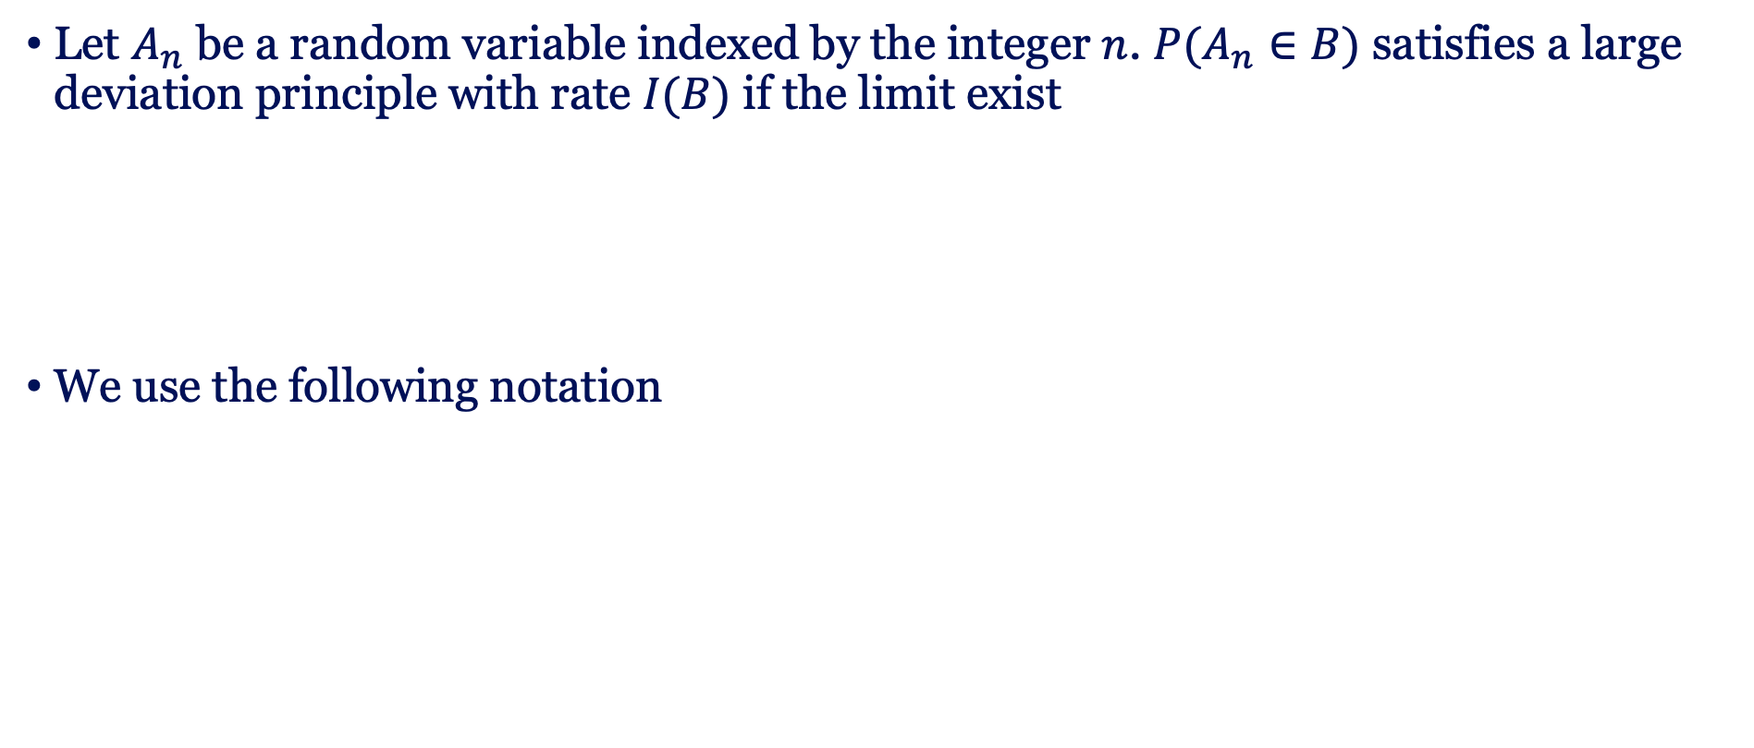
Large deviation principle
Let $A_{n}$ be a random variable indexed by the integer $n$. $P(A_{n}∈B)$ satisfies a large deviation principle with rate $I(B)$ if the limit exist
We use the following notation

Slide 18
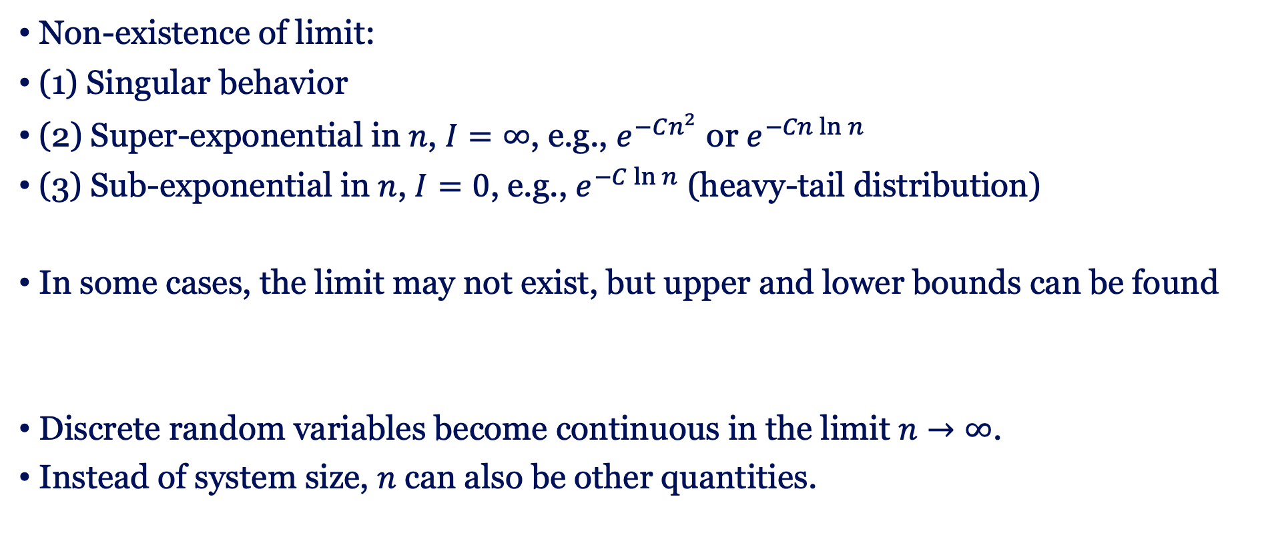
Some remarks
Non-existence of limit:
(1) Singular behavior
(2) Super-exponential in $n$, $I=∞$, e.g., $e^{−Cn^{2}}$ or $e^{−Cn\ln{n}}$
(3) Sub-exponential in $n$, $I=0$, e.g., $e^{−C\ln{n}}$ (heavy-tail distribution)
In some cases, the limit may not exist, but upper and lower bounds can be found
Discrete random variables become continuous in the limit $n→∞$.
Instead of system size, $n$ can also be other quantities.

Slide 19
Calculating rate functions
The large deviation theory addresses two main goals:
(1) Existence of a large deviation principle for random variables.
(2) Derivation to the corresponding rate function.
For non-i.i.d. cases, a more general approach is provided by the Gärtner–Ellis Theorem. We introduce in the following.

Slide 20
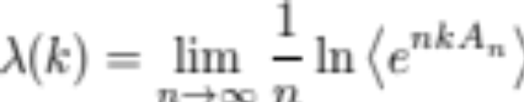
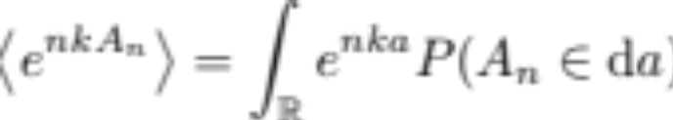
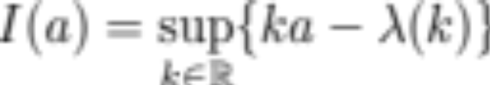
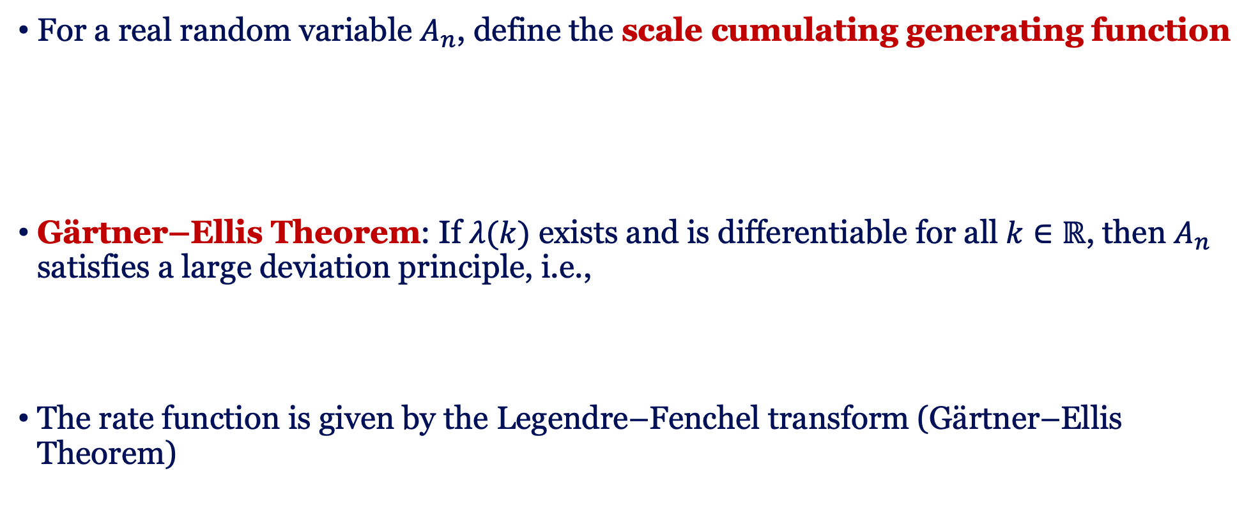
Gärtner–Ellis Theorem
For a real random variable $A_{n}$, define the scale cumulating generating function
Gärtner–Ellis Theorem: If $λ(k)$ exists and is differentiable for all $k∈ℝ$, then $A_{n}$ satisfies a large deviation principle, i.e.,
The rate function is given by the Legendre–Fenchel transform (Gärtner–Ellis Theorem)

Slide 21
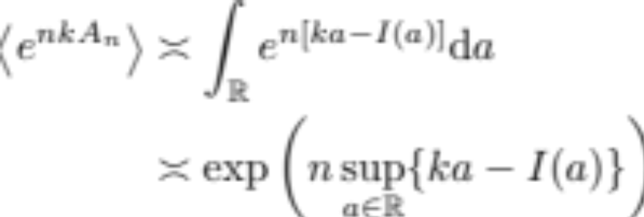
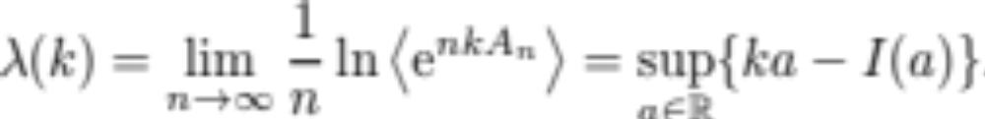
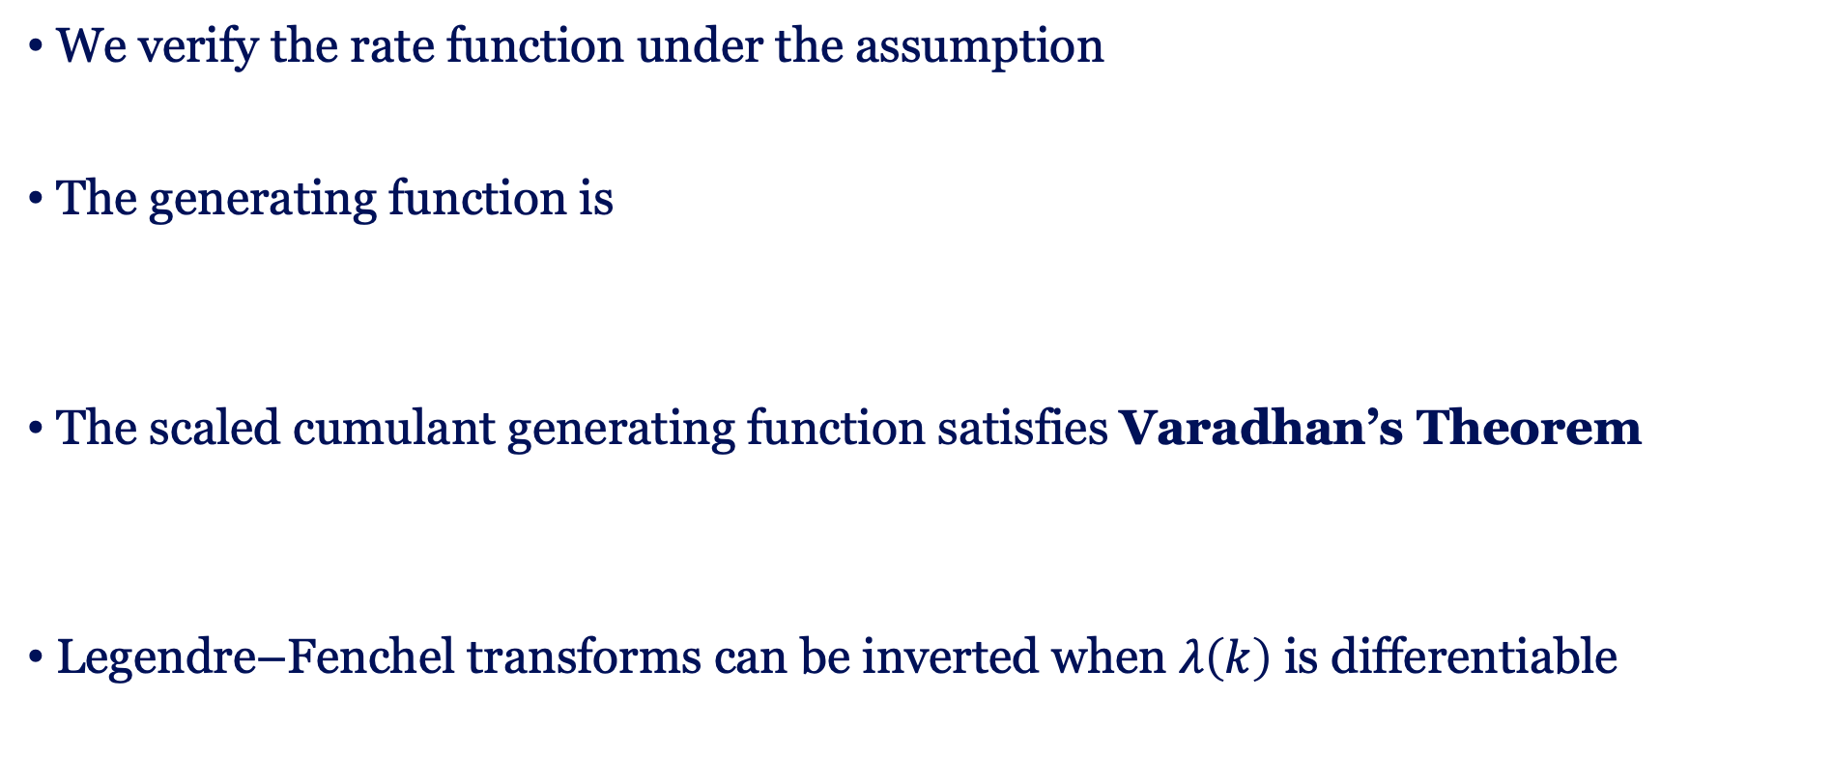
An argument
We verify the rate function under the assumption
The generating function is
The scaled cumulant generating function satisfies Varadhan’s Theorem
Legendre–Fenchel transforms can be inverted when $λ\left(k\right)$ is differentiable

Slide 22
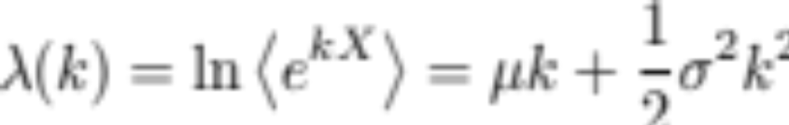
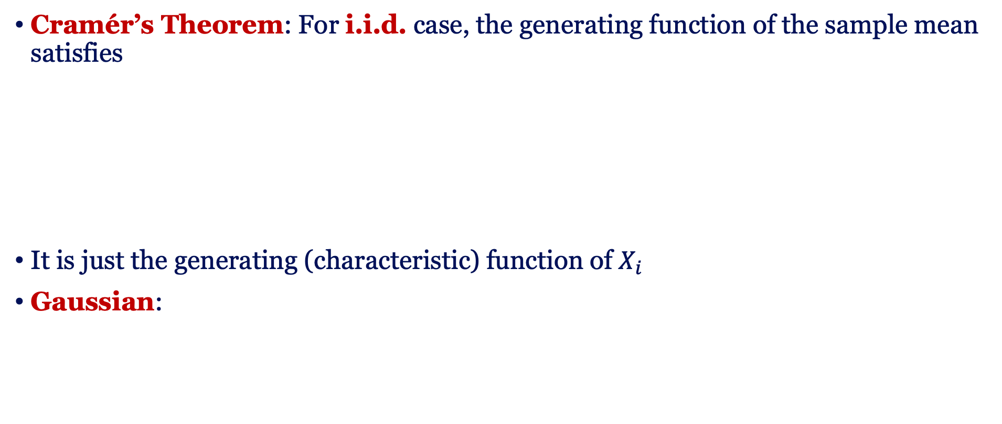
Application: Cramér’s Theorem
Cramér’s Theorem: For i.i.d. case, the generating function of the sample mean satisfies
It is just the generating (characteristic) function of $X_{i}$
Gaussian:

Slide 23

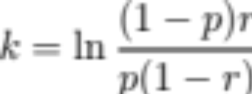
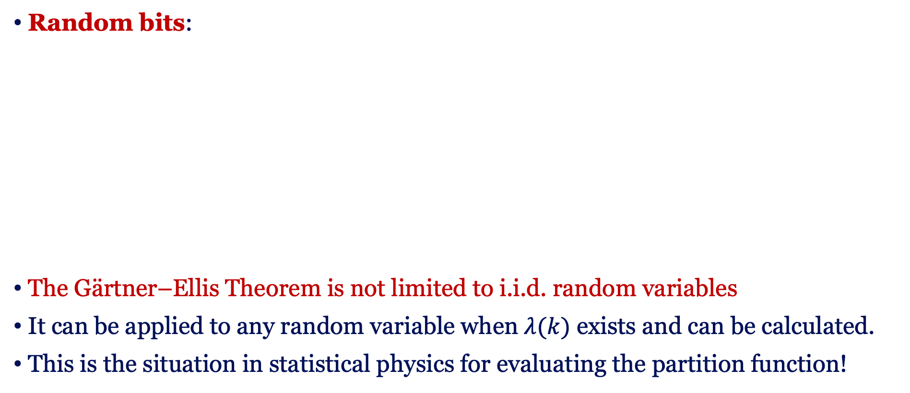
Application: Cramér’s Theorem
Random bits:
The Gärtner–Ellis Theorem is not limited to i.i.d. random variables
It can be applied to any random variable when $λ(k)$ exists and can be calculated.
This is the situation in statistical physics for evaluating the partition function!

Slide 24
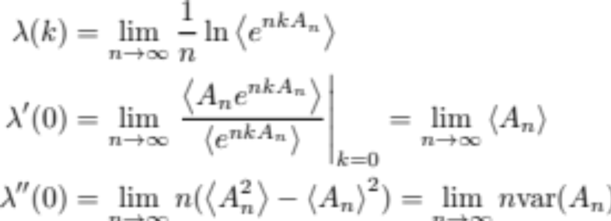
Properties of $λ$
Derivatives
Convexity

Slide 25
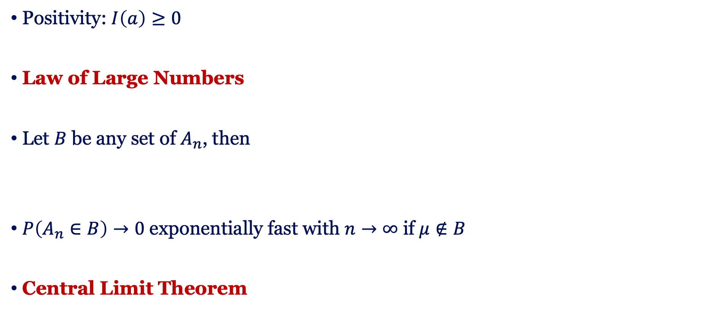
Properties of $I$
Positivity: $I\left(a\right)≥0$
Law of Large Numbers
Let $B$ be any set of $A_{n}$, then
$P\left(A_{n}∈B\right)→0$ exponentially fast with $n→∞$ if $μ∉B$
Central Limit Theorem

Slide 26
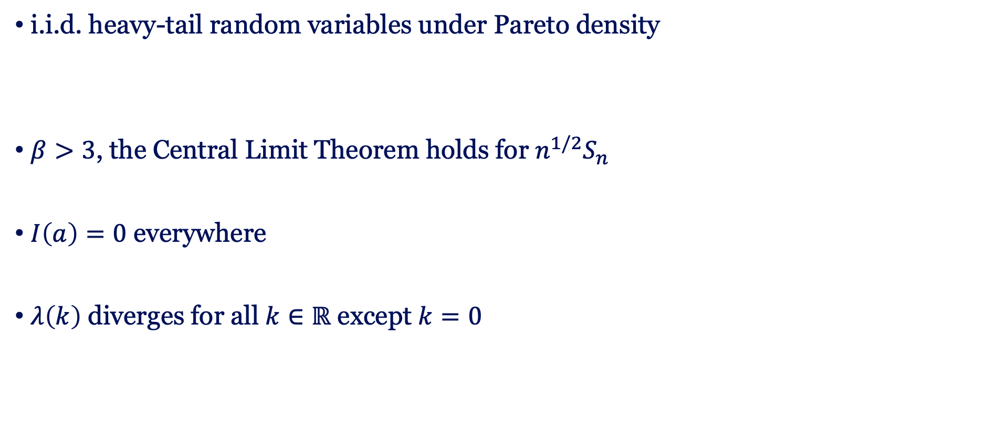
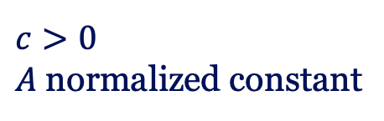
A classic counterexample
i.i.d. heavy-tail random variables under Pareto density
$β>3$, the Central Limit Theorem holds for $n^{1/2}S_{n}$
$I\left(a\right)=0$ everywhere
$λ\left(k\right)$ diverges for all $k∈ℝ$ except $k=0$
$c>0$
$A$ normalized constant

Slide 27



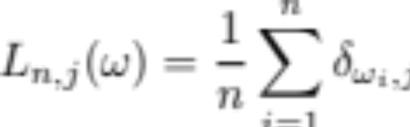
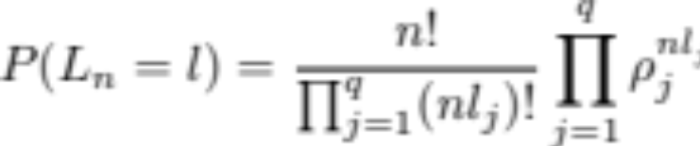
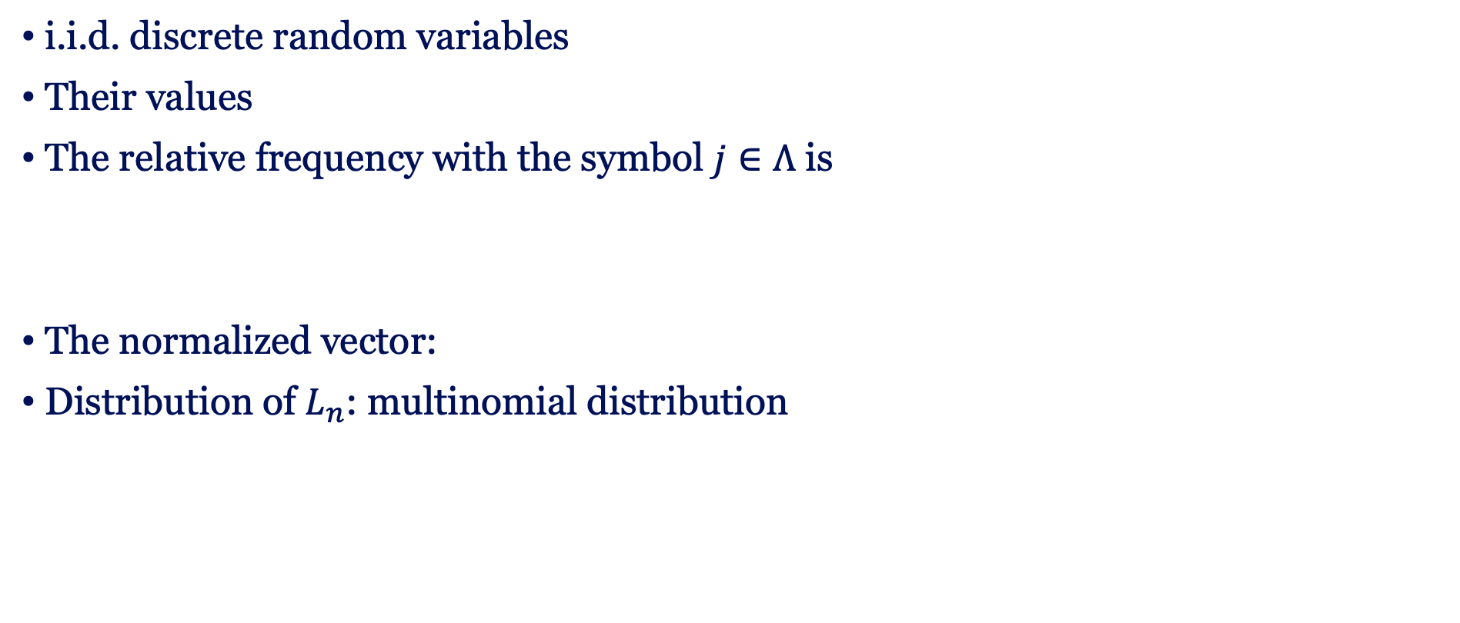
Symbol Frequency
i.i.d. discrete random variables
Their values
The relative frequency with the symbol $j∈Λ$ is
The normalized vector:
Distribution of $L_{n}$: multinomial distribution

Slide 28
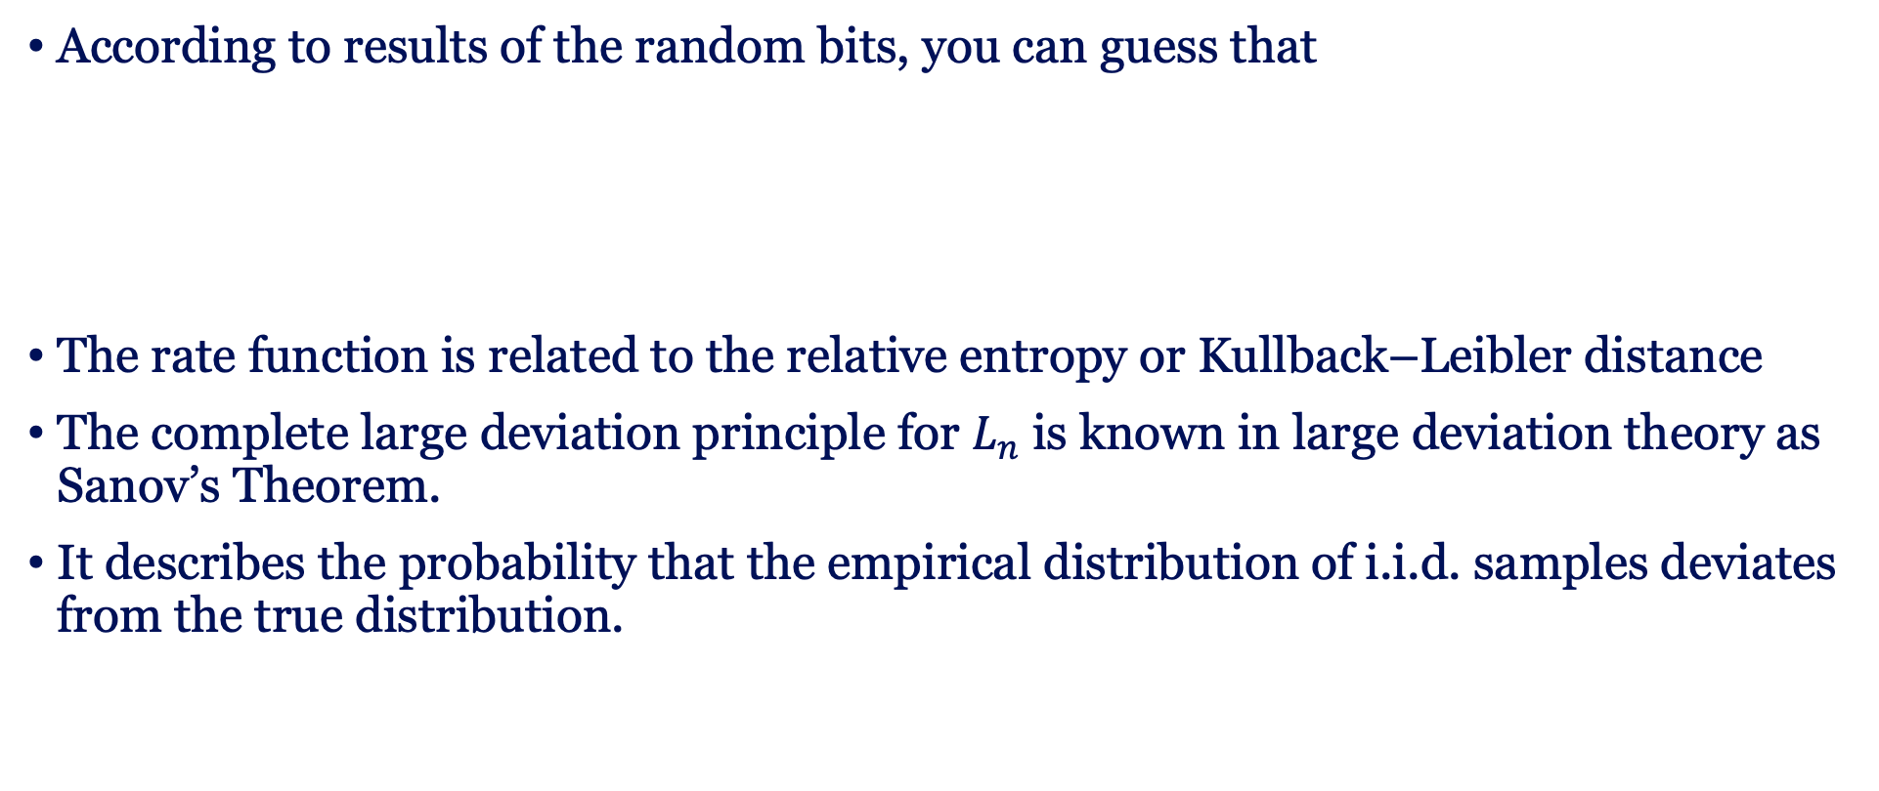
Sanov’s Theorem – Level-2 large deviations
According to results of the random bits, you can guess that
The rate function is related to the relative entropy or Kullback–Leibler distance
The complete large deviation principle for $L_{n}$ is known in large deviation theory as Sanov’s Theorem.
It describes the probability that the empirical distribution of i.i.d. samples deviates from the true distribution.

Slide 29
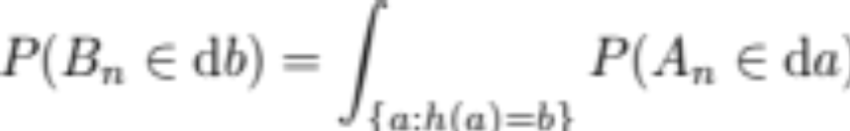
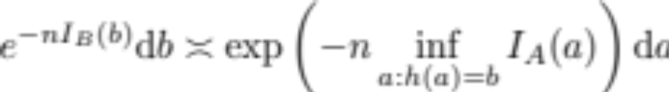

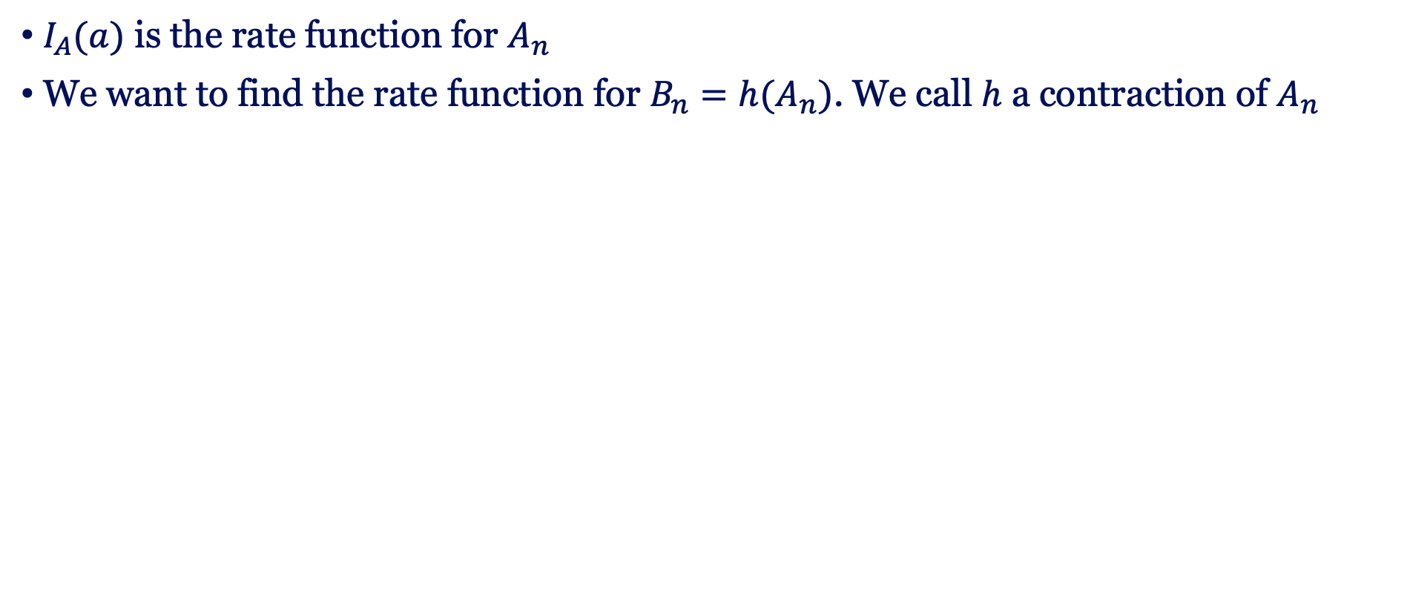
Contraction principle
$I_{A}(a)$ is the rate function for $A_{n}$
We want to find the rate function for $B_{n}=h(A_{n})$. We call $h$ a contraction of $A_{n}$

Slide 30
Contraction from Level-2 to Level-1
Its value
The contraction principle leads to

Slide 31
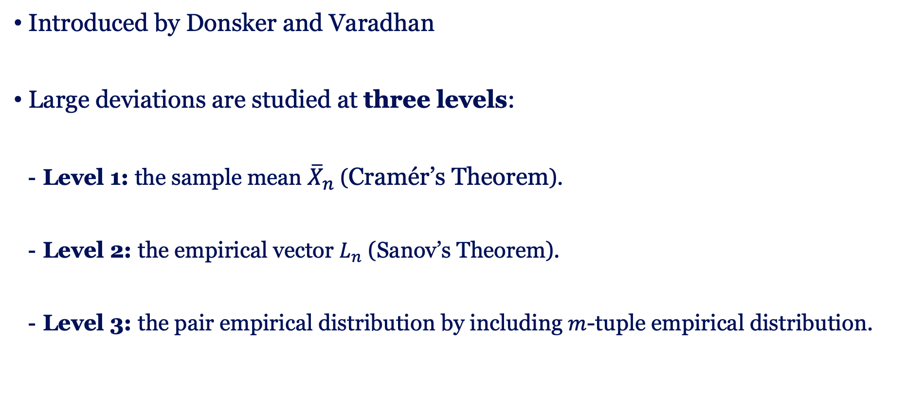
Large deviation principle in 3 levels
Introduced by Donsker and Varadhan
Large deviations are studied at three levels:
  Level 1: the sample mean ${\overline{X}}_{n}$ (Cramér’s Theorem).
  Level 2: the empirical vector $L_{n}$ (Sanov’s Theorem).
  Level 3: the pair empirical distribution by including $m$-tuple empirical distribution.

Slide 32
Summary
In this lecture, we use only i.i.d. random variables for illustration of the large deviation theory.
It can also be applied to more complex models, for example, Ising models, either fully connected (Curie Weiss) or finite dimension
The large deviation theory can be used to study nonequilibrium processes, for example, relaxation processes [see J. Meibohm and M. Esposito, PRL 128, 110603 (2022)]
Metastability is related to the non-convexity in the rate function (recall yesterday’s talk).

Slide 33
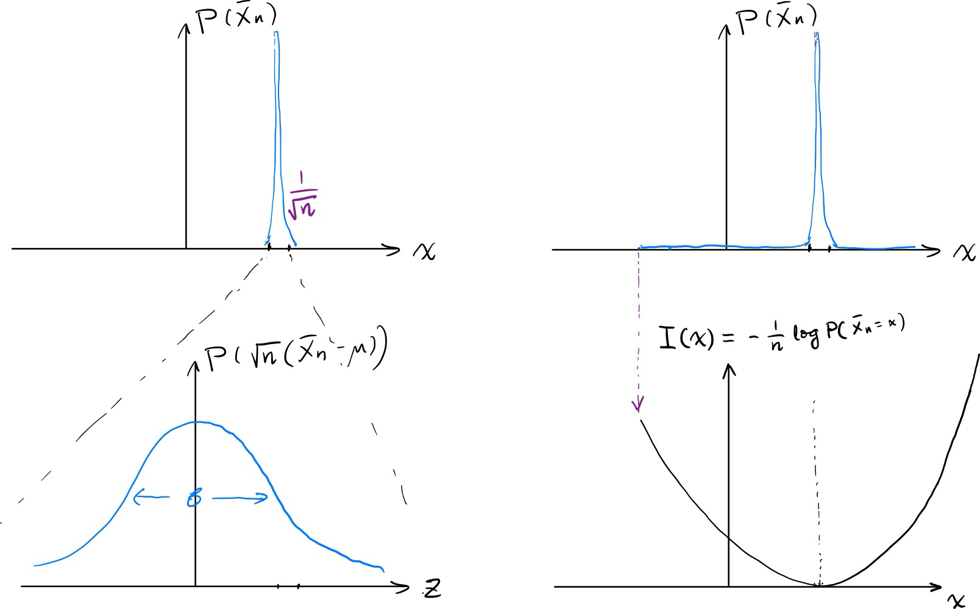
Take-home message
y-axis on log scale!
Small deviation:
Central Limit Theorem
Large deviation:
Rate Function

Slide 34
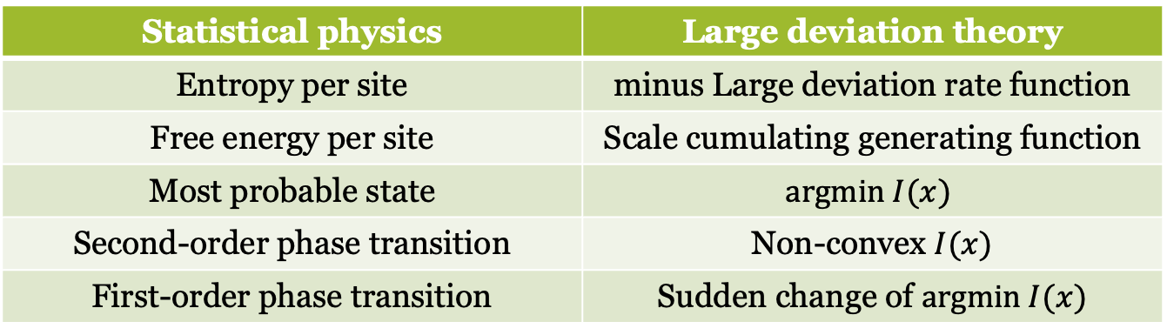
Take-home message
Statistical physics | Large deviation theory
Entropy per site | minus Large deviation rate function
Free energy per site | Scale cumulating generating function
Most probable state | $$argmin I(x)$$
Second-order phase transition | Non-convex $I(x)$
First-order phase transition | Sudden change of $argmin I(x)$

Slide 35


Slide 36

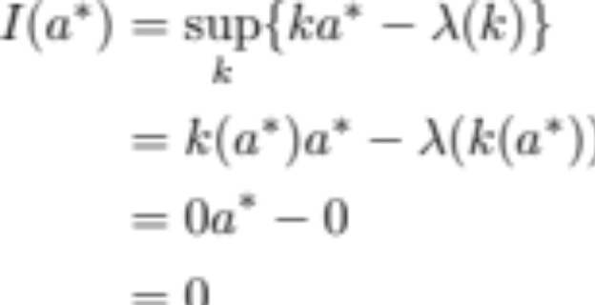

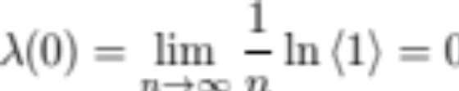

Proof of Properties of $I$
Positivity: $I\left(a\right)≥0$
Law of large numbers
Let $B$ be any set of $A_{n}$, then
$P\left(A_{n}∈B\right)→0$ exponentially fast with $n→∞$ if $a^{∗}∉B$

Slide 37

Next lecture
Large deviations in equilibrium statistical mechanics
  Entropy as a rate function
  Free energy as a scaled cumulant generating function
  Phase transitions
  Legendre transforms in thermodynamics
  Jaynes’s Maximum Entropy Principle
Markov processes, level 3 of large deviations
Examples?

