Slide 1



Boosting thermalization of classical and quantum many-body systems
Jinfu Chen | @NWO Physics, 21.1.2025
arXiv:2411.03420 & ongoing work with Kshiti Sneh Rai,
Patrick Emonts, Donato Farina, Marcin Płodzień,
Przemyslaw Grzybowski, Maciej Lewenstein, Jordi Tura

Slide 2




Motivation
Thermodynamics
+
Equations of motion
Equilibrium
Stochastic thermodynamics Quantum stochastic thermodynamics (?)
Preparing classical and quantum thermal states
Nonequilibrium thermodynamics: thermalization, quench dynamics
Nonequilibrium
Classical detailed balance condition
Continuous-time Markov chain
Quantum detailed balance condition
Lindblad master equation (Lindbladian)
U. Seifert, Rep. Prog. Phys. 75, 126001 (2012)
F. Avanzini, M. Bilancioni, V. Cavina, S. Dal Cengio, M. Esposito, G. Falasco, et al. SciPost Phys. Lect. Notes 80 (2024).
1

Slide 3
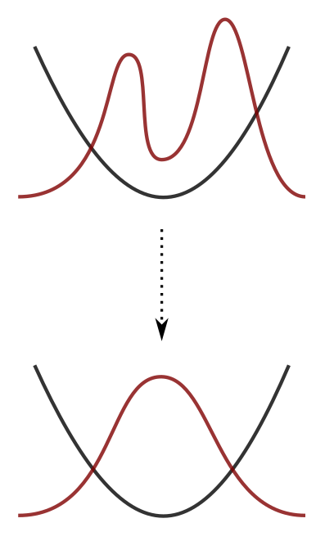

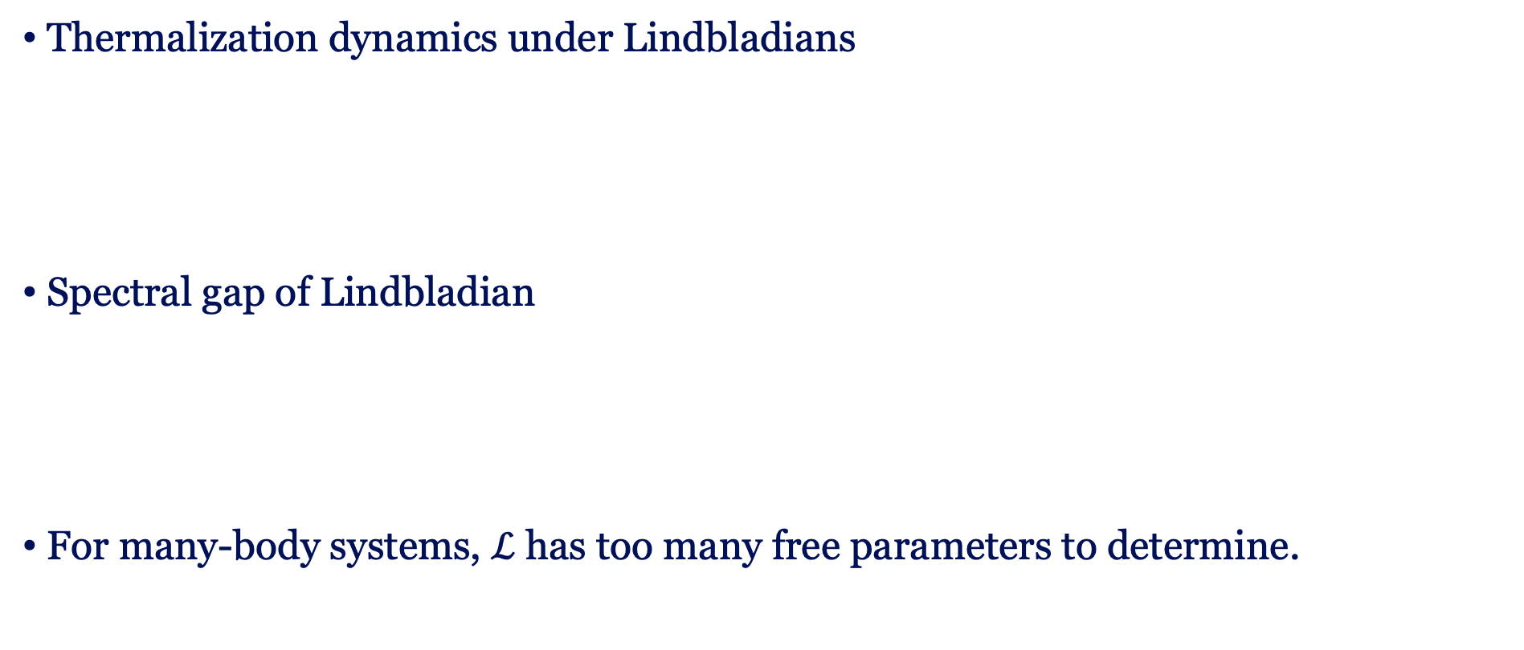

Motivation
Thermalization dynamics under Lindbladians
Spectral gap of Lindbladian
For many-body systems, $ℒ$ has too many free parameters to determine.
Slowest relaxing mode
Harmonic potential
Maximizing $Δ$ Fast thermalization Reducing irreversibility
Reduced by the symmetry of $ρ_{β}$
2

Slide 4
Motivation
Quantum algorithm:
Implement thermodynamic processes on quantum circuits
Nonequilibrium thermodynamic
processes
Quantum circuits:
Quantum simulation, quantum computing
An efficient and exact noncommutative quantum Gibbs sampler,
Chi-Fang Chen, Michael J. Kastoryano, András Gilyén, arXiv:2311,09207
Lindblad engineering for quantum Gibbs state preparation under the eigenstate thermalization hypothesis
Eric Brunner, Luuk Coopmans, Gabriel Matos, Matthias Rosenkranz, Frederic Sauvage, Yuta Kikuchi, arXiv, 2412.17706
3

Slide 5
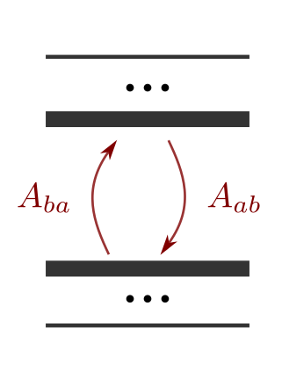
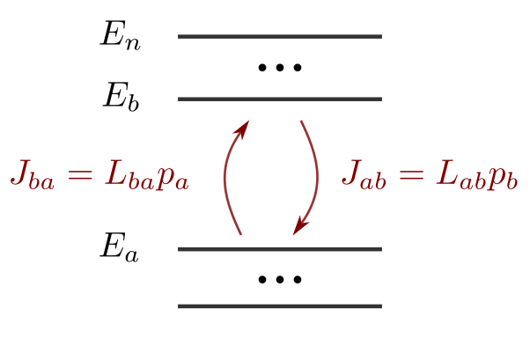



Quantum detailed balance condition
Classical detailed balance condition:
Quantum detailed balance condition:
Time-reversal symmetry:
A pair of Lindblad operators
+
Trajectory in equilibrium:
time-reversal symmetry
Constraint on coherent dynamics (?)
F. Fagnola, V. Umanità, Commun. Math. Phys. 298, 523–547 (2010).
4

Slide 6
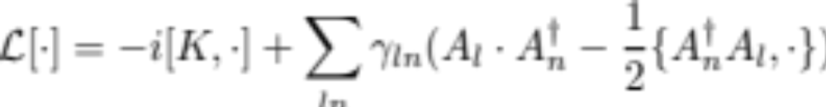

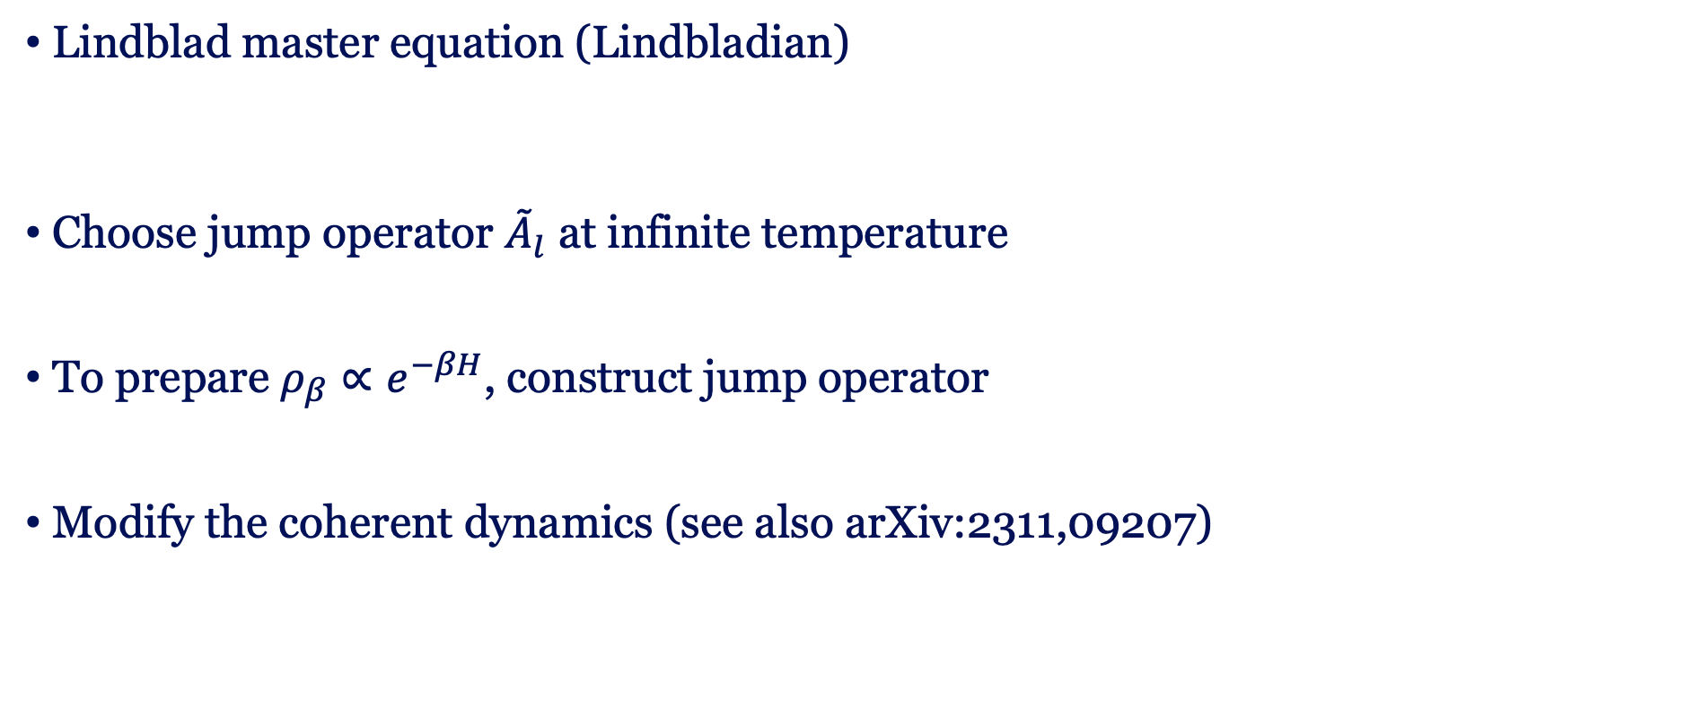
Constructing Lindbladians
Lindblad master equation (Lindbladian)
Choose jump operator ${\tilde{A}}_{l}$ at infinite temperature
To prepare $ρ_{β}∝e^{−βH}$, construct jump operator
Modify the coherent dynamics (see also arXiv:2311,09207)
arXiv:2411.03420
5

Slide 7
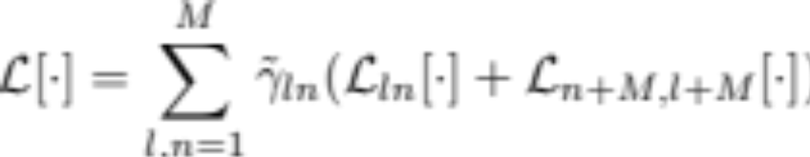
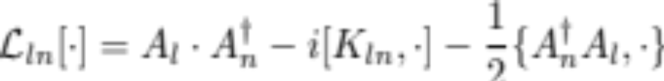

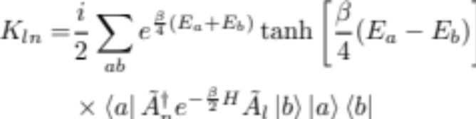
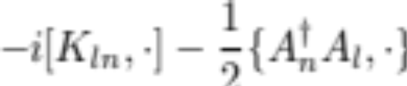

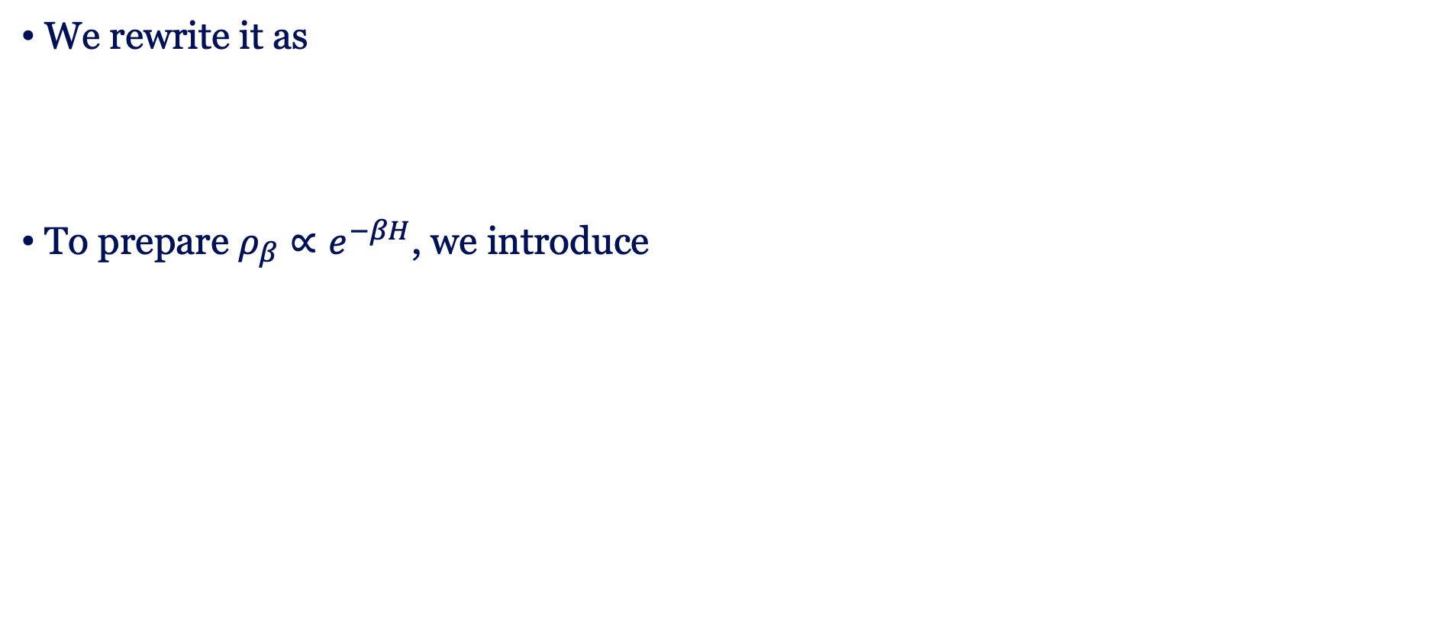
Constructing Lindbladians
$2M$ Lindblad operators
We rewrite it as
To prepare $ρ_{β}∝e^{−βH}$, we introduce
Pairs of transitions
Satisfy quantum detailed
balance condition
6

Slide 8

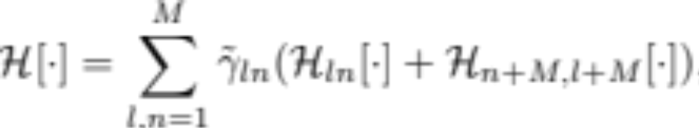
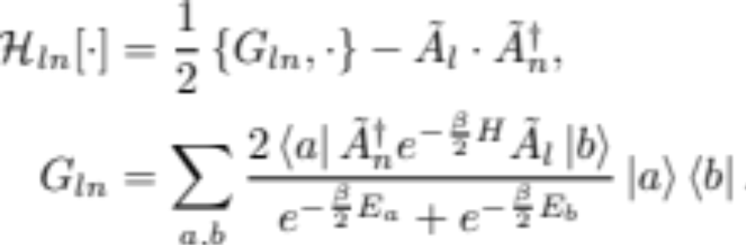
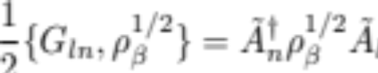
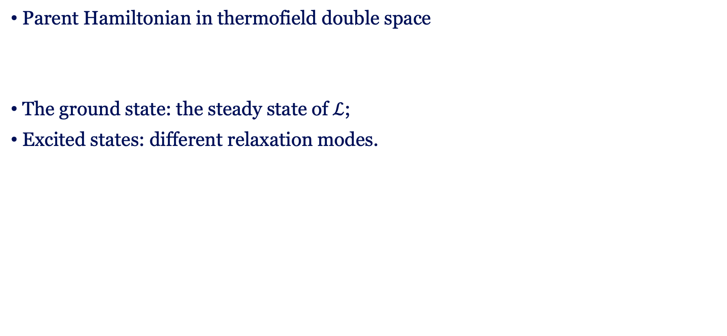
Parent Hamiltonian
Parent Hamiltonian in thermofield double space
The ground state: the steady state of $ℒ$;
Excited states: different relaxation modes.
Quantum detailed balance:
Frustration-free
Symmetric logarithmic derivative
7

Slide 9
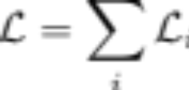
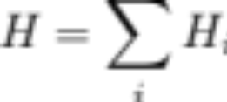




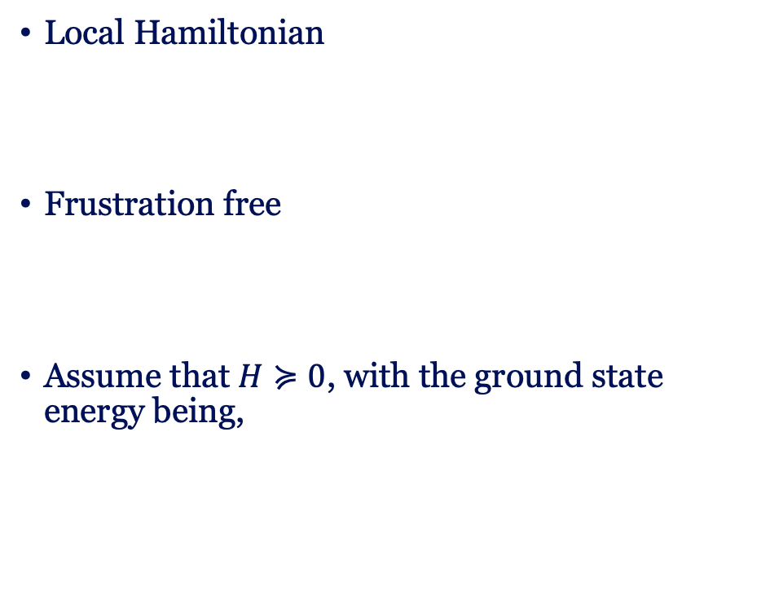
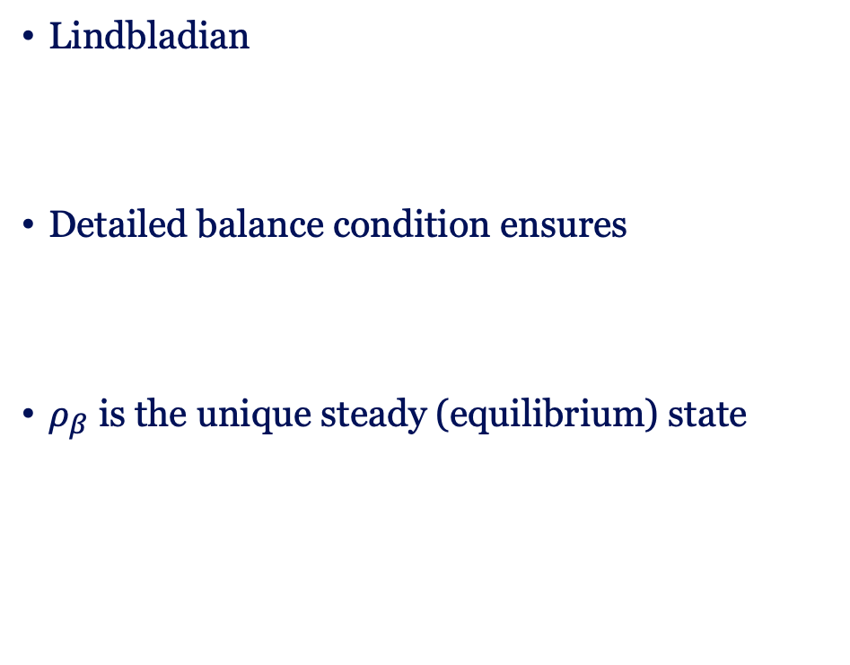
Parent Hamiltonian
Detailed balance condition
Frustration-free Hamiltonians
Lindbladian
Detailed balance condition ensures
$ρ_{β}$ is the unique steady (equilibrium) state
Local Hamiltonian
Frustration free
Assume that $H≽0$, with the ground state energy being,
8

Slide 10

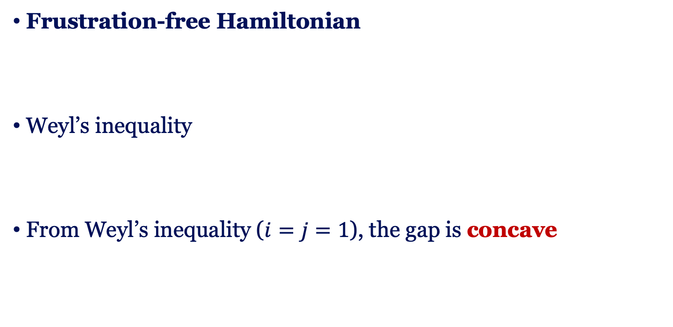
Optimizing gap
Frustration-free Hamiltonian
Weyl’s inequality
From Weyl’s inequality ($i=j=1$), the gap is concave
K. S. Rai, JFC, P. Emonts, J. Tura, Spectral Gap Optimization for Enhanced Adiabatic State Preparation, arXiv:2409.15433, focus session on tensor networks
9

Slide 11




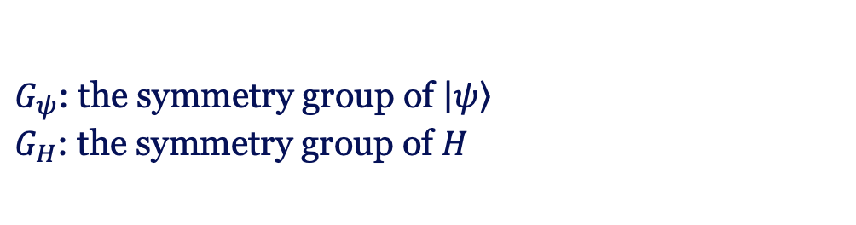
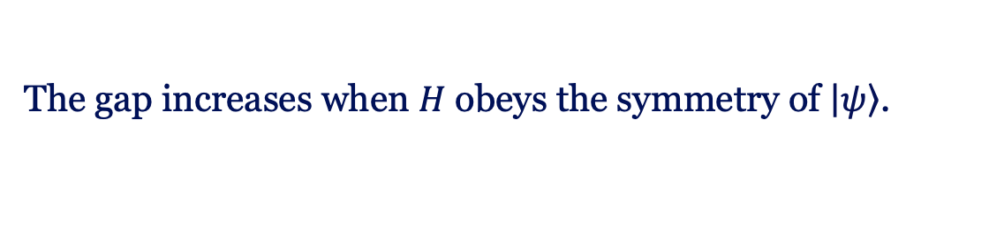
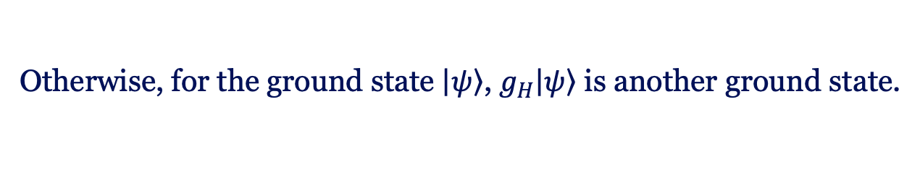
Symmetry
Concavity:
Spontaneous symmetry breaking:
Maximize the gap $Δ$
$G_{ψ}$: the symmetry group of $\left|\left.ψ\right\rangle \right.$
$G_{H}$: the symmetry group of $H$
The gap increases when $H$ obeys the symmetry of $\left|\left.ψ\right\rangle \right.$.
Otherwise, for the ground state $\left|\left.ψ\right\rangle \right.$, $g_{H}\left|\left.ψ\right\rangle \right.$ is another ground state.
K. S. Rai, JFC, P. Emonts, J. Tura, Spectral Gap Optimization for Enhanced Adiabatic State Preparation, arXiv:2409.15433, focus session on tensor networks
10

Slide 12


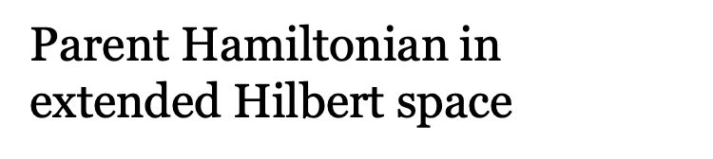
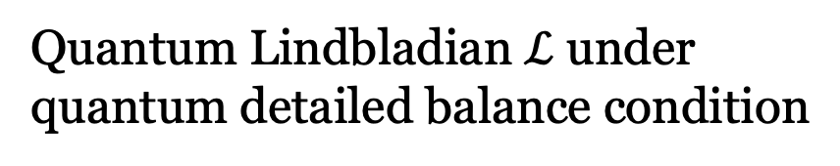

Classical Liouvillians
Quantum Lindbladian $ℒ$ under quantum detailed balance condition
Classical Liouvillian $L$ under detailed balanced condition
Parent Hamiltonian in extended Hilbert space
Parent Hamiltonian
e.g., Lipkin-Meshkov-Glick model
e.g., Kinetic Ising models
arXiv:2411.03420
11

Slide 13
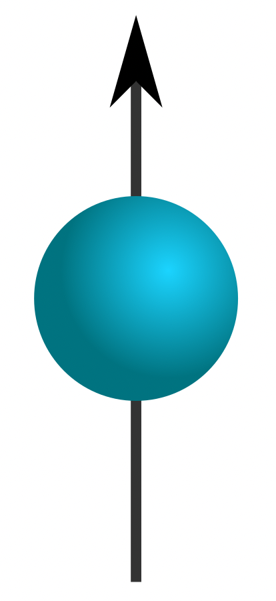
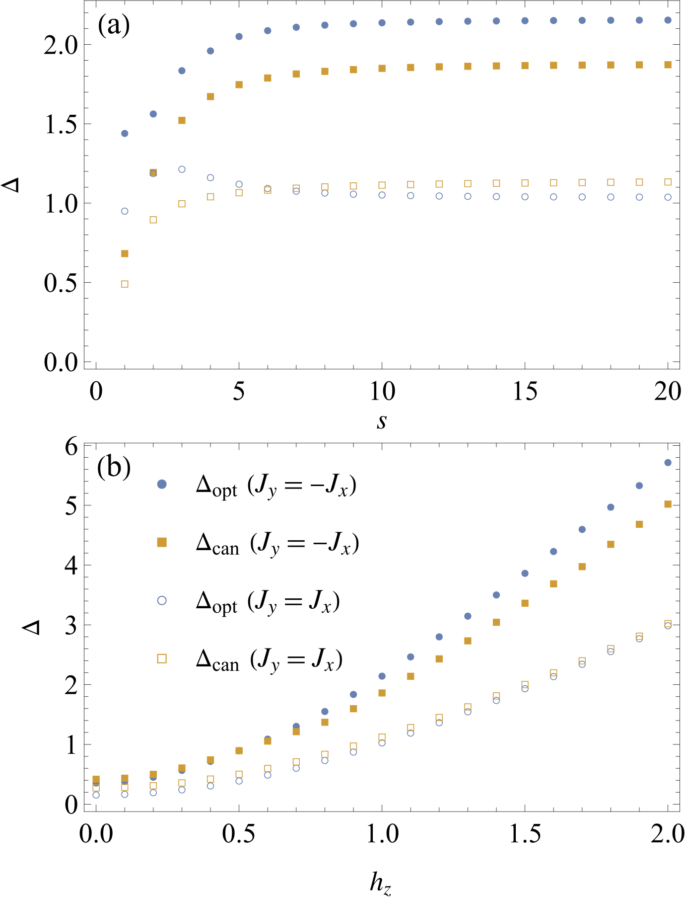
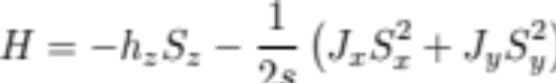
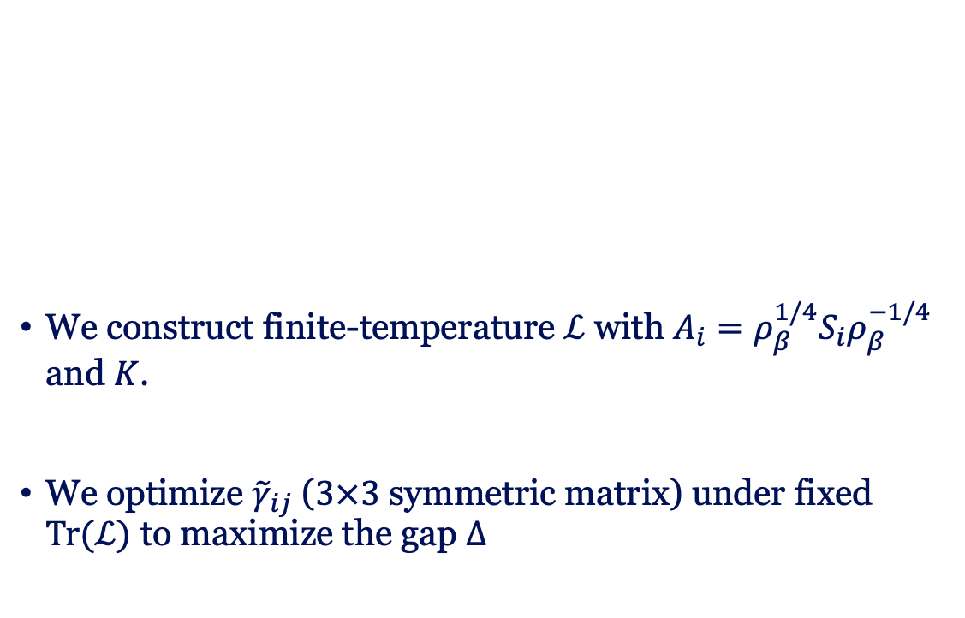

LMG model
We construct finite-temperature $ℒ$ with $A_{i}=ρ_{β}^{1/4}S_{i}ρ_{β}^{−1/4}$ and $K$.
We optimize ${\tilde{γ}}_{ij}$ ($3×3$ symmetric matrix) under fixed $Tr(ℒ)$ to maximize the gap $Δ$
spin-$J$
arXiv:2411.03420
12

Slide 14
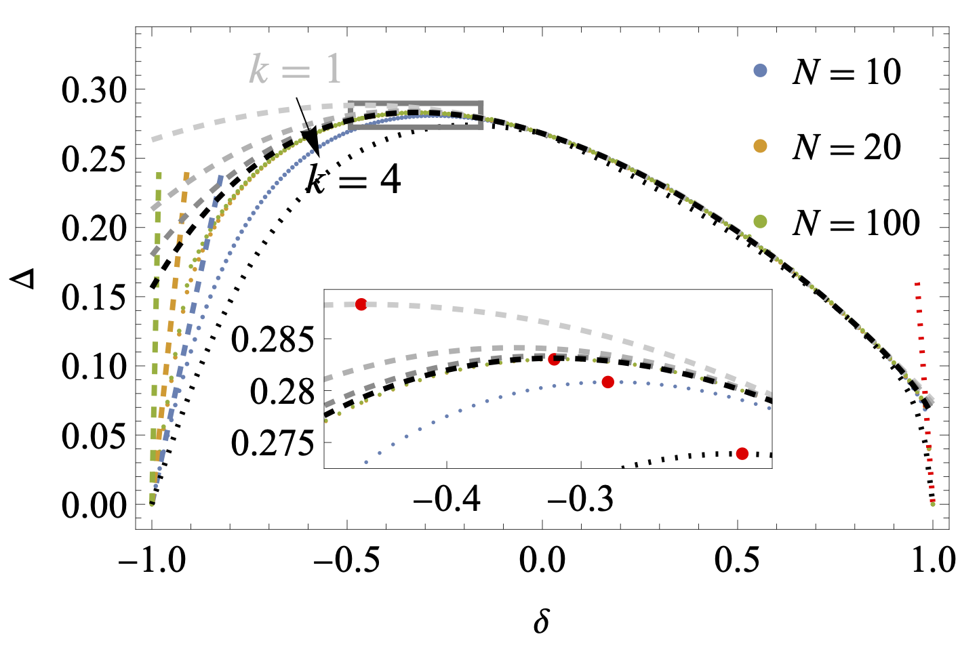
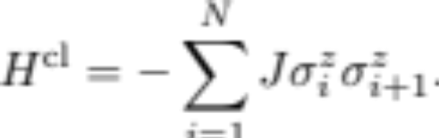

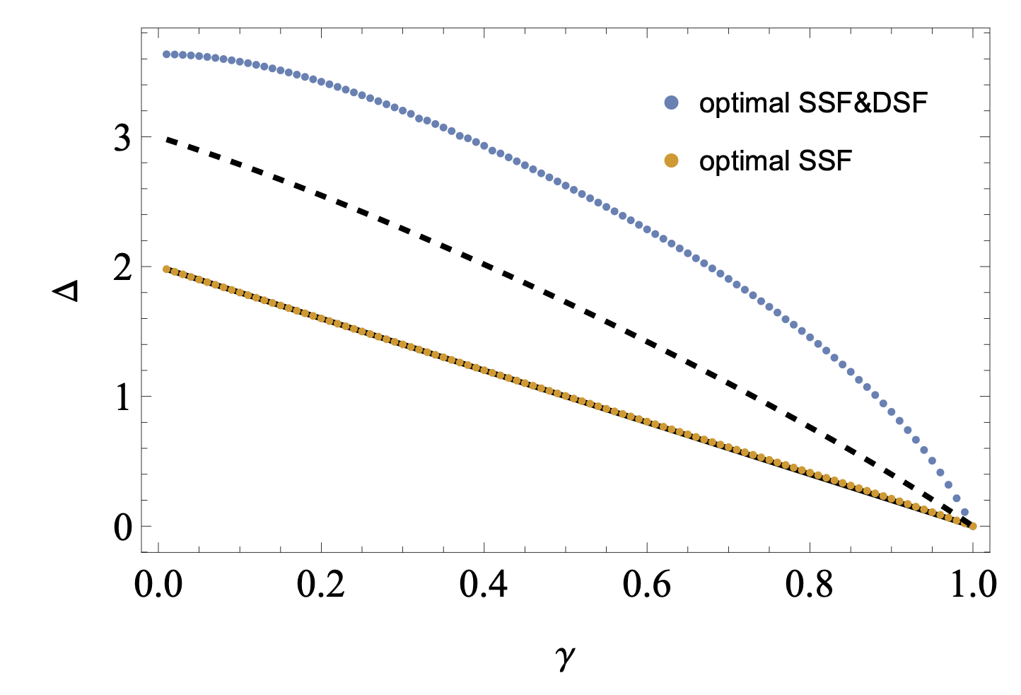


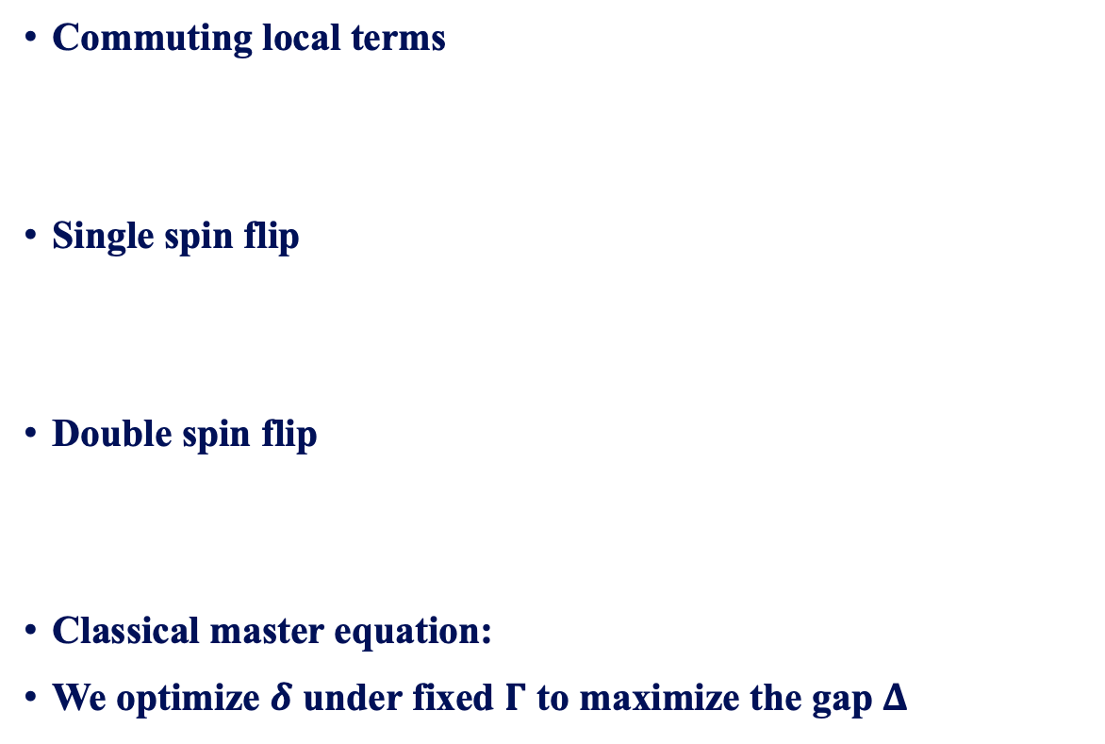
1D Kinetic Ising model model
Variational upper bound
Commuting local terms
Single spin flip
Double spin flip
Classical master equation:
We optimize $δ$ under fixed $Γ$ to maximize the gap $Δ$
SDP lower bound
Translational symmetry
Local Z2 symmetry
2 kinetic coefficients
detailed
balance
⋯ ↑ ↓ ↑ ⋯
⋯ ↑ ↑ ↑ ⋯
4 kinetic coefficients
detailed
balance
⋯ ↑ ↓ ↓ ↑ ⋯
⋯ ↑ ↑ ↑ ↑ ⋯
arXiv:2411.03420
13

Slide 15
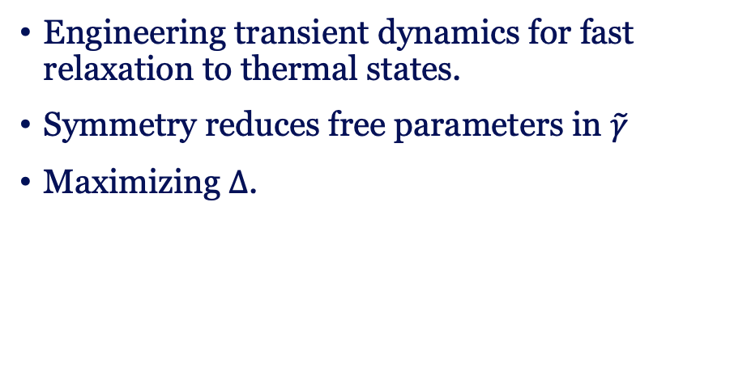
Thermodynamics
Gap optimization
A family of Lindbladians under quantum detailed balance.
Relevant to quantum thermodynamics, simulation, and algorithms.
Engineering transient dynamics for fast relaxation to thermal states.
Symmetry reduces free parameters in $\tilde{γ}$
Maximizing $Δ$.
Future scope
Establish stochastic thermodynamics for these Lindbladians.
Optimizing control of open quantum many-body systems.
Variational and SDP bounds for larger systems.
14

Slide 16


