Slide 1
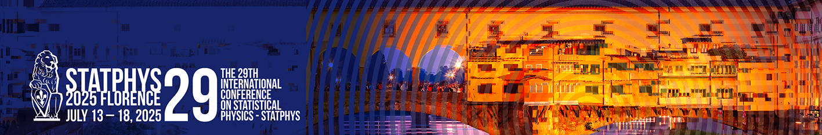


Boosting thermalization of classical and quantum many-body systems
Jinfu Chen | @StatPhys29, 14.7.2025
arXiv:2411.03420 & ongoing work with Kshiti Sneh Rai,
Patrick Emonts, Donato Farina, Marcin Płodzień,
Przemyslaw Grzybowski, Maciej Lewenstein, Jordi Tura

Slide 2


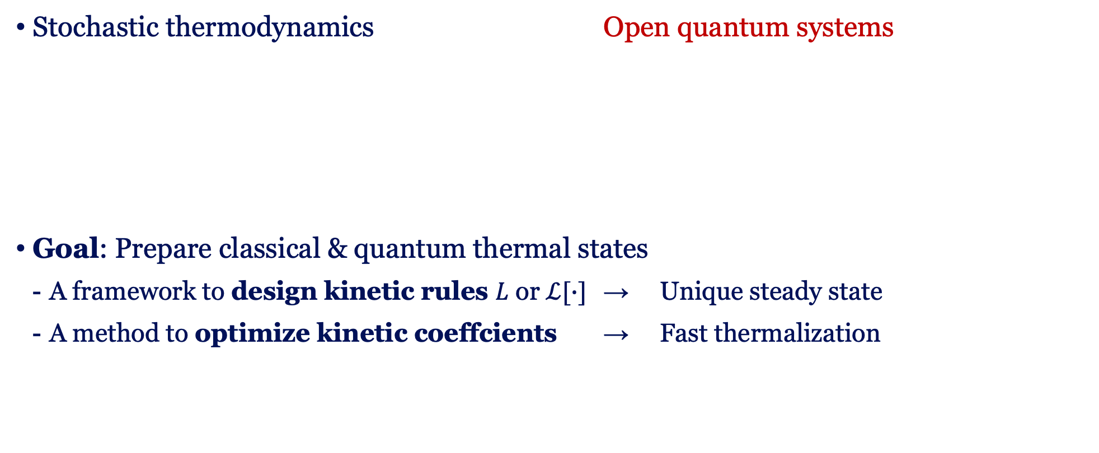
Motivation: thermal state preparation
Stochastic thermodynamics Open quantum systems
Goal: Prepare classical & quantum thermal states
  A framework to design kinetic rules $L$ or $ℒ[∙]$ → Unique steady state
  A method to optimize kinetic coeffcients → Fast thermalization
Classical detailed balance condition
Continuous-time Markov chain
Quantum detailed balance condition
Lindblad master equation (Lindbladian)
F. Avanzini, M. Bilancioni, V. Cavina, S. Dal Cengio, M. Esposito, G. Falasco, et al. SciPost Phys. Lect. Notes 80 (2024).

Slide 3
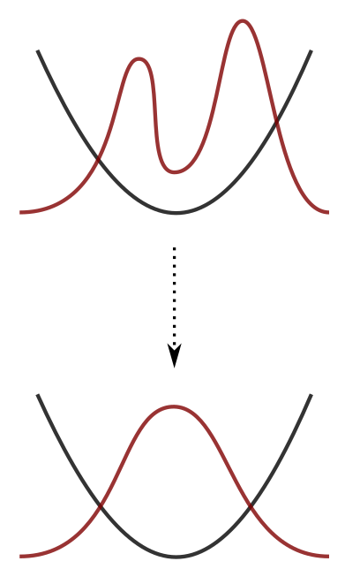


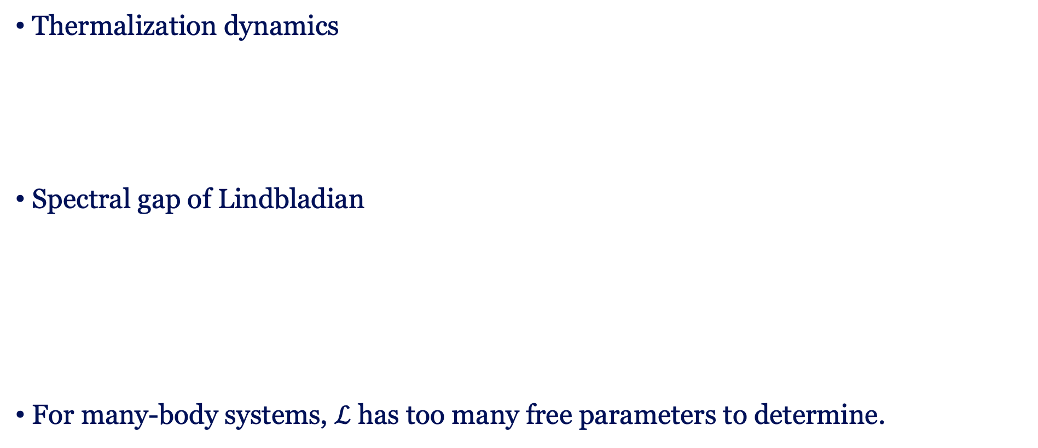
Motivation: boosting thermalization
Thermalization dynamics
Spectral gap of Lindbladian
For many-body systems, $ℒ$ has too many free parameters to determine.
Slowest relaxing mode
Harmonic potential
Maximizing $Δ$ Fast thermalization Reducing irreversibility

Slide 4
Content
Preparing classical thermal states
  A single two-level system
  Kinetic Ising model
  Spectral gap optimization
Preparing quantum thermal states
  Constructing Lindbladians under quantum detailed balance
  Lipkin-Meshkov-Glick model
  Transverse Ising model
Summary

Slide 5
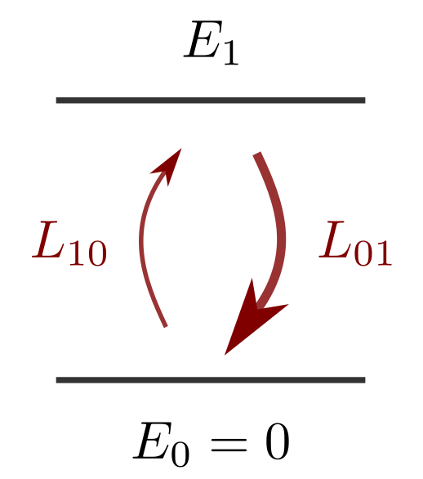
Preparing classical thermal states
Two-level system (a bit)
Liouvillian
Detailed-balanced condition:
dissipation
jump

Slide 6
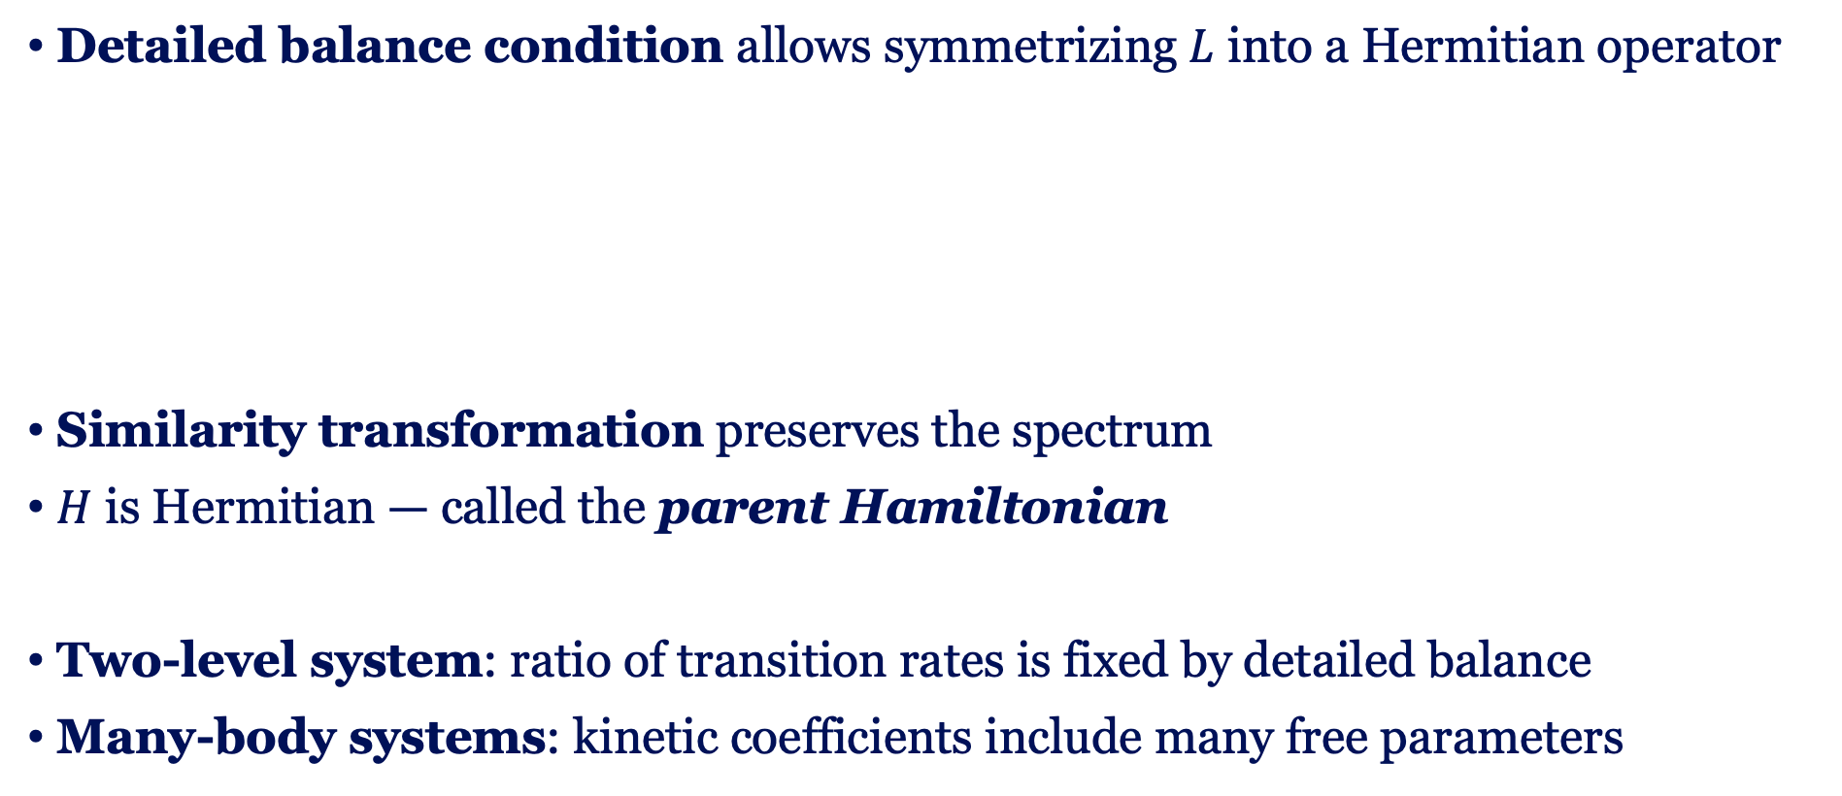
Parent Hamiltonian
Detailed balance condition allows symmetrizing $L$ into a Hermitian operator
Similarity transformation preserves the spectrum
$H$ is Hermitian — called the parent Hamiltonian
Two-level system: ratio of transition rates is fixed by detailed balance
Many-body systems: kinetic coefficients include many free parameters

Slide 7
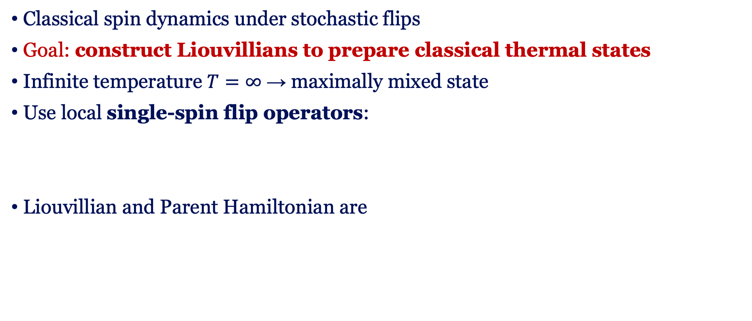
Kinetic Ising model: Single-spin flip
Classical spin dynamics under stochastic flips
Goal: construct Liouvillians to prepare classical thermal states
Infinite temperature $T=∞$ → maximally mixed state
Use local single-spin flip operators:
Liouvillian and Parent Hamiltonian are

Slide 8
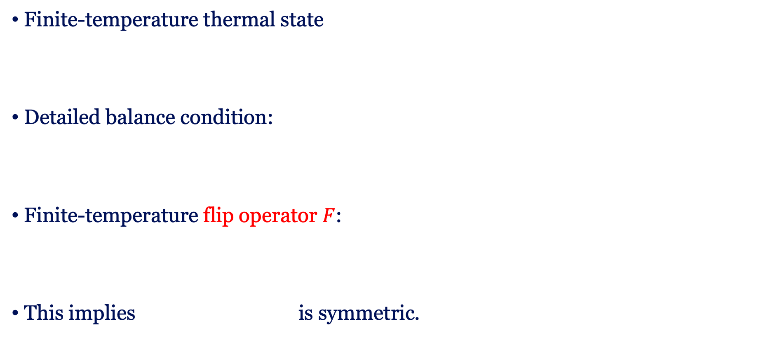
Kinetic Ising model: Single-spin flip
Finite-temperature thermal state
Detailed balance condition:
Finite-temperature flip operator $F$:
This implies is symmetric.

Slide 9
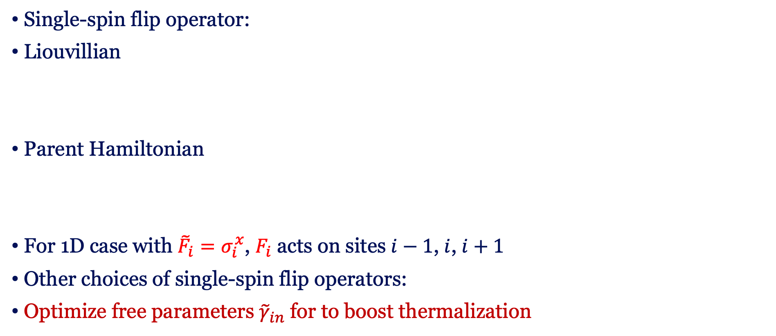
Kinetic Ising model: Single-spin flip
Single-spin flip operator:
Liouvillian
Parent Hamiltonian
For 1D case with ${\tilde{F}}_{i}=σ_{i}^{x}$, $F_{i}$ acts on sites $i−1$, $i$, $i+1$
Other choices of single-spin flip operators:
Optimize free parameters ${\tilde{γ}}_{in}$ for to boost thermalization
Detailed balance condition
Dissipation: diagonal operator

Slide 10
Lindbladian and Parent Hamiltonian
 | Liouvillian | Parent Hamiltonian
Steady state/ ground state
Detailed balance condition
Spectrum

Slide 11
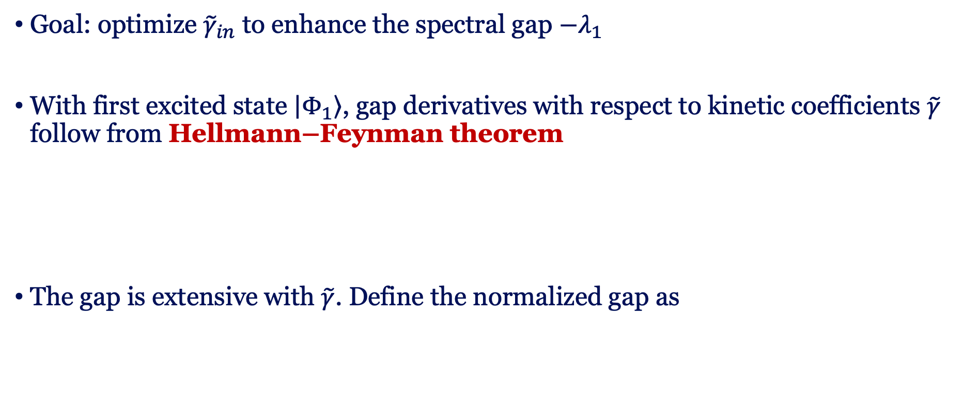
Spectral gap optimization
Goal: optimize ${\tilde{γ}}_{in}$ to enhance the spectral gap $−λ_{1}$
With first excited state $\left|\left.Φ_{1}\right\rangle \right.$, gap derivatives with respect to kinetic coefficients $\tilde{γ}$ follow from Hellmann–Feynman theorem
The gap is extensive with $\tilde{γ}$. Define the normalized gap as

Slide 12
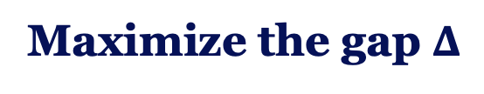
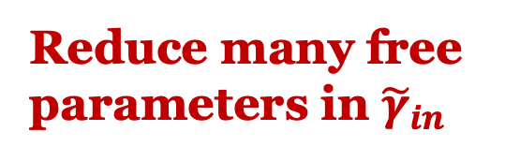
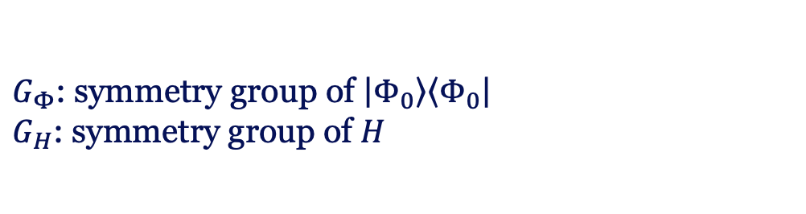
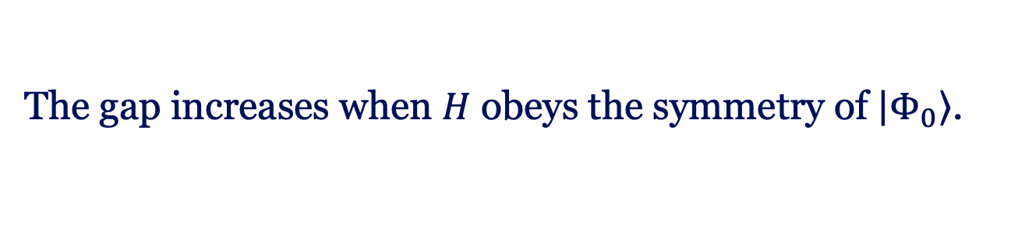
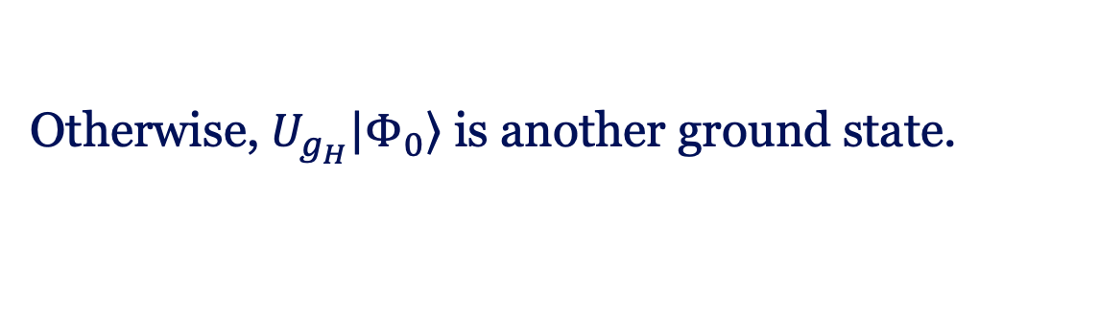
Symmetry
$G_{Φ}$: symmetry group of $\left|\left.Φ_{0}\right\rangle \right.\left\langle \left.Φ_{0}\right|\right.$
$G_{H}$: symmetry group of $H$
Concavity:
Spontaneous symmetry breaking:
Maximize the gap $Δ$
Reduce many free
parameters in ${\tilde{γ}}_{in}$
The gap increases when $H$ obeys the symmetry of $\left|\left.Φ_{0}\right\rangle \right.$.
Otherwise, $U_{g_{H}}\left|\left.Φ_{0}\right\rangle \right.$ is another ground state.
Kshiti Sneh Rai, Jin-Fu Chen, Patrick Emonts, Jordi Tura, Spectral Gap Optimization for Enhanced Adiabatic State Preparation, arXiv:2409.15433, accepted in PRL

Slide 13
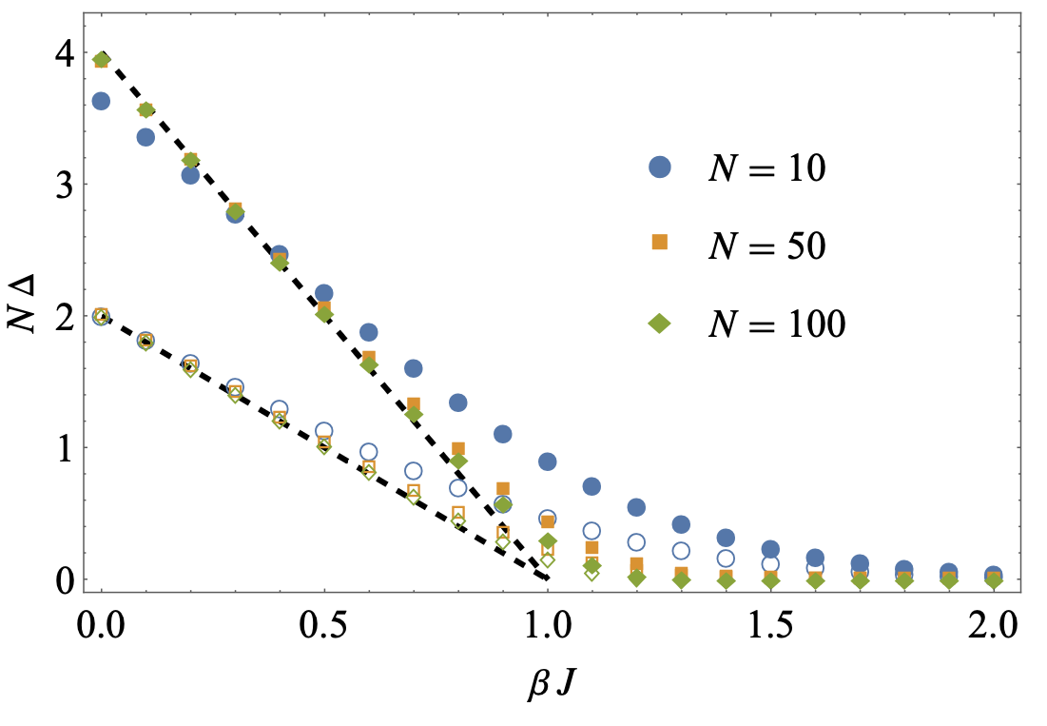
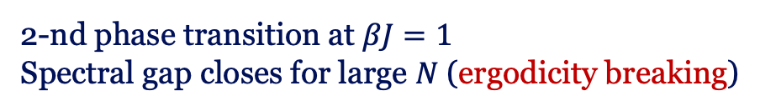
Application: Kinetic Curie-Weiss model
Permutation symmetry
Local Z2 symmetry
Classical Hamiltonian
Single spin flip:
Double spin flip:
2-nd phase transition at $βJ=1$
Spectral gap closes for large $N$ (ergodicity breaking)

Slide 14
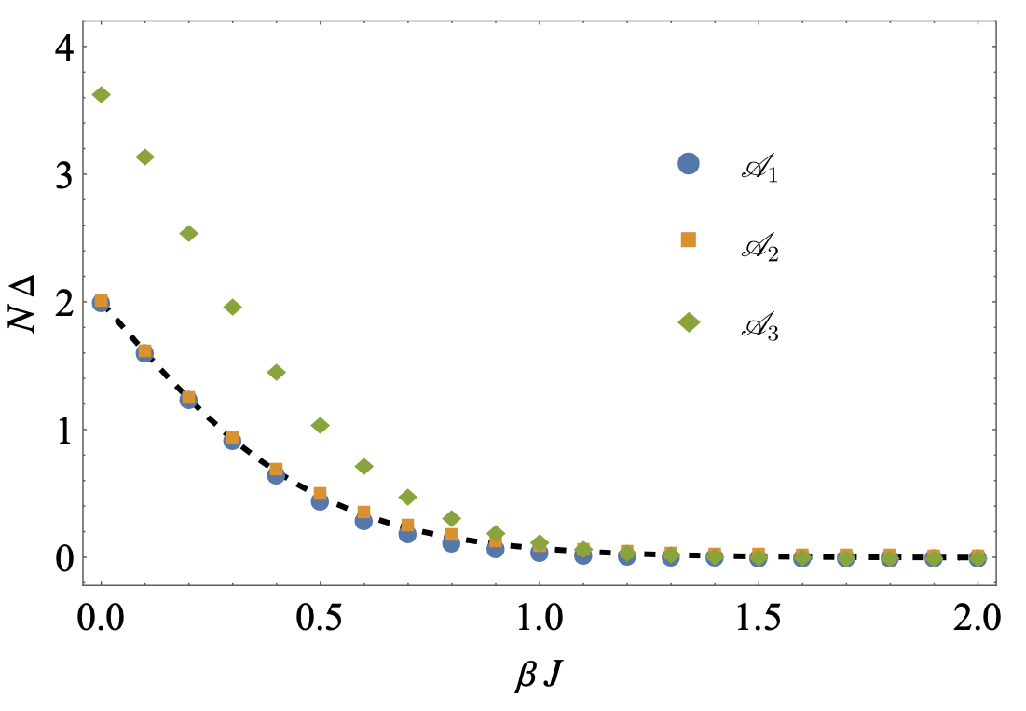
Application: 1D Kinetic Ising model model
Translational symmetry
Local Z2 symmetry
Commuting local terms
Single spin flip
Double spin flip
Dashed curve: Glauber dynamics
arXiv:2411.03420

Slide 15
Preparing quantum thermal states
Preparing quantum thermal states is challenging
It is QMA-hard to prepare the ground state of a local Hamiltonian—also for low-temperature thermal states.
To what extent can current methods prepare quantum thermal states?
Classical Liouvillians (diagonal) Lindbladians (density matrix)
Lindblad operator set:
unitary
jump
dissipation

Slide 16

Lindbladian
The adjoint Lindblad equation
Quantum detailed balance condition:
Decompose it into
F. Fagnola, V. Umanità, Commun. Math. Phys. 298, 523–547 (2010).

Slide 17


Quantum detailed balance condition
Infinite-temperature Lindbladian
Detailed balance condition
Pairs of Lindblad
operators:
arXiv:2411.03420

Slide 18

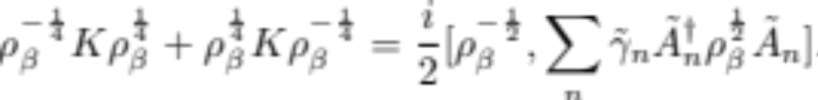
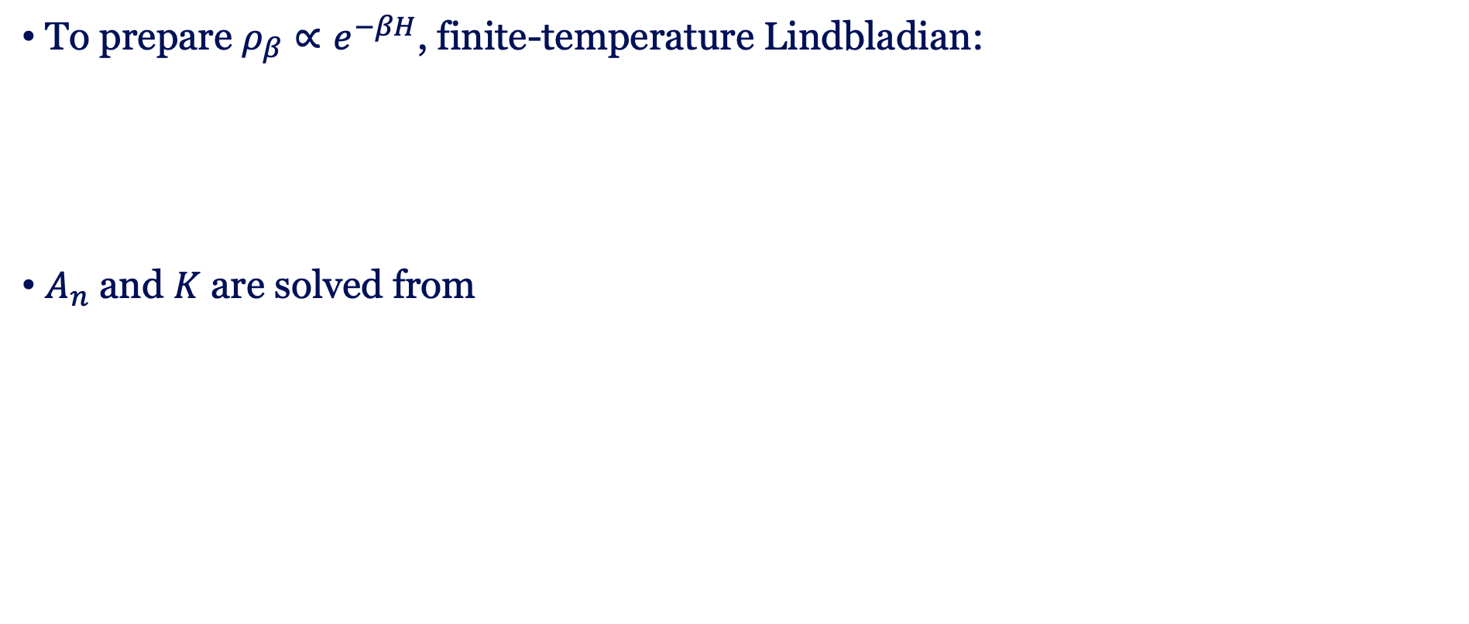
Finite-temperature Lindbladian
To prepare $ρ_{β}∝e^{−βH}$, finite-temperature Lindbladian:
$A_{n}$ and $K$ are solved from
unitary
jump
dissipation
arXiv:2411.03420

Slide 19

Parent Hamiltonian
Parent Hamiltonian in thermofield double space
It can be constructed as
Symmetric logarithmic derivative
arXiv:2411.03420

Slide 20
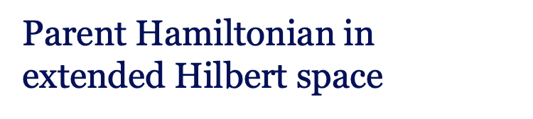
Quantum vs. Classical
Quantum Lindbladian under quantum detailed balance condition
Classical Liouvillian under detailed balanced condition
Parent Hamiltonian in extended Hilbert space
Parent Hamiltonian
e.g., Lipkin-Meshkov-Glick model
e.g., Kinetic Ising models

Slide 21
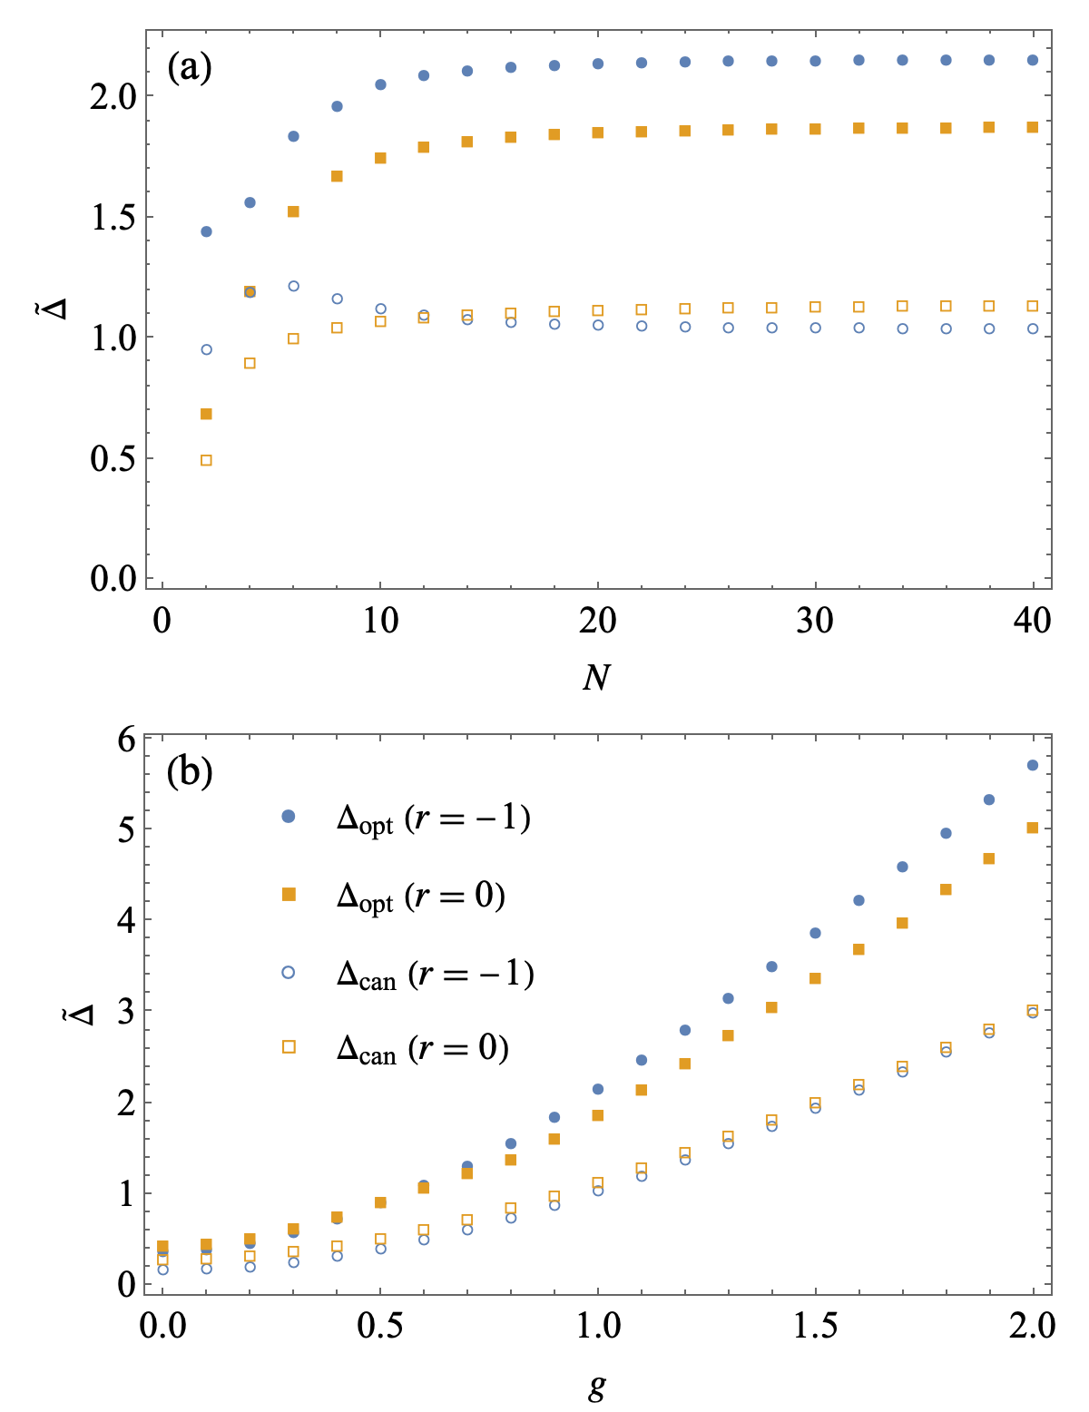
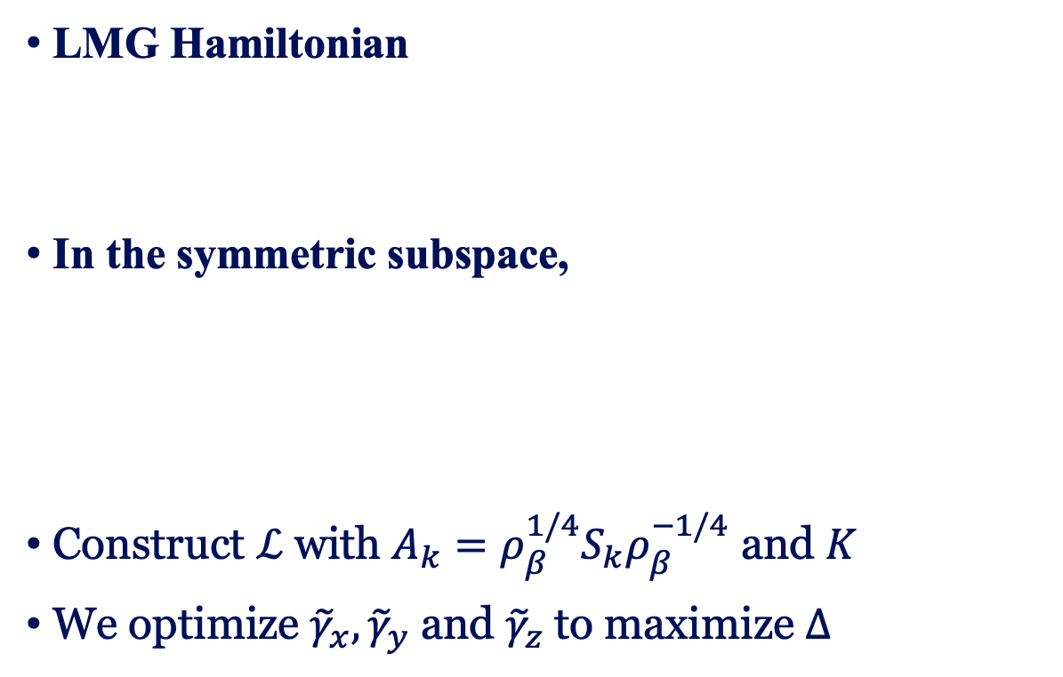
Lipkin-Meshkov-Glick model
LMG Hamiltonian
In the symmetric subspace,
Construct $ℒ$ with $A_{k}=ρ_{β}^{1/4}S_{k}ρ_{β}^{−1/4}$ and $K$
We optimize ${\tilde{γ}}_{x},{\tilde{γ}}_{y}$ and ${\tilde{γ}}_{z}$to maximize $Δ$
arXiv:2411.03420

Slide 22
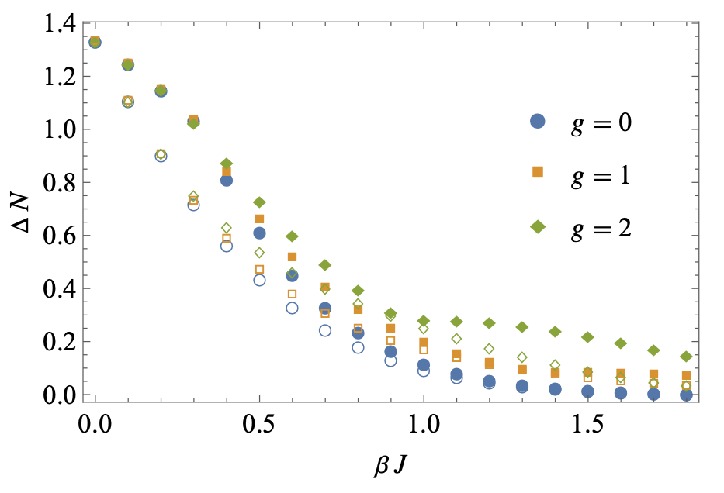
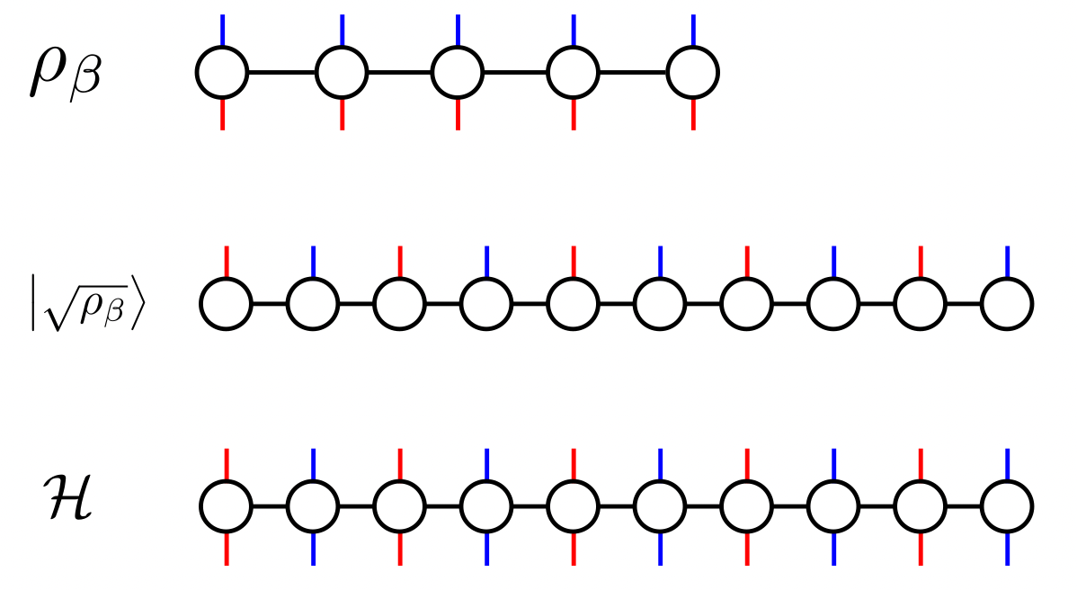
Application: 1D Transverse Ising model
Translational symmetry
Local Z2 symmetry
Transverse Ising Hamiltonian
Infinite-temperature Lindblad operators
MPS representation：
Filled: optimal kinetic coefficients
Empty: canonical kinetic coefficients

Slide 23
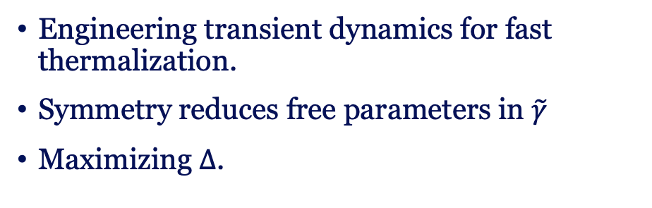
Thermodynamics
Summary
Gap optimization
A family of Lindbladians under quantum detailed balance.
Relevant to quantum thermodynamics, simulation, and algorithms.
Engineering transient dynamics for fast thermalization.
Symmetry reduces free parameters in $\tilde{γ}$
Maximizing $Δ$.
Future scope
Study stochastic thermodynamics for these Lindbladians.
Optimizing control of open quantum many-body systems.
MPS Variational and SDP bounds for larger systems.

Slide 24


Slide 25
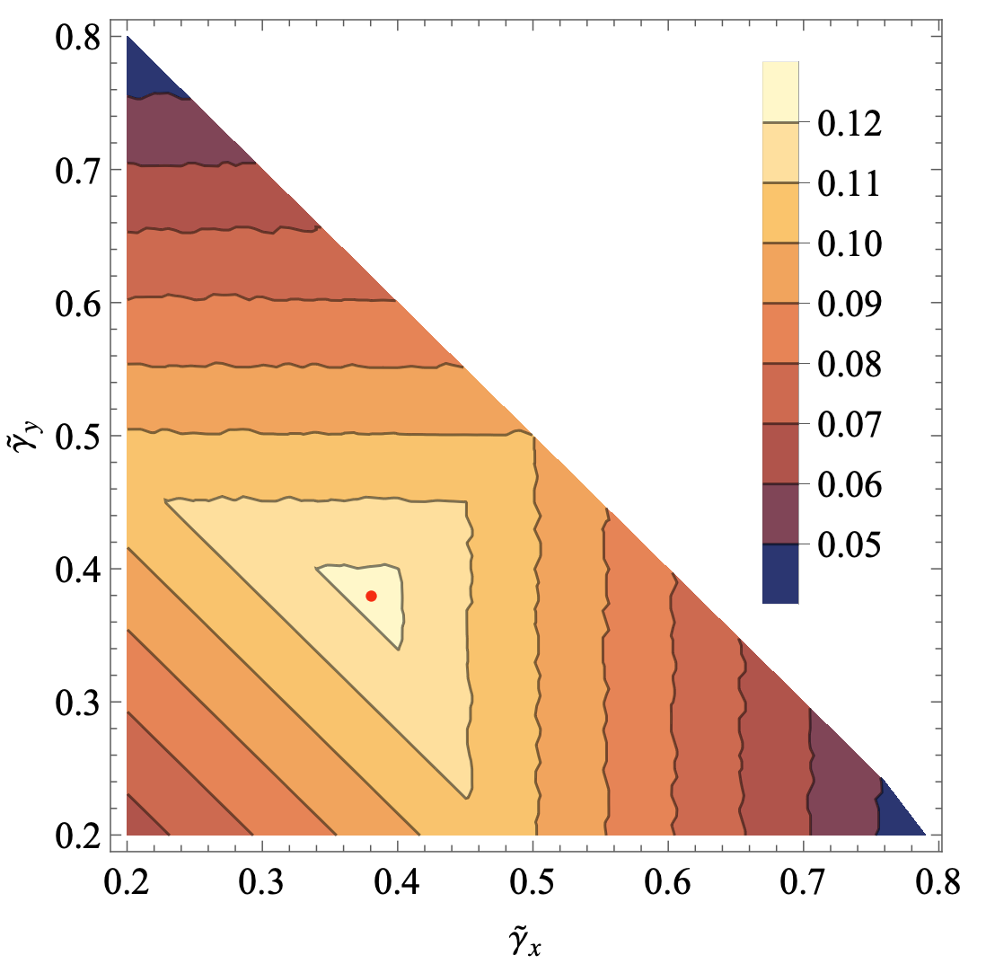
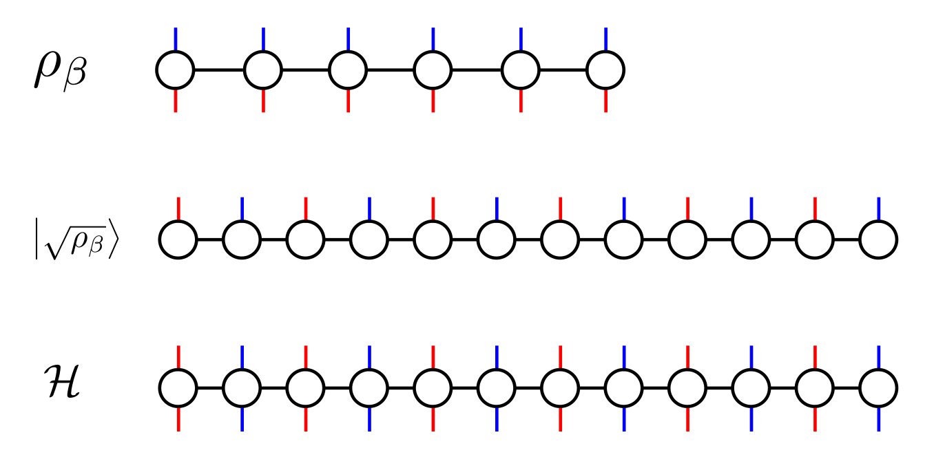
Translational symmetry
Local Z2 symmetry
Transverse Ising Hamiltonian
Infinite-temperature Lindblad operators

