Slide 1

Finite-time Thermodynamic Optimization: Thermodynamic Geometry
陈劲夫|集智俱乐部@非平衡统计物理读书会, 2025.3.20

Slide 2
Outline
Background on finite-time thermodynamics: Acta Phys. Sin., 72, 230501 (2023)
History developments
  Macroscopic thermodynamic geometry: Phys. Rev. A 20, 1608 (1979)
  Modern interpretation with fisher information metric: Phys. Rev. Lett. 99, 100602 (2007)
  Extension to nonequilibrium: Phys. Rev. Lett. 51, 1127 (1983); Phys. Rev. Lett. 108, 190602 (2012)
1/𝝉-scaling of irreversibility: Phys. Rev. Lett. 125, 210601 (2020)
Extrapolating thermodynamic length: Phys. Rev. E 104, 034117 (2020)
Thermodynamic consistency: constraint on equation of motion: arXiv:2502.20118

Slide 3
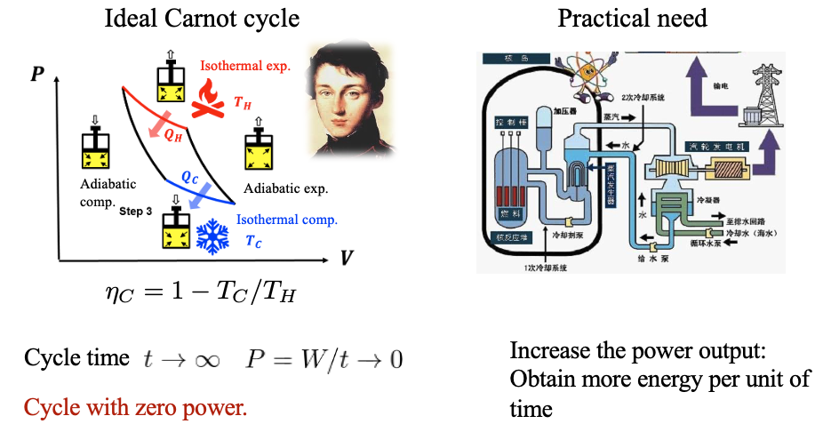
Gap between theory and practice
Finite-time thermodynamics:
Effect of finite-time dynamics on thermodynamics

Slide 4
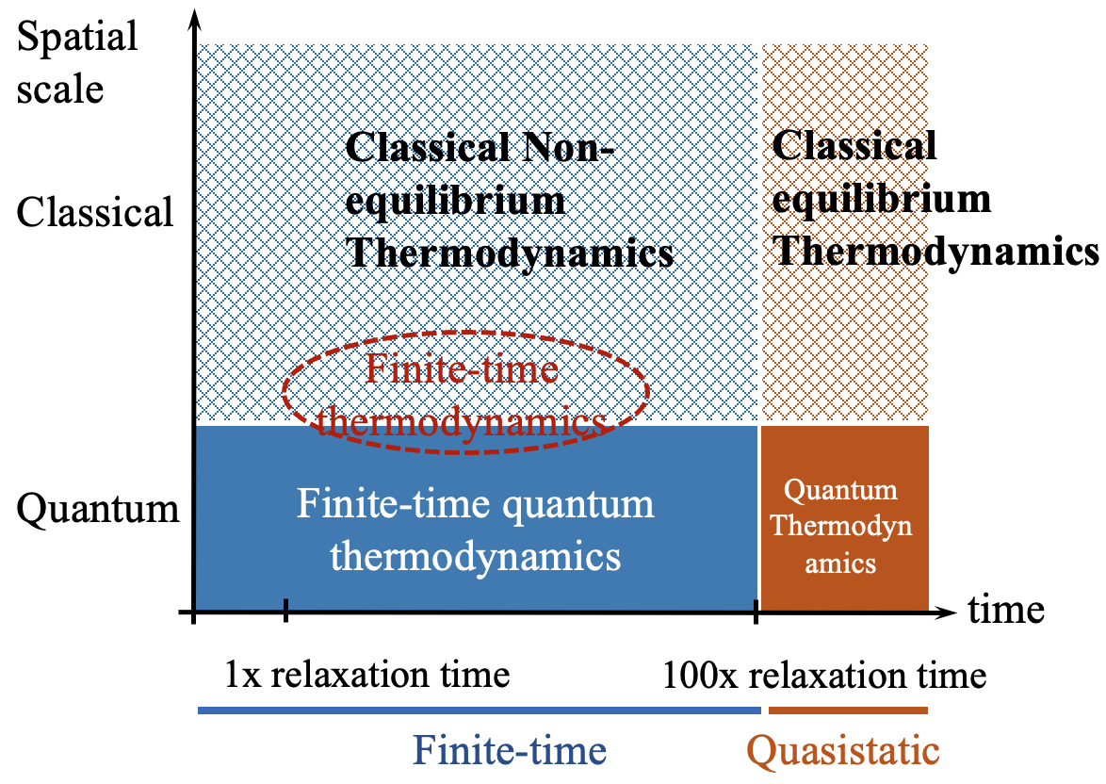
New “Phase” Diagram
Dynamics:
equations of motion
Thermodynamics:
equilibrium ensembles
Key question: integrate time into thermodynamics
H.-T. Quan, H. Dong, C. P. Sun, Acta Phys. Sin., 72, 230501 (2023).

Slide 5
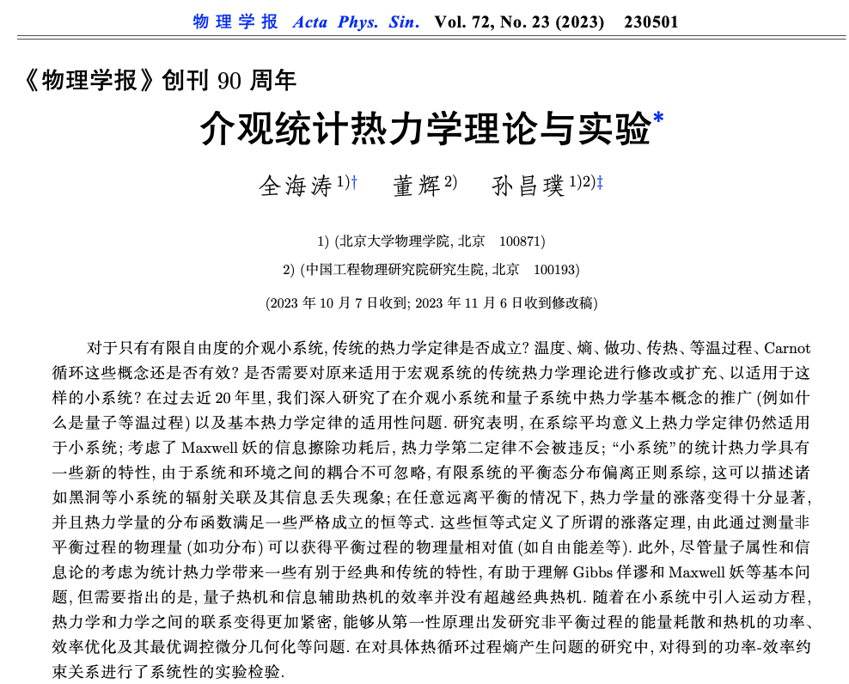
运动方程
Equation of motion
+
(非平衡)热力学
(Nonequilibrium)
thermodynamics

Slide 6
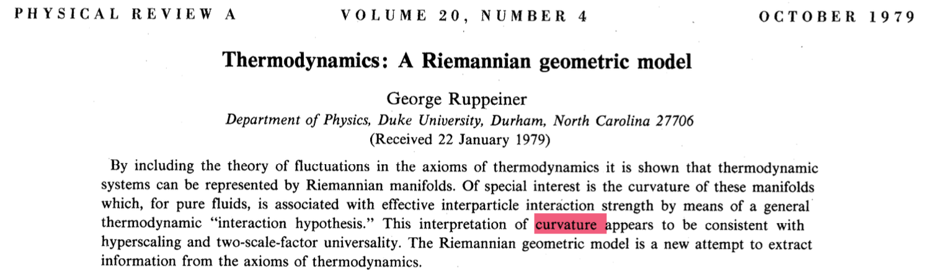
Macroscopic thermodynamic geometry
Equilibrium states + Riemannian manifold
G. Ruppeiner, Phys. Rev. A 20, 1608 (1979)

Slide 7
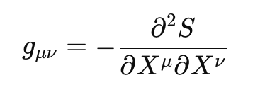
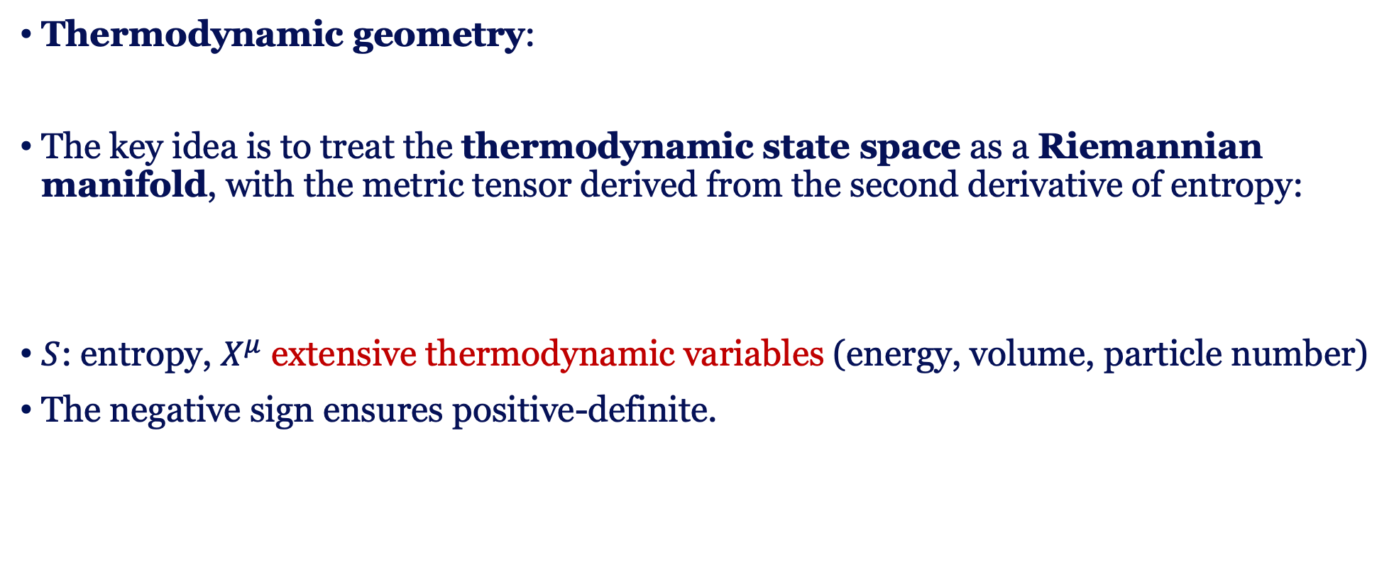

Macroscopic thermodynamic geometry
Curvature
$$R$$
Interaction
Critical behavior
Thermodynamic geometry:
The key idea is to treat the thermodynamic state space as a Riemannian manifold, with the metric tensor derived from the second derivative of entropy:
$S$: entropy, $X^{μ}$ extensive thermodynamic variables (energy, volume, particle number)
The negative sign ensures positive-definite.
G. Ruppeiner, Phys. Rev. A 20, 1608 (1979)

Slide 8
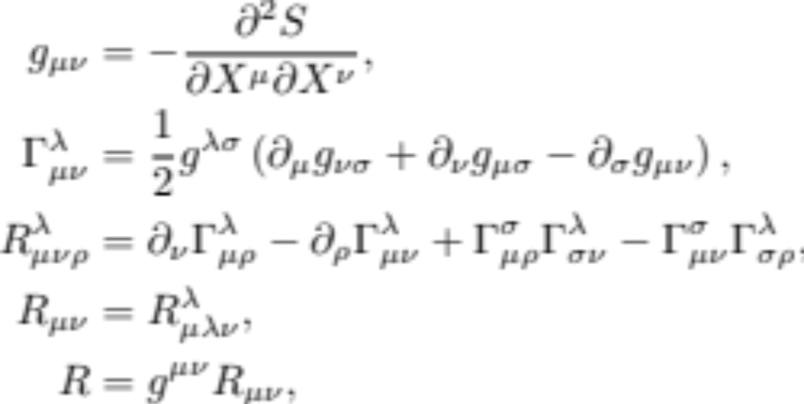
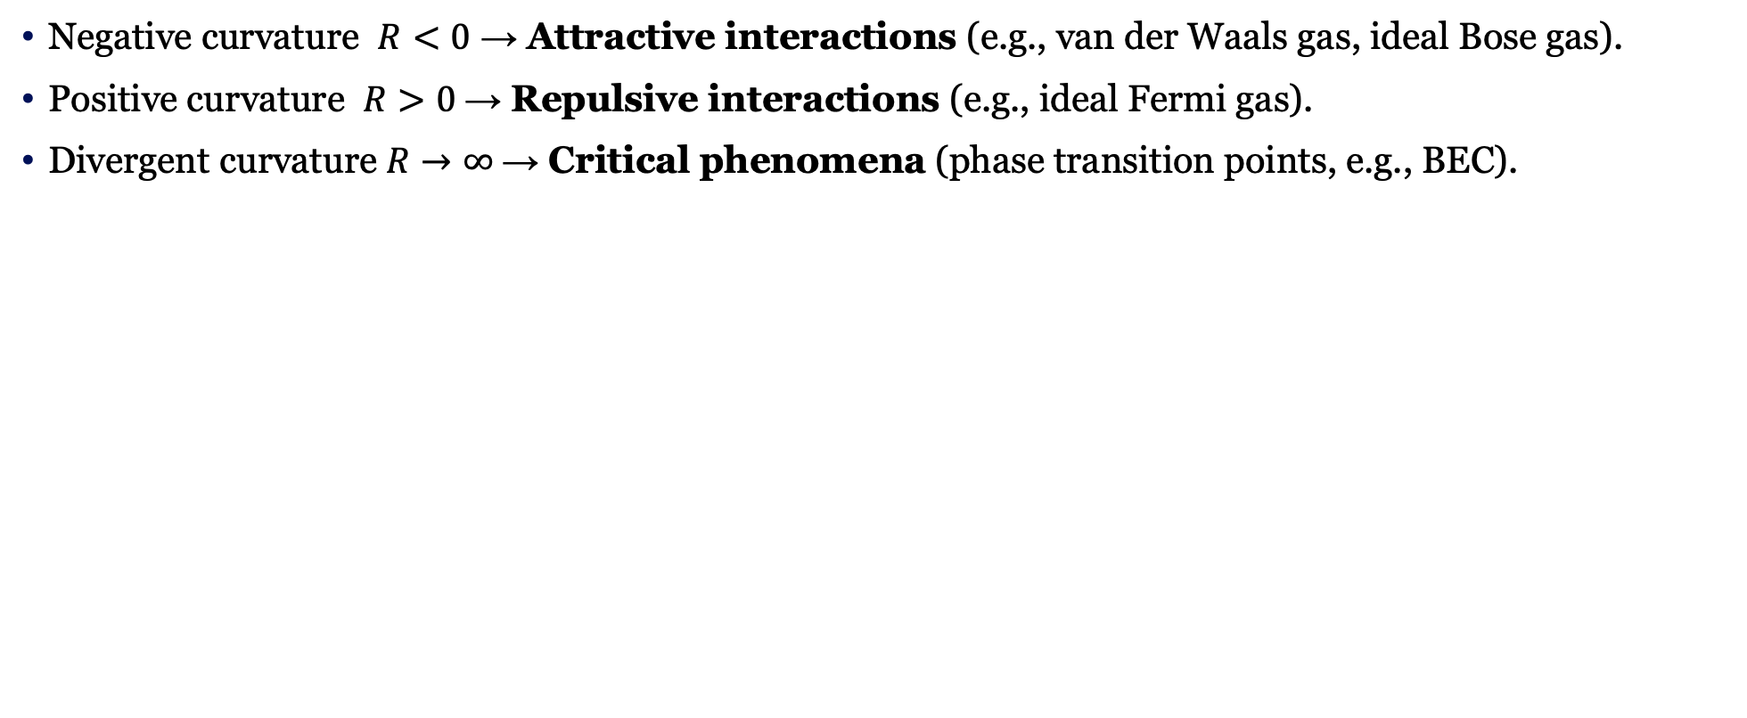
Macroscopic thermodynamic geometry
Negative curvature $R<0$ → Attractive interactions (e.g., van der Waals gas, ideal Bose gas).
Positive curvature $R>0$→ Repulsive interactions (e.g., ideal Fermi gas).
Divergent curvature $R→∞$→ Critical phenomena (phase transition points, e.g., BEC).
Metric
Christoffel symbols
Riemann curvature tensor
Ricci curvature tensor
Scalar curvature
G. Ruppeiner, Rev. Mod. Phys. 67, 605 (1995).

Slide 9
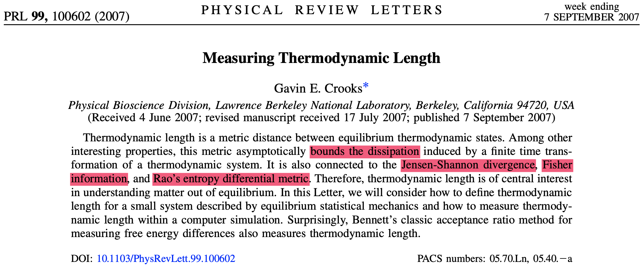
Modern interpretation
Thermodynamic length: Statistical distance
Riemannian metric: Fisher information matrix
Gavin E. Crooks, Phys. Rev. Lett. 99, 100602 (2007)

Slide 10
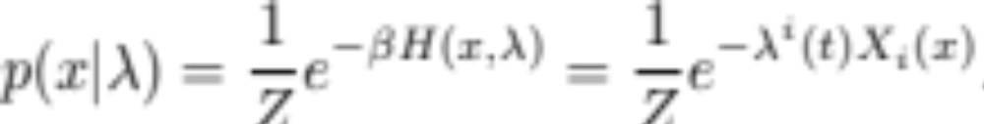
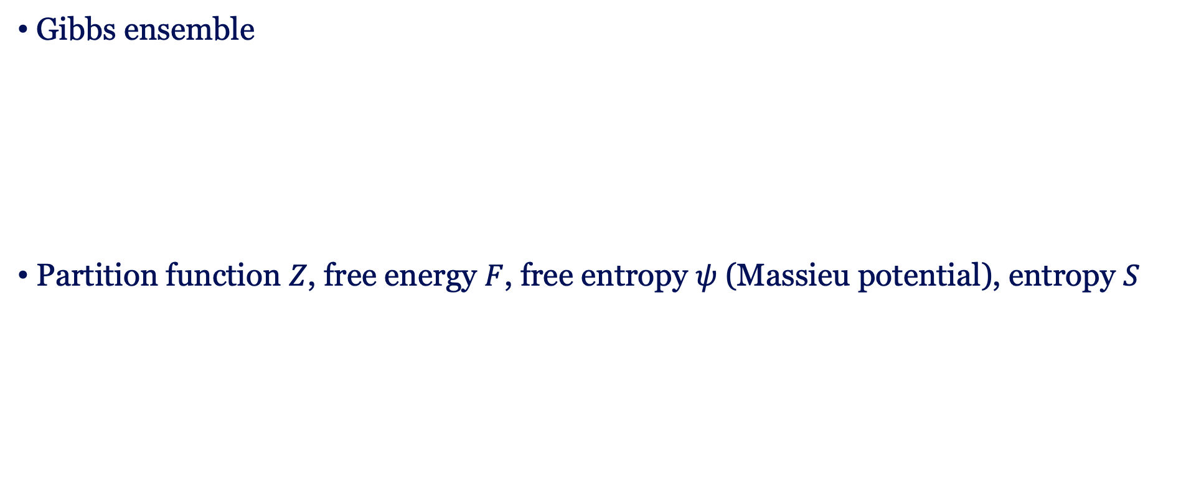
Modern interpretation
Gibbs ensemble
Partition function $Z$, free energy $F$, free entropy $ψ$ (Massieu potential), entropy $S$
Gavin E. Crooks, Phys. Rev. Lett. 99, 100602 (2007)

Slide 11
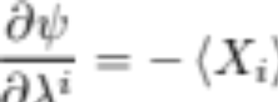
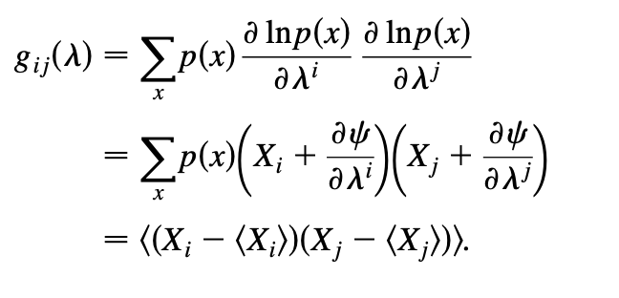
Modern interpretation
First derivatives of the free entropy: first moments of the collective variables
Second derivatives: covariance metric
Classical Fisher information matrix

Slide 12
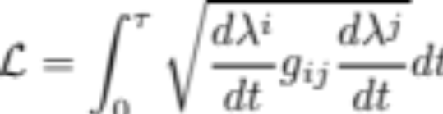
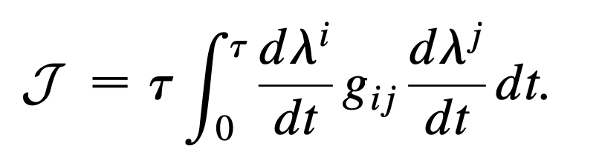
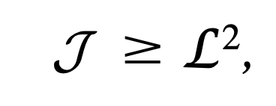
Modern interpretation
Thermodynamic length:
Thermodynamic divergence of the path
The length and the divergence satisfies
Physical meaning of the divergence?

Slide 13
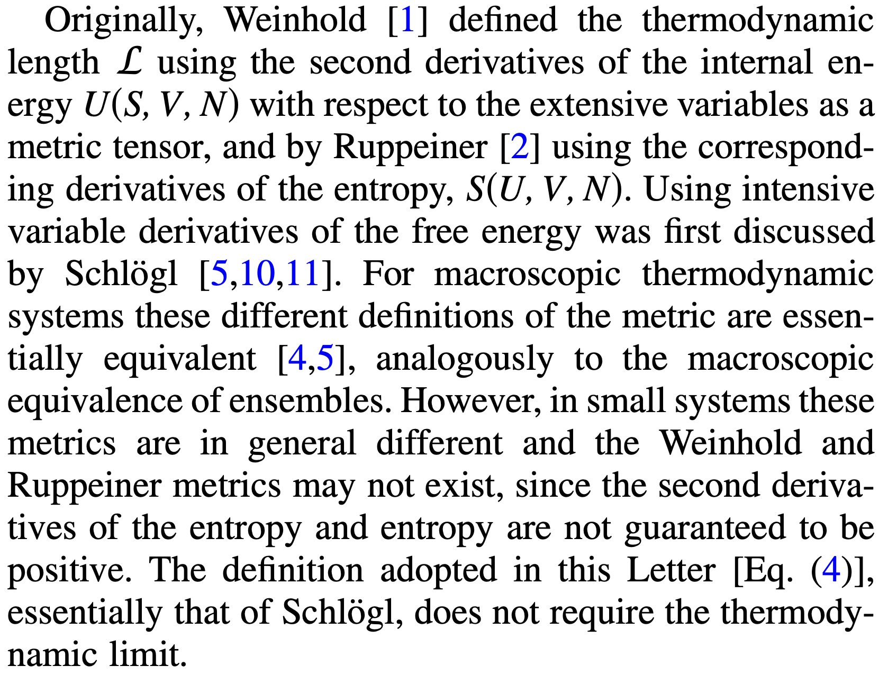
Modern interpretation
Gavin E. Crooks, Phys. Rev. Lett. 99, 100602 (2007)

Slide 14
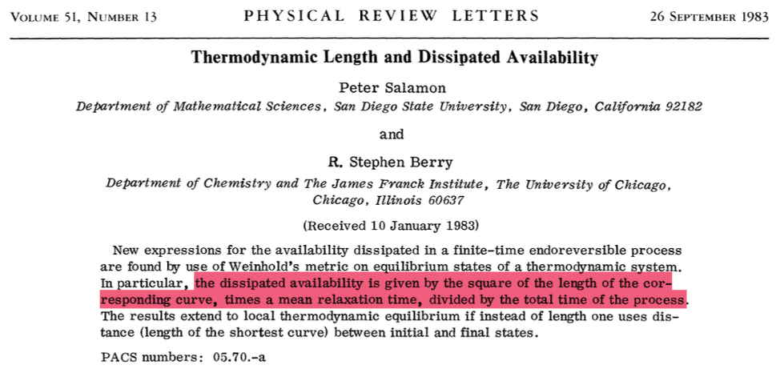
Extension to nonequilibrium
Peter Salamon, R. Stephen Berry, Phys. Rev. Lett. 51, 1127 (1983)

Slide 15
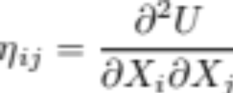
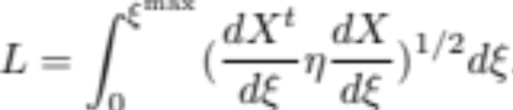
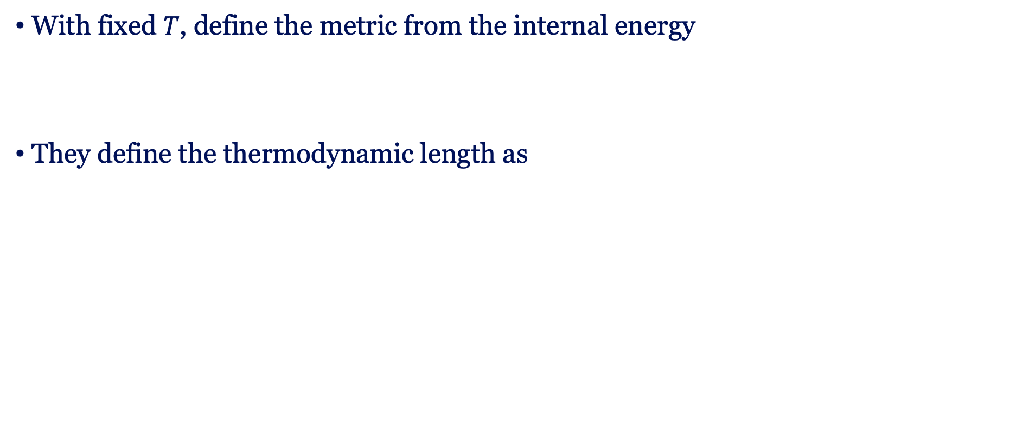
Extension to nonequilibrium
With fixed $T$, define the metric from the internal energy
They define the thermodynamic length as
Weinhold’s approach
F. Weinhold, J. Chem. Phys. 63, 2479–2483 (1975)
Peter Salamon, R. Stephen Berry, Phys. Rev. Lett. 51, 1127 (1983)

Slide 16
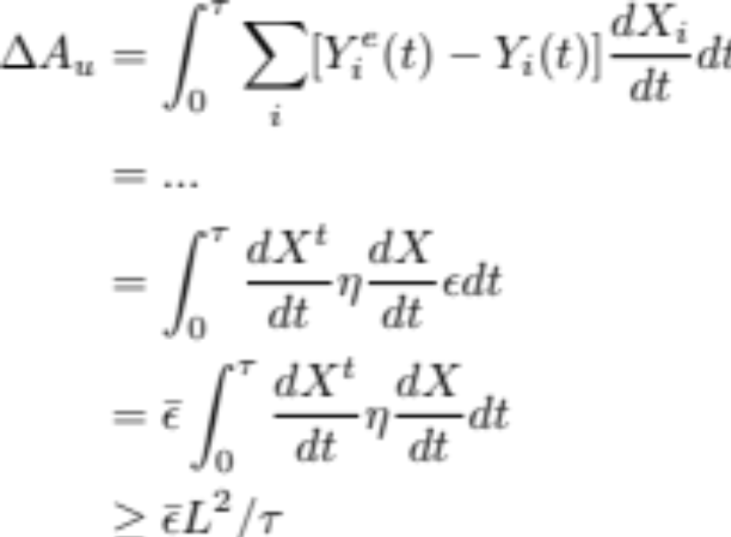
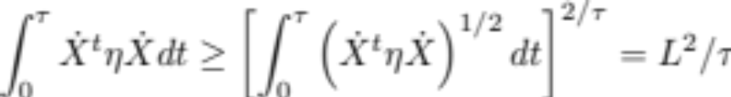

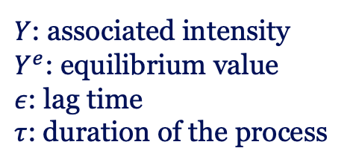
Extension to nonequilibrium
The dissipated availability or the excess work is
$Y$: associated intensity
$Y^{e}$: equilibrium value
$ε$: lag time
$τ$: duration of the process
$1/τ$ scaling of irreversibility
Peter Salamon, R. Stephen Berry, Phys. Rev. Lett. 51, 1127 (1983)

Slide 17
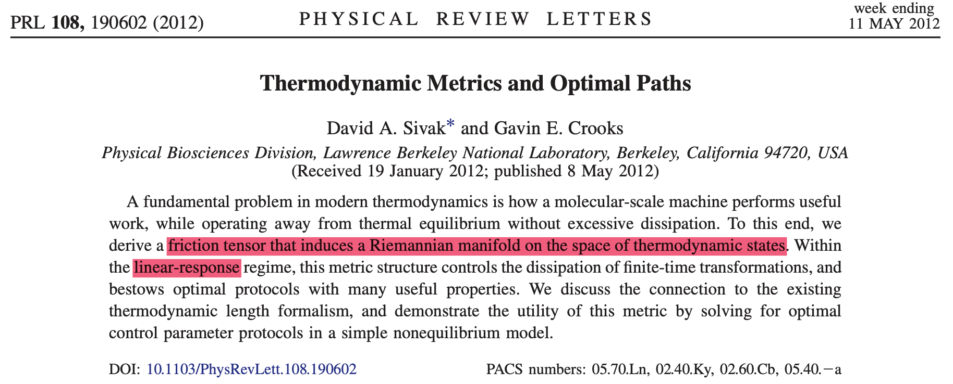
Example in stochastic thermodynamics

Slide 18
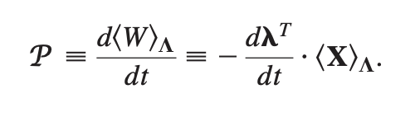
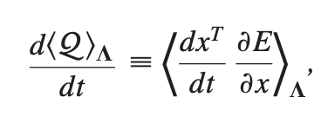
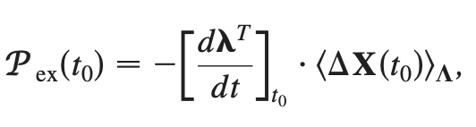


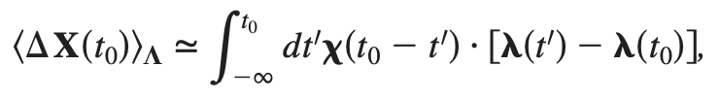

Example in stochastic thermodynamics
Stochastic work and heat
Excess work
Slow driving: linear response theory
Derivation from the equilibrium
David A. Sivak and Gavin E. Crooks, Phys. Rev. Lett. 108, 190602 (2012)

Slide 19
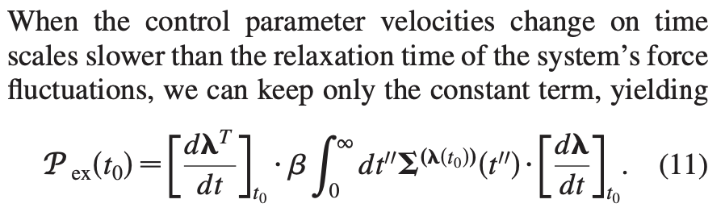
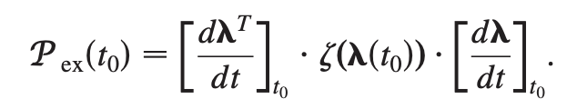
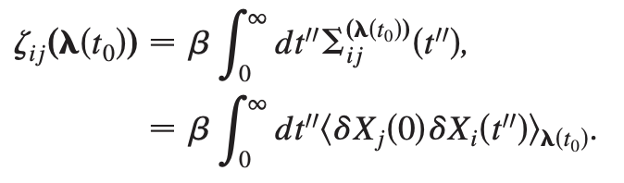
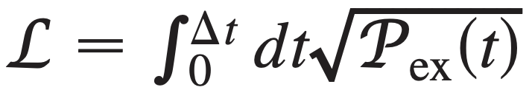
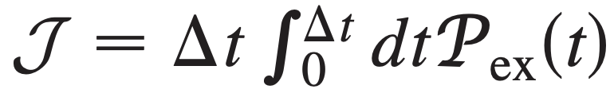
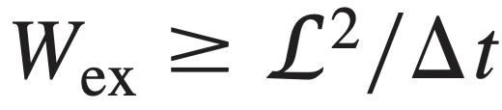

Example in stochastic thermodynamics
The key result:
This metric characterizes the excess work!
$ζ(λ)$: Friction tensor

Slide 20


1/$τ$-scaling of irreversibility
For finite-time thermodynamic processes, the irreversibility is characterized by irreversible entropy production
or the excess work
For dissipative processes without phase transition, the irreversibility satisfies

Slide 21






Irreversibility in isothermal processes
Heat
Work
Quasi-static
Finite-time (textbook)
Finite-time (slow driving)

Slide 22
1/$τ$-scaling in slow-driving regime
Finite-time thermodynamics
  P. Salamon, A. Nitzan, B. Andresen, and R. S. Berry, Phys. Rev. A 21, 2115 (1980)
  T. Schmiedl and U. Seifert, Europhys. Lett. 81, 20003 (2008)
  M. Esposito, R. Kawai, K. Lindenberg, and C. V. den Broeck, Phys. Rev. Lett. 105, 150603 (2010)
Stochastic thermodynamics
  Z. Gong, Y. Lan, and H. T. Quan, Phys. Rev. Lett. 117, 180603 (2016)
  G. Li, H. T. Quan, and Z. C. Tu, Phys. Rev. E 96, 012144 (2017)
Thermodynamics length
  D. A. Sivak and G. E. Crooks, Phys. Rev. Lett. 108, 190602 (2012)
Quantum thermodynamics
  V. Cavina, A. Mari, and V. Giovannetti, Phys. Rev. Lett. 119, 050601 (2017)
  Y. H. Ma, D. Xu, H. Dong, and C. P. Sun, Phys. Rev. E 98, 042112 (2018)

Slide 23
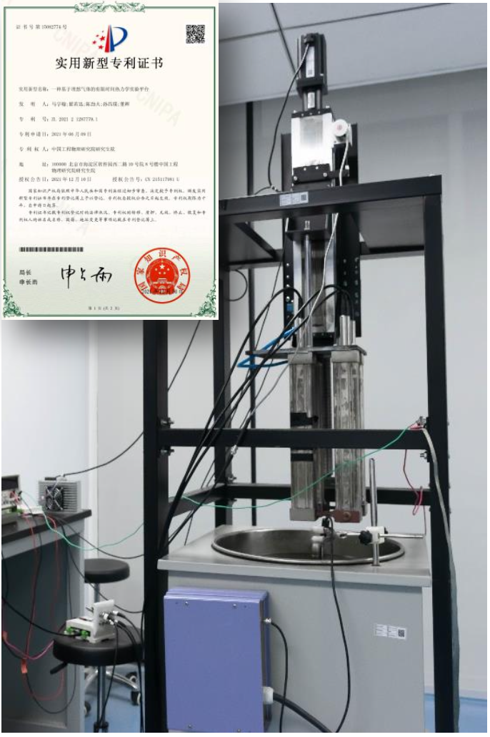
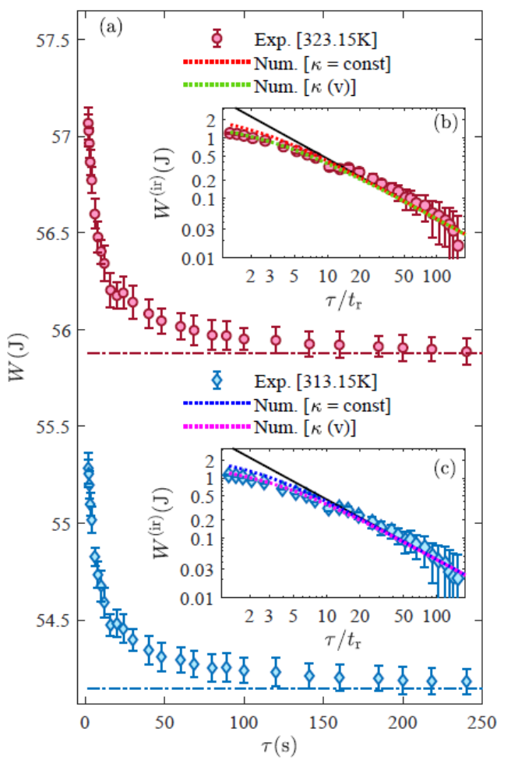
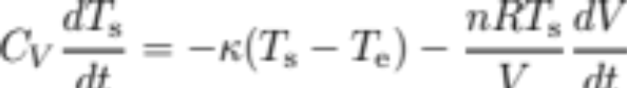
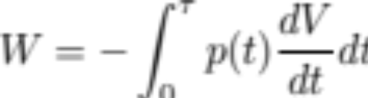


Experimental Test
Internal
energy
Heat
exchange
Work
Temperature of system
Temperature of heat bath
Y. H. Ma, R. X. Zhai, JFC, C. P. Sun, and H. Dong, Phys. Rev. Lett. 125, 210601 (2020)

Slide 24
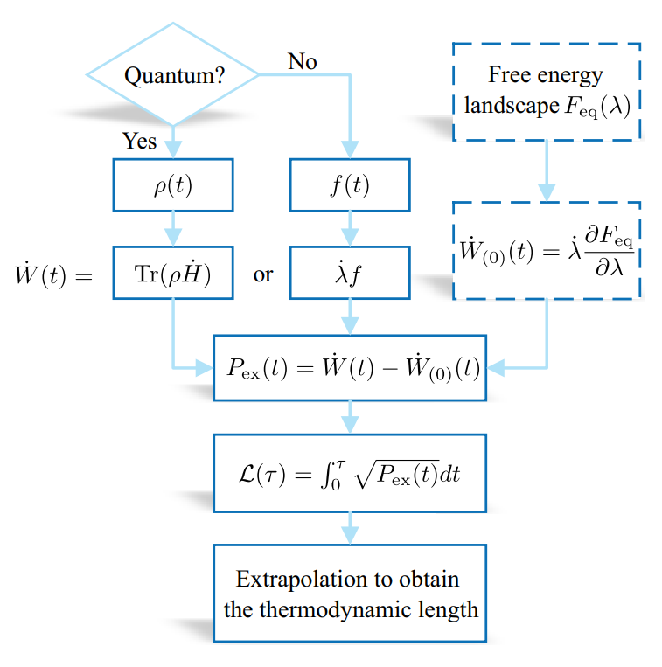
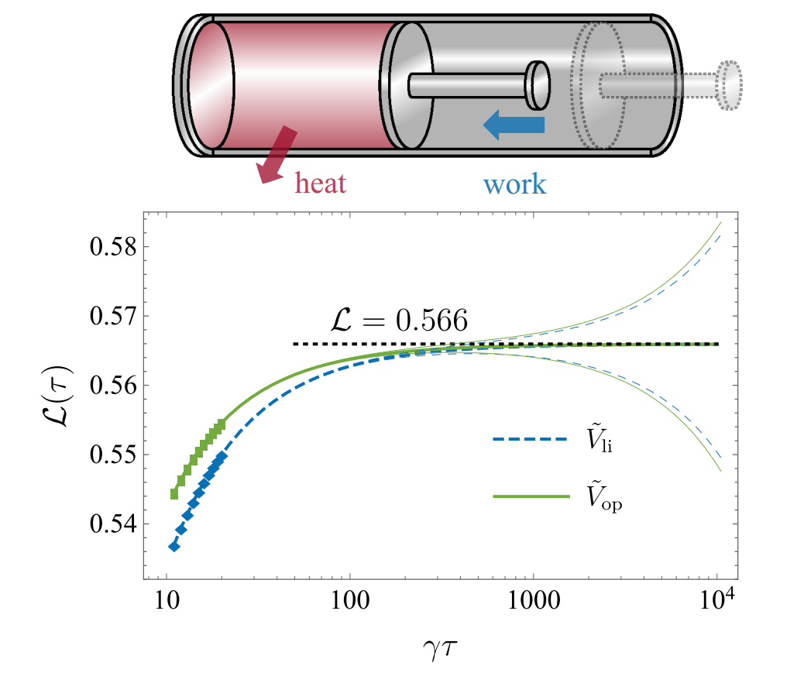
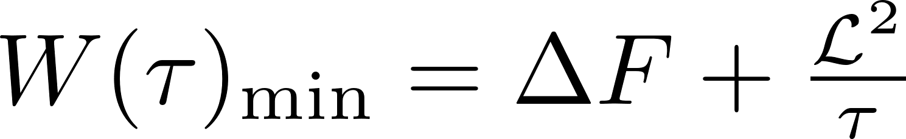
How to measure thermodynamic length?
Error scales with
operation time
JFC, C. P. Sun, H. Dong, Phys. Rev. E 104, 034117 (2020)

Slide 25
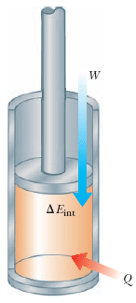
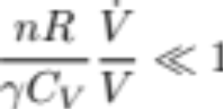
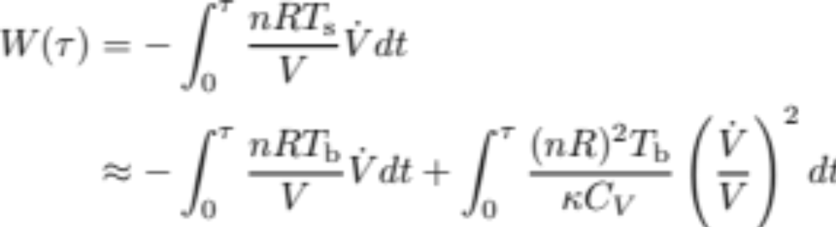
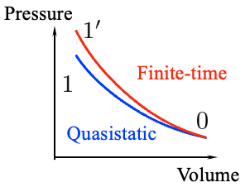



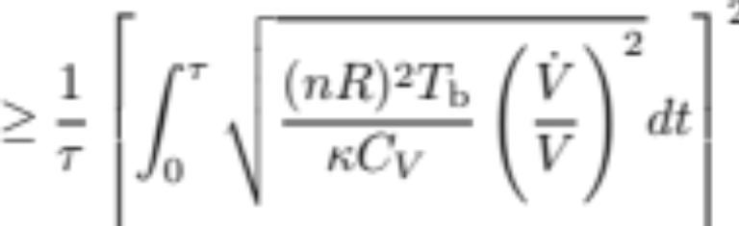
Start with ideal gas compression

Slide 26
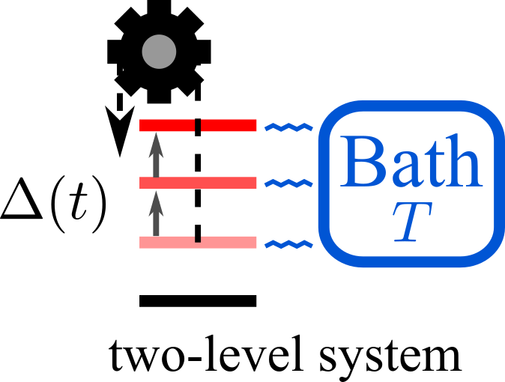
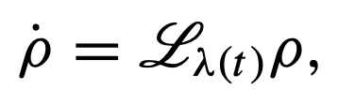
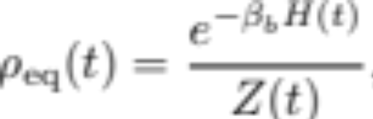




Example in open systems
Time-local master equation
The unique steady state
Work and heat
Excess work
JFC, C. P. Sun, H. Dong, Phys. Rev. E 104, 034117 (2020)

Slide 27





Perturbation expansion
Rewrite
We use the pseudo-inverse
Which gives the perturbative solution
Excess work
Pseudo-inverse

Slide 28



Extrapolating thermodynamic length
In the following, we try to measure the thermodynamic length in finite-time processes
$τ$ cannot be too large since $P_{ex}∝1/τ^{2}$ leads to measurement errors.
Extrapolating strategy:
Measure $ℒ(τ)$ with different protocols $\tilde{λ}\left(s\right)$ and duration $τ$.

Slide 29





Thermodynamically consistency
Ensemble average
Trajectory
First law:
Second law: Fluctuation theorems
    Principle of maximum work
    Equation of motion should be consistent with thermodynamic laws.
A single heat bath

Slide 30


Thermodynamically consistency
    Classical stochastic thermodynamics: Markovian jump processes
    Detailed balance condition (heat exchange with the heat bath)
    The first and second laws can be extended to the trajectories of Markov jump processes and classical Brownian motion.
    Can we formulate a similar framework for quantum systems?

Slide 31

Quantum stochastic thermodynamics
We consider the Lindblad master equations for open quantum systems.
  Dissipators should satisfy quantum detailed balance condition (see Fagnola, F., Umanità, Commun. Math. Phys. 298, 523–547 (2010)).
  Quantum work and heat are not observables: Quasiprobabilities
Consequently, the first law holds on the ensemble average.
The fluctuation theorems hold.
The state during a quasistatic isothermal process is in equilibrium $ρ_{β}∝e^{−βH}$.
The thermodynamic length works for optimizing slow processes works.
Jin-Fu Chen, arXiv:2502.20118

Slide 32





Thermodynamics of open quantum systems
Effective parametrization
Details see arXiv:2411.03420
Work:
Observables:
Jin-Fu Chen, arXiv:2502.20118

Slide 33







Metric: linear response
In the slow driving, the approximate linear equation is
The linear response:
The excess work and the thermodynamic length follow
Linear response of control parameter
Near equilibrium relaxation
Change of equilibrium state

Slide 34


Application to quantum Brownian motion
This framework is applied to quantum Brownian motion with the modified Lindblad master equation
The dissipator is constructed as

Slide 35


Application to quantum Brownian motion
High temperature
Low temperature
Underdamped limit
Overdamped limit
Rescaled time: $s=t/τ$

Slide 36


Summary
Thermodynamic length
Finite-time thermodynamics
JFC, CP Sun, H Dong, Phys. Rev. E 104, 034117 (2020)
JFC†, RX Zhai†, CP Sun, H Dong, PRX Energy 2 (3), 033003 (2023)
Classical stochastic thermodynamics
YH Ma, JFC, CP Sun, H Dong, Phys. Rev. E 106, 034112 (2022)
Shortcut strategies:
G Li, JFC, CP Sun, H Dong, Phys. Rev. Lett. 128, 230603 (2022)
JFC, Phys. Rev. E 106, 054108 (2022)
Quantum stochastic thermodynamics
JFC, arXiv:2502.20118

Slide 37


Summary
Thermodynamically consistent framework
Joint fluctuation theorems of work and heat
JFC, HT Quan, Phys. Rev. E 107, 024135 (2023)
Optimal control theory
YH Chen, JFC, Z Fei, HT Quan, Phys. Rev. E 106, 024105 (2022)
JFC, HT Quan, Phys. Rev. E 110, L042105 (2024)
Finite-time scalings of phase transitions
YX Wu, JFC, HT Quan, arXiv:2401.15592
Quasiprobabilities in quantum thermodynamics
JH Pei, JFC, HT Quan, Phys. Rev. E 108, 054109 (2023)
Relativistic thermodynamics
JH Pei, JFC, HT Quan, arXiv:2312.17621
Quantum many-body systems
JFC, K. S. Rai, P. Emonts, D. Farina, M. Płodzień, P. Grzybowski,
M. Lewenstein, J. Tura, arXiv:2411.03420

Slide 38
Acknowledgments to collaborators
中国工程物理研究院研究生院
孙昌璞、董辉、苏山河(厦门大学)、李耿(北京师范大学) 、马宇翰(北京师范大学)、
费兆宇(浙江理工大学)、袁红、翟若迅
北京大学
全海涛、张凡、吴雨心、裴继辉、陈祎泓
Leiden University
Jordi Tura, Kshiti Sneh Rai, Patrick Emonts
ICFO
Maciej Lewenstein, Donato Farina, Marcin Płodzień, Przemyslaw Grzybowski

Slide 39


