Slide 1


Boosting thermalization of classical and quantum many-body systems
Jinfu Chen | @Qtech’25-budapest, 24.9.2025
arXiv:2411.03420 & ongoing work with Kshiti Sneh Rai,
Patrick Emonts, Donato Farina, Marcin Płodzień,
Przemyslaw Grzybowski, Maciej Lewenstein, Jordi Tura

Slide 2
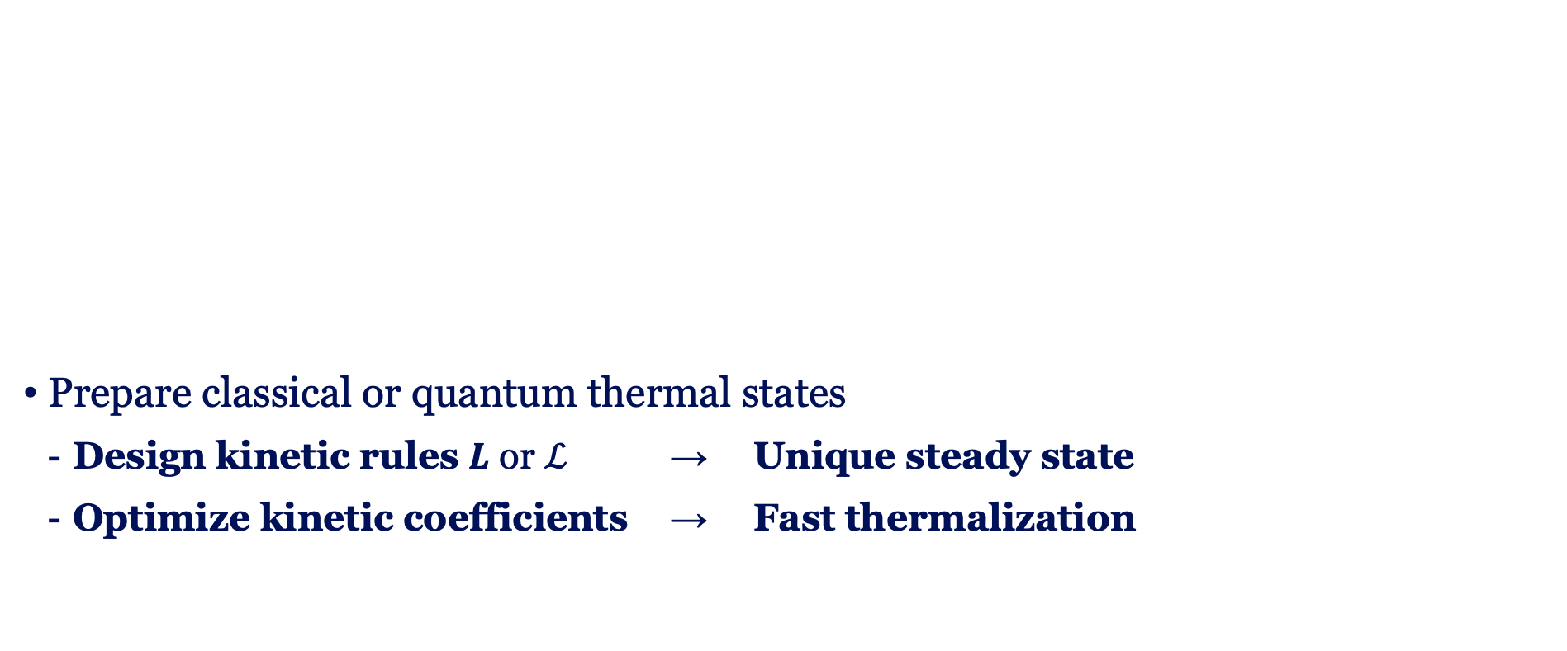
Thermal state preparation
Prepare classical or quantum thermal states
  Design kinetic rules $L$ or $ℒ$ → Unique steady state
  Optimize kinetic coefficients → Fast thermalization
Classical Markov processes
Master equations
Open quantum systems
Lindbladians
Quantum Gibbs
Sampling
C.-F. Chen, M. J. Kastoryano, A. Gilyén, An efficient and exact noncommutative quantum Gibbs sampler (2023)
A. Gilyén, C.-F. Chen, J. F. Doriguello, M. J. Kastoryano, Quantum generalizations of Glauber and Metropolis dynamics (2024)

Slide 3
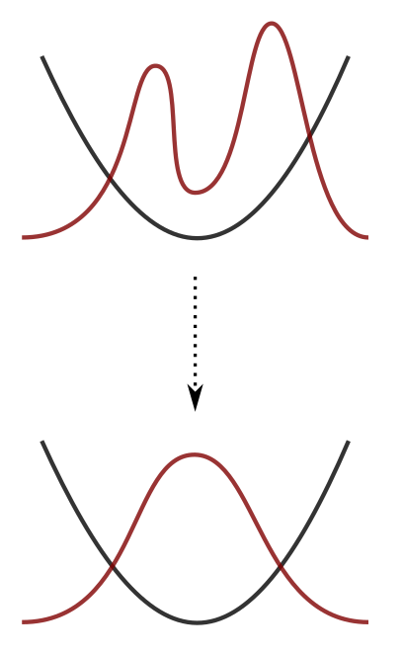

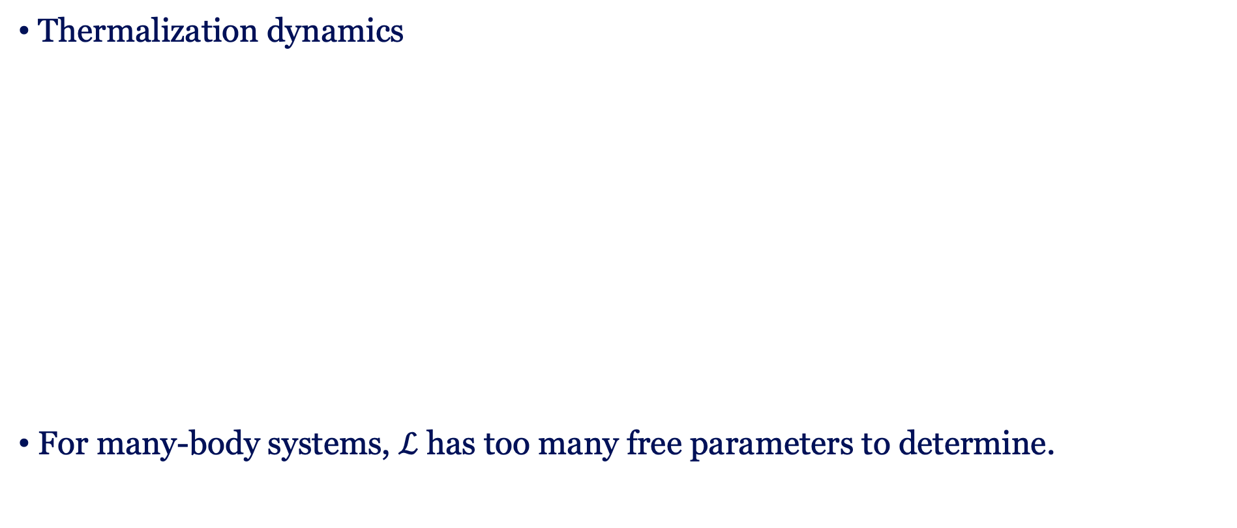
Motivation: boosting thermalization
Thermalization dynamics
For many-body systems, $ℒ$ has too many free parameters to determine.
Slowest relaxing mode
Spectral gap
Maximizing Fast thermalization Reducing irreversibility

Slide 4
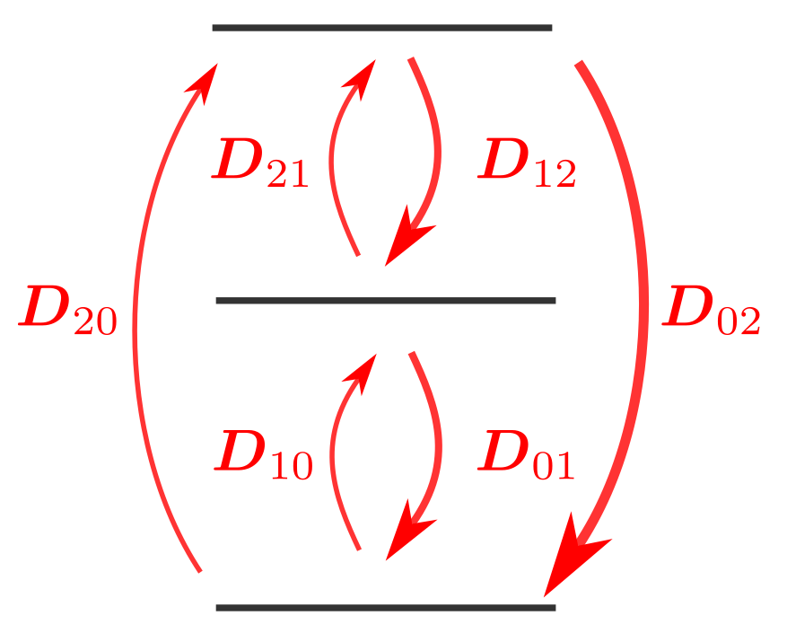


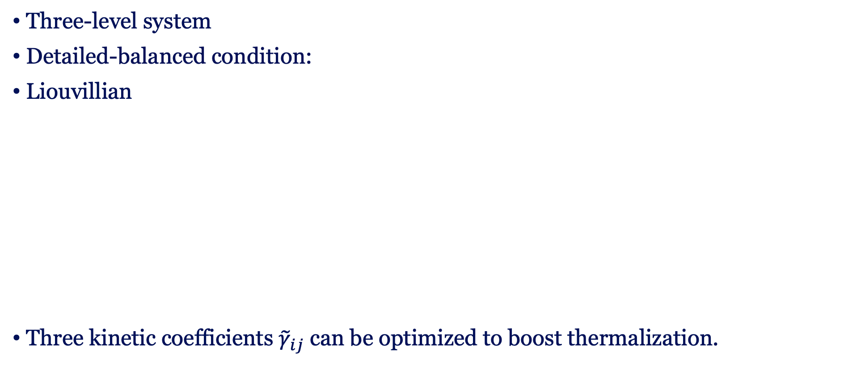
Preparing classical thermal states
Three-level system
Detailed-balanced condition:
Liouvillian
Three kinetic coefficients ${\tilde{γ}}_{ij}$ can be optimized to boost thermalization.
dissipation
jump

Slide 5
Construction of Lindbladians
Dynamical Lie algebra
Lindbladian
Thermofield double
Purification
Parent Hamiltonians

Slide 6
Optimization of spectral gap
Parent Hamiltonians
Symmetry
Hellmann-Feynman theorem
Reduce
parameters
Enhance the spectral gap: boosting thermalization
Gradients

Slide 7
Content
Preparing classical thermal states
  Kinetic Ising model
  Spectral gap optimization
Preparing quantum thermal states
  Constructing Lindbladians under quantum detailed balance
  Dynamical Lie algebra approach
  Lipkin-Meshkov-Glick model
  Transverse Ising model
Summary

Slide 8
Infinite-temperature Liouvillians
Kinetic Ising model: classical spin dynamics under stochastic flips
We first construct Liouvillians to prepare infinite-temperature state
Single spin flip operator:
Liouvillians
Detailed balance condition

Slide 9
Finite-temperature Liouvillians
Finite-temperature thermal state:
Ising Hamiltonian
Flip operator
Liouvillians
Detailed balance condition

Slide 10
Parent Hamiltonians
Parent Hamiltonians
Parent Hamiltonian of kinetic Ising model
Other choices of single spin flip operators

Slide 11
Liouvillians and Parent Hamiltonians
 | Liouvillians | Parent Hamiltonians
Steady state/ ground state
Detailed balance condition
Spectrum

Slide 12
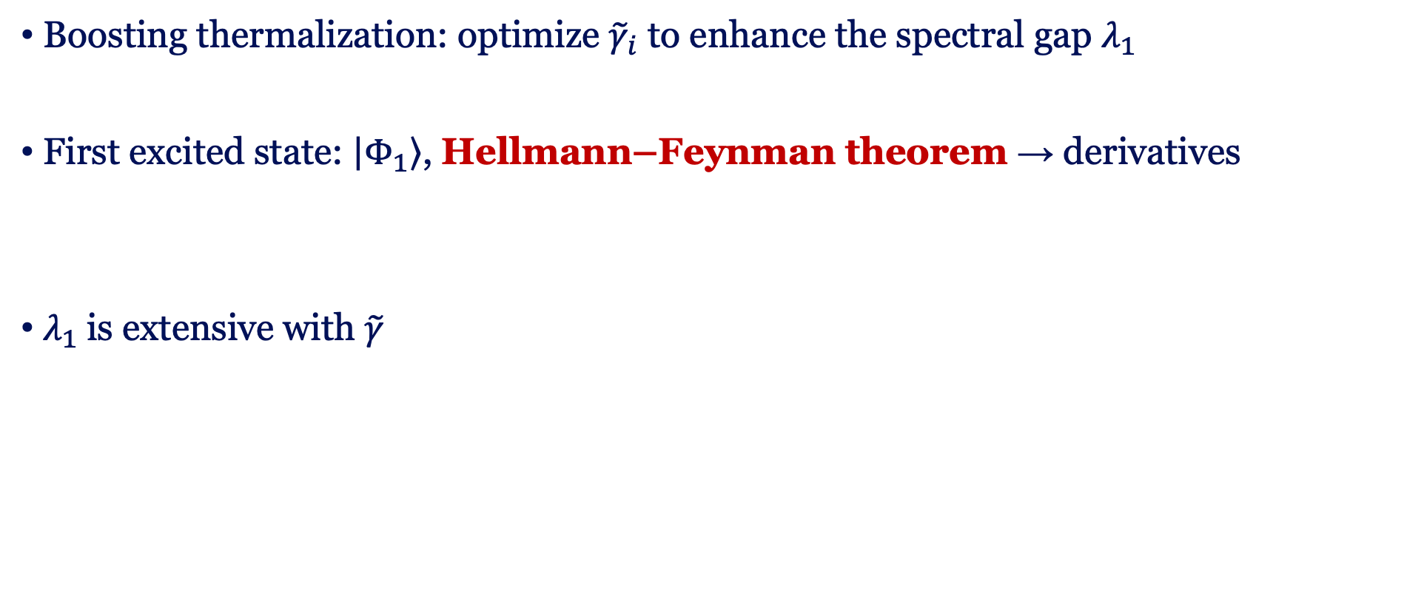
Spectral gap optimization
Boosting thermalization: optimize ${\tilde{γ}}_{i}$ to enhance the spectral gap $λ_{1}$
First excited state: $\left|\left.Φ_{1}\right\rangle \right.$, Hellmann–Feynman theorem → derivatives
$λ_{1}$is extensive with $\tilde{γ}$
Normalized gap

Slide 13
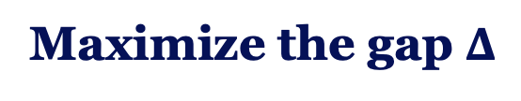
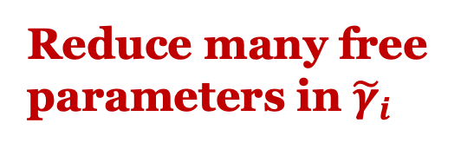
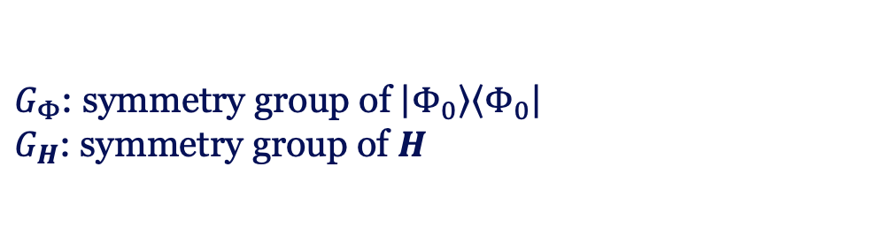
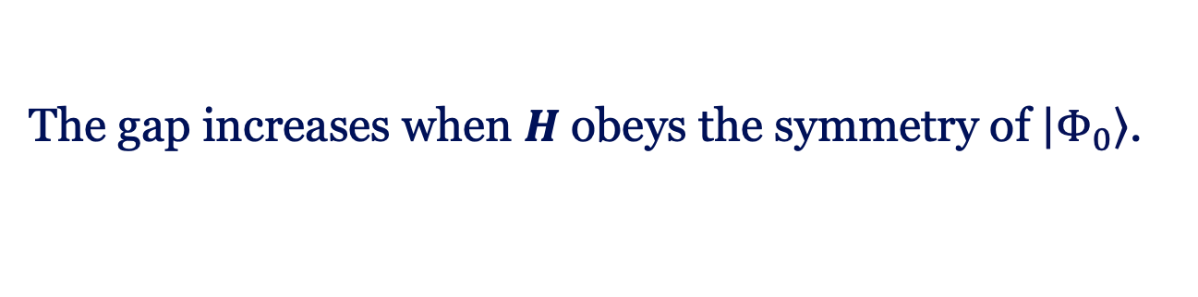
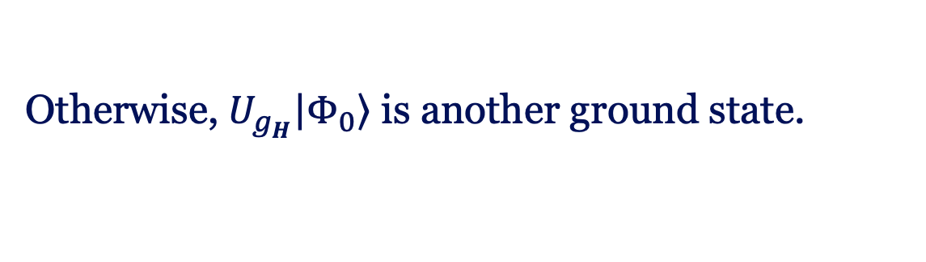
Symmetry
$G_{Φ}$: symmetry group of $\left|\left.Φ_{0}\right\rangle \right.\left\langle \left.Φ_{0}\right|\right.$
$G_{H}$: symmetry group of $H$
Concavity:
Spontaneous symmetry breaking:
Maximize the gap $Δ$
Reduce many free
parameters in ${\tilde{γ}}_{i}$
The gap increases when $H$ obeys the symmetry of $\left|\left.Φ_{0}\right\rangle \right.$.
Otherwise, $U_{g_{H}}\left|\left.Φ_{0}\right\rangle \right.$ is another ground state.
Kshiti Sneh Rai, JFC, Patrick Emonts, Jordi Tura, Spectral Gap Optimization for Enhanced Adiabatic State Preparation, Phys. Rev. Lett. 135, 090602 (2025)

Slide 14
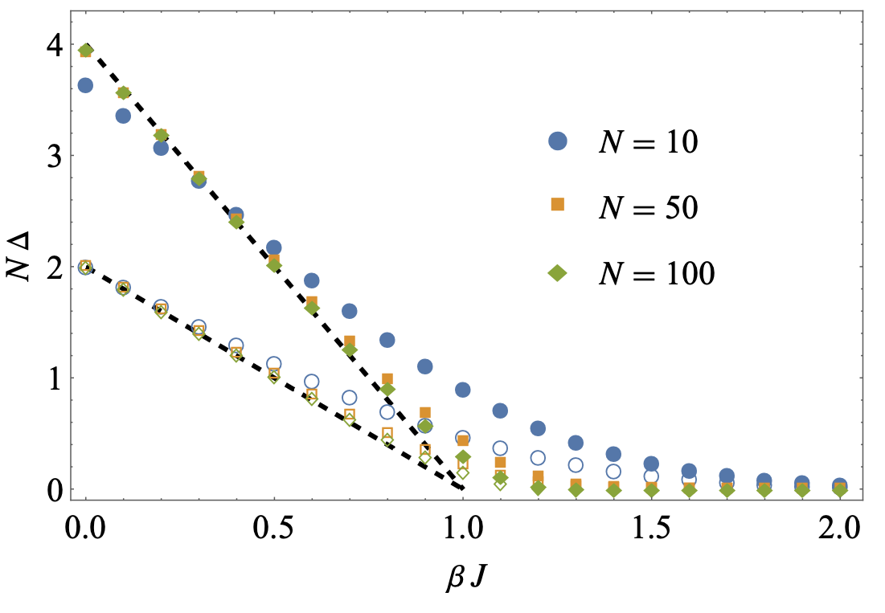
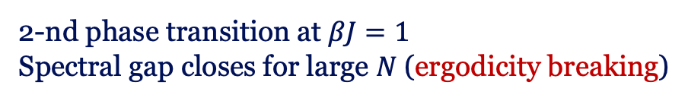
Application: kinetic Curie-Weiss model
Permutation symmetry
Local Z2 symmetry
Classical Hamiltonian
Single spin flip:
Double spin flip:
2-nd phase transition at $βJ=1$
Spectral gap closes for large $N$ (ergodicity breaking)

Slide 15
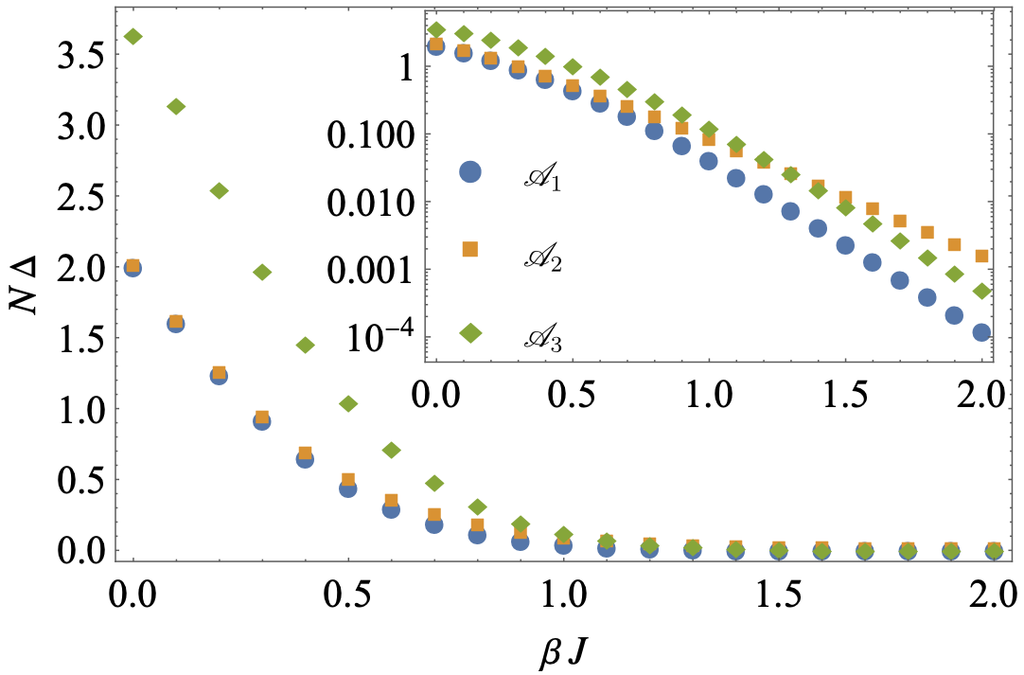
Application: 1D kinetic Ising model
Translational symmetry
Local Z2 symmetry
Commuting local terms
Single spin flip
Double spin flip

Slide 16


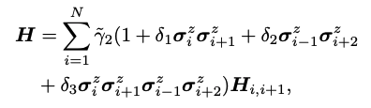
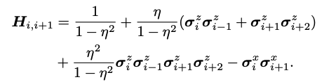
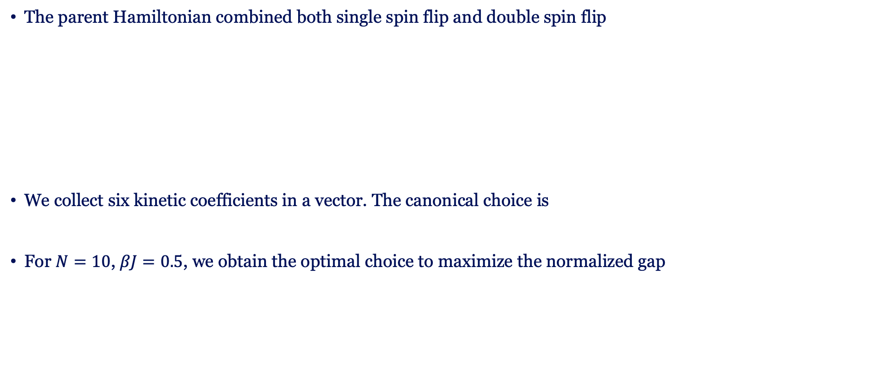
1D kinetic Ising model: cross section
The parent Hamiltonian combined both single spin flip and double spin flip
We collect six kinetic coefficients in a vector. The canonical choice is
For $N=10$, $βJ=0.5$, we obtain the optimal choice to maximize the normalized gap

Slide 17
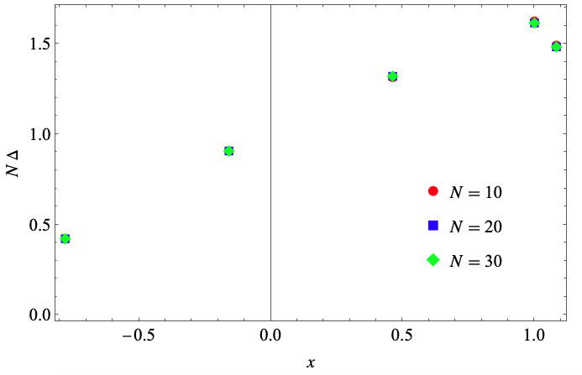
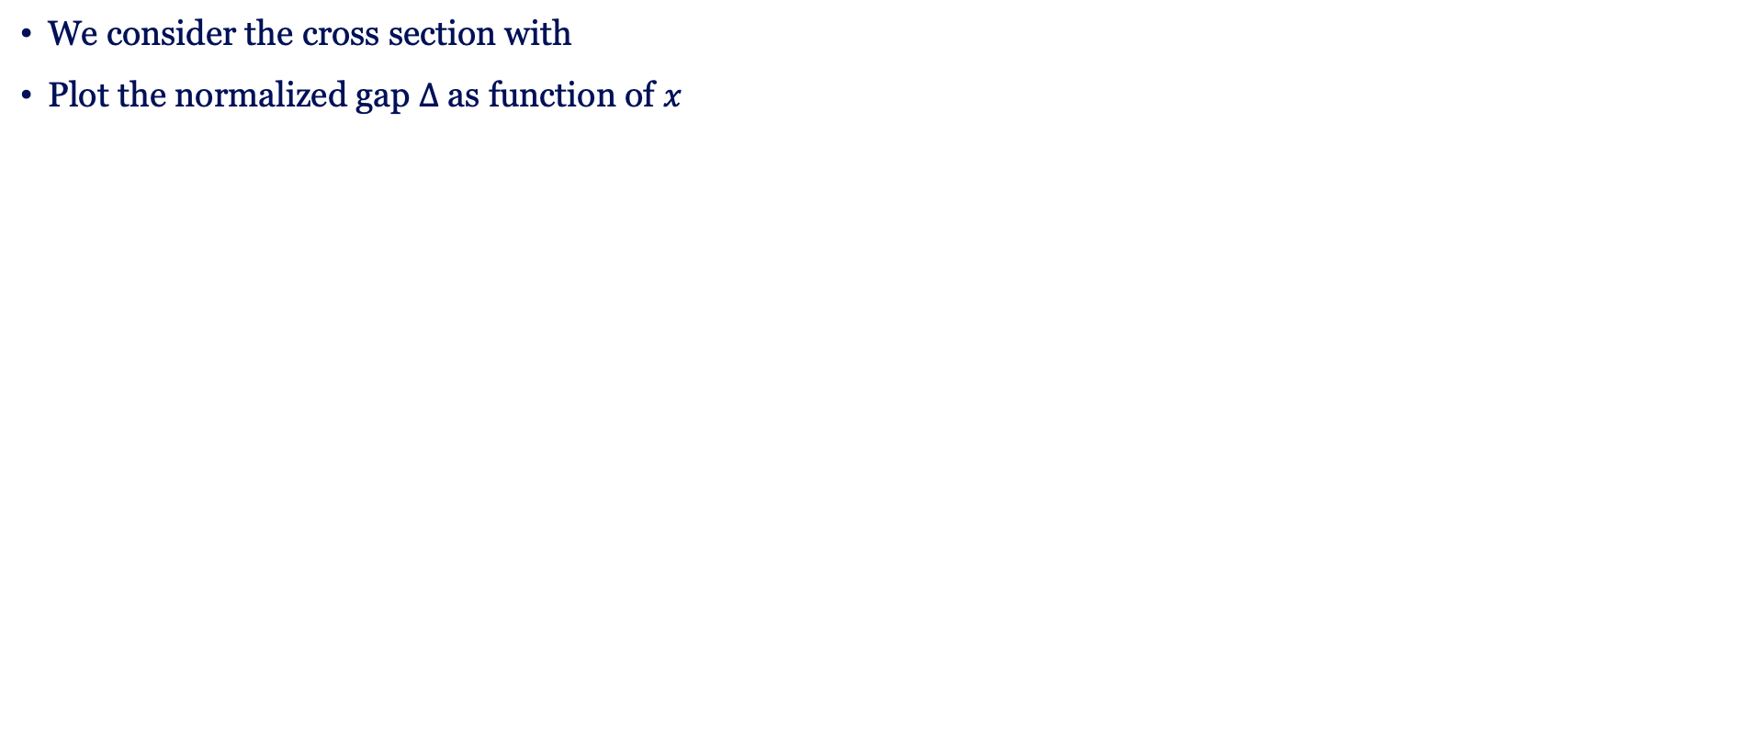
Cross section of the gap
We consider the cross section with
Plot the normalized gap $Δ$ as function of $x$

Slide 18
Preparing quantum thermal states
Apply the spectral gap optimization to quantum Gibbs sampling
Lindbladian and adjoint Lindbladian
unitary
dissipation
jump

Slide 19
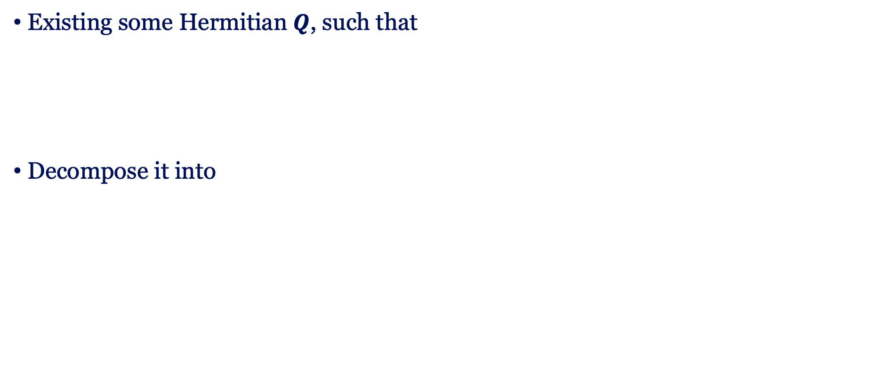
Quantum detailed balance condition
Existing some Hermitian $Q$, such that
Decompose it into
F. Fagnola, V. Umanità, Commun. Math. Phys. 298, 523–547 (2010).

Slide 20

Infinite-temperature Lindbladians
Lindbladians
Detailed balance condition
Pairs of Lindblad operators:

Slide 21
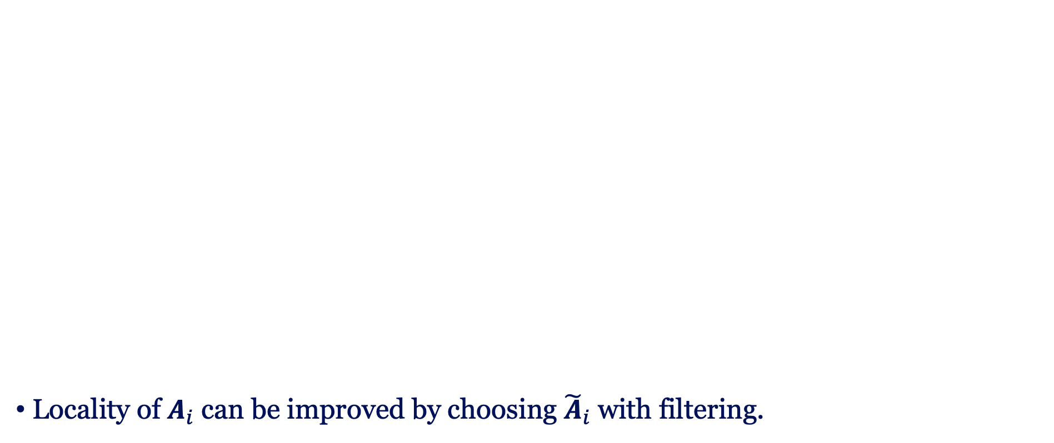
Finite-temperature Lindbladians
Locality of $A_{i}$ can be improved by choosing ${\tilde{A}}_{i}$ with filtering.
Lindbladians and detailed balance condition
Lindblad operators and unitary term

Slide 22
Parent Hamiltonians
Parent Hamiltonian

Slide 23
Dynamical Lie algebra approach
Heisenberg evolution of Lindblad operator:
Krylov expansion:

Slide 24

Dynamical Lie algebra approach
Heisenberg evolution of the dissipation term:
Energy domain
Time domain
Dynamical Lie algebra

Slide 25

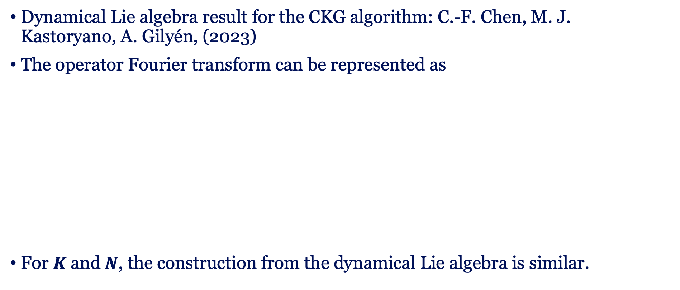
CKG algorithm
Dynamical Lie algebra result for the CKG algorithm: C.-F. Chen, M. J. Kastoryano, A. Gilyén, (2023)
The operator Fourier transform can be represented as
For $K$and $N$, the construction from the dynamical Lie algebra is similar.

Slide 26
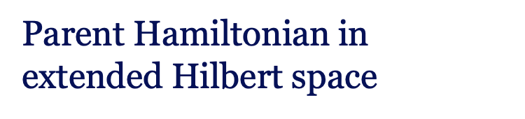
Quantum vs. Classical
Quantum detailed balance condition
Detailed balanced condition
Parent Hamiltonian in extended Hilbert space
Parent Hamiltonian
e.g., Lipkin-Meshkov-Glick model,
Transverse-Field Ising model
e.g., Kinetic Ising model

Slide 27
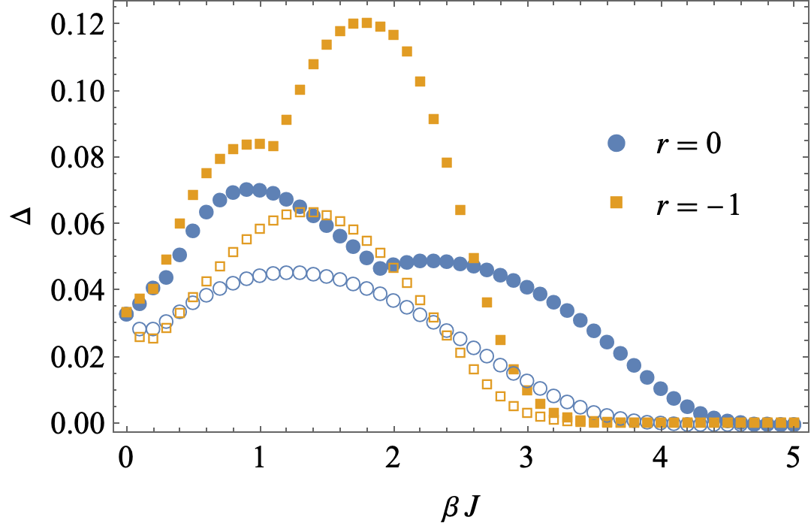
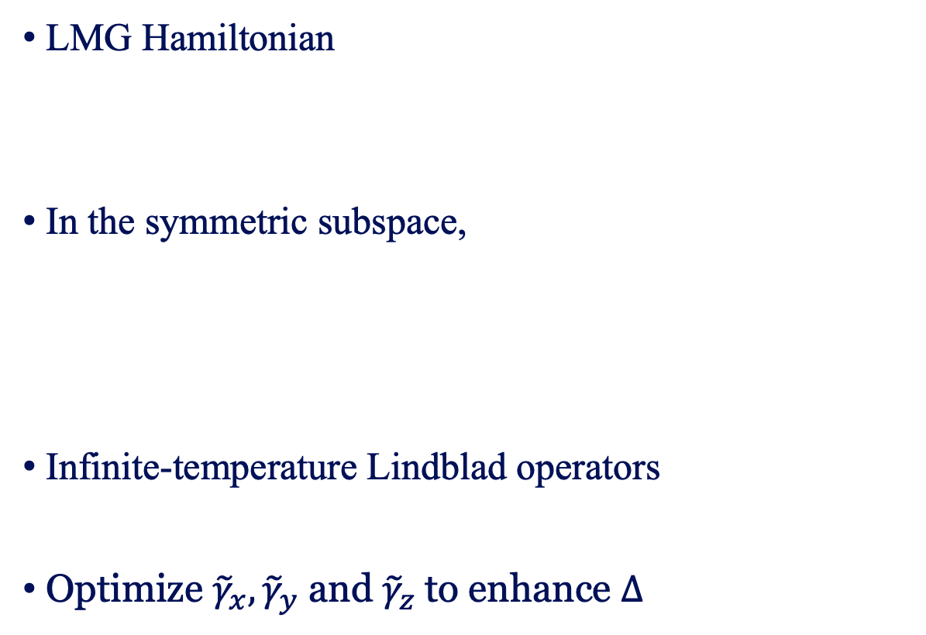
Lipkin-Meshkov-Glick model
LMG Hamiltonian
In the symmetric subspace,
Infinite-temperature Lindblad operators
Optimize ${\tilde{γ}}_{x},{\tilde{γ}}_{y}$ and ${\tilde{γ}}_{z}$to enhance $Δ$
Filled: optimal kinetic coefficients
Empty: canonical kinetic coefficients
arXiv:2411.03420

Slide 28
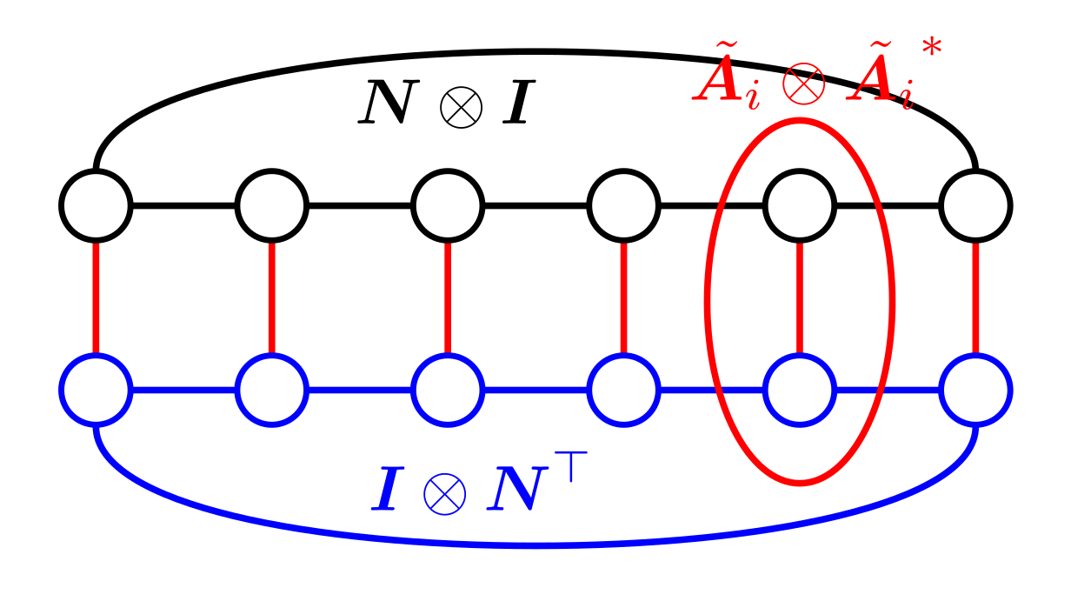
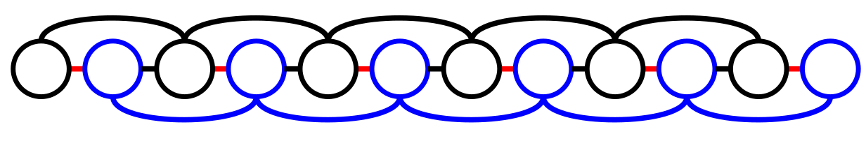
1D transverse-field Ising model
1D spin ladder
2N spin chain

Slide 29
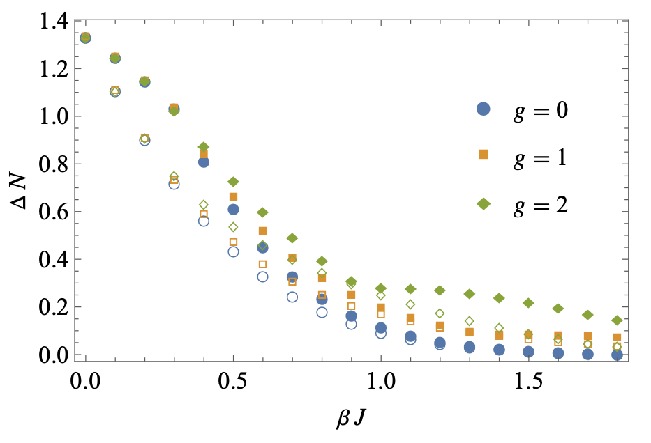
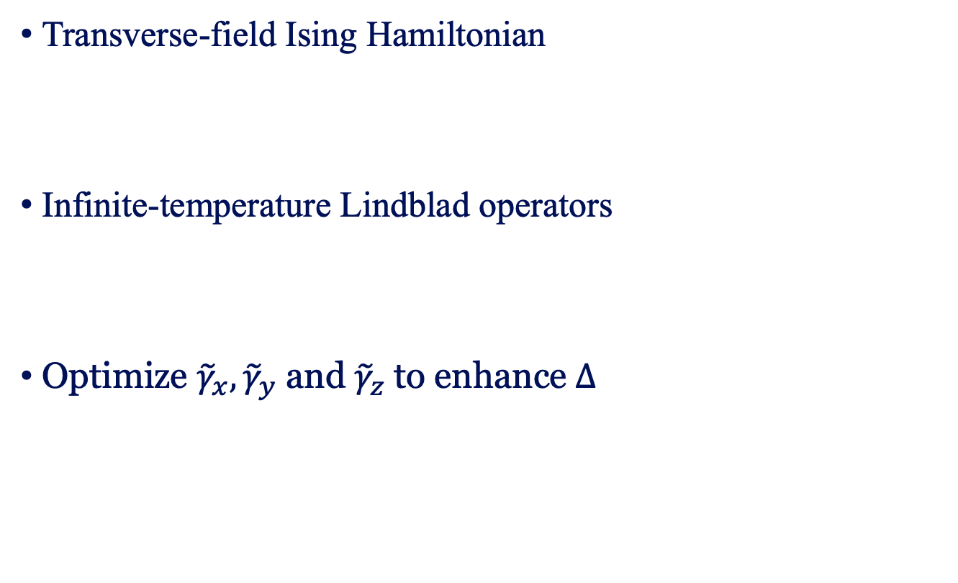
1D transverse-field Ising model
Translational symmetry
Local Z2 symmetry
Transverse-field Ising Hamiltonian
Infinite-temperature Lindblad operators
Optimize ${\tilde{γ}}_{x},{\tilde{γ}}_{y}$ and ${\tilde{γ}}_{z}$to enhance $Δ$
Filled: optimal kinetic coefficients
Empty: canonical kinetic coefficients

Slide 30
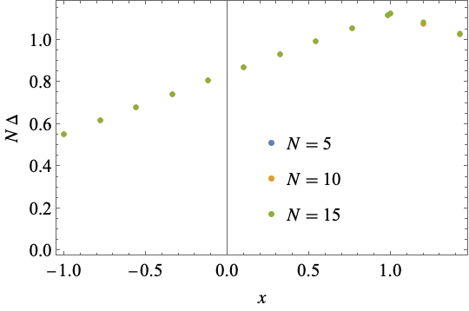
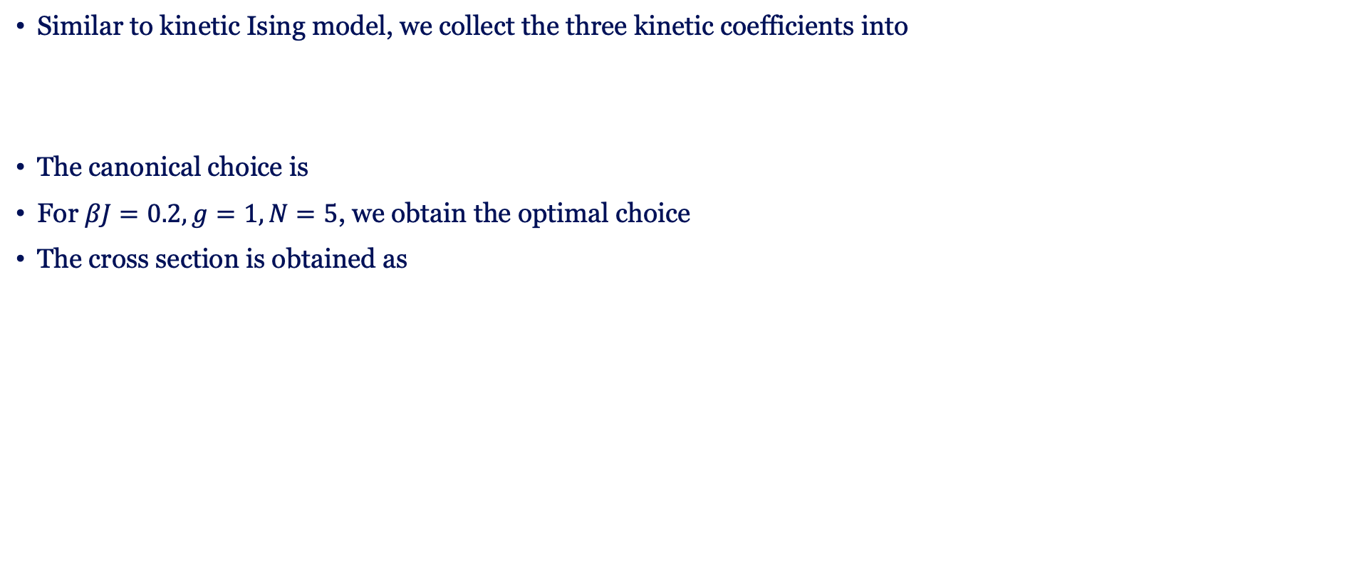
Cross section of the gap
Similar to kinetic Ising model, we collect the three kinetic coefficients into
The canonical choice is
For $βJ=0.2, g=1, N=5$, we obtain the optimal choice
The cross section is obtained as

Slide 31

Quantum Gibbs Sampling
Summary
Gap optimization
Lindbladians and parent Hamiltonians constructed by dynamical Lie algebra.
Relevant to quantum thermodynamics, simulation, and algorithms.
Symmetry reduces free parameters in $\tilde{γ}$
Gradient-based convex optimization for $Δ$
More jump operators → larger optimal gap
Future scope
Stochastic thermodynamics for these Lindbladians.
Optimal control of quantum many-body systems.
MPS Variational and SDP bounds for larger systems.

Slide 32


arXiv:2411.03420

Slide 33
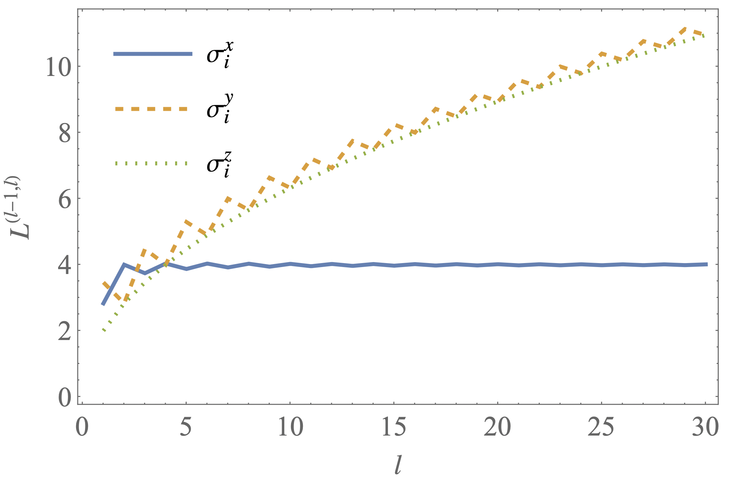
Operator growth in transverse Ising model

