Slide 1

Always Heading for the Peak: Learning to Route with Domain Knowledge
Jing Chen, Zili Meng, Mingwei Xu
Notes:
Hello, everyone
My name is Jing Chen, I am an undergraduate at Tsinghua University, China. The paper I will be presenting today is titled “Always Heading for the Peak: Learning to Route with Domain Knowledge”. I am very honored to present this paper coauthored with zilimeng and prof. mingwei xu here.

Slide 2
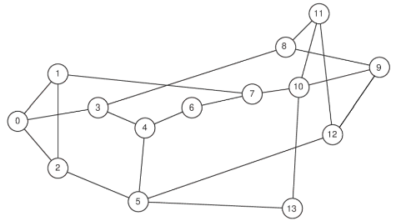
Routing complexity
Inputs
(node pairs)
traffic
demands
Outputs
routing
configurations
(paths)
Constraints
link capacity
(edges)
Notes:
Firstly, I would like to introduce the background of our research.
Routing selects paths for each flow in the network. As a basic networking task, routing is very complex. First of all, routing has high-dimensional inputs. (Click)The scale of traffic demand is the square of the size of node, and the network has complex topological structure. Secondly, there are many routing constraints to be considered. (Click) For example, shared resources like link capacities are limited. Furthermore, (Click) routing outputs are sequential paths for different flows. Paths are difficult to be efficiently expressed, making the solution space very large.
From the view of graph theory, the input traffic demands are features of node pairs(Click), link capacity constraints are edge features(Click), and the output routing configurations are paths(Click). These features on node pairs, edges and paths are coupled with each other by network topology, which makes the routing problem complicated.

Slide 3
Existing methods conventional
Shortest-path
Ill-considered of constraints
Modeling
solving Linear Programming
heavyweight for online decisions
Notes:
Conventional routing methods like shortest-path algorithm(Click) have not fully considered the constraint of link capacities, and critical links are likely to be congested especially when the network is heavy-loaded. (Click)Off-line algorithms tend to cast the problem into a linear program. They offer near-optimal solutions but may take up to tens of seconds. So they are too heavyweight for real-time routing decision-making.

Slide 4
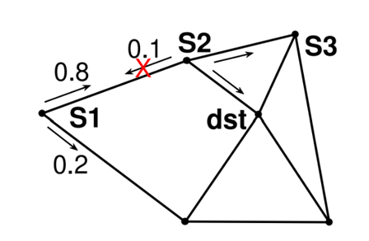
Existing methods machine learning based
Predicting intermediate variables
RouteNet [SOSR’19]: delay and jitter
Learning to Route [HotNets’17]: link weights
Sub-optimal
Scalability issue
How to enforce routing constraints?
Optimizing routing paths: nonexistent links
Optimizing flow splitting ratios: routing loops
Notes:
Recent advances in the machine learning community enable us to achieve near-optimal performance and millisecond-level decision latency at the same time. Existing learning-based routing methods do not directly optimize routing configurations. Instead they optimize a network model. For example, to optimize the delay of packets, they learn a model to understand how delay relates to other network characteristics. These methods simplify the routing problem by introducing intermediate variables. (Click)RouteNet in SOSR 2019 estimates delay and jitter of packets, and (Click)Learning to Route in Hotnets 2017 predicts link weights.
However, after their predictions, they still need to adopt some heuristic routing algorithms or let network operators make decisions subsequently. (Click)This makes them sub-optimal. (Click)Also, they have scalability issues. When scaled to larger topologies, the prediction of these intermediate variables become inaccurate. (Click)Existing methods also do not handle the constraints very well. (Click)Optimizing routing paths may select nonexistent links, (Click)while optimizing the flow splitting ratios at each node can easily result in routing loops. (Click)For example, in the figure, part of flow forwarded from s1 to s2 will be sent back to s1 by s2. With the flow splitting ratios specified by neural networks, loops are almost inevitable. And manually detecting and removing these loops requires considerable human efforts.

Slide 5
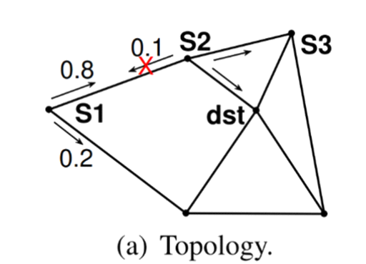
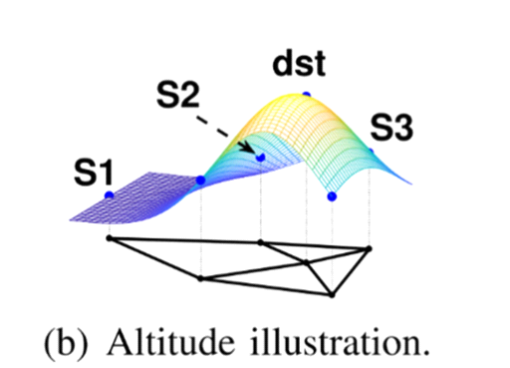
Observation
Good routing policies will roughly route flows towards the destination.
A new decision variable – altitude
Mimicking the hill-climbing process
Notes:
To optimize the network performance directly in real-world scenarios, our solution integrates domain knowledge into design of learning methods. Our key observation is that Good routing policies will roughly route flows towards the destination. It should be directional. Similar to climbing hills, Climbers may either directly climb up along the gradient of the hill or going along the winding hill road in a zig-zag way, but rarely go in the opposite direction. As shown in the figure, flows at s2 may go by the direct link or by s3 to reach dst, but may not go by s1 and make a long detour in the network.
Based on this observation, (Click)we introduce a new decision variable for each node and each destination. We call it altitude to mimic the hill-climbing process. In this case, different destinations construct their respective hills (Click)for each node. As shown in figure on the right, flows can only be routed from a lower-altitude node to a higher-altitude node, so loops are strictly avoided.

Slide 6
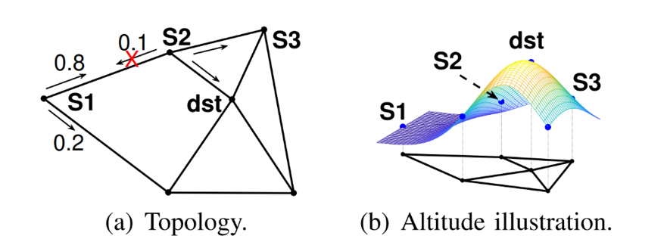
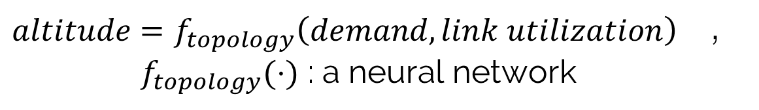
Design
Routing configurations: link weights + altitudes
Loop-free
Intelligent
$altitude=f_{topology}\left(demand,link utilization\right)$，
$f_{topology}(⋅)$ : a neural network
Notes:
For each destination, routing configuration includes not only a set of link weights (for flow splitting ratios’ calculation), but also a set of altitudes. In this way we obtain intelligent and loop-free routing decisions. To avoid loop, shortest-path algorithm restricts the flows on the single paths calculated by distances. We can say, its corresponding altitude is fixed and completely determined by the distance. In the figure, assuming that s2 is closer to the destination than s3, but the direct link between s2 and the destination is congested. In this case we want clever decisions that lower the altitude of s2 to make less flows go by s2 (for example, flows at s3 could go by the direct link to dst). So we leave altitude decisions up to the neural network. We hope that the network topology, traffic demands and link capacities can be considered together.

Slide 7

Design
Challenge #1 Non-differentiable objective
Objective: maximum-link-utilization (MLU)
$MLU=\max_{e_{ij}∈E}{\sum_{f_{k}∈F}{x_{ij}^{k}d^{k}/C^{k}}}$
Solution: Reinforcement learning
Routing strategy (action)
Agent
topology
Environment
Reward
Demand matric (state)
Notes:
We meet 2 challenges during design:
The first one is that the optimization objective in the routing problem is nondifferentiable. For example, the calculation of link utilization needs to query the index of the output of the model. Since the objective cannot be formulated into an explicit, differentiable form, we cannot use optimization methods with direct backpropagation.
(Click)Instead we use reinforcement learning. (Click) We train an agent to make routing decisions by interacting with the environment.

Slide 8
Design
Challenge #2 Slow convergence
Solutions:
Initializing altitudes based on distances
Routing strategy (action)
Agent
topology
Environment
Reward
Demand matric (state)
Notes:
Another challenge is how to make the model converge efficiently. To ease the burden of the neural network, we introduce a naive altitude based on the shortest path algorithm as a baseline. The agent will only optimize the difference between its altitudes and the baseline.
In this way, training an agent on topologies with tens of nodes can converge within a few hours in our experiments.

Slide 9
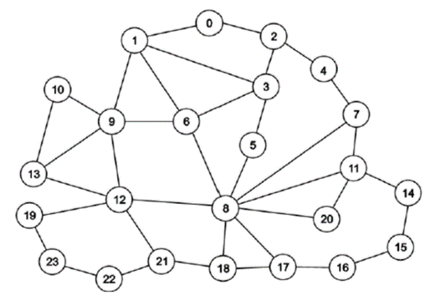


Experimental settings
Topologies*
Traffic demands
$demand\sim U(0.1C_{avg},0.5C_{avg})$
14-node NSF topology
24-node GEANT2 topology
*http://www.knowledgedefinednetworking.org/
Notes:
Okay, now, we move to the experiment part.
We evaluate our algorithm with two real-world topologies: the 14-node NSF and the 24-node GEANT2 topology. (Click)Flow demands are uniformly sampled between 0.1 and 0.5 of the average of network link capacities.

Slide 10
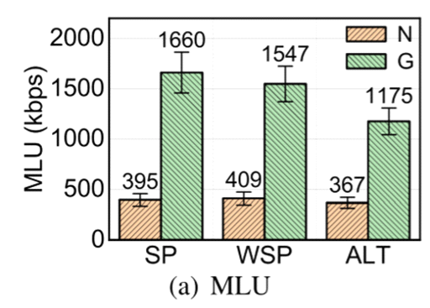
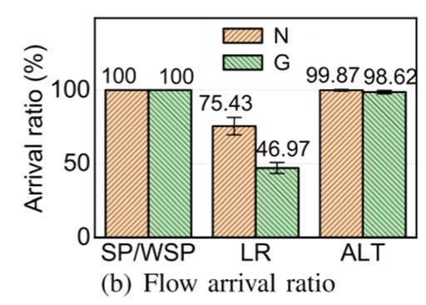
Preliminary evaluation
Our approach
Decreases MLU by 6.9% in NSF and 24.0% in GEANT2
Scales well
Rarely makes
invalid altitude
decisions
(local peaks)
Notes:
Here comes the results. In the figure, the orange bars represent results in NSF network, and green bars represent the ones in GEANT2 network. SP and WSP are short for shortest-path and weighted shortest-path algorithm. Learning to Route is denoted as LR in the figure and our approach is denoted as ALT.
Our preliminary results show that our approach (Click)decreases maximum-link-utilization by 6.9% in NSF network and 24% in GEANT2 network comparing with shortest-path or weighted shortest-path algorithms. We do not compare our MLU with learning to route. Its routing loops lead to packet losses. With a great part of flows dropped, it would be meaningless to refer to its link utilizations.
The performance improvement in the GEANT2 topology is more significant since our approach (Click)scales well to larger topologies while heuristics do not.
(Click) (Click) As for flow arrival ratios, we set Time-to-Live (TTL) as 64 so that more flows (even with routing loops) can reach the destination.
Flow arrival ratios of our approach are not 100% because an intermediate node may have a higher altitude than all of its neighbors. (Click) Results show that invalid altitude decisions are rarely made after training whereas Learning to Route without altitude decision suffers from severe problems of routing loops.

Slide 11
Conclusion
Existing learning-based routing algorithms either predict intermediate variables or handle constraints poorly.
We introduce altitude to enforce the routing constraints in an RL-based routing algorithm.
We successfully reduce MLU from heuristics’ without breaking the constraints.
Notes:
To sum up, we propose an improved reinforcement learning-based routing algorithm by making altitude decisions to enforce the routing constraints. Our approach shows significant improvements against existing ones.

Slide 12
Thank you very much! j-chen16@tsinghua.org.cn
Notes:
Thank you very much for the privilege of presenting our poster

Slide 13
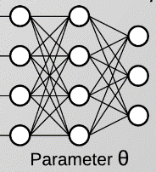
Amendments to invalid decisions
2. Local correction
src
0.3
dst
src
1
0.2
dst
1
0.8
0.6
0.5
0.8
0.3
1. Single point correction
0.3
Local information
New altitudes
Invalid: local peak
src
0.3
dst
1
0.4
0.6
3. Falling back to baselines ……
0.3

