Slide 1



GDAC_capstone_project_dashboard
View in Power BI
Last data refresh:
12/22/2022 3:36:23 PM UTC
Downloaded at:
12/23/2022 12:14:48 AM UTC

Slide 2
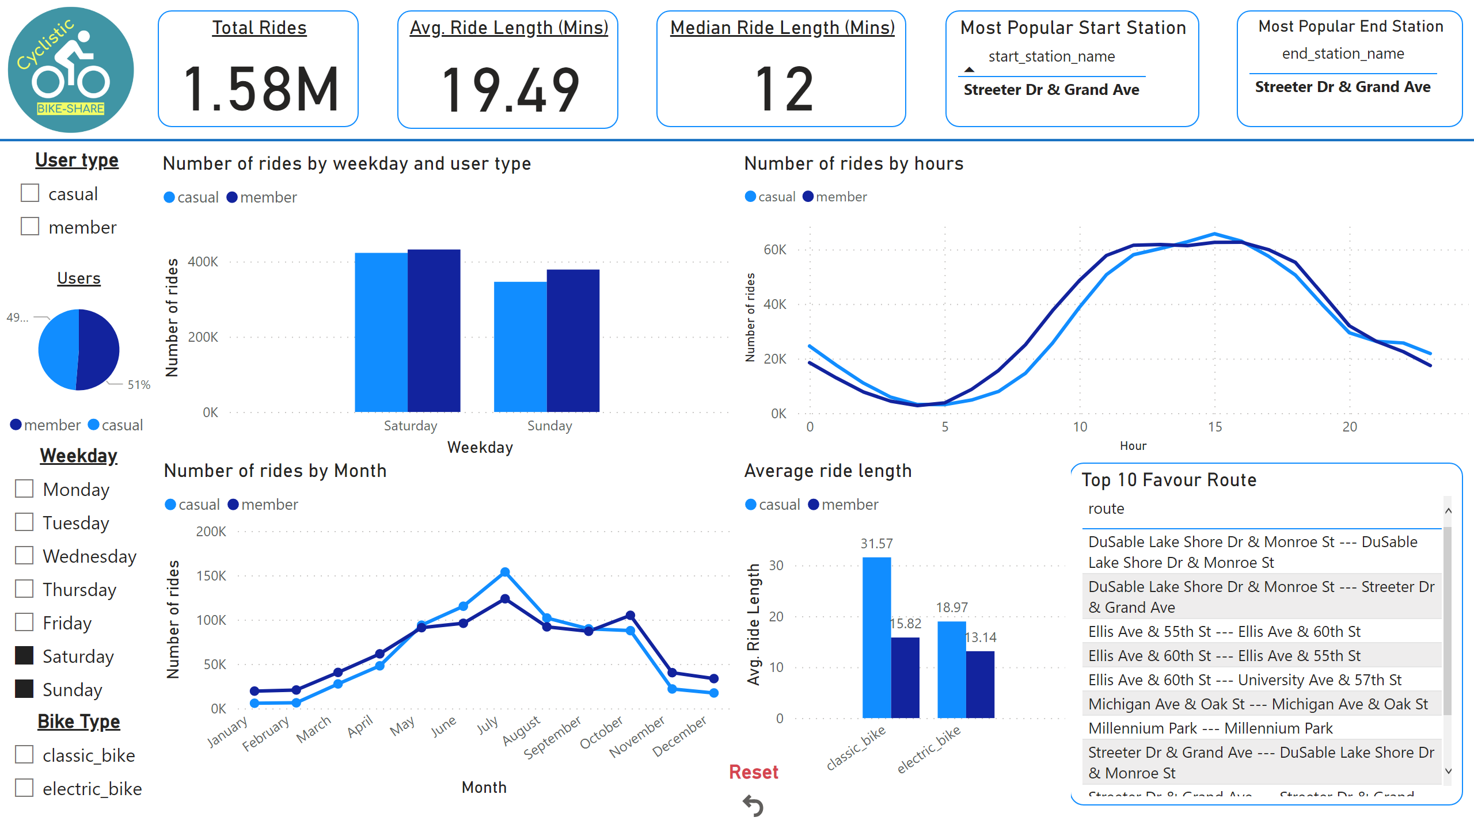
Main Dashboard
Notes:
Top 10 Favour Route
No alt text provided
User type
No alt text provided
image
No alt text provided
Average ride length
No alt text provided
Avg. Ride Length (Mins)
No alt text provided
Users
No alt text provided
Number of rides by weekday and user type
No alt text provided
Number of rides by hours
No alt text provided
Weekday
No alt text provided
shape
No alt text provided
Reset
No alt text provided
Number of rides by Month
No alt text provided
Total Rides
No alt text provided
Bike Type
No alt text provided
Median Ride Length (Mins)
No alt text provided
Most Popular End Station
No alt text provided
Most Popular Start Station
No alt text provided

