Slide 1
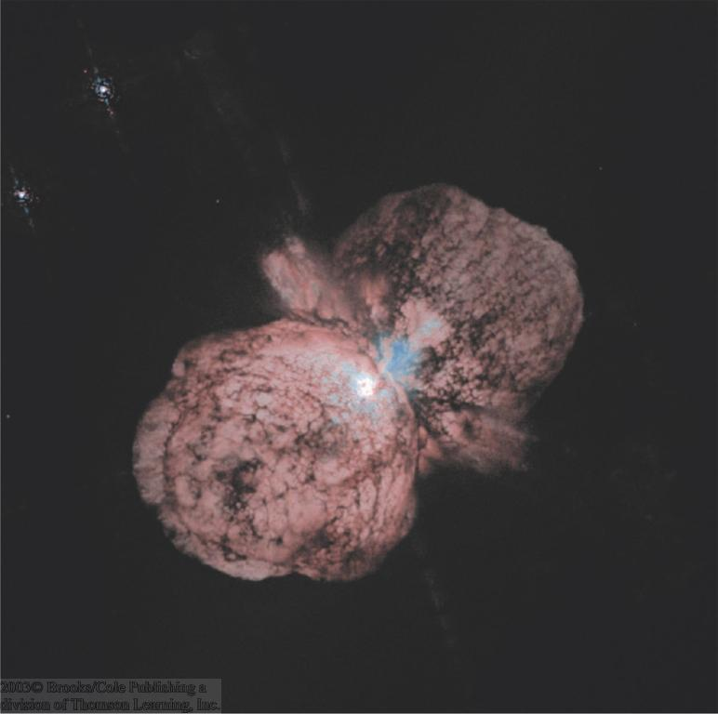
Stellar Evolution
0

Slide 2
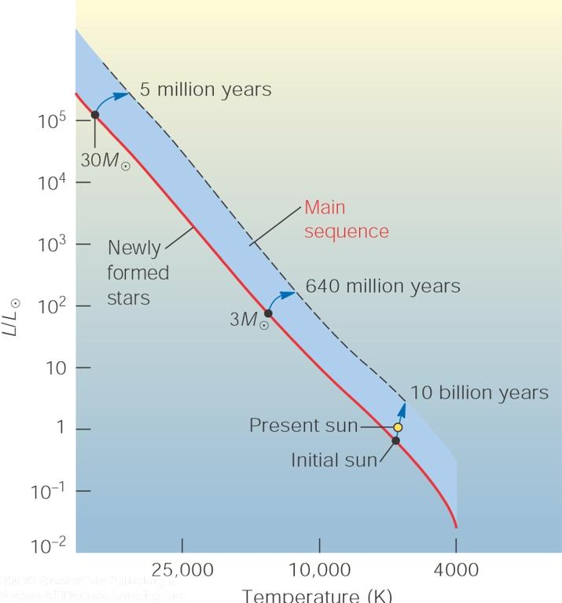
Evolution on the Main Sequence
0
Development of an isothermal core:
dT/dr =
(3/4ac) (κr/T³) (L_{r}/4πr²)
Zero-Age Main Sequence (ZAMS)
MS evolution
L_{r} = 0 => T = const.

Slide 3
Interior of a 1 M₀ Star
0
X_{H} (4.3 x 10⁹ yr)
X_{H} (9.2 x 10⁹ yr)
1.0
L (9.2 x 10⁹ yr)
0.8
L (4.3 x 10⁹ yr)
0.6
T (4.3 x 10⁹ yr)
0.4
T (4.3 x 10⁹ yr)
0.2
0.2
0.4
0.6
0.8
1.0
Mass fraction (along r)

Slide 4
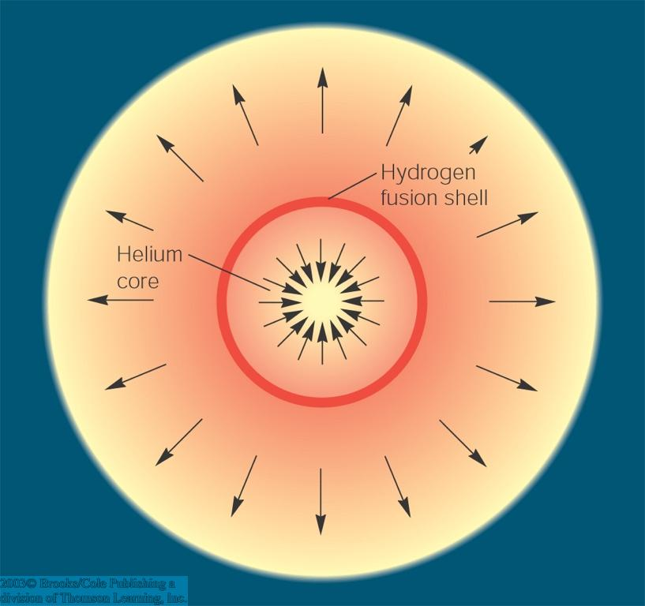

Evolution off the Main Sequence: Expansion into a Red Giant
0
Hydrogen in the core completely converted into He:
→ “Hydrogen burning” (i.e. fusion of H into He) ceases in the core.
H burning continues in a shell around the core.
He Core + H-burning shell produce more energy than needed for pressure support
Helium Core
Expansion and cooling of the outer layers of the star → Red Giant

Slide 5
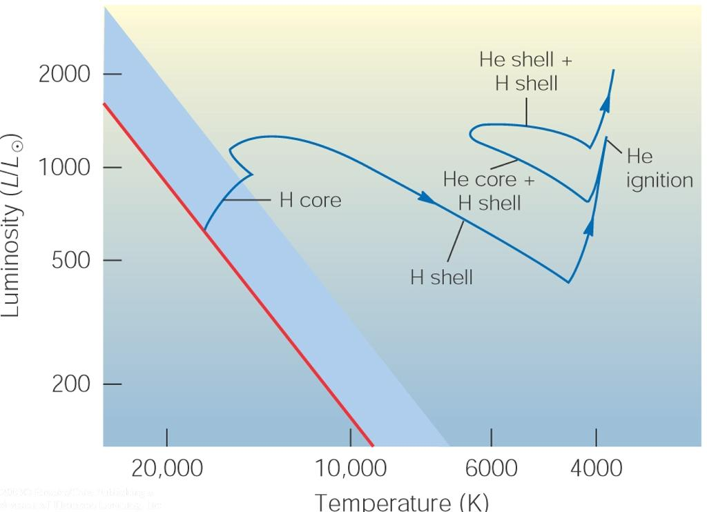
Red Giant Evolution (5 solar-mass star)
Long-Period Varia-bility (LPV) Phase
0
Schönberg-Chandrasekhar limit reached
Inactive C, O
x
3α process
Inactive He
Red Giant phase
1st dredge-up phase: Surface composition altered (³He enhanced) due to strong convection near surface

Slide 6
Helium Flashes
0
H-burning shell dumps He into He-burning shell
He-flash (explosive feedback of 3α process [strong temperature dependence!] due to heating of He-burning shell)
Expansion and cooling of H-burning shell
H-burning reduced
Energy production in He-burning shell reduced
H-shell re-contracts
Renewed onset of H-burning
Period: {
~ 1000 yr for 5 M₀
~ 10⁵ yr for 0.6 M₀

Slide 7
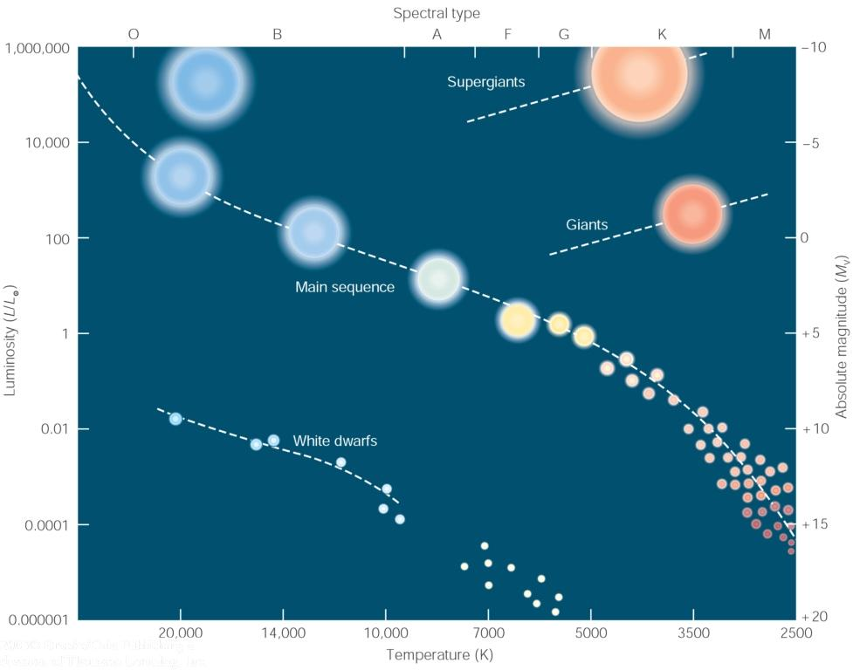
Summary of Post-Main-Sequence Evolution of Stars
0
Core collapses; outer shells bounce off the hard surface of the degenerate C,O core
Formation of a Planetary Nebula
C,O core becomes degenerate
Fusion stops at formation of C,O core.
M < 4 M_{sun}
Red dwarfs: He burning never ignites
M < 0.4 M_{sun}

Slide 8
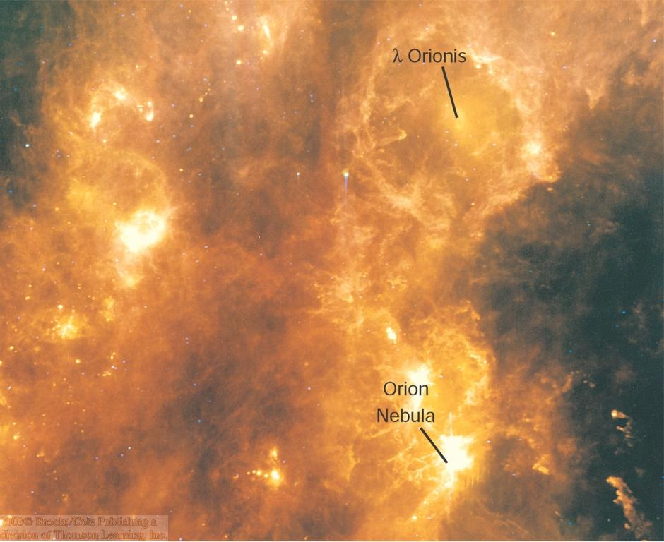
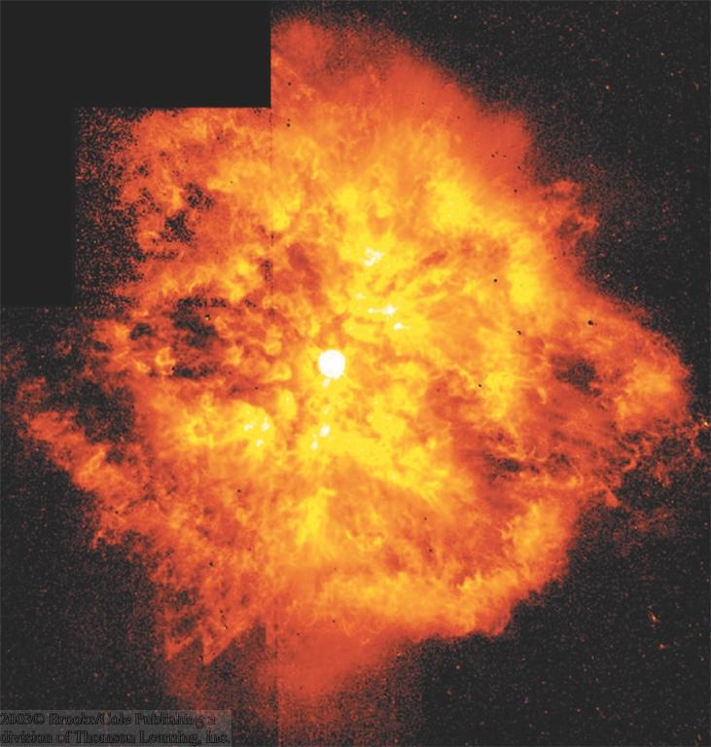
Mass Loss from Stars
0
Stars like our sun are constantly losing mass in a stellar wind (→ solar wind).
The more massive the star, the stronger its stellar wind.
Far-infrared
WR 124

Slide 9
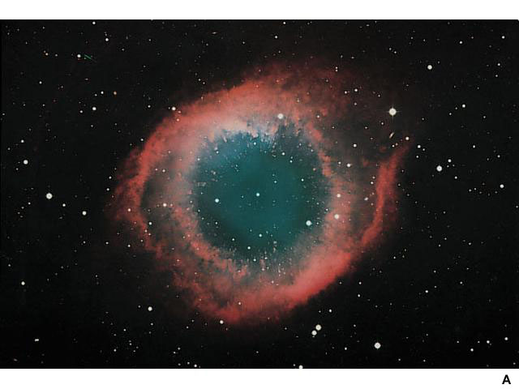
The Final Breaths of Sun-Like Stars: Planetary Nebulae
0
Remnants of stars with ~ 1 – a few M_{sun}
Radii: R ~ 0.2 - 3 light years
Expanding at ~10 – 20 km/s (← Doppler shifts)
Less than 10,000 years old
Have nothing to do with planets!
The Helix Nebula

Slide 10
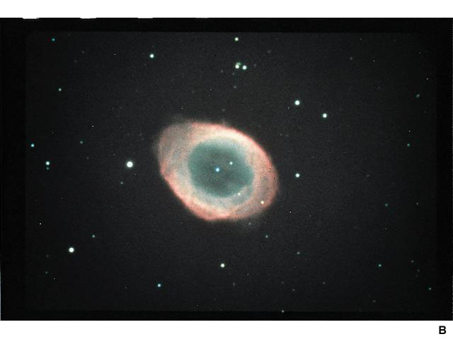
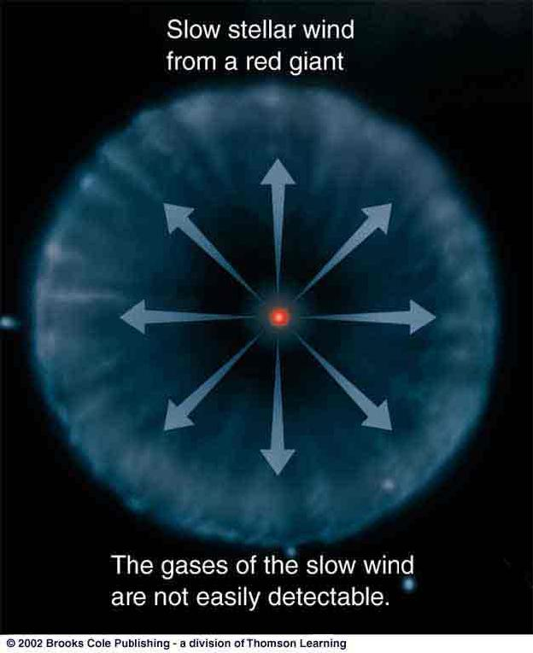
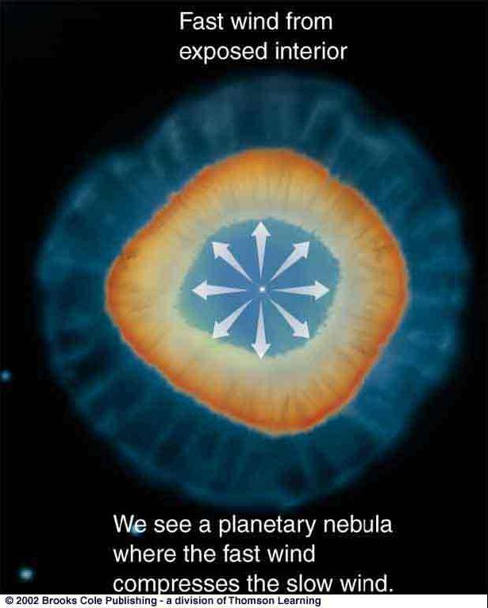
The Formation of Planetary Nebulae
0
Two-stage process:
Slow wind from a red giant blows away cool, outer layers of the star
The Ring Nebula in Lyra
Fast wind from hot, inner layers of the star overtakes the slow wind and excites it => Planetary Nebula

Slide 11
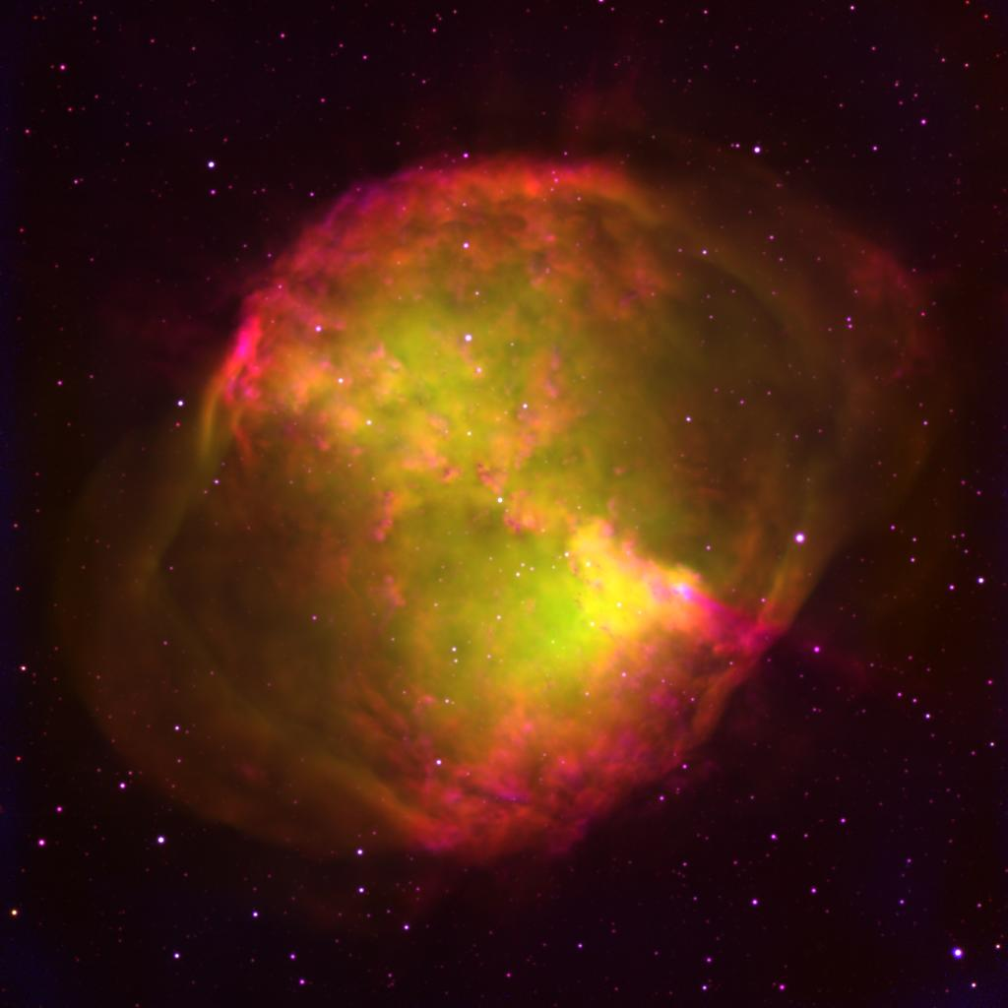
0
Planetary Nebulae
The Helix Nebula
The Ring Nebula
The Dumbbell Nebula

Slide 12
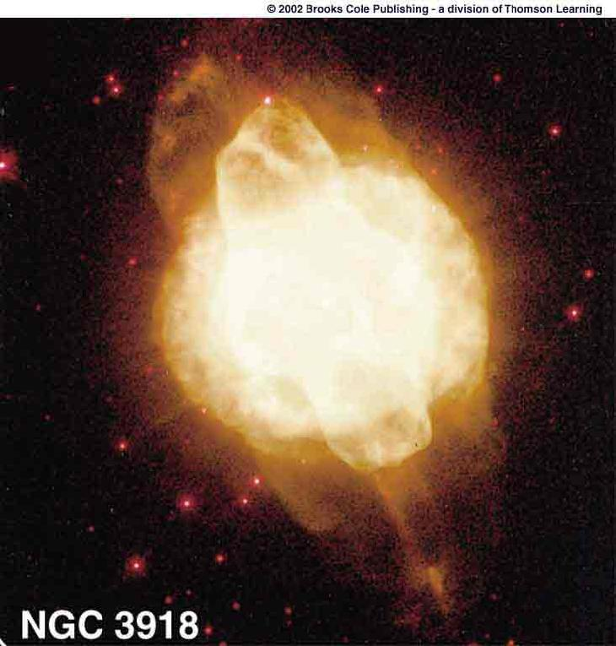
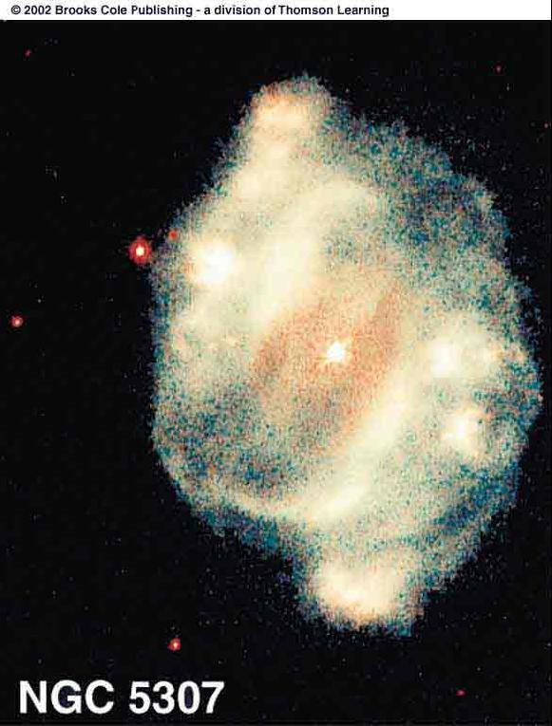
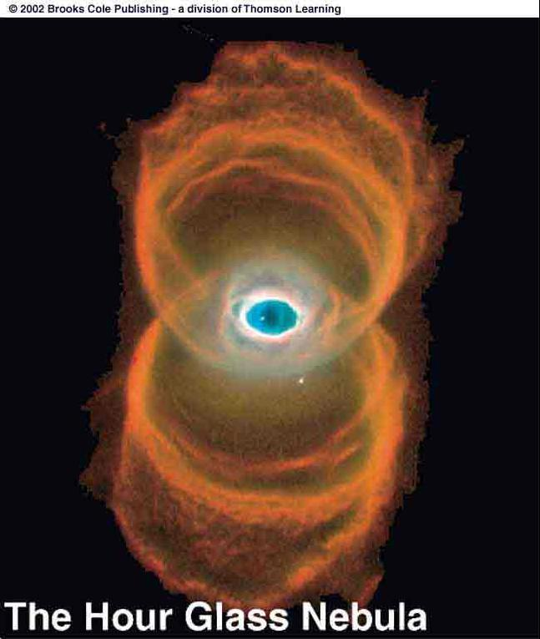
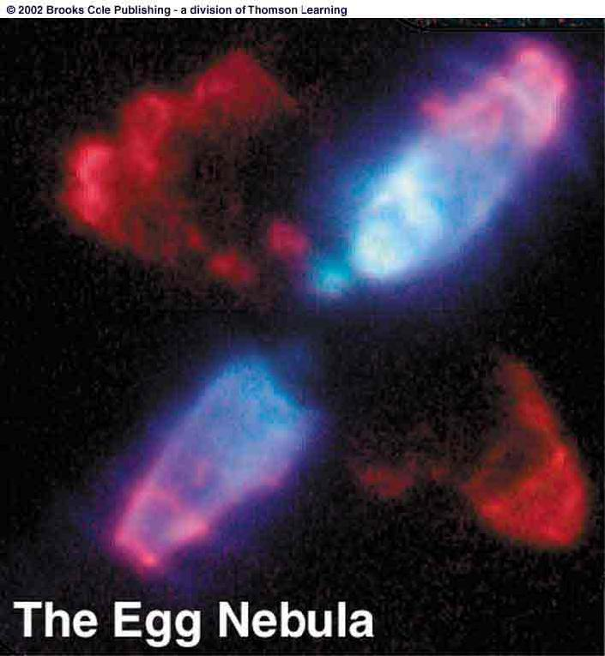
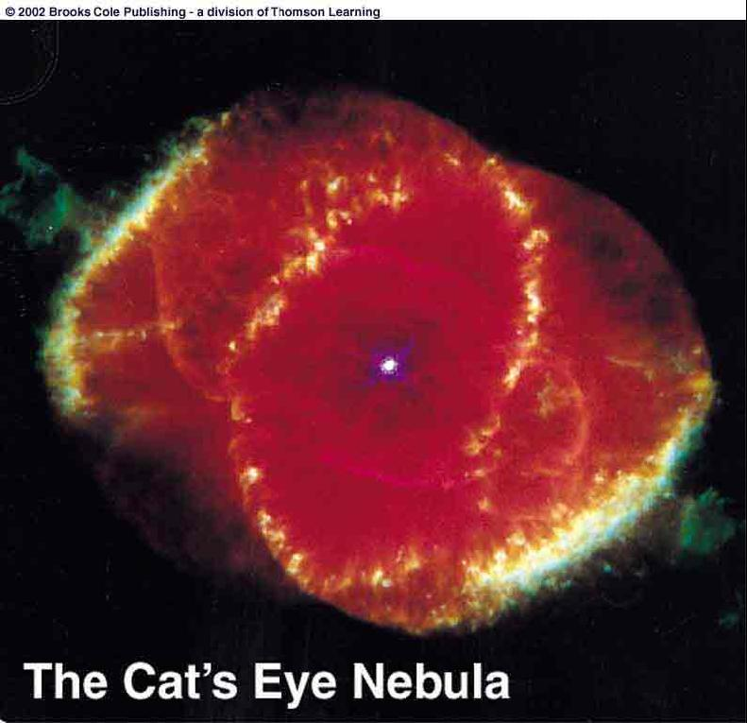
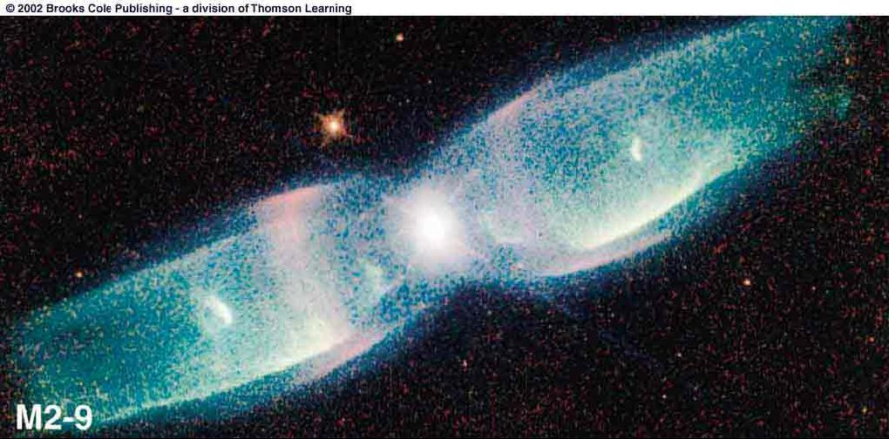
Planetary Nebulae
0
Often asymmetric, possibly due to
Stellar rotation
Magnetic fields
Dust disks around the stars
The Butterfly Nebula

Slide 13
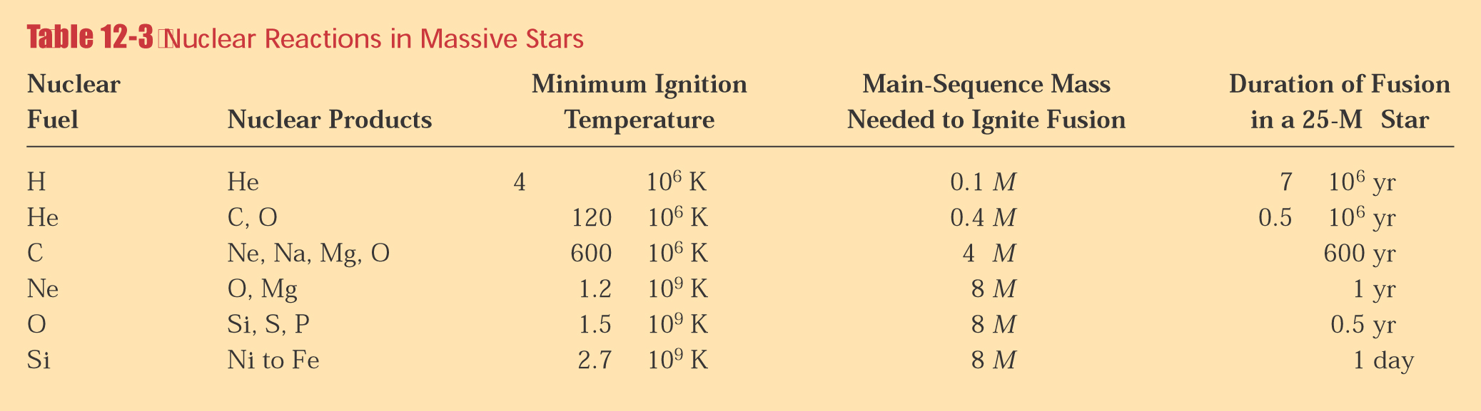
Fusion into Heavier Elements
0
Fusion into heavier elements than C, O:
requires very high temperatures (> 10⁸ K); occurs only in > 8 M₀ stars.

Slide 14
Summary of Post-Main-Sequence Evolution of Stars
0
Supernova
Fusion proceeds; formation of Fe core.
Evolution of 4 - 8 M_{sun} stars is still uncertain.
Mass loss in stellar winds may reduce them all to < 4 M_{sun} stars.
M > 8 M_{sun}
Fusion stops at formation of C,O core.
M < 4 M_{sun}
Red dwarfs: He burning never ignites
M < 0.4 M_{sun}

Slide 15
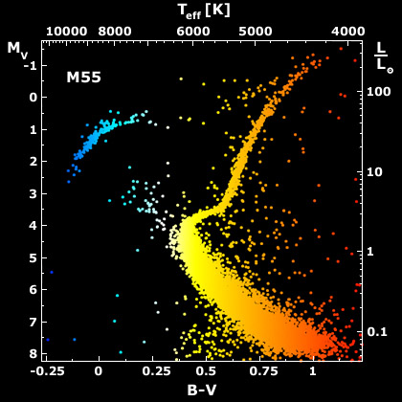
Evidence for Stellar Evolution:
HR Diagram of the Star Cluster M 55
0
High-mass stars evolved onto the giant branch
Turn-off point
Low-mass stars still on the main sequence

Slide 16
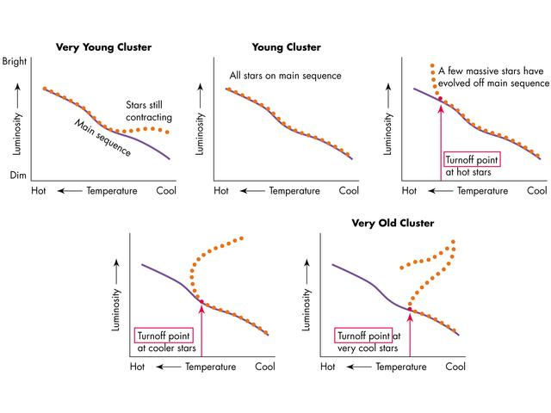
Estimating the Age of a Cluster
0
The lower on the MS the turn-off point, the older the cluster.

Slide 17
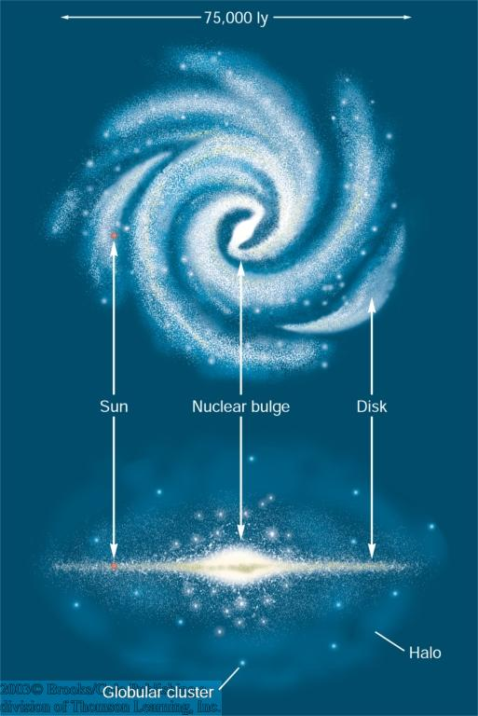
Stellar Populations
0
Population I:
Young stars (< 2 Gyr);
metal rich (Z > 0.03);
located in open clusters in spiral arms and disk
Population II:
Old stars (> 10 Gyr);
metal poor (Z < 0.03);
located in the halo (globular clusters) and nuclear bulge

