Slide 1

Analysis of International
Airline Ticket Prices
FROM
Joy Chen | Stat 418 | Final Project Proposal

Slide 2
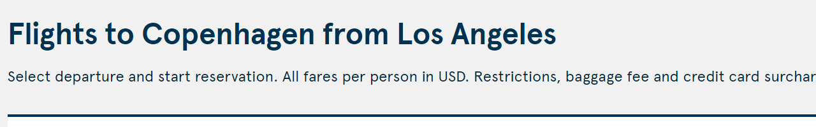
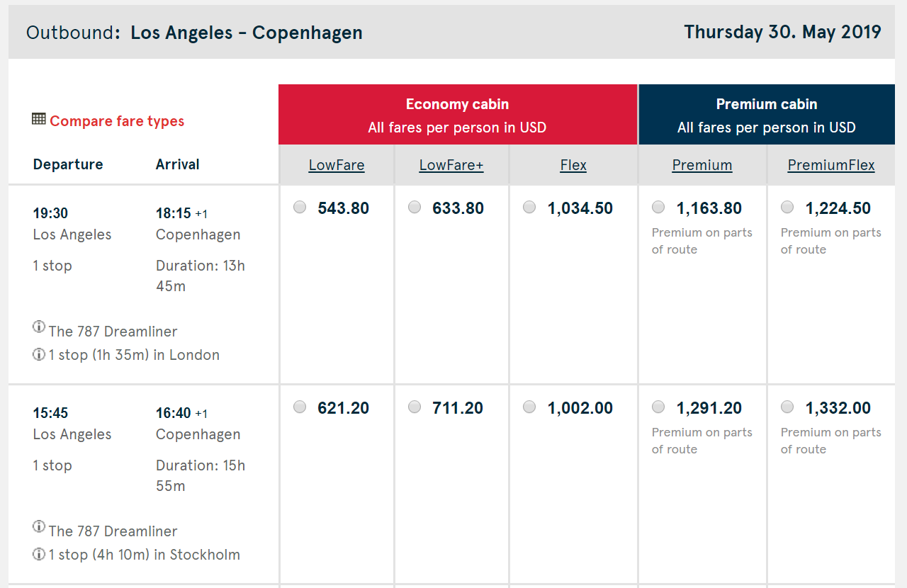
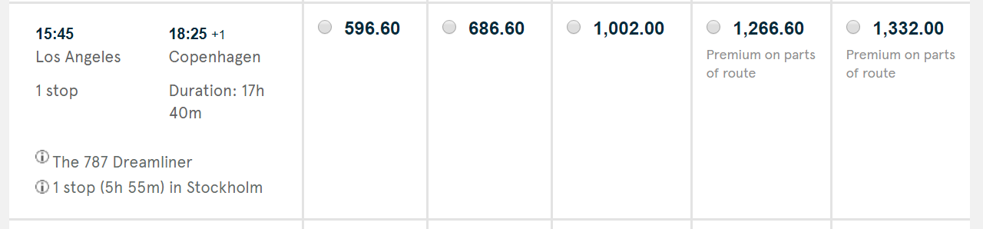
WEBSCRAPE – EXTRACTING DATA
FLIGHT TIMES
STOPS
PRICES
Source: Norwegian Air Shuttle.

Slide 3
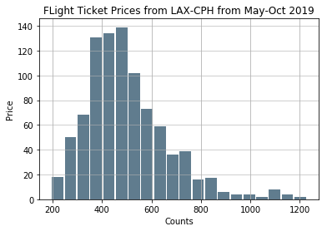
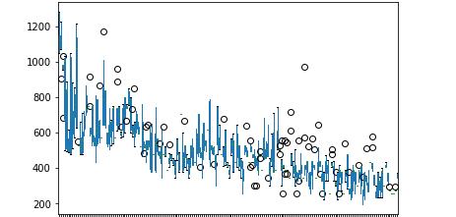
EXPLORATORY ANALYSIS: LAX – CPH
Flight prices appear to be largely stabilized around $350 – $600
There are some extreme outliers > $1,000 and these appear to be correlated with “last-minute” flights
Further analysis to be completed to observe how this histogram changes with time as flight prices are dynamic
Flight Ticket Price Variation by Day
Flight prices appear to follow both seasonal and time-until-travel trends
Significantly more variation for flights closer to current date and well as on-average higher prices for flights with shorter lead times
Prices significantly fall in late Aug after summer season
Price
May
Jun
Jul
Aug
Sep
Oct

Slide 4
PROJECT PROPOSAL
Complete data collection for various combinations of origin to destination airports for six months
Analyze data to determine flight pricing patterns for certain airports and dates
Extend analysis to include web scraping for same flights in different currencies to see if there is foreign exchange arbitrage opportunity
Build tool / predictive model that can assist with purchasing decisions based on certain input criteria

Slide 5
DISCLAIMER
All mentions of Norwegian (Norwegian Air Shuttle) and uses of logos, colors and font schemes are registered trademarks of Norwegian Air Shuttle and subject to all trademark and copyright laws.
All data presented in this analysis is the property of Norwegian Air Shuttle and used for personal academic and educational purposes only.

