Slide 1

Analysis of International
Airline Ticket Prices
FROM
Joy Chen | Stat 418 | Final Project Proposal

Slide 2









PREDICTING INT’L AIRFARE – SUMMARY
90
days starting
June 2, 2019
4,400+
flights
Predicting Airfare
via
Linear Reg. Model
FLIGHT DATA
PRODUCTION
Producing:
NORWEGIAN AIR FLIGHT ITINERARIES

Slide 3
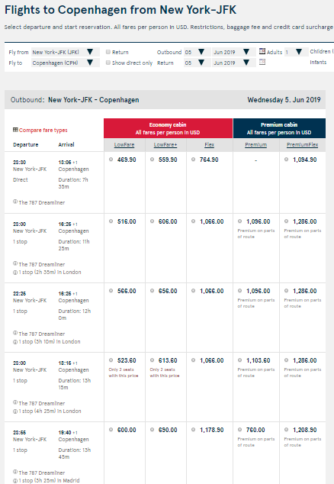
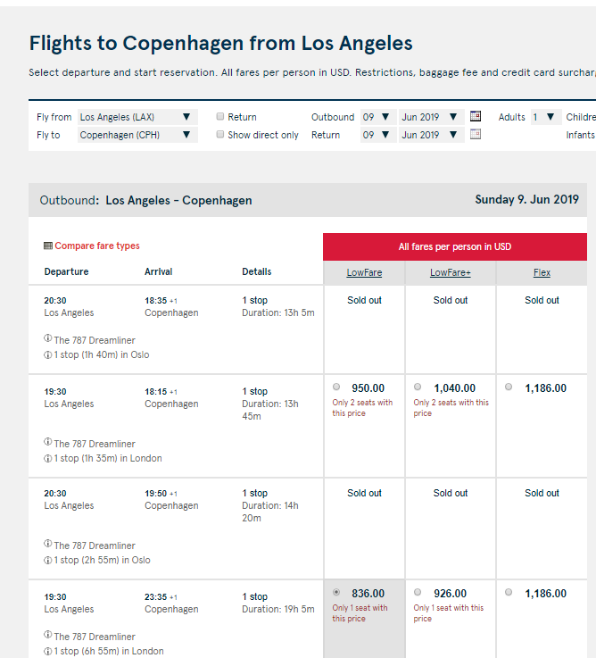
OVERVIEW – DATA COLLECTION
WARNING:
Site structure sometimes changes….
[Notice only 3 price columns here]
STANDARD PAGE FORMAT
Source: Norwegian Air Shuttle.

Slide 4
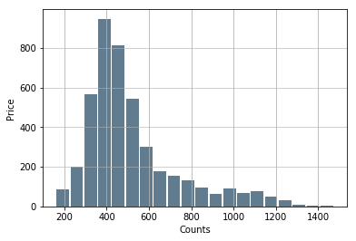
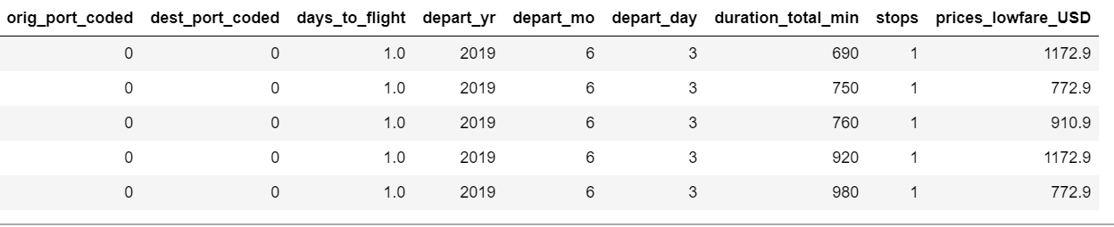


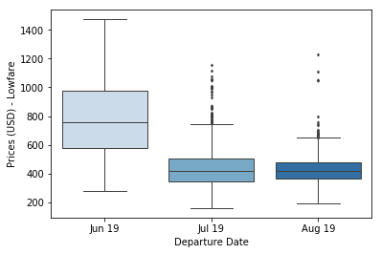






DATA EXPLORATORY ANALYSIS
UNFILTERED
4,847 x 34
3,600
Connecting
813
Direct Flights
PRICES
CLEANED
4,413 x 9
DATA SUMMARY
1,109
225
London
Madrid
840
129
Oslo
Amsterdam
STOP LOCATION
532
101
Stockholm
Paris
361
64
Copenhagen
Rome
239
Barcelona

Slide 5

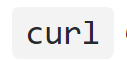
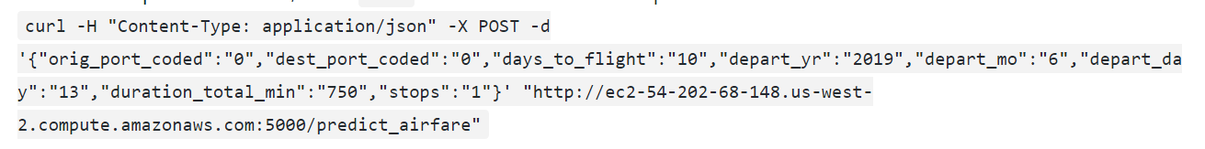
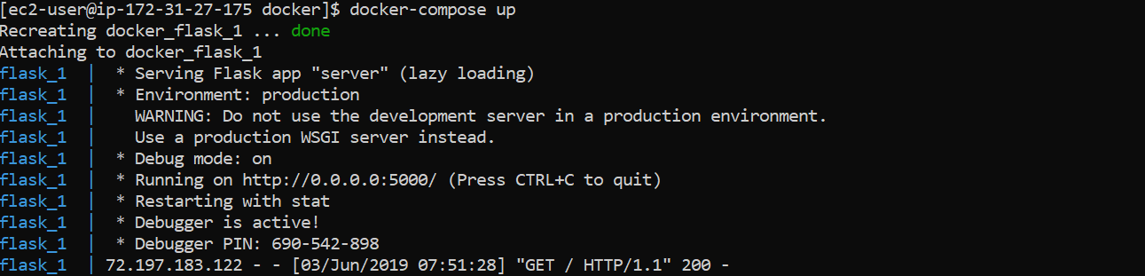
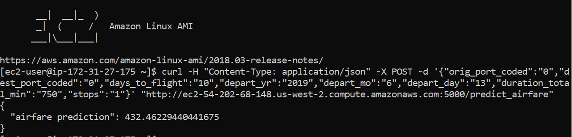
PREDICTIVE LINEAR MODEL & FLASK API
Airfare Price
(Lowfare USD)
Destination Airport
Origin
Airport
REQUEST USING
Days Until Flight
Departure Year
LAUNCHING FLASK API
Departure Month
Departure Day
Total Duration
(Minutes)
# Stops
EXAMPLE: REQUEST PREDICTION
LINEAR MODEL FEATURE DESIGN

Slide 6




CHALLENGES & FUTURE IMPROVEMENTS
SITE STRUCTURE CHANGES
IMPROVEMENTS
Add FX comparisons / access FX API
EXTREMELY
SLOW SCRAPER
Run scraper daily at consistent times to capture changes in ticket prices
SEMI-CLUNKY
CODE
Get better at

Slide 7
DISCLAIMER
All mentions of Norwegian (Norwegian Air Shuttle) and uses of logos, colors and font schemes are registered trademarks of Norwegian Air Shuttle and subject to all trademark and copyright laws.
All data presented in this analysis is collected in adhereance to Norwegian Air Shuttle data policies and used for personal academic and educational purposes only.

