Slide 1



Modeling the Intransitive Pairwise Image Preference from Multiple Angles
Jun Chen, Chaokun Wang, Jianmin Wang
School of Software, Tsinghua University

Slide 2
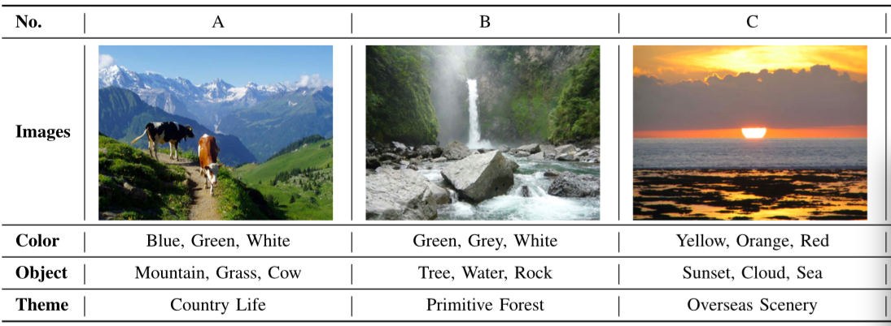
Background
Intransitive image preference
  User preferences on images can be intransitive in pairwise comparisons.
  The preference intransitivity is personalized.
  Traditional models fail due to their transitive preference assumption.
  Q1: how to predict pairwise image preference with intransitivity?
  Q2: how to get multiple embeddings of users/images under different angles.
A > B
B > C
A < C
Preferences from multiple angles
  Compare images from multiple angles, e.g. color, salience object, theme.
  Choosing different subset of angles in different pairwise comparisons.
  Different selections of subsets of angles result in intransitive preferences.

Slide 3
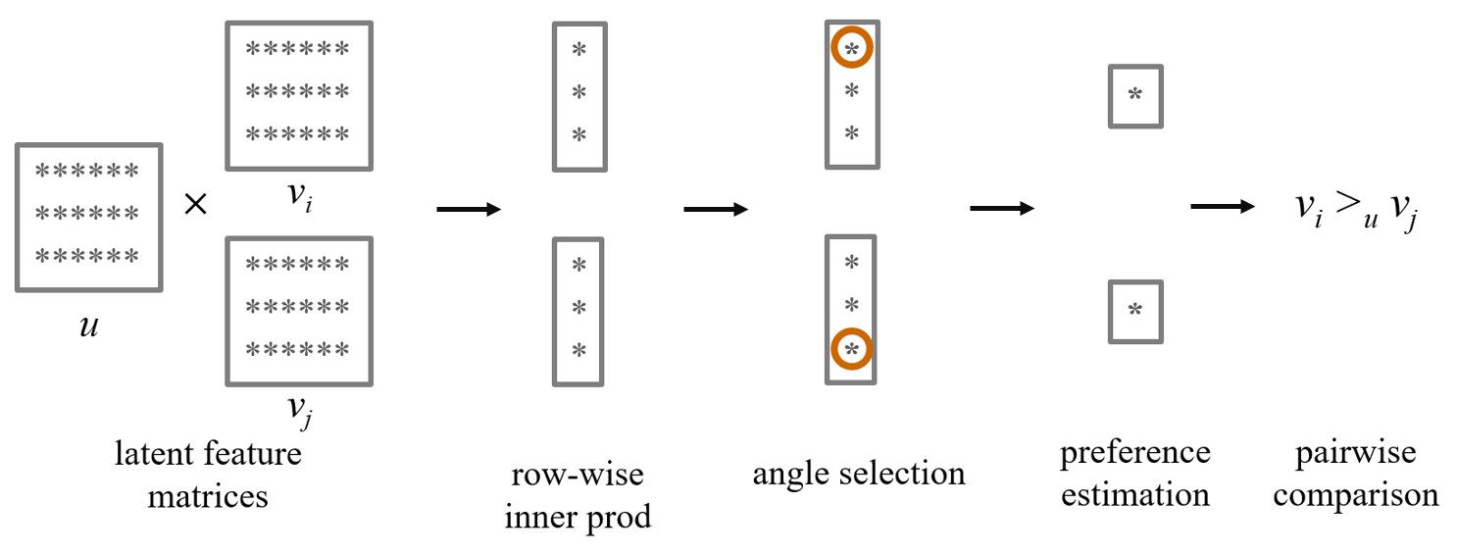
Models
Multi-Angle Preference (MAP) Models

