Slide 1
CS410 Presentation: News for topic Mining
Dataset Creation Track

Slide 2
Instructions to install the dataset

Slide 3
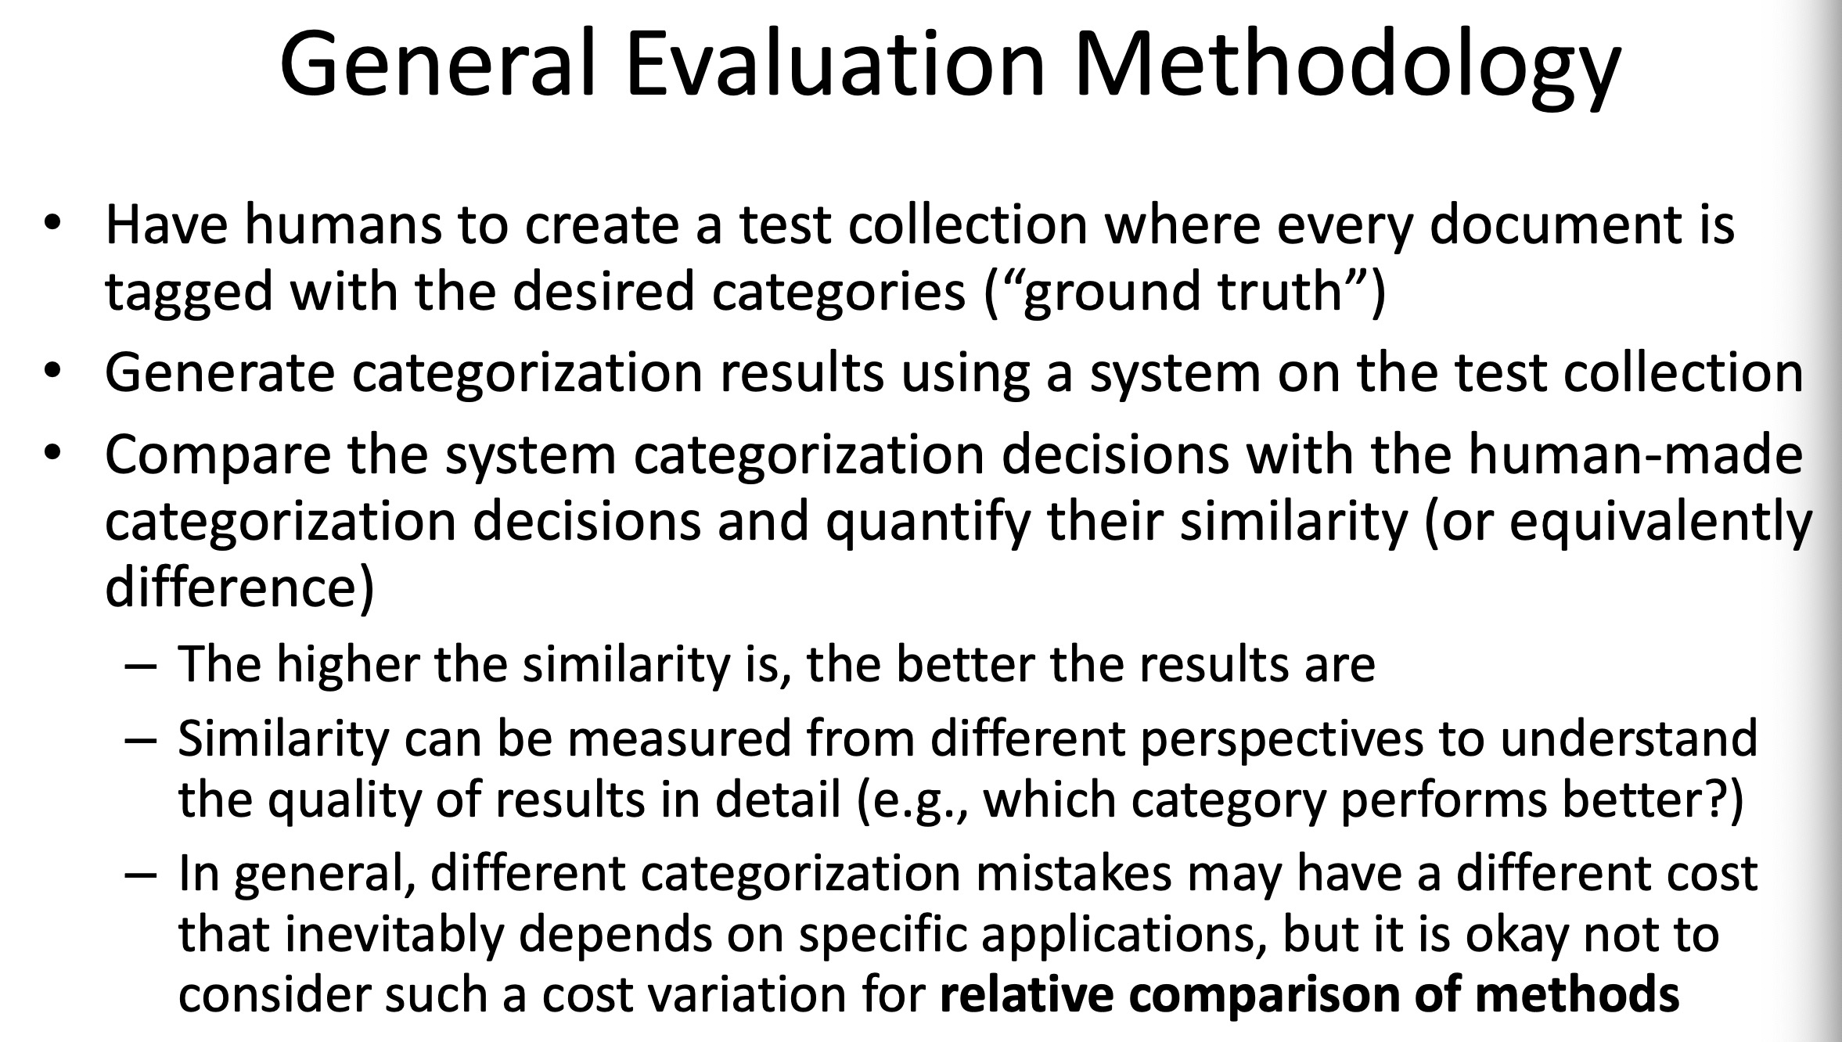
Potential use case: Text Categorization & Topic Mining
(from 11.3 in CS410: Text Information System)
Dataset: Headline-URL file; Headline-Content file; Topic Annotation file

