Slide 1

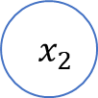

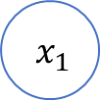
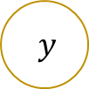
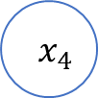

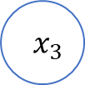

$${ x}_{1}$$
$$θ_{1}$$
$${ x}_{2}$$
$$θ_{2}$$
$$θ_{3}$$
$$y$$
$${ x}_{3}$$
$$θ_{4}$$
$${ x}_{4}$$

Slide 2
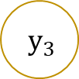
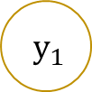
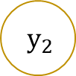
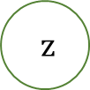
输入层
隐藏层
输出层
$${ x}_{1}$$
$$y_{1}$$
$${ x}_{2}$$
$${ y}_{2}$$
$$z$$
$${ x}_{3}$$
$$y_{3}$$
$${ x}_{4}$$

Slide 3

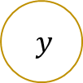

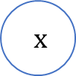
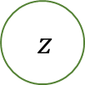


$$w_{1}$$
$$b_{1}$$
$$w_{2}$$
$$b_{2}$$
$$x$$
$$y$$
$$z$$

