Slide 1

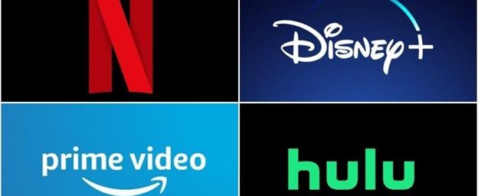
Movies Ratings Analysis
Ke Chen
AIM-5001 Final Project Presentation

Slide 2




Are you going to look at the ratings before you decide to select a movie to watch?

Slide 3
0. Introduction
Data Sources
Kaggle Dataset MoviesOnStreamingPlatforms_updated
Kinopoisk API
Will See:
Factors and Ratings
Ratings and Ratings
Cultural Matter?

Slide 4
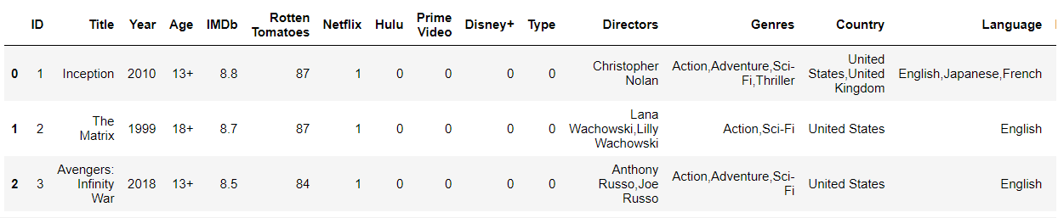

Slide 5
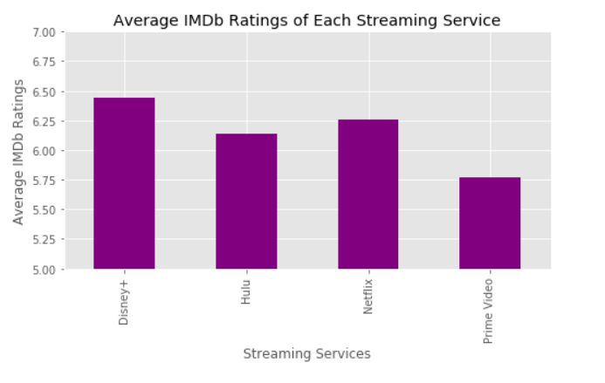
1. Factors vs. ratings
Do streaming services have an influence over the movie ratings?

Slide 6
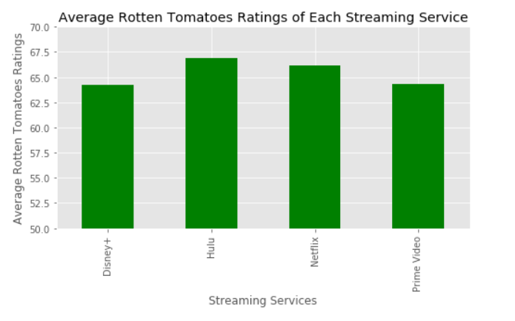

Slide 7
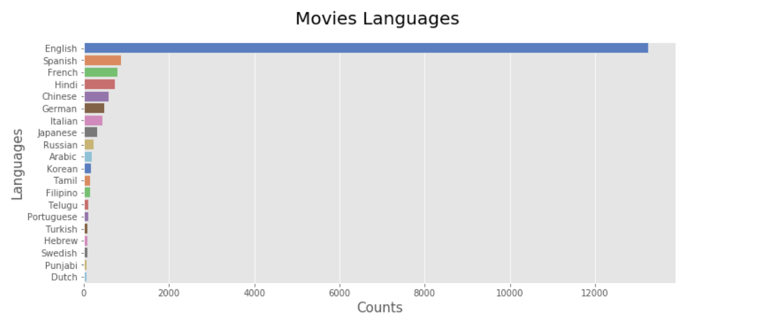
2. Which languages have the highest ratings?
Top 20 Languages

Slide 8
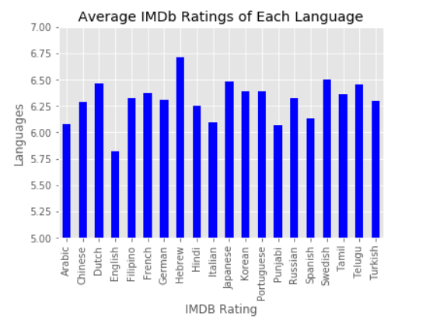
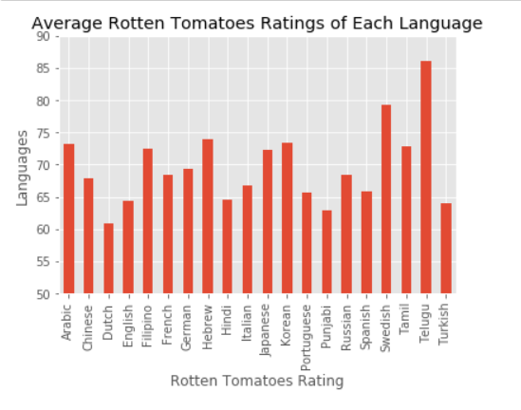

Slide 9

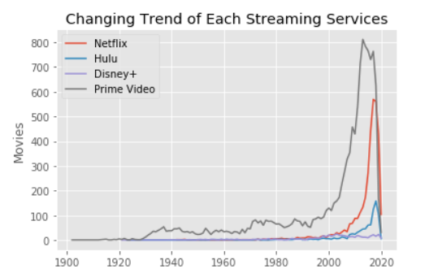
3. Did the year factor affect the number of streaming service collaborations?

Slide 10
4. Do streaming services focus on movie genres?

Slide 11
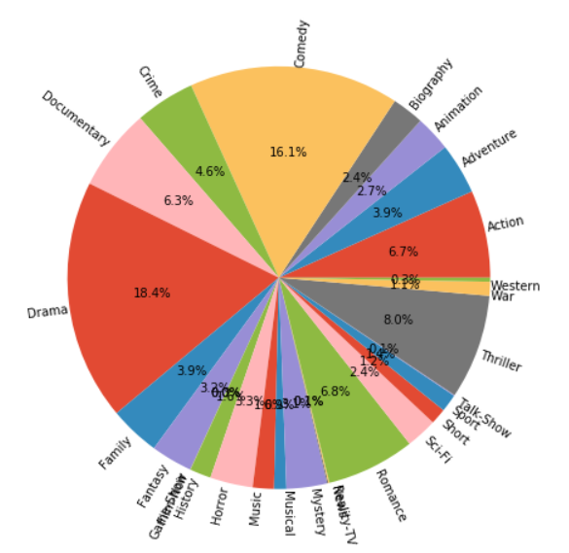
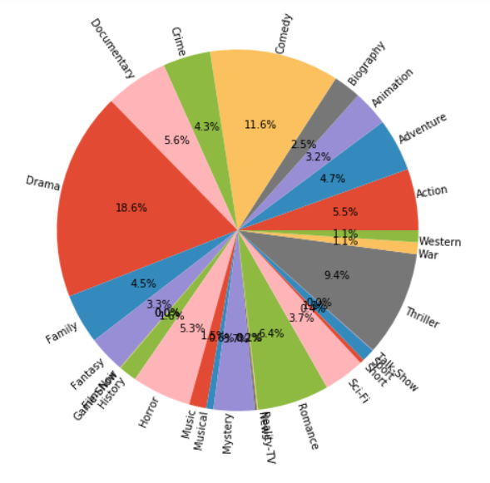
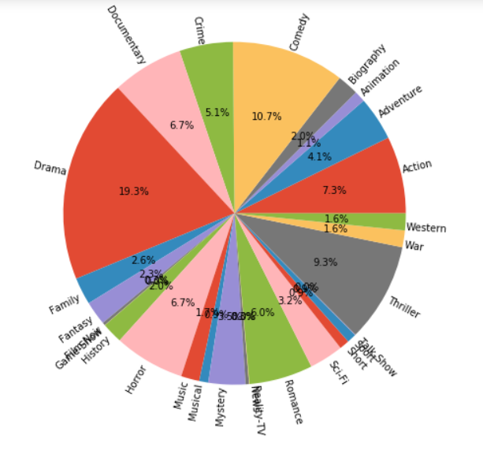
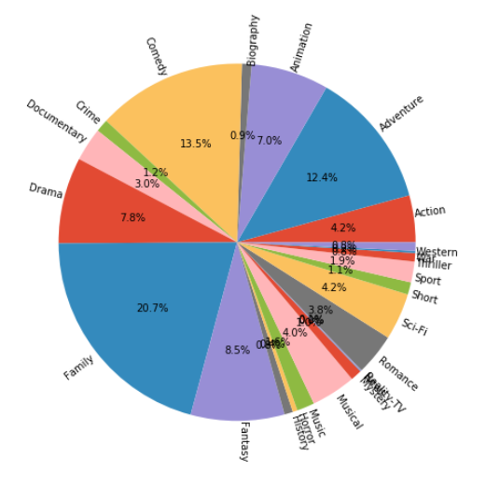
Netflix
Hulu
Prime Video
Disney+

Slide 12
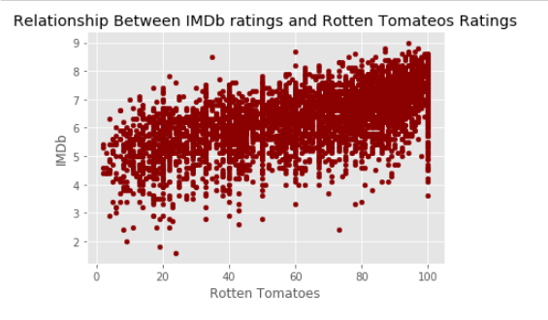

2. Ratings vs. ratings
Are there any differences between the IMDb rating and the Rotten Tomatoes?
IMDb Rotten Tomatoes
IMDb 1.00000 0.61632
Rotten Tomatoes 0.61632 1.00000

Slide 13
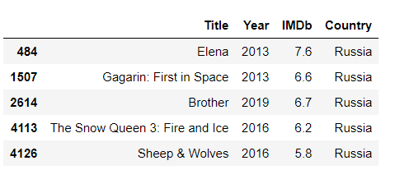
3. Culture matters?
Is there a difference in movie ratings based on cultural reviewer groups?
28 Movies

Slide 14

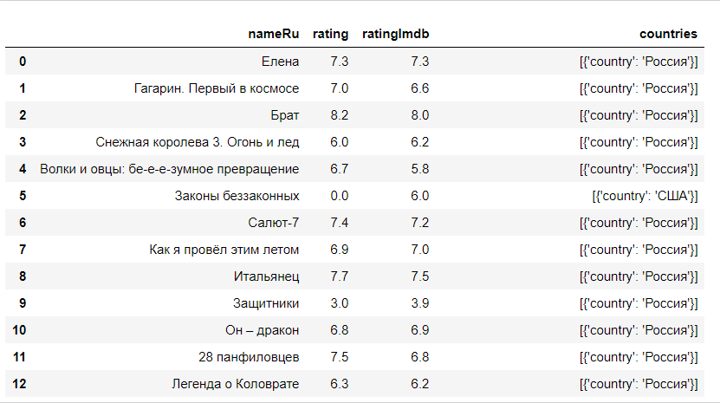

Slide 15
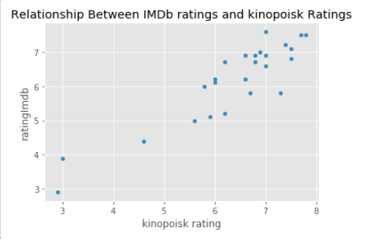
Rating RatingImdb
Rating 1.000000 0.947486
RatingImdb 0.947486 1.000000

Slide 16
4. Confirmed Conclusions
The four streaming services average ratings have differences.
IMDb and Rotten Tomatoes reviewers have different preferences on movies based on languages.
Disney+ provides totally different genres of movies.
Ratings are difference between rating websites, but the trends are the same, even across countries.

Slide 17
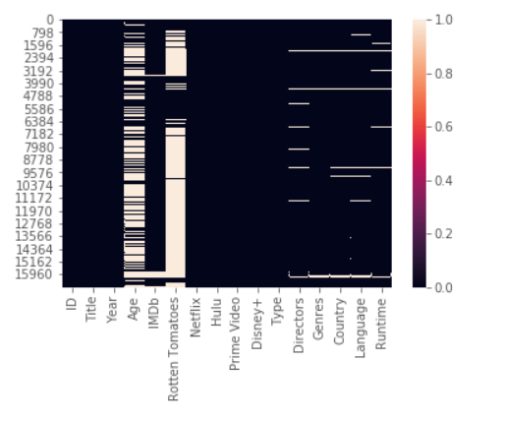
5. Challenges
Data Cleaning (link)
Limitation of Data
(missing values, numbers of data)
API using
Experiment Design

Slide 18
Thank you!
Pictures and other references
https://commons.wikimedia.org/wiki/File:Rotten_Tomatoes_logo.svg
https://www.prophethacker.com/2016/09/interesting-facts-about-computer.html https://en.wikipedia.org/wiki/KinoPoisk https://towardsdatascience.com/a-practical-guide-for-exploratory-data-analysis-movies-on-streaming-platforms-5ea494fee9d2 https://www.kaggle.com/ruchi798/movies-on-netflix-prime-video-hulu-and-disney https://www.lafabbricadellarealta.com/open-data-entertainment/ https://developers.themoviedb.org/3/getting-started/introduction https://www.youtube.com/user/rottentomatoes/featured https://en.wikipedia.org/wiki/IMDb#:~:text=Originally%20a%20fan%2Doperated%20website,as%2083%20million%20registered%20users https://www.pythonfordatascience.org/anova-python/ https://docs.scipy.org/doc/scipy/reference/generated/scipy.stats.f_oneway.html https://www.dataquest.io/blog/python-api-tutorial/

