Slide 1
Aleph Champ Go FISH / The Diver Game Design Document
Flux: learning experiences
Oct 2015

Slide 2
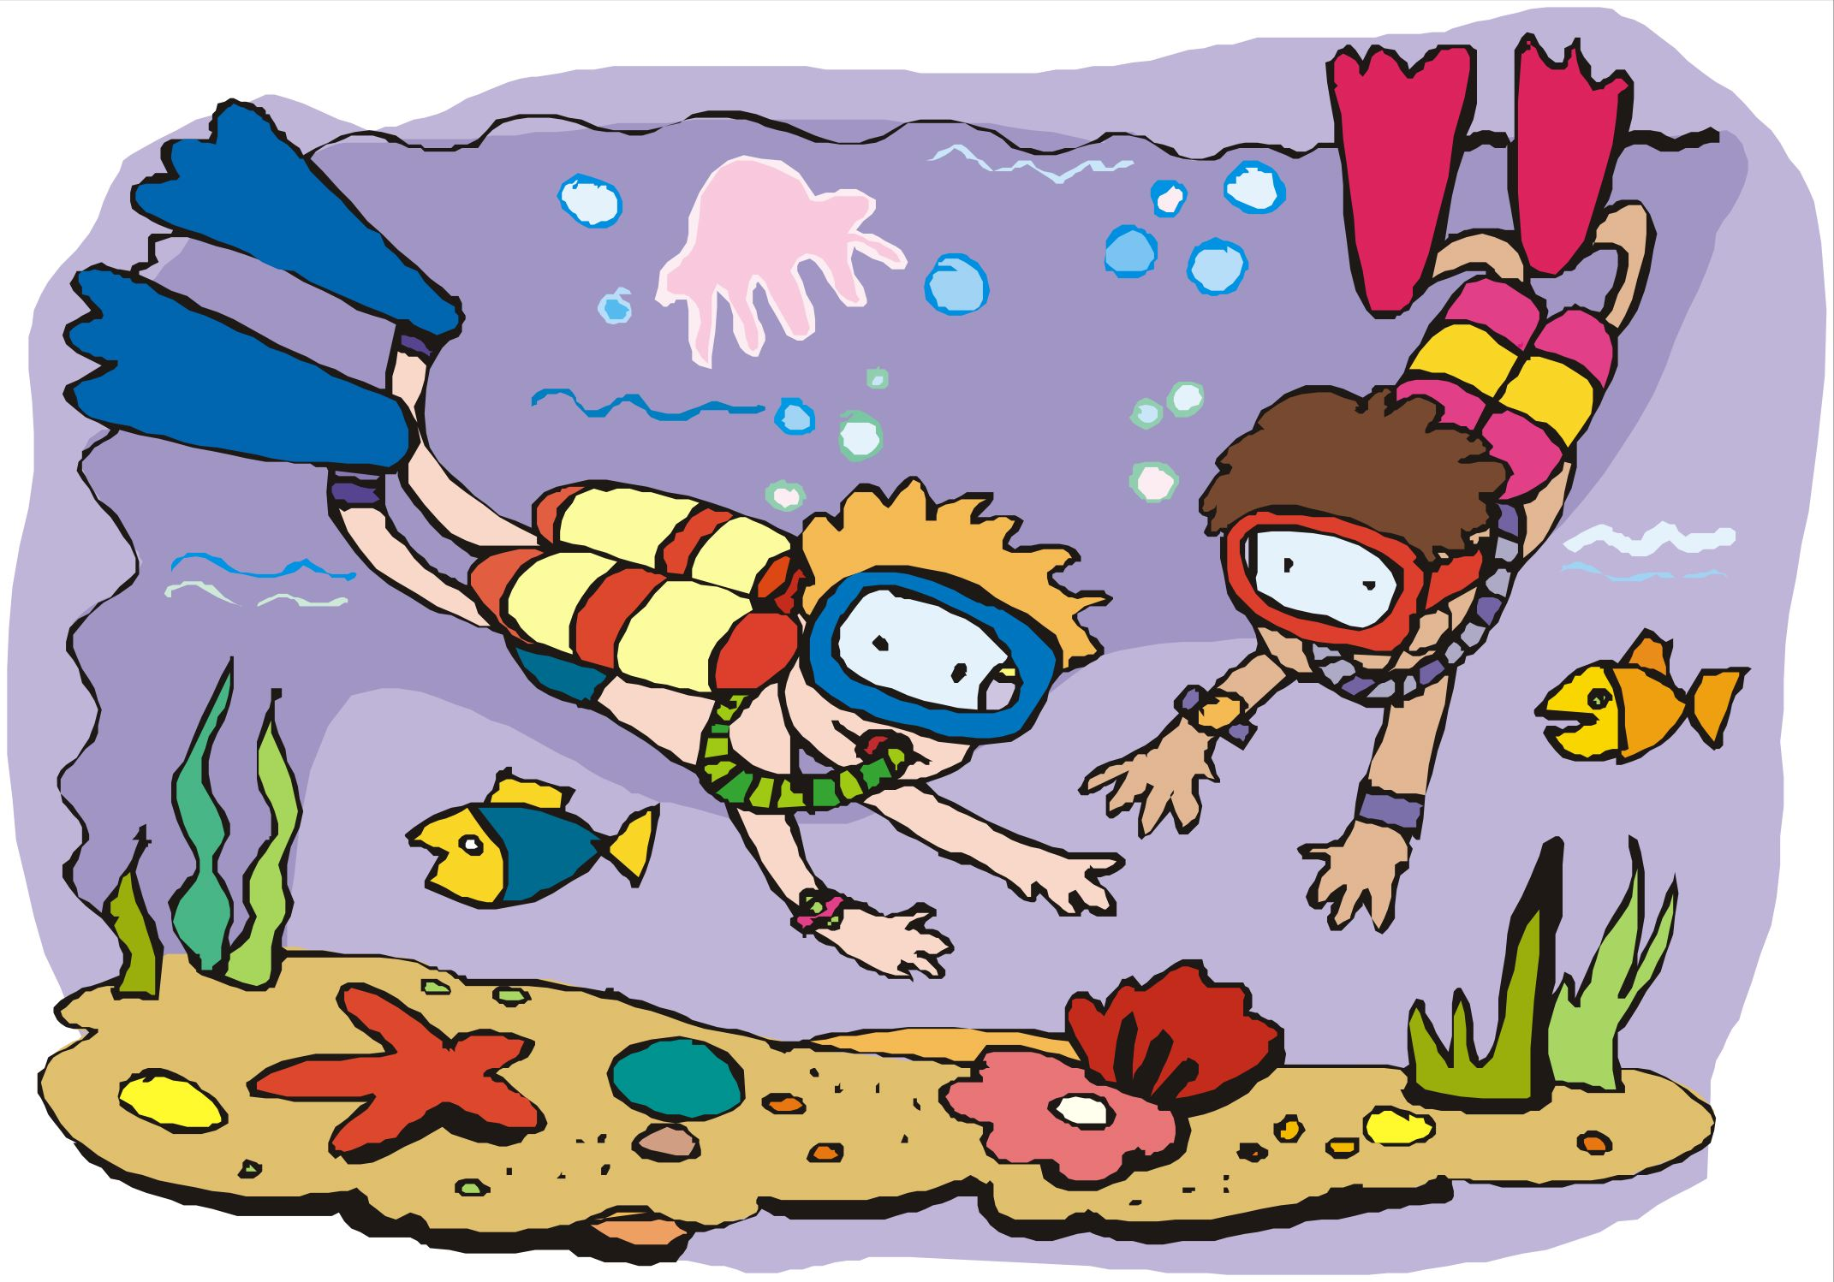
Story
Player is a beginner diver making their first steps in diving. They try discovering fish they don’t know, to learn more about. They release the fish after they do.
As they get better, they will dive further deeper into the ocean and:
Find more sea creatures: bigger, harder to catch, behave differently …
Get gear that would allow them to: see better, catch fish easier …
To dive deeper and open more worlds, they need to reach a certain score (number of dives + variety of fish they discovered)
Player will choose avatar (boy/ girl) they better identify with

Slide 3
Story
imagine yourselves as a beginner Diver exploring the sea for the first time. trying to find new fish and new extraordinary animals.
squids, fish, snakes, sea lions, etc - all will be there. everything should move and make sounds accordingly.
as you go deeper the silence is more felt and the light darkens.
player would need coins to buy more gear (flash light, air balloons, etc). this they would find in the game store (future feature).

Slide 4

Sea level
Find:
ב
Coins:
35
א
fish
ב
Ocean bottom

Slide 5
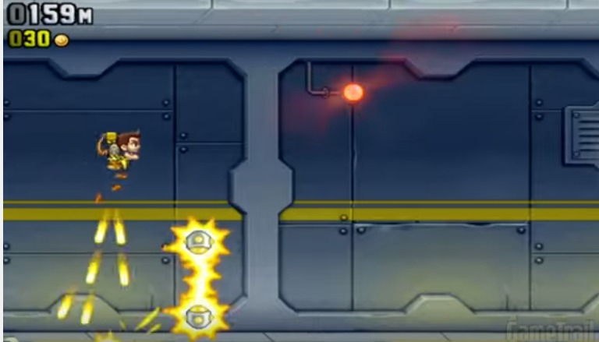
Gameplay
Level based runner gameplay
Get as much score as you can in the time you have
Scroller to the right (screen moves to the right in a constant speed)
5 tracks of possible game elements to show on
Each level is about 1-3 minutes long (depends on level design)
Player moves freely up/down/left/right
Player collects fish that has the letter/word they look for
Each correct fish gives score. Higher score for finding a new fish.
Each false pick gets a score penalty
Run into a blocker and you must restart
Powerups allow player boosts forward, forcefield, slowmo, break blocker
Streak (“on fire”): when player has a sequence of 5 correct pickups in a row, he will get score multiplier until they fail.
Gameplay reference: Jetpack Joyride

Slide 6
Sea level
Find:
ב
Coins:
35
א
fish
ב
Ocean bottom

Slide 7

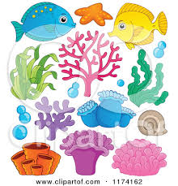
Game elements
fish
Player.
Moves in minimum speed to the right.
Controls: up and down, left and right.
Blocker.
If player hits it, they need to start over.
א
Letter fish.
Fish size according to the content size.
Player needs to get the right letter.
If they hit a wrong one, they get a score penalty.

Slide 8
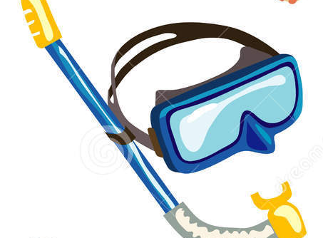

Game elements
powerup.
Helps player for a temporary period.
Player speeds up gradually during the time they have a powerup (until reaching 30% faster).
Reference: jetpack joyride vehicles
knife
See better and further
25% Faster +
50% bonus
score
Cut first blocker coming across

Slide 9
UI elements
Find:
ב
Find letter.
User needs to hit the fish with that letter on it.
The letter updates if the player found it.
Coins:
35
Coins .
Keeps score.
Score updates visually after the action.

Slide 10
Look and feel
Background:
Layered parallax (reference): Sea level and sea bottom. Each layer moves in a different speed related to the player’s speed.
Level progression changes the background as player goes deeper into the ocean.
Each letter means a different fish visual.
Sound fx of deep ocean:
More silent as level progress
Leviathans, dolphins, other squeaks and shrikes

Slide 11
Sea level
Find:
ב
Coins:
35
fish
5-
א
Bad letter
Score effects example
Good letter
10+
fish
ב
Ocean bottom

Slide 12
Animator
האנימציות יהיו מסודרות בspritesheets
האנימטור של כל אובייקט (דג / blocker) צריך לכלול אנימציה ל:
idle
hit
death/ disappear
האנימטור של הצוללן (שלא קיים עדיין) צריך לכלול:
idle (swimming)
catch good fish
catch bad fish
hit blocker

Slide 13
Scripts in the game
GameContent
Content[]
{
Text
Sound
}
Fish
Content
isCorrect
Blocker
Pattern
Difficulty
Elements[]
{
Source GameObject
Time
}
PatternsSequence
Patterns[]
Gap
DifficultyManager

Slide 14
Level design: randomized sequences
Each level is built from several pre-defined sequences of gameplay elements. These would be randomly presented to the player according to the difficulty level of the game.
The sequences are arranged manually in Unity editor (or from an external xml file- future optional task). Each sequence has a difficulty level.
Sequence example:
Row 1 , letter fish correct , 1.2 sec from last object
Row 3 , letter fish false , 2 sec from last object
Row 3 , blocker , 2.5 sec from last object

Slide 15
Level design sequences examples
Correct letter
False letter
Easy/ medium levels:
Hard levels:

Slide 16
Full EASY level example built from sequences
Correct letter
False letter

Slide 17
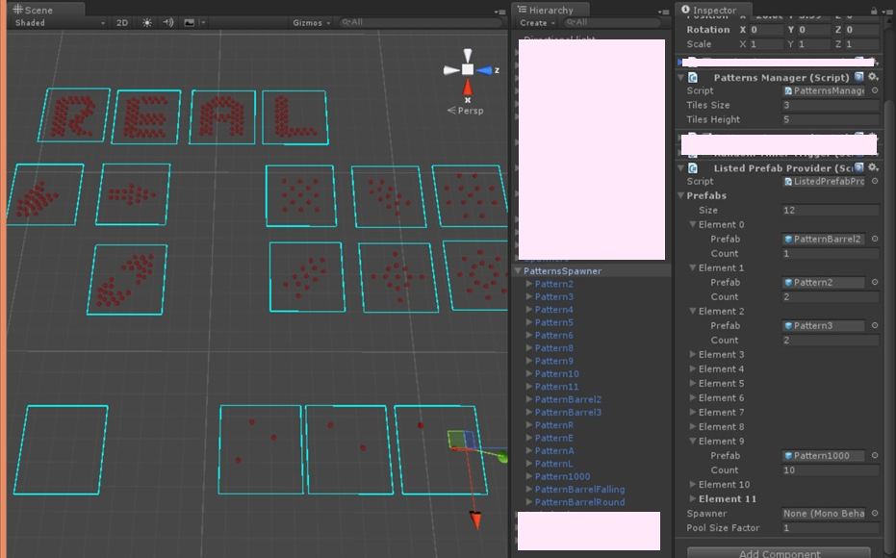
ToyZ : Level design patterns

Slide 18
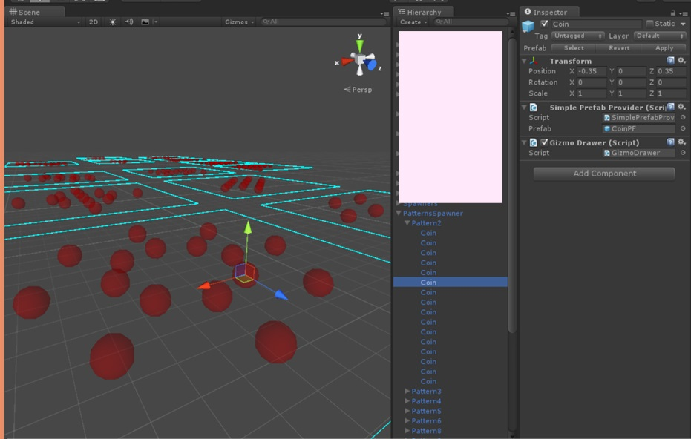
ToyZ : Level design patterns

Slide 19
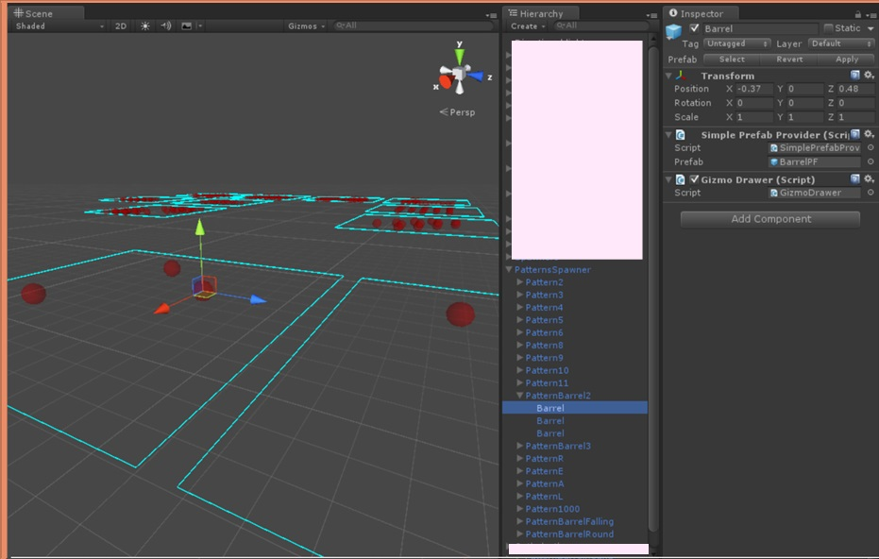
ToyZ : Level design patterns

Slide 20
Dynamic content for games
רמה 5
אבא
בגד
גמל
דבש
הבא
וניל
זאב
חרב
רמה 1
א
ב
ג
ד
ה
ו
ז
ח

Slide 21
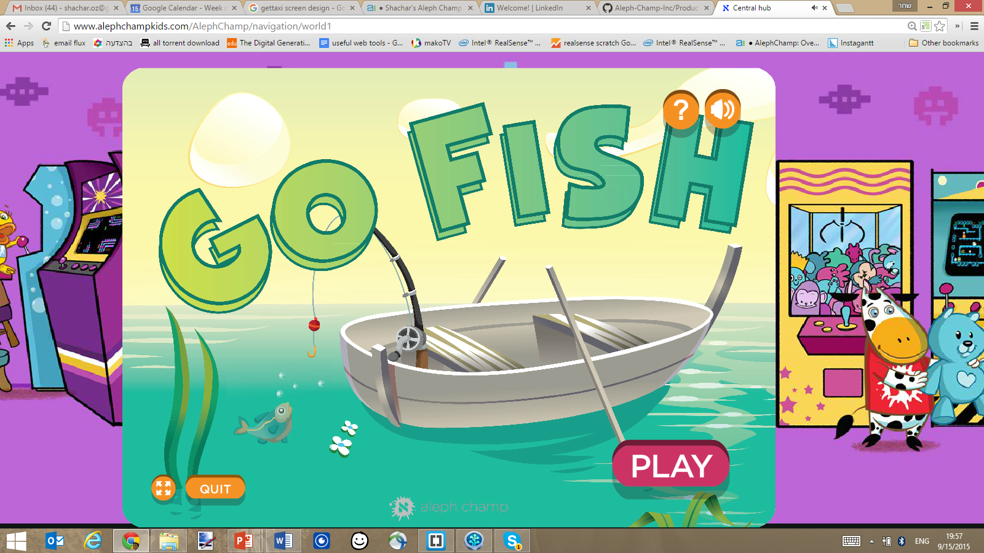
FULL SCREEN PICTURE
+
GAME TAGLINE (part of the image)
BACK TO ARCADE
START SCREEN
START
FULL SCREEN
ABOUT THE GAME

Slide 22
LEVEL SELECTION /
STORYLINE…
BACK TO HOME
LEVEL 1
LEVEL 2
LEVEL 3
LEVEL 4
LEVEL 5
LEVEL 6
LEVEL 7
LEVEL 8
LEVEL 5
LEVEL 10
LEVELS SCREEN
LEVEL 11
LEVEL 12
LEVEL 13
LEVEL 14
LEVEL 15
LEVEL 16
LEVEL 17
LEVEL 18
LEVEL 19
LEVEL 20
prev
next

Slide 23
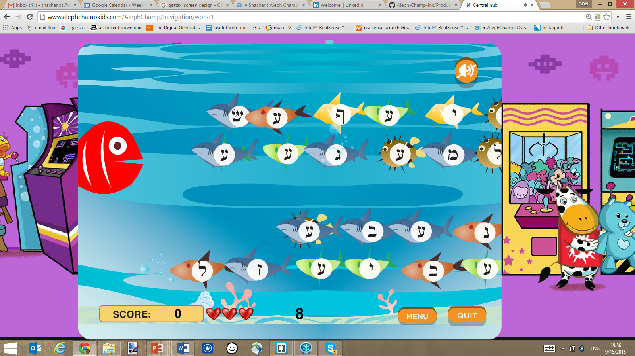
GAMEPLAY SCREEN
SCORE,
UI,
SOCIAL COMPONENTS (facebook),
GAMEPLAY ELEMENTS
GAMPLAY SCREEN

Slide 24
SUMMARY SCREEN
SCORE, RESULTS, STARS, REPLAY/NEXT
BACK TO HOME
SUMMARY SCREEN
NEXT LEVEL
REPLAY

Slide 25
Current situation

Slide 26
Current situation

Slide 27
Current situation

Slide 28
Current situation
Space between fish
Number of rows coming at the same time
Patterns for each level (optional)
Speed of fish
Score per fish
Score per mistake
Score bonus for combo (future feature)

