Slide 1
The Energy Saving Potential of Balancing PECS and Background system on Light under Changing Occupancy
– A Case Study on BEEHub Historical Data
25Fall BPS5231 AI for Sustainable Building Design
Kefan Chen, Guanli Feng
Nov 19, 2025

Slide 2
Problem Description
Methodology – Optimize control strategy, Create Dataset, Train surrogate model, Apply to physical case
Results

Slide 3
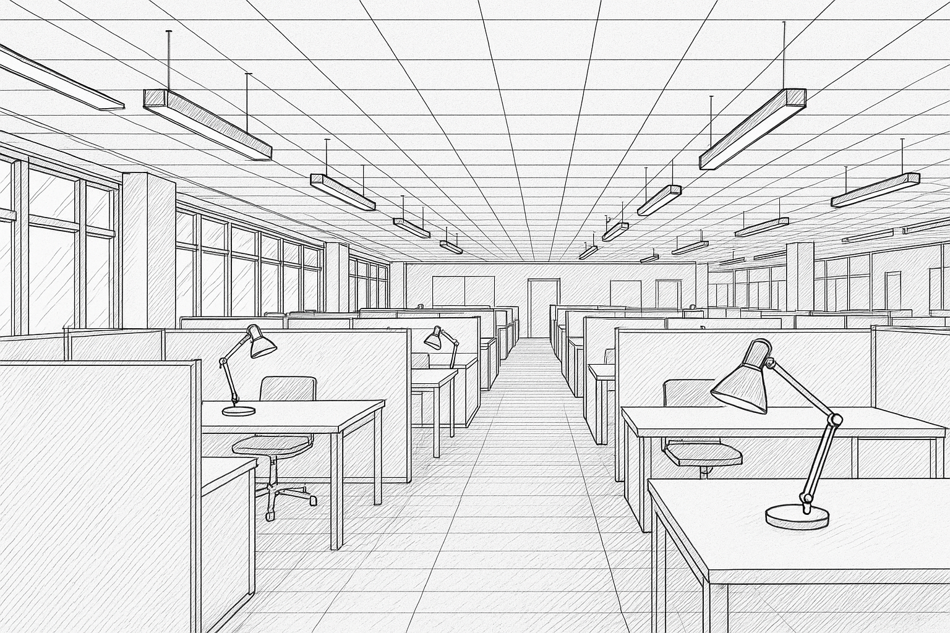
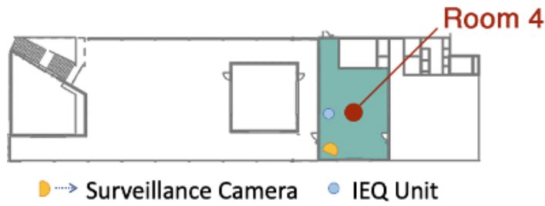
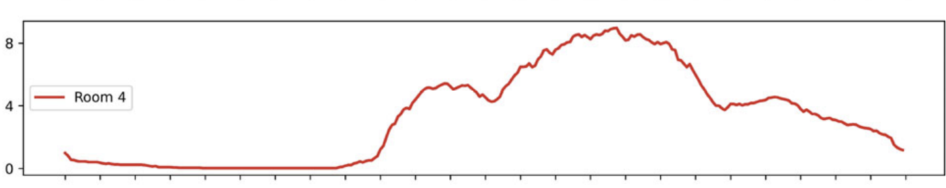
Problem Description
Problem Identification
Background system –> general space control
PECS –> micro-environment of occupants
➡️ And occupants come and leave
➡️ controlling strategy -- changing occupancy condition?
Research Question/Hypothesis
1 > Optimization on light control and energy?:
different occupant distribution
Balancing PECS and background system control on lighting
➡️ visual light comfort
⬇️ lighting energy consumption
2 > Case study on real occupancy historical data of BEE Hub:
Could we utilize ML tools (like surrogate model thinking) to apply such control strategy on different occupant distribution in an accurate and low time-consuming way? Then we could combine it with historical occupancy data to visualize its energy saving potential.
GPT5-generated diagram
Tekler, Z.D., Ono, E., Peng, Y. et al. ROBOD, room-level occupancy and building operation dataset. Build. Simul. 15, 2127–2137 (2022). https://doi.org/10.1007/s12273-022-0925-9
Notes:
The bg system is for general overall space control
PECS, that is .., like – desk fan, task light – is for micro-environment control of individuals – a question of how to balance using them
Meanwhile people come and leave the space, so we wanna explore a dynamic controlling strategy by simulation that if there’s a way to maintain visual light comfort and save energy consumption while occupancy condition keeps changing

Slide 4
Problem Description
Methodology – Optimize control strategy, Create Dataset, Train surrogate model, Apply to physical case
Results

Slide 5
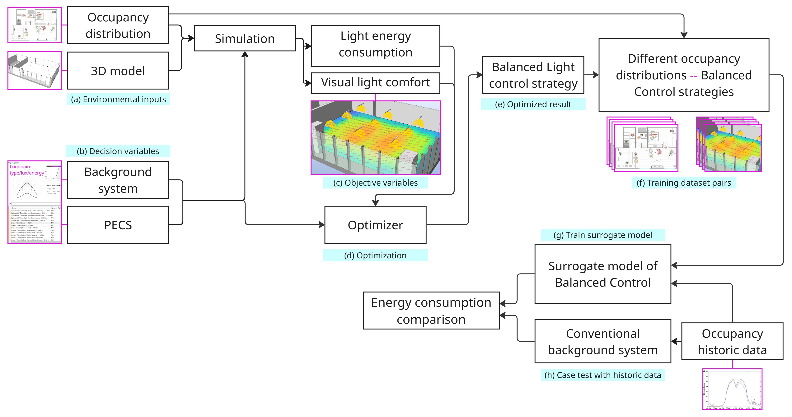
Methodology – Optimize control strategy, Create Dataset, Train surrogate model, Apply to physical case

Slide 6
Methodology – Optimize control strategy, Create Dataset, Train surrogate model, Apply to physical case

Slide 7
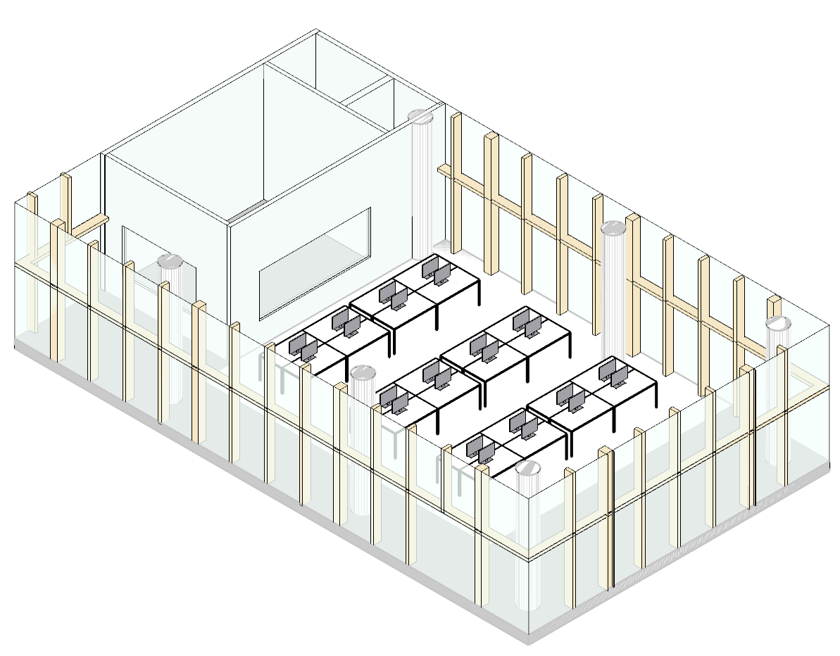

Methodology – Optimize control strategy, Create Dataset, Train surrogate model, Apply to physical case
(a) Environmental inputs of BEE Hub
Occupancy distribution:
Randomly generate occupant distribution on designed seats (max possibility= 2^n, n = 24)
3D model:
BEE Hub
Notes:
For env input, they are occupancy distribution and 3D space model

Slide 8
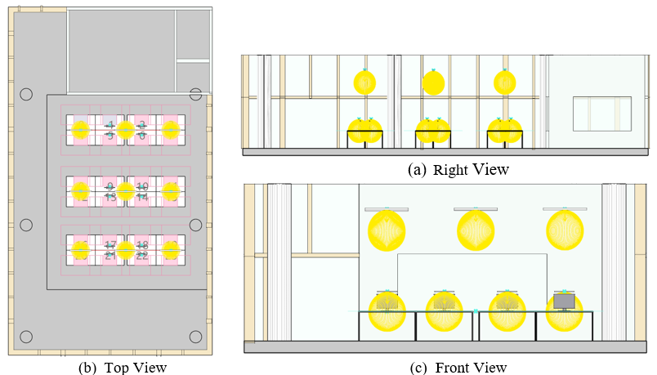
Methodology – Optimize control strategy, Create Dataset, Train surrogate model, Apply to physical case
(a) Environmental inputs of BEE Hub
Occupancy distribution:
Randomly generate occupant distribution on designed seats (max possibility= 2^n, n = 24)
3D model:
BEE Hub
Notes:
And basic layout is like this. U can see the tables, the ceiling lights, and table task lights

Slide 9
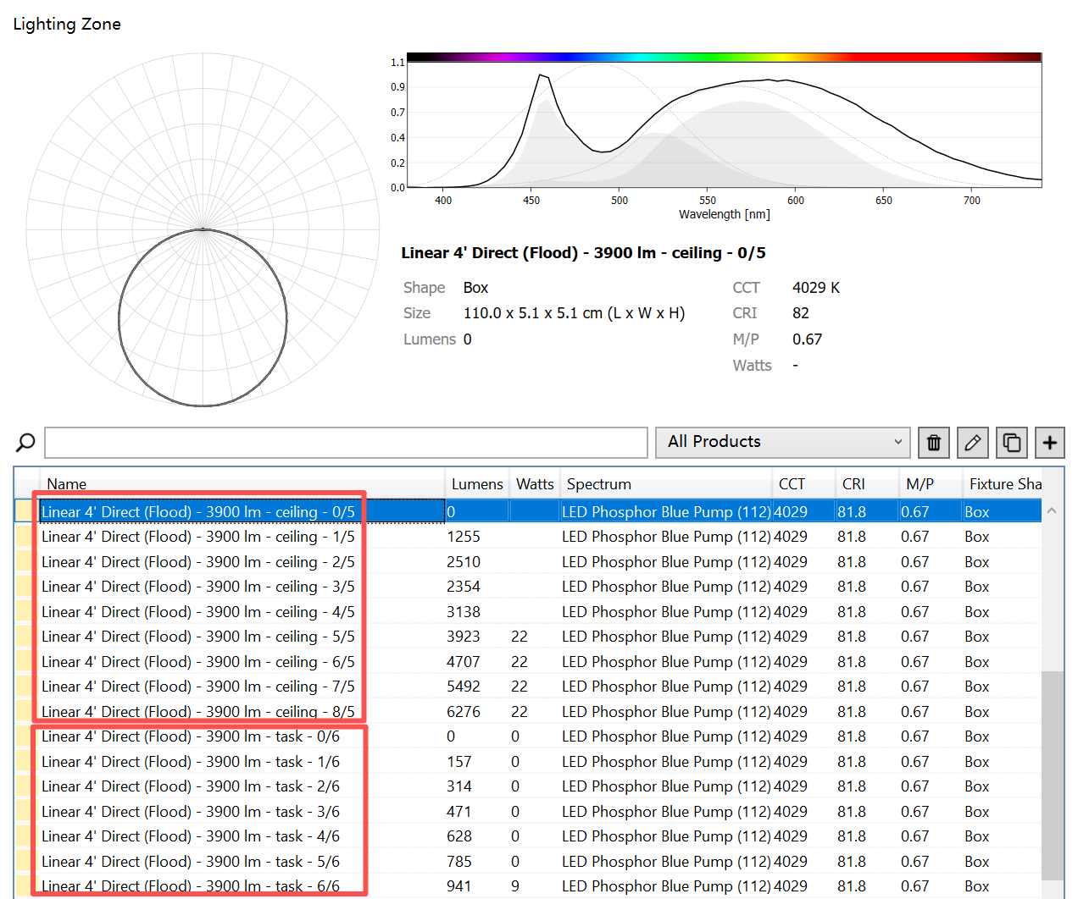
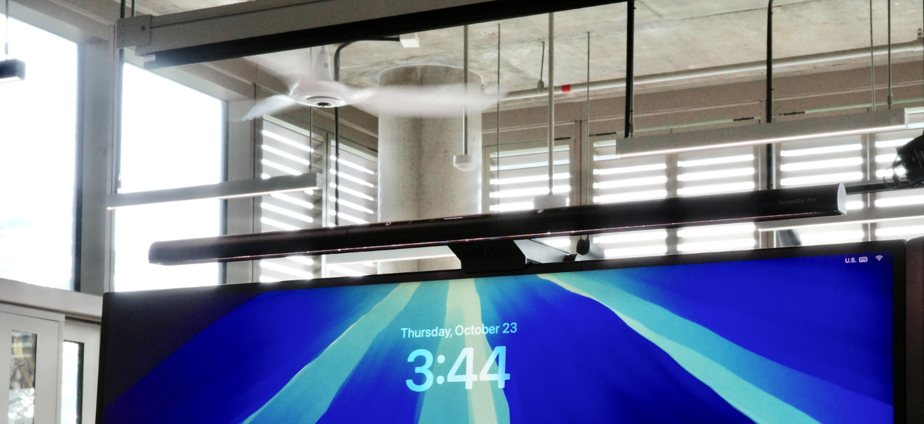
Methodology – Optimize control strategy, Create Dataset, Train surrogate model, Apply to physical case
(b) Decision variables
Background system & Task light:
Level inputs of ceiling and task lights – Lumen & Power
Notes:
For decision variables which we wanna find best setings, they are the light level of ceiling light and table task light
The two types light that we are currently using are both with very low energy standard so we took them as example. All power and lumen data we use for simulation are from official booklet

Slide 10
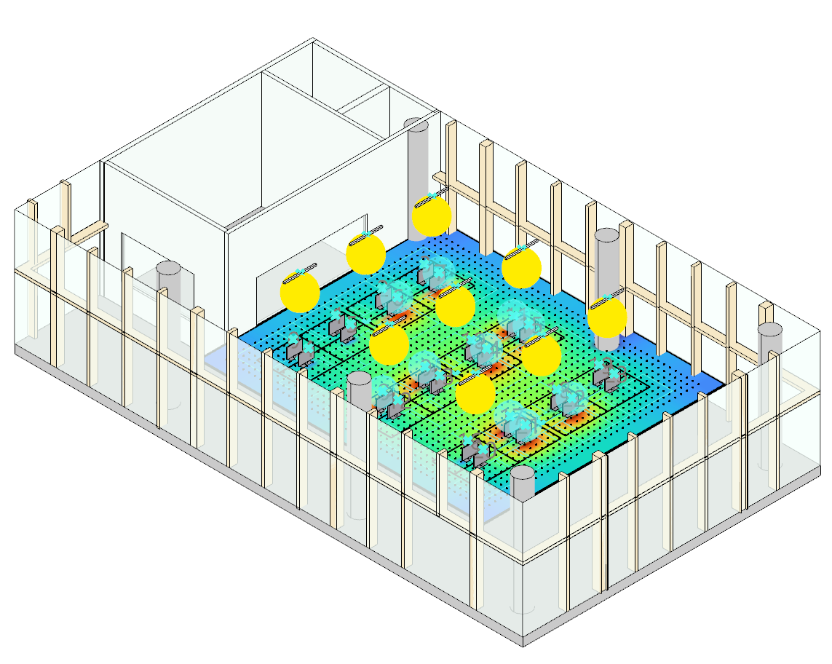
Methodology – Optimize control strategy, Create Dataset, Train surrogate model, Apply to physical case
(b) Decision variables
Background system & Task light:
Level inputs of ceiling and task lights – Lumen & Power
Notes:
So we could put all factors and start simulating

Slide 11
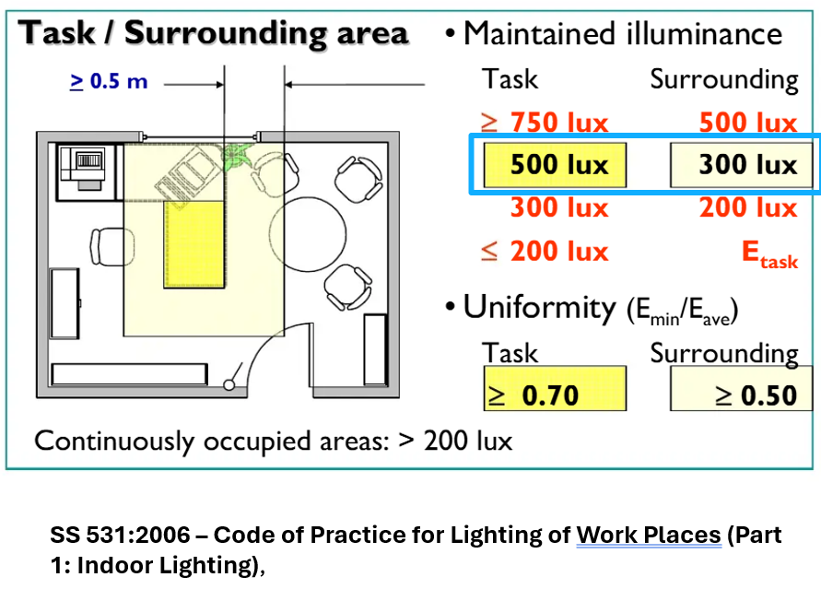
Methodology – Optimize control strategy, Create Dataset, Train surrogate model, Apply to physical case
(c) Objective variables
Light energy consumption:
The parameter that we want to minimize
Visual light comfort:
Quantify from electric lighting simulation
The restriction we need to follow
Notes:
The objective variable that we do optimization based on is the energy consumption and light comfort. Here is how to calculate comfort, the work surface illuminance and uniformity

Slide 12
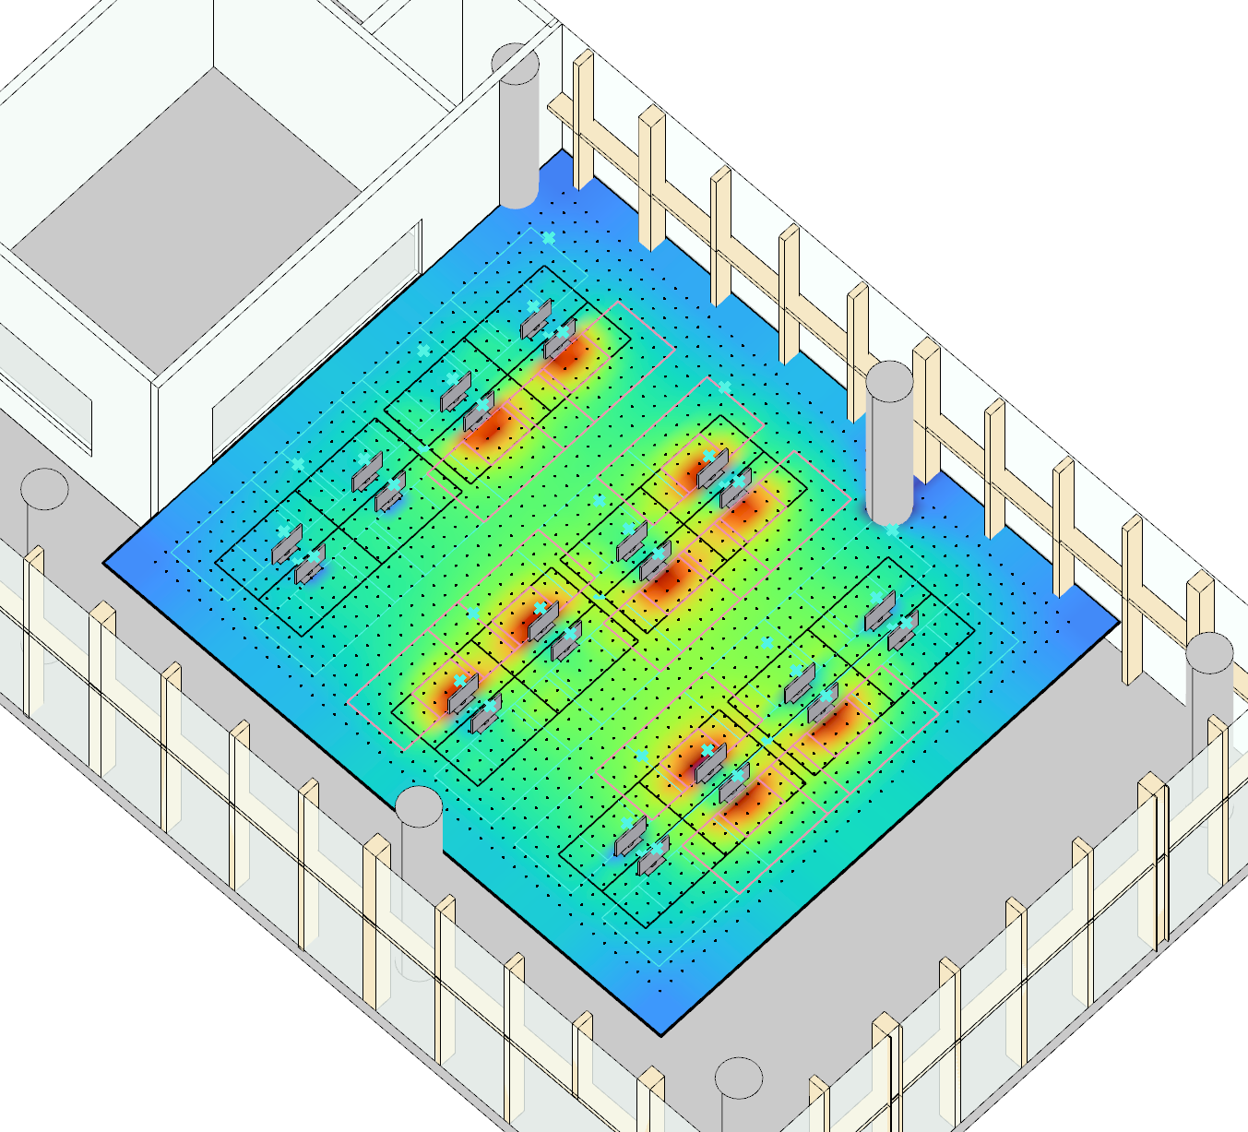

Methodology – Optimize control strategy, Create Dataset, Train surrogate model, Apply to physical case
(c) Objective variables
Light energy consumption:
The parameter that we want to be lower
Visual light comfort:
Quantify from electric lighting simulation
The restriction we need to follow

Slide 13
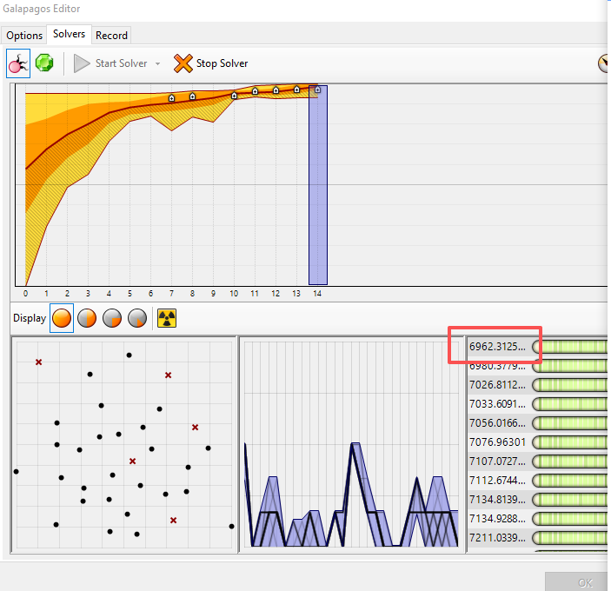
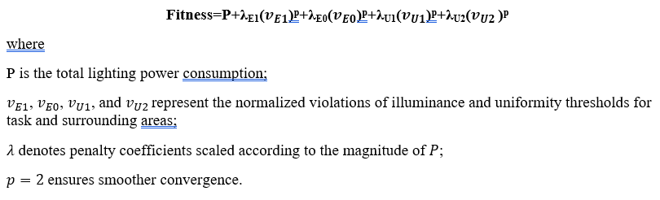
Methodology – Optimize control strategy, Create Dataset, Train surrogate model, Apply to physical case
(d) Optimization
Min(Power + Penalty (luminance and uniformity))
Galapagos Algorithm
Notes:
we combine the power with comfort result. The comfort part works as the penalty term, then we get such formulation. Then we use Galapagos in gh to minimize the total sum by search the best way of controlling all the lights

Slide 14
Methodology – Optimize control strategy, Create Dataset, Train surrogate model, Apply to physical case
(e) Optimized result
The balanced light control strategy based on inputted occupant distribution
Notes:
So it’s like the ceiling light will affect different and how to arrange them in a better way
Then we can results, and output them as one training pair

Slide 15
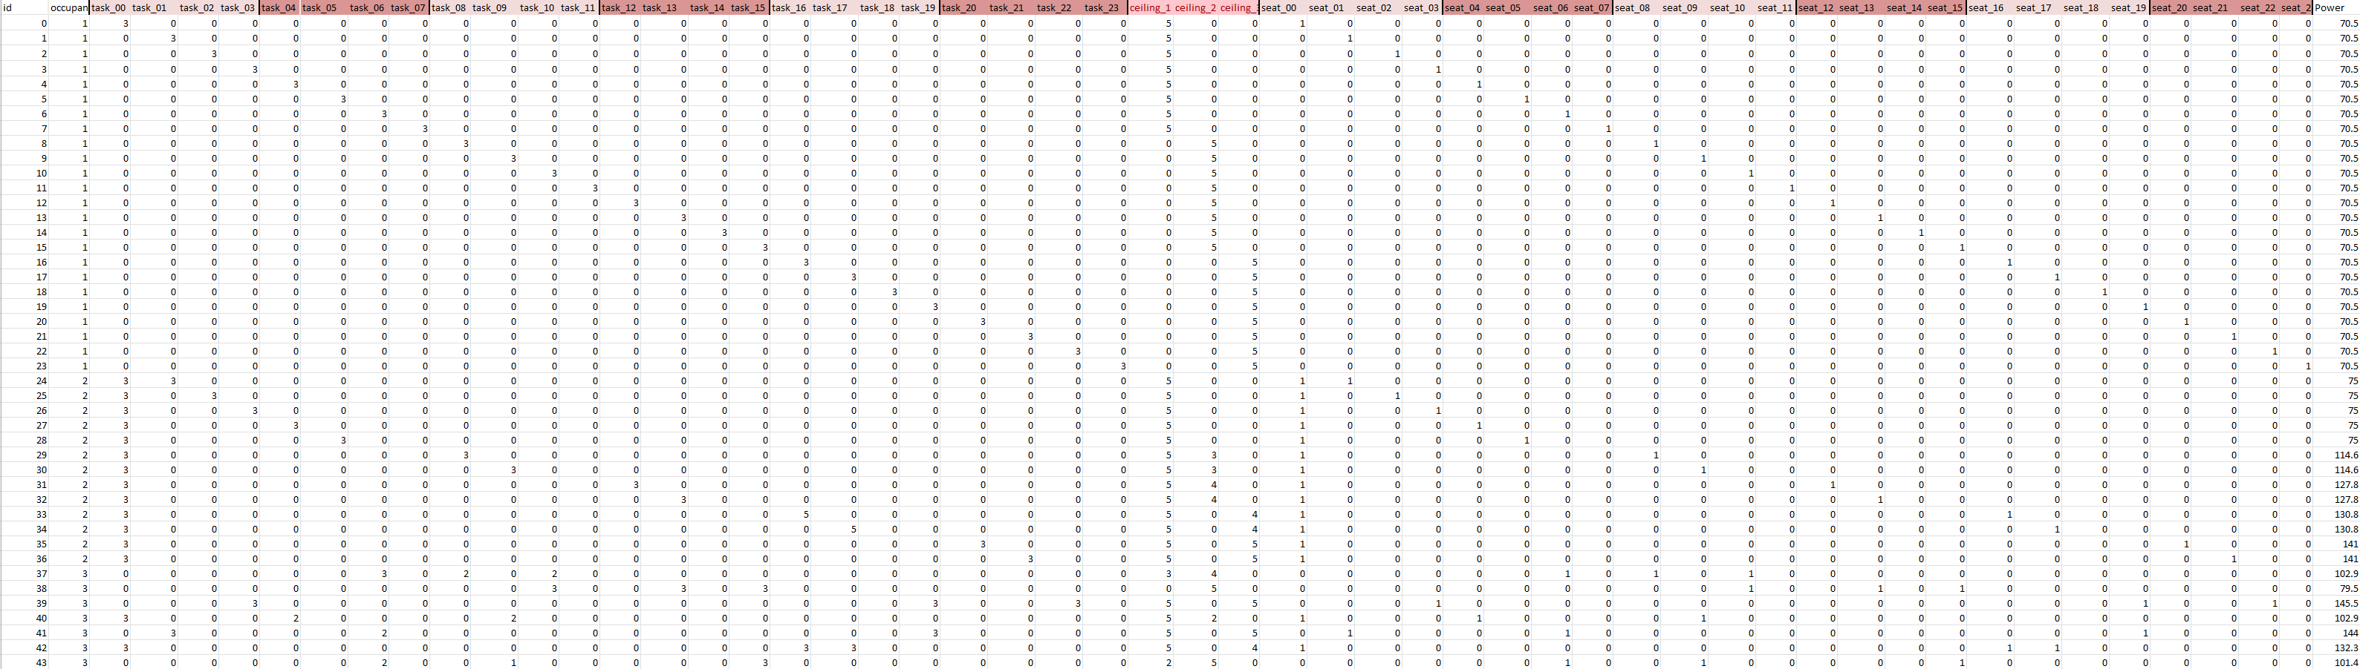
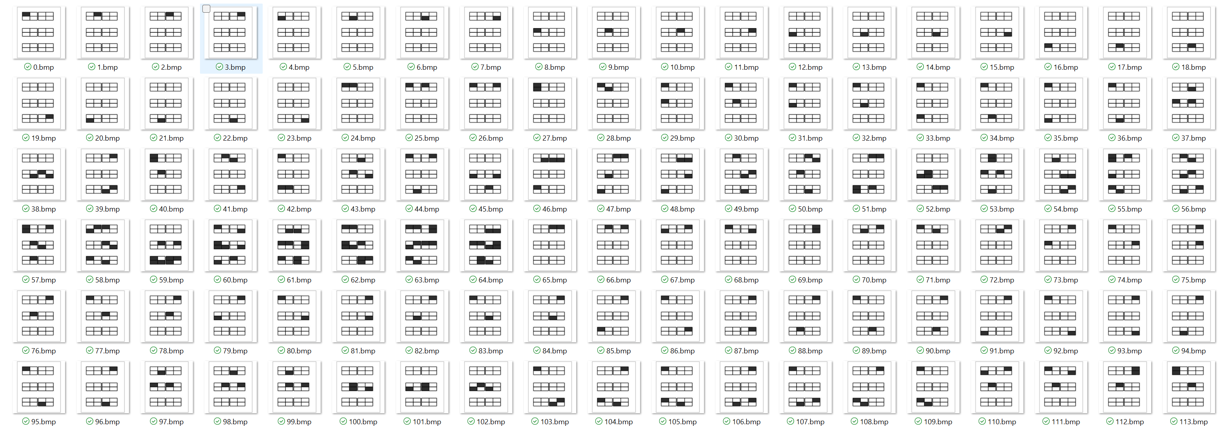
Methodology – Optimize control strategy, Create Dataset, Train surrogate model, Apply to physical case
(f) Training dataset pairs
The balanced light control strategy based on inputted occupant distribution (1094 pairs)
Lighting control – Occupant distribution
Notes:
Later we loop the process and get the over 1k training dataset pairs, that are the occupant distribution and the corresponding light control

Slide 16
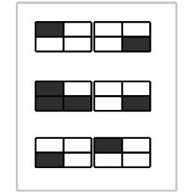
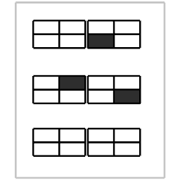
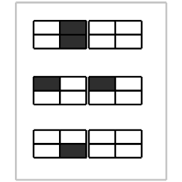
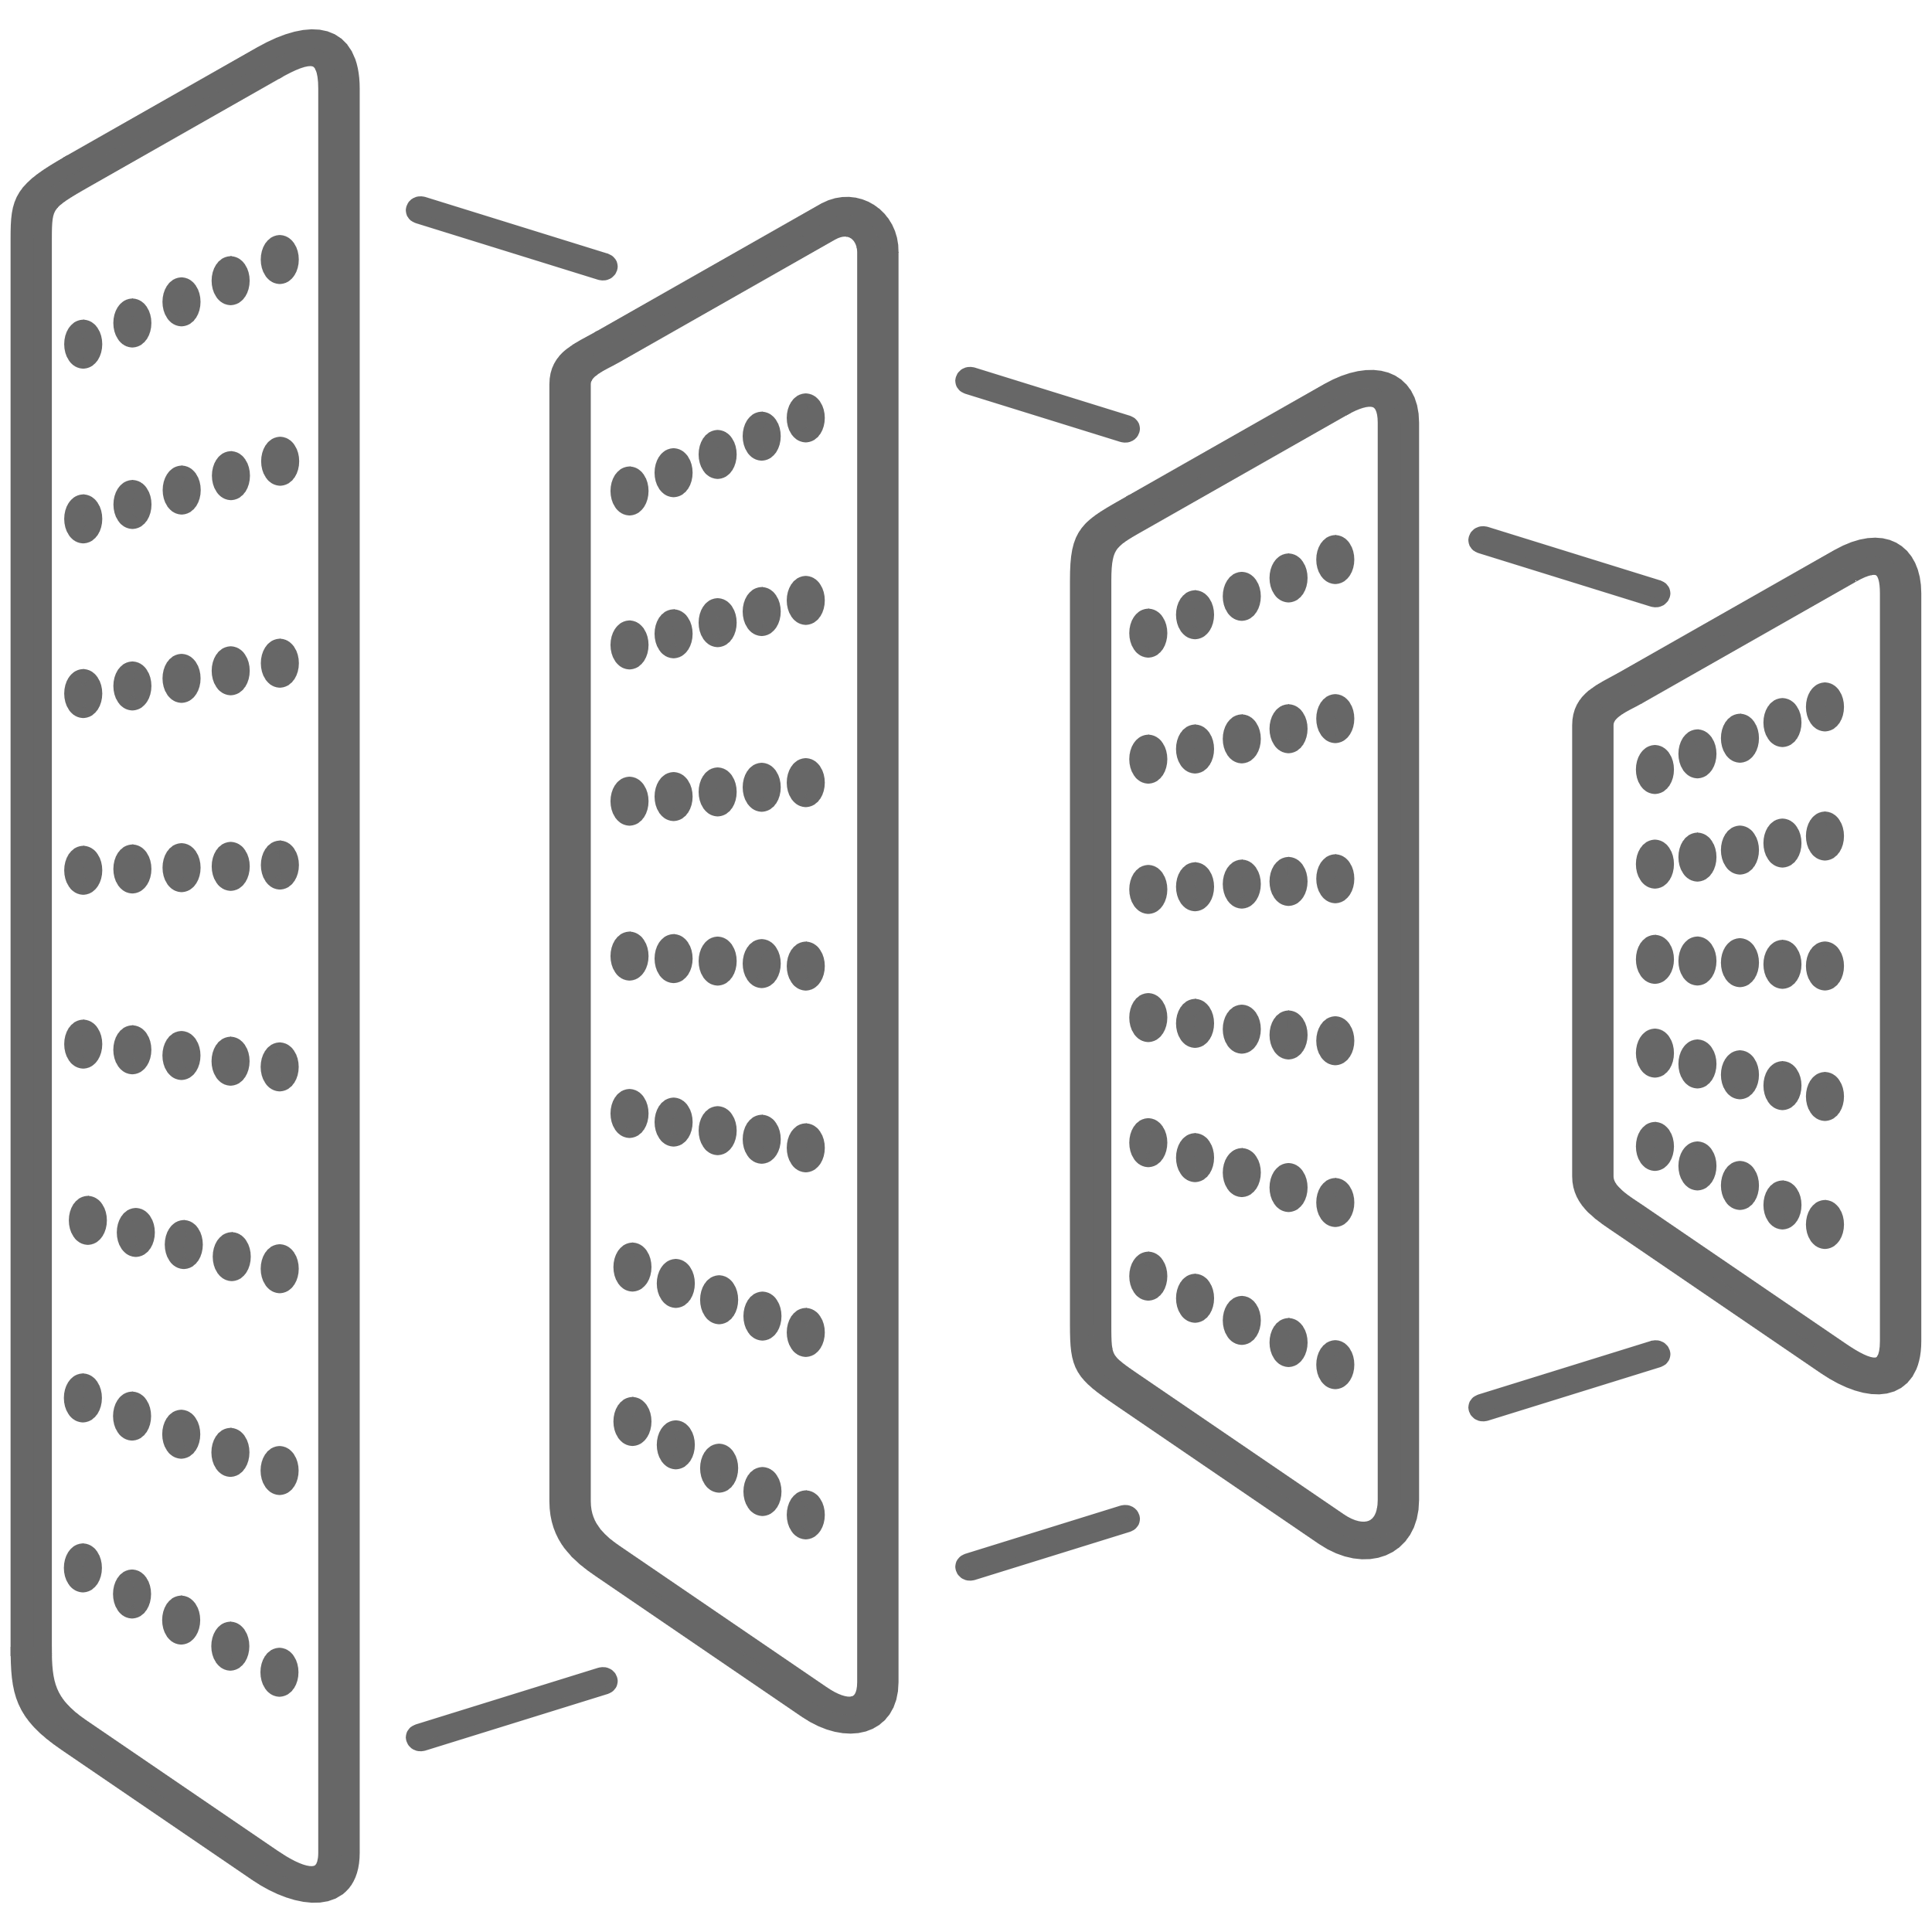
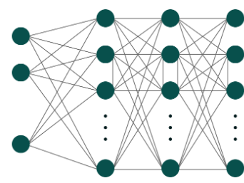
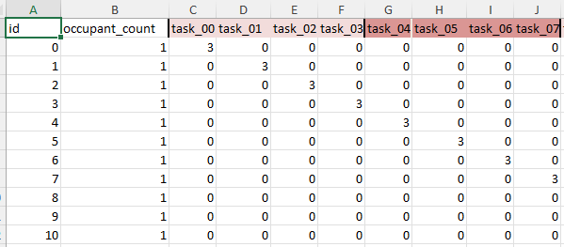
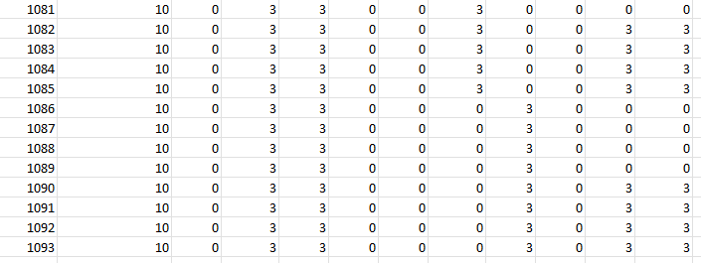
Methodology – Optimize control strategy, Create Dataset, Train surrogate model, Apply to physical case
Image Input:
RGB Plan image of seat occupancy
(g) Train surrogate model
Tabular Input:
Occupant Count + Seat Occupancy
Notes:
Multimodal deep learning model
Image part: CNN
Tabular part: MLP
Fusion MLP

Slide 17
Methodology – Optimize control strategy, Create Dataset, Train surrogate model, Apply to physical case
Image Branch:
Maxpool
Maxpool
3 features 256*256
128*128
64*64
Maxpool
Flatten
AdaptiveAvgPool
(g) Train surrogate model
1024 features
64 features 4*4
32*32
Notes:
3 channels of RGB
Several steps of Conv. & Pooling to 1024 features

Slide 18
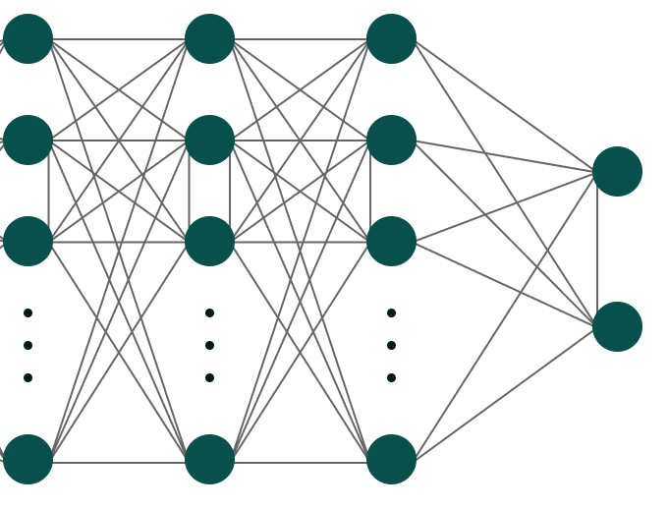
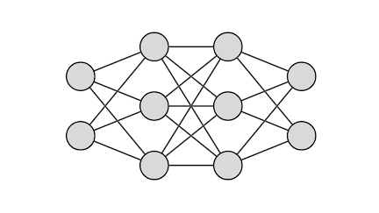
Methodology – Optimize control strategy, Create Dataset, Train surrogate model, Apply to physical case
Tabular Branch:
25 dimensions: occupant_count + occupancy at 24 seats
Fusion MLP:
1088
256
128
28
Feature Embedding
1024 features
(g) Train surrogate model
Outputs: 24 task illuminance levels + 3 ceiling light illuminance levels + power
64 features
Notes:
Tabular data: feature embedding to 64 features
1088 features to MLP
28 outputs

Slide 19
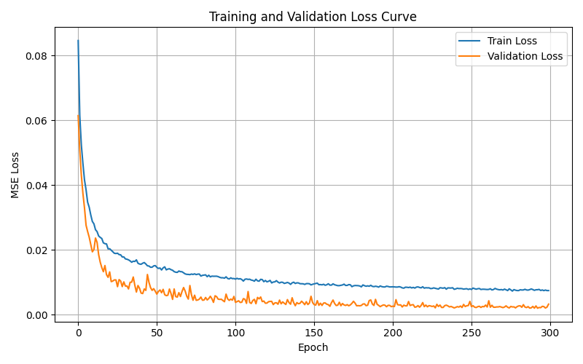
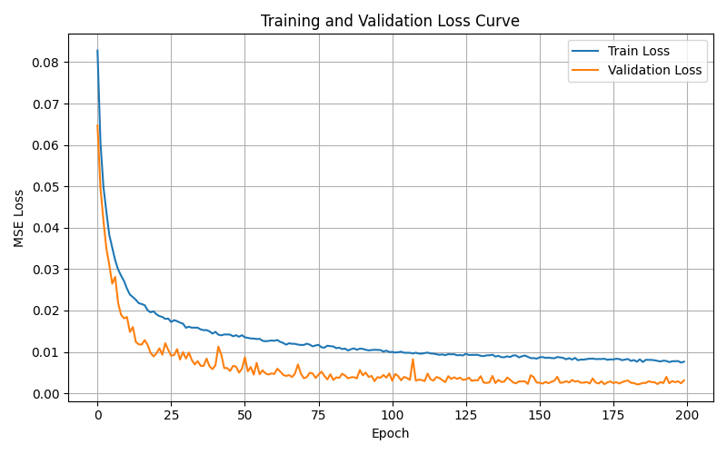
Methodology – Optimize control strategy, Create Dataset, Train surrogate model, Apply to physical case
BATCH_SIZE = 32
NUM_EPOCHS = 300
LEARNING_RATE = 1e-3
VAL_SPLIT = 0.2
BATCH_SIZE = 32
NUM_EPOCHS = 200
LEARNING_RATE = 1e-3
VAL_SPLIT = 0.2
(g) Train surrogate model
Optimizer: Adam
Loss Function: MSE
Notes:
Epoch = 300, convergence goes well

Slide 20
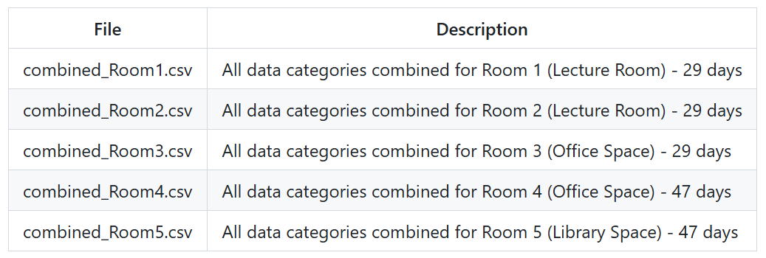
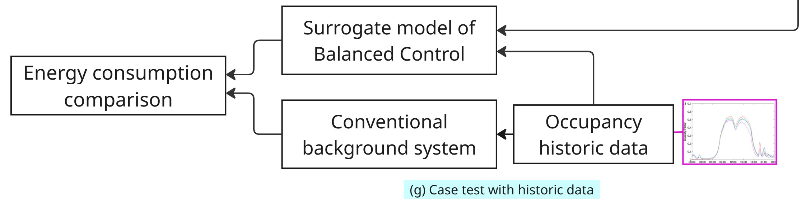
Methodology – Optimize control strategy, Create Dataset, Train surrogate model, Apply to physical case
Average occupant count for BEE Hub on an average day. Tekler, Z.D., Ono, E., Peng, Y. et al. ROBOD, room-level occupancy and building operation dataset. Build. Simul. 15, 2127–2137 (2022). https://doi.org/10.1007/s12273-022-0925-9
(h) Case test on historical data
The occupancy data of BEE Hub (link)
Then apply trained surrogate model and compare the energy performance with solely use background light
Notes:
Use the actual occupancy data to test the results

Slide 21
Problem Description
Methodology – Optimize control strategy, Create Dataset, Train surrogate model, Apply to physical case
Results – Saving potential

Slide 22
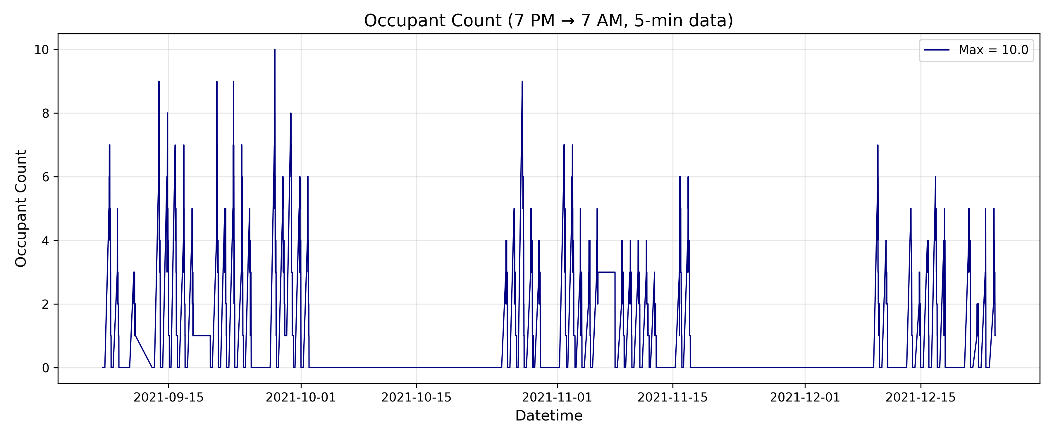
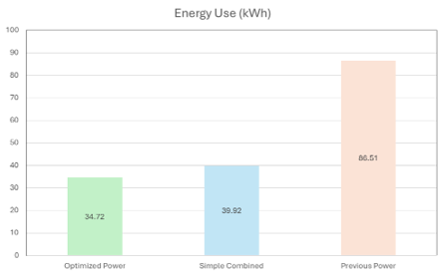
Results – Saving potential
Occupancy could be high in some nights at BEE hub
Maximum occupancy of seats is 10 during the study period
Total energy use: Optimized power from 39.92 kWh to 34.72 kWh in 285 hours in total
Tekler, Z.D., Ono, E., Peng, Y. et al. ROBOD, room-level occupancy and building operation dataset. Build. Simul. 15, 2127–2137 (2022). https://doi.org/10.1007/s12273-022-0925-9

Slide 23
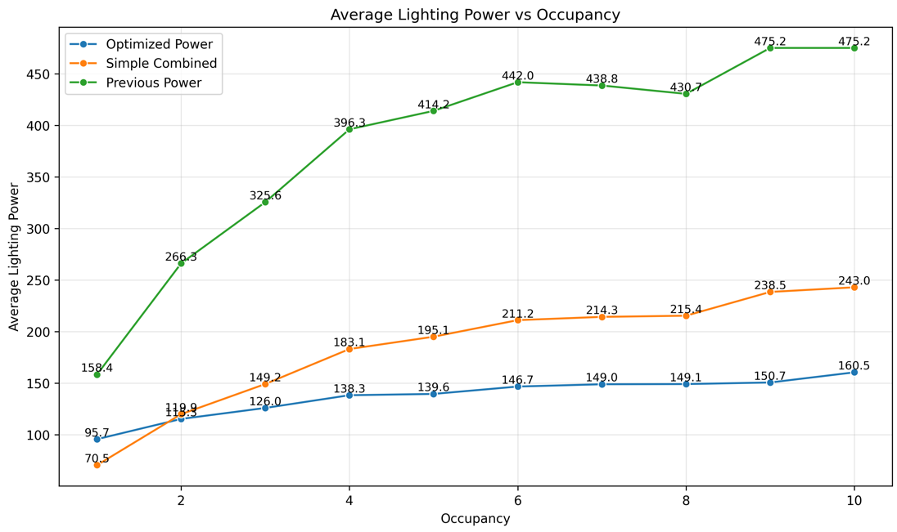
Results – Saving potential
Previous Power: ceiling light control only
Simple Combined: 5-level desk light + 3-level ceiling light at the seats occupied
Optimized Power: Prediction by ML model
Conclusion:
Compared to previous power, simple combined and optimized power can significantly decrease the lighting power (55.5% and 68.3% respectively)
Optimized Power generally performs better than Simple Combined except 1-person occupancy.

Slide 24
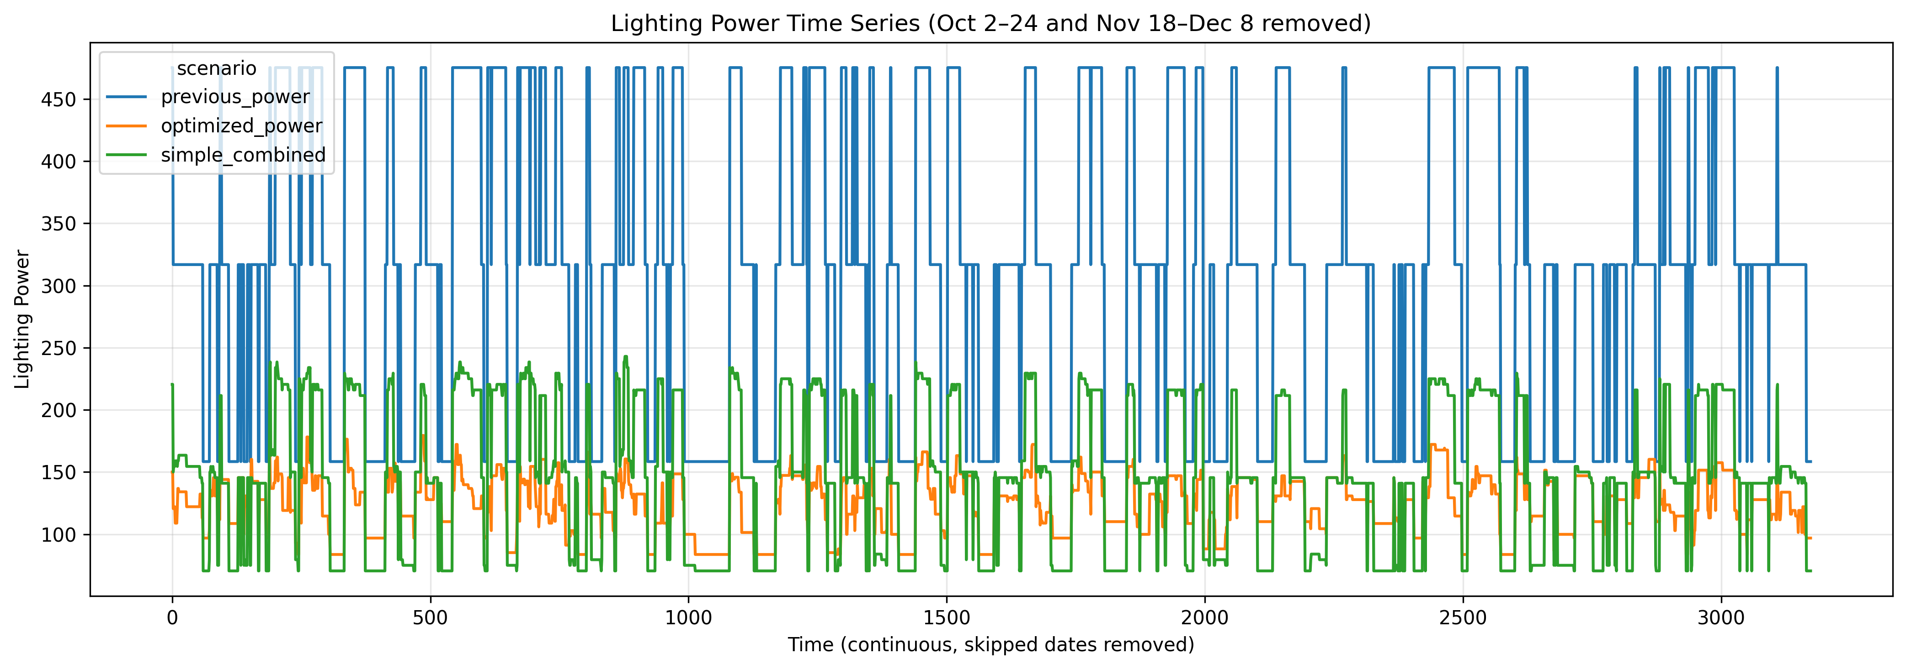
Results – Saving potential
Overall the Optimized Power perform better than the other two.
Limitation: The predictions at low occupancy are often not optimal.
Future work: fix the inaccuracy at lower occupancy; incorporate daylighting simulation

Slide 25
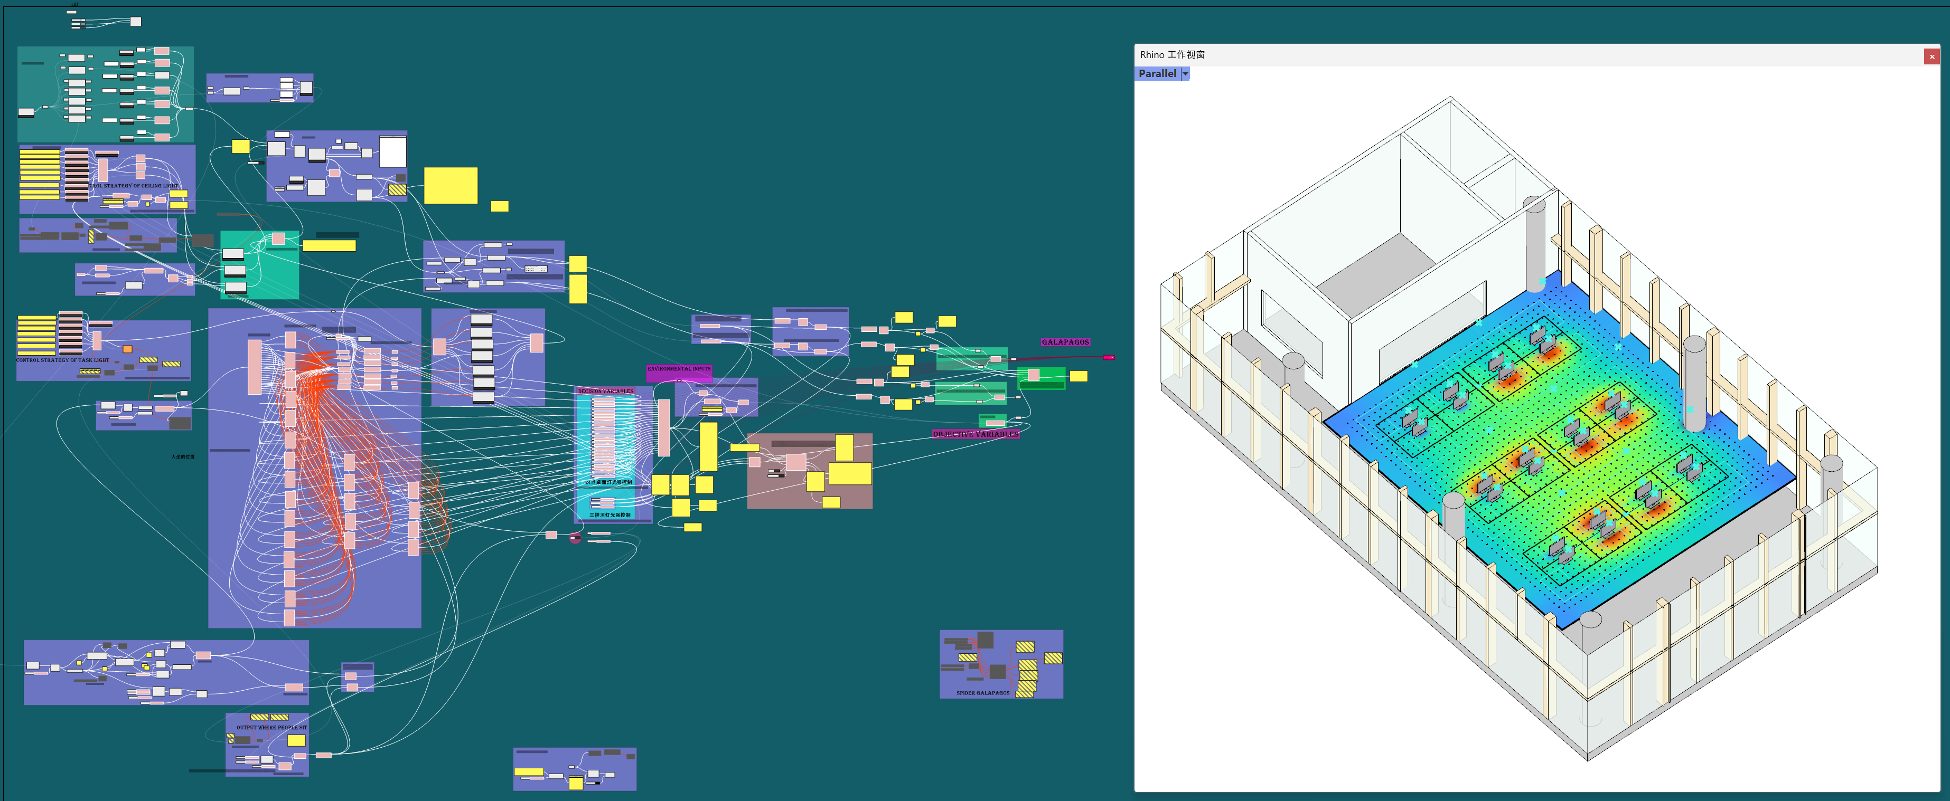
Thanks:)

