Slide 1

Why Rust?
chen@rotemlevy.name
Sayeret Lambda meetup
2017-07-16
Why Rust?
chen@rotemlevy.name
Sayeret Lambda meetup
2017-07-16
Notes:
We are in a Python's meetup
There are lots of other languages
Image: https://blenderartists.org/forum/showthread.php?362836-Rust-language-3D-logoby Yarick Antonov (Nylithius)

Slide 2

chen@rotemlevy.name
chen@rotemlevy.name
Nerd since 1968
Computer geek since 1978
Notes:
A nerd since 1968, a computer geek since 1978, GNU/* fan-boy since 1998
Started writing BASIC on Commodore PET, poked and peek my way around the Commodore 64, wrote Logo, Pascal, C, C++, Bash, Emacs Lisp. Currently writing
Currently coding with Python @ SentinelOne ([[https://sentinelone.com/jobs/][we are hiring]])
Tried to learn lisp(s) several times (and almost got it), tried Haskell (but did not get it), and now learning Rust, enough to see how cool it is, and perhaps share the good word about it.
.

Slide 3

WHAT IS RUST?
WHAT IS RUST?
Notes:
Ferris – unofficial mascot of Rust
Image: http://www.rustacean.net/ (cc-0)

Slide 4
Rust is a SYSTEM's programming language that has the
SPEED and CONTROL of a low level language but with SAFETY and ERGONOMICS of a high level language
Notes:
The dichotomy between safety and speed

Slide 5
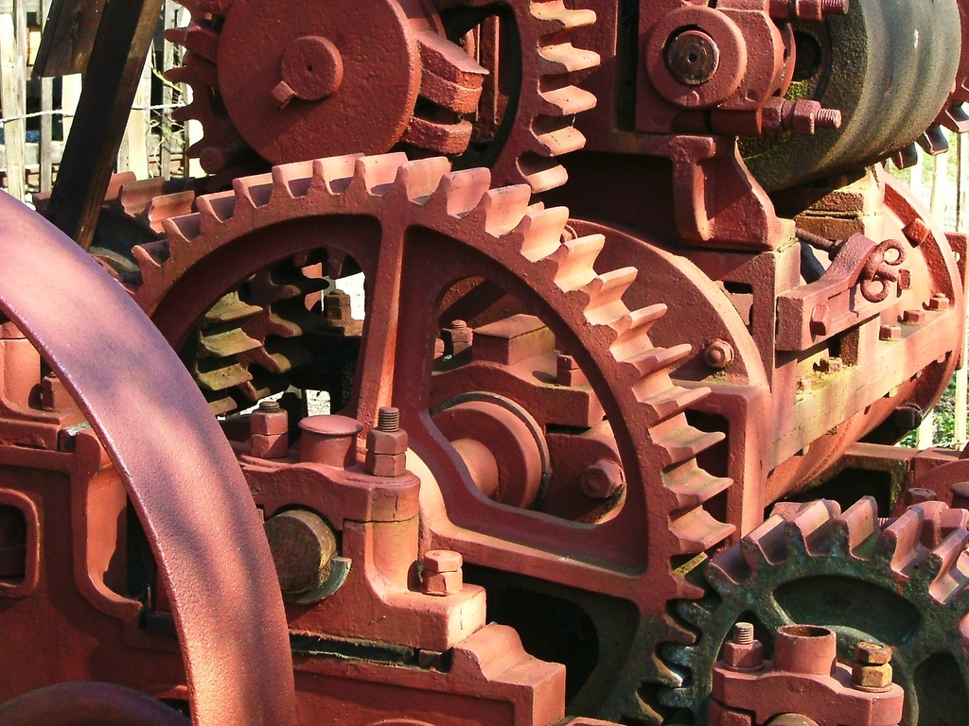
SYSTEM
SYSTEM
Notes:
- Minimal Runtime (no G/C)
- Low level control over H/W
- Suitable for writing O/S and web browsers:
Image: http://flickr.com/photos/61132483@N00/8229790
(cc-by Les Chatfield from Brighton, England)

Slide 6
System
Minimal Runtime (no G/C)
Low level control over H/W
Suitable for writing O/S
and web browsers, etc

Slide 7
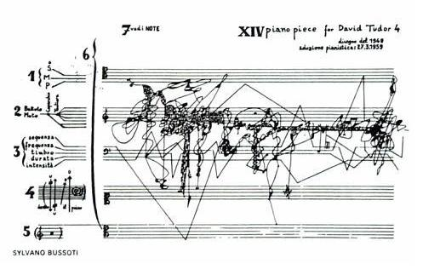
Notes:
IntermezzOS – learn how to write an O/S
Link: https://intermezzos.github.io/book/

Slide 8
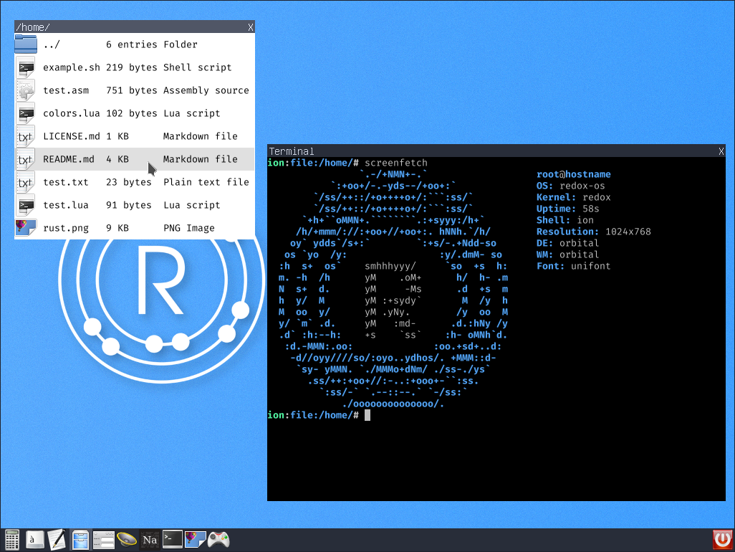
Notes:
- Redux OS
Redox is a Unix-like Operating System written in Rust, aiming to
bring the innovations of Rust to a modern micro-kernel and full set
of applications
Link: http://www.redox-os.org/

Slide 9

Notes:
Servo
Servo is a modern, high-performance browser engine designed for
both application and embedded use.
Link: https://servo.org/

Slide 10

FAST
FAST
Notes:
- Zero cont abstractions* (@ compile time)
- Static dispatching
- Stack allocation
- Near C/C++ speed
- No garbage collection
Image credit: https://unsplash.com/photos/iR8m2RRo-z4 (cc0)

Slide 11
fibonacci.py
#!/usr/bin/env python3.4
def fib(n: int) -> int:
if n < 3:
return 1
else:
return fib(n-1) + fib(n-2)
if __name__ == '__main__':
print("%s" % fib(40))

Slide 12
fibonacci.rs
fn fib(n: u64) -> u64 {
if n < 3 {
1
} else {
fib(n-1) + fib(n-2)
}
}
fn main() {
println!("{}", fib(40));
}

Slide 13
Benchmark
➜ time ./fib.py
36.432s
➜ time ./fib_rs
0.916s
➜ time ./fib_c
0.872s

Slide 14

SAFE
SAFE
Notes:
Safely is the selling feature of Rust.
Since almost everything is our life today is dependent of software we have an obligation to build systems that resists software vulnerabilities like Heart bleed,
Ghost, Dirty Cow, etc.
Image: https://www.flickr.com/photos/pong/288491653 (cc-by Rob Pongsajapan)

Slide 15
Safety
Automatic memory management
Formally defined
  Lifetime
  Ownership
  Mutability
No data races

Slide 16

AUTOMATIC
memory management
AUTOMATIC
memory management
Notes:
Image source: https://unsplash.com/photos/2EJCSULRwC8 (cc0)

Slide 17
Automatic
{
let v = vec![1, 2, 3];
// ...
} // lifetime ends
Notes:
There is already some automatic memory management even in C: the memory on the Stack is allocated and freed when stack frames are pushed and poped.

Slide 18
Stack & Heap
3
2
1
1
v
Notes:
But Vec<i32> is allocated on the heap, and in Rust it is also automatically allocated and deallocated when the Stack object that point to it is allocated and deallocated, a-la smart pointer.

Slide 19

OWNERSHIP
OWNERSHIP
Notes:
While smart pointers aren't unique to Rust, the way it deals with ownership is a new thing Rust intrudes.

Slide 20
Move Ownership
let v = vec![1, 2, 3];
// v owns the Vec<i32>
let u = v;
// ownership moved to u
let t = v;
// ERROR: used moved value: `v`
Notes:
Every object has a variable binding that is its owner.
This ownership is moved my default (for object that uses heap memory).

Slide 21
Borrowing
let v = vec![1, 2, 3];
// v owns the Vec<i32>
let u = &v;
// u borrows from v
let t = &v; // OK
Notes:
Rust uses & to denote “borrow”. The ownership isn't moved with it.

Slide 22
Move
fn print(v: Vec<i32>) {
println!("{:?}", v);
}
fn main() {
let v = vec![1, 2, 3];
print(v);
print(v); // ERROR: used moved
} // value: `v`
Notes:
An other example for move semantic

Slide 23
Borrow
fn print(v: &Vec<i32>) {
println!("{:?}", v);
}
fn main() {
let v = vec![1, 2, 3];
print(&v);
print(&v); // OK
}
Notes:
And the borrow to fix it

Slide 24

Notes:
Lifetime are in rust is a formal entity with its a syntax exposed to the programmer.
It is importunate to keep track of borrows. Rust dues not allow for a borrow to outlive the object it points to.
In most cases it is implicit and the compiler can figure it by itself.
Sometime we do need to give it extra information for example:
- Container data `struct` can't live longer than the borrows it holds.
- Function can't return a borrow for a value it borrows, unless whit it gets lives longer that what it returns.
Image: https://pixabay.com/en/born-died-life-lifespan-cradle-1264699/ (cc-0)

Slide 25
Lifetime
fn main() {
let u: &Vec<i32>;
{
let v = vec![1, 2, 3];
u = &v; // ERROR
} // ← v dies
} // ← u dies
`v` does not live long enough
Notes:
We can first declare u as a borrow, and bind it later.
In such a case there is a scope where u outlives v, and this is forbidden.
This would have been the case even without the inner `{` and `}` because objects are dropped in a revers order of their creation.

Slide 26
COPY?
COPY?
Notes:
In addition to move and borrow, there is also copy semantic.
Image:https://upload.wikimedia.org/wikipedia/commons/6/6a/Icon_Copier.svg By chris 論 (own drawing) (cc-by-sa)

Slide 27
☹ut of scope
#[derive(Copy, Clone)]
struct Rectangle {
height: f64, width: f64,
}
fn main() {
let r1 = Rectangle {
height: 42.0, width: 3.14,
};
let r2 = r1; // Copy
}
Notes:
We will not say much about it due to time limitation.

Slide 28

MUTABILITY
MUTABILITY
Notes:
Rust – like some other newish languages picked immutability by default (compare to C++, where mutability is the default).
All the example up to know everything was immutable.
Image: https://upload.wikimedia.org/wikipedia/commons/9/9d/Mutation_of_Genes.jpg
(cc-by-sa By Kaden11a)

Slide 29
Immutability
let v = vec![1, 2, 3];
v.push(4); // ERROR
cannot borrow immutable local variable `v` as mutable
Notes:
If we try to mutate an immutable (default) object we will get an error.

Slide 30
Mutability
let mut v = vec![1, 2, 3];
v.push(4); // OK
Notes:
We have to declare that object as mutable with mut

Slide 31
Immutability
fn mutate(v: &Vec<i32>) {
v.push(4); // ERROR
}
fn main() {
let v = vec![1, 2, 3];
mutate(&v);
}

Slide 32
Mutability
fn mutate(v: &mut Vec<i32>) {
v.push(4); // OK
}
fn main() {
let mut v = vec![1, 2, 3];
mutate(&mut v);
}

Slide 33

Notes:
Shared mutable state is the root of all eval
It will keep you late at work, and make it harder to sleep at night.

Slide 34
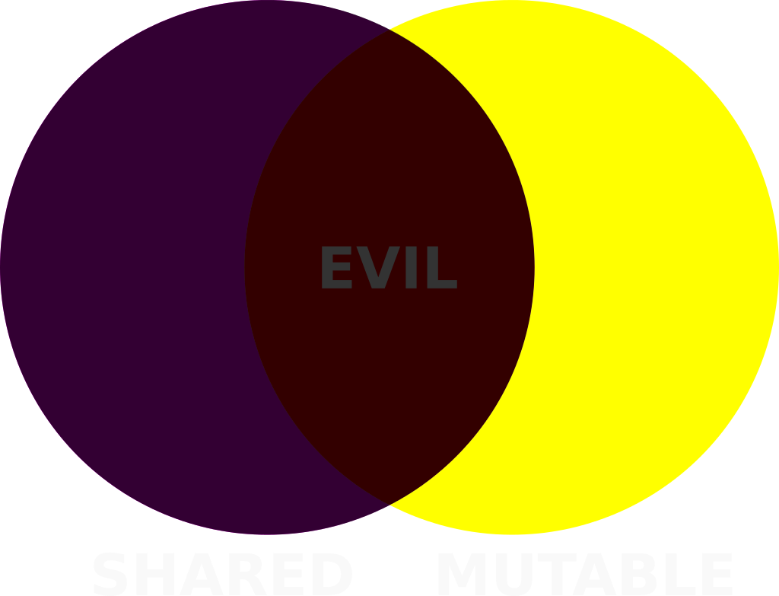
Notes:
We can try to avoid shared state. It is hard and it preclude some types of concurrency.

Slide 35

Notes:
Some languages (Clojure, Haskell, …), forgo mutability and has some clever technique to allow things to change while keeping them actually immutable.

Slide 36

Notes:
Since Rust knows about shared state, mutability and and lifetime it can simply prevent just the shared mutable state.

Slide 37
Borrow & Borrow mut
let mut v = vec![1, 2 ,3];
let u = &v;
let t = &v;
let s = &mut v; // ERROR
cannot borrow `v` as mutable because it is also borrowed as immutable
Notes:
The rule is:
You can have any number of immutable references (shared state)
– OR –
Only one mutable reference.
(the first reference locks the original object, and while it's alive the owner is immutable.)
Here we try to take mutable borrow while we have immutable borrows.

Slide 38

Notes:
With all these compilation errors, you may fill that the borrow checker is fighting with you.
But you need to realize the Rust's compiler is here to help you.
The next slides will demonstrate why you should not fight, and with the compiler...
Image: http://www.publicdomainpictures.net/view-image.php?image=7195
(public domain)

Slide 39
Why Not?
let mut v = vec![1,2,3];
3
2
1
1
cap
len
v
Notes:
Let stat with a vector that for some reason is at capacity.

Slide 40
Why Not?
let mut v = vec![1,2,3];
let u = &v;
3
2
1
1
u
cap
len
v
Notes:
Lets also have a borrow for that vector.

Slide 41
Why Not?
let mut v = vec![1,2,3];
let u = &v;
v.push(4);
3
2
1
1
u
cap
len
v
Notes:
And then try to mutate the vector by adding an element.

Slide 42
Why Not?
let mut v = vec![1,2,3];
let u = &v;
v.push(4);
3
2
1
1
u
cap
len
v
Notes:
Since the vector is at capacity, we need to allocate a new (larger) chunk of memory...

Slide 43
Why Not?
let mut v = vec![1,2,3];
let u = &v;
v.push(4);
3
2
1
1
3
u
2
1
1
cap
len
v
Notes:
Copy the exiting memory.

Slide 44
Why Not?
let mut v = vec![1,2,3];
let u = &v;
v.push(4);
3
2
1
1
3
u
2
1
1
cap
len
v
Notes:
Move the pointer...

Slide 45
Why Not?
let mut v = vec![1,2,3];
let u = &v;
v.push(4);
3
2
1
1
3
u
2
1
1
cap
len
v
Notes:
And invalidate the old memory.
(we didn't added the new element yet)

Slide 46
Why Not?
let mut v = vec![1,2,3];
let u = &v;
v.push(4); // ERROR
3
2
1
1
3
u
2
1
1
cap
len
v
Notes:
And we already have a prblem.
The borrow is pointing the an invalid memory.
It will might work for you when you test it, but will cause all sort of mischief at the customer's site.
In C++ this will be a valid code.
In Rust it will not compile.

Slide 47
Error Messages
error[E0502]:
cannot borrow `v` as mutable because
it is also borrowed as immutable
fn main() {
let mut v = vec![1,2,3];
let u = &v;
v.push(4);
}
immutable borrow occurs here
mutable borrow occurs here
immutable borrow ends here
Notes:
And the error message will tell you exactly what went wrong.

Slide 48
Error Codes
error[E0502]:
➜ rustc --explain E0502
This error indicates that …
Example of erroneous code: ...
To fix this error, …
For more information ...
Notes:
You can get even more information by asking the compiler to explain the error code.

Slide 49

CONCURRENCY
CONCURRENCY
Notes:
It turns out that rust safety tools (ownership, lifetime and mutability) as well as traits that we can't cover here, are a great bases to build concurrency story.
So Rust's can implement all the needed concurrency approaches in its libraries (both standard and and external).
Here we will show only one approach implemented by the Rayon library.

Slide 50
Serial Code
fn load_images(paths: &[PathBuf])
-> Vec<Images> {
paths.iter()
.map(|path| Images::Load(path))
.collect()
}
Notes:
But first lets look at some serial code.
It uses iterator, map and a closure.

Slide 51
Parallel Code
extern crate rayon;
use rayon::prelude::*;
fn load_images(paths: &[PathBuf])
-> Vec<Images> {
paths.par_iter()
.map(|path| Images::Load(path))
.collect()
}
Notes:
This case is suable to parallelize with the Rayon library:
This example is taken from a talk by the author: https://www.youtube.com/watch?v=gof_OEv71Aw&t=661s

Slide 52
Parallel Error
fn load_images(paths: &[PathBuf])
-> Vec<Images> {
let mut pngs = 0;
paths.par_iter()
.map(|path| {
if path.ends_with("png") {
pngs += 1;
}
Images::Load(path) })
.collect()
}
Notes:
While such parallelism is not unique to Rust, it can catch errors in a new way.
Consider the png counter we wish to add, that would have been legal in the serial example.
Here it is an mistake because “+=” is not atomic, and there can be a data race here, leading to wrong result (some of the times).
Here it is a compilation error, because because we actually have a shared mutable state (the pngs variable that is shared among the threads).

Slide 53
Fix Parallel Error
use std::sync::atomic::AtomicUsize,
Ordering};
fn load_images(paths: &[PathBuf])
-> Vec<Images> {
let mut pngs = AtomicUsize::new(0);
paths.par_iter()
.map(|path| {
if path.ends_with("png") {
pngs.fetch_add(1, Ordering::SecCst);
}
Images::Load(path) })
.collect()
}
Notes:
One way to fix this is by using and Atomic type (that is defined by th standard library)
This type has the sync trait that makes it safe to pass objects among threads and mutate it safely.
Under the hood it uses unsafe { … } code, that have been vetted to be safe by humans. This is an escape hatch Rust leaves us to do things that are otherwise impossible.
This is helpful because it let us writing most of the code in safe rust, and have the compiler save us form making mistakes, so we can limit our unsafe code to the well libraries that were written very carefully and tested thoroughly.

Slide 54

MORE
MORE
Notes:
There is much more we can talk about but we are out of time.
Image: https://upload.wikimedia.org/wikipedia/commons/6/62/Starsinthesky.jpg(cc-by ESA/Hubble)

Slide 55
Much more
The type system: struct + enum
Pattern matching: match
Static duck typing: traits + generics
Meta programming with macros
Tooling: cargo, rustdoc, rustup, RLS…
Ecosystem: Community + crates.io
Rust progress: 1.0 2015/05→ 1.18 2017/06
Rust ❤ Other languages: FFI

Slide 56
github.com/chenl/talks
github.com/chenl/talks
Notes:
Credits:
- Rayon: Data Parallelism for Fun and Profit — Nicholas Matsakis – https://www.youtube.com/watch?v=gof_OEv71Aw&t=661s
-

