Slide 1
PET Writing
学习目标｜选定一项活动，用具体细节解释它为什么受欢迎。
Article: Free-time activities
审题 → 看图回顾 → 展开原因 → 组织语言 → 独立写作
About 100 words
ONE activity + WHY people enjoy it
PET ARTICLE · FREE-TIME ACTIVITIES
01
Notes:
导入：今天写杂志文章，约100词。先让学生概括任务，再单击显示核心目标。
单击1：ONE activity + WHY people enjoy it。

Slide 2
1. Read the task
审题｜先读原题：文章写给谁？需要回答什么？
Articles wanted!
Free-time activities
Tell us about a free-time activity which is popular with young people in your country.
Why do people enjoy it so much?
Write an article answering these questions and we’ll publish the most interesting ones on our website.
Write your answer in about 100 words.
PET ARTICLE · FREE-TIME ACTIVITIES
02
Notes:
题干按用户图片转录。英文杂志征集文章，优秀文章会在网站刊登。先请学生圈出 a free-time activity / young people / in your country / Why。本题不要求评价当地运动设施是否足够，也不限于运动。

Slide 3
2. What must we include?
审题拆解｜每次先回答一个问题，再单击核对。
What?
ONE free-time activity
选一项能讲清楚的活动
Who?
Where?
Young people in your country
补充活动的参与者和时间地点
Why?
Reasons + specific details
解释喜欢的原因，再给具体说明
用一项活动贯穿全文；原因要有具体细节支撑。
PET ARTICLE · FREE-TIME ACTIVITIES
03
Notes:
单击1：ONE free-time activity；单击2：Young people in your country；单击3：Reasons + specific details。国别不必固定为中国；学生按自己真实背景写。可以有两个清楚的原因，但不是题目硬性要求的数量。

Slide 4
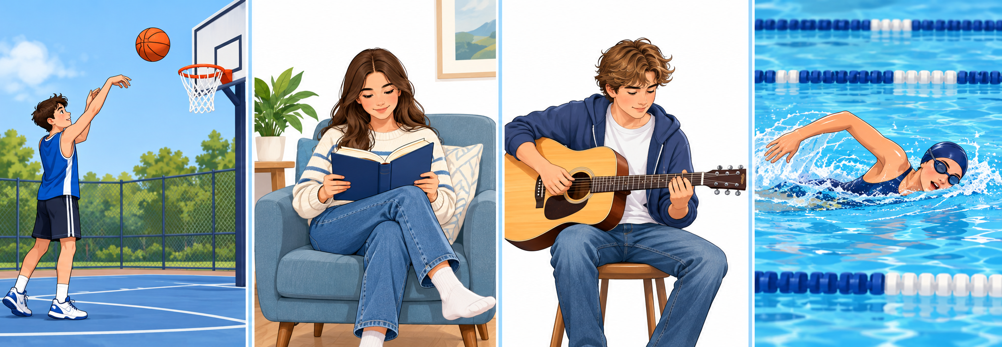
3. Brainstorm: look and say
看图回顾｜先说活动，再说英文搭配；单击逐项揭晓。
play basketball
read books
play the guitar
go swimming
PET ARTICLE · FREE-TIME ACTIVITIES
04
Notes:
图片依次为打篮球、读纸质书、弹吉他、游泳；初始只显示图片。
单击1：play basketball；单击2：read books；单击3：play the guitar；单击4：go swimming。
每项先等学生回答，再单击。接受 reading / reading books 等正确表达，随后归纳常用搭配。追问：Which one is popular with young people in your country?

Slide 5
4. Choose ONE activity
内容构思｜选一项熟悉的活动：原因是什么？有什么具体细节？
Activity
Why enjoy it?
One specific detail
Basketball
Time with friends
Classmates can play
together after school.
Reading
A way to relax
A funny story can help
them forget a busy day.
Playing the guitar
A sense of progress
They feel proud when
they learn a new song.
示例供选择；请使用符合你所在国家和真实生活的细节。
PET ARTICLE · FREE-TIME ACTIVITIES
05
Notes:
先看左栏，让学生口头给出一个原因和一个细节。单击1：篮球；单击2：阅读；单击3：吉他。每行只是可能的写法，并非关于整个国家的统计结论。最终只选一项；不要求把所有活动写进文章。

Slide 6
5. Show that it is popular
内容展开｜“很受欢迎”后面，补充谁在做、何时做。
Who does it? · Where? · When?
示例：以中国的篮球活动为例
In China, basketball is popular with young people.
At my school, many students play it after class.
国家与学校情况可替换；不要把个人喜好当成全部说明。
PET ARTICLE · FREE-TIME ACTIVITIES
06
Notes:
先问：仅写 I like basketball 是否回答了 young people in your country？再单击。单击1：活动与国家；单击2：学校中可观察到的具体情况。学生只在情况属实时使用此句；不编造调查数字，不要求国家级数据。

Slide 7
6. Why do young people enjoy it?
观点展开｜先说原因，再补充能解释这个原因的具体细节。
Reason
Specific detail
It is a great way to spend
time with friends.
For example, classmates can
play together after school.
It is easy to start.
You only need a ball
and a court.
具体细节要回答：为什么这个原因会让人喜欢这项活动？
PET ARTICLE · FREE-TIME ACTIVITIES
07
Notes:
篮球作为贯穿示例。每次先问学生，再揭晓。单击1：朋友相处的原因；单击2：放学后一起打球的细节；单击3：容易开始；单击4：球与场地。可接受其他合理原因，不把“运动对年轻人重要”当成本题必须回答的第三问。

Slide 8
7. Make your sentence stronger
句子升级｜从笼统评价，走向原因和具体说明。
It is fun.
↓ Why?
It is fun because we can play with friends.
↓ Give a specific detail.
For example, my classmates and I play after school
and laugh together.
观点 → 为什么 → 具体发生了什么
PET ARTICLE · FREE-TIME ACTIVITIES
08
Notes:
参考课件的逐步扩句方式。原句先显示；单击1显示 because 解释；单击2显示具体例子。强调这三步是思考过程，不要求把 It is fun 重复写三次。实际写作只保留展开后的自然表达。

Slide 9
8. Useful language
词汇整理｜先试着说出搭配，再单击回顾。
Popularity & time
Reasons
be popular with young people
受年轻人欢迎
spend time with friends
与朋友共度时光
in their free time
在他们的空闲时间
relax after a busy day
忙碌一天后放松
after school / at weekends
放学后／在周末
feel proud of themselves
为自己感到自豪
PET ARTICLE · FREE-TIME ACTIVITIES
09
Notes:
六次单击，依次为左栏由上到下，再右栏由上到下。先让学生回忆或尝试补充表达，再揭晓。popularity 表达 be popular with；作文视角保持一致：they/their/themselves，个人例子可用 I/my。活动搭配见看图回顾页。

Slide 10
9. Choose linking words by meaning
连接词用法｜本题主要需要：原因、举例、补充、结果。
Purpose
Linker
Example
原因
because
They enjoy it because
they can play with friends.
举例
for example /
for instance
For example, classmates
can play after school.
补充
also
It also helps them relax.
结果
so
There are courts nearby,
so they can play there.
for example / for instance 通常可互换；连接词不必全部使用。
PET ARTICLE · FREE-TIME ACTIVITIES
10
Notes:
按行单击显示例句：because、for example/for instance、also、so。for example 与 for instance 在本页例句中都正确，不设置唯一替换答案。because 引导原因；so 连接结果；同一关系不用 because...so... 的组合。

Slide 11
10. Linking words: your turn
连接词练习｜先口头补全句子；举例处接受两种合理表达。
1 Young people enjoy basketball ______
they can play with friends.
because
2 It is easy to start. ______, you only
need a ball and a court.
For example / For instance
3 It is fun. It ______ helps them
relax after school.
also
PET ARTICLE · FREE-TIME ACTIVITIES
11
Notes:
先给学生思考时间，再逐题单击。单击1：because；单击2：For example / For instance，二者都接受；单击3：also。也可接受其他符合语义与句法的表达，例如第1题 since；应解释为什么成立。不要要求每个词只能用一次。

Slide 12
11. Develop YOUR idea
口头构思｜换成你选的活动，保留自己的原因和例子。
My activity: __________________
Why do young people enjoy it?
They enjoy it because __________________.
What specific detail supports your reason?
For example, _________________________.
细节提示：谁一起做？在哪里？何时？具体做什么？
PET ARTICLE · FREE-TIME ACTIVITIES
12
Notes:
此页不提供统一范答。让学生选一项活动并口头展开，不能要求全部选篮球。追问例子如何解释原因。最后一次单击只给细节角度提示，不填入学生判断和例子。

Slide 13
12. Writing scaffold
写作框架｜约100词；自己决定活动、原因与具体细节。
OPENING
引出活动
In __________, __________ is popular with young people.
They often __________.
WHY?
展开原因
One reason is __________.
For example / For instance, __________.
They also enjoy it because __________.
ENDING
自然收尾
That is why __________.
OR Why not __________?
框架可调整；收尾二选一，也可以写自己的句子。
PET ARTICLE · FREE-TIME ACTIVITIES
13
Notes:
三次单击逐段出现框架：引出活动；展开原因；自然收尾。标题可自拟；不是固定必背句型。They often 后填写真实情况，两个原因只是建议。保留全部关键内容为空。OR 表示二选一，不抄进作文。约100词，以答全题目和解释清楚为先。

Slide 14
13. Write and check
独立写作｜先完成自己的文章，再按本题要求检查。
ONE activity throughout the article?
Young people in my country included?
Clear reasons why people enjoy it?
Specific details that support my reasons?
Correct linking words and about 100 words?
Write your article. Give it a suitable title.
PET ARTICLE · FREE-TIME ACTIVITIES
14
Notes:
学生独立写作，再自查。五项检查全部保持可见，便于使用；它们是检查问题，不是待揭晓的答案。标题可简短自然。下一页范文放在独立写作之后，按实际课堂进度选择是否展示。

Slide 15
14. Model article: read after writing
范文回看｜写完后再看：找出活动、原因和支撑细节。
Basketball with friends
In China, basketball is popular with young people. At my school, many students play it after class.
One reason is that it is a great way to spend time with friends. For example, my classmates and I play in the park at weekends. We laugh and enjoy being together. It is also easy to start because you only need a ball and a court. After a busy school day, a short game helps us relax.
That is why so many young people enjoy basketball. Why not try it with your friends this weekend?
PET ARTICLE · FREE-TIME ACTIVITIES
15
Notes:
示例正文 93 词（不含标题）。示例背景为中国；学校与周末打球的细节是示例叙述，学生按真实情况替换。
单击1：活动、国家和受欢迎的具体表现。单击2：朋友相处、容易开始、放松，以及周末在公园打球的细节。单击3：自然收尾并邀请读者尝试。
让学生对比自己的内容，不要求背诵范文，也不要求写相同原因。

