Slide 1
1. Read the task
先不急着写：找出两个问题，特别注意 enough 和 Why。
You see this announcement on an English-language website.
Articles wanted!
Sport and exercise
Are there enough sports activities for young people to do in your area?
Do you think it’s important for young people to do sport and exercise?
Why?
Write an article answering these questions and we’ll publish the best ones.
Write your article.
① Enough locally? Give evidence. ② Important? Explain why.
PET Writing · Sport and exercise
1

Slide 2
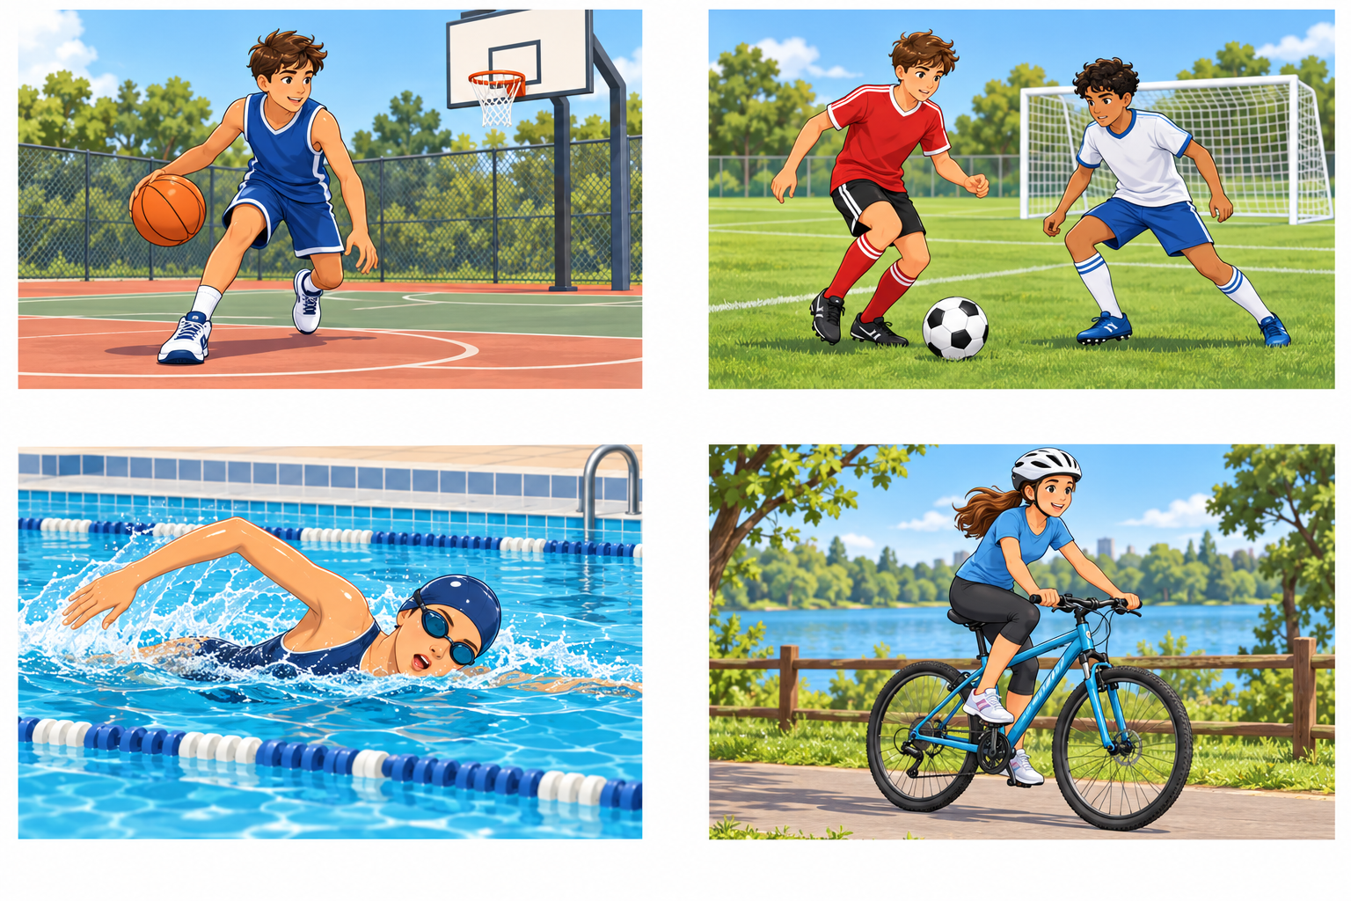
2. Brainstorm: sports activities
先看图说运动，再回顾 play / go 的搭配。
Which activities can young people do in your area?
Where? Is it free?
When can you go?
PET Writing · Sport and exercise
2

Slide 3
3. Brainstorm: are there enough activities?
先选立场，再用地点、费用或开放时间说明是否足够。
Think about choice, places, cost and opening times.
Your view | Local evidence | What this shows
Yes, enough | Free courts + weekend clubs | Choice and easy access
Not enough | Only one club; it is expensive | Limited affordable options
Some, but not enough | A park, but no indoor centre | Fewer options on rainy days
Example: There are not enough activities because the only club is expensive.
PET Writing · Sport and exercise
3

Slide 4
4. Useful vocabulary
把词汇分成两组：当地活动条件 + 运动带来的帮助。
LOCAL ACTIVITIES
play basketball / football
go swimming / cycling
a sports centre / a local club
join a team / take part in activities
ACCESS AND BENEFITS
free activities / an expensive club
open at weekends
keep fit / feel less stressed
make friends / learn teamwork
We can play basketball on the free courts near my home.
Taking part in team sports can help us make friends.
PET Writing · Sport and exercise
4

Slide 5
5. Linking words: fill in the blanks
连接词练习｜先完整读文，再按语义选词；举例表达可以互换。
above all · another thing · such as
for example · for instance
Sport in our area
Do young people have enough opportunities to exercise?
I think there are enough activities in my area. We can play sports
such as
football and basketball.
For example
, there are free courts near my home
and swimming classes at weekends.
Sport is important because it helps us make friends. When we join a team,
we meet other young people and learn to work together.
Another thing
I like about sport is that it helps me relax after school.
Above all
, regular exercise helps us stay healthy.
Why not try a new activity with your friends this weekend?
PET Writing · Sport and exercise
5
Notes:
完整文章填空，正文97词，不含标题。先让学生完整阅读并回答，再按文章顺序单击。
单击1：such as；单击2：For example（同样接受 For instance）；单击3：Another thing；单击4：Above all。
初始答案卡隐藏；每次单击后绿底黄字答案卡在相应空白原位出现。不是自动播放或一开始显示所有答案。
such as 后接 football and basketball 两个名词例子。For example 引出当地免费球场和周末游泳课的具体情况，支持足够的判断。
Another thing I like ... 是补充观点的完整结构。Above all 强调作者最重视的健康益处，不只是表示最后。
本文只是示例：先判断当地活动足够并给证据，再说明运动的重要性。学生保留自己的当地情况和判断。

Slide 6
6. Language focus: enough
“有活动”还不够，要回答这些活动是否满足需要。
enough + plural noun
There are enough sports activities in my area.
not enough + plural noun
There are not enough clubs for young people.
adjective + enough
The sports centre is not cheap enough for many students.
Link your judgement to evidence: choice, cost, place or time.
PET Writing · Sport and exercise
6

Slide 7
7. Language focus: examples and benefits
分清怎样举例，再用 important / help 说明运动的作用。
such as + noun examples
We can do sports such as football and basketball.
for example / for instance + a specific example
There are free activities. For example, we can use the park.
It is important for someone to do something.
It is important for young people to exercise regularly.
help someone (to) do something
Team sports help us (to) make friends.
PET Writing · Sport and exercise
7

Slide 8
8. Sentence development
不要停在一句观点：加上具体例子，或解释它怎样有用。
LOCAL SITUATION 当地情况
There are enough sports activities in my area.
For example, we can play basketball on free courts
and join swimming classes at weekends.
WHY SPORT MATTERS 重要性与原因
Sport helps us make friends.
When we join a team, we meet other young people
and spend time with them every week.
Your turn: Sport helps us feel less stressed. Add an explanation.
PET Writing · Sport and exercise
8

Slide 9
9. Writing scaffold
把前面的内容组织成文章；保留自己的观点和例子，约 100 词。
TITLE + OPENING 标题与开头
Choose a short title. Introduce sport in your area in one sentence.
LOCAL SITUATION 当地活动是否足够
There are enough / not enough … because …
For example, …
IMPORTANCE + WHY 是否重要与原因
I think it is important for young people to …
… helps us … because / when …
SHORT ENDING 简短收尾
Give a suggestion or encourage readers to try an activity.
PET Writing · Sport and exercise
9

Slide 10
10. Final checklist
写完先查是否答全题目，再查观点展开和语言。
1. Did I say whether there are enough activities in my area?
2. Did I support this with a specific local example?
3. Did I say whether sport is important and explain why?
4. Did I check enough, verb forms and linking expressions?
5. Does my article suit website readers and have about 100 words?
Write your article using your own ideas.
PET Writing · Sport and exercise
10

