Slide 1
Python is Fast aspect from coding competitions

Slide 2
Intro To Google Code Jam
https://code.google.com/codejam
Once per year, normally from April to August. Several on-line rounds and one on-site round. $20k prizes.
Should solve 3 to 5 problems with known-correct solution.
ALL programming language allowed:
Download input, run code on your computer, upload output
Competition is timeboxed to a few hours, Code runtime to a few minutes.
A small and a large input datasets with different scores
Ranking by problem score and submission time

Slide 3
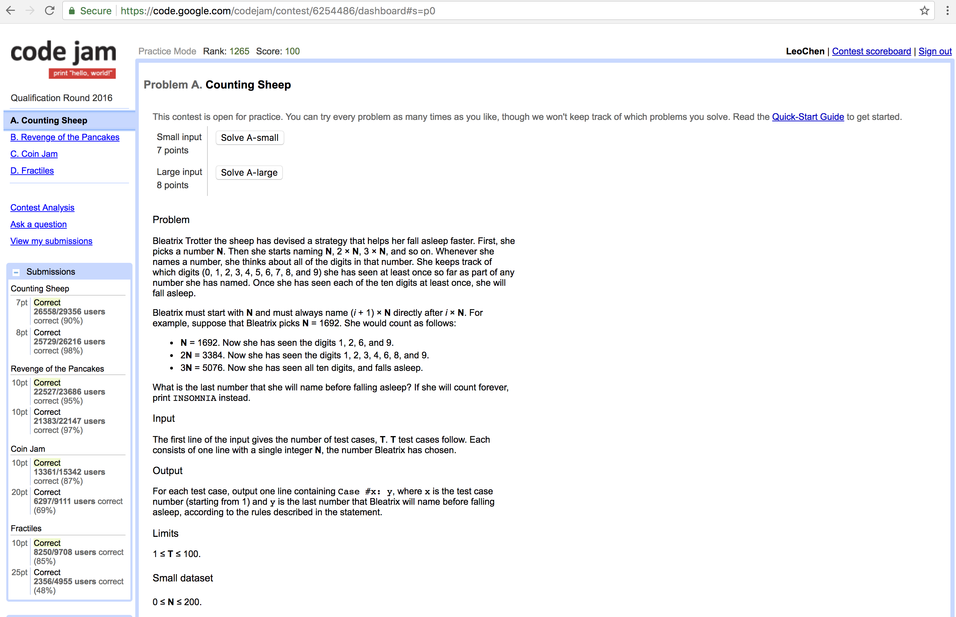
Problem Demo

Slide 4
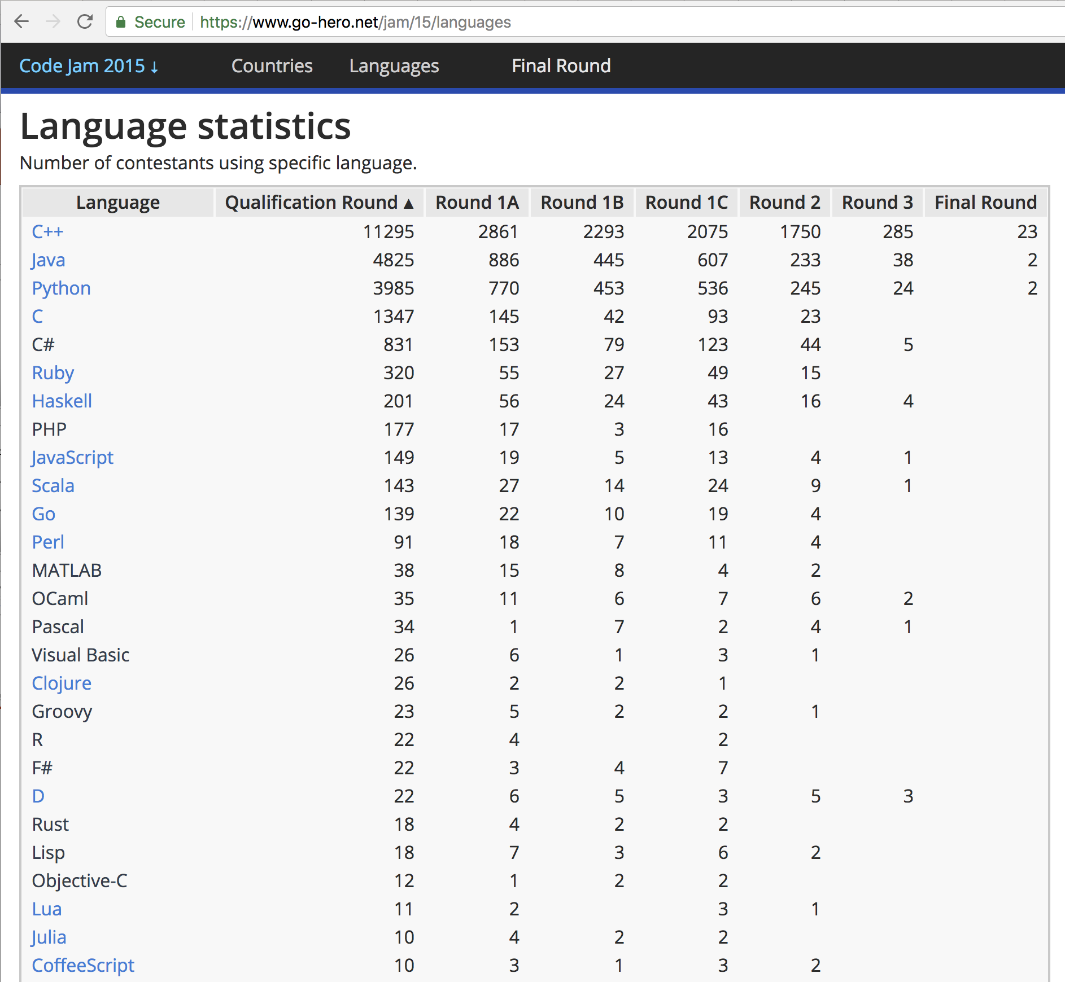
Language Distribution In 2015

Slide 5
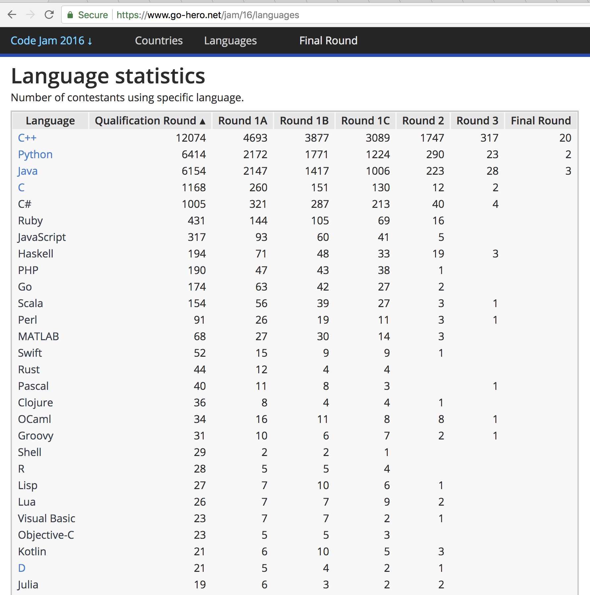
Language Distribution In 2016

Slide 6
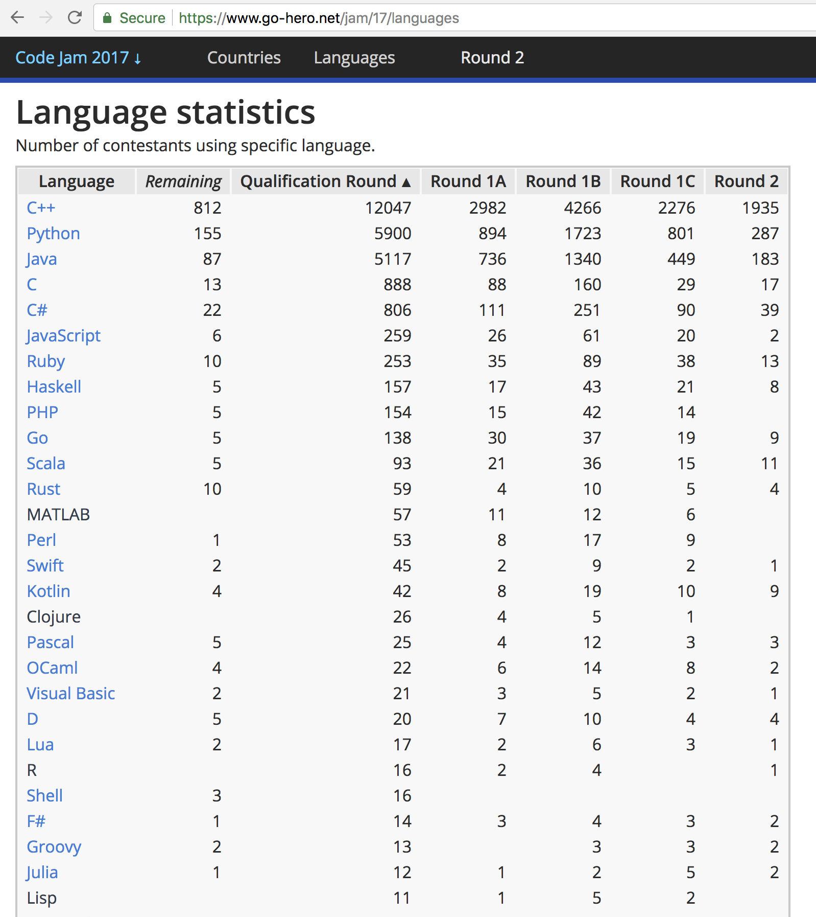
Language Distribution In 2017 Till Round 2

Slide 7
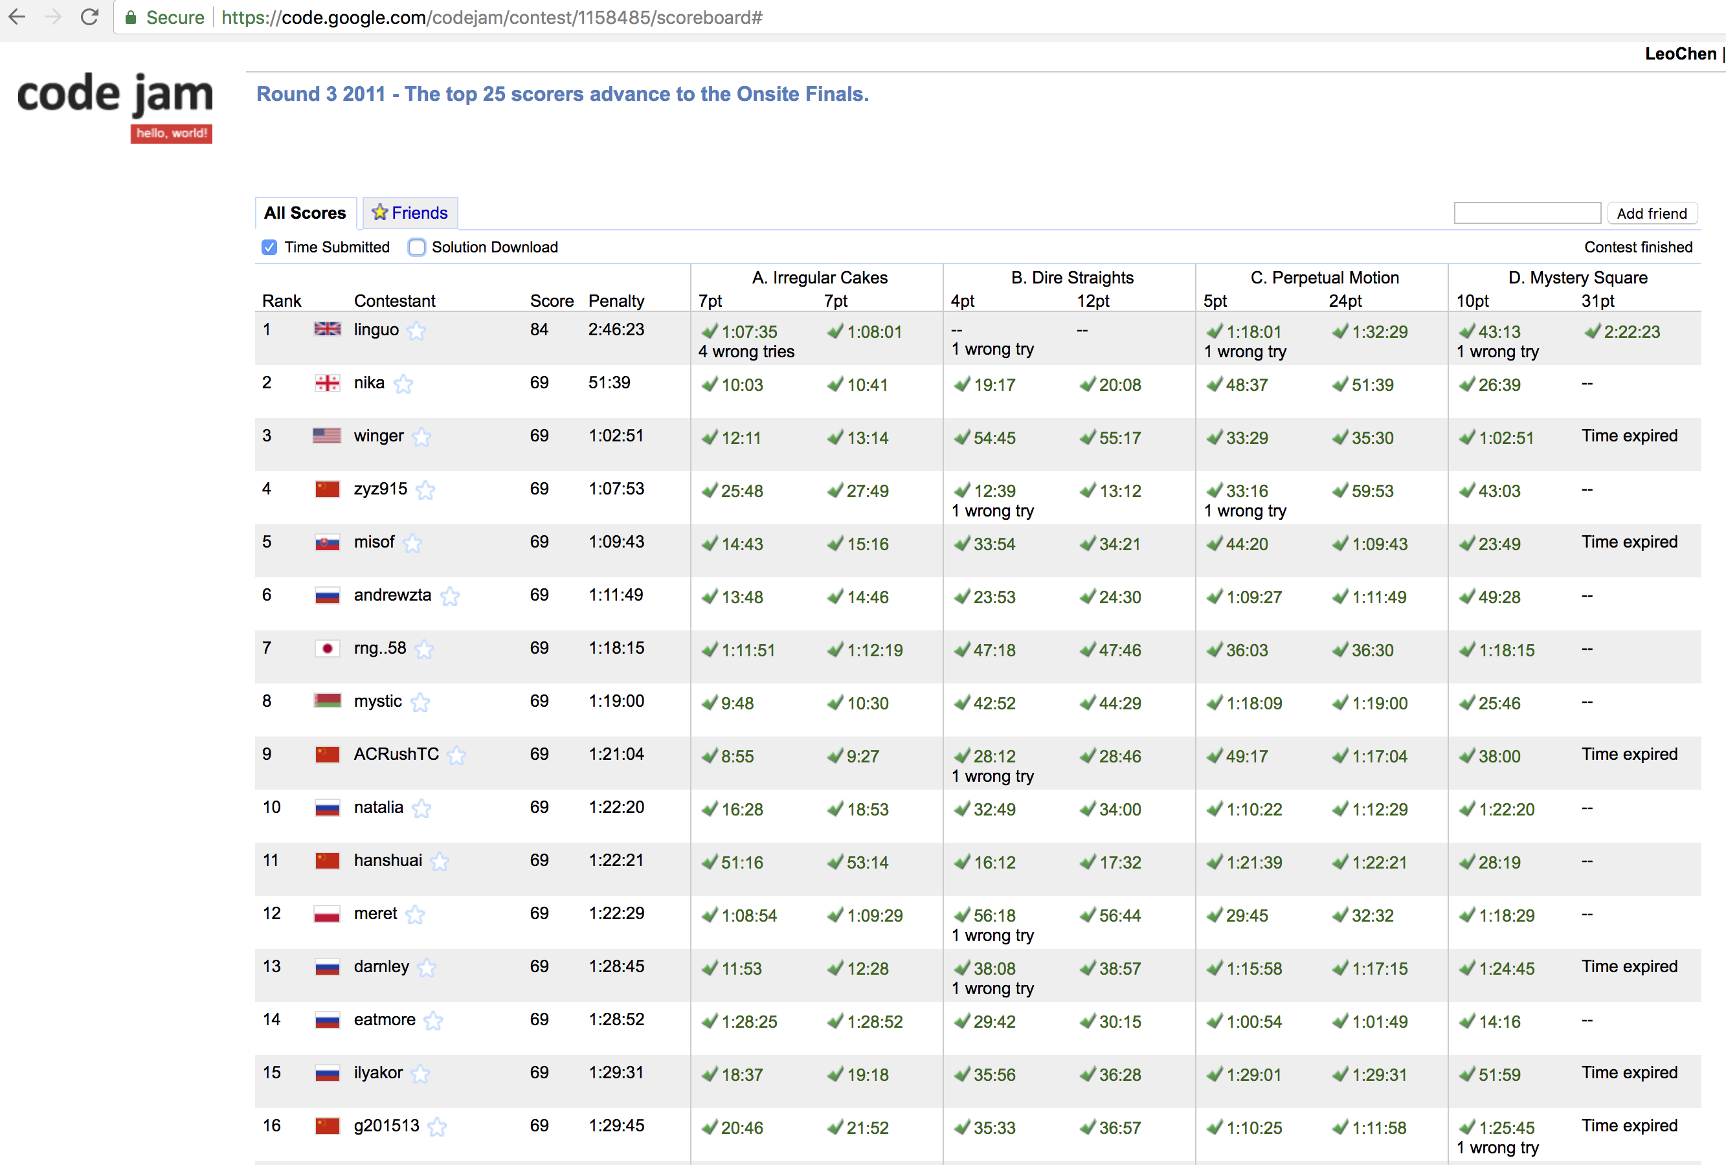
Python Wins Competition (1/3)

Slide 8
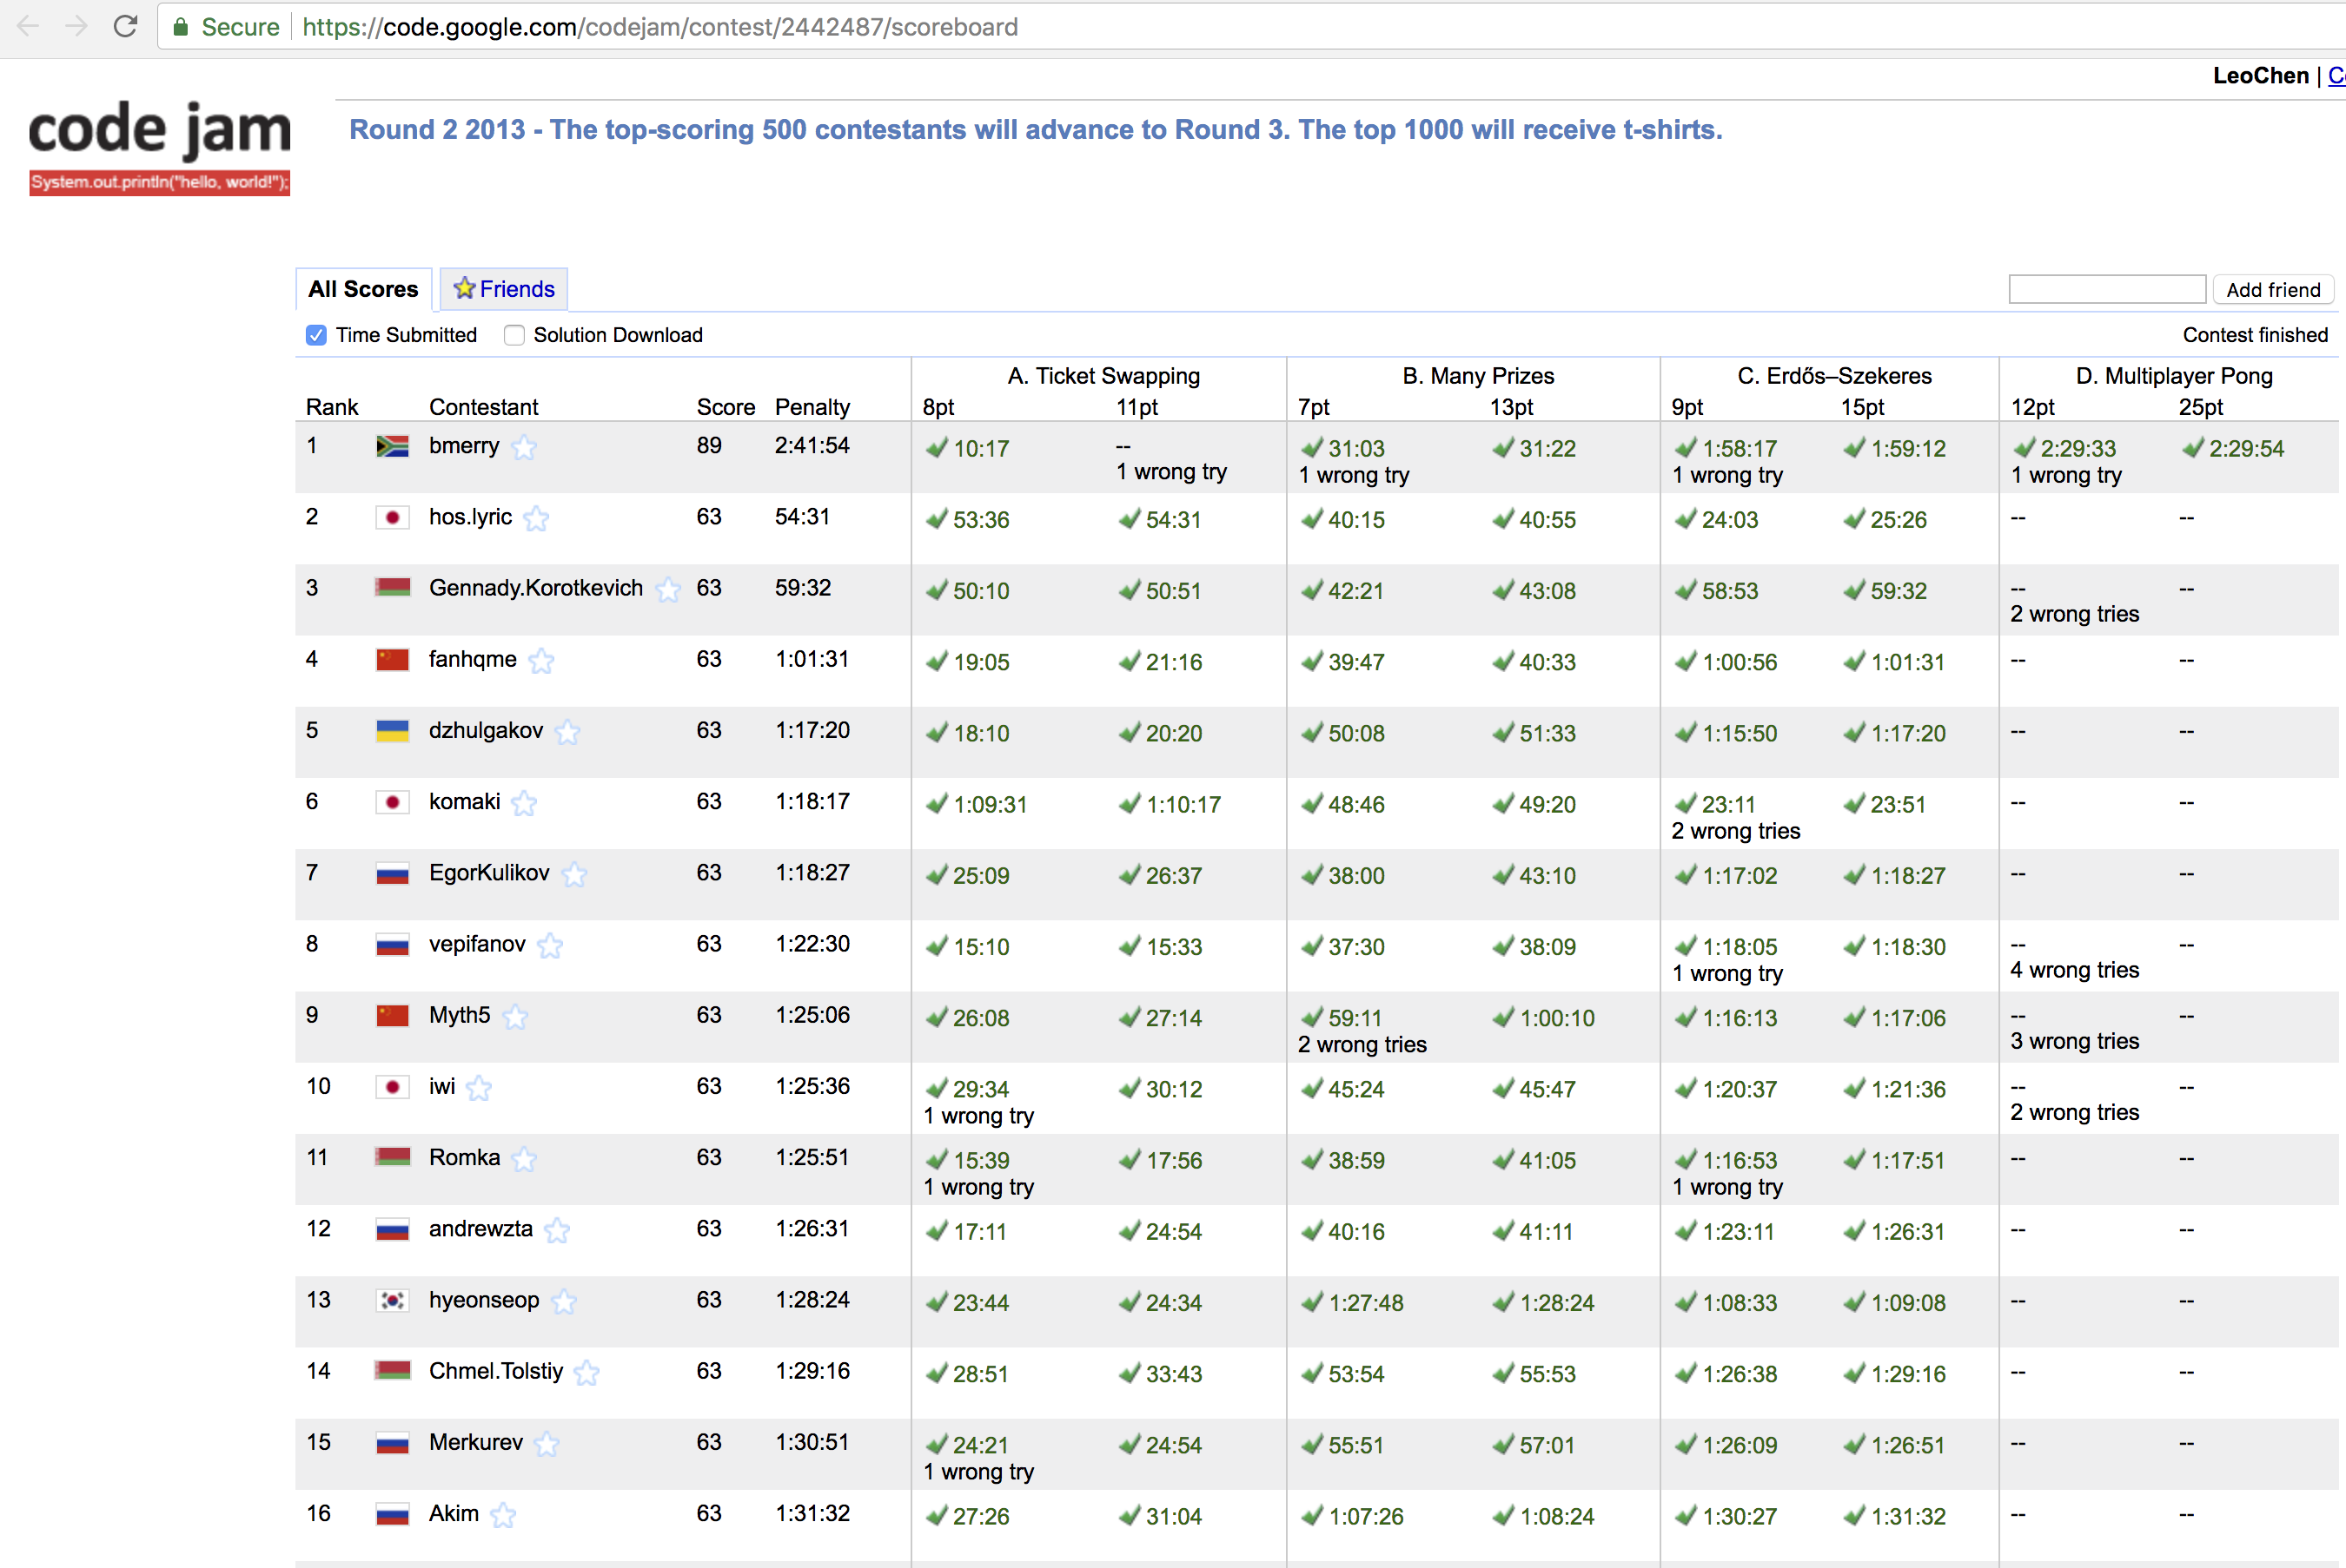
Python Wins Competition (2/3)

Slide 9
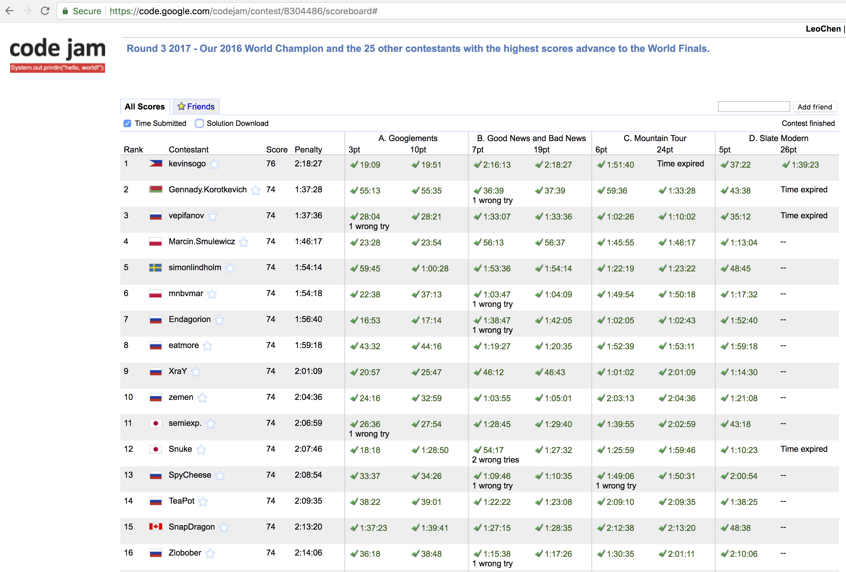
Python Wins Competition (3/3)

