Slide 1
Latency Focused Function Placement and Request Routing in Multi Access Mobile Edge Computing Networks
Mustafa F. Ozkoc(mfo254)
Chen Li (cl5089)
May 19th
1

Slide 2




Motivation
Applications requiring ultra reliability and/or low latency
Augmented Reality (AR) Applications
Virtual Reality (VR) Applications
Remote Control
Autonomous Driving
2

Slide 3
Overview
Motivation
Achieving Ultra Reliable Low Latency Communications (URLLC)
Key enablers of 5G networking
Mobile Edge Computing (MEC)
Network Function Virtualization (NFV)
Software Defined Networks (SDN)
Issues, Problems
MEC resources are limited, distributed -> constraints on storage, computational power, bandwidth
Varying wireless links
Coupled functions
Delay Limited Services
Possible Solutions
Optimization framework to allocate services and functionalities while satisfying service requirements
virtualization of network functions based on physical constraints of the network.
Benefits
Proof of achievability of services with tight quality of service (QoS) requirements
3

Slide 4
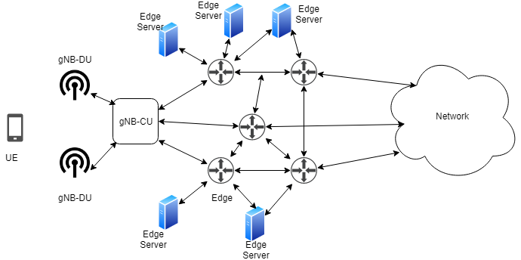
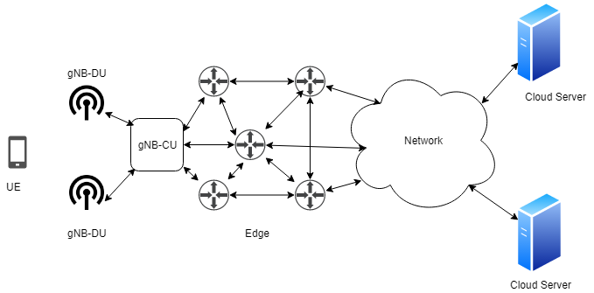
Mobile Edge Computing (MEC）
A service must go through the core network
A service can be served at the edge
User mobility and service migration issues
Migration cost vs transmission cost
Stress on control plane functions
Costly compared to consolidated data center
Limited resources compared to centralized cloud
Network congestion is reduced
Quality of service is improved
Reduces the network operation cost
4

Slide 5
Issues and Problems
MEC resources are limited [1]
Computational power constraint
Can compute limited number of requests at a given time
Bandwidth constraints
Connecting links have bandwidth limitations hence can communicate with limited number of user equipment hence limited number of requests can be accepted
Storage constraints [2]
Can not store every network function, each node can store a subset of functions hence limited number of requests can be satisfied
This resource can be shared between applications [3]
[1] P. Mach and Z. Becvar, "Mobile Edge Computing: A Survey on Architecture and Computation Offloading," in IEEE Communications Surveys & Tutorials, vol. 19, no. 3, pp. 1628-1656, 2017.
[2] K. Poularakis, J. Llorca, A. M. Tulino, I. Taylor, L. Tassiulas, “ Joint Service Placement and Request Routing in Multi-cell Mobile Edge Computing Networks, arXiv:1901.08946
[3] T. He, H. Khamfroush, S. Wang, T. La Porta and S. Stein, "It's Hard to Share: Joint Service Placement and Request Scheduling in Edge Clouds with Sharable and Non-Sharable Resources," 2018 IEEE 38th International Conference on Distributed Computing Systems (ICDCS), Vienna, 2018, pp. 365-375.
5

Slide 6
Possible Solution
A service placement solution is required subject to service and physical substrate constraints.
Delay sensitive services require careful network planning for data plane and control plane
What is already in the literature ?
[2] Focuses on node physical constraints but neglects QoS constraints and control plane functions. Does not consider other edge nodes as candidate servers.
[5] Focuses on VNF placements in order to reduce bandwidth but neglects computation constraints
[6] Focuses on energy saving by running smallest possible number of computational node but neglects physical constraints of each node and control plane functionality
[2] K. Poularakis, J. Llorca, A. M. Tulino, I. Taylor, L. Tassiulas, “ Joint Service Placement and Request Routing in Multi-cell Mobile Edge Computing Networks, arXiv:1901.08946
[5] M. Pozza, A. Patel, A. Rao, H. Flinck, S. Tarkoma, “ Composing 5G Network Slices by Co-locating VNFs in uslices”, IFIP Networking, 2019
[6] B. Yang, W. K. Chai, Z. Xu, K. V. Katsaros and G. Pavlou, "Cost-Efficient NFV-Enabled Mobile Edge-Cloud for Low Latency Mobile Applications," in IEEE Transactions on Network and Service Management, vol. 15, no. 1, pp. 475-488, March 2018.
6

Slide 7
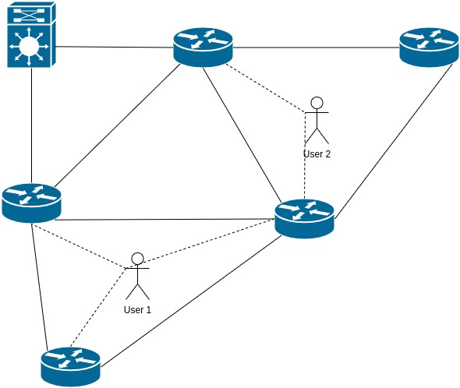
System Model
Base Stations
N Base Stations
C_{n} : Computational Capacity
M_{n} : Memory/Storage Capacity
Services
A library of services in set S are offered
c_{s} : capacity requirement
m_{s} : memory/storage space requirement
h_{s} : traffic volume
t_{s} : maximum tolerable latency
w_{s} : pricing
Users
A user u can access to network through nodes N_{u} a subset of N
Each user u requests a service s_{u} from the network
7
Notes:
7

Slide 8
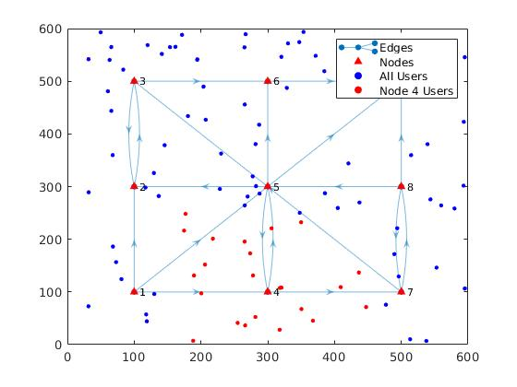
Formulation
Indices :
u = {1,..,U} : Users
n = {1,..,N, l } : Nodes, where l is the centralized cloud
e = {1,...,E} : links between nodes, directed
Constants
c_{e} : Capacity of link w
l_{e} : latency introduced at link e, can be formulated as a function of load in future. 1/(c_{e} - y_{e})
a_{ev} = 1 if link e originates at node v; 0, otherwise
b_{ev} = 1 if link e terminates at node v; 0, otherwise
W_{su} = price of the service requested by user u
Variables
x_{nu} : binary variable. 1 if the request of user u is served at node n, 0 otherwise.
y_{n’u} : binary variable. 1 if the user u access the network through node n’ where n’ ∈ N_{u} , 0 otherwise
u_{ue} : binary variable. 1 if the link e is used while serving the user u, 0 otherwise. (can be changed to volume if we want to allow flow splitting.)
8
Notes:
8

Slide 9
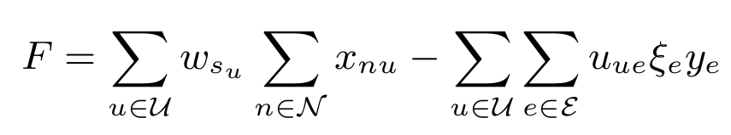
Formulation
Indices :
u = {1,..,U} : Users
n = {1,..,N, l } : Nodes, where l is the centralized cloud
e = {1,...,E} : links between nodes, directed
Constants
c_{e} : Capacity of link w
l_{e} : latency introduced at link e, can be formulated as a function of load in future. 1/(c_{e} - y_{e})
a_{ev} = 1 if link e originates at node v; 0, otherwise
b_{ev} = 1 if link e terminates at node v; 0, otherwise
W_{su} = price of the service requested by user u
Variables
x_{nu} : binary variable. 1 if the request of user u is served at node n, 0 otherwise.
y_{n’u} : binary variable. 1 if the user u access the network through node n’ where n’ ∈ N_{u} , 0 otherwise
u_{ue} : binary variable. 1 if the link e is used while serving the user u, 0 otherwise. (can be changed to volume if we want to allow flow splitting.)
Objective Function
Two possible design choices
Minimize the network operation & installation cost for given user-service pairs.
Maximize the number of served user-service pairs for a given network configuration.
Generate the largest possible revenue from a centralized cloud server and a MEC network topology pair.
9
Notes:
9

Slide 10
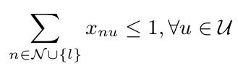
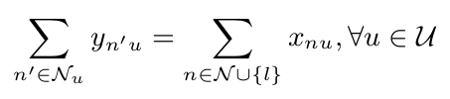
Formulation
Indices :
u = {1,..,U} : Users
n = {1,..,N, l } : Nodes, where l is the centralized cloud
e = {1,...,E} : links between nodes, directed
Constants
c_{e} : Capacity of link w
l_{e} : latency introduced at link e, can be formulated as a function of load in future. 1/(c_{e} - y_{e})
a_{ev} = 1 if link e originates at node v; 0, otherwise
b_{ev} = 1 if link e terminates at node v; 0, otherwise
W_{su} = price of the service requested by user u
Variables
x_{nu} : binary variable. 1 if the request of user u is served at node n, 0 otherwise.
y_{n’u} : binary variable. 1 if the user u access the network through node n’ where n’ ∈ N_{u} , 0 otherwise
u_{ue} : binary variable. 1 if the link e is used while serving the user u, 0 otherwise. (can be changed to volume if we want to allow flow splitting.)
Constraints
1. A user can be served at most one location or neglected:
2. If a user is to be served the user needs to access the network through any of its access nodes, otherwise it shouldn’t access to the network and waste resources at access nodes:
10
Notes:
10

Slide 11
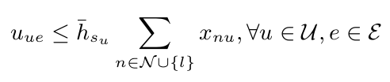

Formulation
Indices :
u = {1,..,U} : Users
n = {1,..,N, l } : Nodes, where l is the centralized cloud
e = {1,...,E} : links between nodes, directed
Constants
c_{e} : Capacity of link w
l_{e} : latency introduced at link e, can be formulated as a function of load in future. 1/(c_{e} - y_{e})
a_{ev} = 1 if link e originates at node v; 0, otherwise
b_{ev} = 1 if link e terminates at node v; 0, otherwise
W_{su} = price of the service requested by user u
Variables
x_{nu} : binary variable. 1 if the request of user u is served at node n, 0 otherwise.
y_{n’u} : binary variable. 1 if the user u access the network through node n’ where n’ ∈ N_{u} , 0 otherwise
u_{ue} : binary variable. 1 if the link e is used while serving the user u, 0 otherwise. (can be changed to volume if we want to allow flow splitting.)
Constraints
3. The flow generated by user u should be allocated to links if and only if that user is to be served:
4. Each link has a capacity bound. The total flow realized on a link should be less than this capacity:
11
Notes:
11

Slide 12

Formulation
Indices :
u = {1,..,U} : Users
n = {1,..,N, l } : Nodes, where l is the centralized cloud
e = {1,...,E} : links between nodes, directed
Constants
c_{e} : Capacity of link w
l_{e} : latency introduced at link e, can be formulated as a function of load in future. 1/(c_{e} - y_{e})
a_{ev} = 1 if link e originates at node v; 0, otherwise
b_{ev} = 1 if link e terminates at node v; 0, otherwise
W_{su} = price of the service requested by user u
Variables
x_{nu} : binary variable. 1 if the request of user u is served at node n, 0 otherwise.
y_{n’u} : binary variable. 1 if the user u access the network through node n’ where n’ ∈ N_{u} , 0 otherwise
u_{ue} : binary variable. 1 if the link e is used while serving the user u, 0 otherwise. (can be changed to volume if we want to allow flow splitting.)
Constraints
5. The total delay experienced over the network by a service flow should be less than end to end latency requirement of the service:
if the service will not be served this constraint is trivially satisfied by the constraint (4)
12
Notes:
12

Slide 13

Formulation
Indices :
u = {1,..,U} : Users
n = {1,..,N, l } : Nodes, where l is the centralized cloud
e = {1,...,E} : links between nodes, directed
Constants
c_{e} : Capacity of link w
l_{e} : latency introduced at link e, can be formulated as a function of load in future. 1/(c_{e} - y_{e})
a_{ev} = 1 if link e originates at node v; 0, otherwise
b_{ev} = 1 if link e terminates at node v; 0, otherwise
W_{su} = price of the service requested by user u
Variables
x_{nu} : binary variable. 1 if the request of user u is served at node n, 0 otherwise.
y_{n’u} : binary variable. 1 if the user u access the network through node n’ where n’ ∈ N_{u} , 0 otherwise
u_{ue} : binary variable. 1 if the link e is used while serving the user u, 0 otherwise. (can be changed to volume if we want to allow flow splitting.)
Constraints
6. For any node in the network the flow conservation should be satisfied, i.e the summation of total incoming flows and flows generated at that node should be the summation of total outgoing flows and flows destined to that node:
13
Notes:
13

Slide 14
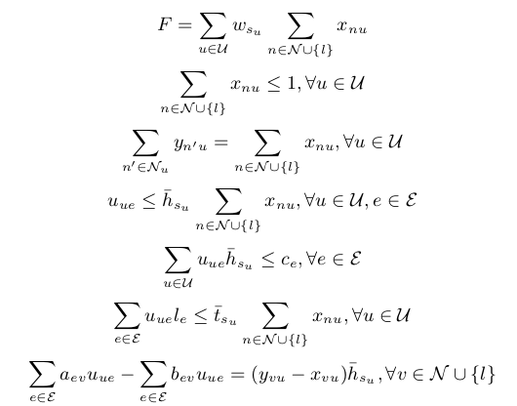
Indices :
u = {1,..,U} : Users
n = {1,..,N, l } : Nodes, where l is the centralized cloud
e = {1,...,E} : links between nodes, directed
Constants
c_{e} : Capacity of link w
l_{e} : latency introduced at link e, can be formulated as a function of load in future. 1/(c_{e} - y_{e})
a_{ev} = 1 if link e originates at node v; 0, otherwise
b_{ev} = 1 if link e terminates at node v; 0, otherwise
W_{su} = price of the service requested by user u
Variables
x_{nu} : binary variable. 1 if the request of user u is served at node n, 0 otherwise.
y_{n’u} : binary variable. 1 if the user u access the network through node n’ where n’ ∈ N_{u} , 0 otherwise
u_{ue} : binary variable. 1 if the link e is used while serving the user u, 0 otherwise. (can be changed to volume if we want to allow flow splitting.)
Maximize
Subject to

Slide 15
Heuristic 1
Bottom up approach
Heuristic 2
Top to bottom approach
15
Notes:
15

Slide 16
Heuristic 2
Basic idea
Iteration with sub-mixed integer programming.
More integer variables, more time the algorithm will take. We can make iterative procedures to optimize the objective function with less integer variables.
In our model, we have binary variable: access_indicator (y_{n’u}),link_indicator (u_{ue}) and server_indicator(x_{nu}). But when we fix link_indicator and access_indicator to binary variables, the server_indicator will be binary automatically.
So we fix link_indicator to be binary, and get ‘binary’ access_indicator iteratively. During the iteration, we add more constraints to the model according to the output of each iteration to gradually get the mixed integer solution.
16
Notes:
(constrain flow to route at most one path)
16

Slide 17
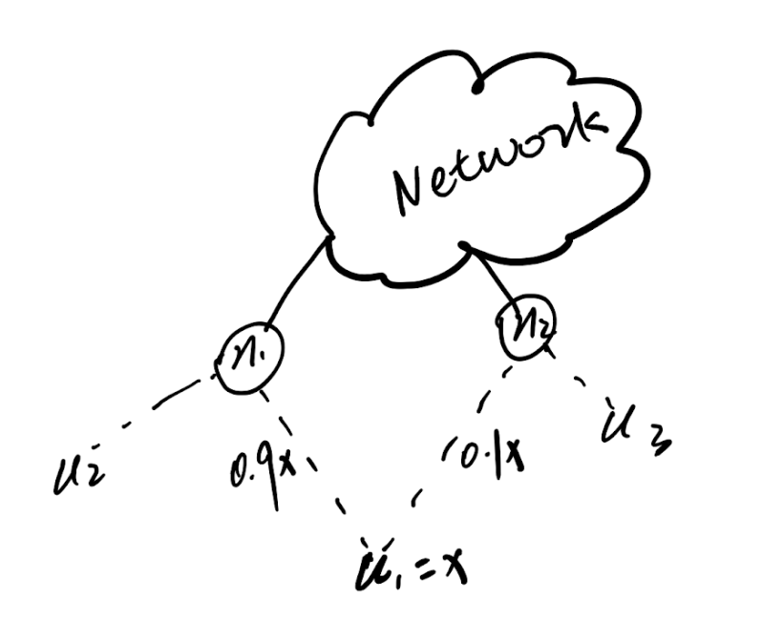
Heuristic 2
Algorithm
The most intuitive idea is to fix access_indicator =1 as soon as they become 1 in the iterative procedure.
How about < 1?
Increase 0.9 to 1?
(may cause infeasible solution)
17
Notes:
17

Slide 18
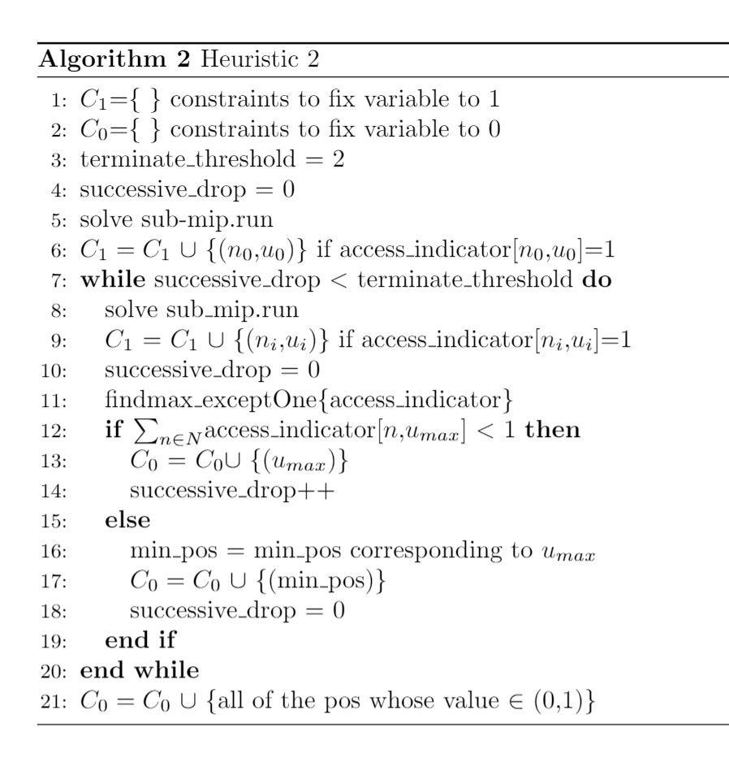
Heuristic 2
Algorithm here
Idea:
Try to increase these majority part of flow to one by reducing the minority to zero, which will guarantee the feasible solution.
If majority of u_{i} came to 1 → Fix to 1.
If not, sum(all flow of u_{i}) < 1 → drop off
Successive drop off will terminate the iteration.
18
Notes:
Because it has relatively the higher probability to became 1
18

Slide 19
Heuristic 2
Two important properties:
Property 1: We just drop off user x if and only if it has the lowest value on the access node of the flow’s majority part.
Property 2:For these user who is not drop off. If the shortest path can not accommodate this user, it will choose the second shortest path. If the second shortest path can not do either, then the third …
19
Notes:
19

Slide 20
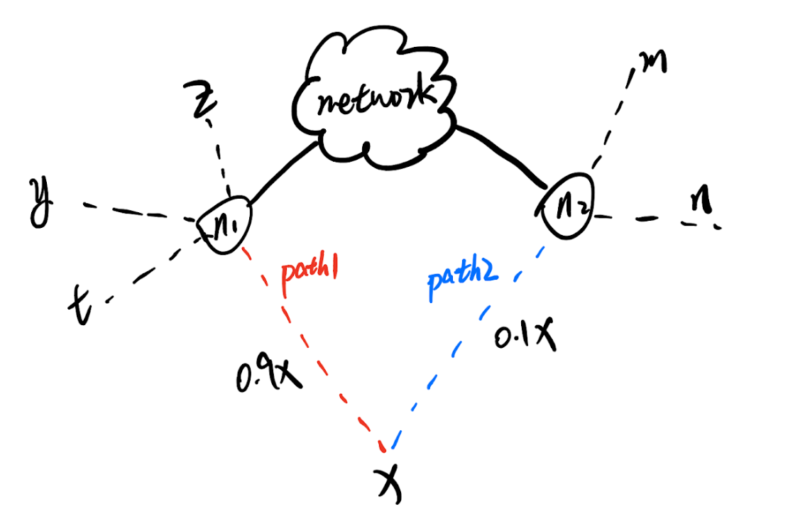
Heuristic 2
Sketch proof on two splits:
Two cases:
Path1 is the SP:
X.v = min{V_{n1}}
Decrease 0.1x to 0, then due to X.v = min{V_n1}, 0.9x can not increase(not infect y,z,t).
sum{flow of user x}<1 drop off in the future iteration. →property 1
Path 2 is the SP:
X.v = min{V_{n2}}
if X.v = max{V_{n1}}
decrease 0.1x to 0 will have 0.9x→ (0.9+0.1)x →property 2
if X.v = min{V_{n1}}
decrease 0.1x to 0 will not infect y,z,t .Then 0.9x will be kept and drop off in the future iteration. → property 1
else(y.v<z.v<x.v<t.v)
decrease 0.1x to 0 will lead to 0.9x→(0.9x+wx)
First result: 0.9x→ (0.9+0.1)x →property 2
Second result: w<0.1(after remove y and z on node1→
X.v = min{V_{n1}}) →(0.9x+wx)<1→
drop off→property 1
Split happens when the available shortest path(SP) can not fully accommodate one user.
In our model:
Each node can serve/access at least one service.
Each node can serve all services, so service type does not matter for node. The value of each service matters. →Only the Higher value flow effects the lower value flow
Figure here

Slide 21
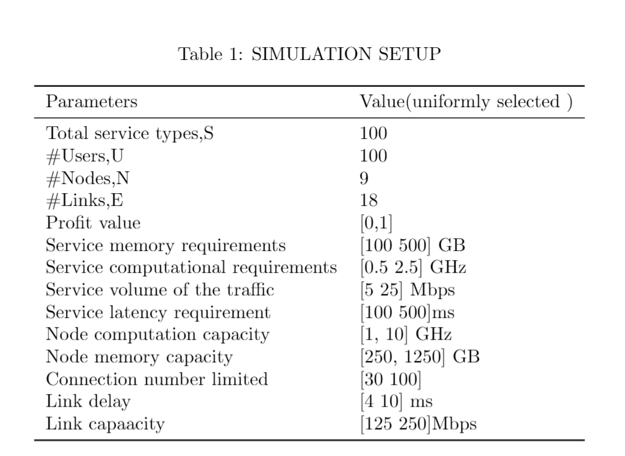
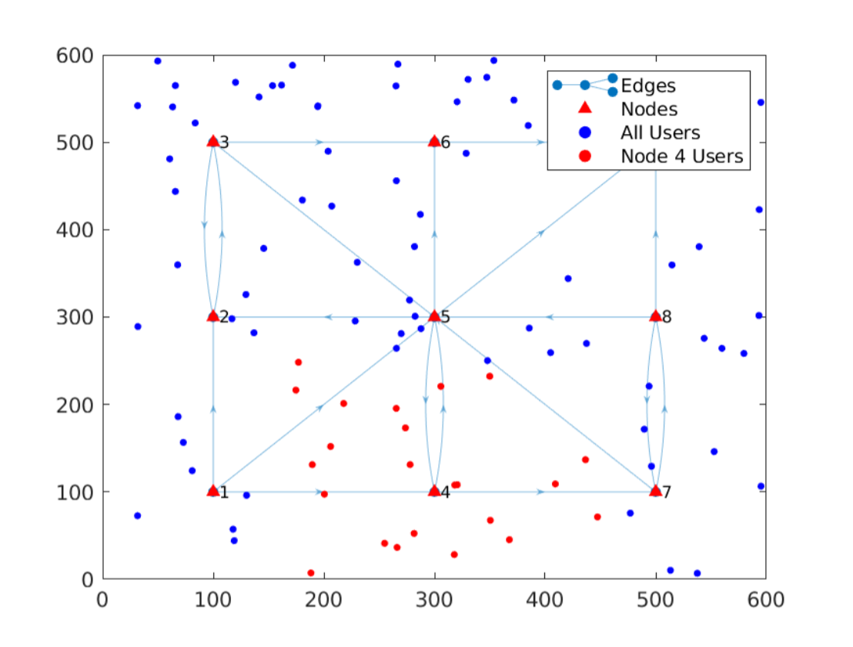
Experiments
simulator

Slide 22
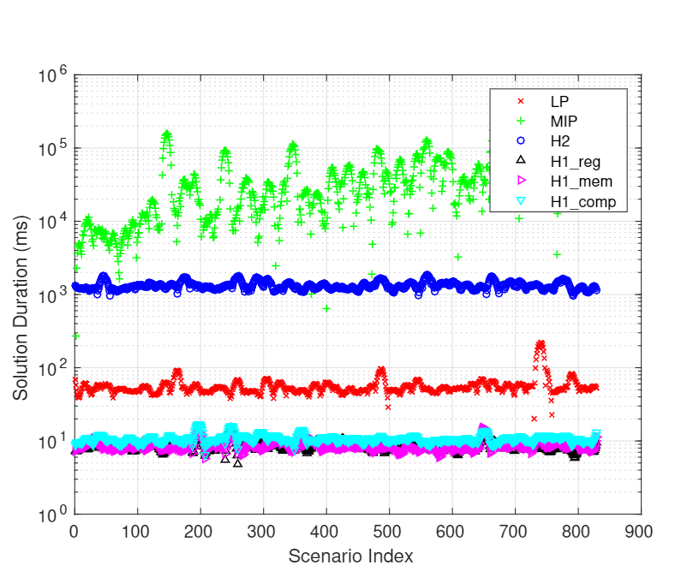
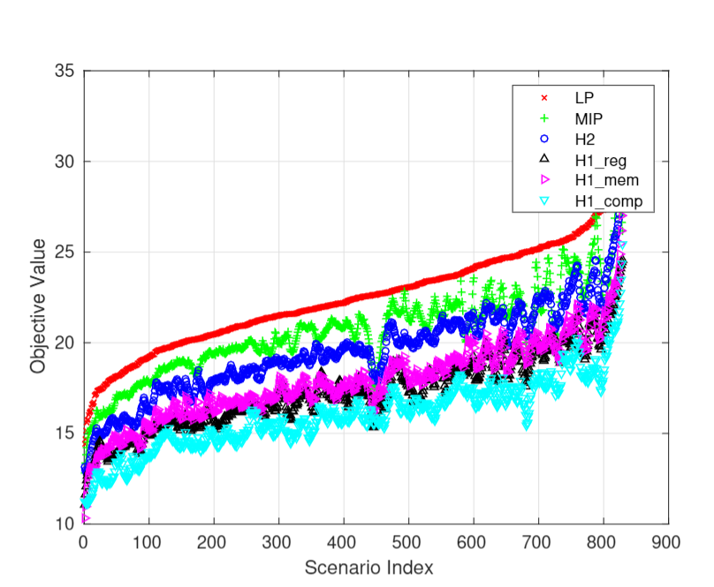
Heuristic 2
Experiments
22
Notes:
22

Slide 23
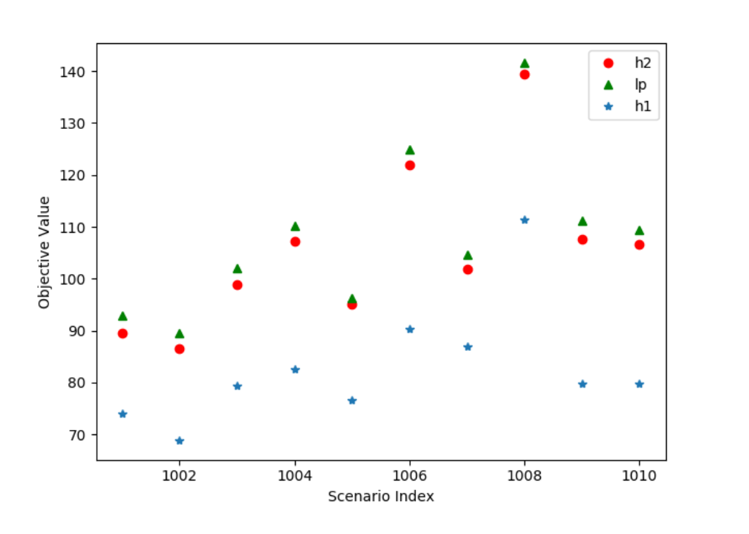
500 users

Slide 24
Heuristic 2
Summary
Pros:
Achieve good approximation(5% loss) for mixed integer programming with much less computation.
Used less memory for computation compared with the original MIP
Solution duration is much more stable than mip’s.
Adjustable(parameters, terminate condition)
Cons:
Still mixed integer programming in each iteration(LP in future work)
24
Notes:
24

Slide 25
Thank you!
Q&A
25

