Slide 1
Introduction to Linux
Week 1
Chen Liu

Slide 2
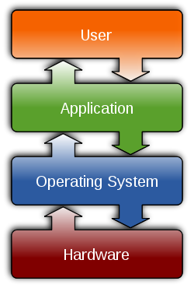
Operating System
  Interface between application and hardware
    Process Management
    Memory Management
    File Systems
    Hardware Drivers
    Networking
    Security
http://en.wikipedia.org/wiki/Operating_system
Notes:
Operating System is a piece of software acting as the interface between application and hardware. It manage hardware devices using interrupts and drivers, manage storage resources using memory management technique and building a file system to store files on harddisks. It also manage all the applications running on it using process management and security options. Last but not least, it provides the basic interface of networking with other devices.

Slide 3
Brief History of Operating System
  The Dark Ages
    Manually loaded programs
    Reboot after each program
    Programming on different machines requires rewriting
  OS/360
    Batch operating system
    Single OS spanning the whole product line
    Managing hardware resources

Slide 4
Brief History of Operating System
  Unix
    Multi-task multi-user (Unics -> Unix)
    Migrates from assembler to C in 1972
    Paged virtual memory
    Hierarchical File system (Tom and Richie)
  Linux
    Linus Torvalds
    MINIX
  POSIX Standard
Read more: http://www.bell-labs.com/history/unix/

Slide 5


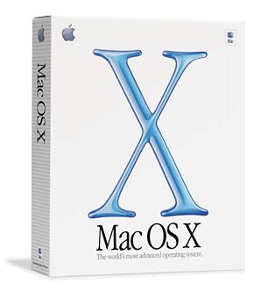


Modern Operating Systems

Slide 6
Why Linux?
  Cost
    Free
    Free applications
  Quality
    Stability
    Reliability
  Open Source
    Good community, heavily documented
    Widely used among researchers and developers
    Customizable at OS level

Slide 7
User Interfaces: CLI vs GUI
CLI - Command Line Interface
  Steep learning curve
  More control
  Cumbersome multitasking
  Speed with commands
  Low resources
  Power of scripting
  Convenient remote access
GUI - Graphic User Interface
  Intuitive to use
  Limited by interface
  Easy multitasking
  Limited by pointing
  Graphic eats resources
  Difficult to automate
  Graphical remote access
http://www.computerhope.com/issues/ch000619.htm

Slide 8
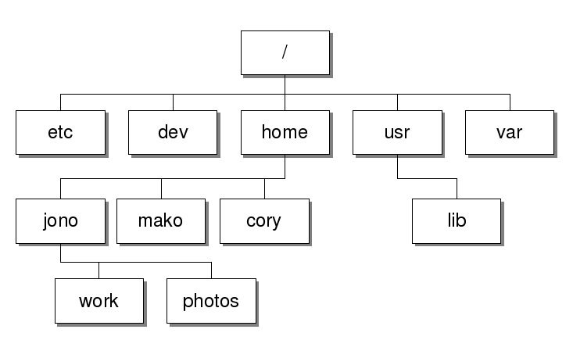
Unix File Systems
  File
    Data items / documents (text, music, video, etc.)
    Link to another file
    Directory: collection of files
    Associated with devices
    Associated with processes
    Everything is a file
  Tree structured hierarchy
  Path
    /users/home/jono/work/

Slide 9
The Basics: Linux command
  man <command>
    Show the manual of the given command
    Always using man to lookup the usage of command parameters
  which <command>
    Show you the path of the command
  Navigating with command history in bash
    <up arrow>: previous command
    <tab>: auto-complete

Slide 10
The Basics: Moving Around
  pwd: print working directory
  cd: change working directory
  ~: home directory
  .: current directory
  ..: parent directory
  /: root directory

Slide 11
The Basics: Manipulating Files
  mv: move (rename) a file
  cp: copy a file
  rm: remove a file (no trash bin available!)
    -r: recursively remove files under the file in the hierarchy
  ln: create a link (shortcut) of a file
    -s: create a symbolic link
  mkdir: make a directory
  rmdir: remove a directory
  ls: list contents of a directory
    -l: long format listing, showing details info of files
    -a: list all files including hidden ones
    ls -lah
    man ls
Use man to look up the full usage!

Slide 12
The Basics: File Attributes
  Listing files with attributes: ls –l
  Permission bits:
  Change permission:
    chmod
    chmod u+x myfile: gives user execution permission on my file
    chmod 751 myfile: gives user full permission, group read & execute permission and other only execute permission.
1 | 2 | 3 | 4 | 5 | 6 | 7 | 8 | 9 | 10
File Type | User Permissions |  |  | Group Permissions |  |  | Other Permission
 | Read | Write | Execute | Read | Write | Execute | Read | Write | Execute
d | r | w | e | r | w | e | r | w | e

Slide 13
The Basics: Read Text Files
  cat: output content of file to stdout
  less: read content of file
    f: next page
    b: previous page
    /<string>: search for a string in the text
    n: next occurrence
    Man page is viewed with less by default!

Slide 14
Text Editor: VIM
Command line text editor
Not WYSIWYG
Powerful editing command
Tutorial:
blog.interlinked.org/tutorials/vim_tutorial.html
$vimtutor

Slide 15
Modes of VIM
Command Mode (<esc> to enter)
  All key strokes are interpreted as commands
  VIM starts with command mode
  <count> <command> <object>
Insert mode (i, a, I, A etc. to enter)
  Most keystrokes are interpreted as text
  Input text
Visual mode (v, V, ^v, <esc> to enter)
  Helps to visually select some text

Slide 16
Basic VIM
Close / Save
Move around
Editing
Visual Block
Search / Replace

Slide 17
Linux Command Revisited
Unix command philosophy
  Do one thing well
  Default to standard I/O
  Don’t be chatty
  Outputs is compatible to inputs
  Regular expressions (in next lecture)

Slide 18
Linux Command Revisited
Toolbox philosophy
  Combine single purpose tools into useful gadgets
Pipeline
  Redirect the output of the first tool to the input of the following one.
  ls | wc, ls | less
  Often useful with | grep
  man ls | grep “\-a”
  More about grep and pipeline in the next lecture!

Slide 19
More commands: Redirection
  >: write stdout to a file
  >>: append stdout to a file
  <: use contents of a file as stdin

Slide 20
More commands: Manage Processes
  ps: report a snapshot of current processes
  top: dynamic view of linux tasks
  kill: send a terminate signal to a process
Notes:
top: monitoring processes
ps: write information about processes, subject to having appropriate privileges to obtain information about those processes.

Slide 21
Text Editor: Emacs
Powerful Text Editor
Can be everything but a WYSIWYG editor
  Debug programs
  Check emails
  … basically everything
Command prefix
  C, M, Escape prefix
No mode switching
X window support

Slide 22
Basic Emacs
Close / Save
Move around
Editing
Mark and region
Search / replace

