Slide 1
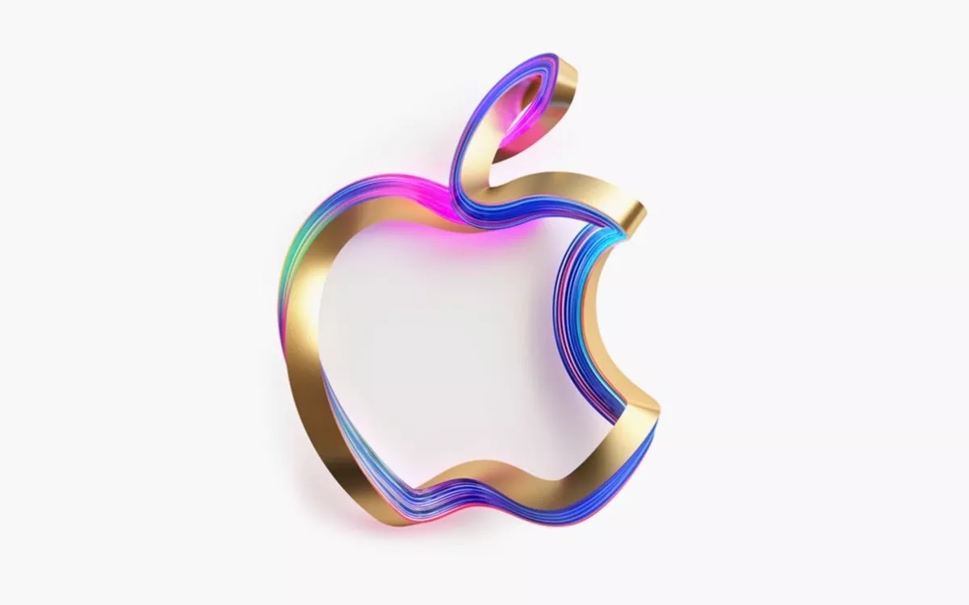
APPLE DIY SERVICE
Jerry Yang (tao)
Qifeng Wu
Austin Budhram
Chuancheng Zhang
Chen liu
Li Hua Liao

Slide 2
SWOT
Strength:
-A unique DIY product
-Increase Revenue
-Bring in more customers
Opportunity:
-Meet different needs
-Creativity
-The company can get design inspiration
Weakness:
-Increase in shipping costs
-No return or exchange service
-New Product Line Needed
Threat:
- Customer will shift their purchase with bad price or service
-Competitors can imitate once it’s success is proven
-Service can be replaced by phone cases

Slide 3
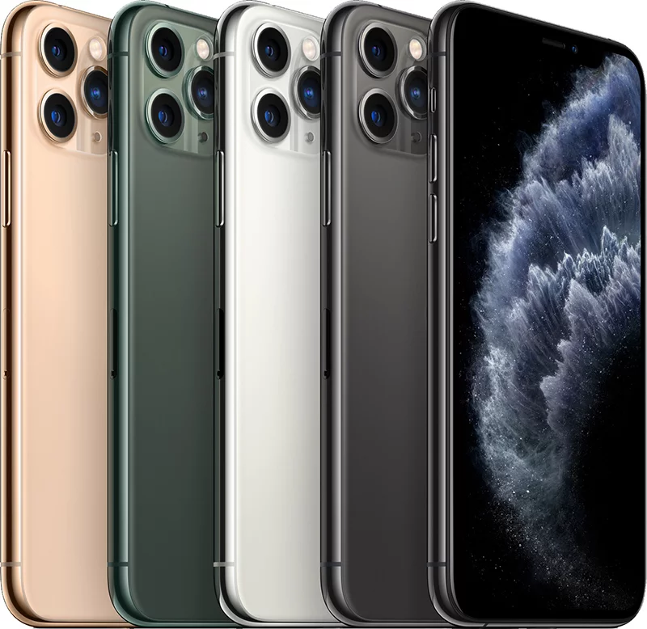
Marketing Objective
To develop brand loyalty
Increase revenue and sales, as well as number of new clients
value gains achieved by their customers
Gain 15% of customization sales throughout the years

Slide 4
Target Market and Positioning Statement
1. Primary target market
Age：between 50-15
Monthly salary below 3k，or annual household income 35k-60k
Love fashion and new technology
2. Secondary target market:
Age：between 50-15
Monthly salary above 3k, or annual household income above 60k
have different positions on themselves than ordinary consumers
Positioning:
Merging fashion technology and customer ideas and make customers more satisfied and confident with their Apple devices.

Slide 5
Product, Price, Place & Promotion
Price:
$150 for all physical customization options, including design, logos, and lettering.
Premium upgrades (including physical customizations, graphics card, improved battery, scratch-resilient screen) will carry an additional cost.
Product:
Do-it-yourself service allows full customization options for customers
Can order, design, and receive service, all from the comfort of your home
Place:
Three Major Markets: US, Europe, China
Apple Store and www.apple.com Only
Promotion:
No Substantial Discount
$30 Gift Card during first month of launching

