Slide 1





Final Game Team Dog

Slide 2
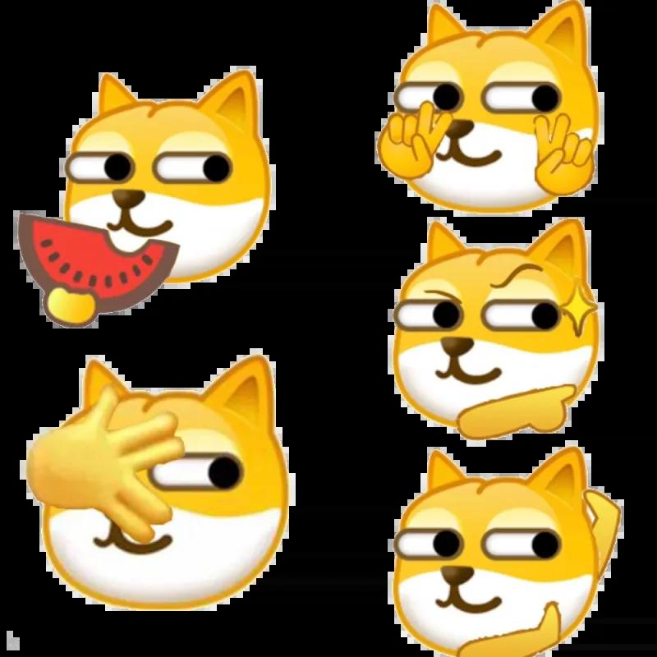
About our team
Team Lead: Lize Chen
Tech Lead: Huaminghui Ding
Documentation Lead: Tingting Li
Developer: Daolun Chen
Developer: Ruimin Li
Developer: Yichen Sun
Developer: Junhao Yu

Slide 3
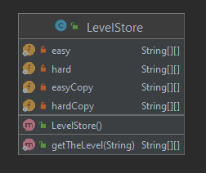
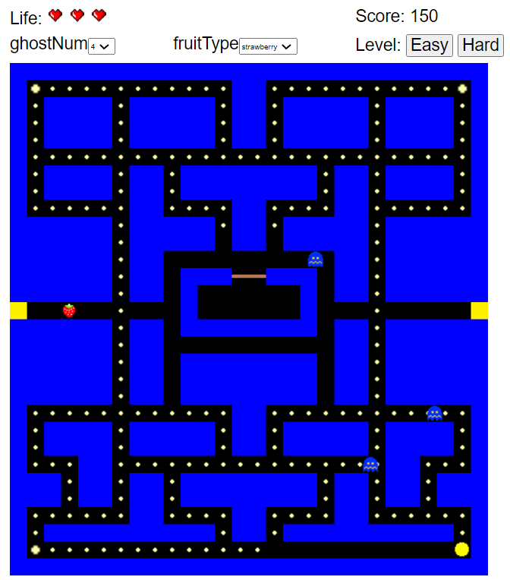
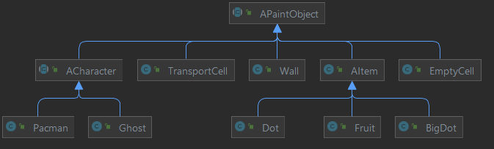
Game Initialization
1. Select the number of ghost and type of fruit.
2. Click easy or hard button.
3. Use WASD or Arrow Key to let Pac-Man move.
W B b R G: Wall of different colors
D: Dot
L: BigDot
E: EmptyWall
S: Fruit
P: pacman
T: TransportCell
1: red
2: pink
3: orange
4: cyan

Slide 4

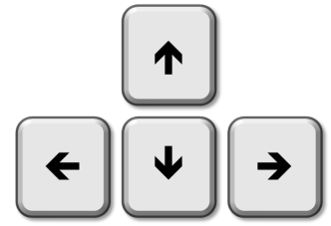


Pac-man movement
Move: WASD or arrow keys
Eat items:
small dots – 10
large dots – 50
fruit – 100
ghosts in the
same turn – 200/400/800/1600
Avoid walls: move in the passage
Transport Wall: exit A and enter B

Slide 5
User Extensible
The game map will change to a different level based on the user’s selection.
The number of ghosts can change from one to four. The more ghosts, the harder for Pac-man to avoid the ghosts.
The type of fruit can be changed based on the selection like apple and strawberry.
Notes:
Self-design the original map, and the game map will change to your personalized layout. (More ghosts, more dots, complex wall, etc.)
In the higher level of game, ghosts will speed up and intervals of strategy switching will be modified.
Ghost strategies are extensible and can be more challenging.

Slide 6
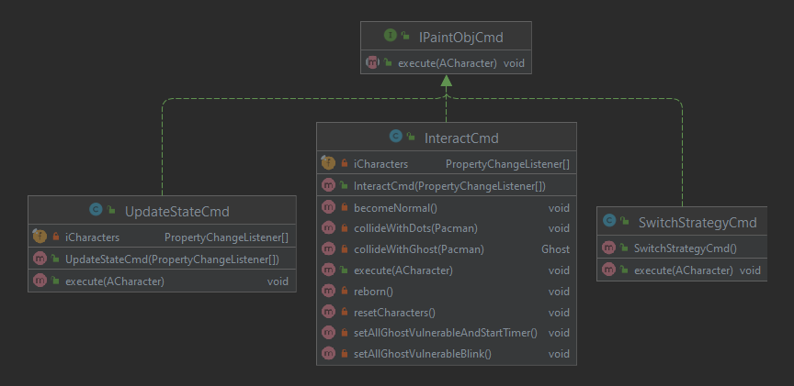
Interact between Pac-man and Items
Command design pattern
pass commands to receivers in the Pac-man world (interaction between items, update locations, switch strategies…)

Slide 7
Ghost movement
Mode | Description
Chasing | The ghosts will actively pursue the Pac-Man using pre-defined behaviors.
Frightened | The ghosts turn dark blue and then start flashing using random strategy.
Dead | The ghosts become two eyes and travel quickly to the square box in the middle of the screen. The strategy will back to the born strategy after the ghost comes out again.

Slide 8
Ghost Strategy
Color | Target | Strategy | Description
Red | Pac-Man | ChaseStrategy | The red ghost will target at the location of Pac-Man and get closer to it. (A star algorithm)
Pink | Four units ahead of Pan-Man’s direction | AmbushStrategy | The pink ghost will target ahead of Pac-Man four units and get closer to it.
Orange | Pac-Man/zone in corner | StupidStrategy | Within 8 squares: back to its zone in a pre-defined corner. More than 8 squares: same as red using chase strategy
Cyan | Based on distance | AvoidStrategy | Avoid the Pac-man basing on the distance from Pac-man to ghost. Pac-man will never meet Cyan.

Slide 9
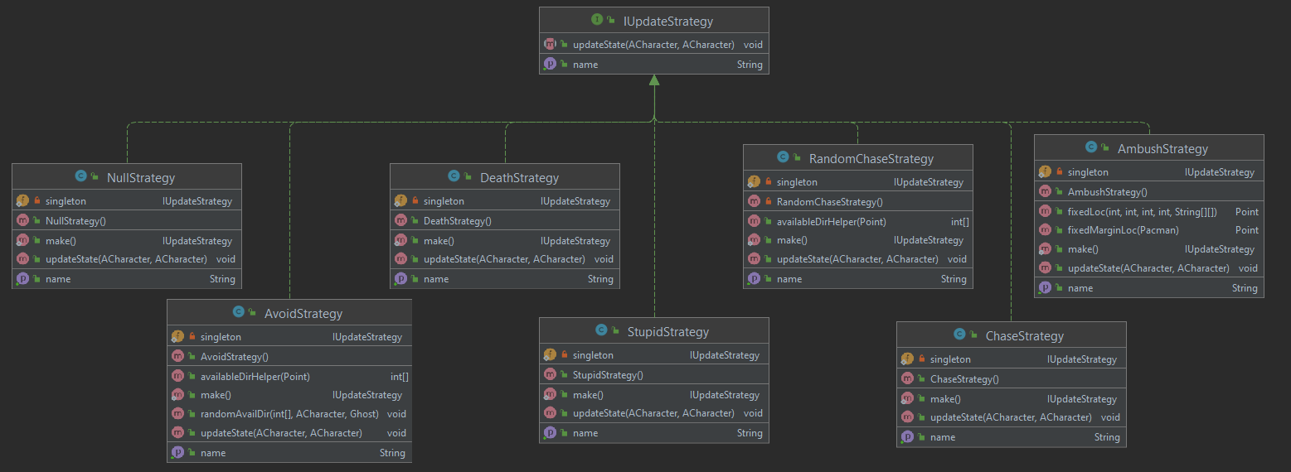
Ghost Strategy

Slide 10
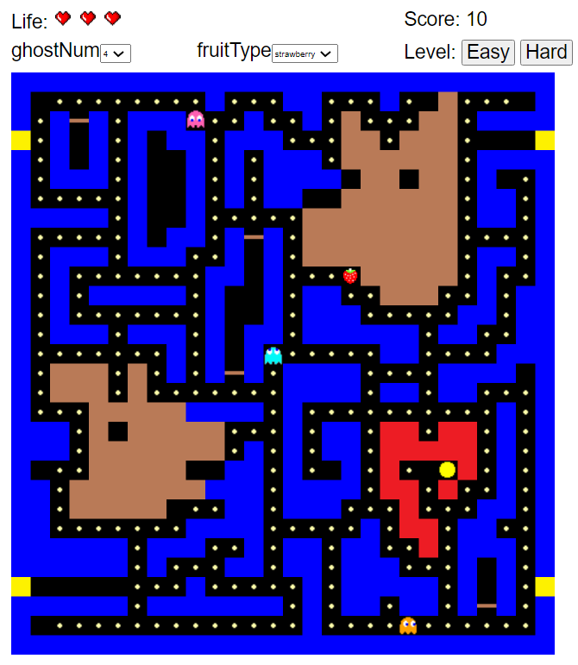
Our Pac-Man game
https://pacman-final-team-dog.herokuapp.com/

Slide 11

Thank you!

