Slide 1

CSC 335
Puzzle Platformer
Eujin Ko, Lize Chen,
Perry Wang, Suyang Chen

Slide 2
Basic Movement
Go Left: Press “<=”
Go Right: Press “=>”
Jump: Press “space”

Slide 3
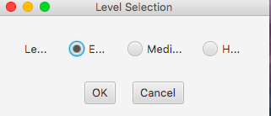
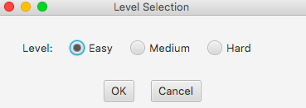
Game started pressed
You can make the window big as you like to
See better

Slide 4
game level rules:
You can move the red box with circle around you by left and right mouse with jump(space)
K button: if you pick up key and press “K” when you around the door, you will open it
The little box could be push
The pink circle around red box could kill the monster
Key: as for the key, you can pick it up by pass it and on the right side, the keys number would increase
Countdown: there is a timing section which set amount time for user to play
health: user have three hearts to use
The attack pink circle would inside one of the key, you pick up key and have attack circle

Slide 5
