Slide 1
Semantic Analysis
TeachING Assistant: David Trabish

Slide 2
Semantic Analysis
Perform various checks:
Type checking
1 + “1”
Scopes
Undefined variables
Other
Division by zero
Visibility semantics in classes (public, private, …)

Slide 3
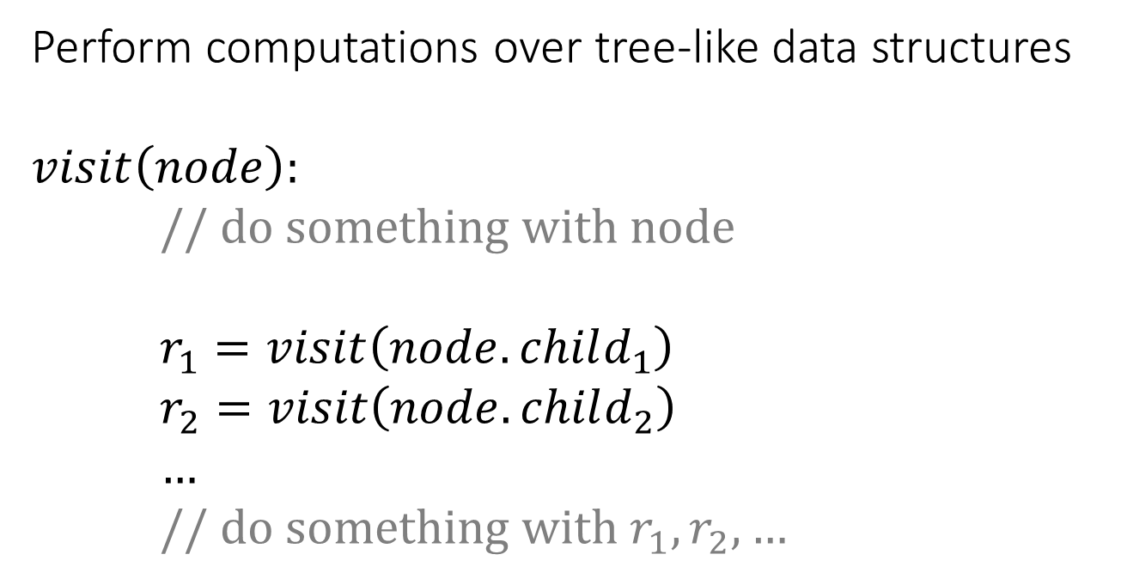
Visitor Design Pattern
Perform computations over tree-like data structures
$$visit\left(node\right):$$
// do something with node
$r_{1}=visit\left(node.child_{1}\right)$
$r_{2}=visit\left(node.child_{2}\right)$
$…$
// do something with $r_{1},r_{2},…$
…

Slide 4
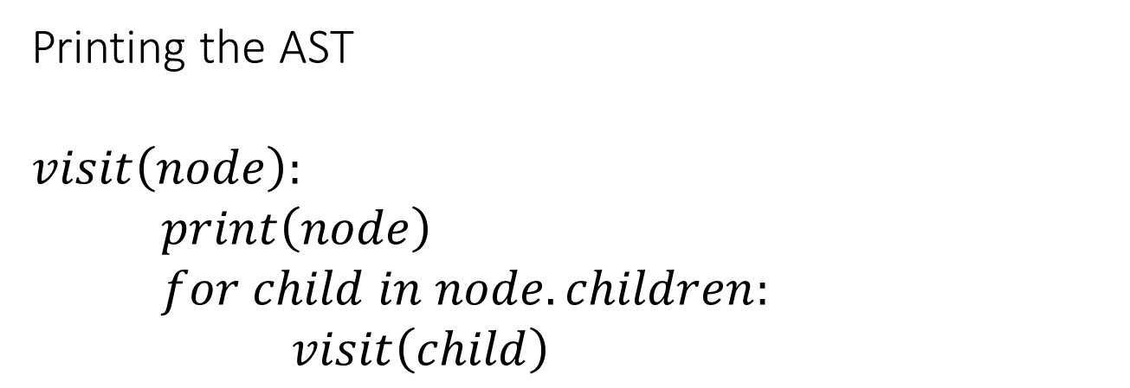
Visitor Design Pattern: Example
Printing the AST
$$visit\left(node\right):$$
$print\left(node\right)$
$for child in node.children:$
$visit\left(child\right)$

Slide 5
Symbol Table
Stack of scopes
Each scope contains information about identifiers
Name
Type (int, string, …)
Kind (variable, function, method, …)

Slide 6



Symbol Table
main scope
top of stack
ID | Type | Kind
main | int, void | function
msg | string | variable
ID | Type | Kind
x | int | variable
y | int | variable
…
ID | Type | Kind
result | int | variable
y | string | variable
$$scope_{1}$$
$$scope_{2}$$
$$scope_{n}$$

Slide 7
Symbol Table Operations
Insert symbol
Lookup symbol
Enter scope
Exit scope

Slide 8


Symbol Table: Insert
Example:
Insert(z, int, variable)
main scope
ID | Type | Kind
x | int | variable
y | int | variable
ID | Type | Kind
tmp | int | variable
$$scope_{1}$$
$$scope_{2}$$

Slide 9
Symbol Table: Insert
Example:
Insert(z, int, variable)
main scope
ID | Type | Kind
x | int | variable
y | int | variable
ID | Type | Kind
tmp | int | variable
z | Int | variable
$$scope_{1}$$
$$scope_{2}$$

Slide 10
Symbol Table: Lookup
Example:
Lookup(y)
Start from the top of the stack, return first match
main scope
ID | Type | Kind
x | int | variable
y | int | variable
ID | Type | Kind
tmp | int | variable
$$scope_{1}$$
$$scope_{2}$$

Slide 11
Symbol Table: Lookup
Example:
Lookup(y)
Start from the top of the stack, return first match
main scope
ID | Type | Kind
x | int | variable
y | int | variable
ID | Type | Kind
tmp | int | variable
$$scope_{1}$$
$$scope_{2}$$

Slide 12
Symbol Table: Enter
main scope
ID | Type | Kind
x | int | variable
y | int | variable
ID | Type | Kind
tmp | int | variable
$$scope_{1}$$
$$scope_{2}$$

Slide 13

Symbol Table: Enter
main scope
ID | Type | Kind
x | int | variable
y | int | variable
ID | Type | Kind
tmp | int | variable
ID | Type | Kind
$$scope_{1}$$
$$scope_{2}$$
$$scope_{3}$$

Slide 14
Symbol Table: Exit
main scope
ID | Type | Kind
x | int | variable
y | int | variable
ID | Type | Kind
tmp | int | variable
$$scope_{1}$$
$$scope_{2}$$

Slide 15
Symbol Table: Exit
main scope
ID | Type | Kind
x | int | variable
y | int | variable
$$scope_{1}$$

Slide 16
Symbol Table Construction
Identifier declaration
Insert
Identifier reference
Lookup
When visiting a new block
Enter
When leaving a block
Exit

Slide 17
void foo(int x) {
int a = 1;
int b = 2;
if (x) {
string a = “abc”;
}
}
Function
foo
Type
void,int
Param
x
Statements
Type
int

Slide 18
void foo(int x) {
int a = 1;
int b = 2;
if (x) {
string a = “abc”;
}
}
Function
foo
Type
void,int
Param
x
Statements
Type
int
ID | Type | Kind
foo | void,int | function

Slide 19
void foo(int x) {
int a = 1;
int b = 2;
if (x) {
string a = “abc”;
}
}
Function
foo
Type
void,int
Param
x
Statements
Type
int
ID | Type | Kind
foo | void,int | function
ID | Type | Kind

Slide 20
void foo(int x) {
int a = 1;
int b = 2;
if (x) {
string a = “abc”;
}
}
Function
foo
Type
void,int
Param
x
Statements
Type
int
ID | Type | Kind
foo | void,int | function
ID | Type | Kind
x | int | variable

Slide 21
void foo(int x) {
int a = 1;
int b = 2;
if (x) {
string a = “abc”;
}
}
Function
foo
Statements
Assign
ID | Type | Kind
foo | void,int | function
Type
int
INT
1
Var
a
ID | Type | Kind
x | int | variable
a | int | variable

Slide 22
void foo(int x) {
int a = 1;
int b = 2;
if (x) {
string a = “abc”;
}
}
Function
foo
Statements
Assign
ID | Type | Kind
foo | void,int | function
Type
int
INT
2
Var
b
ID | Type | Kind
x | int | variable
a | int | variable
b | int | variable

Slide 23
void foo(int x) {
int a = 1;
int b = 2;
if (x) {
string a = “abc”;
}
}
Function
foo
Statements
If
ID | Type | Kind
foo | void,int | function
Var
x
Assign
ID | Type | Kind
x | int | variable
a | int | variable
b | int | variable
ID | Type | Kind

Slide 24
void foo(int x) {
int a = 1;
int b = 2;
if (x) {
string a = “abc”;
}
}
Function
foo
Statements
If
ID | Type | Kind
foo | void,int | function
Var
x
Assign
ID | Type | Kind
x | int | variable
a | int | variable
b | int | variable
ID | Type | Kind

Slide 25
void foo(int x) {
int a = 1;
int b = 2;
if (x) {
string a = “abc”;
}
}
Function
foo
Statements
If
ID | Type | Kind
foo | void,int | function
Var
x
Assign
ID | Type | Kind
x | int | variable
a | int | variable
b | int | variable
Type
string
Var
a
String
abc
ID | Type | Kind
a | string | variable

Slide 26
void foo(int x) {
int a = 1;
int b = 2;
if (x) {
string a = “abc”;
}
}
Function
foo
Statements
If
ID | Type | Kind
foo | void,int | function
Var
x
Assign
ID | Type | Kind
x | int | variable
a | int | variable
b | int | variable
Type
string
Var
a
String
abc

Slide 27
void foo(int x) {
int a = 1;
int b = 2;
if (x) {
string a = “abc”;
}
}
Function
foo
Statements
ID | Type | Kind
foo | void,int | function

Slide 28
void foo(int x) {
int a = 1;
int b = 2;
if (x) {
string a = “abc”;
}
}

Slide 29
Type Checking
Goals:
Type correctness of expressions
Compute type of expressions
Performed using:
AST visitor
Symbol table

Slide 30
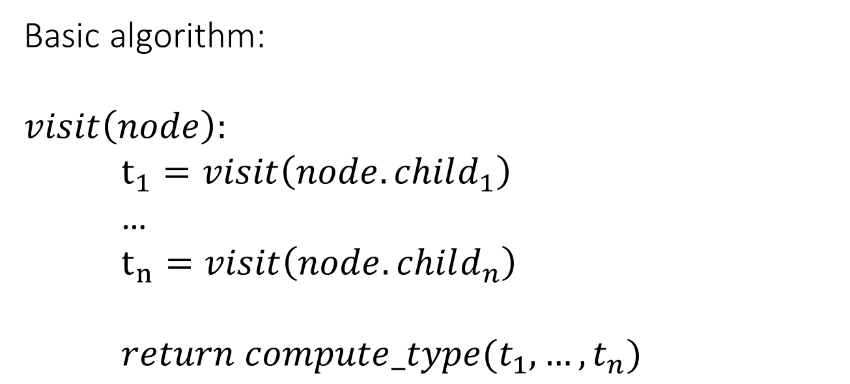
Type Checking
Basic algorithm:
$$visit\left(node\right):$$
$t_{1}=visit\left(node.child_{1}\right)$
…
$t_{n}=visit\left(node.child_{n}\right)$
$return compute_type(t_{1},…,t_{n})$
…
node specific

Slide 31
int a = foo() + b - 7;
...
Assign
Type
int
Var
a
Binop
-
ID | Type | Kind
foo | int,void | function
Binop
+
INT
7
ID | Type | Kind
b | int | variable
Call
foo
Var
b

Slide 32
int a = foo() + b - 7;
...
Assign
Type
int
Var
a
Binop
-
ID | Type | Kind
foo | int,void | function
Binop
+
INT
7
ID | Type | Kind
b | int | variable
Call
foo
Var
b

Slide 33
int a = foo() + b - 7;
...
Assign
Type
int
Var
a
Binop
-
ID | Type | Kind
foo | int,void | function
Binop
+
INT
7
ID | Type | Kind
b | int | variable
Call
foo
Var
b

Slide 34
int a = foo() + b - 7;
...
Assign
Type
int
Var
a
Binop
-
ID | Type | Kind
foo | int,void | function
Binop
+
INT
7
ID | Type | Kind
b | int | variable
Call
foo
Var
b

Slide 35
int a = foo() + b - 7;
...
Assign
Type
int
Var
a
Binop
-
ID | Type | Kind
foo | int,void | function
Binop
+
INT
7
ID | Type | Kind
b | int | variable
Call
foo
Var
b
int

Slide 36
int a = foo() + b - 7;
...
Assign
Type
int
Var
a
Binop
-
ID | Type | Kind
foo | int,void | function
Binop
+
INT
7
ID | Type | Kind
b | int | variable
Call
foo
Var
b
int
int

Slide 37
int a = foo() + b - 7;
...
Assign
Type
int
Var
a
Binop
-
ID | Type | Kind
foo | int,void | function
Binop
+
INT
7
int
ID | Type | Kind
b | int | variable
Call
foo
Var
b
int
int

Slide 38
int a = foo() + b - 7;
...
Assign
Type
int
Var
a
Binop
-
ID | Type | Kind
foo | int,void | function
Binop
+
INT
7
int
int
ID | Type | Kind
b | int | variable
Call
foo
Var
b
int
int

Slide 39
int a = foo() + b - 7;
...
Assign
Type
int
Var
a
Binop
-
int
ID | Type | Kind
foo | int,void | function
Binop
+
INT
7
int
int
ID | Type | Kind
b | int | variable
Call
foo
Var
b
int
int

Slide 40
Examples

Slide 41
Assignments
Function
main
void main() {
int main = 0
j = 0;
}
Statements
Assign
Assign
Type
int
INT
0
Var
j
Var
main
INT
0

Slide 42
Assignments
Function
main
void main() {
int main = 0
j = 0;
}
Statements
Assign
Assign
Type
int
INT
0
Var
j
Var
main
INT
0
Invalid

Slide 43
Binary Operations
Function
main
void main() {
string x = “A”;
string y = “B”;
string z = x * y;
}
Statements
Assign
Assign
Assign
Binop
*
Type
int
Var
z
Var
x
Var
y

Slide 44
Binary Operations
Function
main
void main() {
string x = “A”;
string y = “B”;
string z = x * y;
}
Statements
Assign
Assign
Assign
Binop
*
Type
int
Var
z
Var
x
Var
y
Invalid

Slide 45
Binary Operations
Function
void main() {
int x = 7 / 0;
}
Statements
Assign
Binop
/
ID
int
Var
x
INT
7
INT
0

Slide 46
Binary Operations
Function
void main() {
int x = 7 / 0;
}
Statements
Assign
Binop
/
ID
int
Var
x
INT
7
INT
0
Invalid

Slide 47
If, While, …
Statements
void main() {
int x = 1;
if (x + 1) {
int z = 2;
}
}
If
Assign
Statements
Binop
+
Var
x
INT
1

Slide 48
If, While, …
Statements
void main() {
int x = 1;
if (x + 1) {
int z = 2;
}
}
If
Assign
Statements
Binop
+
Var
x
INT
1
Valid

Slide 49
Return Statement
Function
void main() {
int x = 1;
return x + 1;
}
Type
void
Statements
Assign
Return
Binop
+
Var
x
INT
1

Slide 50
Return Statement
Function
void main() {
int x = 1;
return x + 1;
}
Type
void
Statements
Assign
Return
Binop
+
Var
x
INT
1
Invalid

Slide 51
Function Calls
Function
main
int g(int x) {
return x + 1;
}
int main() {
string z = “...”
return g(z);
}
Type
int
Statements
Function
g
Assign
Return
Type
int
Param
x
Call
g
Type
int
Var
z

Slide 52
Function Calls
Function
main
int g(int x) {
return x + 1;
}
int main() {
string z = “...”
return g(z);
}
Type
int
Statements
Function
g
Assign
Return
Type
int
Param
x
Call
g
Type
int
Var
z
Invalid

Slide 53
Function Calls
Function
foo
int foo(int k) {
int a = k * 10;
return foo(a, a);
}
Type
int
Param
k
Statements
Assign
Return
Type
int
Call
foo
Var
a
Var
a

Slide 54
Function Calls
Function
foo
int foo(int k) {
int a = k * 10;
return foo(a, a);
}
Type
int
Param
k
Statements
Assign
Return
Type
int
Call
foo
Var
a
Var
a
Invalid

Slide 55
Arrays
Statements
void foo(int d) {
int k = 3;
int[] arr = new int[10];
arr[k] = 17;
}
Assign
Assign
Array
Var
arr
INT
17
Var
k
Type
int []
Var
arr
New
Array
Type
int
INT
10

Slide 56
Arrays
Statements
void foo(int d) {
int k = 3;
int[] arr = new int[10];
arr[k] = 17;
}
Assign
Assign
Array
Var
arr
INT
17
Var
k
Type
int []
Var
arr
New
Array
Type
int
INT
10
Valid

Slide 57
Classes
class A {
int x;
int y;
void foo(int) { }
}
x : int
y : int
foo : void, int
type of A

Slide 58
Program
Classes
Class
Base
Function
main
class Base {
int x;
}
void main() {
Base o = new Base;
o.y = 1;
}

Slide 59
Program
Classes
Class
Base
Function
main
class Base {
int x;
}
void main() {
Base o = new Base;
o.y = 1;
}
VarDec
x
Type
int

Slide 60


Program
Classes
Class
Base
Function
main
class Base {
int x;
}
void main() {
Base o = new Base;
o.y = 1;
}
VarDec
x
Type
int
ID | Type | Kind
Base | … | class
ID | Type | Kind
x | int | variable
$$scope_{1}$$
$$scope_{2}$$

Slide 61
Program
Classes
Class
Base
Function
main
class Base {
int x;
}
void main() {
Base o = new Base;
o.y = 1;
}
Statements
Assign
Assign
Type
Base
Var
o
New
Class
Base
Field
Var
o
INT
1
ID
y

Slide 62


Program
Classes
Class
Base
Function
main
class Base {
int x;
}
void main() {
Base o = new Base;
o.y = 1;
}
Statements
Assign
Assign
Type
Base
Var
o
New
Class
Base
Field
Var
o
INT
1
ID | Type | Kind
Base | … | class
main | … | function
ID | Type | Kind
o | Base | variable
ID
y
$$scope_{1}$$
$$scope_{2}$$

Slide 63
Program
Classes
Class
Base
Function
main
class Base {
int x;
}
void main() {
Base o = new Base;
o.y = 1;
}
Statements
Assign
Assign
Type
Base
Var
o
New
Class
Base
Field
Var
o
INT
1
Invalid
ID
y

Slide 64
Classes
Class
Base
class Base {
int a;
int foo() {
return a;
}
}
VarDec
a
Function
foo
Type
int
Statements
Type
int
Return
Var
a

Slide 65

Classes
Class
Base
class Base {
int a;
int foo() {
return a;
}
}
VarDec
a
Function
foo
Type
int
Statements
Type
int
Return
ID | Type | Kind
Base | … | class
ID | Type | Kind
a | int | variable
foo | … | function
ID | Type | Kind
Var
a
$$scope_{1}$$
$$scope_{2}$$
$$scope_{3}$$

Slide 66
Classes
Class
Base
class Base {
int a;
int foo() {
return a;
}
}
VarDec
a
Function
foo
Type
int
Statements
Type
int
Return
Var
a
Valid

Slide 67
Classes
Class
Base
class Base {
int bar() {
return 17;
}
int foo() {
return bar();
}
}
Function
bar
Function
foo
Statements
Statements
Type
int
Type
int
Return
Return
INT
17
Call
bar

Slide 68



Classes
Class
Base
class Base {
int bar() {
return 17;
}
int foo() {
return bar();
}
}
Function
bar
Function
foo
Statements
Statements
Type
int
Type
int
Return
Return
ID | Type | Kind
Base | … | class
ID | Type | Kind
bar | … | function
foo | … | Function
ID | Type | Kind
INT
17
Call
bar
$$scope_{1}$$
$$scope_{2}$$
$$scope_{3}$$

Slide 69
Classes
Class
Base
class Base {
int bar() {
return 17;
}
int foo() {
return bar();
}
}
Function
bar
Function
foo
Statements
Statements
Type
int
Type
int
Return
Return
INT
17
Call
bar
Valid

Slide 70
Classes
Function
foo
class A {
void foo() {
A o = new A;
o.foo();
}
}
Statements
Assign
Method
Call
Type
A
Var
o
New
Class
A
Field
Var
o
ID
foo

Slide 71
Classes
Function
foo
class A {
void foo() {
A o = new A;
o.foo();
}
}
Statements
Assign
Method
Call
Type
A
Var
o
New
Class
A
Field
Var
o
ID | Type | Kind
A | … | class
ID | Type | Kind
foo | … | function
ID | Type | Kind
o | A | variable
ID
foo
$$scope_{1}$$
$$scope_{2}$$
$$scope_{3}$$

Slide 72
Classes
Function
foo
class A {
void foo() {
A o = new A;
o.foo();
}
}
Statements
Assign
Method
Call
Type
A
Var
o
New
Class
A
Field
Var
o
ID
foo
Valid

Slide 73
Inheritance
Function
main
class A {
int x;
}
class B extends A {
int foo() {
B o = new B;
return o.x;
}
}
Statements
Assign
Return
Type
B
Var
o
New
Class
B
Field
Var
o
ID
x

Slide 74
Inheritance
class hierarchy
class A {
int x;
}
class B extends A {
int foo() {
B o = new B;
return o.x;
}
}
A
x : int
inherits
B

Slide 75
Inheritance
Function
main
class A {
int x;
}
class B extends A {
int foo() {
B o = new B;
return o.x;
}
}
Statements
Assign
Return
Type
B
Var
o
New
Class
B
Field
Var
o
ID
x
Valid

Slide 76
Inheritance
class
A
class
B
class A {
int z;
}
class B extends A {
int foo() {
return z;
}
}
VarDec
z
Function
foo
Type
int
Statements
Return
Var
z

Slide 77



Inheritance
class
A
class
B
class A {
int z;
}
class B extends A {
int foo() {
return z;
}
}
VarDec
z
Function
foo
Type
int
Statements
Return
ID | Type | Kind
A | … | class
B | … | class
ID | Type | Kind
foo | … | function
ID | Type | Kind
Var
z
$$scope_{1}$$
$$scope_{2}$$
$$scope_{3}$$

Slide 78



Inheritance
class A {
int z;
}
class B extends A {
int foo() {
return z;
}
}
ID | Type | Kind
A | … | class
B | … | class
ID | Type | Kind
foo | … | function
ID | Type | Kind
$$scope_{1}$$
$$scope_{2}$$
$$scope_{3}$$
(scope of class B)

Slide 79
Inheritance
class A {
int z;
}
class B extends A {
int foo() {
return z;
}
}
ID | Type | Kind
A | … | class
B | … | class
ID | Type | Kind
foo | … | function
ID | Type | Kind
$$scope_{1}$$
$$scope_{2}$$
$$scope_{3}$$
(scope of class B)
A
z : int
inherits
B
foo : int,void

Slide 80
Inheritance
class A {
int z;
}
class B extends A {
int foo() {
return z;
}
}
ID | Type | Kind
A | … | class
B | … | class
ID | Type | Kind
foo | … | function
ID | Type | Kind
$$scope_{1}$$
$$scope_{2}$$
$$scope_{3}$$
(scope of class B)
A
z : int
inherits
B
foo : int,void

Slide 81
Inheritance
class A {
int z;
}
class B extends A {
int foo() {
return z;
}
}
ID | Type | Kind
A | … | class
B | … | class
ID | Type | Kind
foo | … | function
ID | Type | Kind
$$scope_{1}$$
$$scope_{2}$$
$$scope_{3}$$
(scope of class B)
A
z : int
inherits
Valid
B
foo : int,void

Slide 82
Inheritance
Class
A
Class
B
class A {
int foo() {
return 17;
}
}
class B extends A {
int foo(int x) {
return x + 1;
}
}
Function
foo
Function
foo
Type
int
Type
int
Type
int

Slide 83
Inheritance
Class
A
Class
B
class A {
int foo() {
return 17;
}
}
class B extends A {
int foo(int x) {
return x + 1;
}
}
Function
foo
Function
foo
Type
int
Type
int
Type
int
Invalid

Slide 84
Inheritance
Function
main
class A { }
class B extends A { }
void foo(B b) { }
void main() {
A o = new A;
foo(o);
}
Statements
Assign
Call
foo
Type
A
Var
o
New
Class
A
Field
Var
o

Slide 85
Inheritance
Function
main
class A { }
class B extends A { }
void foo(B b) { }
void main() {
A o = new A;
foo(o);
}
Statements
Assign
Call
foo
Type
A
Var
o
New
Class
A
Field
Var
o
Invalid

Slide 86
Library Functions
Function
main
void main() {
int z = 100;
print(z + 1);
}
Statements
Assign
Call
print
Type
int
Var
z
INT
100
Binop
+
Var
z
INT
1

Slide 87
Library Functions
Function
main
void main() {
int z = 100;
print(z + 1);
}
Statements
Assign
Call
print
Type
int
Var
z
INT
100
Binop
+
Var
z
INT
1
Valid

Slide 88
Implementation
The AST is traversed in a top-down manner:
Each AST node class, has a visit API
Performs the relevant semantic checks
May call the visitors of the node’s children
The traversal starts from the root node

Slide 89
Implementation
class ASTExpBinOp {
public ASTExp left;
public ASTExp right;
…
public Type visit() {
Type t1 = left.visit();
Type t2 = right.visit();
if (t1 != t2) { // error }
// check if op is supported w.r.t. t1/t2
return t1;
}
}

Slide 90
Implementation
class ASTStatmentList {
public ASTStatement head;
public ASTStatmentList tail;
…
public Type visit() {
if (head)
head.visit();
if (tail)
tail.visit();
return null;
}
}

