Slide 1
MLlib
Apache Spark's scalable machine learning library

Slide 2
What is MLlib
MLlib contains many algorithms and utilities:
Classification: logistic regression, SVM, …
Regression: generalized linear regression, …
Recommendation: alternating least squares (ALS)
Clustering: K-means, …
Machine learning pipeline
Distributed linear algebra: SVD, PCA, ...
Optimization methods: SGD, L-BFGS, …

Slide 3
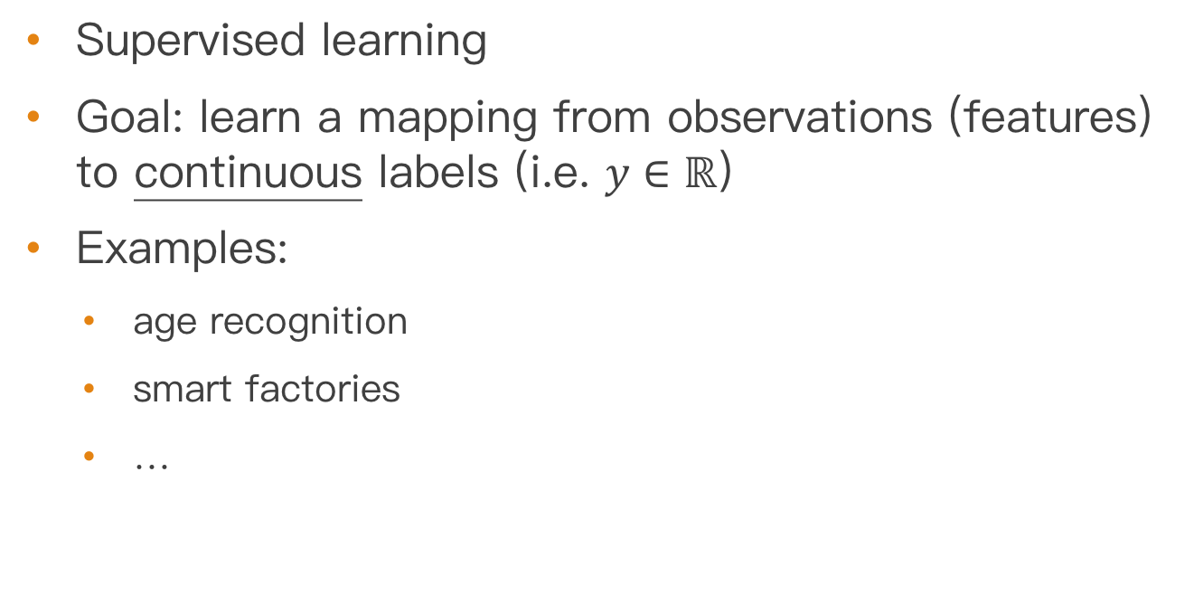
Regression
Supervised learning
Goal: learn a mapping from observations (features) to continuous labels (i.e. $y∈ℝ$)
Examples:
age recognition
smart factories
…

Slide 4
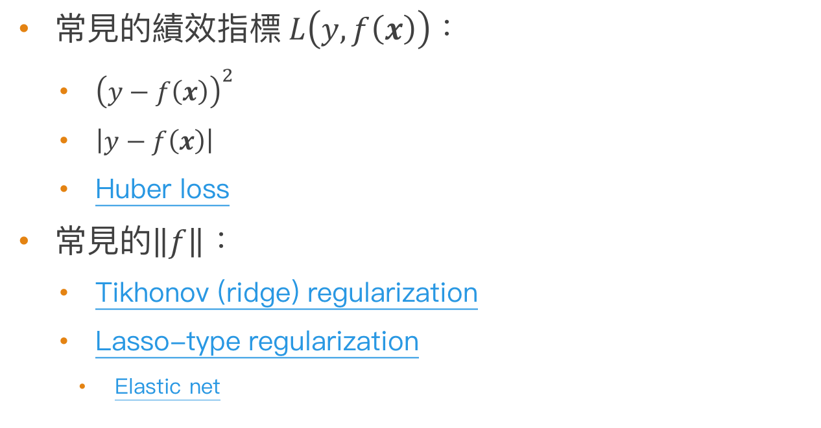
Regression
常見的績效指標$L\left(y,f\left(x\right)\right)$：
${\left(y−f\left(x\right)\right)}^{2}$
$\left|y−f\left(x\right)\right|$
Huber loss
常見的$\left\|f\right\|$：
Tikhonov (ridge) regularization
Lasso-type regularization
Elastic net

Slide 5

Regression in MLlib
$L\left(y,f\left(x\right)\right)={\left(y−f\left(x\right)\right)}^{2}$
$f\left(x\right)=α+x′β$ (linear of $x$)
$\left\|f\right\|$：elastic net

Slide 6
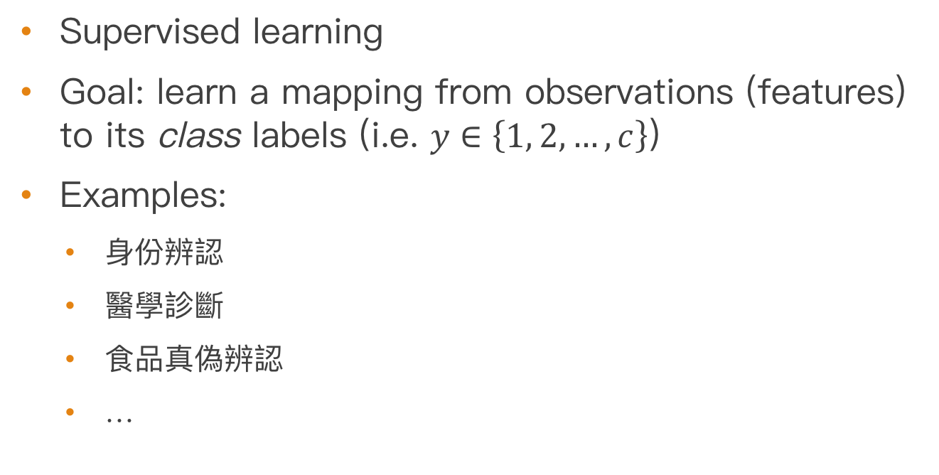
Classification
Supervised learning
Goal: learn a mapping from observations (features) to its class labels (i.e. $y∈\left\{1, 2,…,c\right\}$)
Examples:
身份辨認
醫學診斷
食品真偽辨認
…

Slide 7

Classification
常見的績效指標$L\left(y,f\left(x\right)\right)$：
0-1 loss
hinge loss
corss entropy (softmax) loss

Slide 8
Loss functions

Slide 9
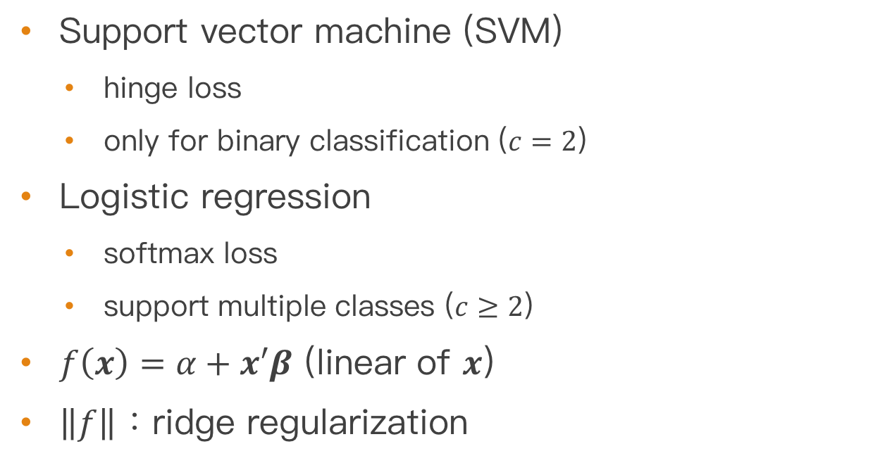
Classification in MLlib
Support vector machine (SVM)
hinge loss
only for binary classification ($c=2$)
Logistic regression
softmax loss
support multiple classes ($c≥2$)
$f\left(x\right)=α+x′β$ (linear of $x$)
$\left\|f\right\|$：ridge regularization

Slide 10

Clustering
Unsupervised learning
Classification without training labels $y_{i}$
Usually requires more model assumptions

Slide 11
Clustering in MLlib
K-means [1], [2]
GMM (Gaussian Mixture Model)
…

Slide 12
Recommendation
非監督學習
目標：根據用戶歷史行為結合其他用戶的相似決策建立模型，預測用戶對哪些物品可能感興趣（或用戶對物品的感興趣程度）
Examples:
Amazon等購物網站

Slide 13
Recommendation in MLlib
Alternating least squares (ALS)
Model ratings R as product of user and movie feature matrices A and B
Solve A and B alternatively as regression problems

