Slide 1
Amazon AI Enterprise Risk Assessment
A quantitative ERM presentation for the AI customer service and warehouse strategy risk study
Prepared from the final report and enterprise risk project outputs
Prepared by: Musa Oseni Oyakhire | ALY6130 Risk Management for Analytics

Slide 2
Background and purpose
Why the risk assessment matters for decision makers
Amazon plans to acquire and integrate an AI customer service platform while also extending AI capability into warehouse operations. The assessment brings the earlier SWOT work into a full enterprise risk management view with qualitative scoring, quantitative loss modelling, ML based risk prediction, Monte Carlo simulation, KRIs, and a treatment plan.
10
$719m
0.85
Risks assessed
mean simulated annual loss exposure
ROC AUC for the best prediction model
The goal is not only to list risks. The goal is to show which risks are most likely to affect performance, how severe the losses could become, and which indicators should trigger management action early.
ALY6130 Risk Management for Analytics
2

Slide 3
Integrated situation assessment
Business and nonbusiness conditions shaping the model inputs
Business environment
Nonbusiness environment
Market competition from cloud providers and specialist AI platforms increases urgency. Financial pressure matters because delayed ROI and cost overruns can weaken the acquisition case. Supply chain and warehouse performance also influence fulfilment reliability and customer trust.
Technology changes quickly, so AI models may lose advantage within a short period. Regulation creates privacy and compliance pressure across markets. Cyber threats and cloud disruptions also affect customer data, service continuity, and public confidence.
Competition intensity
80%
Regulatory pressure
76%
Financial pressure
72%
Technology volatility
84%
ALY6130 Risk Management for Analytics
3

Slide 4
Risk identification
Only the 10 risks requested by the lecturer are used
1
Competitor AI Advantage
6
Cloud Service Outage
2
AI Warehouse Strategy Failure
7
Workforce Adoption Failure
3
Cybersecurity and Data Breach
8
Cost Overrun and Delayed ROI
4
AI Forecasting Failure
9
Regulatory and Privacy Non Compliance
5
System Integration Failure
10
AI Governance and Ethics Failure
These risks connect strategy, operations, technology, information security, finance, compliance, people, and governance. This makes the assessment suitable for enterprise wide decision making rather than a narrow IT review.
ALY6130 Risk Management for Analytics
4

Slide 5
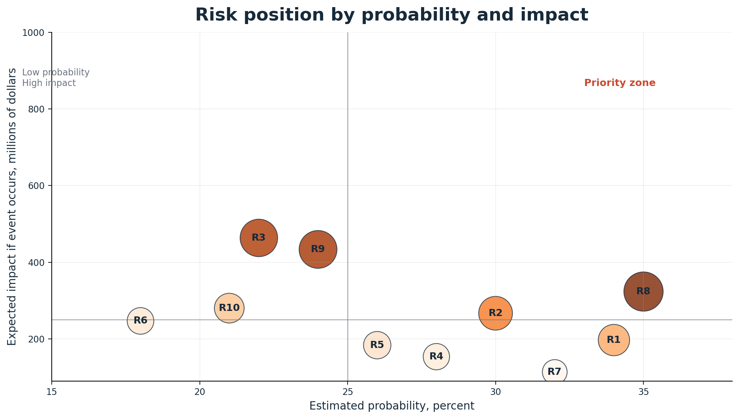
Qualitative risk assessment
Probability and impact show where management attention should go first
Interpretation
The priority zone contains risks with both high expected impact and meaningful likelihood. Cost overrun, regulatory non compliance, cybersecurity, and AI warehouse strategy failure sit close to the highest concern area.
Qualitative assessment was used to set assumptions for probability, impact ranges, KRI thresholds, and treatment urgency.
R2
AI Warehouse Strategy Failure
Cost Overrun and Delayed ROI
R8
R1 to R10 risk ranking.
R3
Cybersecurity and Data Breach
Regulatory and Privacy Non Compliance
R9
ALY6130 Risk Management for Analytics
5

Slide 6
Quantitative risk modelling approach
Moving beyond descriptive risk assessment
1
2
3
4
Probability distribution
Impact distribution
Expected loss
Scenario model
Each risk uses a beta distribution to represent uncertainty around likelihood.
Each risk uses a triangular loss range with minimum, most likely, and maximum impact.
Expected loss combines estimated probability and expected impact.
Monte Carlo simulation combines all risk events to estimate annual exposure.
Where real data was unavailable, synthetic and proxy data were used. The assumptions were grounded in the earlier SWOT findings and in the risk register logic from the prior assignment.
ALY6130 Risk Management for Analytics
6

Slide 7
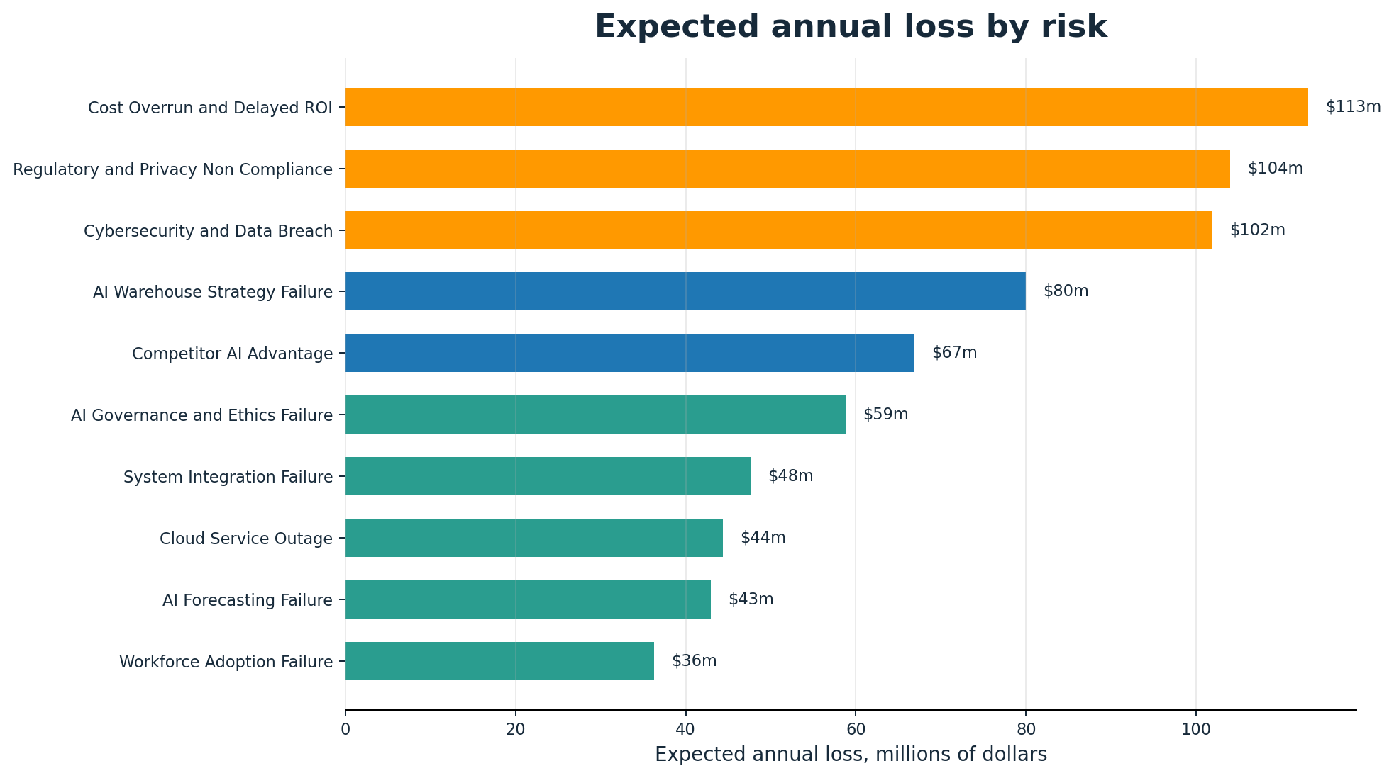
Expected loss results
The strongest loss drivers are financial, compliance, and security risks
Top quantified exposures
$113m
$104m
Cost Overrun and Delayed ROI
Regulatory and Privacy Non Compliance
$102m
$80m
Cybersecurity and Data Breach
AI Warehouse Strategy Failure
These four risks should receive the highest level of executive oversight because they explain a large portion of expected annual loss.
ALY6130 Risk Management for Analytics
7

Slide 8
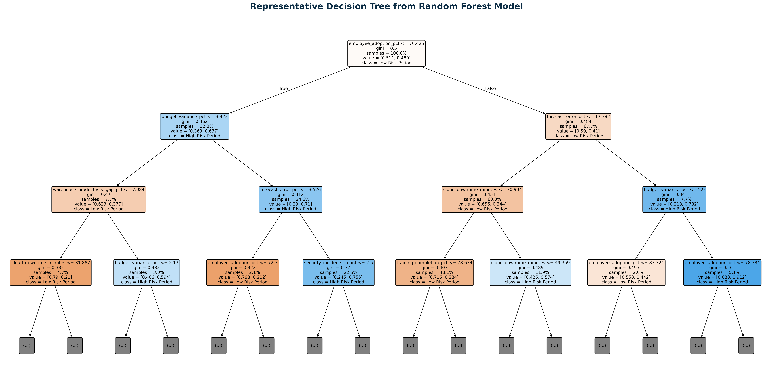
Representative Decision Tree from Random Forest Model
ALY6130 Risk Management for Analytics
8

Slide 9
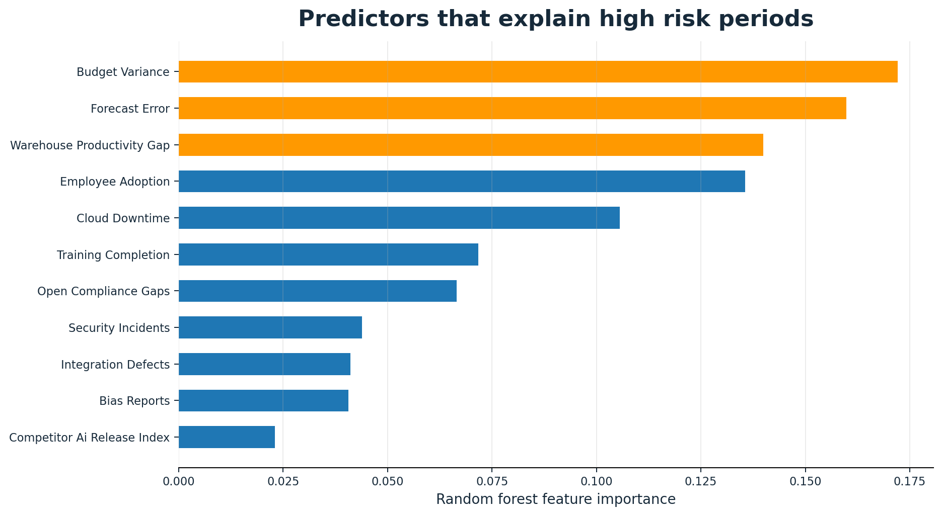
ML based risk prediction
Predictive analytics turns KRIs into early warning signals
Key Insights
Random Forest Feature Importance identifies which operational indicators contribute most to predicting future high-risk periods. Budget variance, forecast error, warehouse productivity gap, and employee adoption consistently rank as the strongest predictors across the model. This suggests that financial control, operational efficiency, and workforce readiness are the earliest warning signals before major losses occur.
Business implication
These variables can be monitored as proactive Key Risk Indicators (KRIs. However, feature importance measures only the relative influence of each predictor. It does not indicate whether a variable increases or decreases risk, which is addressed in the next section using Logistic Regression..
ALY6130 Risk Management for Analytics
9

Slide 10
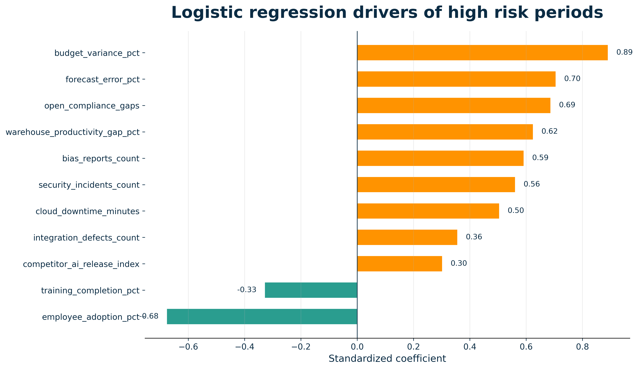
Logistic Regression
Positive coefficients increase risk, while negative coefficients indicate protective factors.
Key Findings
▲ Budget variance is the strongest predictor.
▲ Forecast error and compliance gaps also substantially increase risk.
▼ Employee adoption reduces enterprise risk exposure.
Recommendation
Improve budgeting discipline, forecast accuracy, and workforce adoption.
ALY6130 Risk Management for Analytics
10

Slide 11
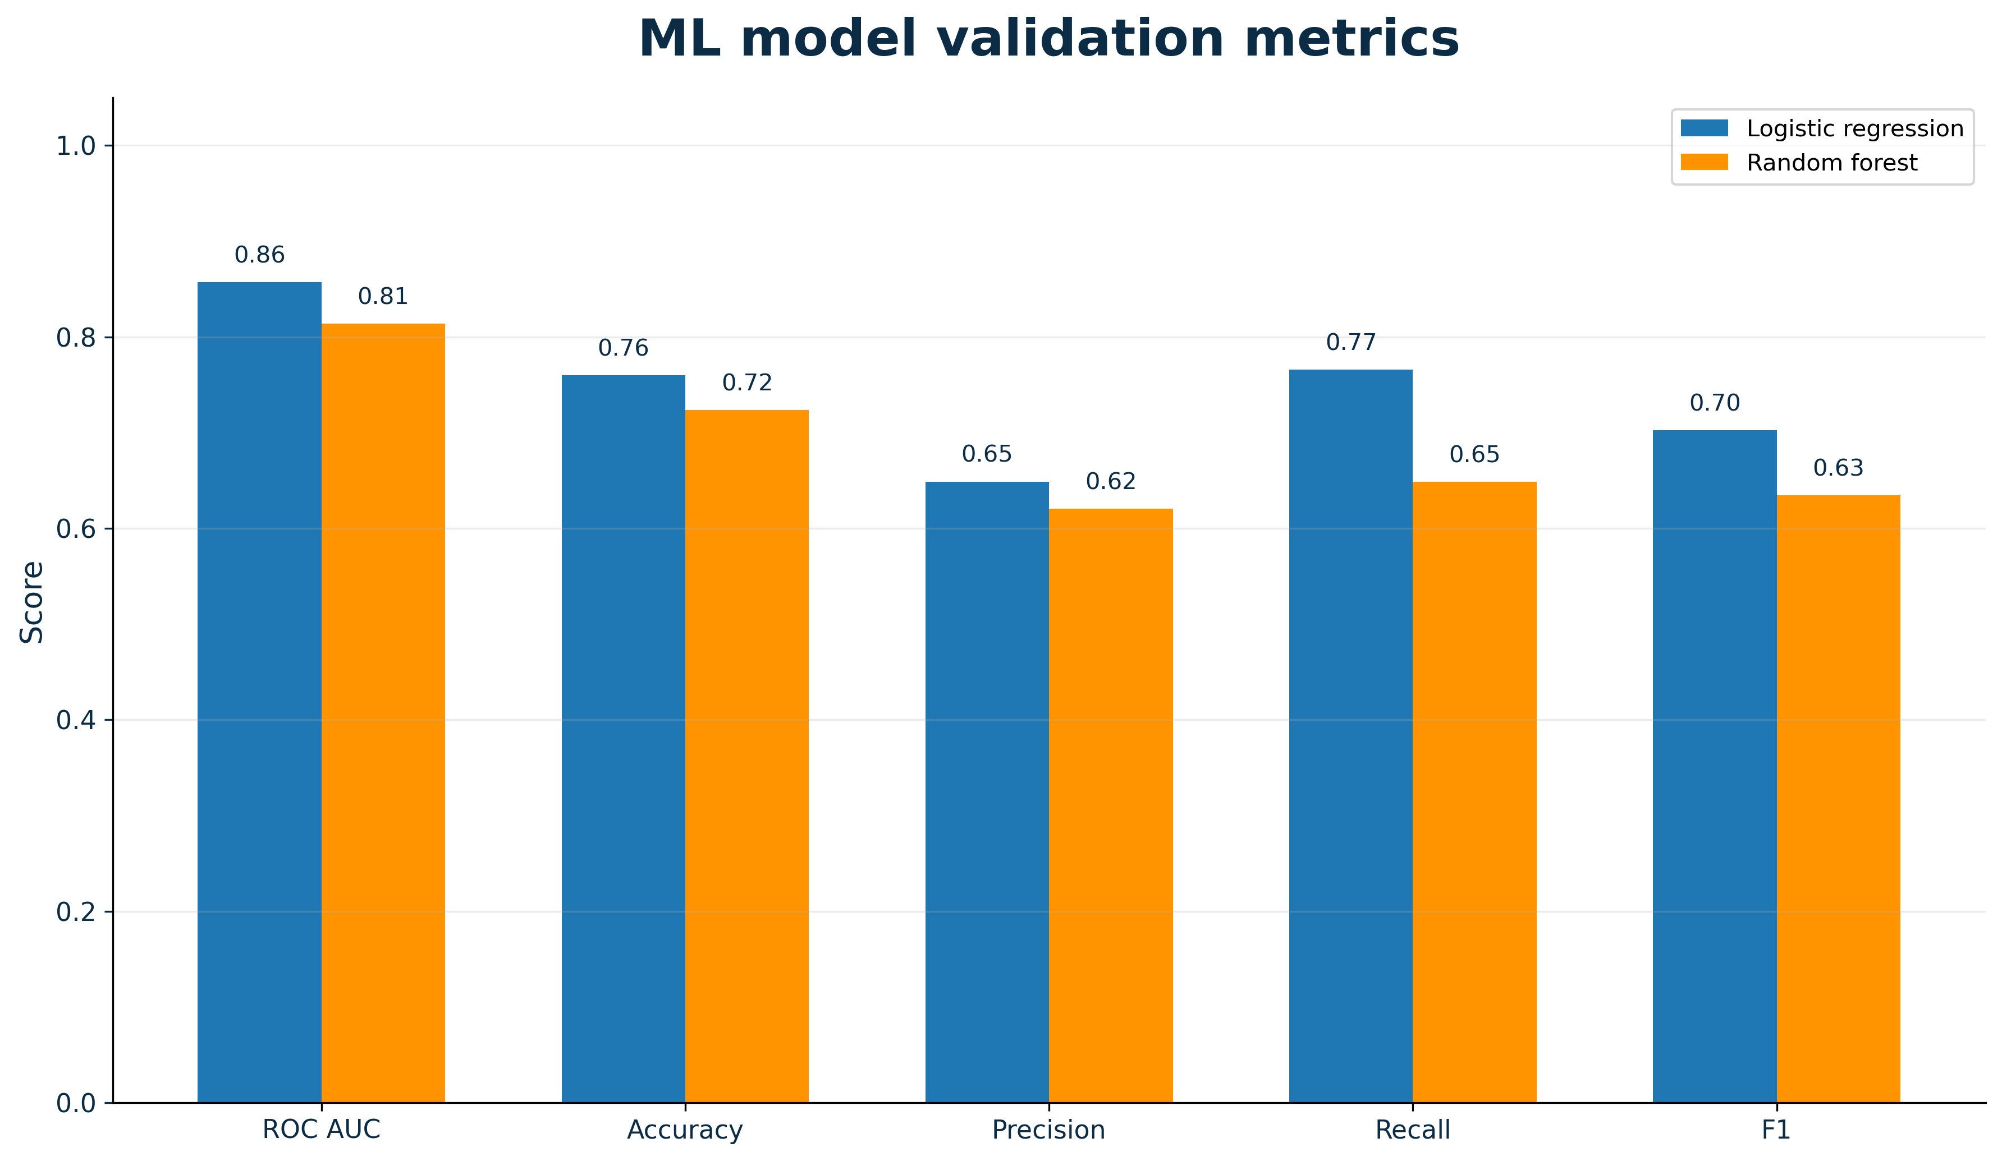
ML-Based Risk Prediction: Model Validation
Model performance was evaluated using ROC AUC, Accuracy, Precision, Recall, and F1 Score.
Validation and Comparison
Logistic Regression achieved the strongest overall performance.
ROC AUC = 0.86 indicates good discrimination.
Higher recall makes it suitable for identifying high-risk periods.
Therefore, Logistic Regression was selected for risk interpretation.
ALY6130 Risk Management for Analytics
11

Slide 12
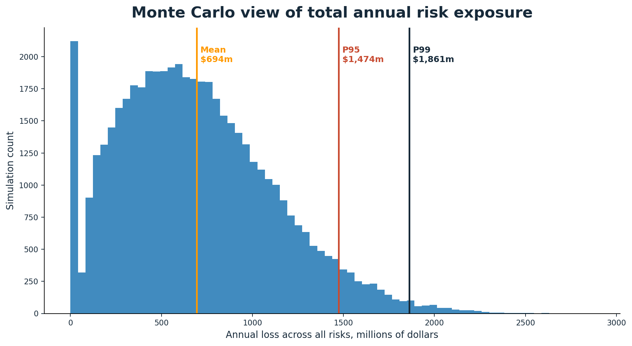
Monte Carlo simulation
Total exposure is wider than a single expected loss number
$719m
$1.59bn
mean annual loss
P95 annual loss
63%
25%
probability annual loss exceeds $500m
probability annual loss exceeds $1bn
The simulation shows that Amazon should plan for tail risk and not rely only on the mean estimate.
ALY6130 Risk Management for Analytics
12

Slide 13
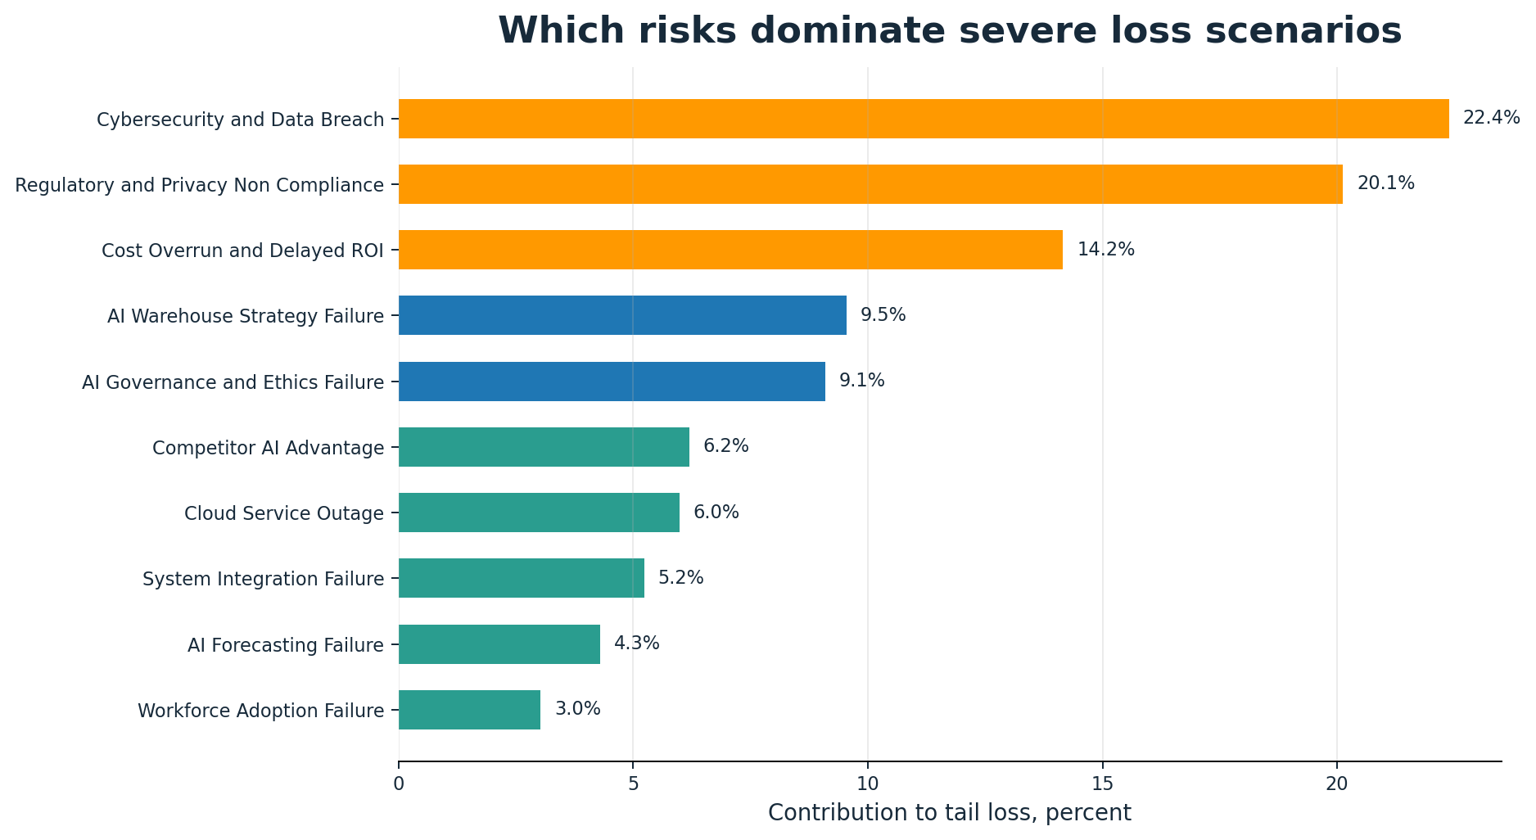
Severe loss contribution
Cybersecurity and regulatory risk dominate the tail
Tail scenarios are the cases decision makers worry about most. In those outcomes, cybersecurity and regulatory non compliance together contribute about 42 percent of severe losses. Cost overrun and AI warehouse strategy failure are the next major contributors.
The practical message is clear: the risk treatment budget should not be spread evenly. It should be weighted toward risks that drive severe downside exposure.
ALY6130 Risk Management for Analytics
13

Slide 14
KRIs and trigger points for action
Management needs measurable thresholds, not only risk descriptions
Risk area
KRI
Trigger for action
AI competition
Competitor AI release index
Two major rival releases in a quarter
Warehouse AI
Productivity gap
Gap exceeds 10 percent for two weeks
Cybersecurity
Security incident count
Any major breach or repeated alerts
Forecasting
Forecast error rate
Error above 15 percent
Cloud outage
System uptime
Below 99.9 percent
Workforce adoption
Employee adoption rate
Below 75 percent
Cost and ROI
Budget variance
Above 15 percent
Compliance and ethics
Open gaps or bias reports
Any unresolved high severity issue
ALY6130 Risk Management for Analytics
14

Slide 15
Conclusion and references
Main decision message for Amazon leadership
The assessment shows that Amazon should continue the AI strategy, but only with stronger governance, security controls, integration discipline, workforce adoption planning, and financial monitoring. The highest treatment priority should go to cost overrun and delayed ROI, regulatory and privacy non compliance, cybersecurity and data breach, and AI warehouse strategy failure.
References
Amazon. (2025). About Amazon. Amazon Official Website.
Amazon Web Services. (2025). Cloud computing services and security infrastructure.
Chapman, R. J. (2011). Simple tools and techniques for enterprise risk management. Wiley Finance.
Fleisher, C. S., & Bensoussan, B. E. (2015). Business and competitive analysis. Pearson.
International Organization for Standardization. (2018). ISO 31000: Risk management guidelines. ISO.
Kaplan, R. S., & Mikes, A. (2012). Managing risks: A new framework. Harvard Business Review, 90(6), 48 to 60.
Lam, J. (2014). Enterprise risk management: From incentives to controls. John Wiley and Sons.
National Institute of Standards and Technology. (2024). Artificial intelligence risk management framework. U.S. Department of Commerce.
Olson, D. L., & Wu, D. D. (2017). Enterprise risk management models. Springer.
PwC. (2024). Enterprise risk management and digital transformation. PwC Official Website.
ALY6130 Risk Management for Analytics
15

