Slide 1

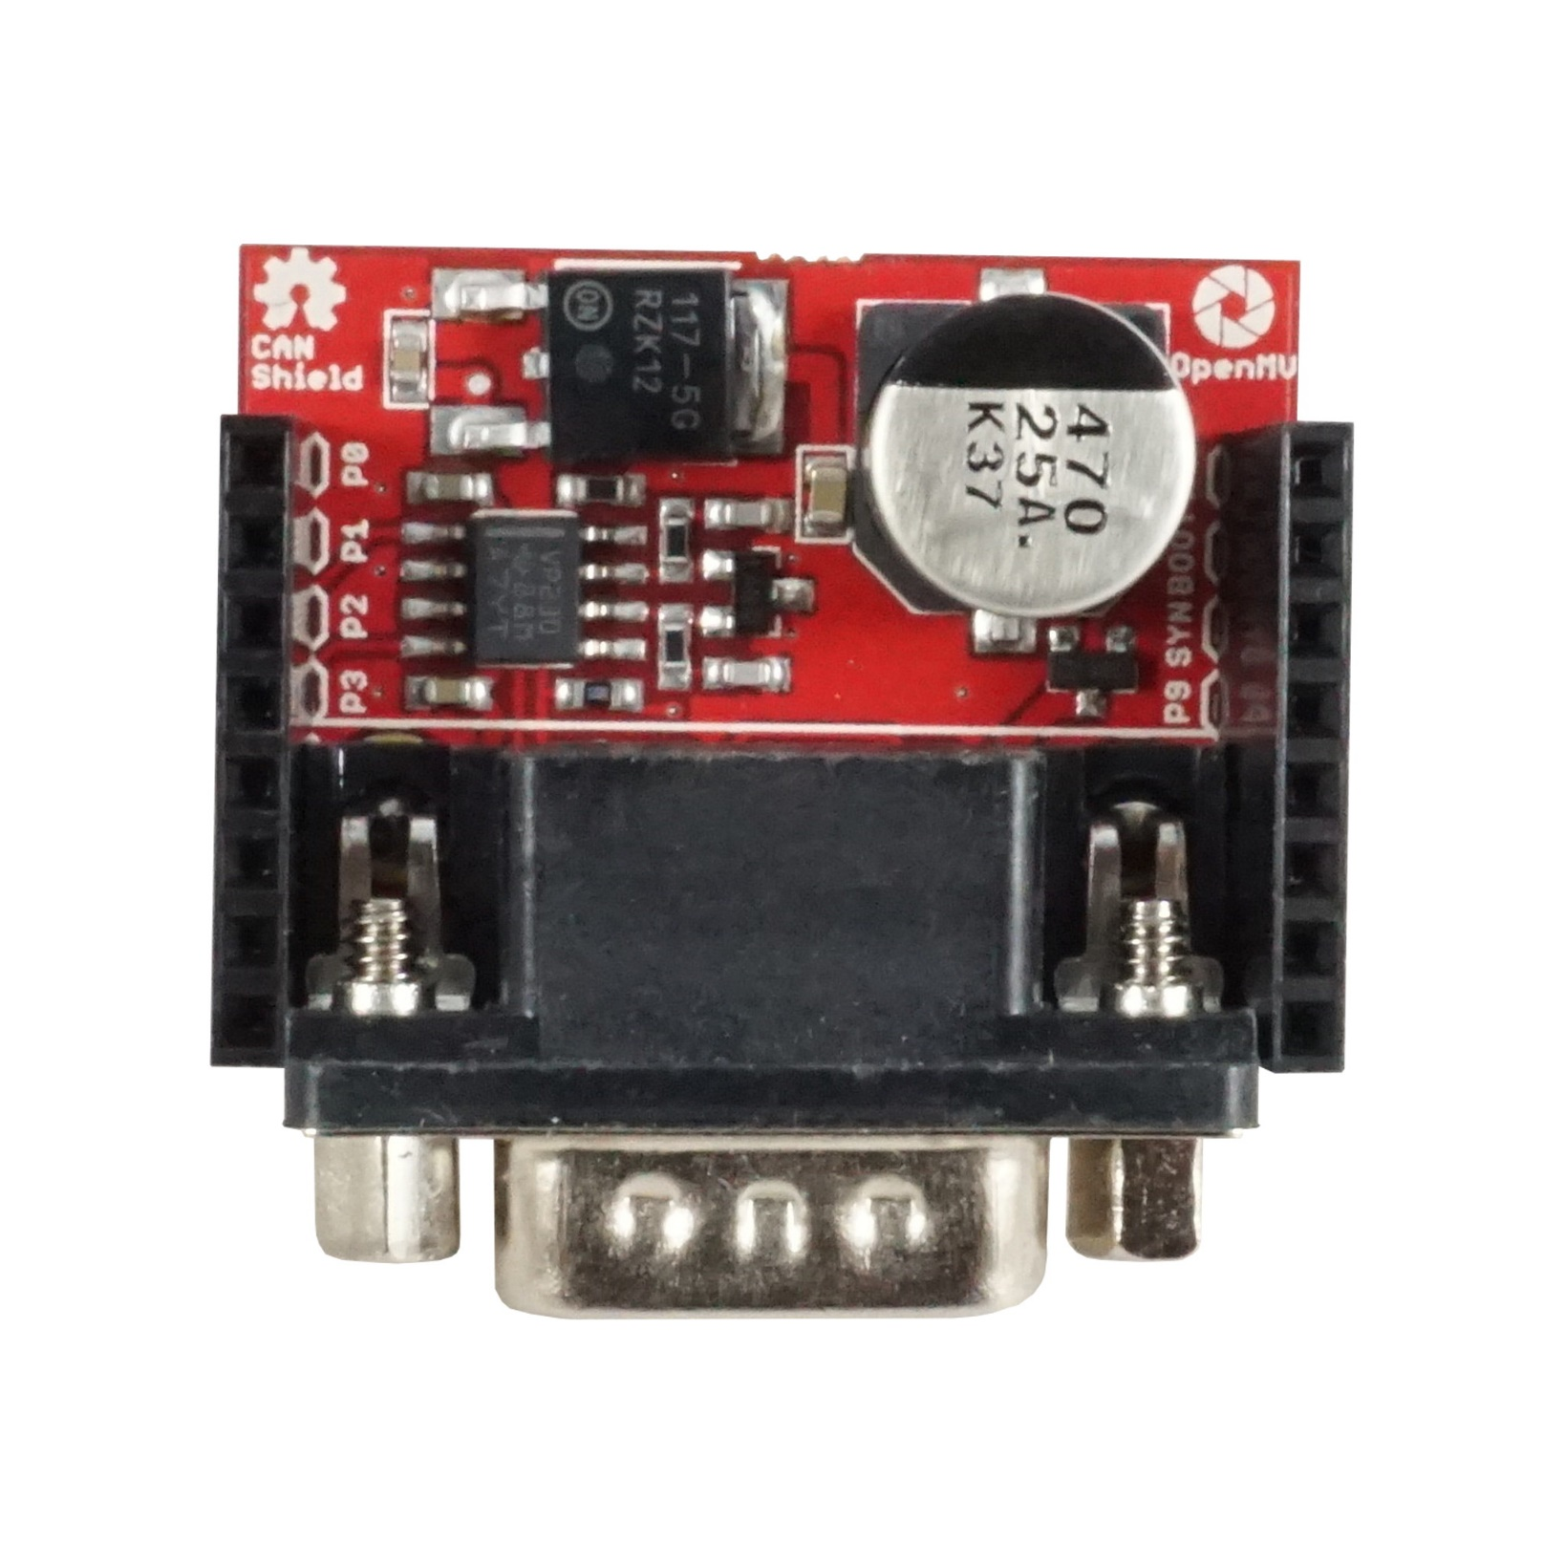
CAN Shield
Pinout
Not Connected
Not Connected
Not Connected
Not Connected
CAN TX
Not Connected
CAN RX
Not Connected
Not Connected
Not Connected
Not Connected
Not Connected
CAN Standby if connected
VIN Rail – 5V Regulator Out
3.3V Rail – SN65HVD230 Logic PWR
GND Rail

