Slide 1
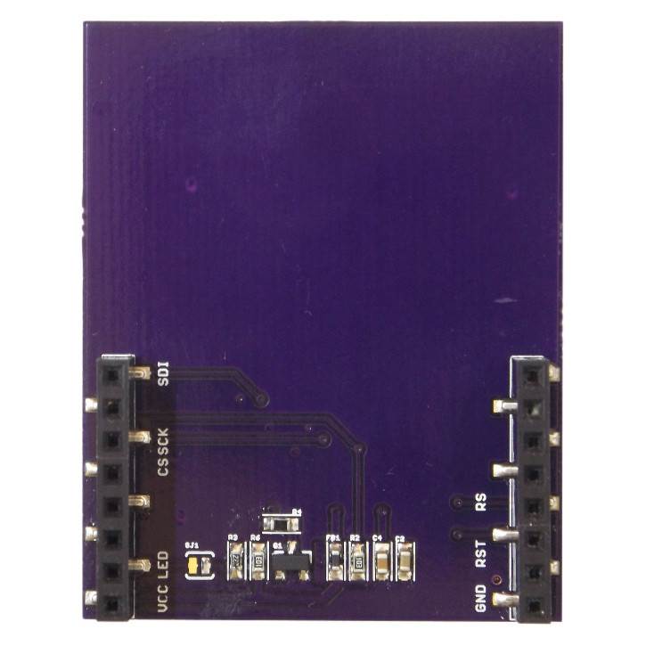

LCD Shield
Pinout
Cut to disconnect Backlight Control
(backlight will then always be on)
SPI Data In – to LCD
Not Connected
Not Connected
Not Connected
SPI Clock
Not Connected
SPI Chip Select
Not Connected
Not Connected
SPI Command
Not Connected
LCD Reset
Backlight Control
Not Connected
3.3V Rail
GND Rail

