Slide 1
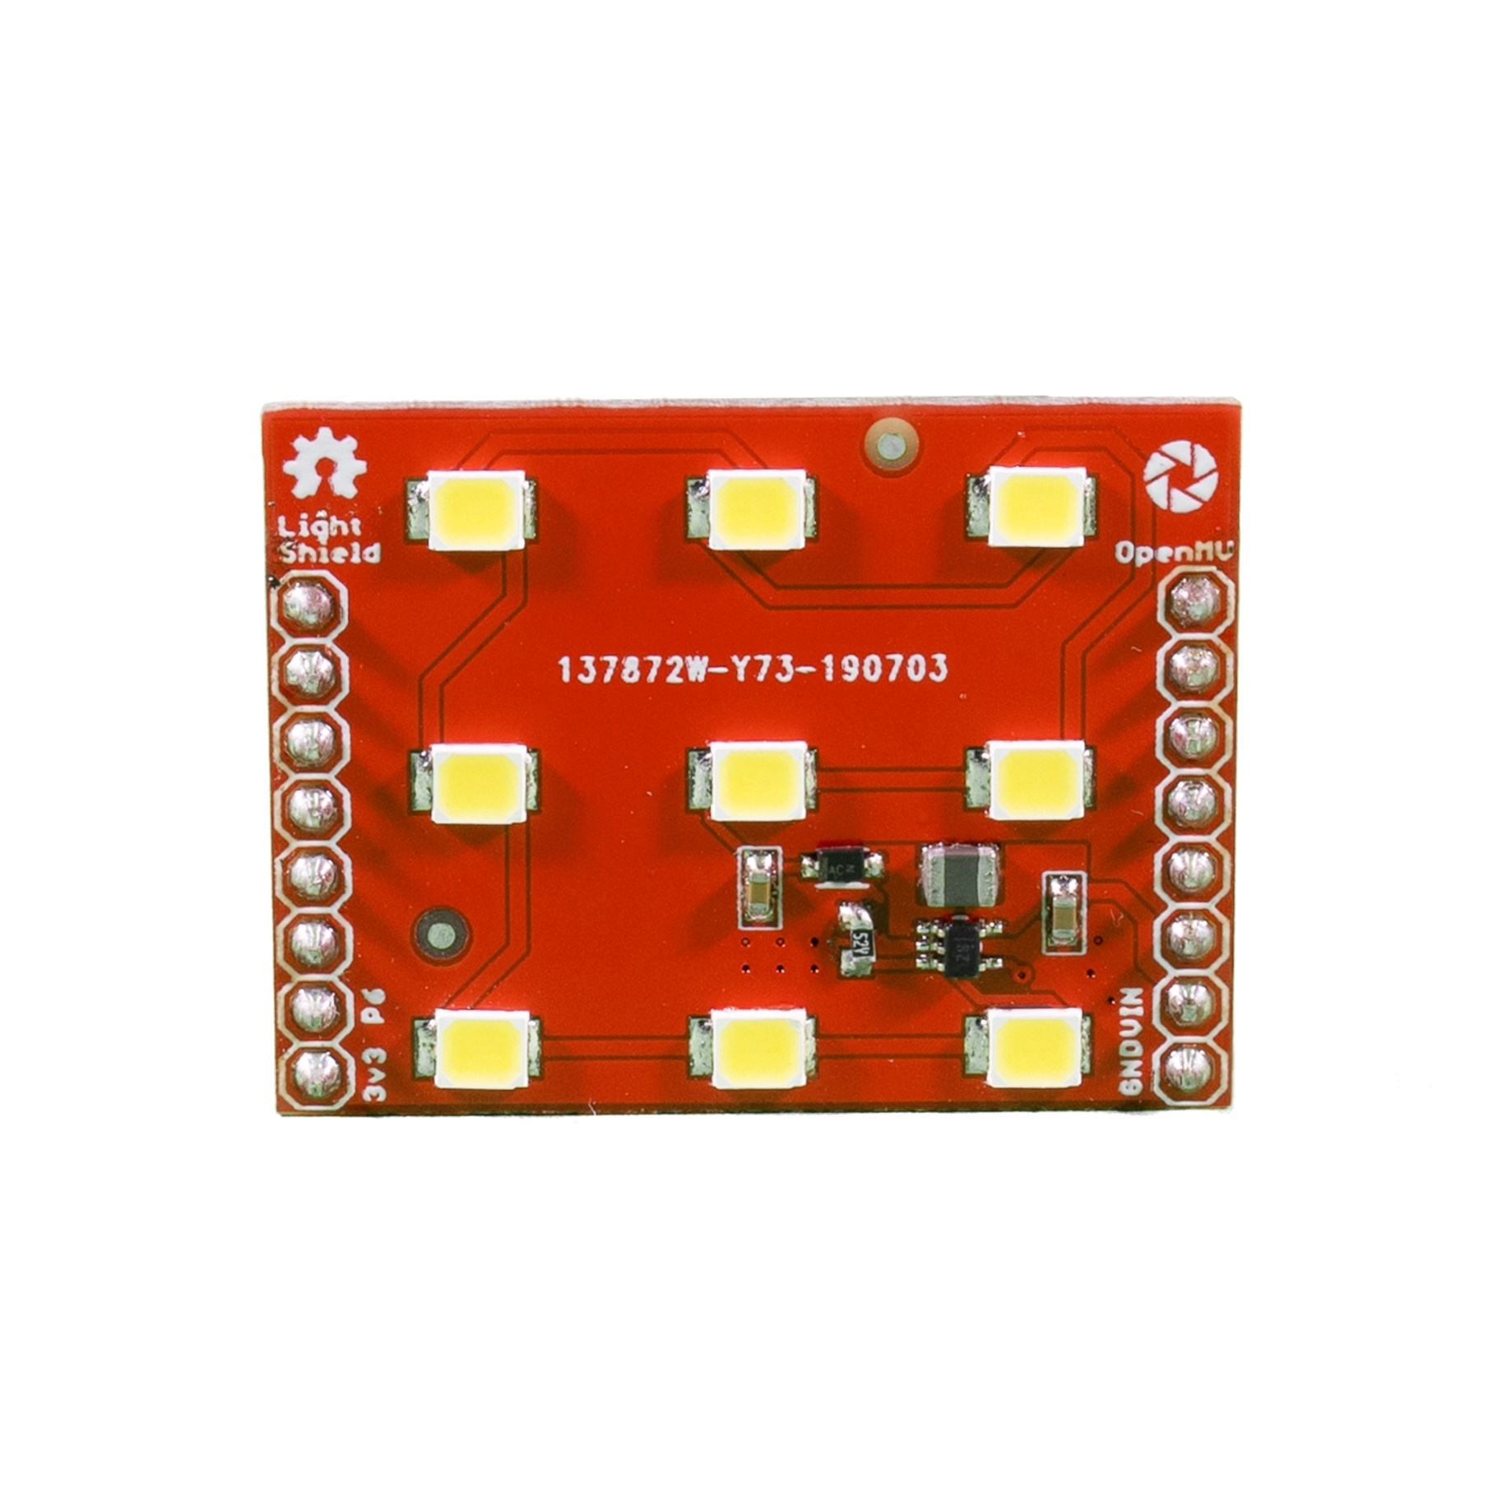

Light Shield
Pinout
Not Connected
Not Connected
Not Connected
Not Connected
Not Connected
Not Connected
Not Connected
Not Connected
Not Connected
Not Connected
Not Connected
Not Connected
PWM Lighting Control
Power In (needs VIN – not USB)
Not Connected
GND Rail

