Slide 1

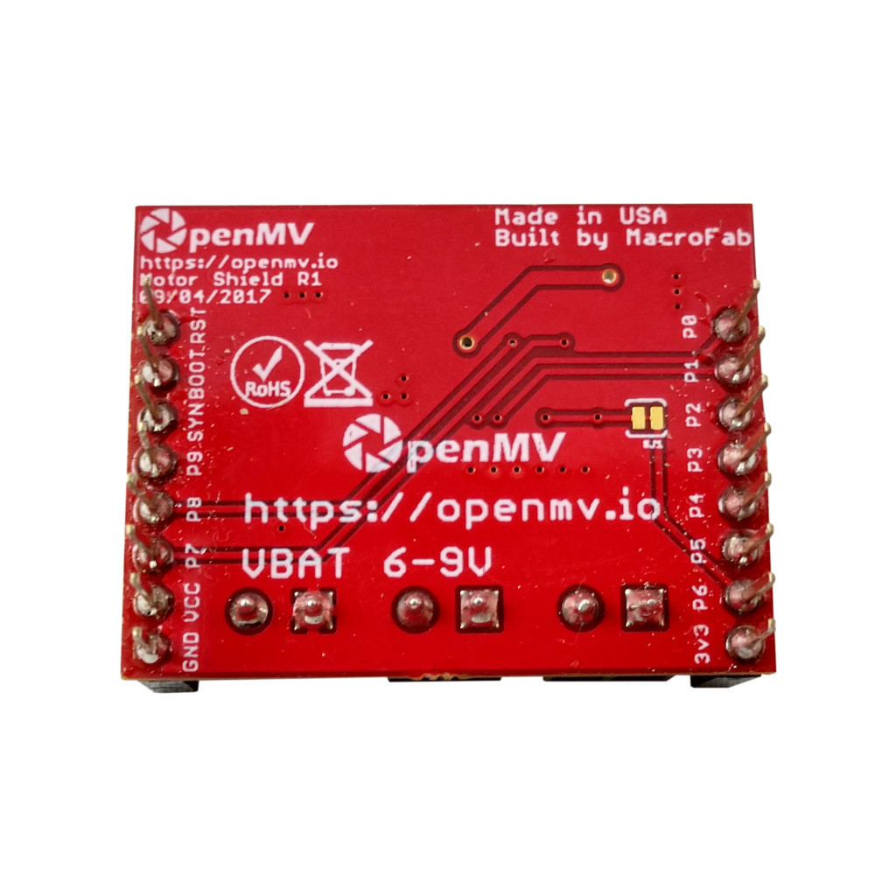
Motor Shield
Pinout
Cut this solder trace to reclaim P6 for use. Otherwise, pull P6 low to put the motor shield into low power mode (defaults to on).
Not Connected
DIR B1
Not Connected
DIR B0
Not Connected
DIR A1
Not Connected
DIR A0
PWM B Speed Input
Not Connected
PWM A Speed Input
Not Connected
VIN Rail – 5V Regulator Out
TB6612FNG STANDBY (pull low)
GND Rail
3.3V Rail – TB6612FNG Logic PWR

