Slide 1
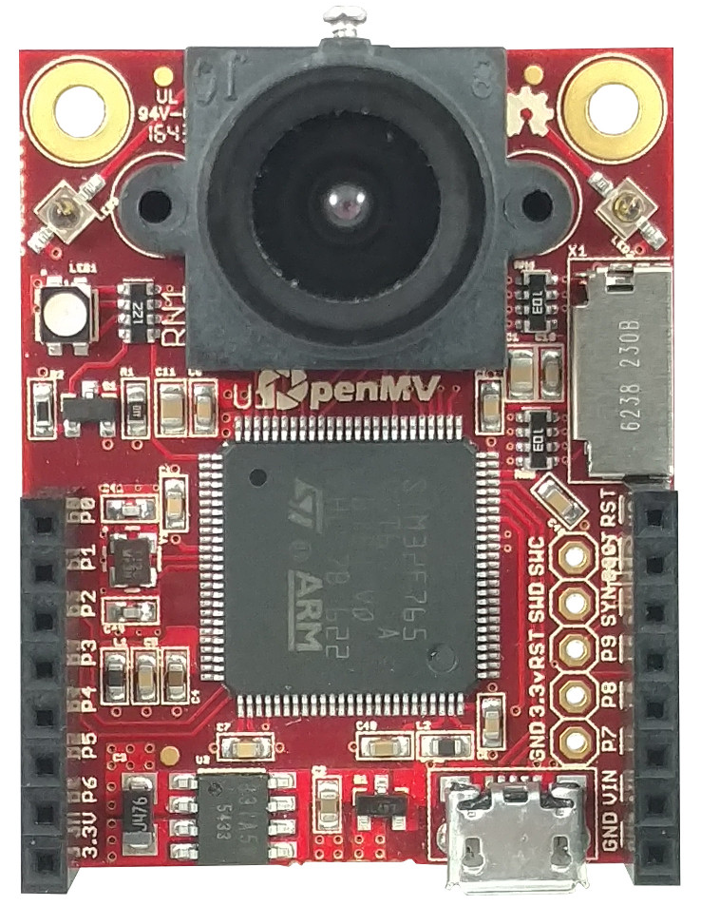

All pins are 5V tolerant¹ with a 3.3V output
All pins can sink or source up to 25 mA²
¹ P6 is not 5V tolerant in ADC or DAC mode
² Up to 120mA in total between all pins
OpenMV Cam
By: Ibrahim Abdelkader & Kwabena W. Agyeman
https://openmv.io
Max current used wo/ µSD card < 150 mA
Max current used w/ µSD card < 250 mA
LED1 – Red
LED2 – Green
LED3 – Blue
LED4 – IR
Micro SD Slot
SD < 2GB Max
SDHC < 32GB Max
SDXC < 2TB Max
Peripherals / Timers
CPU
Name
Pin
Name
Pin
Name
CPU
Name
Peripherals / Timers
UART 1 RX
TM1
CH3N
SPI 2
MOSI
PB15
P0
Reset (Connect to GND to reset)
UART 1 TX
TM1
CH2N
SPI 2
MISO
PB14
P1
BOOT 0 (Connect to 3.3V for DFU mode)
CAN2 TX
TM1
CH1N
SPI 2
SCLK
PB13
P2
Frame Sync (use to frame sync cams)
CAN2 RX
SPI 2
SS
PB12
P3
P9
PD14
Servo 3
TIM4 CH3
TIM2
CH3
I2C 2
SCL
UART 3
TX
PB10
P4
P8
PD13
Servo 2
TIM4 CH2
I2C4
SDA
TIM2
CH4
I2C 2
SDA
UART 3
RX
PB11
P5
P7
PD12
Servo 1
TIM4 CH1
I2C4
SCL
TIM2
CH1
DAC
ADC
PA5
P6
VIN (3.6V - 5V)
3.3V Rail (250 mA supply Max)
GND Rail

