Slide 1

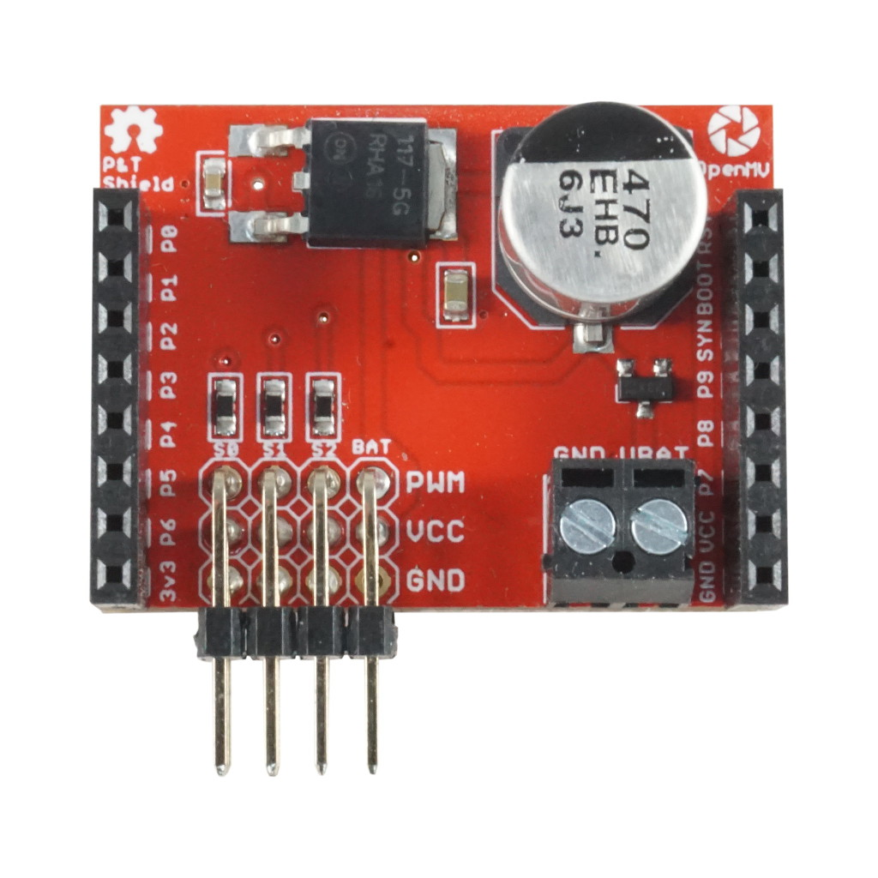
Pan And Tilt
Shield Pinout
Not Connected
Not Connected
Not Connected
Not Connected
Not Connected
Not Connected
Not Connected
Servo 2 – S2
Not Connected
Servo 1 – S1
Not Connected
Servo 0 – S0
Not Connected
VIN Rail – Servo Power
Not Connected
GND Rail – Servo Power
5V-6V on Servo BAT comes out on VIN (VCC) to power the OpenMV Cam and Servos (S0/S1/S2) if the unregulated VBAT input is not used
Unregulated battery voltage input – Regulated 5V output comes out on VIN (VCC) and Servo BAT

