Slide 1

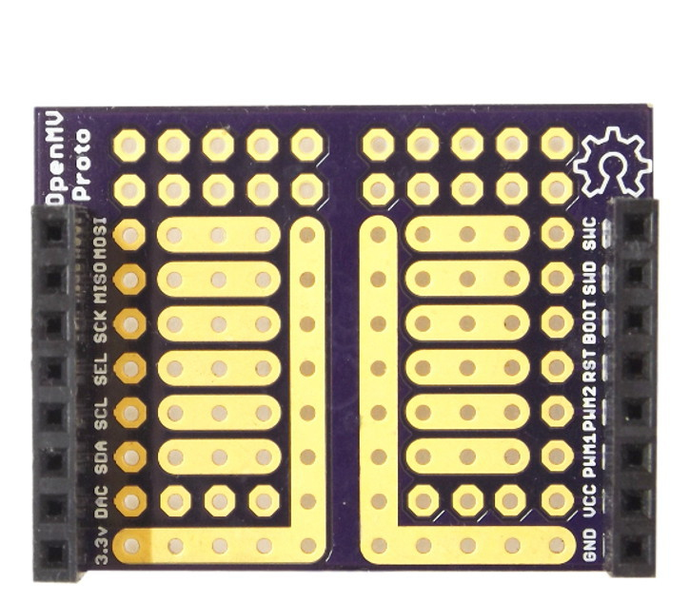
Proto Shield
Pinout
Not Connected
Not Connected
Not Connected
Not Connected
Not Connected
Not Connected
Not Connected
Not Connected
Not Connected
Not Connected
Not Connected
Not Connected
Not Connected
Not Connected
3.3V Rail
GND Rail

