Slide 1

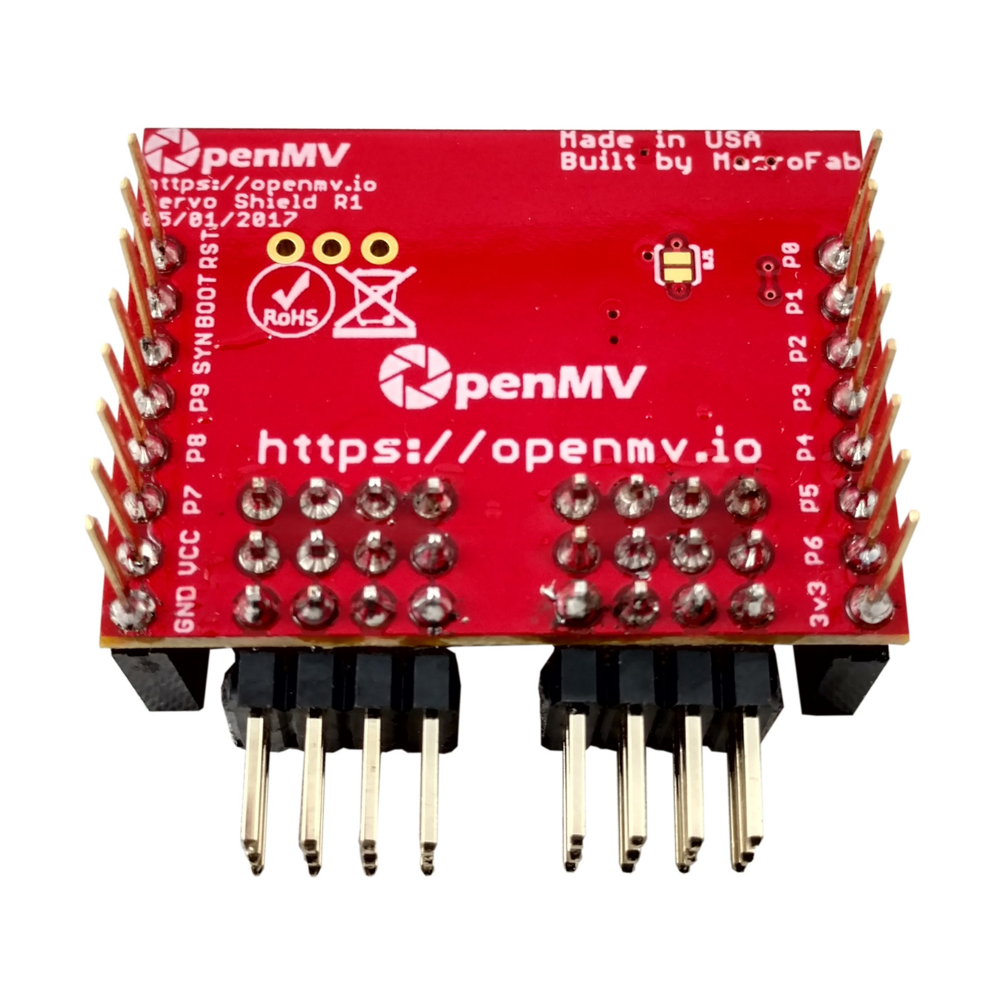
Servo Shield
Pinout
The default I2C address is 0x40. Connect the solder bridge to set the I2C address to 0x60.
Not Connected
Not Connected
Not Connected
Not Connected
Not Connected
Not Connected
Not Connected
Not Connected
Not Connected
I2C SCL
Not Connected
I2C SDA
VIN Rail – Servo Power
Not Connected
GND Rail – Servo Power
3.3V Rail – PCA9685 Power

