Slide 1

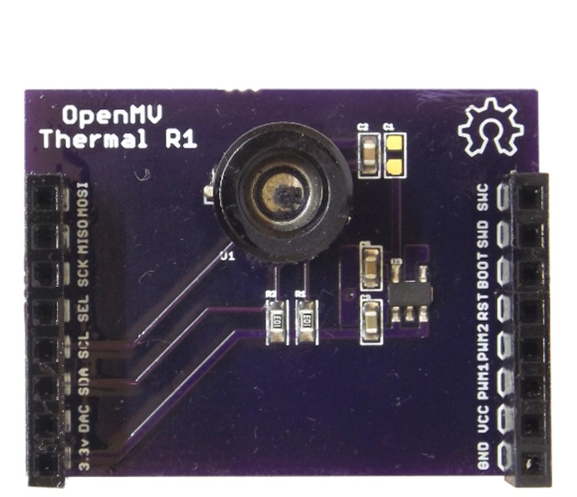
Thermopile Shield
Pinout
Not Connected
Not Connected
Not Connected
Not Connected
Not Connected
Not Connected
Not Connected
Not Connected
I2C SCL
Not Connected
I2C SDA
Not Connected
Not Connected
Not Connected
3.3V Rail
GND Rail

