Slide 1

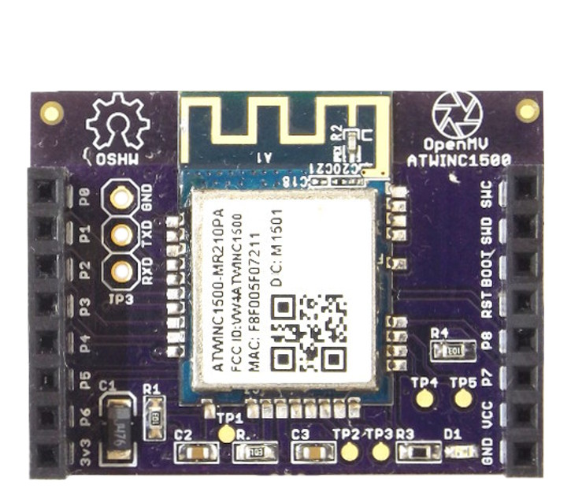
WiFi Shield
Pinout
SPI Data In – to module
Not Connected
SPI Data Out – from module
Not Connected
SPI Clock
Not Connected
SPI Chip Select
Not Connected
Not Connected
Module Interrupt
Not Connected
Module Reset
Chip Enable
Not Connected
3.3V Rail
GND Rail

