Slide 1

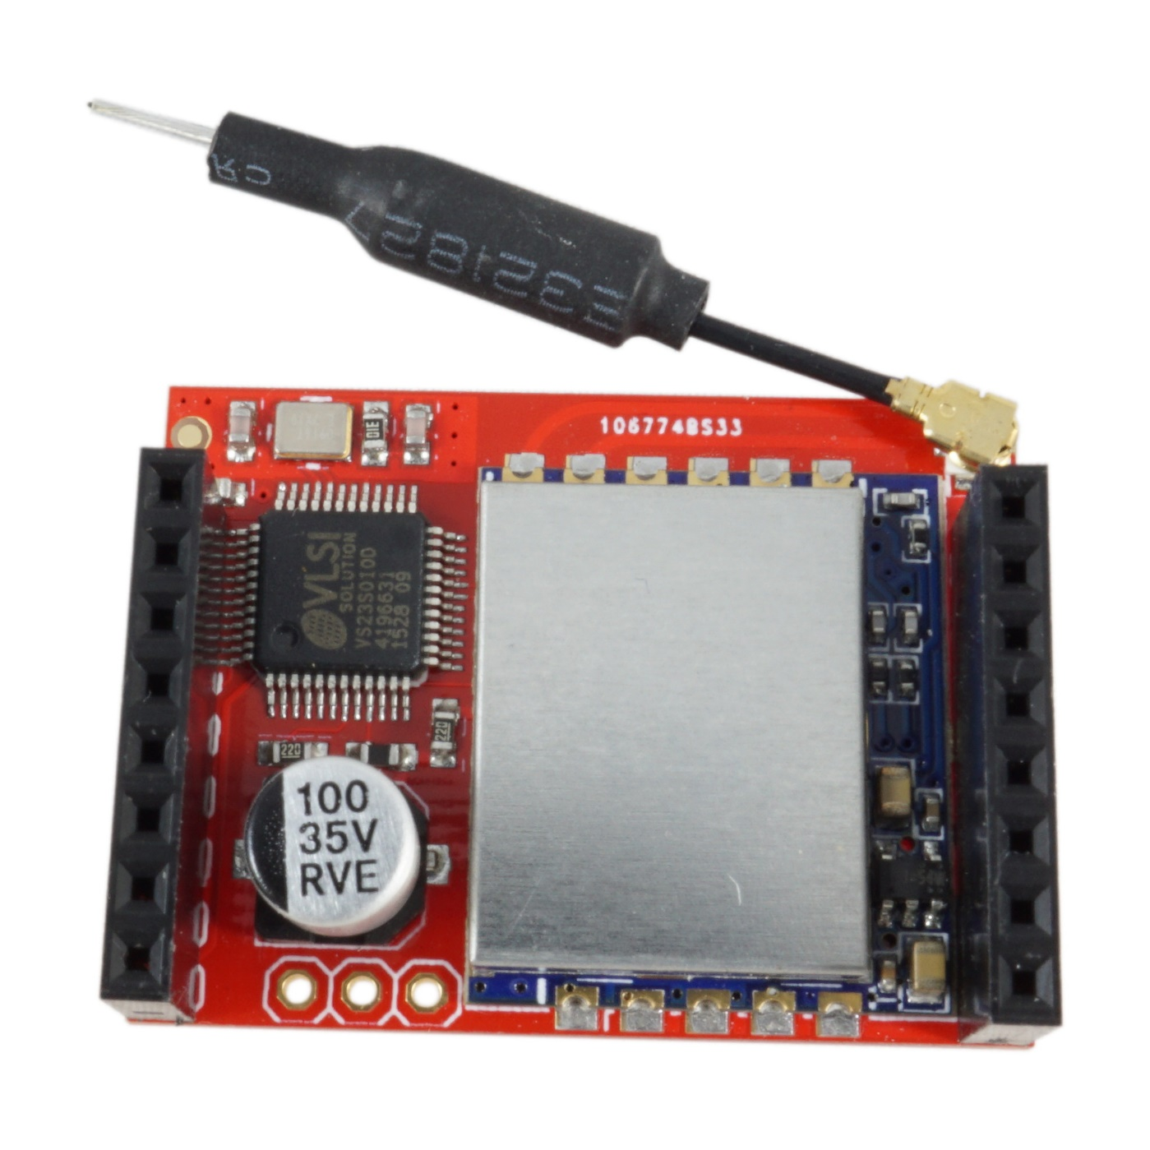
Wireless TV
Shield Pinout
SPI – MOSI
Not Connected
Not Connected
Not Connected
SPI - SLCK
Not Connected
SPI - CSS
Not Connected
Not Connected
Not Connected
Not Connected
Not Connected
Not Connected
Not Connected
3.3V - Power
GND

