Slide 2
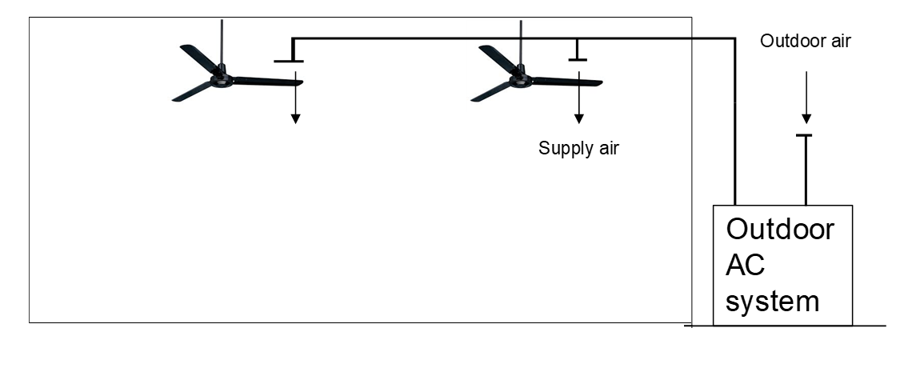

Objective
2 rows x 2 columns

Slide 3
Notes for collecting data
February, 2018
Sunday | Monday | Tuesday | Wednesday | Thursday | Friday | Saturday
 |  |  |  | 1 | 2 | 3
4 | 5 | 6 | 7 | 8 | 9 | 10
11 | 12 | 13 | 14 | 15 | 16 | 17
18 | Day1(9am) 19 | Day2(9am) 20 | Day3(9am) 21 | Day4(9am) 22 | Day5(9am) 23 | 24
25 | Day6(9am) 26 | Day7(9am) 27 | Day8(9am) 28
March, 2018
Sunday | Monday | Tuesday | Wednesday | Thursday | Friday | Saturday
 |  |  |  | Day9(9am) 1 | Day10(9am) 2 | 3
4 | Day11(9am) 5 | Day12(9am) 6 | Day13(9am) 7 | Day14(9am) 8 | Day15(9am) 9 | 10
11 | 12 | 13 | 14 | 15 | 16 | 17
18 | 19 | 20 | 21 | 22 | 23 | 24
25 | 26 | 27 | 28 | 29 | 30 | 31

Slide 4
Notes for collecting data
Thermal sensation is a seven scaled estimation by yourself
When you experiences all the environment well enough, you know how to divide your sensation into seven scale properly.

Slide 5
First design
Train by sample data
Reward 0 to -1 and 0 to 1 is different. 0 is equal to no effect to the update.
Negative reward

Slide 6
Result-First design (negative reward, decreased exploration)
State | Action | Action Number | Q-value
-2 | Fan on | 1
-1 | Fan heater and Fan on | 5
0 | All off | 7
1 | Air conditioner on | 2
2 | Fan on | 1 |  | Issue with Sample
3 | Fan heater and Fan on | 5 |  | (Not enough exploration?)

Slide 7
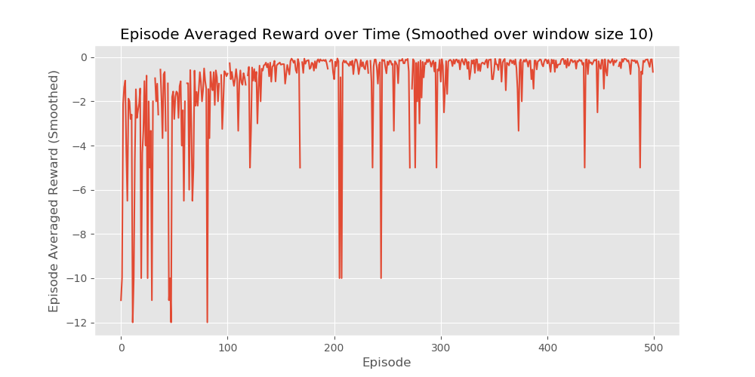
Result-First design (negative reward, decreased exploration)

Slide 8
Result-Second design (positive reward, decreased exploration) 500 episode
State | Action | Action Number | Q-value
-2 | Fan heater and Fan on | 5
-1 | Fan heater and Fan on | 5
0 | All off | 7
1 | All off | 7
2 | Fan on | 1
3 | Fan on | 1

Slide 9
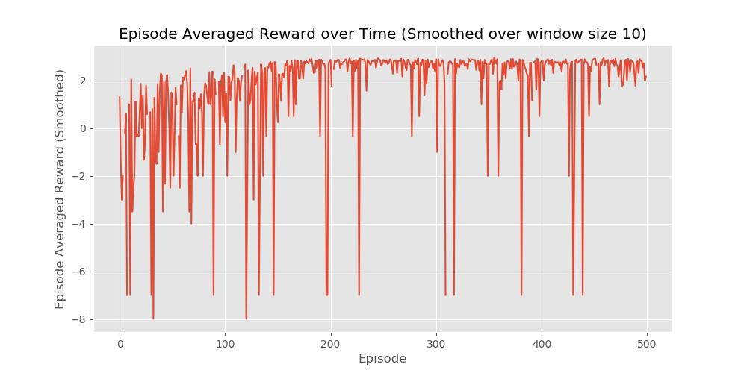
Result-Second design (positive reward, decreased exploration) 500 episode

Slide 10
State | Action
0 | Fan heater on
1 | Fan on
2 | Air conditioner on
3 | Fan and Air conditioner on
4 | Fan heater and Air conditioner on
5 | Fan heater and Fan on
6 | All on
7 | All off
There is a outlier for state = 0 , which is 0, 2, 0

