Slide 1
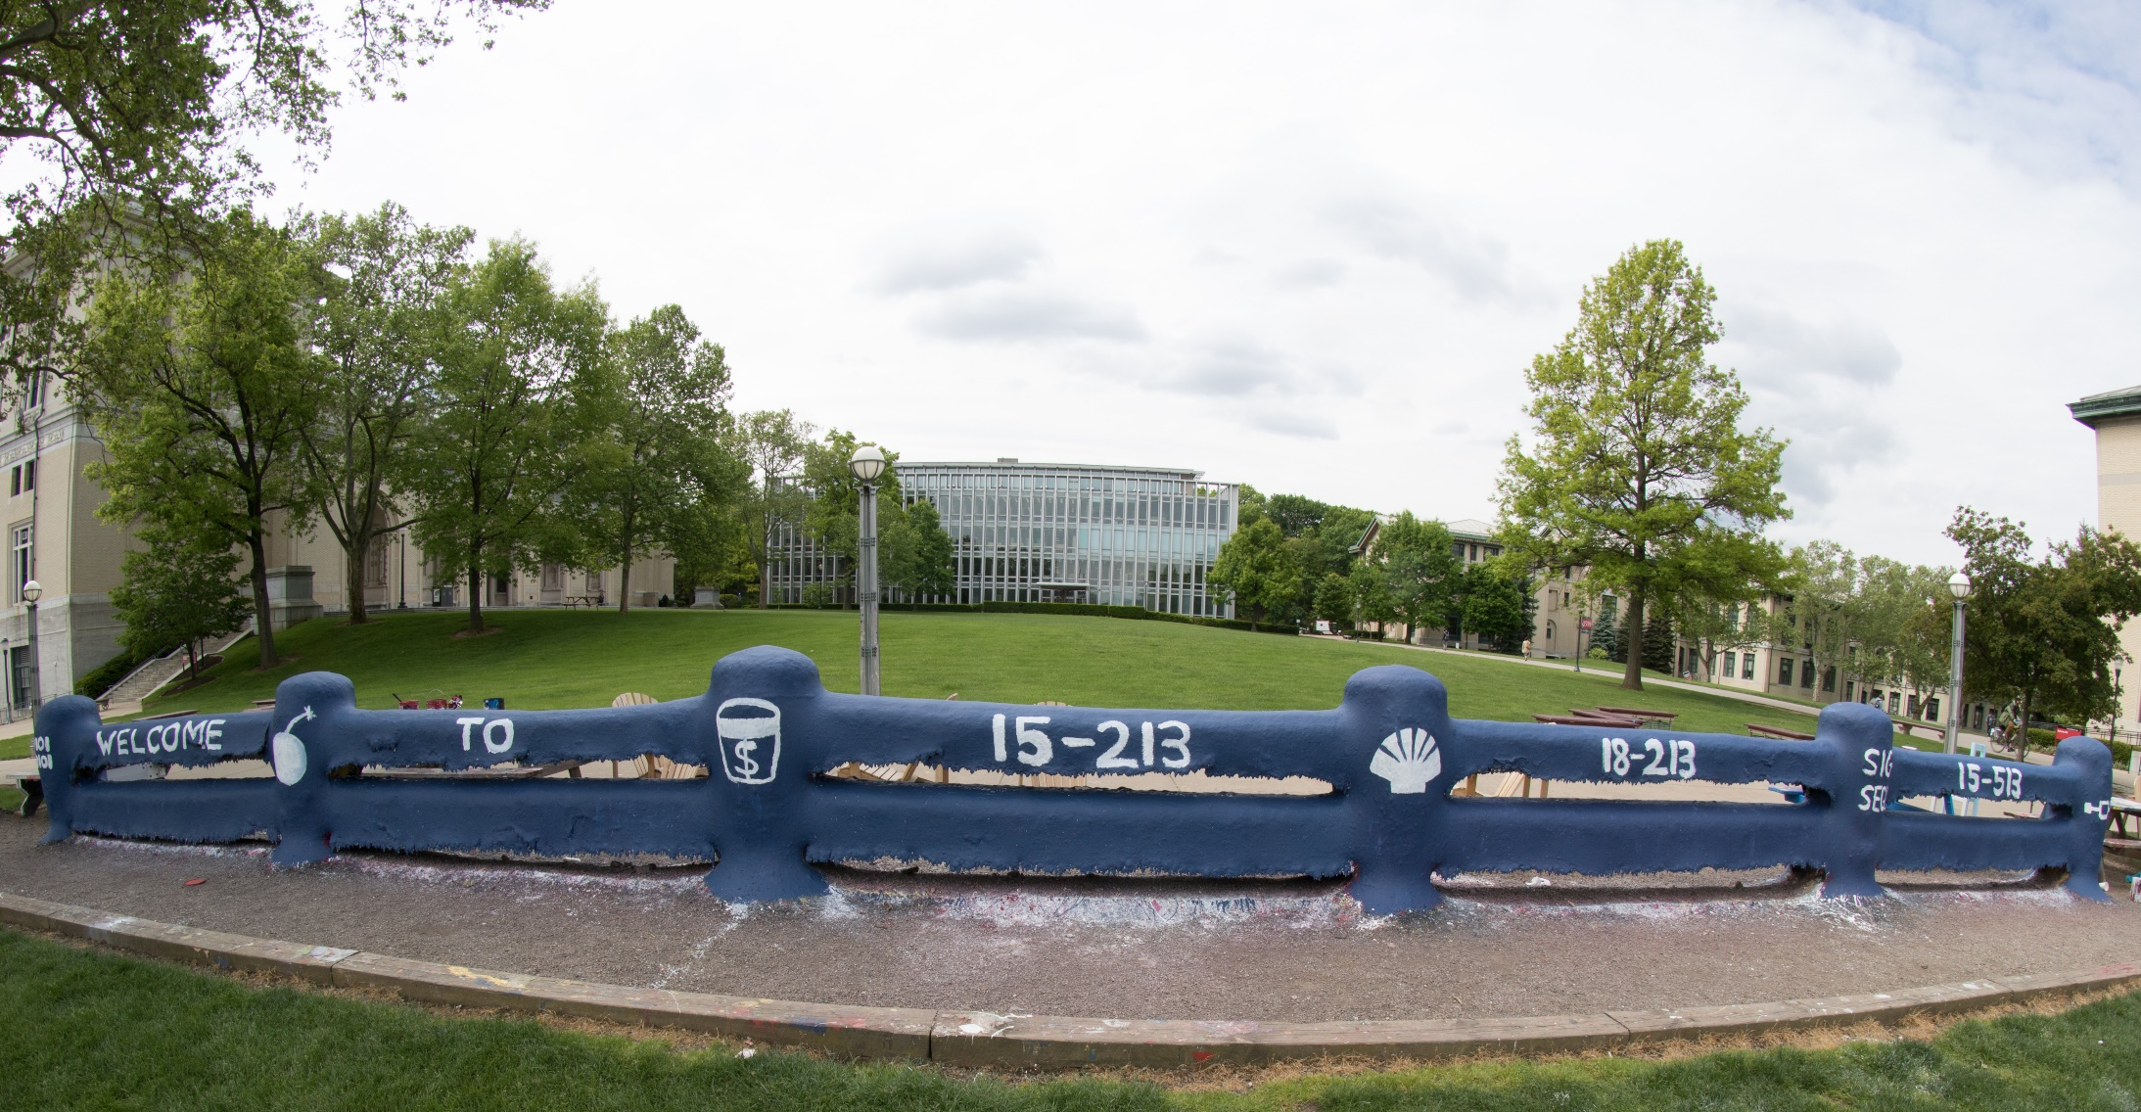
14-513
18-613

Slide 2
Cache Memories 15-213/14-513/15-513: Introduction to Computer Systems 10th Lecture, Feb 12, 2025

Slide 3
Today
Cache memory organization and operation CSAPP 6.4-6.5
Performance impact of caches
Rearranging loops to improve spatial locality CSAPP 6.6.2
Using blocking to improve temporal locality CSAPP 6.6.3

Slide 4
Recall: General Cache Concepts
Smaller, faster, more expensive
memory caches a subset of
the blocks
Cache
8
4
9
14
3
Data is copied in block-sized transfer units
4
Larger, slower, cheaper memory
viewed as partitioned into “blocks”
Memory
0
1
2
3
4
4
5
6
7
8
9
10
11
12
13
14
15

Slide 5
General Cache Concepts: Hit
Request: 14
Data in block b is needed
Block b is in cache:
Hit!
Cache
8
9
14
3
14
Memory
0
1
2
3
4
5
6
7
8
9
10
11
12
13
14
15

Slide 6
General Cache Concepts: Miss
Request: 12
Data in block b is needed
Block b is not in cache:
Miss!
Cache
8
12
9
14
3
Block b is fetched from
memory
12
Request: 12
Block b is stored in cache
Placement policy: determines where b goes
Replacement policy: determines which block gets evicted (victim)
Memory
0
1
2
3
4
5
6
7
8
9
10
11
12
12
13
14
15

Slide 7
Recall: Working Set, Locality, and Caches
Working Set: The set of data a program is currently “working on”
Definition of “currently” depends on context, e.g., in this loop
Includes accesses to data and instructions
Principle of Locality: Programs tend to use data and instructions with addresses near or equal to those they have used recently
Nearby addresses: Spatial Locality
Equal addresses: Temporal locality
Caches take advantage of temporal locality by storing recently used data, and spatial locality by copying data in block-sized transfer units
Locality reduces working set sizes
Caches are most effective when the working set fits in the cache

Slide 8
Recall: General Caching Concepts: 3 Types of Cache Misses
Cold (compulsory) miss
Cold misses occur because this is the first reference to the block.
(Misses with infinitely large cache with no placement restrictions)
Capacity miss
Occurs when the set of active cache blocks is larger than the cache. (Additional misses from finite-sized cache with no placement restrictions)
Conflict miss
Occurs when the cache is large enough, but too many data objects all map (by the placement policy) to the same limited set of blocks (Additional misses due to actual placement policy)

Slide 9
CPU Cache Memories
CPU cache memories are small, fast SRAM-based memories managed automatically in hardware
Hold frequently accessed blocks of main memory
CPU looks first for data in cache
Typical system structure:
CPU chip
Register file
ALU
Cache
memory
Memory bus
Main
memory
Memory Controller

Slide 10
Cache Organization: Direct-Mapped
Advantages?
Disadvantages?
Cache
8
4
9
14
3
Memory
0
1
2
3
4
4
5
6
7
8
9
10
11
12
13
14
15

Slide 11
Cache Organization: Set-Associative
Why?
Cache
8
4
8
3
14
Memory
0
1
2
3
4
4
5
6
7
8
9
10
11
12
13
14
15

Slide 12
General Cache Organization (S, E, B)
E = 2e lines per set
set
line
S = 2^{s} sets
Cache size
= S x E x B data bytes
v
tag
0
1
2
B-1
valid bit
B = 2^{b} bytes per cache block (the data)

Slide 13
Cache Read
Locate set
Check if any line in set has matching tag
Yes + line valid: hit
Locate data starting at offset
A = *0xFFFFF1032;
E = 2e lines per set
Address of word:
t bits
s bits
b bits
S = 2^{s} sets
tag
set
index
block
offset
data begins at this offset
v
tag
0
1
2
B-1
valid bit
B = 2^{b} bytes per cache block (the data)

Slide 14
Example: Direct Mapped Cache (E = 1)
Direct mapped: One line per set
Assume: cache block size B=8 bytes
Address of int:
v
tag
0
1
2
3
4
5
6
7
t bits
0…01
100
v
tag
0
1
2
3
4
5
6
7
find set
S = 2^{s} sets
v
tag
0
1
2
3
4
5
6
7
v
tag
0
1
2
3
4
5
6
7

Slide 15
Example: Direct Mapped Cache (E = 1)
Direct mapped: One line per set
Assume: cache block size B=8 bytes
Address of int:
valid? +
match: assume yes (= hit)
t bits
0…01
100
v
tag
0
1
2
3
4
5
6
7
tag
block offset

Slide 16
Example: Direct Mapped Cache (E = 1)
Direct mapped: One line per set
Assume: cache block size B=8 bytes
Address of int:
valid? +
match: assume yes (= hit)
t bits
0…01
100
v
tag
0
1
2
3
4
5
6
7
block offset
int (4 Bytes) is here
If tag doesn’t match (= miss): old line is evicted and replaced

Slide 17
Direct-Mapped Cache Simulation
t=1
s=2
b=1
4-bit addresses (address space size M=16 bytes)
S=4 sets, E=1 blocks/set, B=2 bytes/block
Address trace (reads, one byte per read):
0 [0000₂],
1 [0001₂],
7 [0111₂],
8 [1000₂],
0 [0000₂]
x
xx
x
miss
(cold)
hit
miss
(cold)
miss
(cold)
miss
(conflict)
v
Tag
Block
Set 0
1
0
M[0-1]
0
0
M[0-1]
1
1
M[8-9]
Set 1
0
Set 2
0
Set 3
1
0
M[6-7]
0
Notes:
Pause at the end of this slide to consider that M[0] and M[8] have nothing to do with one another, but that they interfere with one anothers’ existences in the cache.

Slide 18
E-way Set Associative Cache (Here: E = 2)
E = 2: Two lines per set
Assume: cache block size B=8 bytes
Address of short int:
2 lines per set
t bits
0…01
100
v
tag
0
1
2
3
4
5
6
7
v
tag
0
1
2
3
4
5
6
7
v
tag
0
1
2
3
4
5
6
7
v
tag
0
1
2
3
4
5
6
7
find set
v
tag
0
1
2
3
4
5
6
7
v
tag
0
1
2
3
4
5
6
7
v
tag
0
1
2
3
4
5
6
7
v
tag
0
1
2
3
4
5
6
7
S sets

Slide 19
E-way Set Associative Cache (Here: E = 2)
E = 2: Two lines per set
Assume: cache block size B=8 bytes
Address of short int:
compare both
t bits
0…01
100
valid? +
match: yes (= hit)
v
tag
0
1
2
3
4
5
6
7
tag
v
tag
0
1
2
3
4
5
6
7
block offset

Slide 20
E-way Set Associative Cache (Here: E = 2)
E = 2: Two lines per set
Assume: cache block size B=8 bytes
Address of short int:
compare both
t bits
0…01
100
valid? +
match: yes (= hit)
v
tag
0
1
2
3
4
4
5
tag
5
6
7
v
tag
0
1
2
3
4
5
6
7
block offset
short int (2 Bytes) is here
No match or not valid (= miss):
One line in set is selected for eviction and replacement
Replacement policies: random, least recently used (LRU), …

Slide 21
2-Way Set Associative Cache Simulation
t=2
s=1
b=1
xx
x
x
4-bit addresses (M=16 bytes)
S=2 sets, E=2 blocks/set, B=2 bytes/block
Address trace (reads, one byte per read):
0 [0000₂],
1 [0001₂],
7 [0111₂],
8 [1000₂],
0 [0000₂]
miss
(cold)
hit
miss
(cold)
miss
(cold)
hit
v
Tag
Block
1
00
M[0-1]
Set 0
0
1
10
M[8-9]
0
1
01
M[6-7]
Set 1
0
0

Slide 22
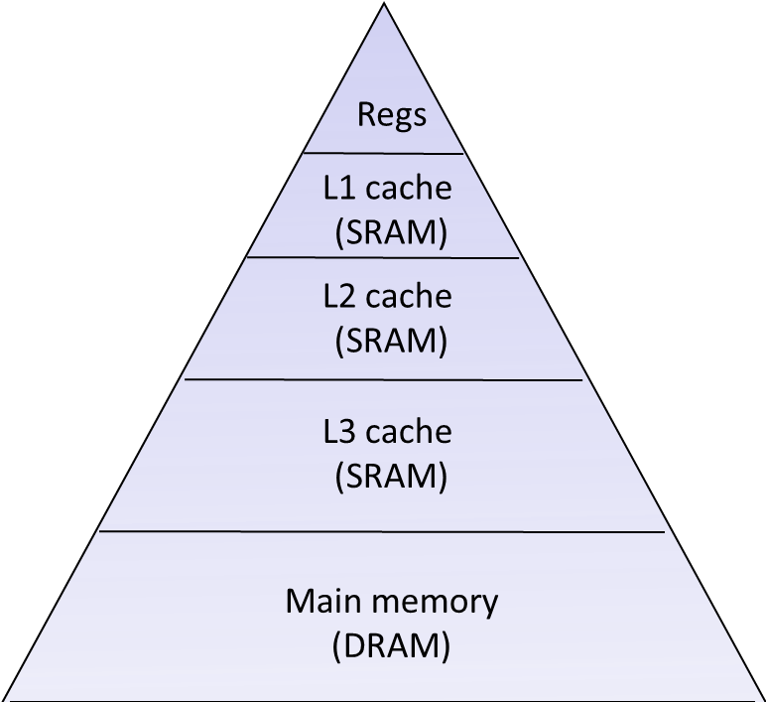
What about writes?
Multiple copies of data exist:
L1, L2, L3, Main Memory
What to do on a write-hit?
Write-through (write immediately to memory)
Write-back (defer write to memory until replacement of line)
Each cache line needs a dirty bit (set if data has been written to)
What to do on a write-miss?
Write-allocate (load into cache, update line in cache)
Good if more writes to the location will follow
No-write-allocate (writes straight to memory, does not load into cache)
Typical
Write-through + No-write-allocate
Write-back + Write-allocate
v
d
tag
0
1
2
B-1
valid bit
dirty bit
B = 2^{b} bytes

Slide 23
Practical Write-back Write-allocate
A write to address X is issued
If it is a hit
Update the contents of block
Set dirty bit to 1 (bit is sticky and only cleared on eviction)
If it is a miss
Fetch block from memory (per a read miss)
Then perform the write operations (per a write hit)
If a line is evicted and dirty bit is set to 1
The entire block of 2^{b} bytes are written back to memory
Dirty bit is cleared (set to 0)
Line is replaced by new contents
v
d
tag
0
1
2
B-1
valid bit
dirty bit
B = 2^{b} bytes

Slide 24
Cache Performance Metrics
Miss Rate
Fraction of memory references not found in cache (misses / accesses) = 1 – hit rate
Typical numbers (in percentages):
3-10% for L1
can be quite small (e.g., < 1%) for L2, depending on size, etc.
Hit Time
Time to deliver a line in the cache to the processor
includes time to determine whether the line is in the cache
Typical numbers:
4 clock cycle for L1
10 clock cycles for L2
Miss Penalty
Additional time required because of a miss
typically 50-200 cycles for main memory (Trend: increasing!)

Slide 25
Huge difference between a hit and a miss
Could be 100x, if just L1 and main memory
Would you believe 99% hits is twice as good as 97%?
Consider this simplified example: cache hit time of 1 cycle miss penalty of 100 cycles
Average access time:
97% hits: 1 cycle + 0.03 x 100 cycles = 4 cycles
99% hits: 1 cycle + 0.01 x 100 cycles = 2 cycles
This is why “miss rate” is used instead of “hit rate”

Slide 26
Writing Cache Friendly Code
Make the common case go fast
Focus on the inner loops of the core functions
Minimize the misses in the inner loops
Repeated references to variables are good (temporal locality)
Stride-1 reference patterns are good (spatial locality)
Key idea: Our qualitative notion of locality is quantified through our understanding of cache memories

Slide 27
Quiz Time!
Canvas Quiz: Day 10 – Cache Memories

Slide 28
Today
Cache organization and operation
Performance impact of caches
Rearranging loops to improve spatial locality
Using blocking to improve temporal locality

Slide 29
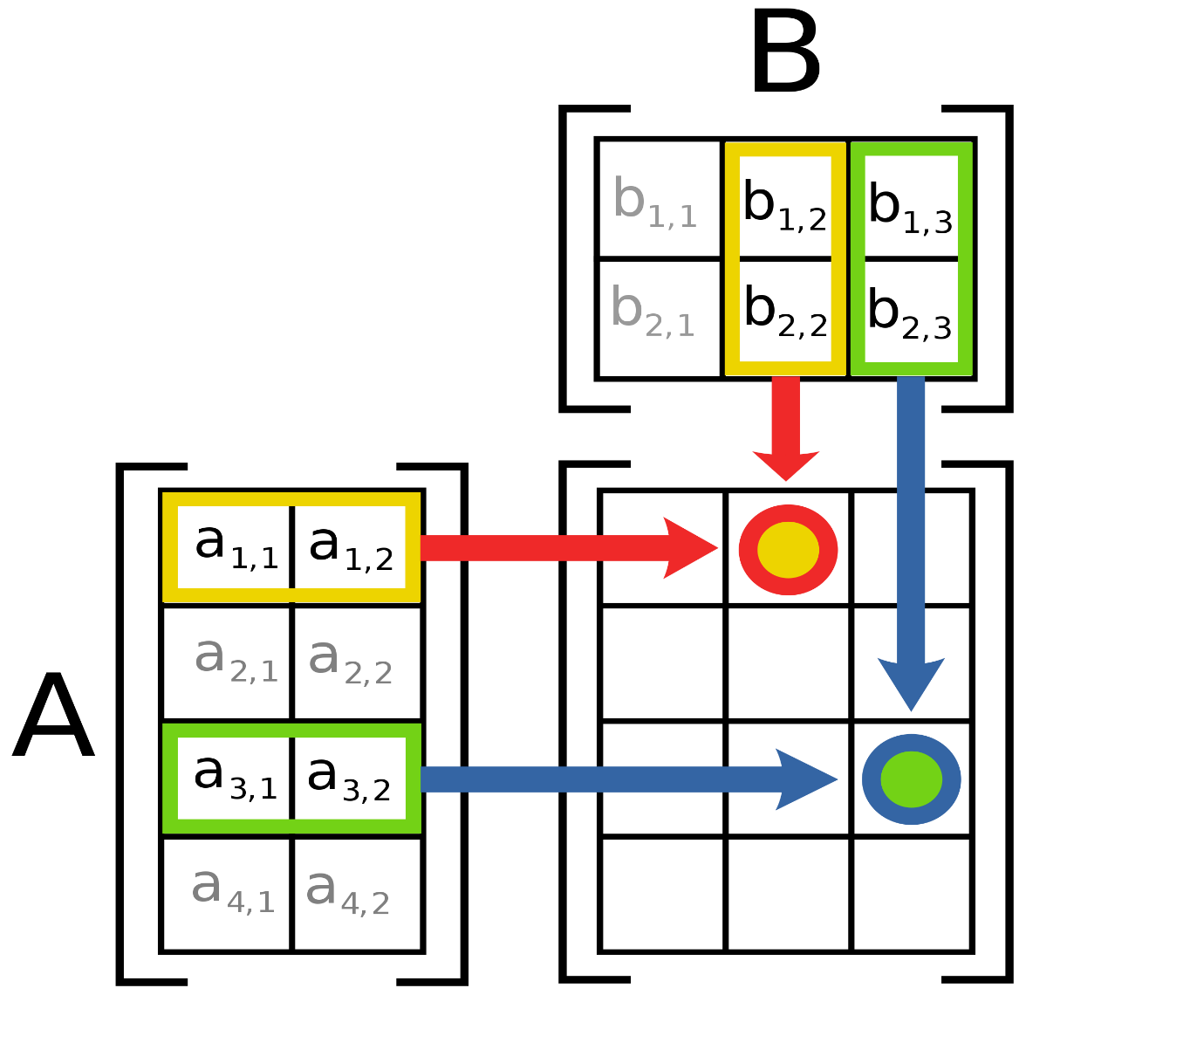
Remember matrix multiplication
Out[i, j] = dot product(A[i, ..], B[..,j])
= sum ( a[i, 0] * b[0, j],
a[i, 1] * b[1, j],
…
a[i, n] * b[n, j] )
Notes:
Matrix Multiplication image from Wikimedia, attribution: By File:Matrix multiplication diagram.svg:User:BilouSee below. - This file was derived from: Matrix multiplication diagram.svg, CC BY-SA 3.0, https://commons.wikimedia.org/w/index.php?curid=15175268

Slide 30
Matrix Multiplication Example
Description:
Multiply N x N matrices
Matrix elements are doubles (8 bytes)
O(N³) total operations
N reads per source element
N values summed per destination
but may be able to hold in register
Variable sum
held in register
/* ijk */
for (i=0; i<n; i++) {
for (j=0; j<n; j++) {
sum = 0.0;
for (k=0; k<n; k++)
sum += a[i][k] * b[k][j];
c[i][j] = sum;
}
}
matmult/mm.c

Slide 31
Miss Rate Analysis for Matrix Multiply
Assume:
Block size = 32B (big enough for four doubles)
Matrix dimension (N) is very large
Approximate 1/N as 0.0
Cache is not even big enough to hold multiple rows
Analysis Method:
Look at access pattern of inner loop
j
k
j
=
x
i
i
k
C
A
B

Slide 32
Layout of C Arrays in Memory (review)
C arrays allocated in row-major order
Stepping through columns in one row:
for (i = 0; i < N; i++)
sum += a[0][i]
if block size (B) > sizeof(a_{ij}) bytes, exploit spatial locality
miss rate = sizeof(a_{ij}) / B
Stepping through rows in one column:
for (i = 0; i < M; i++)
sum += a[i][0];
accesses distant elements: no spatial locality!
miss rate = 1 (i.e. 100%)
• • •
a
[0]
[0]
a
[0]
[N-1]
• • •
a
[1]
[0]
a
[1]
[N-1]
• • •
• • •
a
[M-1]
[0]
a
[M-1]
[N-1]

Slide 33
Matrix Multiplication (ijk)
/* ijk */
for (i=0; i<n; i++) {
for (j=0; j<n; j++) {
sum = 0.0;
for (k=0; k<n; k++)
sum += a[i][k] * b[k][j];
c[i][j] = sum;
}
}
Inner loop:
(*,j)
(i,j)
(i,*)
A
B
C
matmult/mm.c
Row-wise
Column-
wise
Fixed
Miss rate for inner loop iterations:
A B C
Block size = 32B (four doubles)

Slide 34
Matrix Multiplication (ijk)
/* ijk */
for (i=0; i<n; i++) {
for (j=0; j<n; j++) {
sum = 0.0;
for (k=0; k<n; k++)
sum += a[i][k] * b[k][j];
c[i][j] = sum;
}
}
Inner loop:
(*,j)
(i,j)
(i,*)
A
B
C
matmult/mm.c
Row-wise
Column-
wise
Fixed
Miss rate for inner loop iterations:
A B C
0.25 1.0 0.0
Block size = 32B (four doubles)

Slide 35
Matrix Multiplication (kij)
/* kij */
for (k=0; k<n; k++) {
for (i=0; i<n; i++) {
r = a[i][k];
for (j=0; j<n; j++)
c[i][j] += r * b[k][j];
}
}
Inner loop:
(i,k)
(k,*)
(i,*)
A
B
C
matmult/mm.c
Fixed
Row-wise
Row-wise
Miss rate for inner loop iterations:
A B C
Block size = 32B (four doubles)

Slide 36
Matrix Multiplication (kij)
/* kij */
for (k=0; k<n; k++) {
for (i=0; i<n; i++) {
r = a[i][k];
for (j=0; j<n; j++)
c[i][j] += r * b[k][j];
}
}
Inner loop:
(i,k)
(k,*)
(i,*)
A
B
C
matmult/mm.c
Fixed
Row-wise
Row-wise
Miss rate for inner loop iterations:
A B C
0.0 0.25 0.25
Block size = 32B (four doubles)

Slide 37
Matrix Multiplication (jki)
Inner loop:
/* jki */
for (j=0; j<n; j++) {
for (k=0; k<n; k++) {
r = b[k][j];
for (i=0; i<n; i++)
c[i][j] += a[i][k] * r;
}
}
(*,k)
(*,j)
(k,j)
A
B
C
matmult/mm.c
Column-
wise
Fixed
Column-
wise
Miss rate for inner loop iterations:
A B C
Block size = 32B (four doubles)

Slide 38
Matrix Multiplication (jki)
Inner loop:
/* jki */
for (j=0; j<n; j++) {
for (k=0; k<n; k++) {
r = b[k][j];
for (i=0; i<n; i++)
c[i][j] += a[i][k] * r;
}
}
(*,k)
(*,j)
(k,j)
A
B
C
matmult/mm.c
Column-
wise
Fixed
Column-
wise
Miss rate for inner loop iterations:
A B C
1.0 0.0 1.0
Block size = 32B (four doubles)

Slide 39
Summary of Matrix Multiplication
for (i=0; i<n; i++) {
for (j=0; j<n; j++) {
sum = 0.0;
for (k=0; k<n; k++)
sum += a[i][k] * b[k][j];
c[i][j] = sum;
}
}
ijk (& jik):
2 loads, 0 stores
avg misses/iter = 1.25
for (k=0; k<n; k++) {
for (i=0; i<n; i++) {
r = a[i][k];
for (j=0; j<n; j++)
c[i][j] += r * b[k][j];
}
}
kij (& ikj):
2 loads, 1 store
avg misses/iter = 0.5
for (j=0; j<n; j++) {
for (k=0; k<n; k++) {
r = b[k][j];
for (i=0; i<n; i++)
c[i][j] += a[i][k] * r;
}
}
jki (& kji):
2 loads, 1 store
avg misses/iter = 2.0

Slide 40
Core i7 Matrix Multiply Performance
Cycles per inner loop iteration
jki / kji (2.0)
ijk / jik (1.25)
kij / ikj (0.5)

Slide 41
Today
Cache organization and operation
Performance impact of caches
Rearranging loops to improve spatial locality
Using blocking to improve temporal locality

Slide 42
Example: Matrix Multiplication
c = (double *) calloc(sizeof(double), n*n);
/* Multiply n x n matrices a and b */
void mmm(double *a, double *b, double *c, int n) {
int i, j, k;
for (i = 0; i < n; i++)
for (j = 0; j < n; j++)
for (k = 0; k < n; k++)
c[i*n + j] += a[i*n + k] * b[k*n + j];
}
j
c
a
b
=
x
i

Slide 43
Cache Miss Analysis
Assume:
Matrix elements are doubles
Cache block = 8 doubles
Cache size C << n (much smaller than n)
First iteration:
n/8 + n = 9n/8 misses
Afterwards in cache: (schematic)
n
=
x
=
x
8 wide
Notes:
n/8 – comes from taking n and doing it in chunks of 8 that fit in a cache line, with perfect stride 1 accesses.
N – comes from missing on everything but the 1 double needed going down a column

Slide 44
Cache Miss Analysis
Assume:
Matrix elements are doubles
Cache block = 8 doubles
Cache size C << n (much smaller than n)
Second iteration:
Again: n/8 + n = 9n/8 misses
Total misses:
(9n/8) n² = (9/8) n³
n
=
x
8 wide

Slide 45
Blocked Matrix Multiplication
c = (double *) calloc(sizeof(double), n*n);
/* Multiply n x n matrices a and b */
void mmm(double *a, double *b, double *c, int n) {
int i, j, k;
for (i = 0; i < n; i+=B)
for (j = 0; j < n; j+=B)
for (k = 0; k < n; k+=B)
/* B x B mini matrix multiplications */
for (i1 = i; i1 < i+B; i1++)
for (j1 = j; j1 < j+B; j1++)
for (k1 = k; k1 < k+B; k1++)
c[i1*n+j1] += a[i1*n + k1]*b[k1*n + j1];
}
matmult/bmm.c
j1
c
a
b
c
=
x
+
i1
Block size B x B

Slide 46
Cache Miss Analysis
Assume:
Cache block = 8 doubles
Cache size C << n (much smaller than n)
Three blocks fit into cache: 3B² < C
First (block) iteration:
B*B/8 misses for each block
2n/B x B²/8 = nB/4 (omitting matrix c)
Afterwards in cache (schematic)
n/B blocks
=
x
Block size B x B
=
x
Notes:
2n/B comes from doing n/B blocks of size B^2 in each source matrix
B^2 / 8 comes from taking B^2 bytes per block and perfectly caching them 8 doubles at a time.

Slide 47
Cache Miss Analysis
Assume:
Cache block = 8 doubles
Cache size C << n (much smaller than n)
Three blocks fit into cache: 3B² < C
Second (block) iteration:
Same as first iteration
2n/B x B²/8 = nB/4
Total misses:
nB/4 * (n/B)² = n³/(4B)
n/B blocks
=
x
Block size B x B
Notes:
n/B is the dimension of the matrix in blocks. (n/B)^2 is the number of iterations. nB/4 is the misses per iteration. N^3/4B is the total miss count.

Slide 48
Blocking Summary
No blocking: (9/8) n³ misses
Blocking: (1/(4B)) n³ misses
Use largest block size B, such that B satisfies 3B² < C
Fit three blocks in cache! Two input, one output.
Reason for dramatic difference:
Matrix multiplication has inherent temporal locality:
Input data: 3n², computation 2n³
Every array elements used O(n) times!
But program has to be written properly
Notes:
3B^2 to accommodate M3 = M1 x M2, with M1,2,3 all supplying blocks of dim B^2

Slide 49
Cache Summary
Cache memories can have significant performance impact
You can write your programs to exploit this!
Focus on the inner loops, where bulk of computations and memory accesses occur.
Try to maximize spatial locality by reading data objects sequentially with stride 1.
Try to maximize temporal locality by using a data object as often as possible once it’s read from memory.

Slide 50
Supplemental slides

Slide 51
Recall: Locality
Principle of Locality: Programs tend to use data and instructions with addresses near or equal to those they have used recently
Temporal locality:
Recently referenced items are likely to be referenced again in the near future
Spatial locality:
Items with nearby addresses tend to be referenced close together in time

Slide 52
Recall: Memory Hierarchy
L0:
Regs
CPU registers hold words retrieved from the L1 cache.
Smaller,
faster,
and
costlier
(per byte)
storage
devices
L1:
L1 cache
(SRAM)
L1 cache holds cache lines retrieved from the L2 cache.
L2:
L2 cache
(SRAM)
L2 cache holds cache lines
retrieved from L3 cache.
L3:
L3 cache
(SRAM)
L3 cache holds cache lines
retrieved from main memory.
Larger,
slower,
and
cheaper
(per byte)
storage
devices
L4:
Main memory
(DRAM)
Main memory holds disk blocks retrieved from local disks.
L5:
Local secondary storage
(local disks)
Local disks hold files retrieved from disks
on remote servers.
L6:
Remote secondary storage
(e.g., Web servers)

Slide 53
Recall: Modern CPU Design
Instruction Control
Fetch
Control
Address
Instruction
Cache
Retirement
Unit
Register
File
Instruction
Decode
Instructions
Operations
Register Updates
Prediction OK?
Execution
Functional
Units
Branch
Arith
Arith
Arith
Load
Store
Operation Results
Addr.
Addr.
Data
Data
Data
Cache

Slide 54
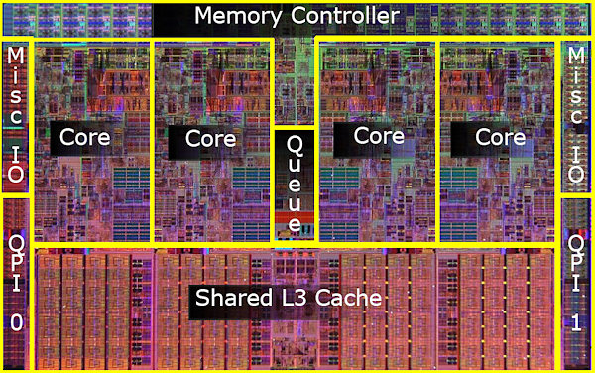
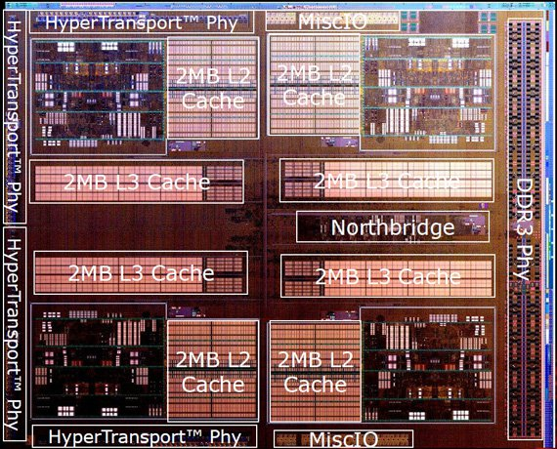
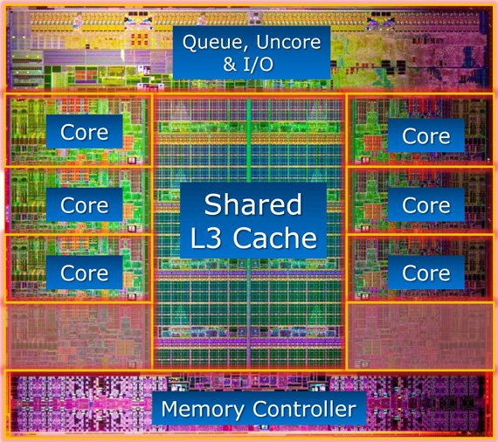
What it Really Looks Like
CPU chip
Register file
ALU
Cache
memory
Bus interface
Nehalem
AMD FX 8150
Core i7-3960X

Slide 55
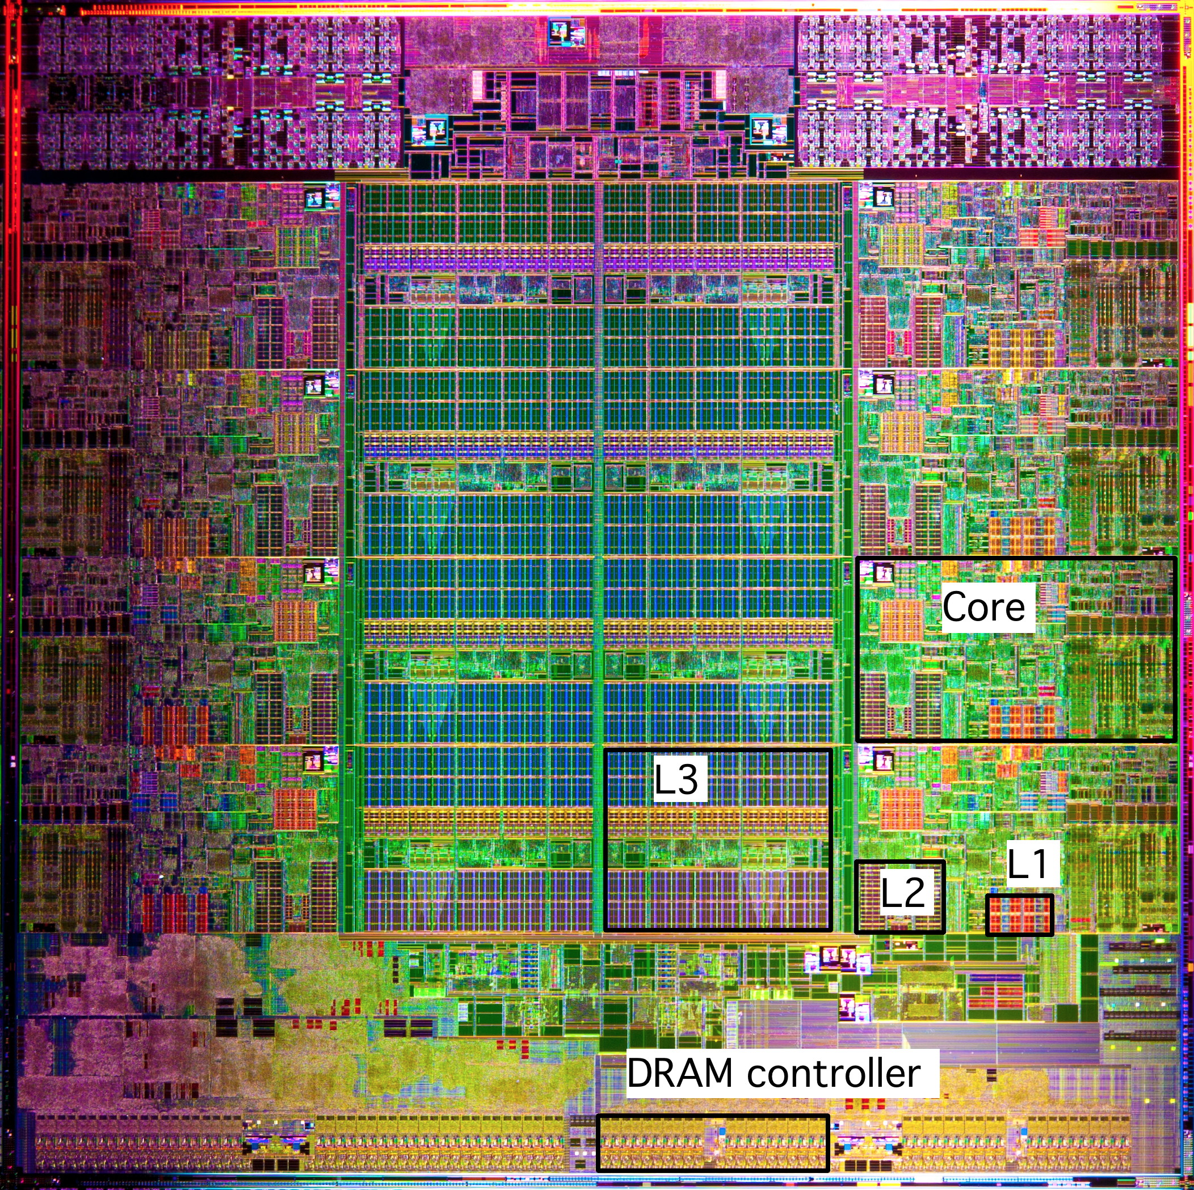
What it Really Looks Like (Cont.)
Intel Sandy Bridge
Processor Die
L1: 32KB Instruction + 32KB Data
L2: 256KB
L3: 3–20MB

Slide 56
Why Index Using Middle Bits?
Direct mapped: One line per set
Assume: cache block size 8 bytes
Standard Method:
Middle bit indexing
Address of int:
v
tag
0
1
2
3
4
5
6
7
t bits
0…01
100
v
tag
0
1
2
3
4
5
6
7
find set
S = 2^{s} sets
v
tag
0
1
2
3
4
5
6
7
Alternative Method:
High bit indexing
Address of int:
v
tag
0
1
2
3
4
5
6
7
1…11
t bits
100
find set

Slide 57
Illustration of Indexing Approaches
0000xx
0001xx
0010xx
64-byte memory
6-bit addresses
16 byte, direct-mapped cache
Block size = 4. (Thus, 4 sets; why?)
2 bits tag, 2 bits index, 2 bits offset
0011xx
0100xx
0101xx
0110xx
0111xx
1000xx
1001xx
Set 0
1010xx
Set 1
1011xx
Set 2
1100xx
Set 3
1101xx
1110xx
1111xx
Notes:
16byte direct mapped $, 4B blocks -> must be 4 sets to account for all 16B of cache

Slide 58
Middle Bit Indexing
0000xx
0001xx
0010xx
Addresses of form TTSSBB
TT Tag bits
SS Set index bits
BB Offset bits
Makes good use of spatial locality
0011xx
0100xx
0101xx
0110xx
0111xx
1000xx
1001xx
Set 0
1010xx
Set 1
1011xx
Set 2
1100xx
Set 3
1101xx
1110xx
1111xx

Slide 59
High Bit Indexing
0000xx
0001xx
0010xx
Addresses of form SSTTBB
SS Set index bits
TT Tag bits
BB Offset bits
Program with high spatial locality would generate lots of conflicts
0011xx
0100xx
0101xx
0110xx
0111xx
1000xx
1001xx
Set 0
1010xx
Set 1
1011xx
Set 2
1100xx
Set 3
1101xx
1110xx
1111xx
Notes:
Go from block with set index bits 00 to 01, displace the line sitting in set 0 from the block with set index 00.

Slide 60
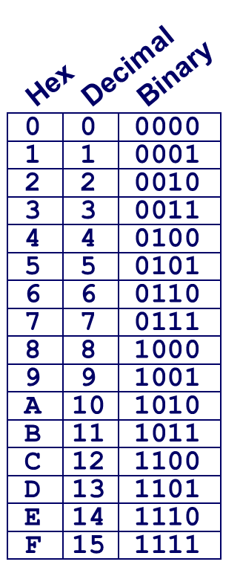
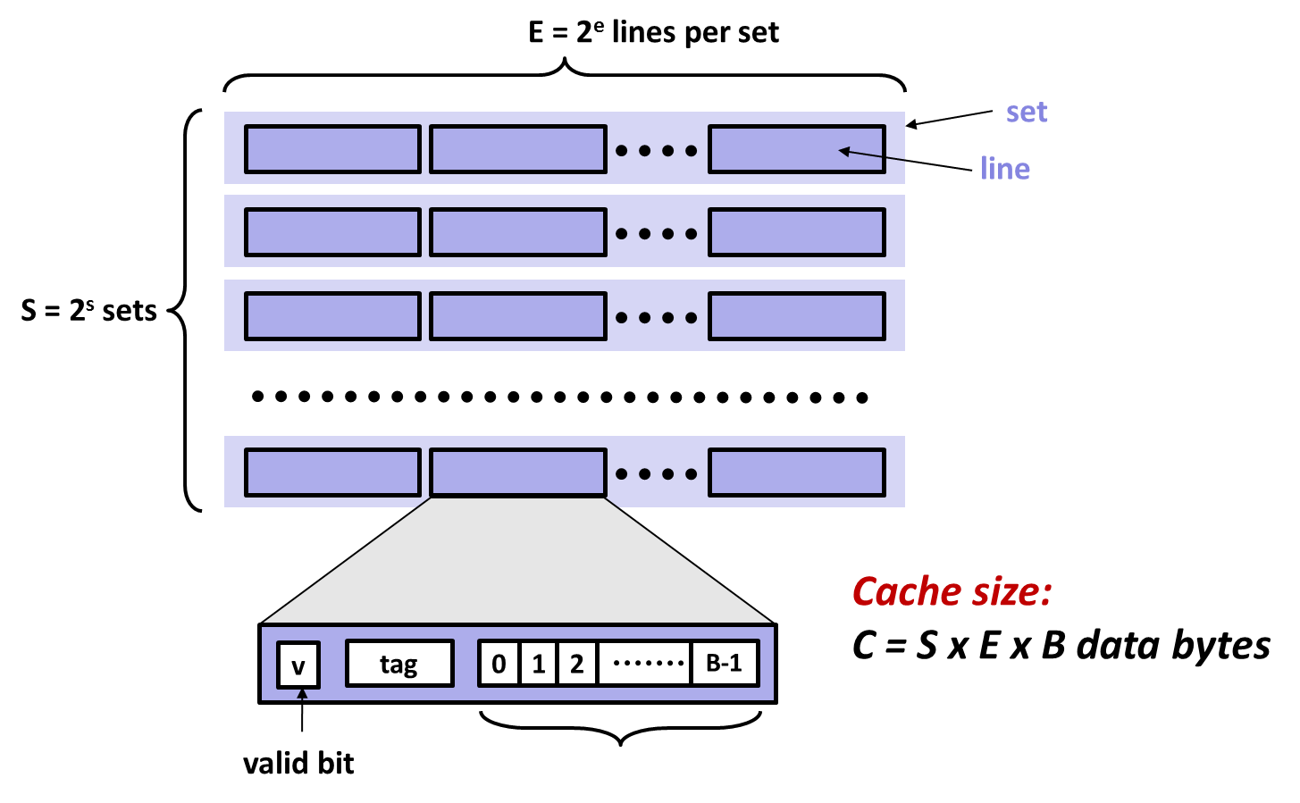
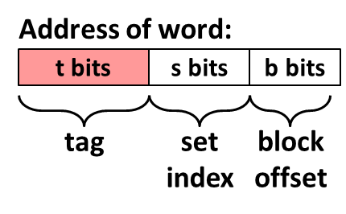
Example: Core i7 L1 Data Cache
32 kB 8-way set associative
64 bytes/block
47 bit address range
B =
S = , s =
E = , e =
C =
Stack Address: 0x00007f7262a1e010
Block offset: 0x??
Set index: 0x??
Tag: 0x??
Block offset: . bits
Set index: . bits
Tag: . bits
Notes:
B = 64 (2^6)
E = 8 (2^3)
S = 64 (2^6) [need to infer from B, E, and Cache Size]
Cache Size = 2^15 (32768)

Slide 61
Example: Core i7 L1 Data Cache
32 kB 8-way set associative 64 bytes/block
47 bit address range
B = 64
S = 64, s = 6
E = 8, e = 3
C = 64 x 64 x 8 = 32,768
Stack Address: 0x00007f7262a1e010
Block offset: 0x10
Set index: 0x0
Tag: 0x7f7262a1e
Block offset: 6 bits
Set index: 6 bits
Tag: 35 bits
0000 0001 0000
Notes:
0x010 => 0000 0001 0000, say that it awkwardly segments the bits, but that’s ok

Slide 62
Matrix Multiplication (jik)
/* jik */
for (j=0; j<n; j++) {
for (i=0; i<n; i++) {
sum = 0.0;
for (k=0; k<n; k++)
sum += a[i][k] * b[k][j];
c[i][j] = sum
}
}
Inner loop:
(*,j)
(i,j)
(i,*)
A
B
C
matmult/mm.c
Row-wise
Column-
wise
Fixed
Misses per inner loop iteration:
A B C
0.25 1.0 0.0
Block size = 32B (four doubles)

Slide 63
Matrix Multiplication (ikj)
/* ikj */
for (i=0; i<n; i++) {
for (k=0; k<n; k++) {
r = a[i][k];
for (j=0; j<n; j++)
c[i][j] += r * b[k][j];
}
}
Inner loop:
(i,k)
(k,*)
(i,*)
A
B
C
matmult/mm.c
Fixed
Row-wise
Row-wise
Misses per inner loop iteration:
A B C
0.0 0.25 0.25
Block size = 32B (four doubles)

Slide 64
Matrix Multiplication (kji)
/* kji */
for (k=0; k<n; k++) {
for (j=0; j<n; j++) {
r = b[k][j];
for (i=0; i<n; i++)
c[i][j] += a[i][k] * r;
}
}
Inner loop:
(*,k)
(*,j)
(k,j)
A
B
C
matmult/mm.c
Column-
wise
Fixed
Column-
wise
Misses per inner loop iteration:
A B C
1.0 0.0 1.0
Block size = 32B (four doubles)

