Slide 1
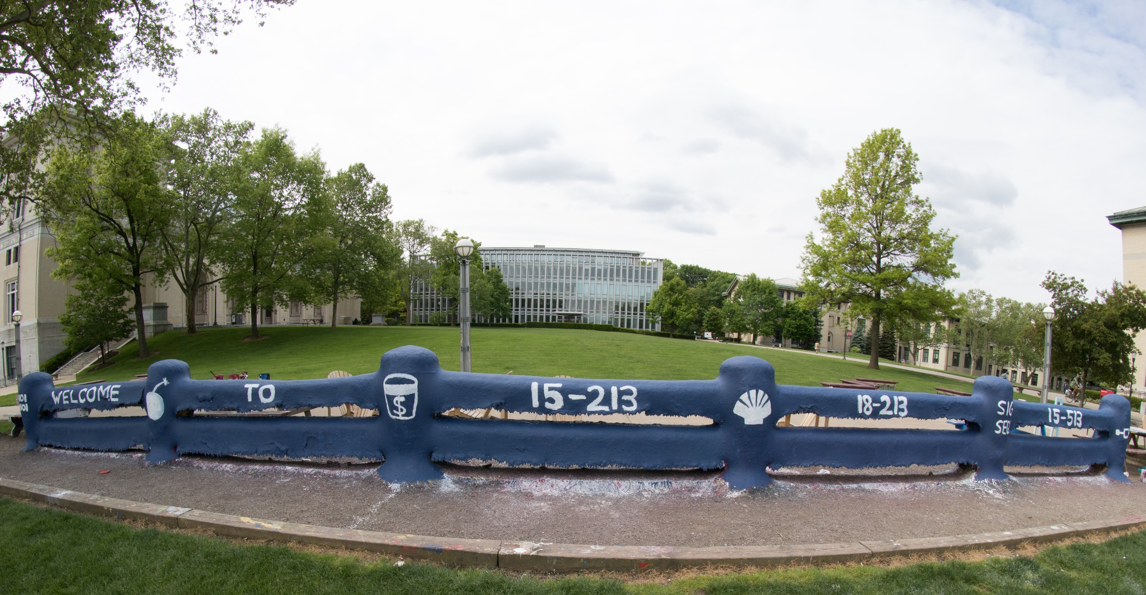
14-513
18-613

Slide 2
Virtual Memory: Details 15-213/15-513: Introduction to Computer Systems 15th Lecture, March 14, 2024

Slide 3
Announcements
Written #5: Midterm Written
Available on Gradescope (not canvas)
Covers first half of course, with questions similar to the final exam
Due Wed Oct 11 at 11:59 pm
No peer grading. Instead, graded by TAs before Fall break
Counts double a normal Written (can be 2 of your 2 dropped Writtens)
For mid-semester grades, we will temporarily count it as 20%
Cache Lab
Due Thurs Oct 12
Code review signup due Fri Oct 13
Fall Break
Sat Oct 14 to Sun Oct 22

Slide 4
Today
Review concepts from last lecture
Simple memory system example CSAPP 9.6.4
Case study: Core i7/Linux memory system CSAPP 9.7
Memory mapping CSAPP 9.8

Slide 5
Review: Virtual Addressing
physical memory
0:
CPU Chip
1:
Virtual address
(VA)
Physical address
(PA)
2:
CPU
MMU
3:
4
4:
4100
5:
6:
7:
8:
...
M-1:
Data word
Virtual address space is an abstraction, not real memory
Physical memory refers to the actual computer memory (DRAM)

Slide 6
Review: Per-process Virtual Address Space
Each process has its own virtual address space
All processes share the same Physical Memory
0
Address
translation
0
Virtual Address Space for Process 1:
Physical
Address
Space (DRAM)
VP 1
VP 2
PP 2
...
N-1
PP 6
(e.g., read-only
library code)
Virtual Address Space for Process 2:
0
PP 8
VP 1
...
...
N-1
VP k
M-1

Slide 7
Review: Page Table
Physical memory
(DRAM)
Physical page
number or
disk address
Virtual address
Valid
VP 1
PP 0
PTE 0
0
null
VP 2
1
VP 7
VP 4
PP 3
1
0
1
0
null
Virtual memory
(disk)
0
PTE 7
1
VP 1
Memory resident
page table
(DRAM)
VP 2
VP 3
VP 4
VP 6
VP 7
A page table contains page table entries (PTEs) that map virtual pages to physical pages.

Slide 8
Conceptual Question
The MMU must know the physical address of the page table in order to read page table entries from memory. Why does it need a physical address?
If the MMU knew only a virtual address for the page table, then, in order to find the page table in memory, it would first need to look up the physical address of the page table, in the page table itself, …

Slide 9
Review: Translating with a k-level Page Table
Having multiple levels greatly reduces total page table size
Page table base register
(part of the process’ context)
n-1
VIRTUAL ADDRESS
p-1
0
VPN 1
VPN 2
...
VPN k
VPO
the Level 1
page table
a Level 2
page table
a Level k
page table
...
...
PPN
m-1
p-1
0
PPN
PPO
PHYSICAL ADDRESS
Notes:
A heads up: One of the quiz questions requires understanding this structure.

Slide 10
Conceptual Questions
Why are one-level page tables impractical?
For typical system sizes, the table would require more physical memory (e.g., 512 GBs) than most computers have.
How does a multi-level page table fix this problem?
Only allocates the part of the page table tree that’s needed for the virtual addresses the program uses.
Why is memory access slower with a multi-level page table than with a one-level page table?
A k-level page table requires k memory loads in order to determine the physical address. There is no spatial locality to these loads (see next slide).

Slide 11
The problem (with k-level page tables)
Page table base register
n-1
VIRTUAL ADDRESS
p-1
0
VPN 1
VPN 2
...
VPN k
VPO
the Level 1
page table
a Level 2
page table
a Level k
page table
...
...
PPN
Cache miss!
Cache miss!
Cache miss!
Cache miss!
Cache miss!
PPN
PPO

Slide 12
Review: Translation Lookaside Buffer (TLB)
A small cache dedicated to storing mappings from virtual addresses to physical addresses (page table entries)
MMU consults the TLB for each address as its first action. If there is a TLB hit, it does not need to fetch anything from the page table (avoiding k lookups)
TLB
2
PTE
VPN
3
Cache/
Memory
MMU
CPU
VA
PA
1
4
Data
5

Slide 13
Review: Accessing the TLB
MMU uses the VPN portion of the virtual address to access the TLB:
T = 2^{t} sets
VPN
TLBT matches tag of line within set
n-1
p+t
p+t-1
p
p-1
0
TLB tag (TLBT)
TLB index (TLBI)
VPO
Set 0
v
tag
PTE
v
tag
PTE
TLBI selects the set
Set 1
v
tag
PTE
v
tag
PTE
…
Set T-1
v
tag
PTE
v
tag
PTE

Slide 14
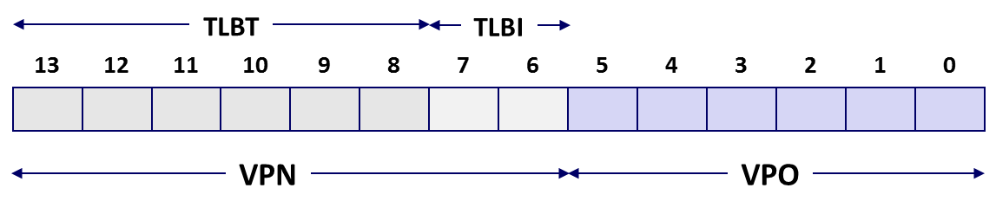
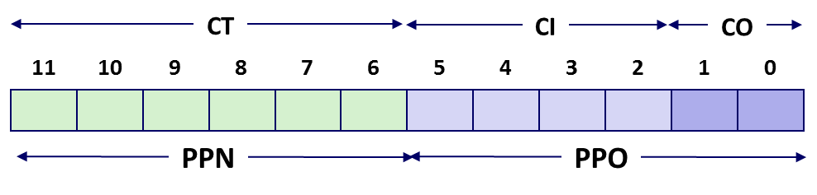

Conceptual Question
How does virtual memory interact with the CPU cache(s)?
The cache’s function is to speed up access to whatever data is most frequently used. The MMU sits “in between” the CPU and the cache; the cache works only with physical addresses. This means data from multiple processes may coexist in the cache (or compete for cache space).
1. MMU uses VA to find PTE & get PA
2. PA is used to look in cache for data

Slide 15
Today
Review concepts from last lecture
Simple memory system example
Case study: Core i7/Linux memory system
Memory mapping

Slide 16
Simple Memory System Example
Addressing
14-bit virtual addresses
12-bit physical address
Page size = 64 bytes
Why is the VPO 6 bits?
Why is the PPO 6 bits?
Why is the
VPN 8 bits?
Why is the PPN 6 bits?
13
12
11
10
9
8
7
6
5
4
3
2
1
0
VPN
VPO
Virtual Page Number
Virtual Page Offset
11
10
9
8
7
6
5
4
3
2
1
0
PPN
PPO
Physical Page Number
Physical Page Offset
Notes:
Understanding these Why questions will be relevant for today’s quiz.

Slide 17
Simple Memory System TLB
16 entries
4-way associative
TLBT
TLBI
13
12
11
10
9
8
7
6
5
4
3
2
1
0
0
0
0
0
1
1
0
1
VPN
VPO
VPN = 0b1101 = 0x0D
Translation Lookaside Buffer (TLB)
Set
Tag
PPN
Valid
Tag
PPN
Valid
Tag
PPN
Valid
Tag
PPN
Valid
Set
Tag
PPN
Valid
Tag
PPN
Valid
Tag
PPN
Valid
Tag
PPN
Valid
0
03
–
0
09
0D
1
00
–
0
07
02
1
0
03
–
0
09
0D
1
00
–
0
07
02
1
1
03
2D
1
02
–
0
04
–
0
0A
–
0
1
03
2D
1
02
–
0
04
–
0
0A
–
0
2
02
–
0
08
–
0
06
–
0
03
–
0
2
02
–
0
08
–
0
06
–
0
03
–
0
3
07
–
0
03
0D
1
0A
34
1
02
–
0
3
07
–
0
03
0D
1
0A
34
1
02
–
0

Slide 18
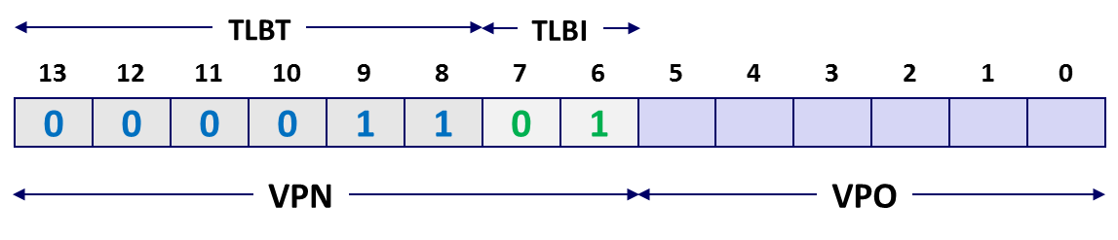
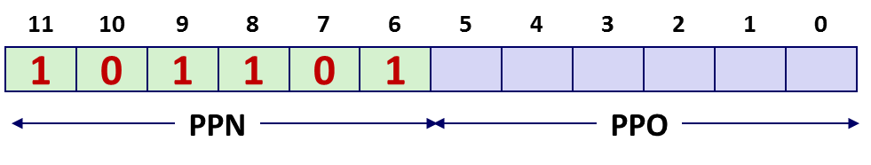
Simple Memory System Page Table
Only showing the first 16 entries (out of 256)
VPN
PPN
Valid
VPN
PPN
Valid
00
28
1
08
13
1
01
–
0
09
17
1
02
33
1
0A
09
1
03
02
1
0B
–
0
04
–
0
0C
–
0
05
16
1
0D
2D
1
0x0D → 0x2D
06
–
0
0E
11
1
07
–
0
0F
0D
1

Slide 19
Simple Memory System Cache
16 lines, 4-byte cache line size
Physically addressed
Direct mapped
V[0b00001101101001] = V[0x369]
P[0b101101101001] = P[0xB69] = 0x15
CT
CI
CO
11
10
9
8
7
6
5
4
3
2
1
0
1
0
1
1
0
1
1
0
1
0
0
1
PPN
PPO
Idx
Tag
Valid
B0
B1
B2
B3
Idx
Tag
Valid
B0
B1
B2
B3
Idx
Tag
Valid
B0
B1
B2
B3
Idx
Tag
Valid
B0
B1
B2
B3
0
19
1
99
11
23
11
8
24
1
3A
00
51
89
0
19
1
99
11
23
11
8
24
1
3A
00
51
89
1
15
0
–
–
–
–
9
2D
0
–
–
–
–
1
15
0
–
–
–
–
9
2D
0
–
–
–
–
2
1B
1
00
02
04
08
A
2D
1
93
15
DA
3B
2
1B
1
00
02
04
08
A
2D
1
93
15
DA
3B
3
36
0
–
–
–
–
B
0B
0
–
–
–
–
3
36
0
–
–
–
–
B
0B
0
–
–
–
–
4
32
1
43
6D
8F
09
C
12
0
–
–
–
–
4
32
1
43
6D
8F
09
C
12
0
–
–
–
–
5
0D
1
36
72
F0
1D
D
16
1
04
96
34
15
5
0D
1
36
72
F0
1D
D
16
1
04
96
34
15
6
31
0
–
–
–
–
E
13
1
83
77
1B
D3
6
31
0
–
–
–
–
E
13
1
83
77
1B
D3
7
16
1
11
C2
DF
03
F
14
0
–
–
–
–
7
16
1
11
C2
DF
03
F
14
0
–
–
–
–
Notes:
Click to reveal PPO. Then run through lookup that retrieves 0x15 before clicking again to reveal the answer.

Slide 20
Address Translation Example
Virtual Address: 0x03D4
VPN ___ TLBI ___ TLBT ____ TLB Hit? __ Page Fault? __ PPN: ____
Physical Address
CO ___ CI___ CT ____ Hit? __ Byte: ____
TLBT
TLBI
13
12
11
10
9
8
7
6
5
4
3
2
1
0
0
0
0
0
1
1
1
1
0
1
0
1
0
0
VPN
VPO
0x0F
0x3
0x03
Y
N
0x0D
TLB
Set
Tag
PPN
Valid
Tag
PPN
Valid
Tag
PPN
Valid
Tag
PPN
Valid
0
03
–
0
09
0D
1
00
–
0
07
02
1
1
03
2D
1
02
–
0
04
–
0
0A
–
0
2
02
–
0
08
–
0
06
–
0
03
–
0
3
07
–
0
03
0D
1
0A
34
1
02
–
0
03
0D
1
11
10
9
8
7
6
5
4
3
2
1
0
0
0
1
1
0
1
0
1
0
1
0
0
PPN
PPO

Slide 21
Address Translation Example
Physical Address
CO ___ CI___ CT ____ Hit? __ Byte: ____
CT
CI
CO
11
10
9
8
7
6
5
4
3
2
1
0
0
0
1
1
0
1
0
1
0
1
0
0
PPN
PPO
0
0x5
0x0D
Y
0x36
Cache
Idx
Tag
Valid
B0
B1
B2
B3
Idx
Tag
Valid
B0
B1
B2
B3
0
19
1
99
11
23
11
8
24
1
3A
00
51
89
1
15
0
–
–
–
–
9
2D
0
–
–
–
–
2
1B
1
00
02
04
08
A
2D
1
93
15
DA
3B
3
36
0
–
–
–
–
B
0B
0
–
–
–
–
4
32
1
43
6D
8F
09
C
12
0
–
–
–
–
5
0D
1
36
72
F0
1D
D
16
1
04
96
34
15
6
31
0
–
–
–
–
E
13
1
83
77
1B
D3
7
16
1
11
C2
DF
03
F
14
0
–
–
–
–

Slide 22
Address Translation Example: TLB/Cache Miss
Virtual Address: 0x0020
VPN ___ TLBI ___ TLBT ____ TLB Hit? __ Page Fault? __ PPN: ____
Physical Address
CO___ CI___ CT ____ Hit? __ Byte: ____
TLBT
TLBI
13
12
11
10
9
8
7
6
5
4
3
2
1
0
0
0
0
0
0
0
0
0
1
0
0
0
0
0
VPN
VPO
0x00
0
0x00
N
N
0x28
Page table
VPN
PPN
Valid
CT
CI
CO
00
28
1
11
10
9
8
7
6
5
4
3
2
1
0
01
–
0
1
0
1
0
0
0
1
0
0
0
0
0
02
33
1
03
02
1
PPN
PPO
04
–
0
0
0x8
0x28
05
16
1
06
–
0
07
–
0
Notes:
We are not showing the TLB on the slide, but by assumption it’s a TLB miss, so we need to look at the Page Table for the translation.

Slide 23
Address Translation Example: TLB/Cache Miss
Cache
Physical Address
CO___ CI___ CT ____ Hit? __ Byte: ____
Idx
Tag
Valid
B0
B1
B2
B3
Idx
Tag
Valid
B0
B1
B2
B3
0
19
1
99
11
23
11
8
24
1
3A
00
51
89
1
15
0
–
–
–
–
9
2D
0
–
–
–
–
2
1B
1
00
02
04
08
A
2D
1
93
15
DA
3B
3
36
0
–
–
–
–
B
0B
0
–
–
–
–
4
32
1
43
6D
8F
09
C
12
0
–
–
–
–
5
0D
1
36
72
F0
1D
D
16
1
04
96
34
15
6
31
0
–
–
–
–
E
13
1
83
77
1B
D3
7
16
1
11
C2
DF
03
F
14
0
–
–
–
–
CT
CI
CO
11
10
9
8
7
6
5
4
3
2
1
0
1
0
1
0
0
0
1
0
0
0
0
0
PPN
PPO
0
0x8
0x28
N
Mem

Slide 24
Quiz Time!
Canvas Quiz: Day 12 – Virtual Memory: Details

Slide 25
Today
Review concepts from last lecture
Simple memory system example
Case study: Core i7/Linux memory system
Memory mapping

Slide 26
Intel Core i7 Memory System
Processor package
Core x4
Registers
Instruction
fetch
MMU
(addr translation)
L1 d-cache
32 KB, 8-way
L1 i-cache
32 KB, 8-way
L1 d-TLB
64 entries, 4-way
L1 i-TLB
128 entries, 4-way
L2 unified cache
256 KB, 8-way
L2 unified TLB
512 entries, 4-way
To other
cores
QuickPath interconnect
4 links @ 25.6 GB/s each
To I/O
bridge
L3 unified cache
8 MB, 16-way
(shared by all cores)
DDR3 Memory controller
3 x 64 bit @ 10.66 GB/s
32 GB/s total (shared by all cores)
Main memory

Slide 27
End-to-end Core i7 Address Translation
CPU
32/64
L2, L3, and
main memory
Result
Virtual address (VA)
36
12
VPN
VPO
L1
hit
L1
miss
32
4
TLBT
TLBI
L1 d-cache
(64 sets, 8 lines/set)
TLB
hit
TLB
miss
...
...
L1 d-TLB (16 sets, 4 entries/set)
9
9
9
9
40
12
40
6
6
VPN1
VPN2
VPN3
VPN4
PPN
PPO
CT
CI
CO
Physical
address
(PA)
CR3
PTE
PTE
PTE
PTE
Page tables
Notes:
1. 48-bit virtual addresses and 52-bit physical addresses. Why would one ever need *more* DRAM than a complete virtual address space? Hold working sets for *many* concurrent processes.
2. 9-bit VPNi implies 8 byte PTEs

Slide 28
Core i7 Level 1-3 Page Table Entries
63
62
52
51
12
11
9
8
7
6
5
4
3
2
1
0
XD
Unused
Page table physical base address
Unused
G
PS
A
CD
WT
U/S
R/W
P=1
Available for OS (page table location on disk)
P=0
Each entry references a 4K child page table. Significant fields:
P: Child page table present in physical memory (1) or not (0).
R/W: Read-only or read-write access access permission for all reachable pages.
U/S: user or supervisor (kernel) mode access permission for all reachable pages.
WT: Write-through or write-back cache policy for the child page table.
A: Reference bit (set by MMU on reads and writes, cleared by software).
PS: Page size either 4 KB or 4 MB (defined for Level 1 PTEs only).
Page table physical base address: 40 most significant bits of physical page table address (forces page tables to be 4KB aligned)
XD: Disable or enable instruction fetches from all pages reachable from this PTE.
Notes:
Reference bit – used in LRU. G = Global page (don’t evict from TLB on task switch). CD = Caching disabled for the child page table.

Slide 29
Core i7 Level 4 Page Table Entries
63
62
52
51
12
11
9
8
7
6
5
4
3
2
1
0
XD
Unused
Page physical base address
Unused
G
D
A
CD
WT
U/S
R/W
P=1
Available for OS (page location on disk)
P=0
Each entry references a 4K child page. Significant fields:
P: Child page is present in memory (1) or not (0)
R/W: Read-only or read-write access permission for child page
U/S: User or supervisor mode access
WT: Write-through or write-back cache policy for this page
A: Reference bit (set by MMU on reads and writes, cleared by software)
D: Dirty bit (set by MMU on writes, cleared by software)
G: Global page (don’t evict from TLB on task switch)
Page physical base address: 40 most significant bits of physical page address (forces pages to be 4KB aligned)
XD: Disable or enable instruction fetches from this page.
Notes:
CD = Cache disabled or enabled

Slide 30
Core i7 Page Table Translation
9
9
9
9
12
Virtual
address
VPN 1
VPN 2
VPN 3
VPN 4
VPO
L1 PT
Page global
directory
L2 PT
Page upper
directory
L3 PT
Page middle
directory
L4 PT
Page
table
40
40
40
40
CR3
/
/
/
/
Physical
address
of L1 PT
Offset into
physical and
virtual page
/
12
L1 PTE
L2 PTE
L3 PTE
L4 PTE
Physical
address
of page
512 GB
region
per entry
1 GB
region
per entry
2 MB
region
per entry
4 KB
region
per entry
40
/
40
12
Physical
address
PPN
PPO

Slide 31
Trick for Speeding Up L1 Access
CPU Chip
Virtual address
(VA)
Physical address
(PA)
CPU
MMU
L1 cache
The story so far
MMU accessed before L1 cache
Doesn’t that make L1 cache hits slower?
Yes! So real systems don’t do this…

Slide 32
Trick for Speeding Up L1 Access
CT
Tag Check
40
6
6
Physical
address
(PA)
CT
CI
CO
PPN
PPO
Address
Translation
No
Change
Virtual
address
(VA)
CI
VPN
VPO
L1 Cache
36
12
Observation
Bits that determine CI identical in virtual and physical address
Can index into cache while address translation taking place
Generally we hit in TLB, so PPN bits (CT bits) available quickly
“Virtually indexed, physically tagged”
Cache carefully sized to make this possible

Slide 33
Trick for Speeding Up L1 Access
L1 cache
CPU Chip
Virtual address
(VA)
Physical address
(PA)
CPU
MMU
Set (tags + data)
Virtual memory with no impact on memory performance!
MMU moved off critical path (faster than L1 cache)

Slide 34
Today
Review concepts from last lecture
Simple memory system example
Case study: Core i7/Linux memory system
Memory mapping

Slide 35
Memory-Mapped Files
Paging = every page of a program’s physical memory is backed by some page of disk*
Normally, those pages belong to swap space
But what if some pages were backed by … files?
* This is how it used to work 20 years ago. Nowadays, not always true.

Slide 36
Memory-Mapped Files
Process
virtual memory
Physical
memory
Swap space
File on disk

Slide 37
Memory-Mapped Files
Process 2
virtual memory
Process 1
virtual memory
Physical
memory
Swap space
File on disk

Slide 38
Copy-on-write sharing
fork creates a new process by copying the entire address space of the parent process
That sounds slow
It is slow
Parent
virtual memory
Physical
memory
Swap space
File on disk
Clever trick:
Just duplicate the page tables
Mark everything read only (PTE permission bits for all pages set to read-only)
Copy only on write faults

Slide 39
Copy-on-write sharing
Child
virtual memory
Parent
virtual memory
Physical
memory
Swap space
File on disk
Clever trick:
Just duplicate the page tables
Mark everything read only
Copy only on write faults

Slide 40
Copy-on-write sharing
Child
virtual memory
Parent
virtual memory
Physical
memory
Child wrote to this page
Swap space
File on disk
Clever trick:
Just duplicate the page tables
Mark everything read only
Copy only on write faults

Slide 41
User-Level Memory Mapping
void *mmap(void *start, int len,
int prot, int flags, int fd, int offset)
Map len bytes starting at offset offset of the file specified by file description fd, preferably at address start
start: may be 0 for “pick an address”
prot: PROT_READ, PROT_WRITE, PROT_EXEC, ...
flags: MAP_ANON, MAP_PRIVATE, MAP_SHARED, ...
Return a pointer to start of mapped area (may not be start)
Notes:
PROT_READ = ok to read pages
PROT_WRITE = ok to read or write
PROT_EXEC = ok to execute
MAP_ANON = backing store is anonymous object & pages are demand-zeroed
MAP_PRIVATE = copy-on-write object
MAP_SHARED = shared object

Slide 42
User-Level Memory Mapping
void *mmap(void *start, int len,
int prot, int flags, int fd, int offset)
len bytes
start
(or address
chosen by kernel)
len bytes
offset
(bytes)
0
0
Disk file specified by
file descriptor fd
Process virtual memory

Slide 43
Uses of mmap
Reading big files
Uses paging mechanism to bring files into memory
Shared data structures
When call with MAP_SHARED flag
Multiple processes have access to same region of memory (Risky!)
File-based data structures
E.g., database
When unmap region, file will be updated via write-back
Can implement load from file / update / write back to file
Enable Attack Lab
Allow students to execute code on the stack (which is forbidden on shark machines)
See backup slides for details

Slide 44
Summary
Programmer’s view of virtual memory
Each process has its own private linear address space
Cannot be corrupted by other processes
System view of virtual memory
Uses memory efficiently by caching virtual memory pages
Efficient only because of locality
Simplifies memory management and programming
Simplifies protection by providing a convenient interpositioning point to check permissions
Implemented via combination of hardware & software
MMU, TLB, exception handling mechanisms part of hardware
Page fault handlers, TLB management performed in software

Slide 45
Review Question
For a simple system with a one-level page table, what sub-steps does the MMU take when it fetches a PTE from a page table?
The MMU has to split the virtual address into VPN and VPO.
The VPN can then be used to index directly into the page table.
If the valid bit is set on the PTE, the entry contains a PPN and the physical address is PPN followed by PPO (=VPO).
Otherwise, a page fault is triggered.

Slide 46
Address Translation With a Page Table
Virtual address
Page table base register (PTBR)
(CR3 in x86)
n-1
p
p-1
0
Virtual page number (VPN)
Virtual page offset (VPO)
Page table
Valid
Physical page number (PPN)
Physical page table
address for the current
process
Valid bit = 0:
Page not in memory
(page fault)
Valid bit = 1
m-1
p
p-1
0
Physical page number (PPN)
Physical page offset (PPO)
Physical address

Slide 47
Example: Using mmap to Support Attack Lab
Problem
Want students to be able to perform code injection attacks
Shark machine stacks are not executable
Solution
Suggested by Sam King (now at UC Davis)
Use mmap to allocate region of memory marked executable
Divert stack to new region
Execute student attack code
Restore back to original stack
Use munmap to remove mapped region

Slide 48
Using mmap to Support Attack Lab
Memory
invisible to
user code
Kernel virtual memory
User stack
(created at runtime)
%rsp
(stack
pointer)
Memory-mapped region for
shared libraries
Run-time heap
(created by malloc)
Read/write segment
(.data, .bss)
Read-only segment
(.init, .text, .rodata)
0x40000000
Unused
0

Slide 49
Using mmap to Support Attack Lab
Memory
invisible to
user code
Kernel virtual memory
User stack
(created at runtime)
%rsp
(stack
pointer)
Memory-mapped region for
shared libraries
Region created by mmap
0x55586000
Run-time heap
(created by malloc)
Read/write segment
(.data, .bss)
0x55586000
Read-only segment
(.init, .text, .rodata)
0x40000000
Unused
0
Notes:
Save a copy of the original %rsp, before update %rsp to point to start of mmap region.

Slide 50
Using mmap to Support Attack Lab
Memory
invisible to
user code
Kernel virtual memory
User stack
(created at runtime)
%rsp
(stack
pointer)
Frame for launch
Memory-mapped region for
shared libraries
Frame for test
Region created by mmap
Frame for getbuf
0x55586000
Run-time heap
(created by malloc)
Read/write segment
(.data, .bss)
0x55586000
Read-only segment
(.init, .text, .rodata)
0x40000000
Unused
0

Slide 51
Using mmap to Support Attack Lab
Memory
invisible to
user code
Kernel virtual memory
User stack
(created at runtime)
%rsp
(stack
pointer)
Memory-mapped region for
shared libraries
Restore original %rsp
Use munmap to remove mapped region
Run-time heap
(created by malloc)
Read/write segment
(.data, .bss)
Read-only segment
(.init, .text, .rodata)
0x40000000
Unused
0

Slide 52
Using mmap to Support Attack Lab
Allocate new region
void *new_stack = mmap(START_ADDR, STACK_SIZE, PROT_EXEC|PROT_READ|PROT_WRITE,
MAP_PRIVATE | MAP_GROWSDOWN | MAP_ANONYMOUS | MAP_FIXED,
0, 0);
if (new_stack != START_ADDR) {
munmap(new_stack, STACK_SIZE);
exit(1);
}
Divert stack to new region & execute attack code
Restore stack and remove region
stack_top = new_stack + STACK_SIZE - 8;
asm("movq %%rsp,%%rax ; movq %1,%%rsp ; movq %%rax,%0"
: "=r" (global_save_stack) // %0
: "r" (stack_top) // %1
);
launch(global_offset);
asm("movq %0,%%rsp"
:
: "r" (global_save_stack) // %0
);
munmap(new_stack, STACK_SIZE);

Slide 53
Virtual Address Space of a Linux Process
Process-specific data
structs (ptables,
task and mm structs, kernel stack)
Different for each process
Kernel
virtual
memory
Identical for each process
Physical memory
Kernel code and data
%rsp
User stack
Memory mapped region
for shared libraries
Process
virtual
memory
brk
Runtime heap (malloc)
Uninitialized data (.bss)
Initialized data (.data)
0x00400000
Program text (.text)
0

Slide 54
Linux Organizes VM as Collection of “Areas”
Process virtual memory
vm_area_struct
task_struct
mm_struct
vm_end
mm
pgd
vm_start
vm_prot
mmap
vm_flags
Shared libraries
vm_next
vm_end
pgd:
Page global directory address
Points to L1 page table
vm_prot:
Read/write permissions for this area
vm_flags
Pages shared with other processes or private to this process
vm_start
Data
vm_prot
vm_flags
vm_next
Text
vm_end
vm_start
vm_prot
vm_flags
vm_next
0
Each process has own task_struct, etc

Slide 55
Linux Page Fault Handling
vm_area_struct
Process virtual memory
vm_end
vm_start
vm_prot
vm_flags
shared libraries
vm_next
1
Segmentation fault:
accessing a non-existing page
read
vm_end
vm_start
data
3
vm_prot
read
Normal page fault
vm_flags
vm_next
text
2
Protection exception:
e.g., violating permission by writing to a read-only page (Linux reports as Segmentation fault)
write
vm_end
vm_start
vm_prot
vm_flags
vm_next

