Slide 1
This Week:
A Citation Graph with SNAP
A Baseline Model
A Random Walk Model
Next Week
Author, Conference, …

Slide 2
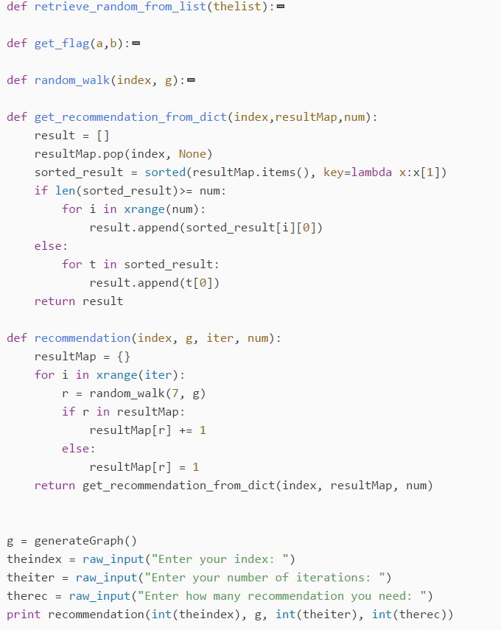
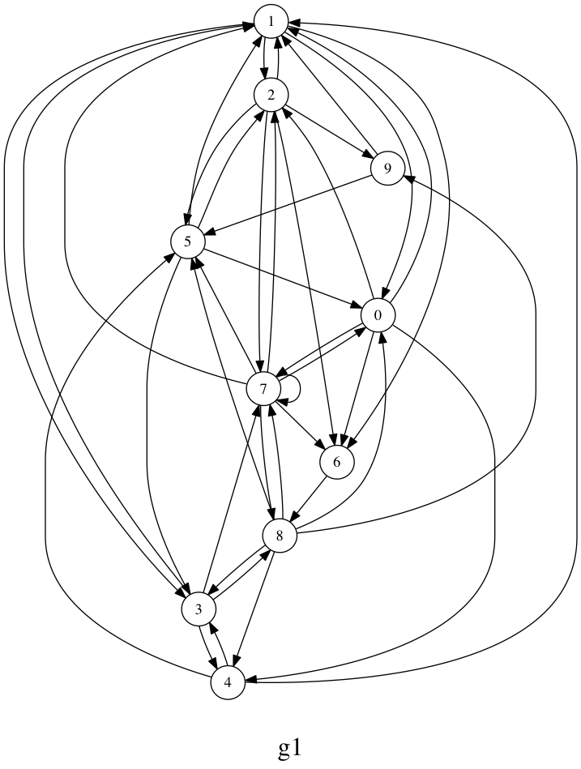

Slide 3
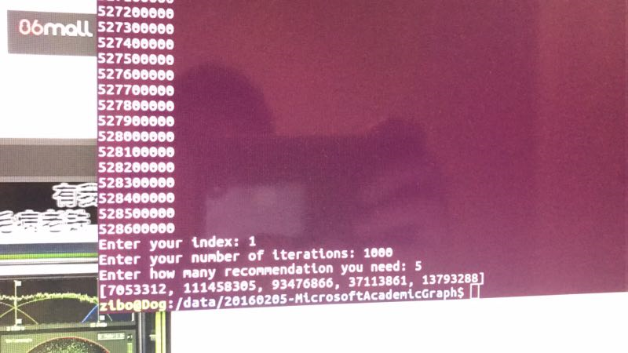

Slide 4
Input:
027D0030 Automatic Monitoring the Content of Audio Broadcasted by Internet Radio Stations automatic monitoring the content of audio broadcasted by internet radio stations 2012 2012/10/27 10.1007/978-3-642-37807-2_11 mexican international conference on artificial intelligence micai 42D7146F 19444
Output:
7F382CA9 Effect of dexmedetomidine and midazolam on human performance and mood effect of dexmedetomidine and midazolam on human performance and mood 1991 1991/09/01 10.1007/BF00315433 European Journal of Clinical Pharmacology eur j clin pharmacol 01E4ECA8 18080
A9 Effect of dexmedetomidine and midazolam on human performance and mood
7D71980F A multi-DSP implementation of a broad-band adaptive beamformer for use in a hands-free mobile radio telephone a multi dsp implementation of a broad band adaptive beamformer for use in a hands free mobile radio telephone 1991 1991/02 10.1109/25.69988 IEEE Transactions on Vehicular Technology ieee trans veh technol 00A6DF1F 17867
5AAA62B4 Extensions of lipschitz mappings into a hilbert space extensions of lipschitz mappings into a hilbert space 1982 14128
7884388B An analytical approach to small amplitude solutions of the extended nearly circular Sitnikov problem an analytical approach to small amplitude solutions of the extended nearly circular sitnikov problem 2009 2009/02/17 10.1007/s10569-009-9187-4 Celestial Mechanics and Dynamical Astronomy celestial mechanics 091FE06B 19142

