Slide 1
This Week:
A Citation Graph with SNAP
A Baseline Model
A Random Walk Model
Next Week
Author, Conference, …

Slide 2
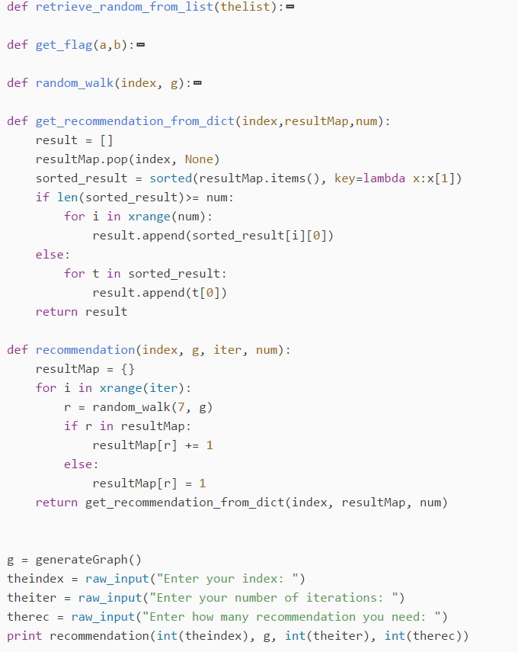
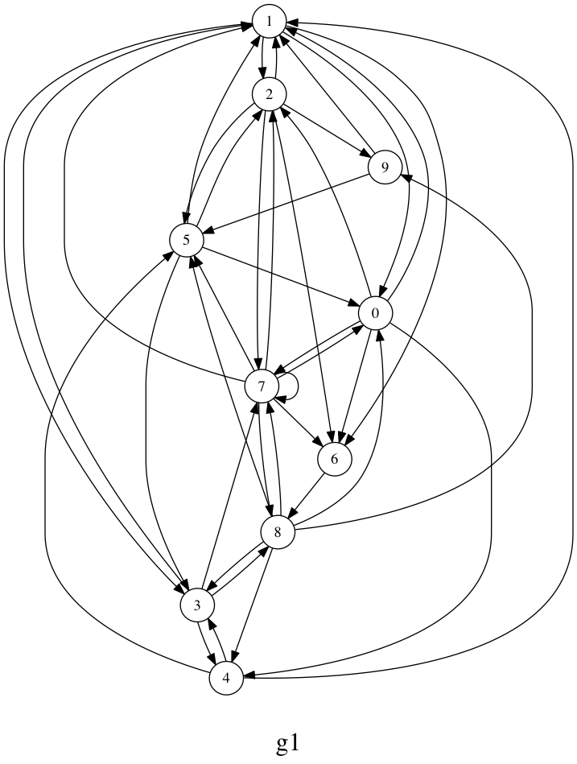

Slide 3
