Slide 1
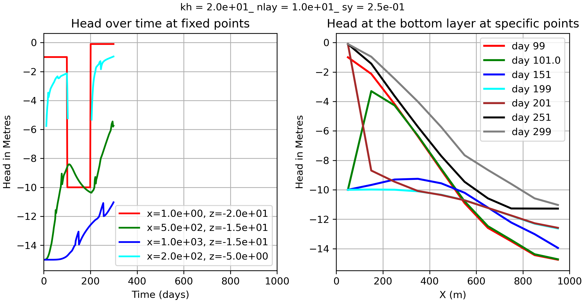
kh_2.0e01_nlay_1.0e01_sy_2.5ne01

Slide 2
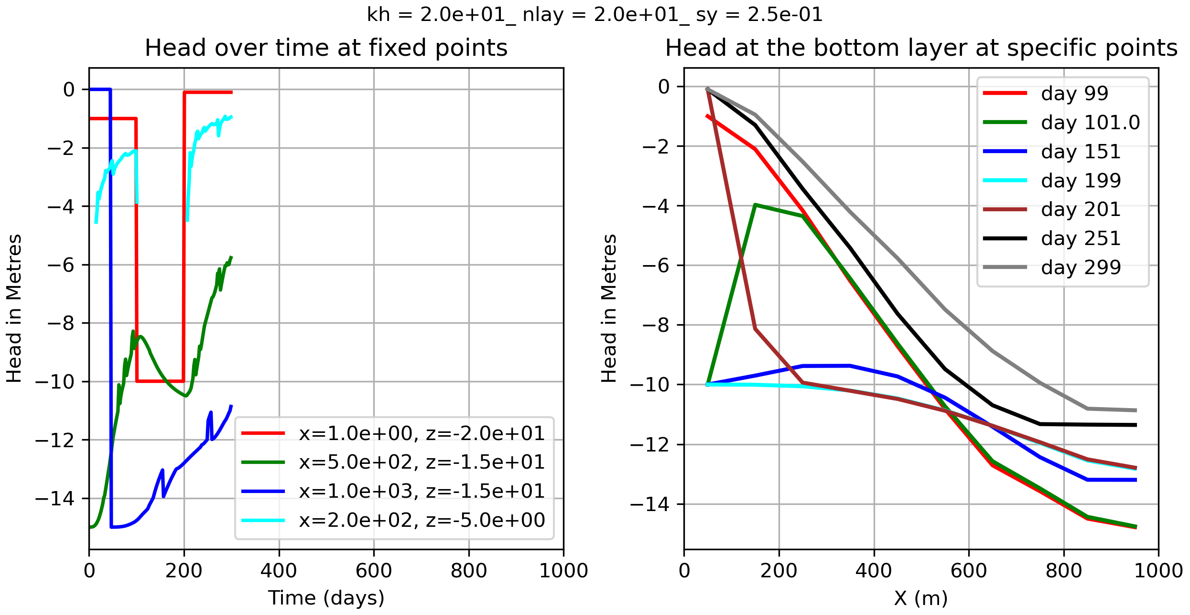
kh_2.0e01_nlay_2.0e01_sy_2.5ne01

Slide 3
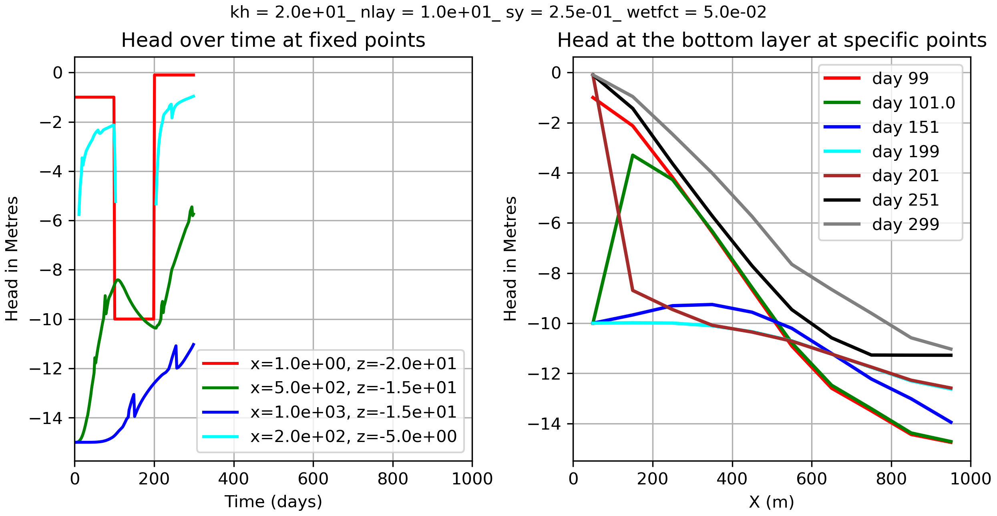
kh_2.0e01_nlay_1.0e01_sy_2.5ne01_wetfct_5.0ne02
So the zig zag has nothing to do with the wetfct.

Slide 4
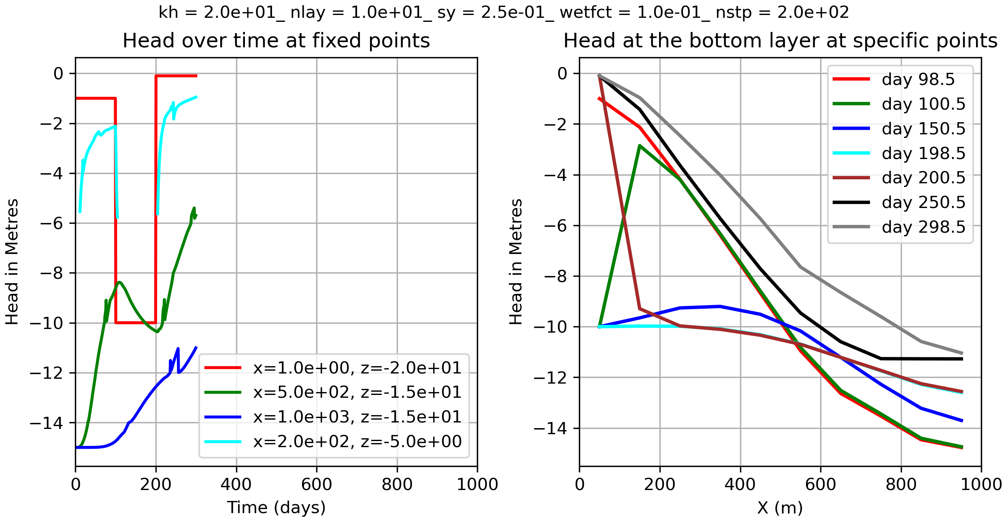
kh_2.0e01_nlay_1.0e01_sy_2.5ne01_wetfct_1.0ne01_nstp_2.0e02

Slide 5
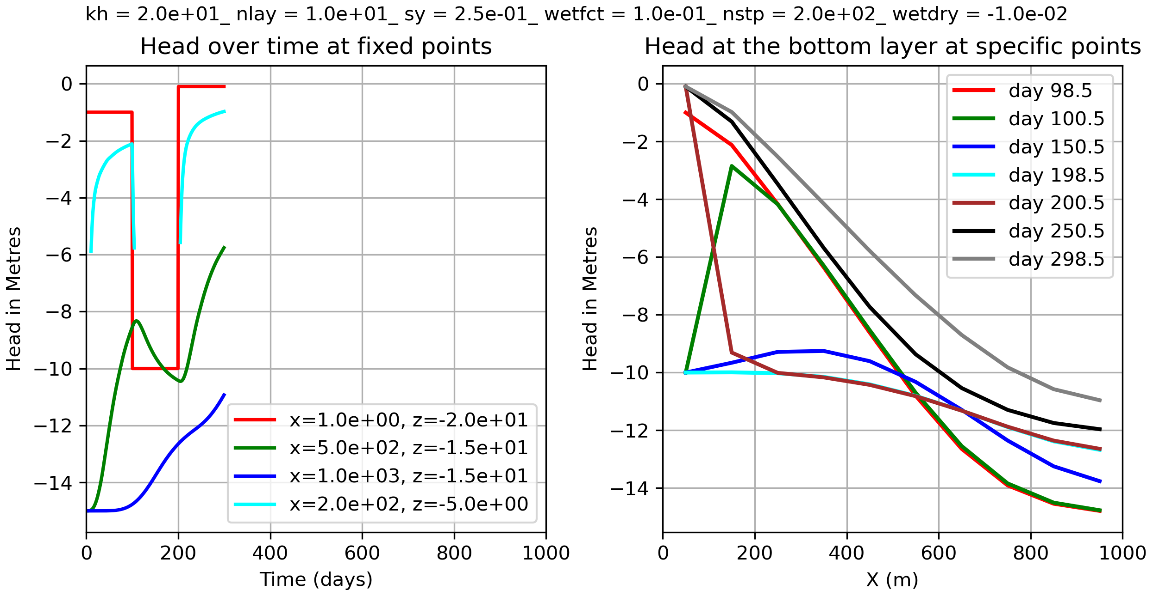
kh_2.0e01_nlay_1.0e01_sy_2.5ne01_wetfct_1.0ne01_nstp_2.0e02_wetdry_-1.0ne02
A wetdry of -1.0ne2 reduced the zigzag of the head over time at some specific points

