Slide 1
Multi-Source Loose Contact Event Query
Processing for Moving Objects
Shuying Duan
Nanjing University of Posts and Telecommunications
1025040904@njupt.edu.cn

Slide 2
Directory
01
Background & Motivation
02
Baseline - MLCEQ
03
Optimized - MLCEQ+
04
Results

Slide 3
1
Part
Background & Motivation
Notes:
“With GIS, mobile phones, IoT sensors and social networks, we now record billions of trajectory points every day. The analysis of trajectory data plays a critical role in diverse
domains,

Slide 4





01
Background
behavior models
traffic congestion
( 1 )
( 2 )
Contact Tracing Query
Notes:
such as human behavior models
Fig 1. analyzes the distribution of the crowd and can be used to determine potential carpooling routes
Figure 2 analyzes traffic congestion to determine k frequently used routes, etc.
Since CO VID-19, trajectory data gained a new mission: Contact Tracing Query .

Slide 5



01
Motivation
Moving objects
Contact sources
O₁
O₁
O₁
S₁
S₁
Multi-source loose contact events
Sliding-window-based baseline query processing
An optimized query processing via InGrid-MBR-based inverted index
O₁
S₁
O₁
S₁
S₁
$∃T>∆T (∀t∈T,dist\left(o1,s1,t\right)≤d$)
(1)
O₂
O₂
O₂
O₂
S₂
O₂
S₂
S₂
S₂
S₂
XU J Q, LU H, BAO Z F. IMO: a toolbox for simulating and querying “infected” moving objects[J]. VLDB 2020,13(12): 2825-2828.

Slide 6
2
Part
Baseline - MLCEQ
Notes:
In part 2 We first introduce the multi-loose contact event

Slide 7
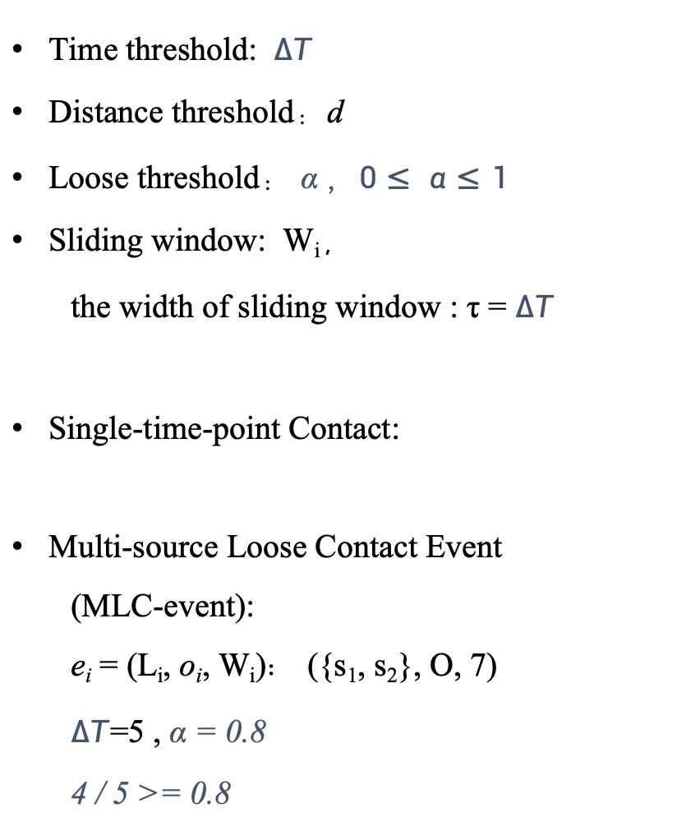
02
Multi-Loose Contact Event
the set of contact source:S=<s₁,...s_{n}>
Time threshold: $∆T$
Distance threshold：d
Loose threshold： α ，$0≤ α≤1$
Sliding window: W_{i}，
the width of sliding window : τ = $∆T$
Single-time-point Contact:
Multi-source Loose Contact Event
(MLC-event):
e_{i} = (L_{i}, o_{i}, W_{i})： ({s₁, s₂}, O, 7)
$∆T$=5 , α = 0.8
4 / 5 >= 0.8
s₁
o₁
s₂
time
1 2 3 4 5 6 7 8
(2)
Notes:
Given a time threshold , a distance threshold d, a loose threshold alpha .
At the same time Given a window width threshold τ = time threshold, a sliding window Wi
is composed of τ consecutive time points starting from the time point ti
“A window of width τ slides along the timeline.
A single-time-point contact occurs if the distance between an object and a contact source is
less than d.
Such as fig left , Single-time-point contacts occur at time 3,4,6 and 7
Then
An MLC event is reported when an object registers at least α times τ such single-time-point
contact
in the earliest window,which can be formalezed as formula 2 .
Obviously in the left figure, assuming the time threshold is 5, there are 4 Single-time-point
contacts thus a mlc-event occurs at 7.

Slide 8
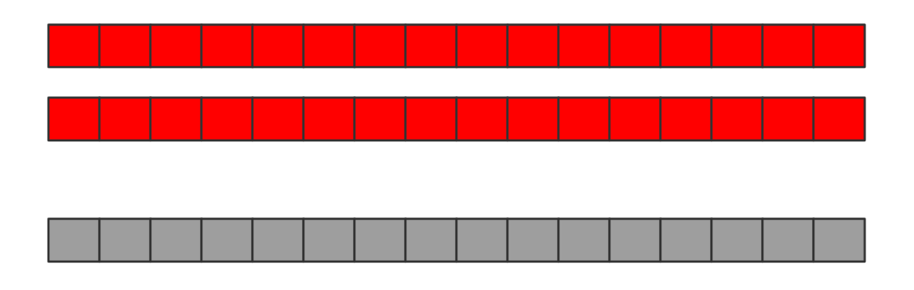
02
Baseline - MLCEQ
W
t₁
t₂
s₁
The set of contact source S
s₂
add o₁ to S
o₁
else
construct e₁ and add it to R
calculate all distance between each contact source and innocent moving object at each time in sliding window W and record the number of Single-time-point Contacts
if satisfy (2)
({s₁, s₂}, o₁, t₁)
MLC-event Result:R
(2)
Notes:
Base on these definitions, we propose baseline Mlceq based on sliding window
we take an example to explain
First, assume that there is an initial contact source set S=<s1,s2> and innocent moving object set O =<o1>
We start processing from the time point in the first sliding window W
MLCEQ enumerates every source–object pair in the window.
calculate all distance between them,and determine whether the single-time-point contact
occurs
if the number of single-time-point contact satisfy the fomula 2
we construct e1 ,add it to the Result set R and add o1 to S,which means o1 begin to contact
others as a source from this time
else if doesnt satisfy 2 slide the window and repeat the above steps until all time have been
processed. Therefore, we can query all mlc-event by traversing each source and each objects
at each time
Obviously it is time-consuming .
Thus，we design an InGrid-MBR inverted index optimization to enhance the query efficiency,
and reuduce redundant computations in part 3

Slide 9
3
Part
Optimized - MLCEQ+

Slide 10
03
InGrid-MBR-based Inverted Index
:moving objects
:contact sources
Candidate grids:
Notes:
Since the trajectory is a set of coordinate points, all the trajectory points form a twodimensional space Ω. We divide the entire area into grids and each grid has its unique id gi.
every trajectory point is assigned to a specific grid cell.
the contact range can be defined as the circle centered at the location of s1 with radius d.
Based on this ,we can define the candidate grids as the grids whose spatial region either
intersect with or are fully contained by the contact range such as g2 g3 g5 g6 in the fig
In this way, when judging a single-time-point contact , only the objects in the candidate grid
need to be considered.
Then Objects inside one grid are close, so we wrap them in a Minimum Bounding Rectangle (MBR).
At each timestamp we store <gi ai ri> ai is the set of objects located in gi at time t and ri is the
mbr of objects in gi all such records form the inverted index for the timestamp , and
concatenating （kongcakaneting）them yields the full InGrid-MBR index.
”

Slide 11
03
Optimzied - MLCEQ+
:moving objects
:contact sources
In MLCEQ, we have to do a dist() for every object
With MBR:
Cheap circle–MBR test (O (1)):
does the circle hit this grid’s MBR or not?
MBR ⊂ contact circle ⇒ all objects in Au have a contact at time t(R6)
MBR ∩ contact circle = ∅ ⇒ prune the entire grid(R2)
otherwise ⇒ compute dist() only for objects inside overlap(R3)
Notes:
“Distance checks are now replaced by o(one) constant-time test:Cheap circle–MBR test does the circle hit this grid’
s MBR or not?
there are three intuitive cases.If the entire MBR sits inside the contact circle, we know every
object in that grid is in contact at that time such as R6
If the MBR and the circle don’t touch at all, we can safely discard the whole grid such as R2
If the circle only partly covers the MBR, we need to compute exact distances, but only for the
objects in this mbr

Slide 12
03
Optimzied - MLCEQ+
W
t₁
t₂
s₁
The set of contact source S
s₂
add o₁ to S
o₁
else
construct e₁ and add it to R
At each time, calculate the candidate grids for each contact source.
Get the objects and MBRs within candidate grids by InGrid-MBR-based Inverted Index
And by judging the position relationship between the contact region and MBRs, we can determine whether the single-time-point contact occurs.
if satisfy (2)
({s₁, s₂}, o₁, t₁)
MLC-event Result:R
Notes:
based on these ideas , next we propose the optimized MLCEQ+
MLCEQ+ retains the sliding window but, at each timestamp,we do
1. calculate the candidate grids for each contact source.
2. Get the objects and MBRs within candidate grids by InGrid-MBR-based Inverted Index
3. by judging the position relationship between the contact region and MBRs, we can
determine whether the single-time-point contact occurs..
4. Then follow the same steps as in mlceq: slide the window until all timestamp have been
processed
5.
Finally, let me introduce the results and conclusion of our experiment in part 4

Slide 13
4
Part
Result & Conclusion

Slide 14
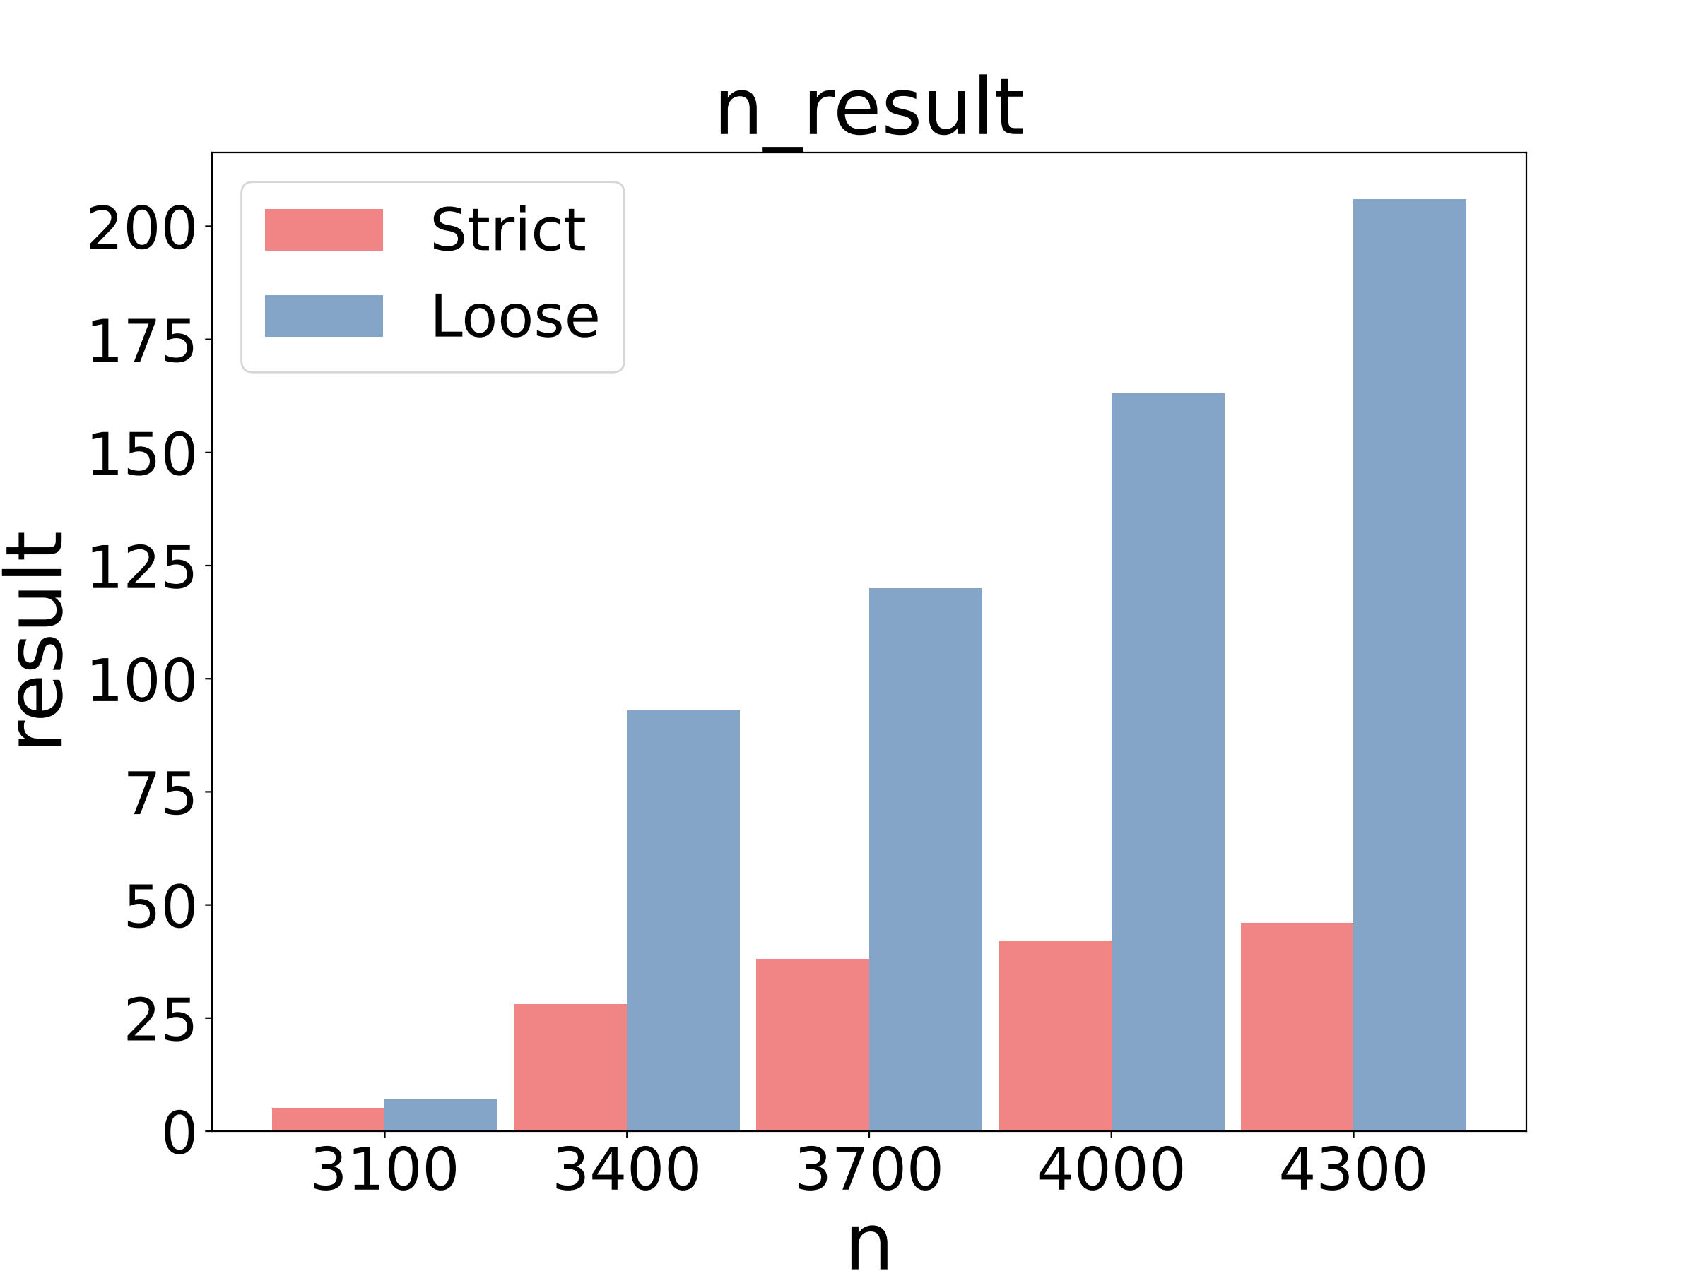
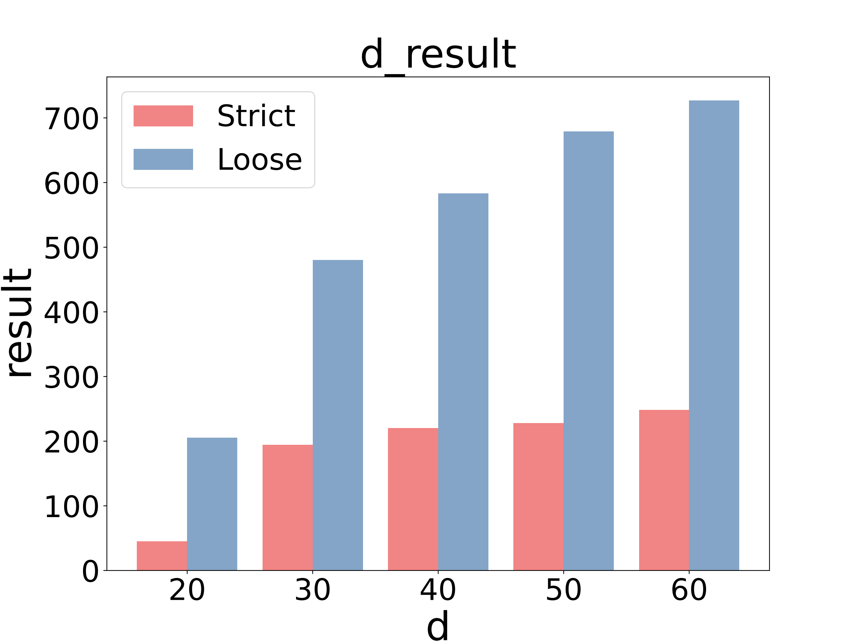
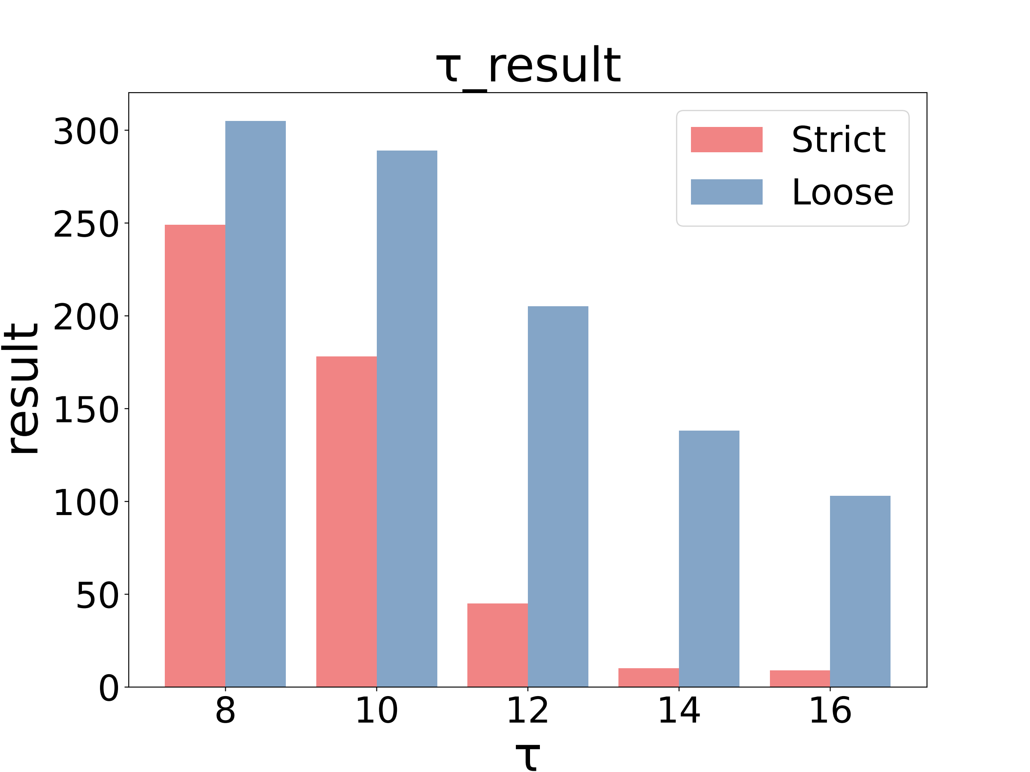
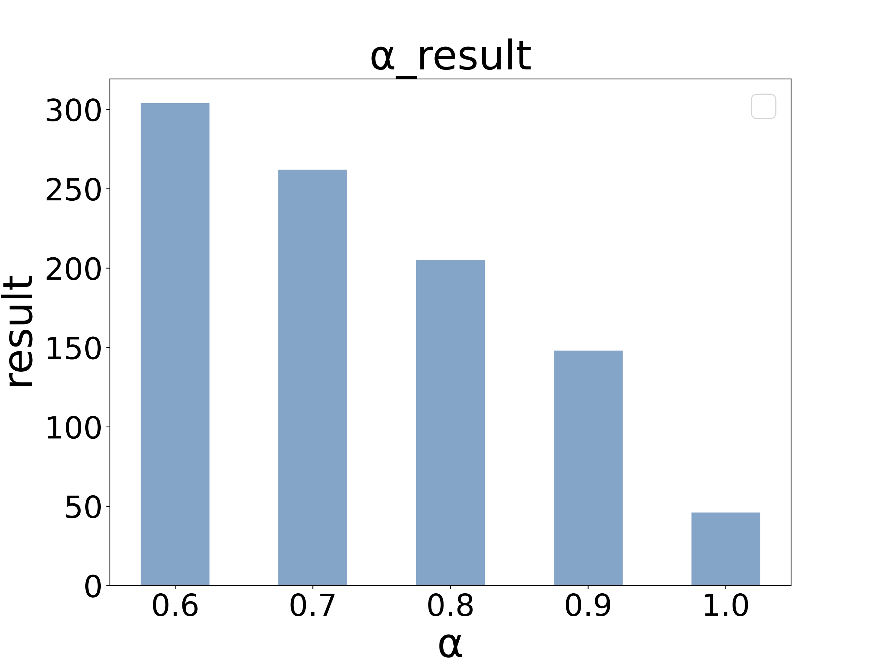
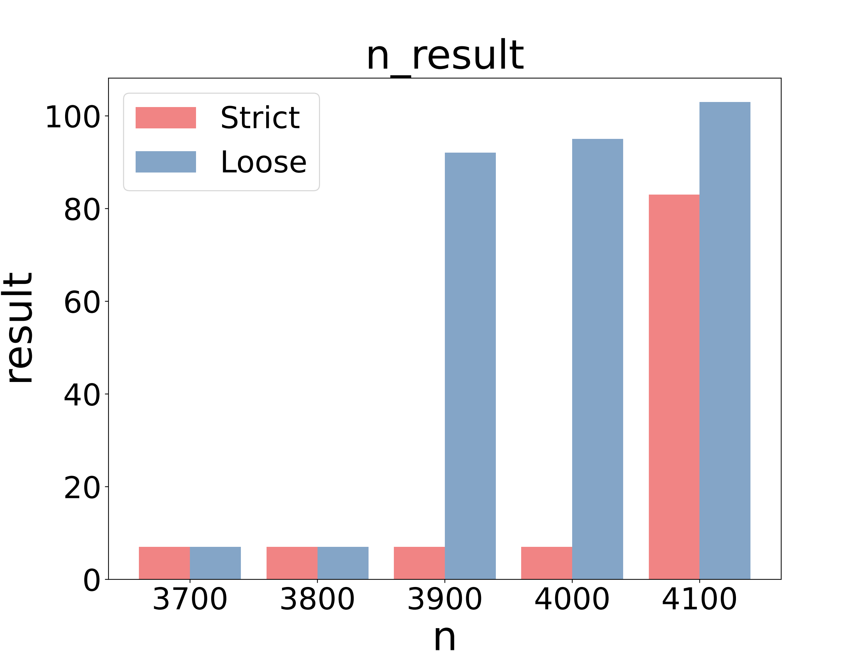
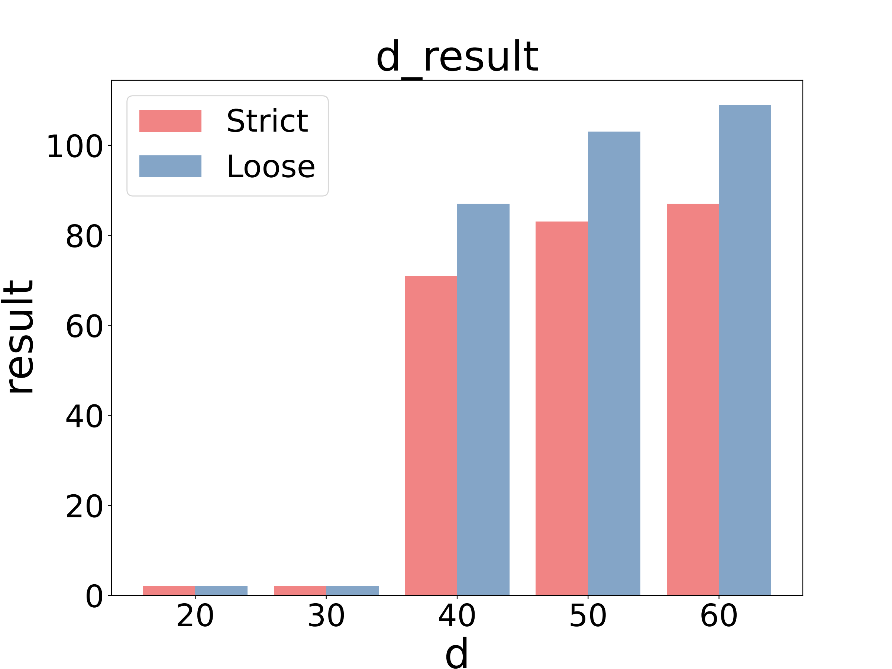
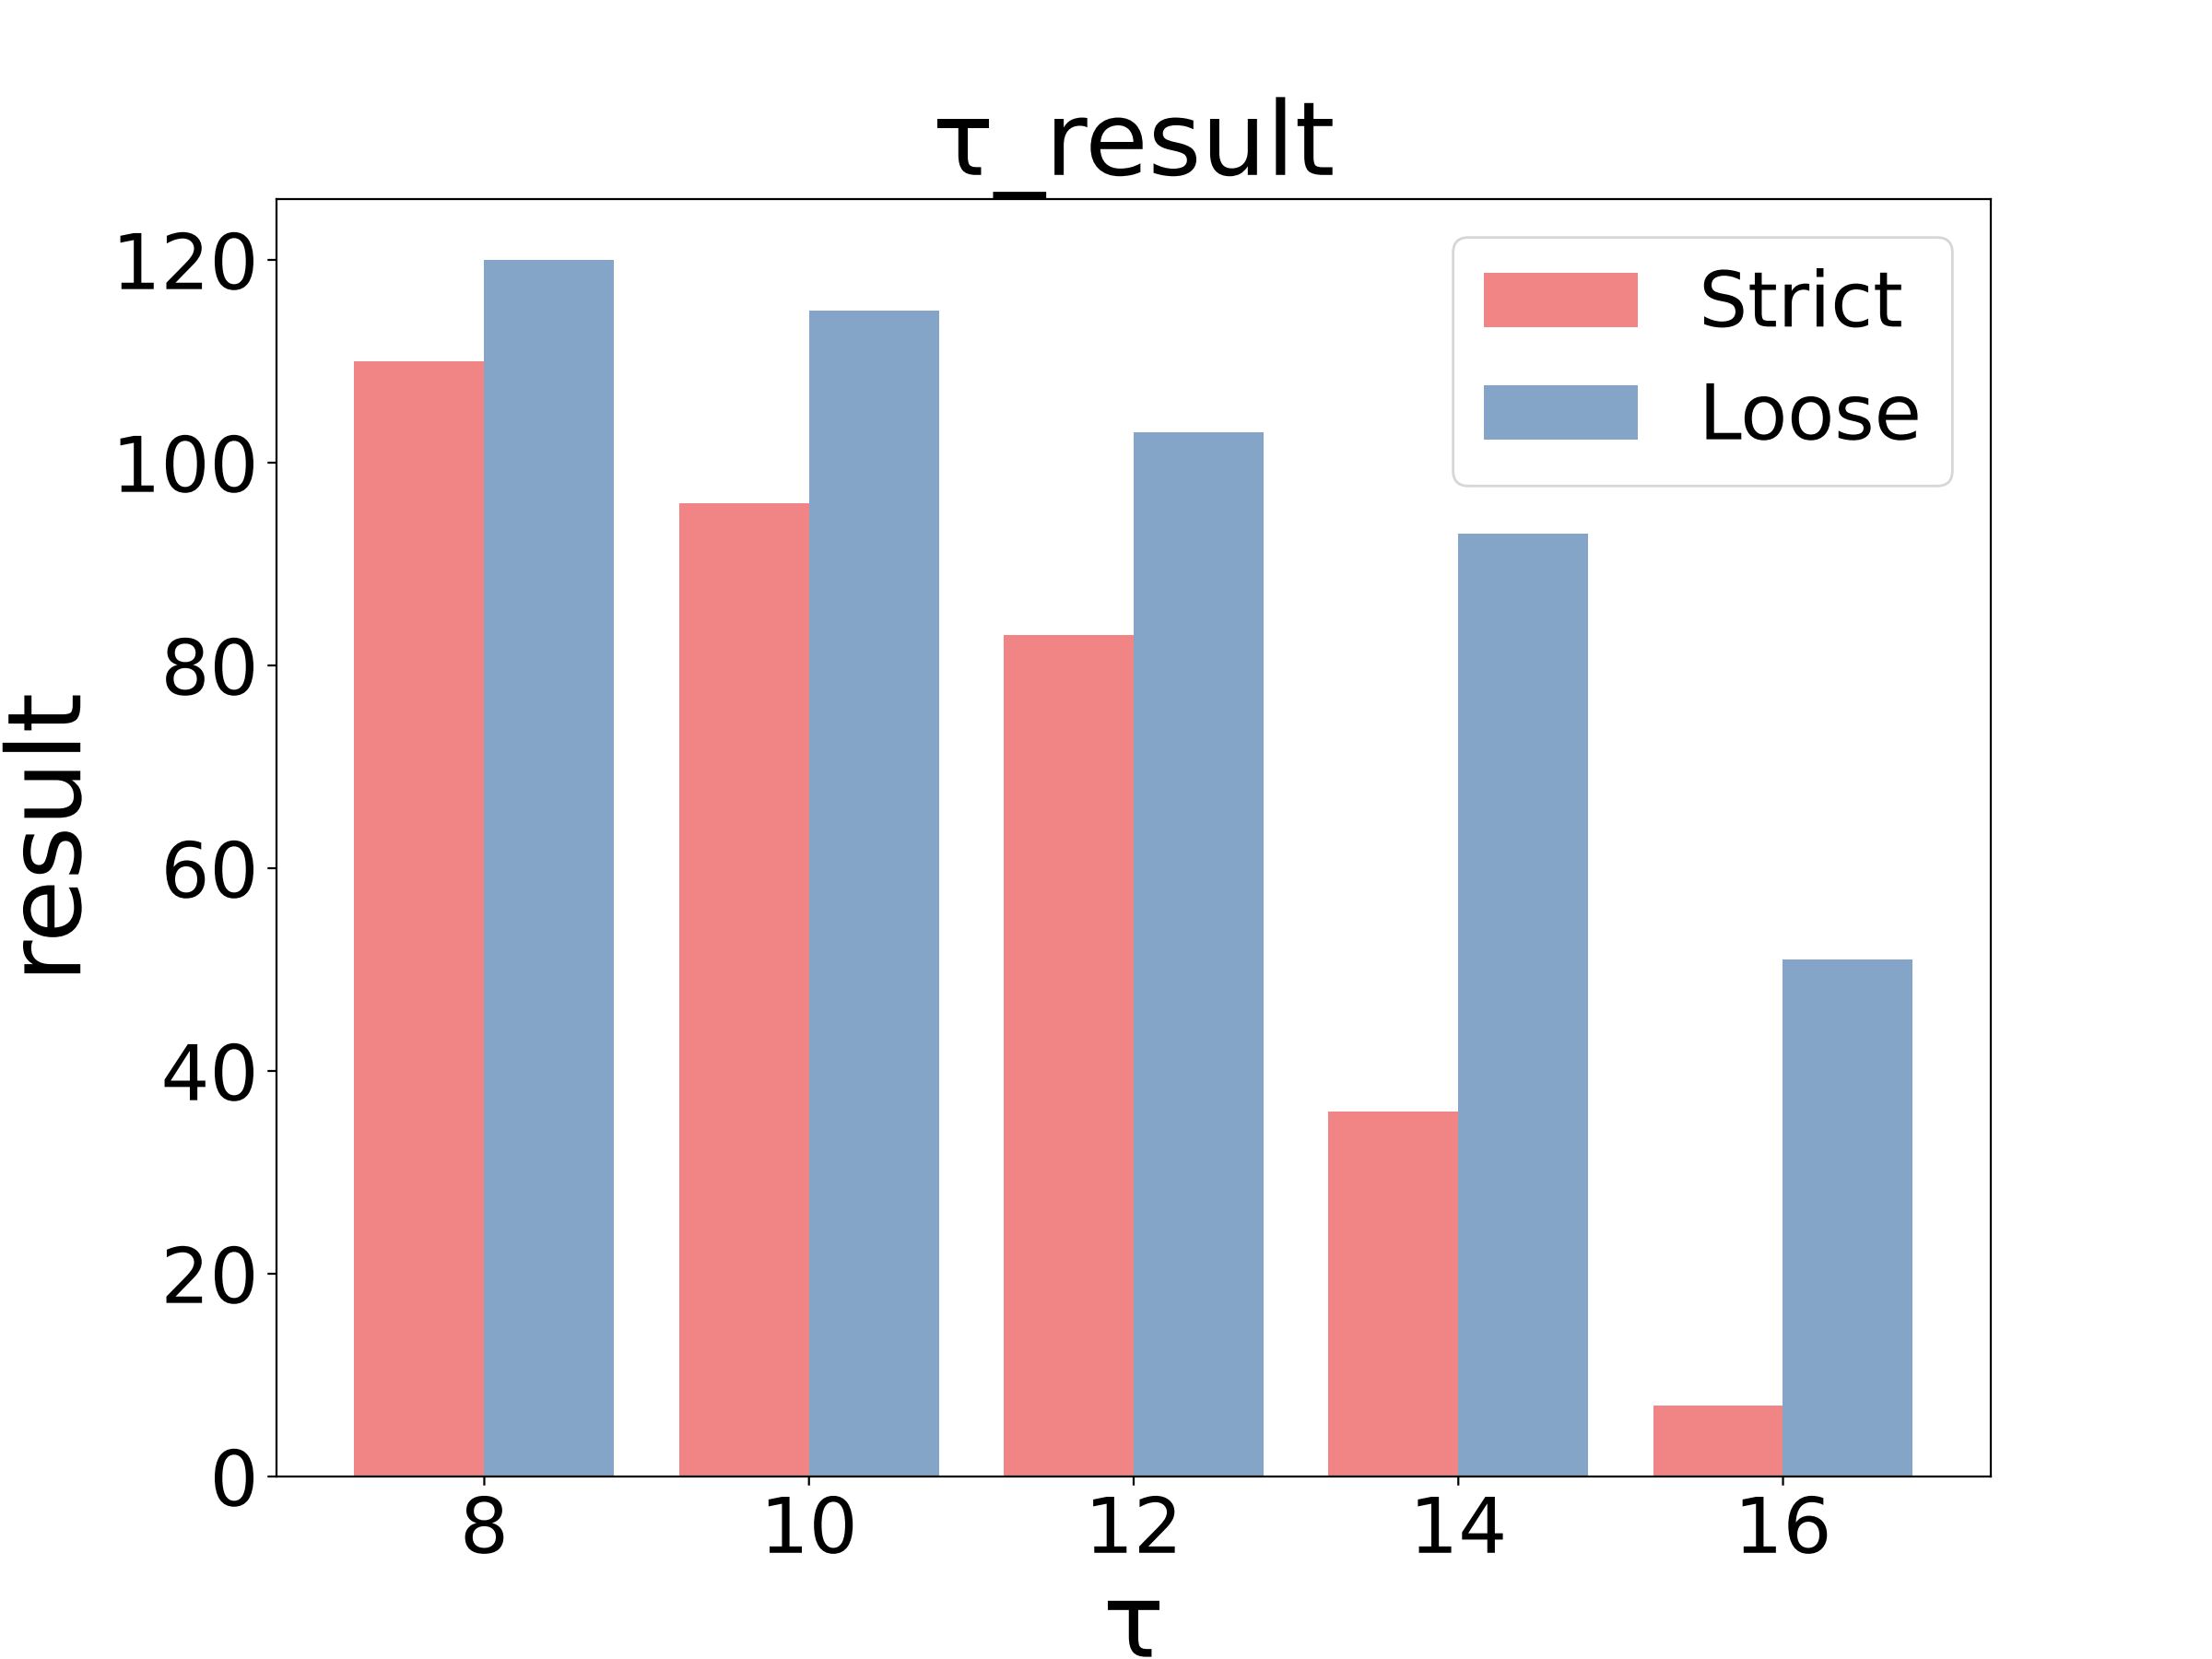
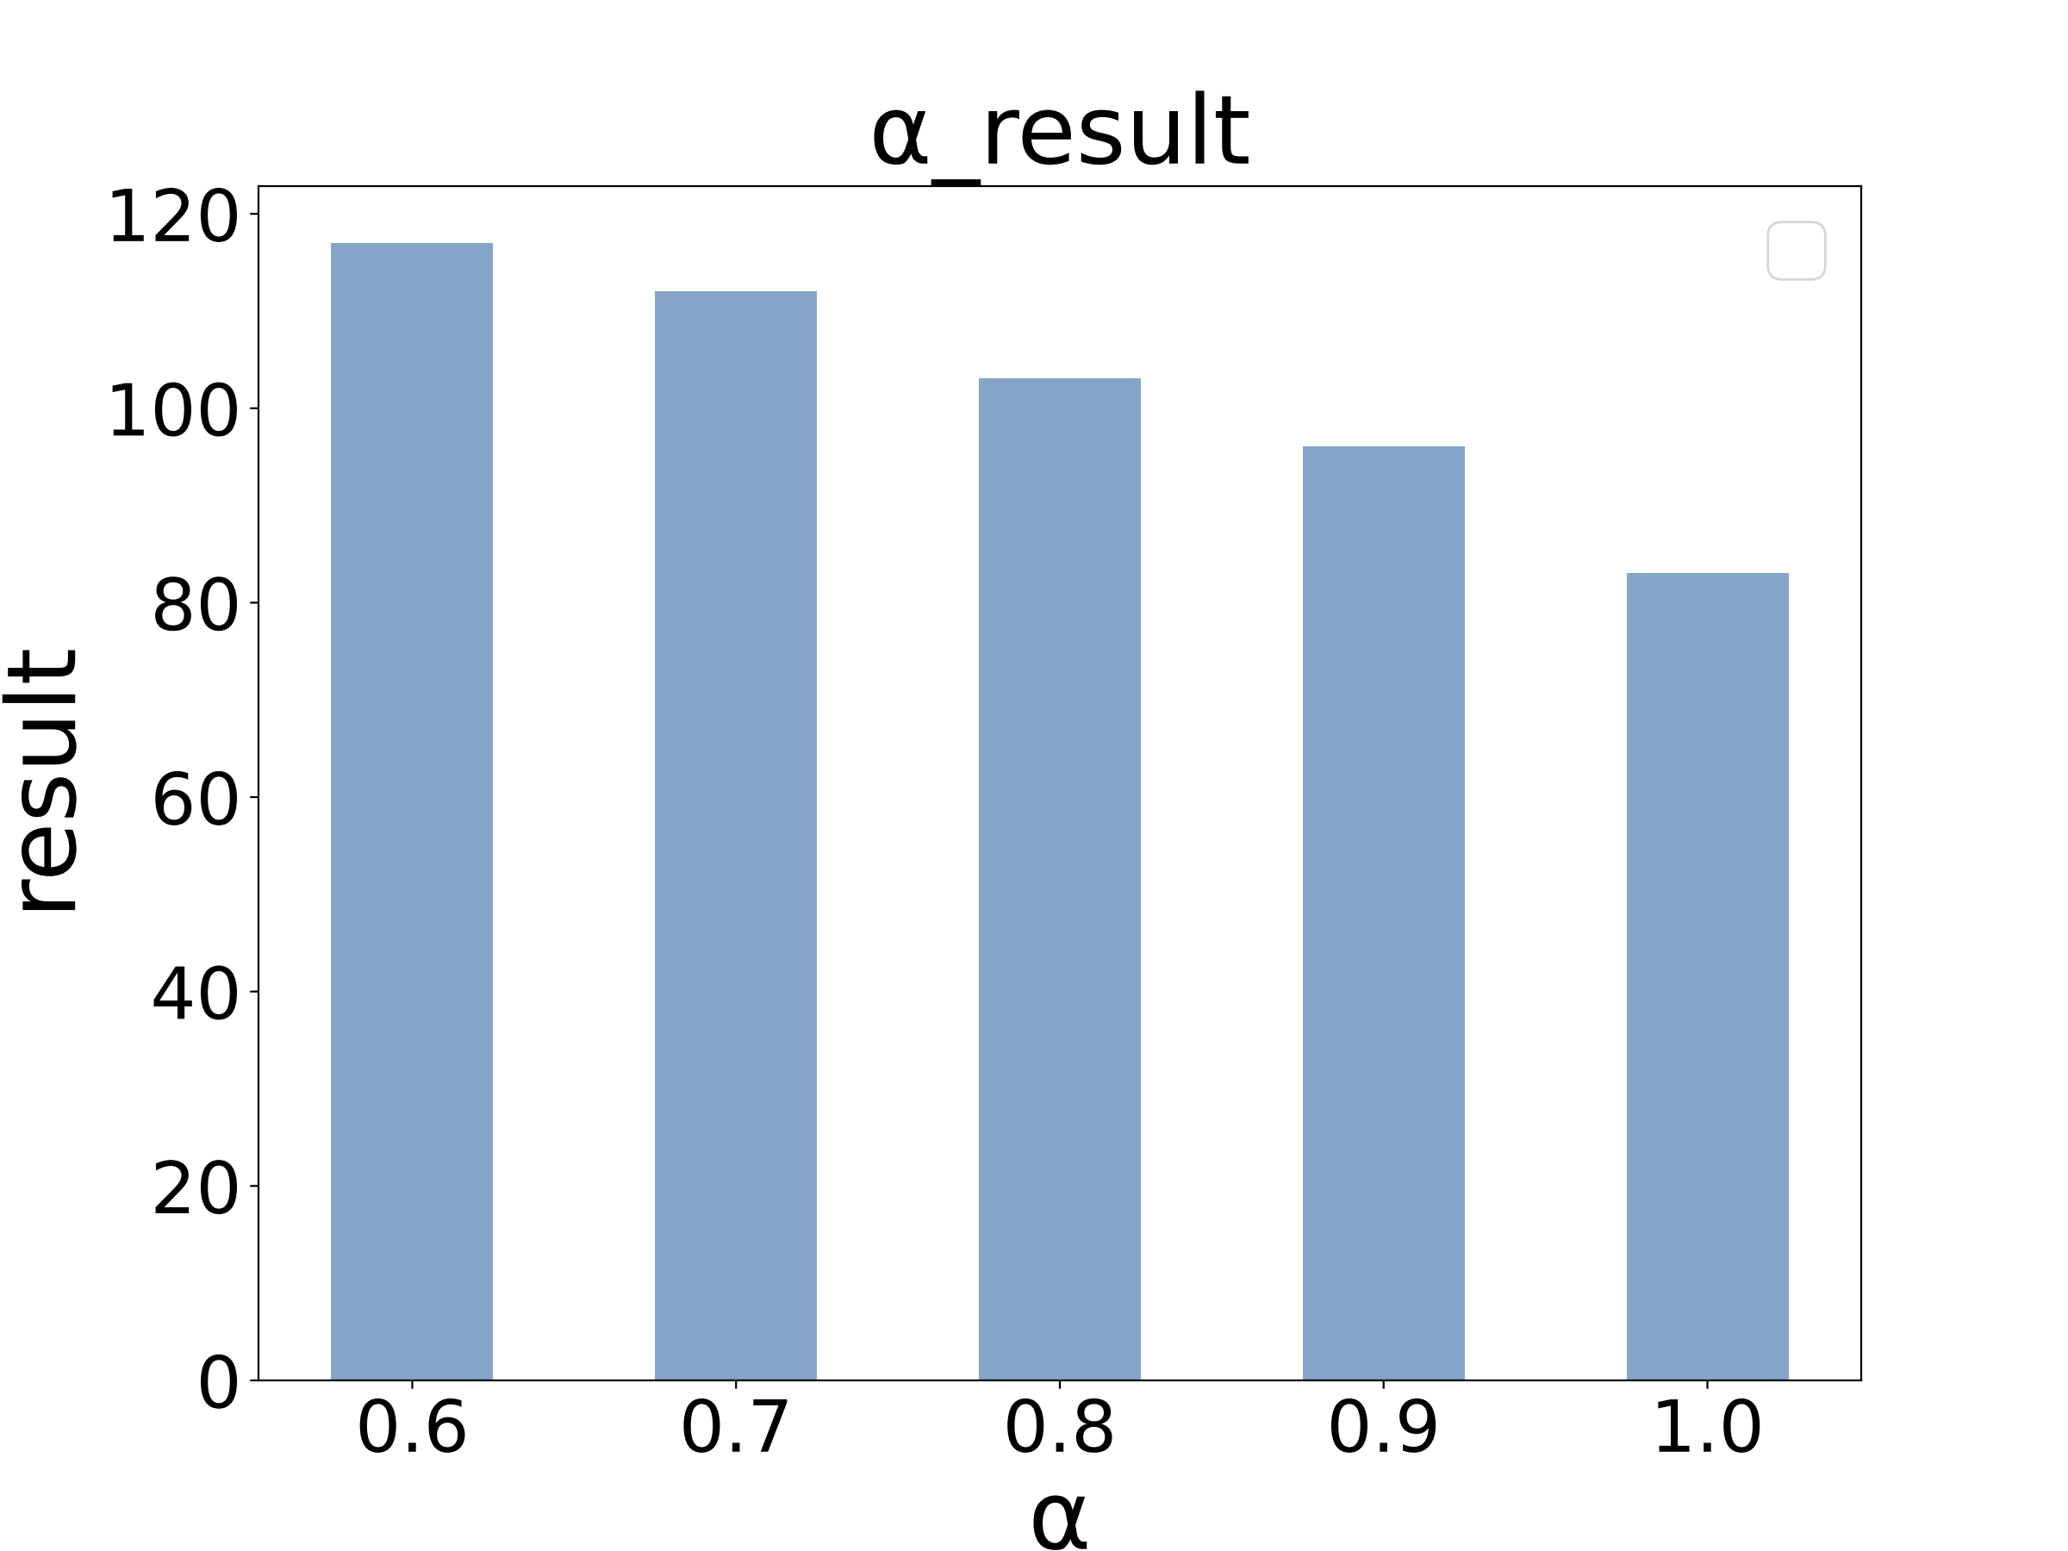
04
Result
Datasets: Taxi (4,315 traces, 1,440 points)
T-Drive (4,142 traces, 2,017 points).
Defaults: d = 20/50 m, τ = 12, α = 0.8.
(a) Taxi
(b) T-Drive
Notes:
Through experiments, we use two real trajectory datasets to analyze the multi-source contact
query proposed in this section from the perspectives of mining results and
mining efficiency（afixiensy）.
Datasets: Taxi (4,315 traces, 1,440 points) and T-Drive (4,142 traces, 2,017 points).
Defaults: d = 20/50 m, τ = 12, α = 0.8.
Obviously
“Loose queries always superset strict models.
Those extra detections are realistic intermittent exposures which may still pose transmission
risks.
Identifying such contacts is crucial in public health contexts,
where missed exposures can lead to secondary transmission
and undermine containment efforts.

Slide 15
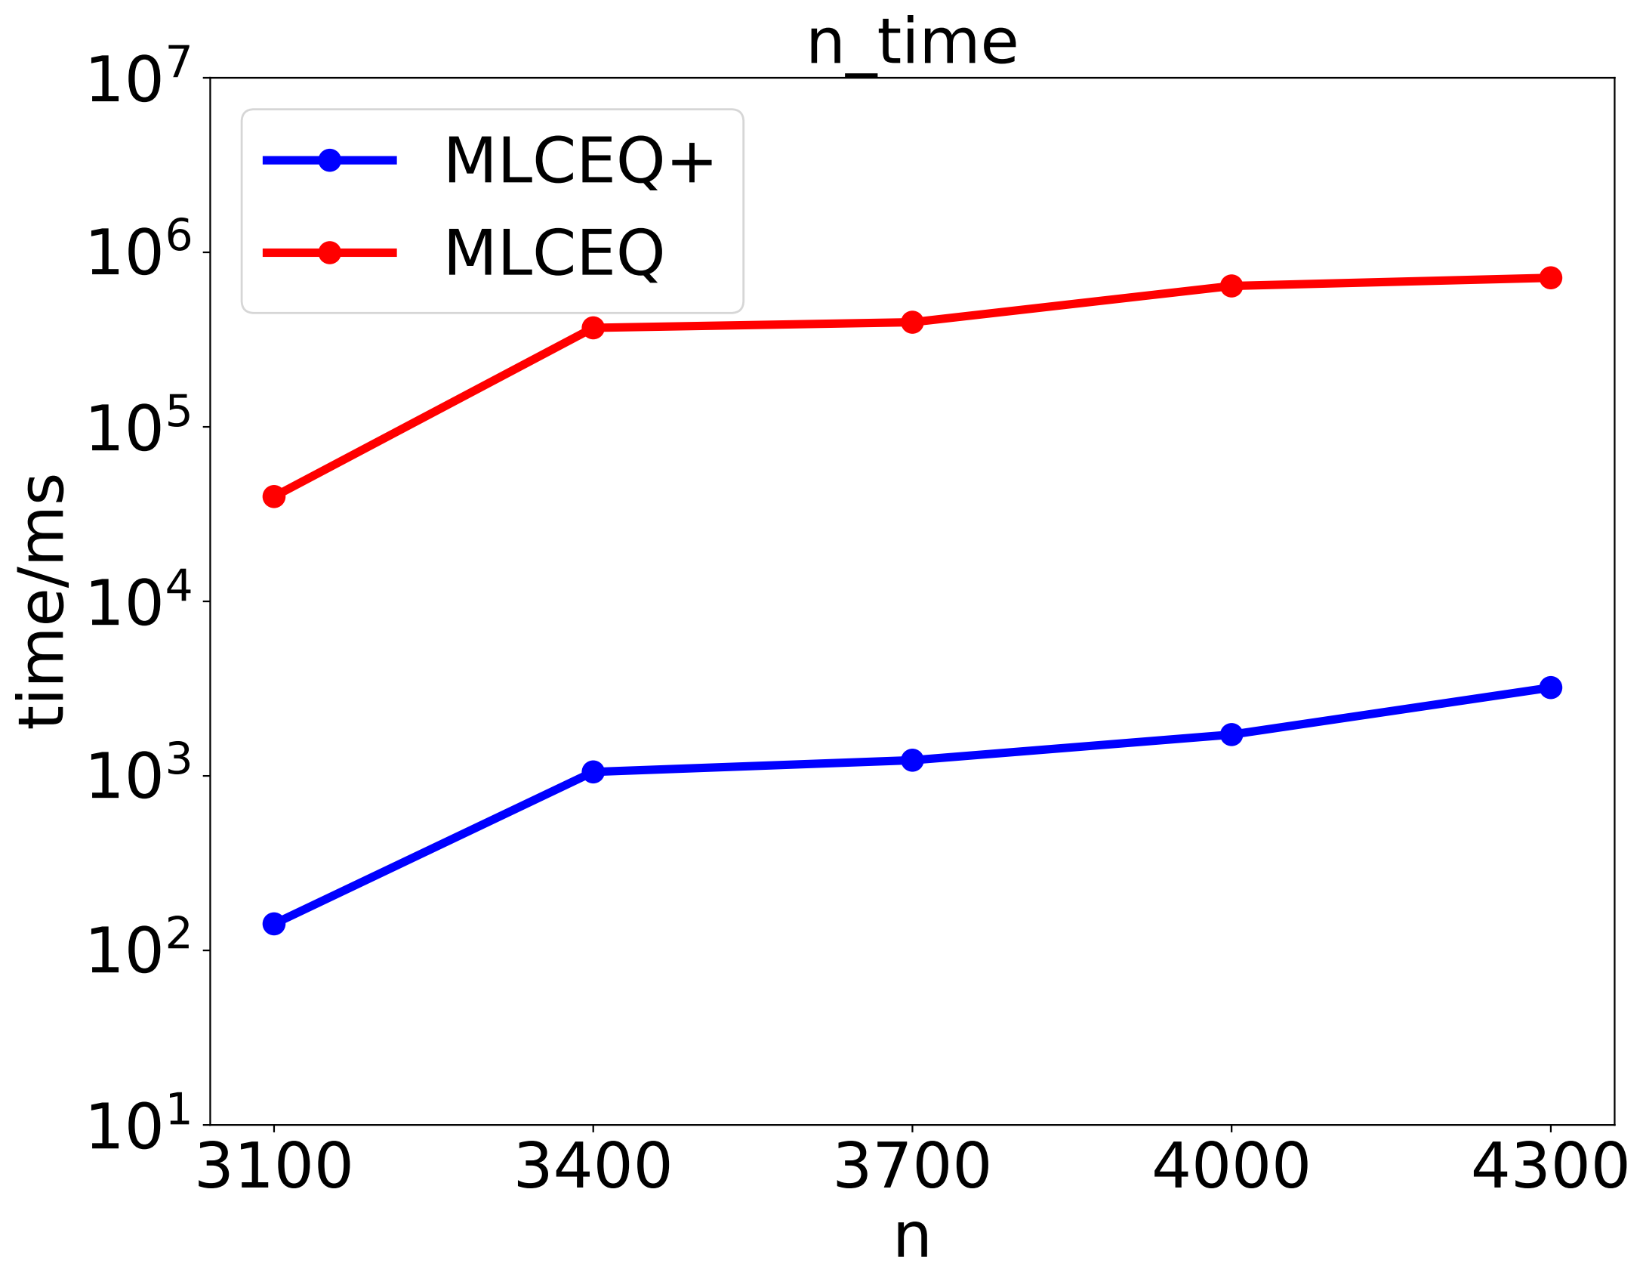
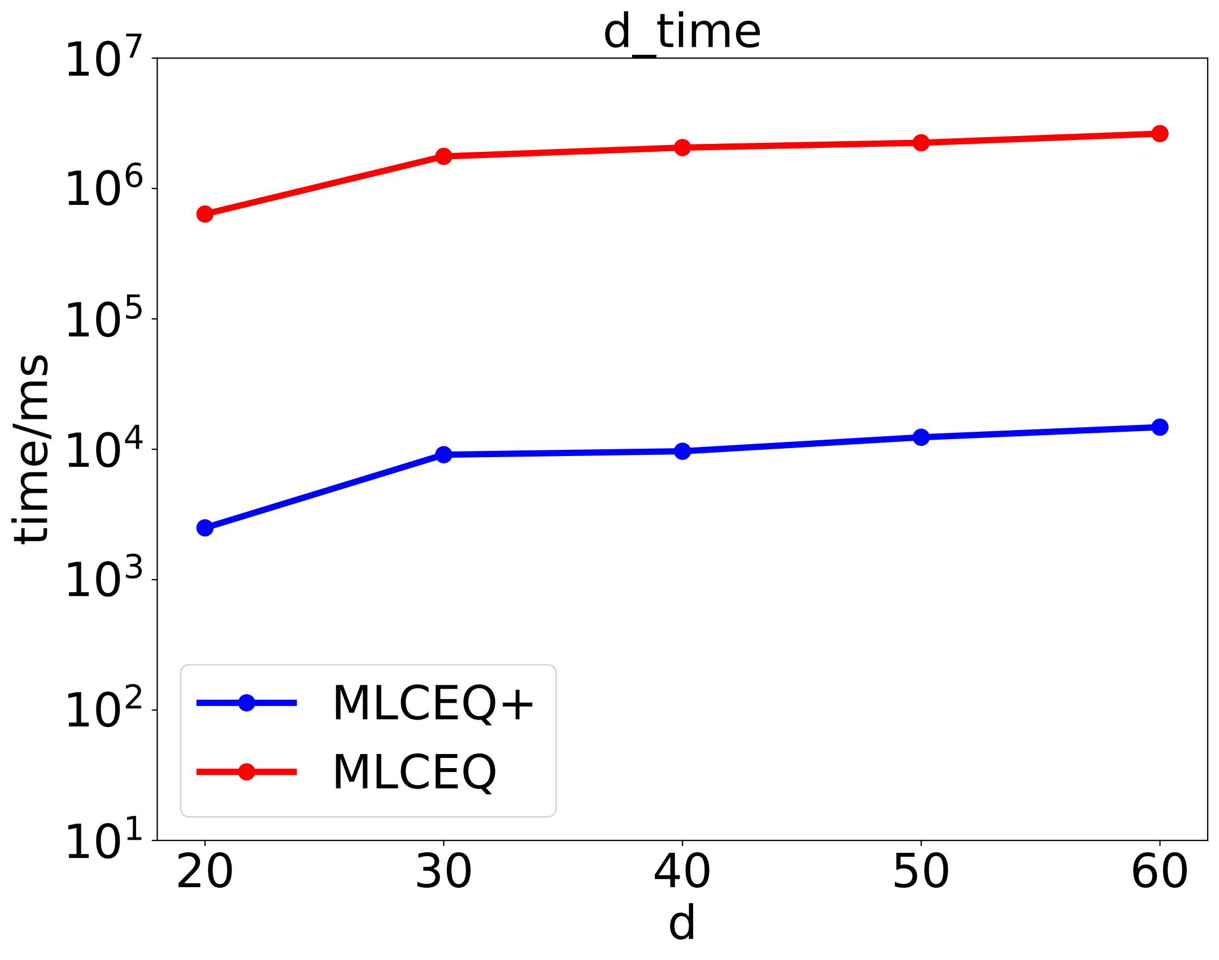
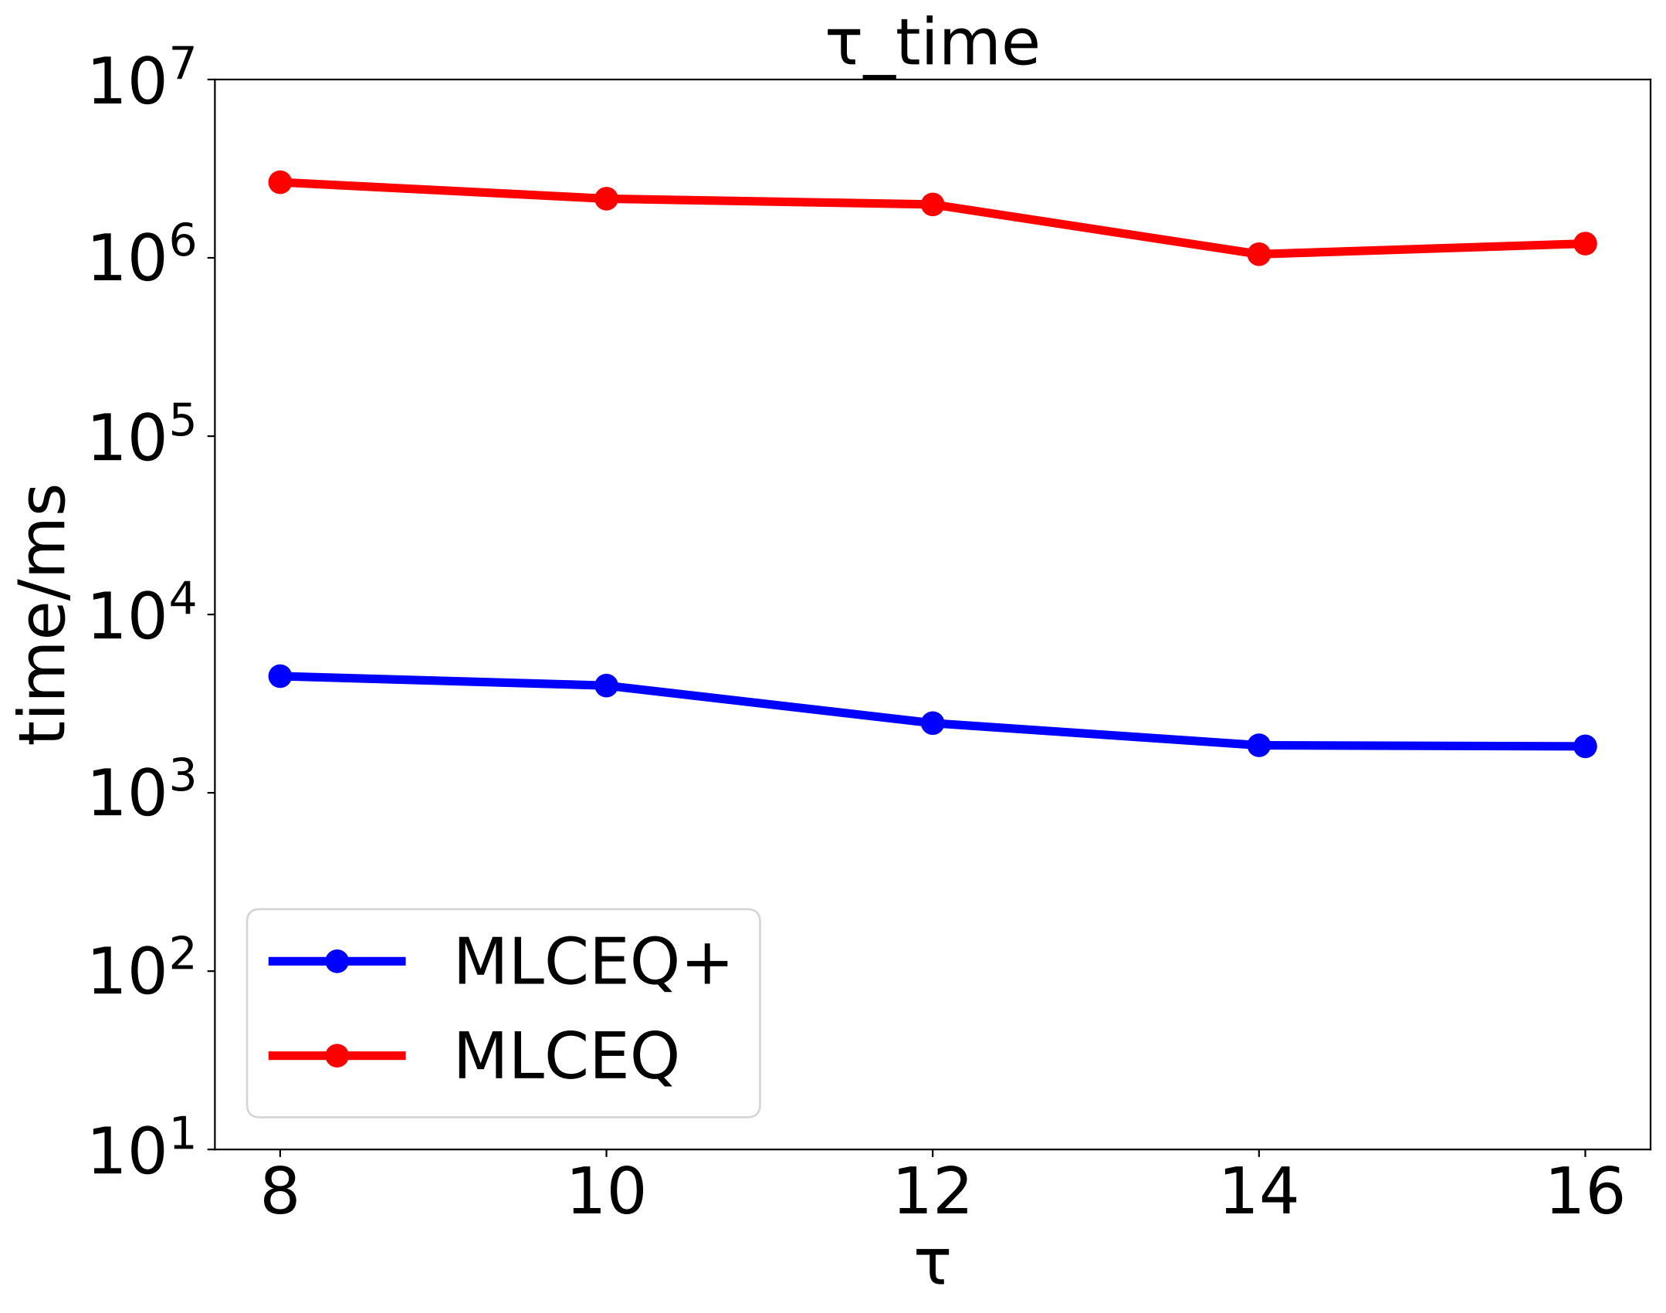
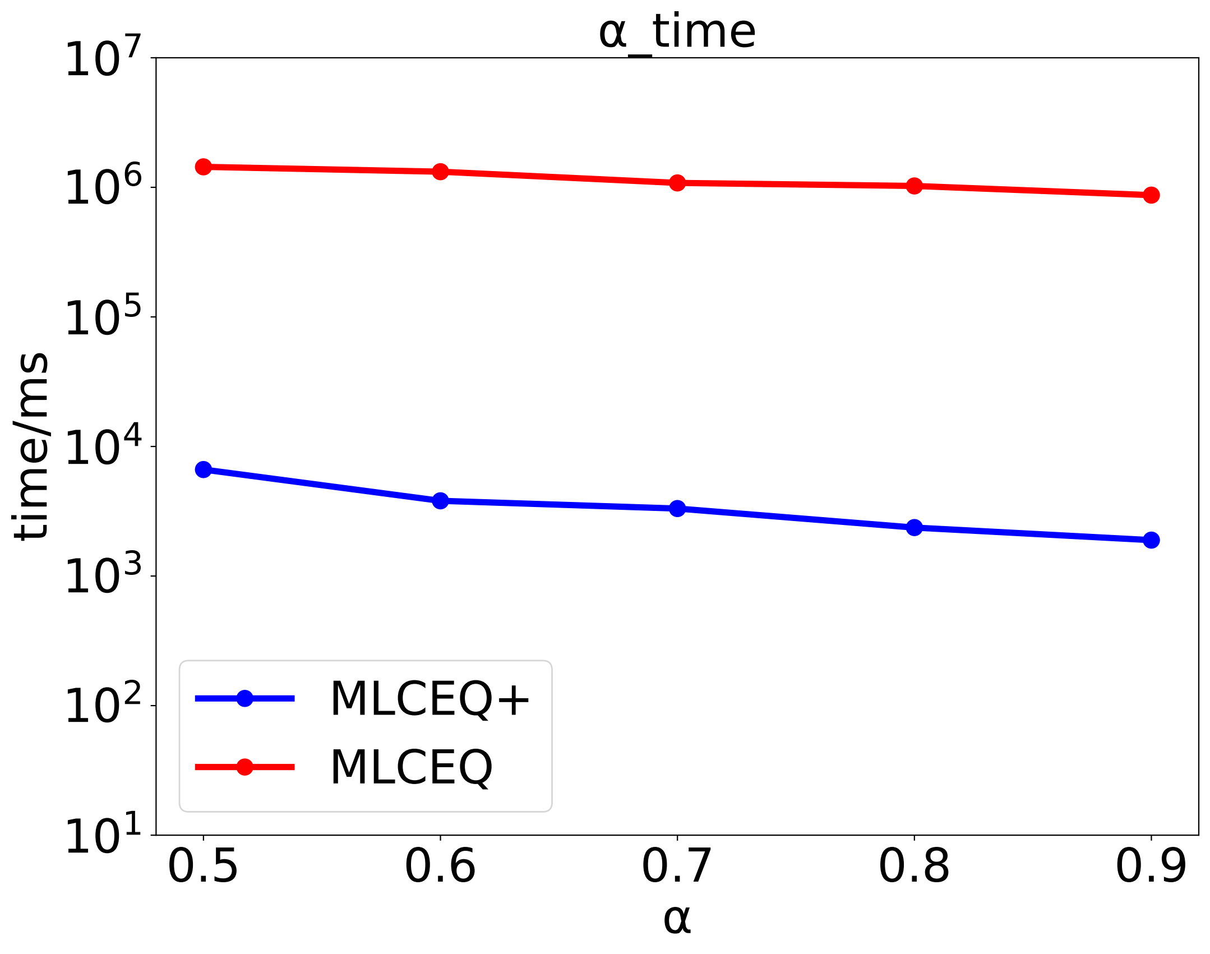
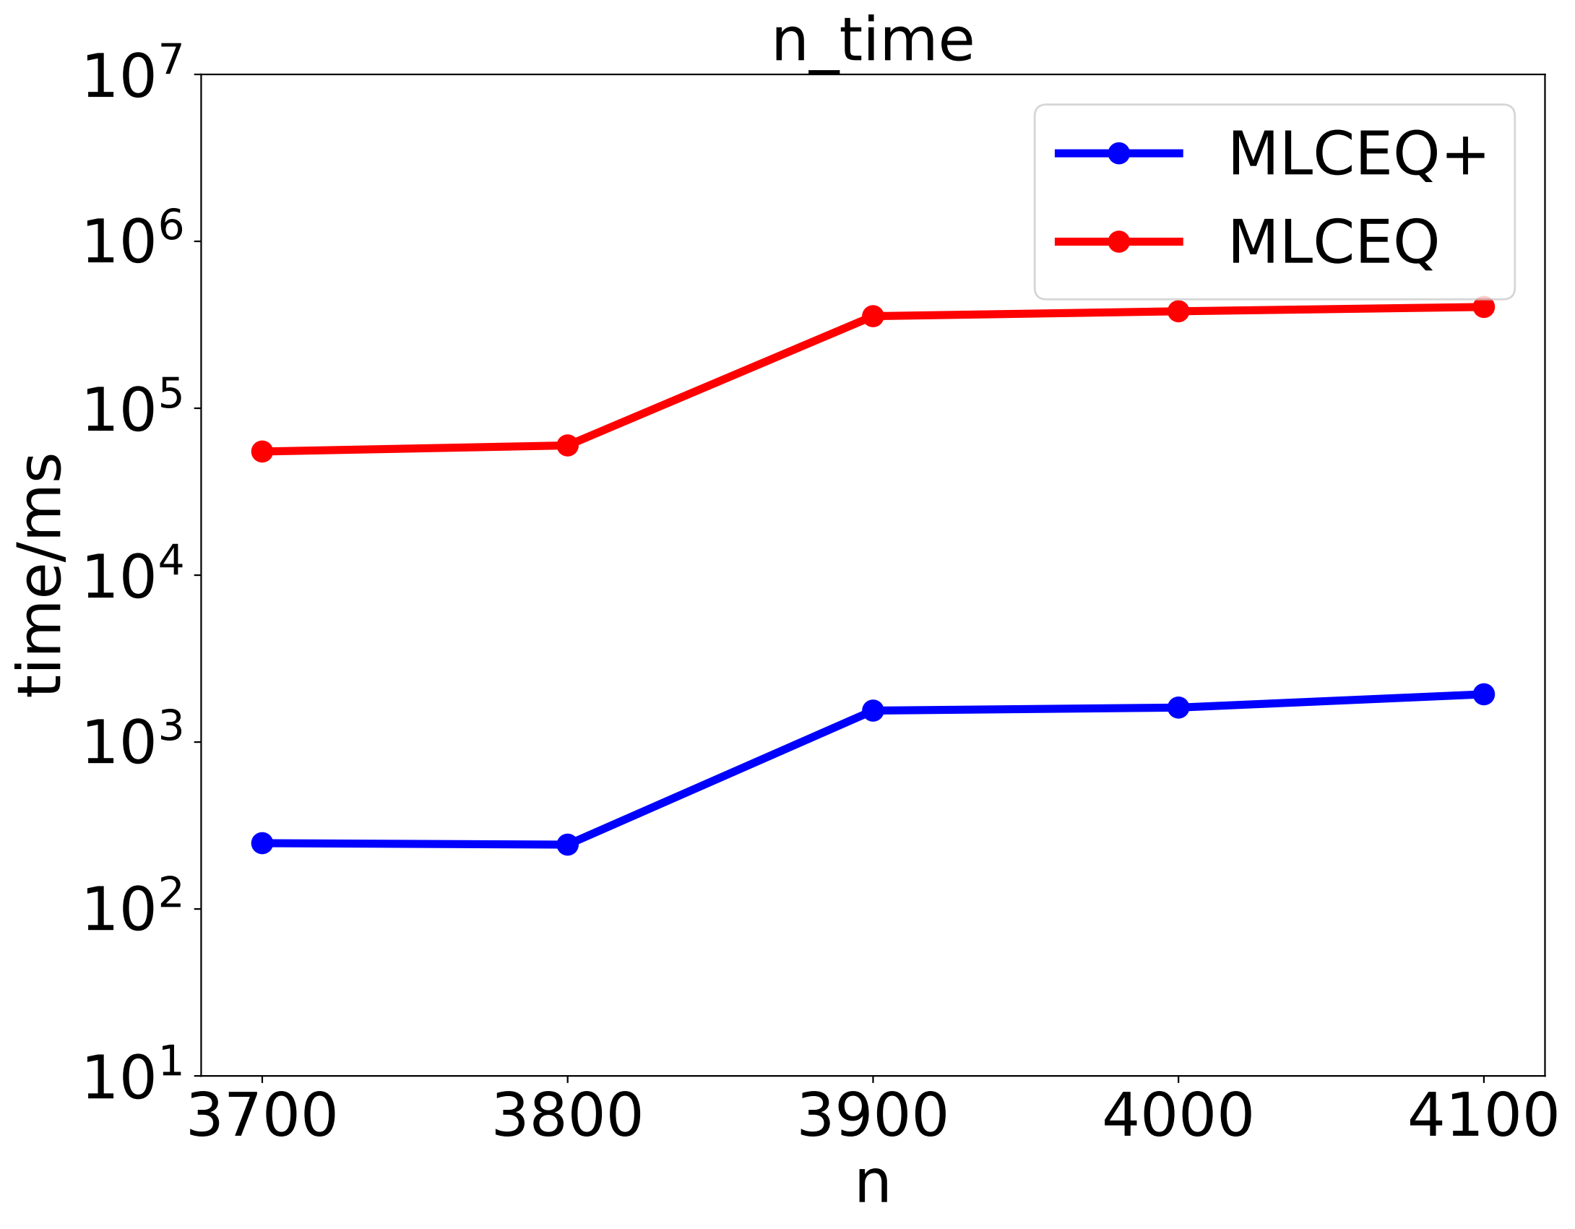
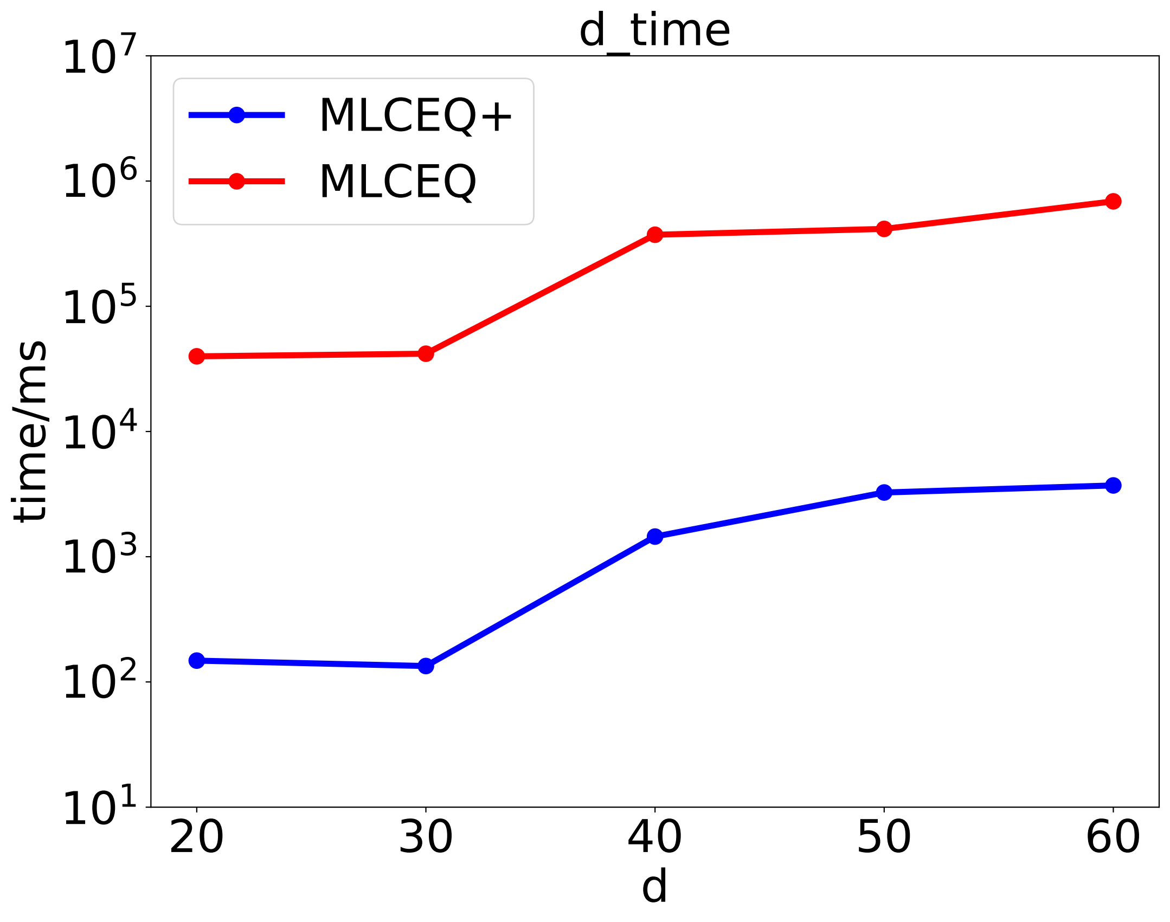
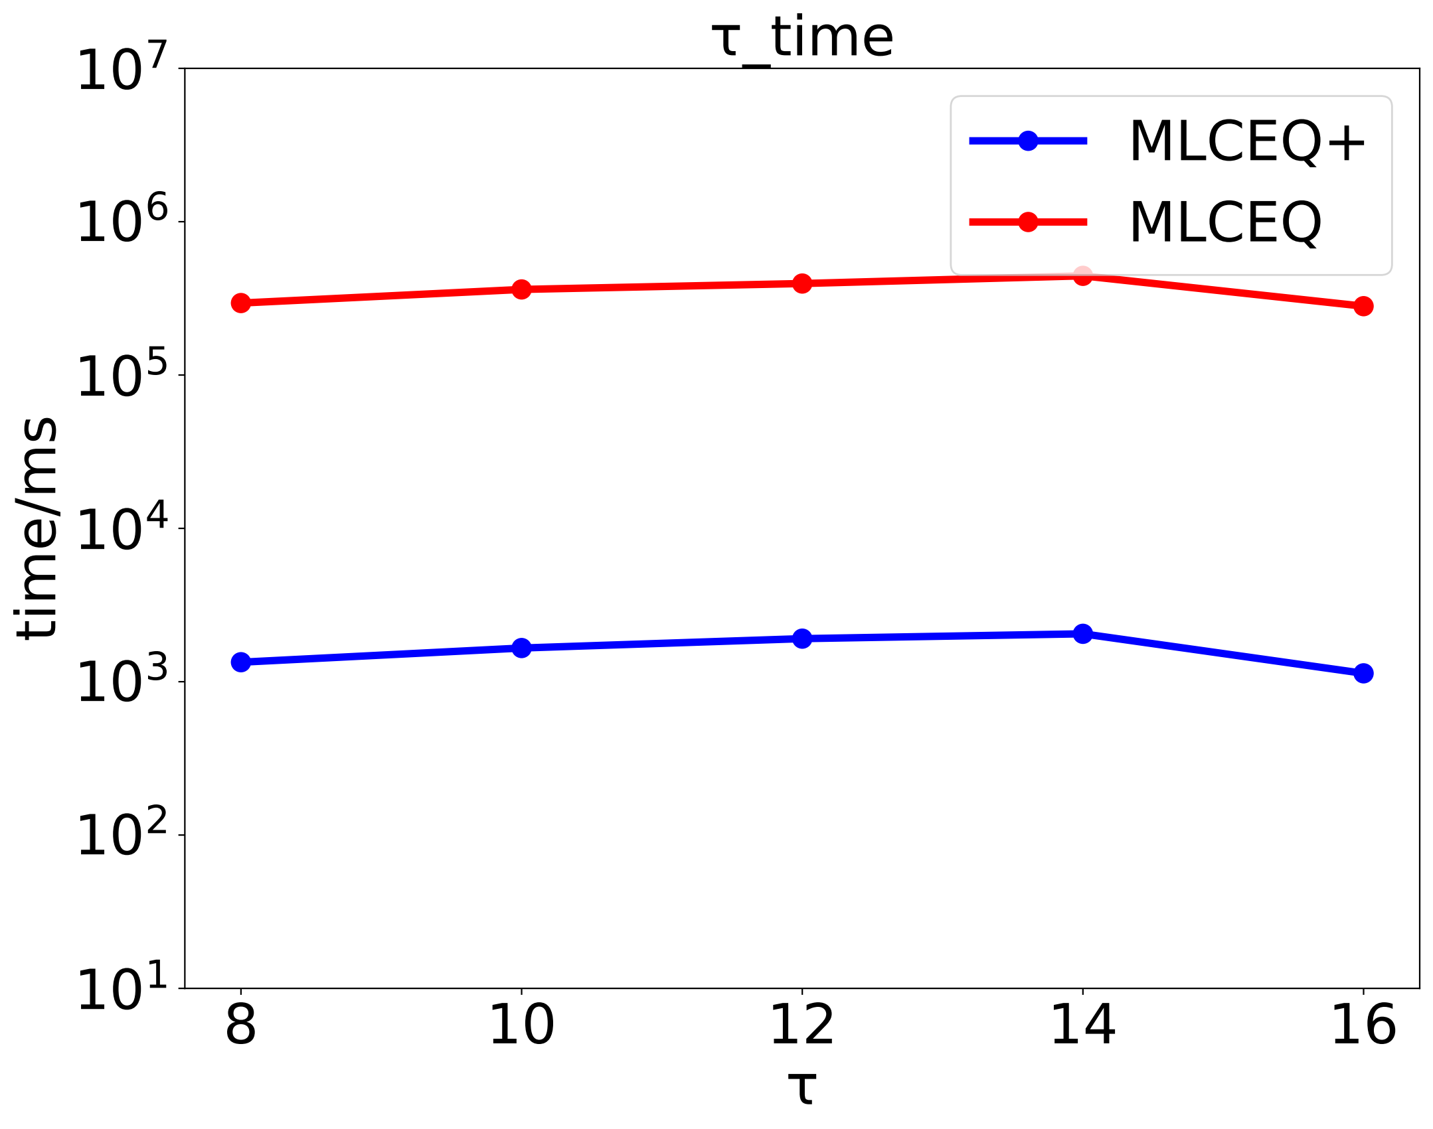
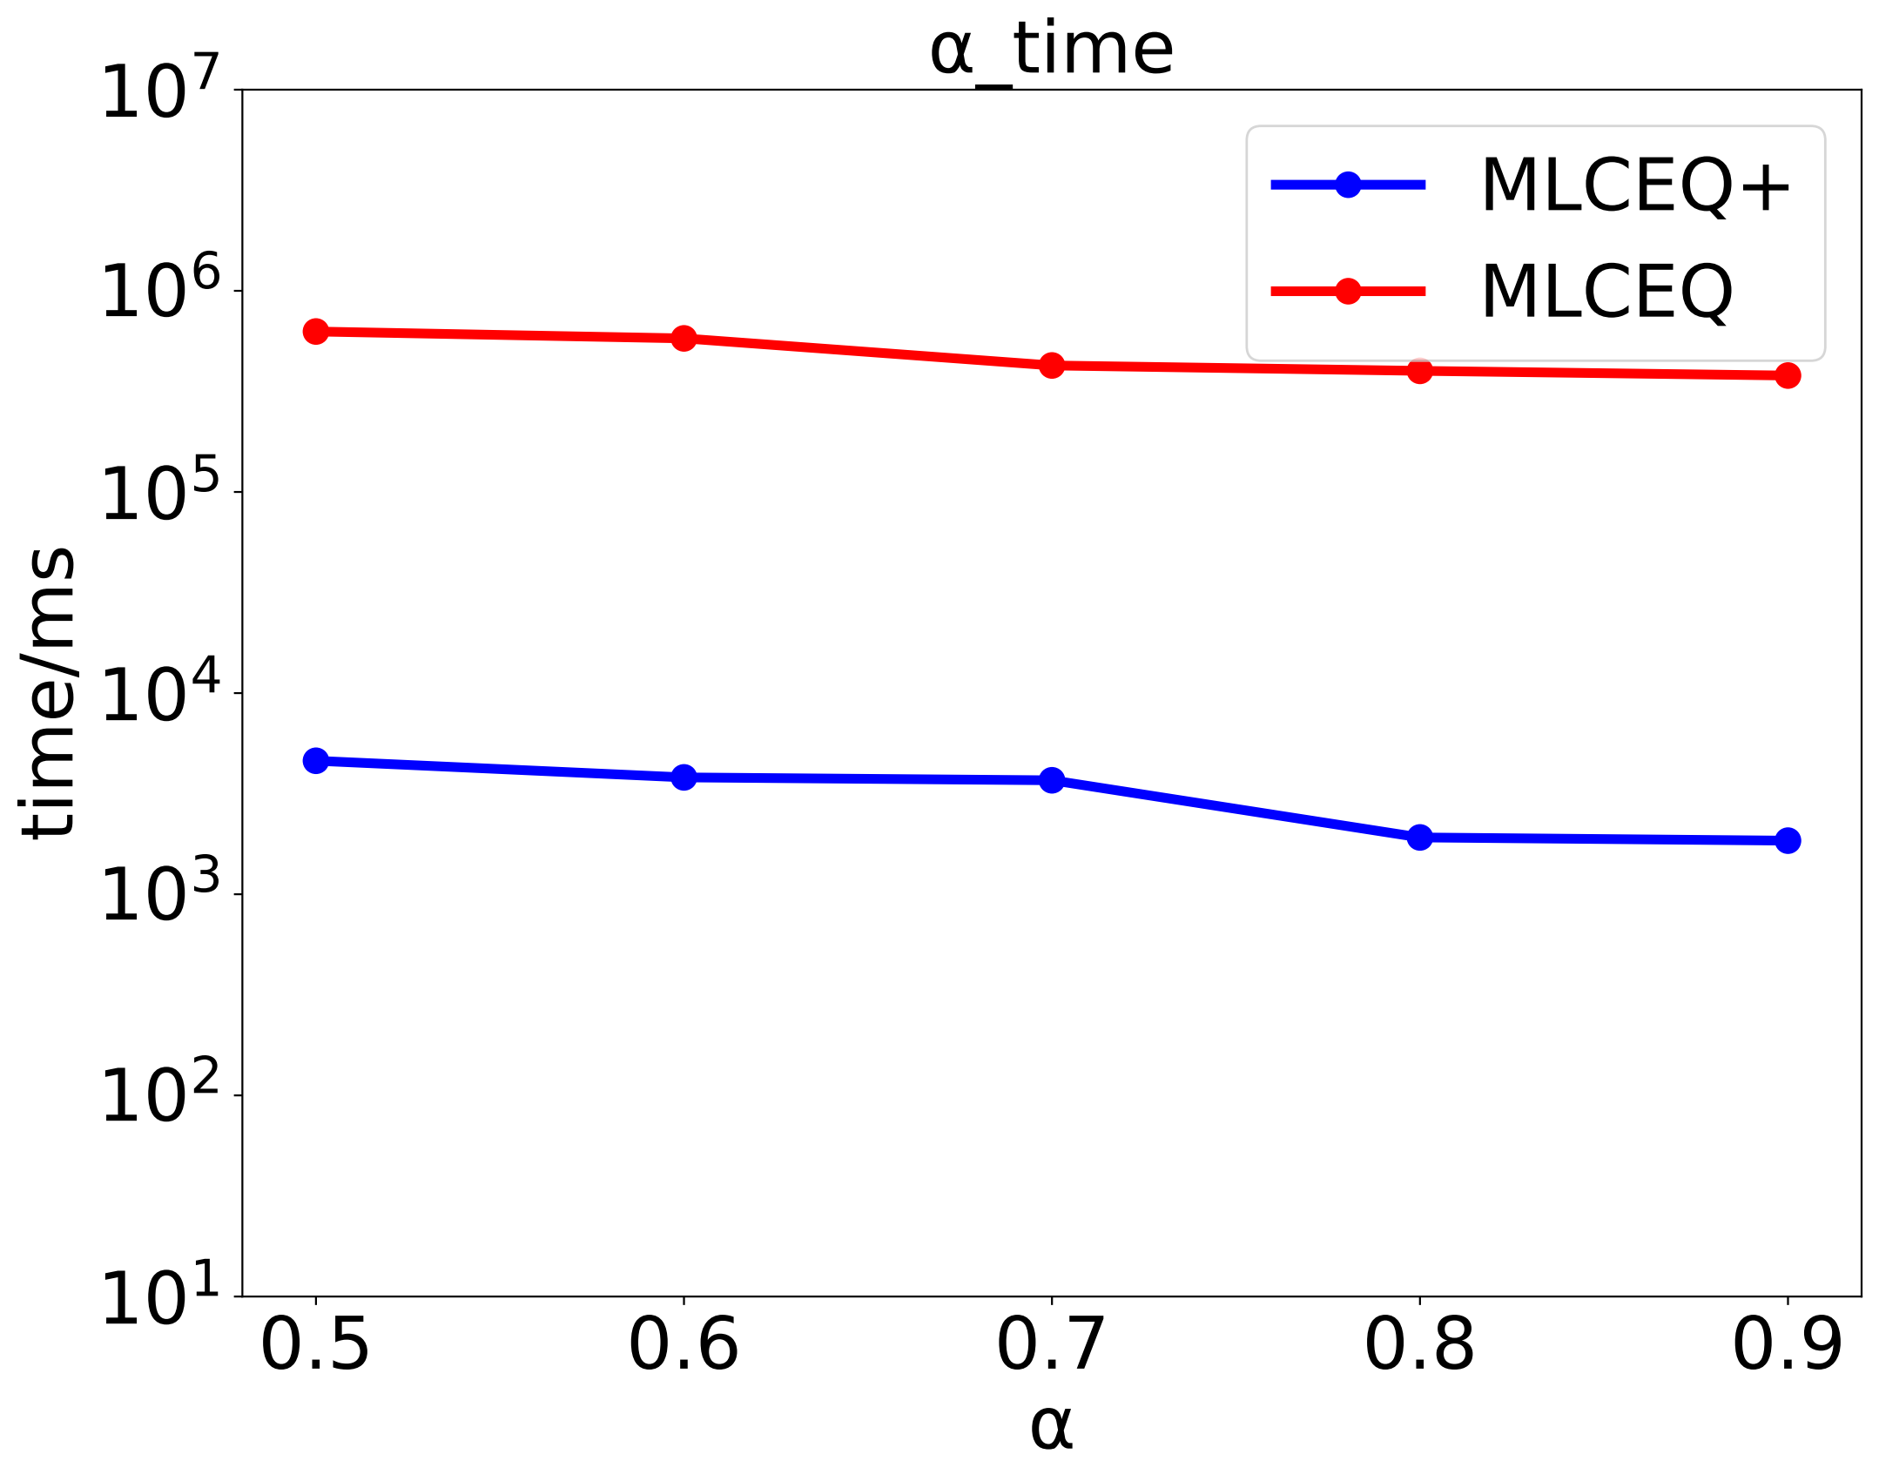
04
Result
(a) Taxi
(b) T-Drive
Notes:
Since the loose model and the traditional model have different definitions in the time dimension,
it is not possible to compare their efficiency well. Therefore, our experiment only compares with
the baseline solution.And the query efficiency of the optimized mlceq+ is much faster than the
baseline mlceq

Slide 16





04
Conclusion
Conclusion
Future
Multi-source loose contact events
privacy-preserving
Sliding-window-based baseline query processing and optimized query processing via InGrid-MBR-based inverted index
Comprehensive performance evaluation using real-world trajectory datasets
Contact tracing
Notes:
To summarise:
• We proposed the MLC model, built the MLCEQ baseline, and accelerated it with InGrid-MBR
and MLCEQ+
.
• Experiments confirm full accuracy and speed-up.
• In the future work , we’ll add privacy-preserving searchable encryption and streaming updates.
”

Slide 17

Thanks for attention!
Shuying Duan
1025040904@njupt.edu.cn

