Slide 1

Play Evolves
$ ansible -m "ping" localhost
localhost | SUCCESS => {
"changed": false,
"ping": "pong"
}

Slide 2
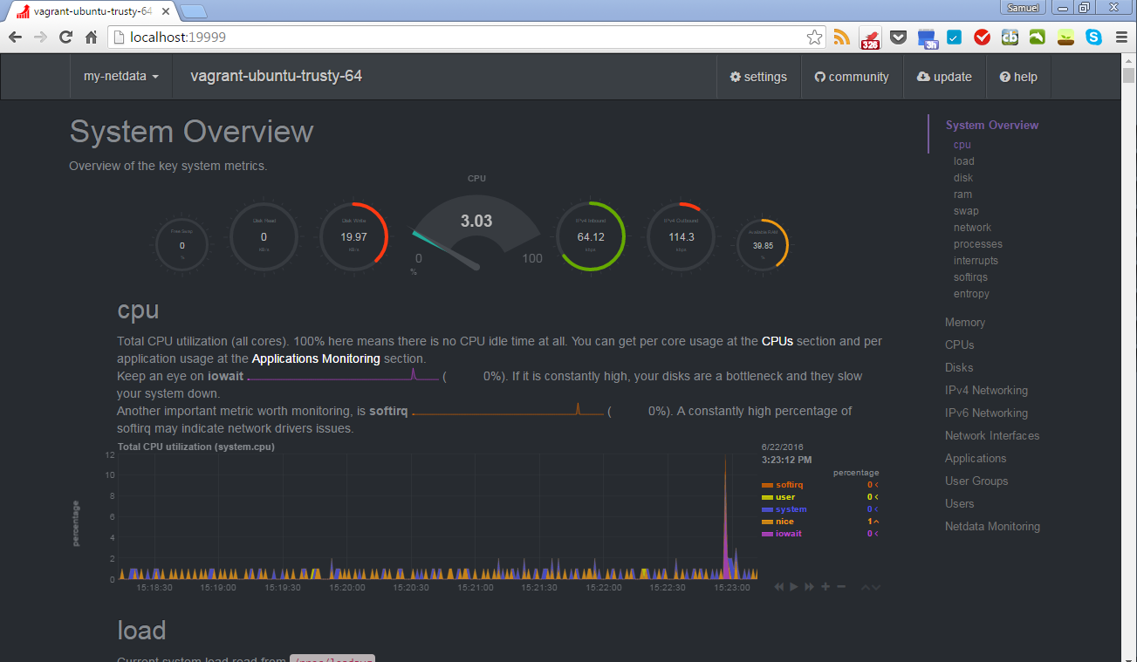
NetData

Slide 3

Figure

Slide 4
Hosts
Group | Name
Address: ansible_host | ansible_port
Connection: ansible_connection
Get it details: ansible_user | ansible_private_key
Who runs?: ansible_become | ansible_become_password
[tao]
yin ansible_host=l27.0.0.1 ansible_connection=local ansible_become=yes

Slide 5
Playbook
---
- name: v1 installation of netdata
hosts: all
tasks:
- name: install dependencies for the netdata
apt: name={{ item }} update_cache=yes state=latest
with_items:
- zlib1g-dev
- uuid-dev
- libmnl-dev
- gcc
- make
. . .
. . .
- name: clone the netdata repo
git: repo=https://github.com/firehol/netdata.git dest=/tmp/netdata depth=1
- name: run the netdata install script
command: ./netdata-installer.sh --dont-wait chdir=/tmp/netdata/
Name
Hosts
Variables
Tasks

Slide 6

Modular

Slide 7
YAMLise Tasks
install_netdata.yml
---
- name: install dependencies for the netdata
apt: name={{ item }} update_cache=yes state=latest
with_items:
- zlib1g-dev
- uuid-dev
- libmnl-dev
- gcc
- make
. . .
. . .
- name: clone the netdata repo
git: repo=https://github.com/firehol/netdata.git dest=/tmp/netdata depth=1
- name: run the netdata install script
command: ./netdata-installer.sh --dont-wait chdir=/tmp/netdata/

Slide 8
Playbook
Include the YAMLised Tasks
---
- name: v1 installation of netdata
hosts: all
tasks:
- include: install_netdata.yml

Slide 9

Durable

Slide 10
Role
$ ansible-galaxy init netdata
$ tree netdata
netdata
├── defaults
│ └── main.yml
├── files
├── handlers
│ └── main.yml
├── meta
│ └── main.yml
├── README.md
├── tasks
│ └── main.yml
├── templates
├── tests
│ ├── inventory
│ └── test.yml
└── vars
└── main.yml
Tasks
Handlers
Templates
Files
Vars

Slide 11
Our Tree
Simple! Only tasks!
No handlers, templates etc.
s$ tree v3
v3
├── hosts
├── roles
│ └── netdata
│ └── tasks
│ └── main.yml
└── site.yml

Slide 12
tasks/main.yml
---
- name: install dependencies for the netdata
apt: name={{ item }} update_cache=yes state=latest
with_items:
- zlib1g-dev
- uuid-dev
- libmnl-dev
- gcc
- make
. . .
. . .
- name: clone the netdata repo
git: repo=https://github.com/firehol/netdata.git dest=/tmp/netdata depth=1
- name: run the netdata install script
command: ./netdata-installer.sh --dont-wait chdir=/tmp/netdata/

Slide 13
Playbook
Include the YAMLised Tasks
---
- name: v1 installation of netdata
hosts: all
roles:
- netdata

Slide 14
Now Play
Play maps a group of hosts to a some well defined “roles”, rerpsented by “tasks”.

Slide 15

Programmable

Slide 16
Pythonic
So much for Python base
#!/usr/bin/python2
from collections import namedtuple
from ansible.parsing.dataloader import DataLoader
from ansible.vars import VariableManager
from ansible.inventory import Inventory
from ansible.playbook import Playbook
from ansible.executor.playbook_executor import PlaybookExecutor
Options = namedtuple('Options', ['connection', 'forks', 'become', 'become_method', 'become_user', 'check', 'listhosts', 'listtasks', 'listtags', 'syntax', 'module_path'])
variable_manager = VariableManager()
loader = DataLoader()
options = Options(connection='local', forks=100, become=None, become_method=None, become_user=None, check=False, listhosts=False, listtasks=False, listtags=False, syntax=False, module_path="")
passwords = dict(vault_pass='secret')
inventory = Inventory(loader=loader, variable_manager=variable_manager, host_list='localhost')
variable_manager.set_inventory(inventory)
playbooks = ["./test.yaml"]
executor = PlaybookExecutor( playbooks=playbooks, inventory=inventory, variable_manager=variable_manager, loader=loader, options=options, passwords=passwords)
executor.run()

