Slide 1
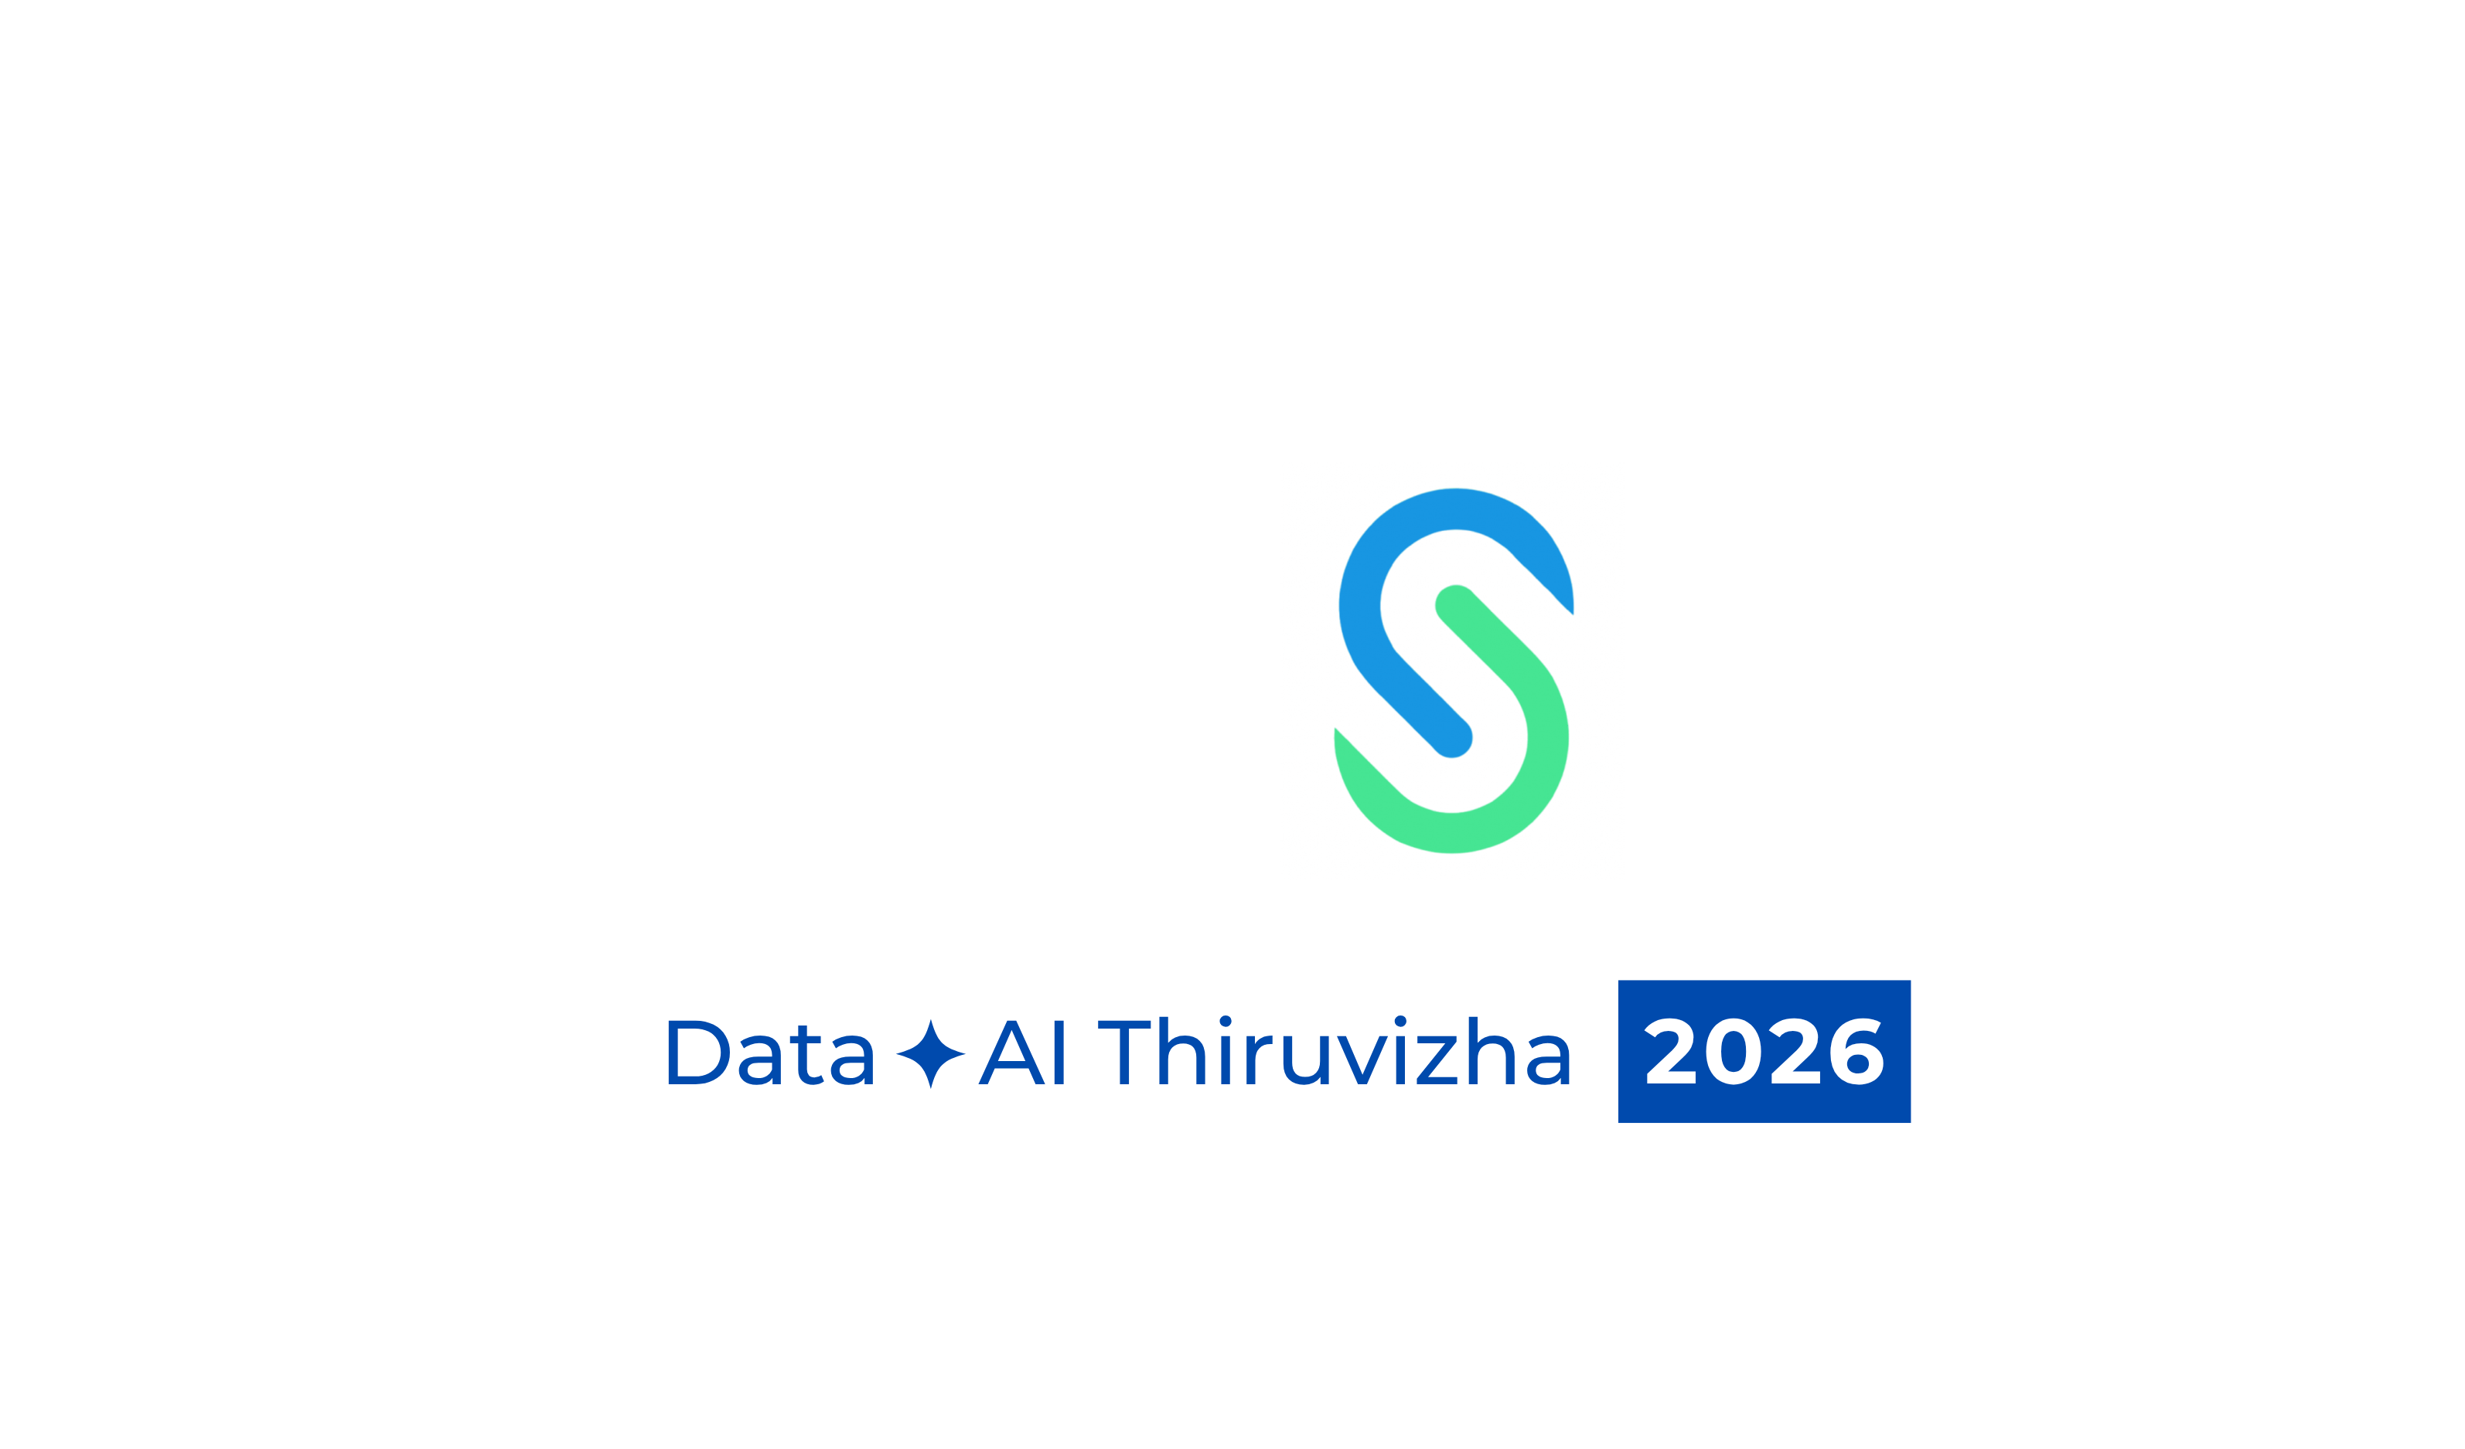
Chasing the
Transformer Killer
The Future of AI is Hybrid

Slide 2
THE SIGNALS ARE ALREADY HERE
Three numbers that should change how you think about AI architecture
60%+
23%
$2.3B
of frontier open-source models released in 2025 were NOT Transformer architecture
speedup found by AlphaEvolve inside Gemini's own architecture — recovering 0.7% of Google's compute
OpenAI's 2024 inference spend 15× more than GPT-4.5 training cost.
Inference IS the new battleground.
Open-source AI landscape, 2025
AlphaEvolve · DeepMind 2025
OpenAI financials 2024

Slide 3
HOW TRANSFORMERS CONQUERED AI
"Attention is All You Need" — 2017
2017
2019
2020
2022
2024
2025
Attention
Mechanism
GPT-2
Scaling Laws
GPT-3
175B Params
ChatGPT
Mass Adoption
Multi-modal
GPT-4o
Cracks Begin
Showing
The secret weapon: Global Attention
Every token can see every other token — simultaneously. This unlocked extraordinary language understanding, code generation, and reasoning.
But this very strength hides three fatal structural flaws.

Slide 4
Problem 1
The O(n²) Compute Tax
Attention: every token must attend to every other token.
Double the context → quadruple the compute.
How can we solve this
State Space Models (SSM) - MAMBA
4K tokens
16M ops
Hyena and RWKV
Use selective recurrence — compress history into a fixed-size state vector.
16K tokens
256M ops
Complexity: O(n) vs O(n²)
64K tokens
4B ops
Memory: 3–8× lower at 100K tokens
Streaming: Native — no reprocessing
128K tokens
16B ops
16B ops

Slide 5
Problem 2
"Lost in the Middle"
Recall accuracy across a 100K-token context window:
The Problem
Transformers systematically under-attend to information in the middle of long contexts. This is reproducible, measurable, and not eliminated by more training data or RLHF.
Patches vs. Architecture Fix
RoPE, ALiBi, YaRN — position encoding improvements.
Start
(high recall)
MIDDLE
(lost)
End
(high recall)
SSMs process sequentially — Structural fix

Slide 6
Problem 3 — THE BIG CLAIM
Hallucination is an Architecture Problem
"A Transformer does not know what it does not know."
✕ The Common Belief
✓ The Architecture Reality
"Train on more data.
Add more parameters.
Hallucinations will decrease."
Transformers structurally lack:
Explicit memory module
GPT-3 → GPT-4 did reduce them.
But never eliminated them.
Scaling returns are diminishing fast.
Uncertainty quantification
Knowledge boundary signal
Paper: "Hallucination Stations: On Some Basic Limitations of Transformer-Based Language Models" (arXiv:2507.07505)
Necessary, not sufficient
The path forward

Slide 7
THE CHALLENGERS
SSMs and MoE: Rethinking the Architecture
STATE SPACE MODELS (SSMs)
MIXTURE OF EXPERTS (MoE)
Mamba, S4
Mixtral · GPT-4 (rumored) · Grok-2 · DeepSeek
O(n) complexity
Sparse activation
vs O(n²) attention
~12B of 45B params active
Selective state compression
FLOPS efficiency
remembers what matters
3–4× per compute unit
Streaming native and Long context windows
Specialist routing
no re-processing
right expert for each token
60%+ open-source adoption
Scales capacity
in 2025 frontier models
without proportional cost

Slide 8
TRANSFORMERS AREN'T STANDING STILL
The Architecture Fights Back
Flash Attention 2 / 3
2–4× speedup
RoPE / ALiBi / YaRN
Better long context
IO-aware tiling reduces memory bandwidth — not the O(n²) complexity, but dramatically more practical. Key to enabling 128K+ context in production.
Rotary Position Embeddings and attention linear biases improve position generalization. Better than sinusoidal, but the lost-in-the-middle effect persists.
Training & inference
Position encoding
GQA / MLA (DeepSeek)
5–13× KV cache cut
AlphaEvolve Auto-Optimization
23% kernel speedup
Grouped Query Attention (Llama 3) and Multi-head Latent Attention compress the KV cache — slashing inference memory requirements dramatically.
AI discovering better attention kernels inside Gemini. Recovered 0.7% of Google's total compute. At hyperscaler scale, that's hundreds of millions.
Inference efficiency
Auto-optimization
Key insight: These are optimizations — they extend the runway. They do not rewrite the blueprint.

Slide 9
WHERE HYBRID WINS
3 Scenarios Where Pure Transformer Cannot Compete
01
02
03
Long-Context
Document Intelligence
Genomics &
Drug Discovery
Edge &
Real-Time AI
Legal · Finance · Healthcare
Biotech · Pharma · Research
IoT · Autonomous · Voice
Problem:
Problem:
Problem:
100K+ token contracts, records, filings. Pure Transformer: expensive + lossy recall.
DNA/protein sequences are naturally sequential, extremely long. Attention is brutally expensive.
Power-constrained, streaming sensor data, sub-10ms latency. KV cache is a killer.
Hybrid Fix:
Hybrid Fix:
Hybrid Fix:
SSM backbone streams the document O(n). Transformer cross-attends to key passages. Best of both worlds.
SSM for sequences (Hyena, Evo), MoE for multi-domain expertise. AlphaFold3-style hybrid.
SSM for streaming (no reprocessing), MoE for sparse activation, Transformer for occasional global reasoning.
90% cost cut · No lost-in-middle failure
State-of-the-art protein structure already uses this
10× lower power · Native streaming
· No KV cache

Slide 10
HALLUCINATION: THE ARCHITECTURE ARGUMENT
Why Scaling Alone Will Never Save Us
"More parameters ≠ understanding. The architecture has no mechanism to know what it does not know."
Training Hypothesis
Scaling Hypothesis
Architecture Hypothesis
More/better data + RLHF.
Result: GPT-4 better than GPT-3. Still hallucinates at scale. Better training is necessary but not sufficient.
Enough parameters = reliable world model.
Result: Returns are diminishing. $2.3B/year inference proves scale isn't free. We cannot scale our way out.
Explicit uncertainty layers, retrieval-augmented grounding, symbolic reasoning, neuro-hybrid memory — these structurally address the problem.
Necessary, not sufficient
Hitting the wall
The path forward

Slide 11
THE VERDICT
The Future of AI is Hybrid
Transformers are not dead — they are evolving. Flash Attention, RoPE, and MoE patches prove sustained investment.
SSMs solve O(n²) and streaming structurally — not with workarounds. This is a real architectural advance.
Hallucination requires architectural fixes — explicit memory, uncertainty grounding, neuro-symbolic layers. Not just more scale.
The winners will be architectures that combine Transformers + SSMs + MoE. Hybrid is not a compromise — it's the design.
Stop asking: "What kills the Transformer?" Ask: "What does it take to make AI reliable, efficient, and grounded?"

Slide 12
Appendix :
Chasing the
Transformer Killer
Jamba (AI21 Labs)
First production hybrid: Mamba + Transformer interleaved layers. 256K token context. Outperforms Mixtral on long-context tasks.
Zamba2 (54B)
SSM-Transformer hybrid. Beats Llama 3.1 70B on most benchmarks at 78% of the parameter count.
Linear recurrence + local attention. Matches Transformer quality on language tasks with linear scaling.
Griffin (Google DeepMind)

Slide 13
Thank You

