Slide 1
DATA PROGRAMMING FINAL PROJECT
Submission by:
Chenna Kesava Reddy Chada- 200524772
Midun Siva- 200512658
Murali Krishna Penikalapati - 200517441

Slide 2
Introduction to the Project
Data Analysis plays a key role in solving the day to day life problems and helps in improving the performance too.
We have taken a data set of Winter Olympics and performed few analysis on the data set using Data frames and Plotly in Python and presented those visualisations.
We will discuss about the methods, database and the visualisations we made in further discussion.
We took country in particular and we can say how the number of medals vary for that country in all these years.

Slide 3


Our Team
Chenna Kesava Reddy Chada
Developer
Midun Siva
Business Analyst
Murali Krishna Penikalapati
Developer and Business Analyst

Slide 4
Our Dataset
This data set contains the records of winter Olympics held from 1924 to 2006.
This dataset includes attributes like as shown below Year, City, Sport, Discipline, NOC, Event, Event gender, Medal.
This dataset contains 2311 Records.
Dataset source - http://winterolympicsmedals.com/medals.csv

Slide 5

The Project
We used jupyter notebook to code this project.
We import pandas to load data and perform data analysis.
We used SQL database to store data, analysis and outputs.

Slide 6
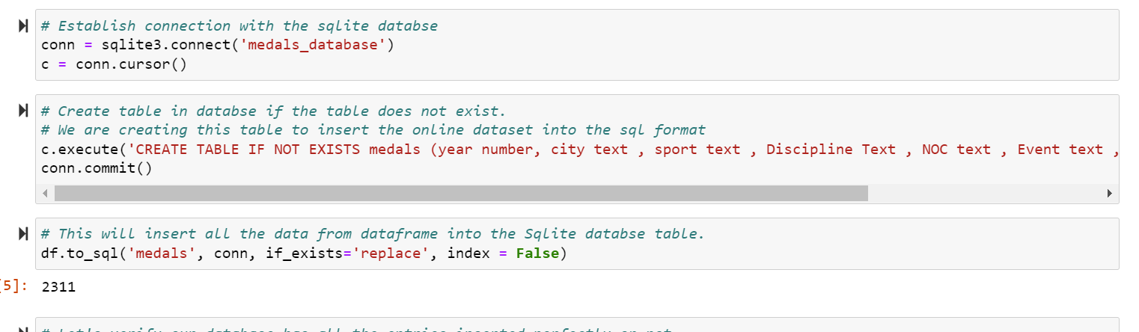
We created a database and table as medals in SQL.

Slide 7
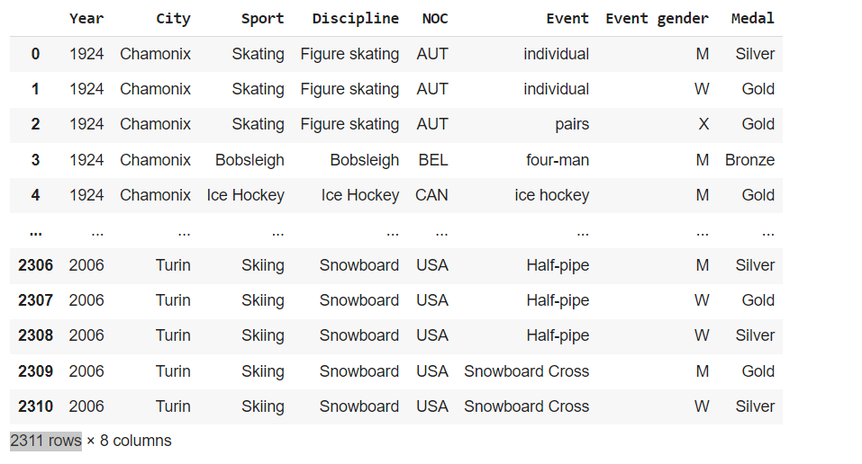
The Project
We created medals table as shown below in SQL Database

Slide 8
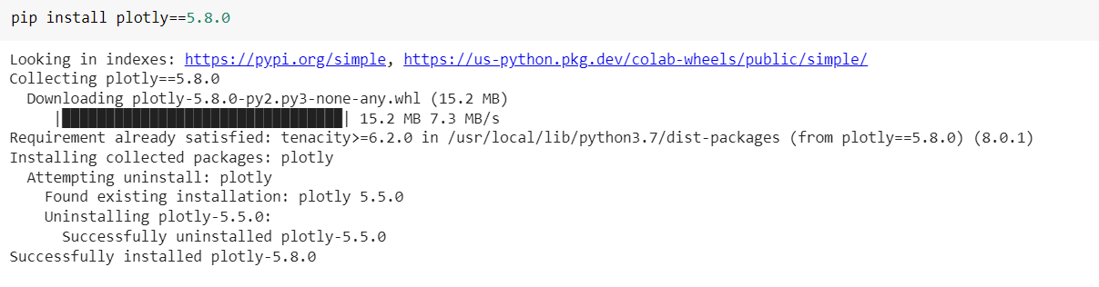
The Project
We used Plotly to create graphs in jupyter notebook
We used flask framework to create a web application

Slide 9
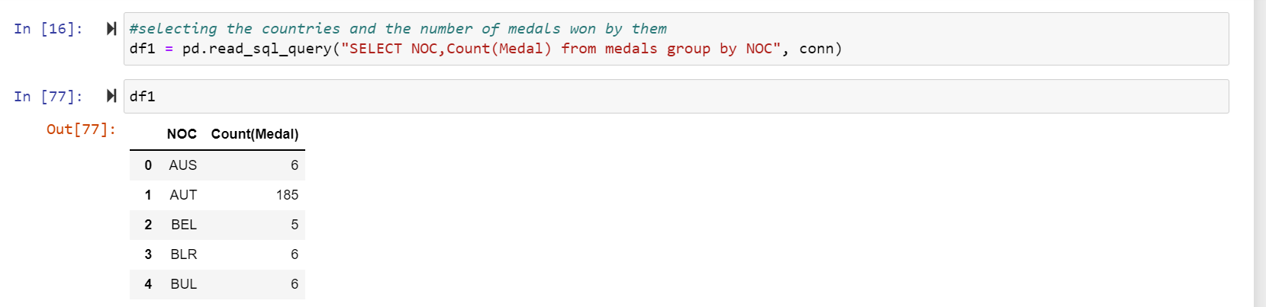
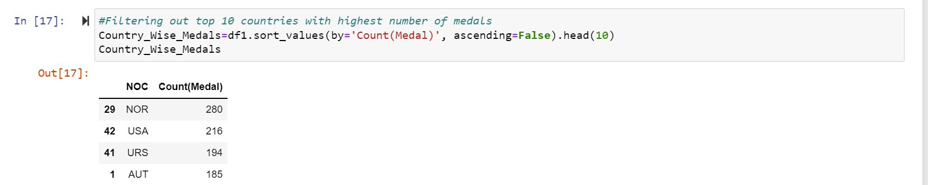
The Project
Code to filter data to create charts
Top 10 country's with highest medals

Slide 10
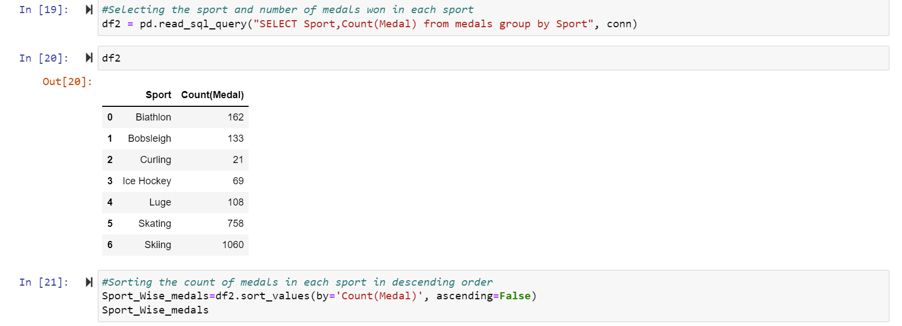
Sports with highest number of medals

Slide 11
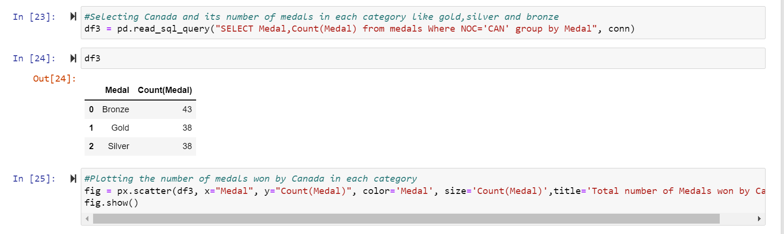
Total number of medals won by Canada in each category

Slide 12
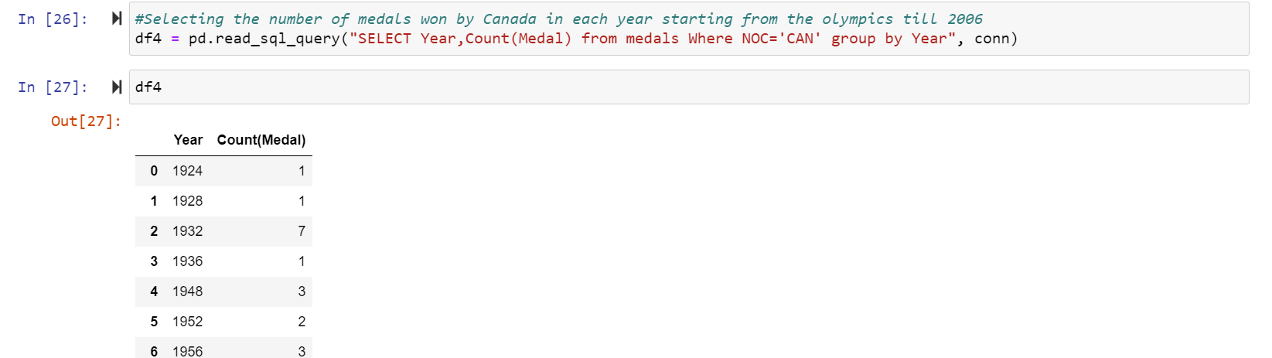
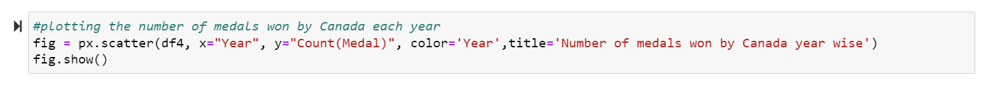
Total number of medals won by Canada each year from 1924 to 2006

Slide 13
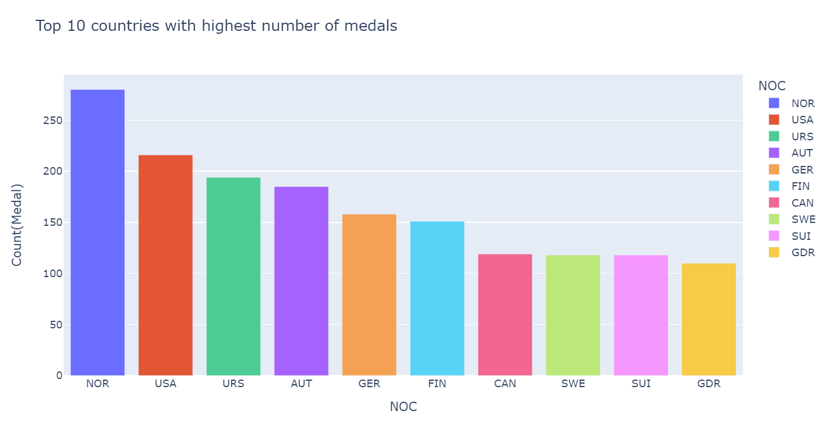
Output Charts
Top 10 countries with highest number of medals

Slide 14
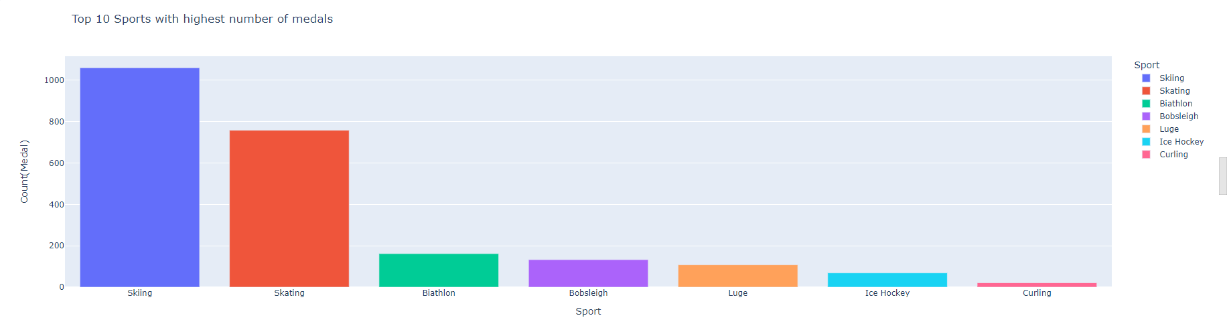
Sports with highest number of medals

Slide 15
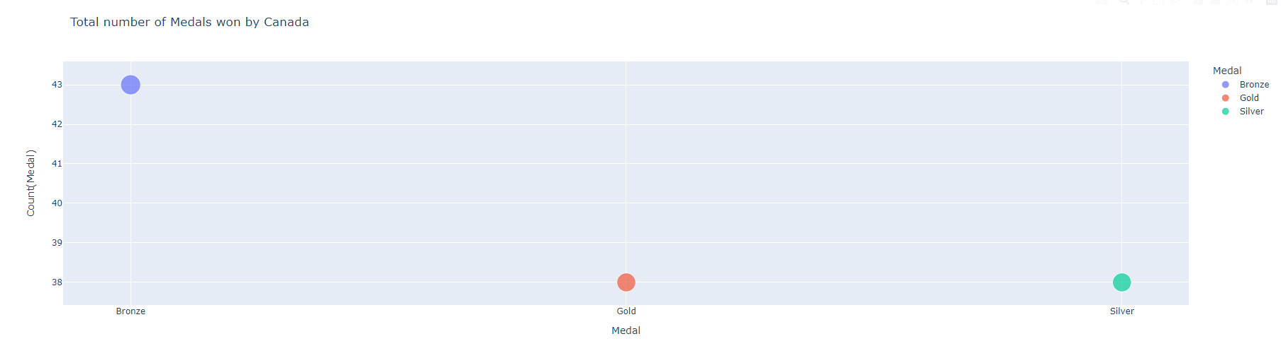
Output Charts
Total number of medals won by Canada

Slide 16
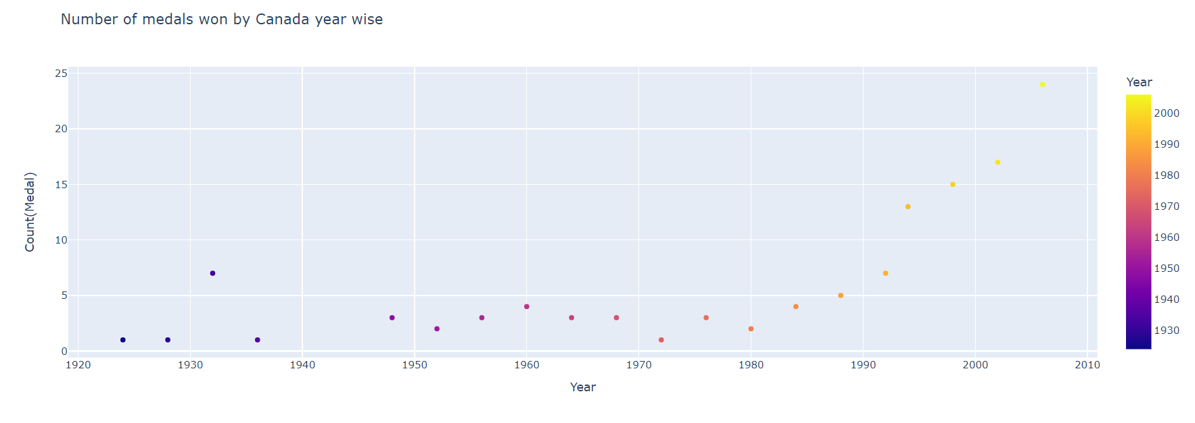
Output Charts
Number of medals won by Canada year wise

Slide 17
The Project
We created an API to this dataset; it automatically runs and update the new data which will be presented in the charts for every 24 hours.
We have provided the URL link for the site where all the visualisations can be viewed, and the API can also be seen.
https://colab.research.google.com/drive/1QIDjc6JRsSBIJBRs7VFmlLJKkKmGceZ_?usp=sharing#scrollTo=5a12fe57
And please find the GIT HUB repository link for seeing all the code and this presentation.
FINAL_PROJECT_GROUP_4/Final Project Group 4.ipynb at main · chennakesava777/FINAL_PROJECT_GROUP_4 (github.com)

